Slide 1

Home Learning
Year R
Term 6 Week 1

Slide 2
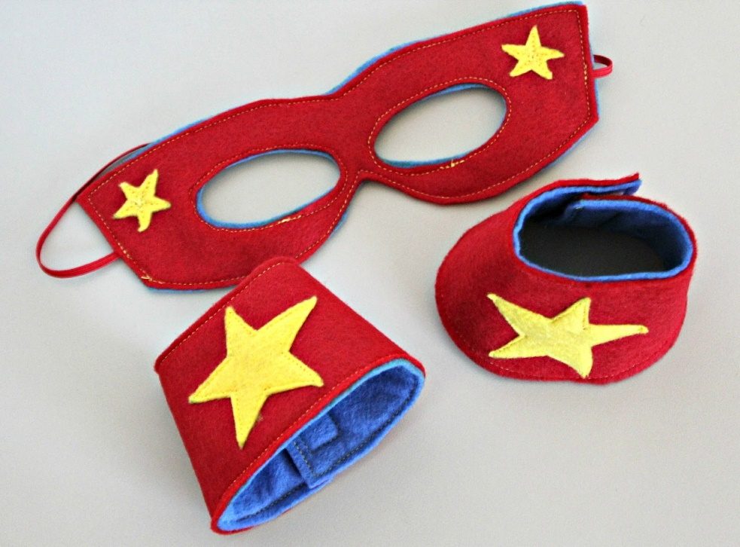
Message from Mrs Coffey
Hi Everyone,
I hope you had a lovely half term and enjoyed the great weather.
This week we are starting our theme of superheroes. In Maths we are looking at how to double and in Phonics learning some new tricky words.
I always enjoy reading your comments and seeing your lovely photos and videos so keep them coming. They make me smile and brighten the day! As usual if you have any questions then I am contactable via Tapestry or the school office.
Have fun.
Mrs. Coffey

Slide 3
English Learning
Task 1
This week we are going to be learning some new tricky words:
you
her
they
all
are
I would like you to practise reading and writing them. Can you put them in a sentence? I have also included a game on tricky word bingo for you to play.

Slide 4
Tricky word bingo
she | you | was | all | be
they | he | my | we | put
are | the | her | me | of

Slide 5

English Learning
Task 2
This week we are going to be thinking about Superheroes.
Can you think of your favourite superhero? What do they wear? What is their superhero power? What problems do they solve?
Watch this clip of Eliot: Midnight Superhero –
https://www.youtube.com/watch?v=P7oVJkgTJT8
  What makes Eliot a midnight superhero?
  When is midnight?
  Who does Eliot help?
  Why do they need help?

Slide 6

English Learning
Task 3
In our story this week Eliot is a superhero. I would like you to draw or paint me a picture of you as a superhero. Then write me a sentence or two about the superhero you are. Do you have a special Superhero name?
What power do you have?
Don’t forget to include describing words and maybe a joining word like and or because.

Slide 7
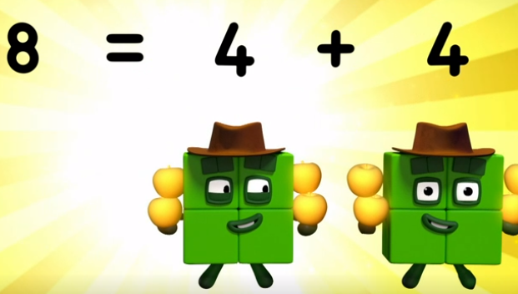
Maths Learning
This week we are learning to double.
Task 1
Watch the Number blocks episode called ‘Double Trouble’.
https://www.bbc.co.uk/iplayer/episode/b08q4jkq/numberblocks-series-2-double-trouble
Discuss with you child what is happening when we double a number?
Use your toys to have a go at doubling.

Slide 8

Maths Learning
Task 2
Remember that doubling a number is adding the same number again. Use the ladybird template to demonstrate doubling of the spots on one side, write as a number sentence.
Task 3
Look at the wings of a butterfly. Look at how you can double the pattern by folding in half, decorating one side and then folding on top of blank side. Can you predict total number of marks?

Slide 9
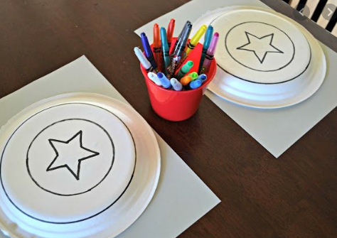
Topic
This week we have been thinking about superheroes and the problems they solve and the powers they have. As part of this you might like to have ago at one of these ideas.
Can you make/draw your own superhero face mask, cape or shield?
Can you carry out a rescue mission?
As a superhero can you complete a superhero time challenge of your choosing?
Can you draw or paint me a picture of your favourite superhero?
Can you create me a superhero healthy snack to keep your energies up?

Slide 10
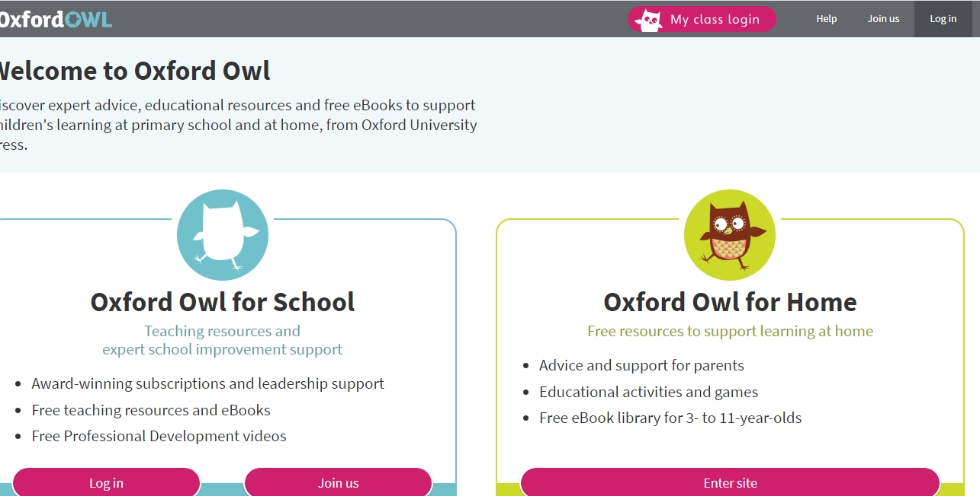
Reading
A good site to use for reading is Oxford Owl, which is free. Please visit - https://www.oxfordowl.co.uk/

Slide 11

Reading
Another useful site for reading is Renaissance myON. This is a good source for books you can read to the children or provide information books that follow their interests. Please visit - http://readon.myon.co.uk

Slide 12

Reading
Choose an area that interests you or use the search option
Please continue sharing books together. Talking about the content and the characters in the books and making predictions about what might happen as you read.

Slide 13

Phonics
Continue using your Orange sound book and Blue tricky word book to practice the sounds and words.
Phonics play https://new.phonicsplay.co.uk/ is a great site for reinforcing our phonics learning. It is free use at the moment.
We have covered all of phase 2 and most of phase 3 and there are lots of fun interactive games to play.

Slide 14

Maths – White Rose Home Leaning
In school we follow the White Rose scheme of learning. Their website has put together free lessons and resources that link to the learning taking place in school. Please visit: https://whiterosemaths.com/homelearning/early-years/
Look out for EYFS pack.

Slide 15

Accessing Twinkl
Many educational content providers are offering free access to their resources. Twinkl is a website that we use from time to time to resource our lessons to aid in teacher input and pupil activities.
We will be able to direct you towards activities and learning via this website based on lessons that may be missed due to absence. To access Twinkl please visit: www.twinkl.co.uk/offer
You will have to sign up and put in the offer code: UKTWINKLHELPS
Search EYFS

Slide 16

P.E.
It is important to keep your children active. If it is safe to do so, ensure they have some time outside throughout the day. Please visit Joe Wicks YouTube channel (https://www.youtube.com/channel/UCAxW1XT0iEJo0TYlRfn6rYQ), which has lots of exercise videos for children. He will also be hosting a live P.E. lessons Monday to Friday at 9:00am.

Slide 17

Classroom Secrets
The site classroom secrets https://classroomsecrets.co.uk/free-home-learning-packs/ has free Reception (EYFS) packs which provide some great additional ideas and resources you can use.

