Slide 1

Home Learning
Year R
Half –Term

Slide 2
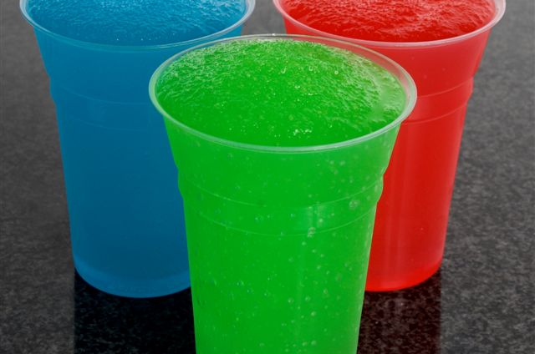
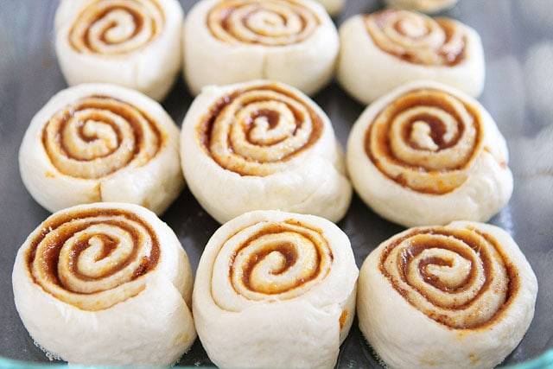

Message from Mrs Coffey, Mrs Daly and Mrs Long
Hi Everyone,
I hope you had fun last week enjoying the sunshine and thinking about people who help us and how we can make each other smile.
Last week Mrs Coffey, Mrs Daly and Mrs Long got to see each other at school (while socially distancing of course) and started to talk about what we have learnt during our time in lock down.
Mrs Daly told us she had learnt how to make super duper slushies with her new slushy machine. Mrs Long told us how she had learnt the song to remember the order of the colours of the rainbow and I told them how I have learnt to make a cinnamon rolls (my favourites) with just 4 ingredients! So our task for you is can you share with us via Tapestry your favourite piece of knowledge or understanding that you have made this term during lock down with either a photo, drawing, painting or video.
Happy half term everyone.
Ramsey Class Team

