Slide 1

Home Learning
Year R
Term 5 Week 6

Slide 2
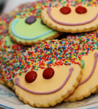
Message from Mrs Coffey
Hi Everyone,
I hope you had fun this week learning about the lifecycle of a frog last week and did lots of good hopping.
This week we are thinking about helping each other and how important it is to have people that help us. We are using our counting skills to count money, so we can go shopping! One day…
I’ve enjoyed reading your comments and seeing your lovely photos and videos this week. They made me smile! As usual if you have any questions then I am contactable via Tapestry as usual.
Have fun.
Mrs. Coffey

Slide 3
English Learning
Task 1
This week we don’t have new sounds or words. Instead we are going to practice our reading of captions and sentences. Can you read them below then choose two to draw/paint a picture to match:
  looking at books
  bow down to the King and Queen
  boats on the river
  Nan is sitting in the rocking chair.
  The farmer gets up at six in the morning.

Slide 4

English Learning
Task 2
This week we are going to be thinking about People Who Help Us.
Can you think of some examples and tell your grown-up?
Watch this clip of The Very Helpful Hedgehog –
https://www.youtube.com/watch?v=MbBWj0OEcaI
  How does the Hedgehog’s behaviour change in the story?
  Can you think of any times you have been helpful at home?
  Can you draw me a picture of a time and tell me about it by labelling or writing me a sentence?

Slide 5
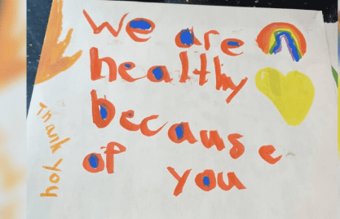

English Learning
Task 3
In our story this week Isaac the hedgehog is helped by the donkey eating the stuck apple from his back.
Can you make you own thank you card to someone?
It might be to someone in you family or to someone in the NHS to brighten their day. Remember to include a beautiful picture on the front and then inside who it is to, a lovely thank you message and who it is from.

Slide 6
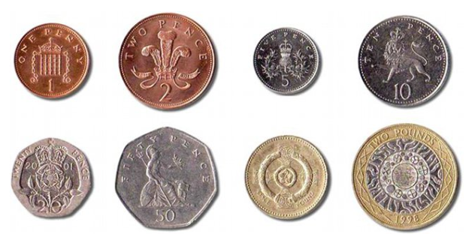
Maths Learning
This week we are counting but using money.
Task 1
Look at the different coins we have in the UK. Can you put them in order?

Slide 7
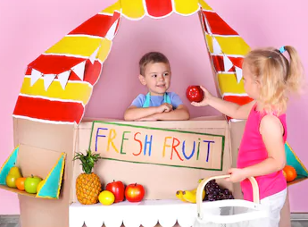
Maths Learning
Task 2
Can you work out how many pennies are in each of the other coins?
Task 3
Play a game as shopkeeper or someone who is shopping. Use your money to pay for your toys. Make sure you get enough change!

Slide 8
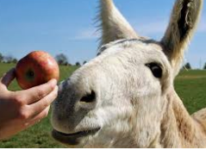
Topic
This week we have read about helping each other and people that help us. So have a go at our fun ideas:
Can you make your own hedgehog or donkey? You might use play dough or an old sock or some recycling junk.
In our story the donkey loved apples, can you make a recipe using apples?
Make someone smile and take a photo.
Write or tell me about what makes people smile.

Slide 9

Reading
A good site to use for reading is Oxford Owl, which is free. Please visit - https://www.oxfordowl.co.uk/

Slide 10

Reading
Another useful site for reading is Renaissance myON. This is a good source for books you can read to the children or provide information books that follow their interests. Please visit - http://readon.myon.co.uk

Slide 11

Reading
Choose an area that interests you or use the search option
Please continue sharing books together. Talking about the content and the characters in the books and making predictions about what might happen as you read.

Slide 12

Phonics
Continue using your Orange sound book and Blue tricky word book to practice the sounds and words.
Phonics play https://new.phonicsplay.co.uk/ is a great site for reinforcing our phonics learning. It is free use at the moment.
We have covered all of phase 2 and most of phase 3 and there are lots of fun interactive games to play.

Slide 13

Maths – White Rose Home Leaning
In school we follow the White Rose scheme of learning. Their website has put together free lessons and resources that link to the learning taking place in school. Please visit: https://whiterosemaths.com/homelearning/early-years/
Look out for EYFS pack.

Slide 14

Accessing Twinkl
Many educational content providers are offering free access to their resources. Twinkl is a website that we use from time to time to resource our lessons to aid in teacher input and pupil activities.
We will be able to direct you towards activities and learning via this website based on lessons that may be missed due to absence. To access Twinkl please visit: www.twinkl.co.uk/offer
You will have to sign up and put in the offer code: UKTWINKLHELPS
Search EYFS

Slide 15

P.E.
It is important to keep your children active. If it is safe to do so, ensure they have some time outside throughout the day. Please visit Joe Wicks YouTube channel (https://www.youtube.com/channel/UCAxW1XT0iEJo0TYlRfn6rYQ), which has lots of exercise videos for children. He will also be hosting a live P.E. lessons Monday to Friday at 9:00am.

Slide 16

Classroom Secrets
The site classroom secrets https://classroomsecrets.co.uk/free-home-learning-packs/ has free Reception (EYFS) packs which provide some great additional ideas and resources you can use.

