Slide 1

Home Learning
Year R
Term 5 Week 5

Slide 2
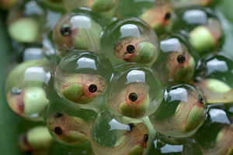
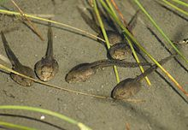
Message from Mrs Coffey
Hi Everyone,
I hope you had fun this week learning about the lifecycle of a caterpillar in the story of ‘The Hungry Caterpillar’ last week.
This week we are continuing our learning about life cycles. We are learning about how tadpoles grow into frogs. We are also going to practice our counting and ordering to 20.
I’ve enjoyed reading your comments and seeing your lovely photos and videos this week. They made me smile! As usual if you have any questions then I am contactable via Tapestry as usual.
Have fun.
Mrs. Coffey

Slide 3
English Learning
Task 1
This week we don’t have new sounds or words. Instead we are practicing the new sounds we learnt.
  ear
  air
  ure
  er
We have a sorting game to play with these sounds. Have a piece of paper for each sound and then using the pictures on the next page, can you cut and stick the pictures to the correct sound?
Then can you stick the right word with the picture.

Slide 4







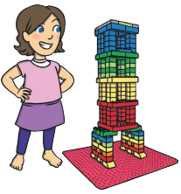

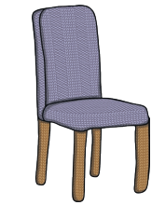
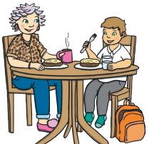
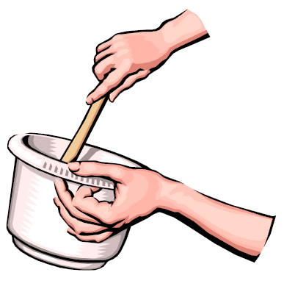




Sorting game

Slide 5
Sorting game - Words
hear | finger | treasure | hair
picture | pair | tear | tower
ear | chair | dinner | mixture
ladder | injure | air | beard

Slide 6

English Learning
Task 2
This week we are continuing our learning on life cycles. We are thinking about how frogs change and grow.
Recap from our learning last week about what a promise is.
Watch this clip of the tadpole’s promise –
https://youtu.be/eKMl-a3-uNY?t=5
Talk about how the tadpole feels at different points in the story and how he is changing. Did you guess the ending?
Have a go at writing about the different stages of a tadpole growing into a frog. Example on the next page.
Can you write a sentence for each stage?

Slide 7
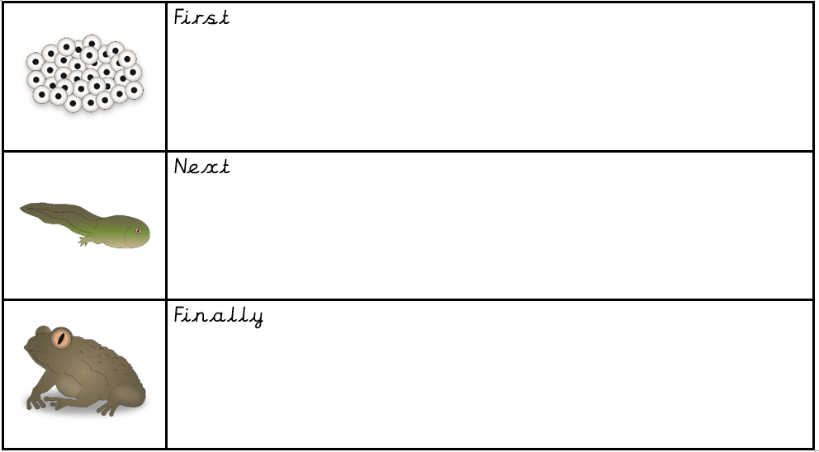
The life cycle of a frog

Slide 8
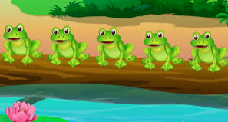
English Learning
Task 3
Together sing five little speckled frogs or listen to the link.
https://www.bbc.co.uk/teach/school-radio/nursery-rhymes-five-little-speckled-frogs/zjjbnrd
Can you make a mask to go with the song? Or make up your own version?

Slide 9
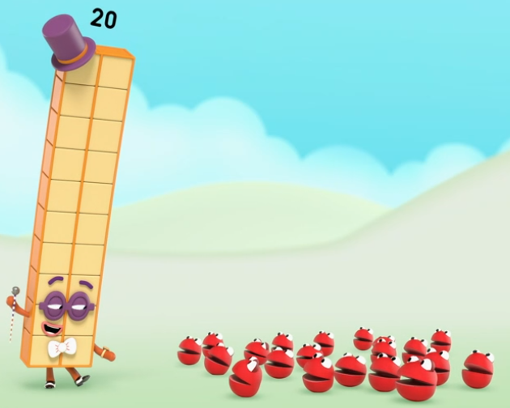
Maths Learning
This week we are counting to 20 as well as ordering numbers to 20.
Task 1
Watch ‘I can count to 20’ on Number blocks
https://www.bbc.co.uk/iplayer/episode/m0006s5q/numberblocks-series-4-14-i-can-count-to-twenty
Then practice counting to 20. Can you count out 20 objects?

Slide 10

Maths Learning
Task 2
Can you order numbers 1 to 20?
If you can do this already can you count to 30, 40, 50 and even all the way up to 100.
Task 3
Make a tower with between 10-19 bricks. How many more do you need to use to get to 20 bricks? Try to encourage your child to count on from the number of bricks in their tower.

Slide 11
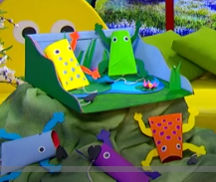
Topic
This week we’ve been learning about the life cycle of how tadpoles change into a frog so I thought of some ideas you might like to try:
Frogspawn jelly, with raisins as the frogspawn’s centre. This will help the children get the idea of the texture of frogspawn.
Tiddlywinks, the action of the counters mimics the action of the frog jumping into a pond.
Leapfrog, can you jump over the back of someone in your family crouched down or if not over a pillow.
Make your own frog. Watch this cbeebies
clip below and have a go.
https://www.bbc.co.uk/cbeebies/makes/
cbeebies-house-frog-make

Slide 12

Reading
A good site to use for reading is Oxford Owl, which is free. Please visit - https://www.oxfordowl.co.uk/

Slide 13

Reading
Another useful site for reading is Renaissance myON. This is a good source for books you can read to the children or provide information books that follow their interests. Please visit - http://readon.myon.co.uk

Slide 14

Reading
Choose an area that interests you or use the search option
Please continue sharing books together. Talking about the content and the characters in the books and making predictions about what might happen as you read.

Slide 15

Phonics
Continue using your Orange sound book and Blue tricky word book to practice the sounds and words.
Phonics play https://new.phonicsplay.co.uk/ is a great site for reinforcing our phonics learning. It is free use at the moment.
We have covered all of phase 2 and most of phase 3 and there are lots of fun interactive games to play.

Slide 16

Maths – White Rose Home Leaning
In school we follow the White Rose scheme of learning. Their website has put together free lessons and resources that link to the learning taking place in school. Please visit: https://whiterosemaths.com/homelearning/early-years/
Look out for EYFS pack.

Slide 17

Accessing Twinkl
Many educational content providers are offering free access to their resources. Twinkl is a website that we use from time to time to resource our lessons to aid in teacher input and pupil activities.
We will be able to direct you towards activities and learning via this website based on lessons that may be missed due to absence. To access Twinkl please visit: www.twinkl.co.uk/offer
You will have to sign up and put in the offer code: UKTWINKLHELPS
Search EYFS

Slide 18

P.E.
It is important to keep your children active. If it is safe to do so, ensure they have some time outside throughout the day. Please visit Joe Wicks YouTube channel (https://www.youtube.com/channel/UCAxW1XT0iEJo0TYlRfn6rYQ), which has lots of exercise videos for children. He will also be hosting a live P.E. lessons Monday to Friday at 9:00am.

Slide 19

Classroom Secrets
The site classroom secrets https://classroomsecrets.co.uk/free-home-learning-packs/ has free Reception (EYFS) packs which provide some great additional ideas and resources you can use.

