Slide 1

Home Learning
Year R
Term 5 Week 4

Slide 2
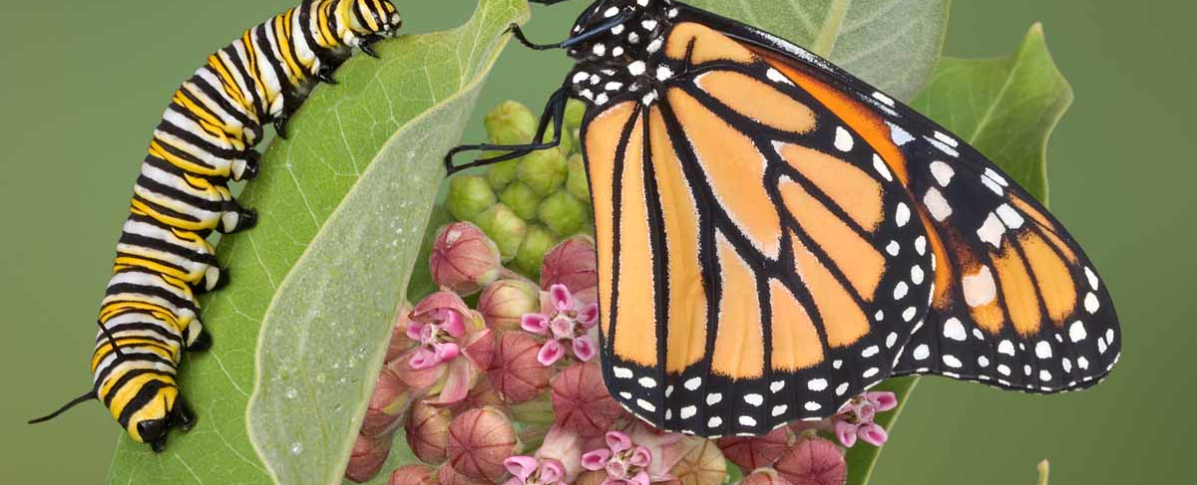
Message from Mrs Coffey
Hi Everyone,
I hope you had fun this week learning about the Ugly Duckling and Noah’s Ark.
For the next couple of weeks we are learning about life cycles. This week we are learning about how caterpillars grow into butterflies. I know some of you have learnt a little about this already but it will be lots of fun.
I’ve enjoyed reading your comments and seeing your lovely photos and videos this week. They made me smile! As usual if you have any questions then I am contactable via Tapestry as usual.
Have fun.
Mrs. Coffey

Slide 3
English Learning
Task 1
This week we are learning some new high frequency words.
  as
  up
  is
  of
  his
  mum
  dad
Can you practice recognising these together in word bingo? Also have a think about sentences you could make with them.

Slide 4
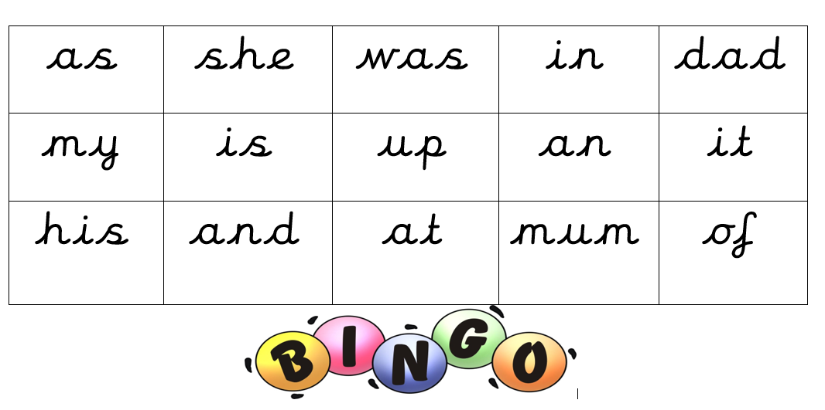
Word bingo

Slide 5
English Learning
Task 3
This week we are moving on to life cycles, so we are thinking about how caterpillars change and grow.
Watch the Hungry Caterpillar video –
https://www.youtube.com/watch?v=75NQK-Sm1YY
Talk about how the caterpillar feels at different points in the story and how he is changing. Do caterpillar’s really eat all those different foods?
Have a go at writing about the different stages of a caterpillar growing into a butterfly. Example on the next page.
Can you write a sentence for each stage?

Slide 6




The life cycle of a caterpillar
 | First
 | Next
 | Then
 | Finally

Slide 7
English Learning
Task 3
Draw me a picture of your favourite foods for the week. Just like the hungry caterpillar what foods do you like to eat each day.
Add some labels and describe your favourite food for me. Mine is chocolate because it’s very yummy!

Slide 8

Maths Learning
This week we are learning about taking one or more away.
Task 1
Watch and listen to the reading of the story of Ten little pirates –
https://youtu.be/GiLySC_emj0?t=20
Discuss how each time a pirate has a misadventure, so we are taking one away.

Slide 9
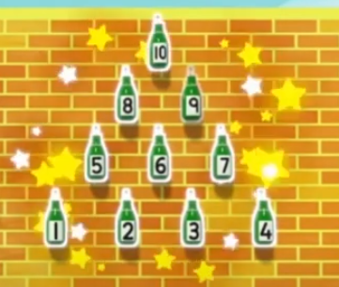
Maths Learning
Task 2
Watch this YouTube video of Number blocks, as an refresher to taking one away.
https://youtu.be/XGRHV_tAglI
Discuss taking 1 away from the different Number blocks.
How could we write this?

Slide 10
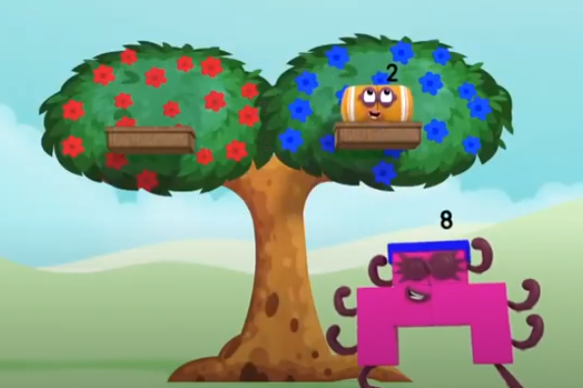
Maths Learning
Task 3
Watch this YouTube video of Number blocks, as an introduction to taking away 2.
https://youtu.be/y-2vJad-VAQ
Can you practice taking away 2 with your toys at home? Perhaps write it down or make a video for me.
Then have a go a taking away a few more.

Slide 11
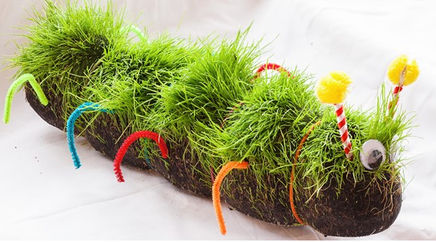
Topic
This week we’ve been learning about the hungry caterpillar. So some fun ideas that you might like to try:
Make your own fruit kebab – like the hungry caterpillar but only include your favourites.
Set up a caterpillar garden.
Draw, paint or make me a beautiful butterfly or caterpillar.
Make a caterpillar with a repeating pattern. How many different colours can you use?

Slide 12

Reading
A good site to use for reading is Oxford Owl, which is free. Please visit - https://www.oxfordowl.co.uk/

Slide 13

Reading
Another useful site for reading is Renaissance myON. This is a good source for books you can read to the children or provide information books that follow their interests. Please visit - http://readon.myon.co.uk

Slide 14

Reading
Choose an area that interests you or use the search option
Please continue sharing books together. Talking about the content and the characters in the books and making predictions about what might happen as you read.

Slide 15

Phonics
Continue using your Orange sound book and Blue tricky word book to practice the sounds and words.
Phonics play https://new.phonicsplay.co.uk/ is a great site for reinforcing our phonics learning. It is free use at the moment.
We have covered all of phase 2 and most of phase 3 and there are lots of fun interactive games to play.

Slide 16

Maths – White Rose Home Leaning
In school we follow the White Rose scheme of learning. Their website has put together free lessons and resources that link to the learning taking place in school. Please visit: https://whiterosemaths.com/homelearning/early-years/
Look out for EYFS pack.

Slide 17

Accessing Twinkl
Many educational content providers are offering free access to their resources. Twinkl is a website that we use from time to time to resource our lessons to aid in teacher input and pupil activities.
We will be able to direct you towards activities and learning via this website based on lessons that may be missed due to absence. To access Twinkl please visit: www.twinkl.co.uk/offer
You will have to sign up and put in the offer code: UKTWINKLHELPS
Search EYFS

Slide 18

P.E.
It is important to keep your children active. If it is safe to do so, ensure they have some time outside throughout the day. Please visit Joe Wicks YouTube channel (https://www.youtube.com/channel/UCAxW1XT0iEJo0TYlRfn6rYQ), which has lots of exercise videos for children. He will also be hosting a live P.E. lessons Monday to Friday at 9:00am.

Slide 19

Classroom Secrets
The site classroom secrets https://classroomsecrets.co.uk/free-home-learning-packs/ has free Reception (EYFS) packs which provide some great additional ideas and resources you can use.

