Slide 1

Home Learning
Year R
Term 5 Week 3

Slide 2

Message from Mrs Coffey
Hi Everyone,
I hope you enjoyed making your woodland scene and the beginning of our Spring learning. This week we are learning some more new sounds, practicing our tricky words and learning about adding more.
We are still thinking about the changes Spring time brings and this week we are looking at Ducklings. We are also thinking about the importance of rainbows and how God sent Noah a rainbow as a symbol of his promise.
I’ve enjoyed reading your comments and seeing your lovely photos and videos this week. They made me smile! As usual if you have any questions then I am contactable via Tapestry as usual.
Have fun.
Mrs. Coffey

Slide 3
English Learning
Task 1
This week we are learning the new sounds ‘air’, ‘ure’, and ‘er’. A good demonstration of how to say these sounds is on YouTube - https://youtu.be/ob7bOrRtX3Q?t=72
Have a go at finding examples. Here are some examples of words below:
air, fair, pair, hair, chair
pure, cure, secure, injure, treasure,
hammer, letter, dinner, burger, boxer
Next:
Practice writing these sounds,
then writing words with these sounds in, and
then using a word of their choice in a sentence.
Use phonics play, to play the game buried treasure with these sounds. These can be found under phase 3.
https://new.phonicsplay.co.uk/resources/phase/3/buried-treasure

Slide 4
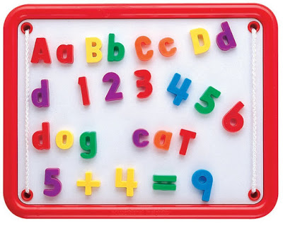
English Learning
Task 2
We are still concentrating on learning our tricky and high frequency words. There are no new ones this week.
So can you use some of these words to write a couple of sentences about your week. Or you could use magnetic letters on the fridge or a computer to type it.
Word bingo is on the next page in case you fancy another game or two.

Slide 5
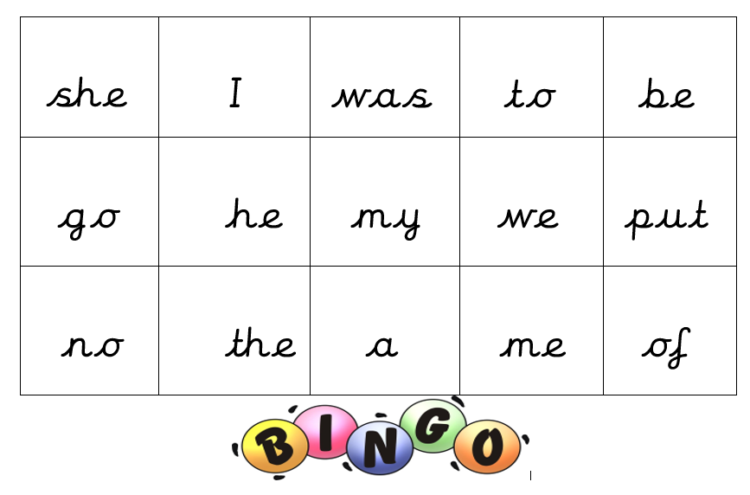
Word bingo

Slide 6
English Learning
Task 3
Continuing our learning on spring time, we are thinking about how animals develop.
Watch the Ugly Duckling video - https://learnenglishkids.britishcouncil.org/short-stories/the-ugly-duckling
Talk about how the duckling feels at different points in the story and how this develops.
Have a go at labelling a duckling on the next page.
You can also write a sentence or two about the ducking using some of the words we used to label the picture. Try to include a describing word too!

Slide 7
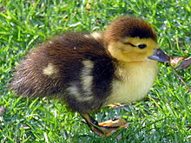
Labelling a Duckling
Identify the different parts of the Duckling
Describe them
Label it
Some words you might use
beak leg wings
webbed feet head
eyes

Slide 8

Maths Learning
This week we are learning about adding more.
Task 1
Watch and listen to the reading of the story of Mr. Gumpy’s Outing –
https://youtu.be/Mi_DV_DWN8M
Discuss how each time a new passenger joins the boat, so we are adding more.

Slide 9
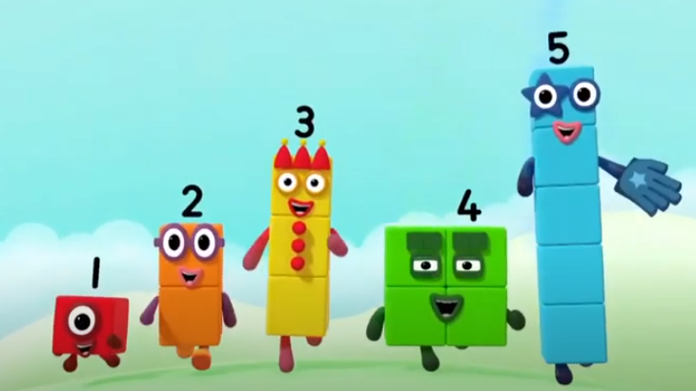
Maths Learning
Task 2
Watch this YouTube video of Number blocks, as an introduction to adding one more.
https://youtu.be/NCaPWZXkcUI
Discuss adding 1 to the different Number blocks.
How could we write this?

Slide 10
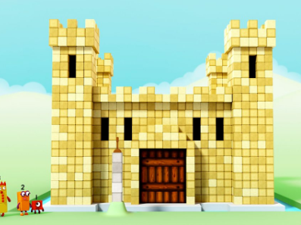
Maths Learning
Task 3
Watch this YouTube video of Number blocks, as an introduction adding more than 1 to objects.
https://youtu.be/Ce6w0WQLrm8
Can you practice adding more than 1 with your toys at home? Perhaps write it down or make a video for me.

Slide 11
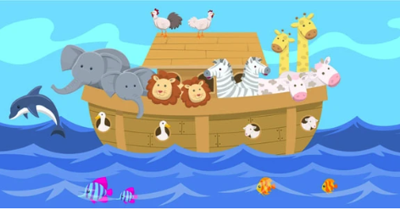
R.E.
Have you spotted many rainbows? The story of Noah uses a rainbow a sign of God’s promise to his people.
You could read this story together (Genesis - 6-9) in children’s bible or watch https://www.youtube.com/watch?v=2JZHXkI9BB4
Perhaps talk about the meaning of promises together and any you’ve made recently.
Have a go at one of these fun activities:
Water play – make boats. Can you transport a toy animal?
Large construction boat making.
Pair toy animals and count in twos.
Match animal families – learn names
Make rainbows using a range of media.
Create a Noah’s Ark display.
Make animal masks.
Draw or paint a rainbow.

Slide 12
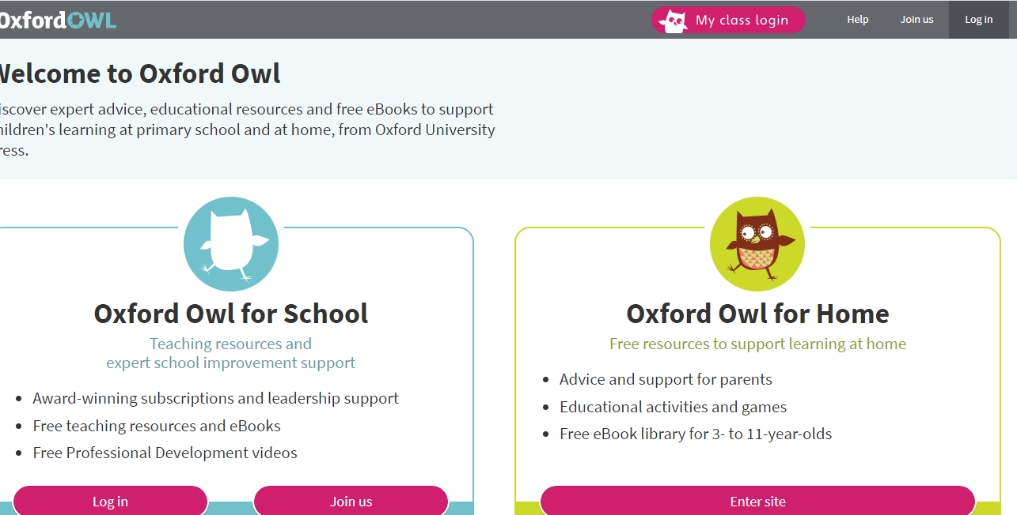
Reading
A good site to use for reading is Oxford Owl, which is free. Please visit - https://www.oxfordowl.co.uk/

Slide 13

Reading
Another useful site for reading is Renaissance myON. This is a good source for books you can read to the children or provide information books that follow their interests. Please visit - http://readon.myon.co.uk

Slide 14

Reading
Choose an area that interests you or use the search option
Please continue sharing books together. Talking about the content and the characters in the books and making predictions about what might happen as you read.

Slide 15

Phonics
Continue using your Orange sound book and Blue tricky word book to practice the sounds and words.
Phonics play https://new.phonicsplay.co.uk/ is a great site for reinforcing our phonics learning. It is free use at the moment.
We have covered all of phase 2 and most of phase 3 and there are lots of fun interactive games to play.

Slide 16

Maths – White Rose Home Leaning
In school we follow the White Rose scheme of learning. Their website has put together free lessons and resources that link to the learning taking place in school. Please visit: https://whiterosemaths.com/homelearning/early-years/
Look out for EYFS pack.

Slide 17

Accessing Twinkl
Many educational content providers are offering free access to their resources. Twinkl is a website that we use from time to time to resource our lessons to aid in teacher input and pupil activities.
We will be able to direct you towards activities and learning via this website based on lessons that may be missed due to absence. To access Twinkl please visit: www.twinkl.co.uk/offer
You will have to sign up and put in the offer code: UKTWINKLHELPS
Search EYFS

Slide 18

P.E.
It is important to keep your children active. If it is safe to do so, ensure they have some time outside throughout the day. Please visit Joe Wicks YouTube channel (https://www.youtube.com/channel/UCAxW1XT0iEJo0TYlRfn6rYQ), which has lots of exercise videos for children. He will also be hosting a live P.E. lessons Monday to Friday at 9:00am.

Slide 19

Classroom Secrets
The site classroom secrets https://classroomsecrets.co.uk/free-home-learning-packs/ has free Reception (EYFS) packs which provide some great additional ideas and resources you can use.

