Slide 1

Home Learning
Year R
Term 5 Week 2

Slide 2
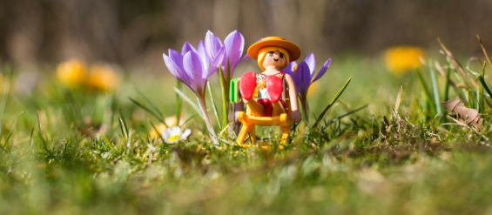
Message from Mrs Coffey
Hi Everyone,
I hope you enjoyed our Egg or not game last week. This week we are learning some new sounds, practicing our tricky words and learning about repeating patterns.
Our topic is Spring time, so we are going to have some fun creating a woodland scene that you can then play with.
As usual if you have any questions then I am contactable via Tapestry as usual. Mrs. Daly and I are looking forward to seeing all your lovely photos and comments again this term.
Have fun.
Mrs. Coffey

Slide 3
English Learning
Task 1
This week we are learning the new sounds ‘ow’, ‘oi’ and ‘ear’. A good demonstration of how to say these sounds is on YouTube - https://youtu.be/BqhXUW_v-1s?t=23
Have a go at finding examples. Here are some examples of words below:
owl, cow, row, town, down
oil, coin, soil, join, coil, boil
ear, hear, beard, fear, tear
Next:
Practice writing these sounds,
then writing words with these sounds in, and
then using a word of their choice in a sentence.
Use phonics play, to play the game buried treasure with these sounds. These can be found under phase 3.
https://new.phonicsplay.co.uk/resources/phase/3/buried-treasure

Slide 4
English Learning
Task 2
To help your child recognise their high frequency and tricky words, we often play word bingo.
The sheet is on the next page. Call out the words so you child can mark them off and once they have them all it’s “bingo”.
You can extend this by asking your child to practice writing the words or using a word in a sentence.

Slide 5
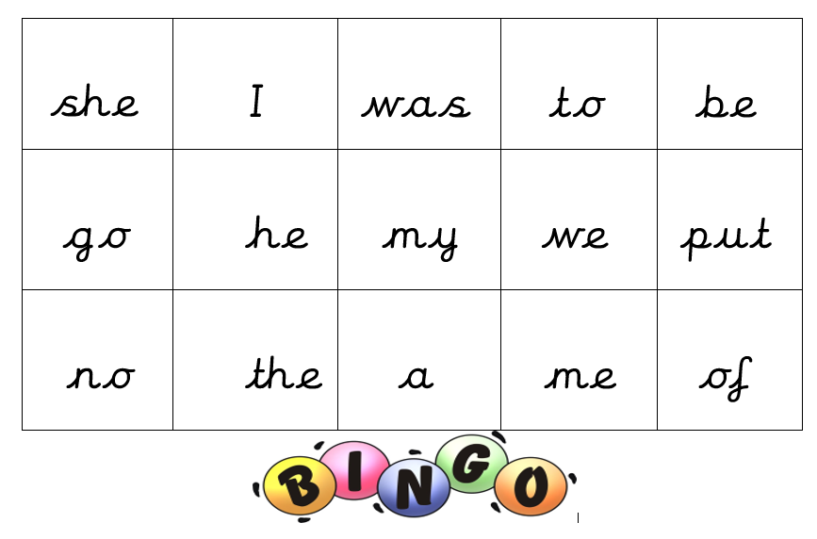
Word bingo

Slide 6
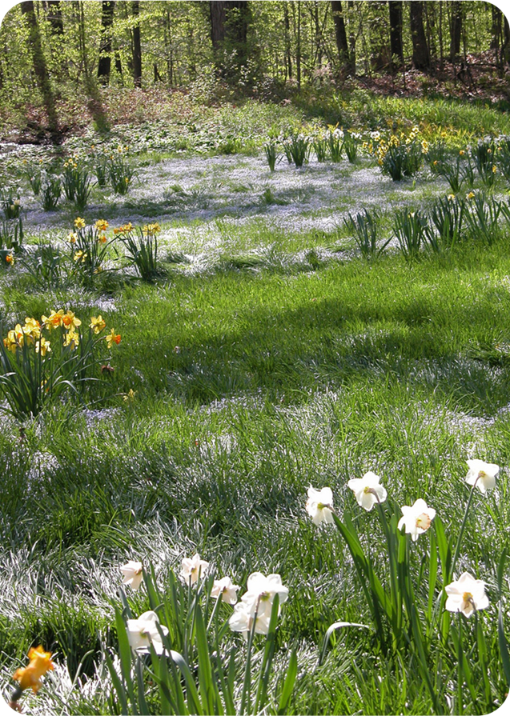
English Learning
Task 3
Can you write some words to describe this spring time picture?
Remember to use your sounds to help you.
For example green grass, white flowers, sunny day, etc.

Slide 7
Maths Learning
This week we are learning about repeating patterns. We are going to be creating our own and learning to talk about the patterns.
Repeating patterns are based on 1 or more repeating units, eg red-green-red-green or red-blue-green-red-blue-green or red-blue-blue-red-blue-blue.
Task 1
Watch this YouTube video of Number blocks, as an introduction to repeating patterns.
https://youtu.be/U__EFzinbA8

Slide 8
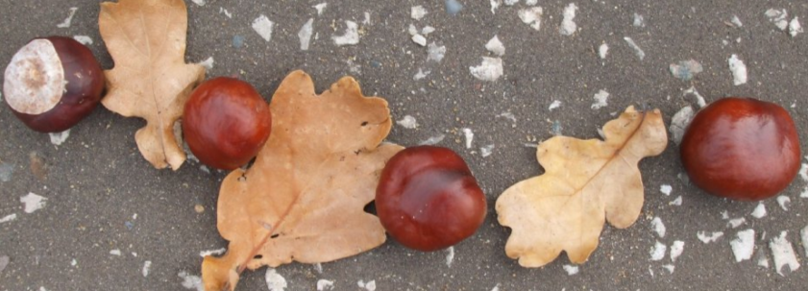
Maths Learning
Task 2
Create your own 2 colour repeating pattern. So you might use your toys, for example red car – blue car – red car.
Can you explain what is that is repeating?
Then try creating a 3 colour repeating pattern.

Slide 9
Maths Learning
Task 3
Continuing a repeating pattern – can you tell what will come next?

Slide 10
Maths Learning
Can you spot the mistake and explain why it is wrong?

Slide 11


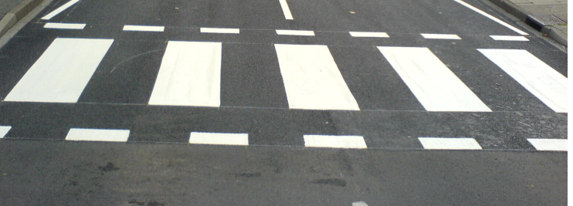

Maths Learning
Can you spot a repeating pattern in your environment and explain it?
Some examples for you

Slide 12
Topic
Create a woodland setting, with animals emerging from hibernation.
Perhaps draw a picture or use your toys to do this.
You could make a spring flowers from card or Lego or pick them in the garden.
Maybe you can a make a Hedgehog or Bear from playdough.

Slide 13

Reading
A good site to use for reading is Oxford Owl, which is free. Please visit - https://www.oxfordowl.co.uk/

Slide 14

Reading
Another useful site for reading is Renaissance myON. This is a good source for books you can read to the children or provide information books that follow their interests. Please visit - http://readon.myon.co.uk

Slide 15

Reading
Choose an area that interests you or use the search option
Please continue sharing books together. Talking about the content and the characters in the books and making predictions about what might happen as you read.

Slide 16

Phonics
Continue using your Orange sound book and Blue tricky word book to practice the sounds and words.
Phonics play https://new.phonicsplay.co.uk/ is a great site for reinforcing our phonics learning. It is free use at the moment.
We have covered all of phase 2 and most of phase 3 and there are lots of fun interactive games to play.

Slide 17

Maths – White Rose Home Leaning
In school we follow the White Rose scheme of learning. Their website has put together free lessons and resources that link to the learning taking place in school. Please visit: https://whiterosemaths.com/homelearning/early-years/
Look out for EYFS pack.

Slide 18

Accessing Twinkl
Many educational content providers are offering free access to their resources. Twinkl is a website that we use from time to time to resource our lessons to aid in teacher input and pupil activities.
We will be able to direct you towards activities and learning via this website based on lessons that may be missed due to absence. To access Twinkl please visit: www.twinkl.co.uk/offer
You will have to sign up and put in the offer code: UKTWINKLHELPS
Search EYFS

Slide 19

P.E.
It is important to keep your children active. If it is safe to do so, ensure they have some time outside throughout the day. Please visit Joe Wicks YouTube channel (https://www.youtube.com/channel/UCAxW1XT0iEJo0TYlRfn6rYQ), which has lots of exercise videos for children. He will also be hosting a live P.E. lessons Monday to Friday at 9:00am.

Slide 20

Classroom Secrets
The site classroom secrets https://classroomsecrets.co.uk/free-home-learning-packs/ has free Reception (EYFS) packs which provide some great additional ideas and resources you can use.

