Slide 1

Home Learning
Year R
Term 5 Week 1

Slide 2
Message from Mrs Coffey
Hi Everyone,
Hope you had a lovely Easter break and enjoyed the sunshine and yummy Easter eggs.
This term I will be setting some tasks each week for you to have a go at together. I hope you find these fun and interesting, and of course educational.
If you have any questions then I am contactable via Tapestry as usual. Mrs. Daly and I are looking forward to seeing all your lovely photos and comments again this term.
Take care and have fun.
Mrs. Coffey

Slide 3

Reading
A good site to use for reading is Oxford Owl, which is free. Please visit - https://www.oxfordowl.co.uk/

Slide 4

Reading
Another useful site for reading is Renaissance myON. This is a good source for books you can read to the children or provide information books that follow their interests. Please visit - http://readon.myon.co.uk

Slide 5

Reading
Choose an area that interests you or use the search option
Please continue sharing books together. Talking about the content and the characters in the books and making predictions about what might happen as you read.

Slide 6

Phonics
Continue using your Orange sound book and Blue tricky word book to practice the sounds and words.
Phonics play https://new.phonicsplay.co.uk/ is a great site for reinforcing our phonics learning. It is free use at the moment.
We have covered all of phase 2 and most of phase 3 and there are lots of fun interactive games to play.

Slide 7

Maths – White Rose Home Leaning
In school we follow the White Rose scheme of learning. Their website has put together free lessons and resources that link to the learning taking place in school. Please visit: https://whiterosemaths.com/homelearning/early-years/
Look out for EYFS pack.

Slide 8

Accessing Twinkl
Many educational content providers are offering free access to their resources. Twinkl is a website that we use from time to time to resource our lessons to aid in teacher input and pupil activities.
We will be able to direct you towards activities and learning via this website based on lessons that may be missed due to absence. To access Twinkl please visit: www.twinkl.co.uk/offer
You will have to sign up and put in the offer code: UKTWINKLHELPS
Search EYFS

Slide 9
English Learning
I would really love to hear about your Easter at home.
Please can you write me a sentence about your favourite part of your Easter break. Remember to use:
a capital letter to start,
finger spaces, and
a full stop at the end.
If you want to challenge yourselves a bit more then add an extra sentence or include some joining words, such as ‘and’ or ‘because’.
Then perhaps draw or paint a picture to go with it.

Slide 10
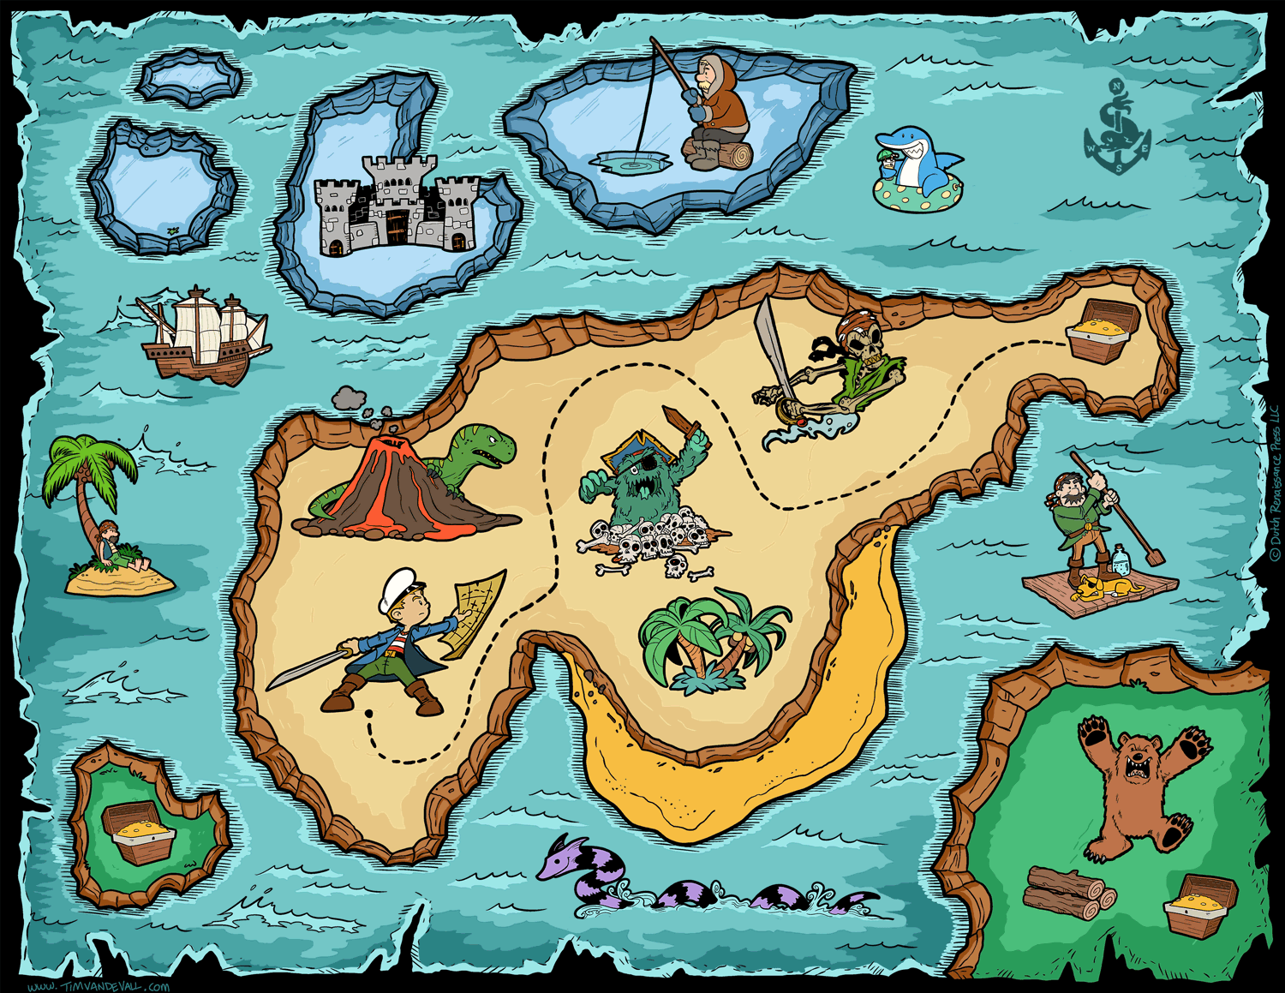
Maths Learning
Treasure Map
Have a go at making your own treasure map.
Remember to include a starting point and a ‘X’
for the treasure.
Choose a room or garden to hide your treasure in. Then create a map using a grid – template on next page.
Can you help find the treasure? Give directions to the treasure, such as go up 1 step, or go across 2 steps, or 3 steps next to the tree, etc.

Slide 11
Treasure map

Slide 12
Topic
This term our topic is Spring and the life cycles of living things.
Can you start looking for the signs of Spring?
Are the flowers blooming?
Have you noticed any changes in the weather?
Have you seen any lambs yet?
Remember to use your senses, what can you hear, see, feel and smell?
Then try discussing which animals hatch and which are born. You can play our fun game of Egg or not?

Slide 13
Egg or not?
These animals hatch from an egg. | These animals grow inside their mothers and are born.

Slide 14






Egg or not?

Slide 15

P.E.
It is important to keep your children active. If it is safe to do so, ensure they have some time outside throughout the day. Please visit Joe Wicks YouTube channel (https://www.youtube.com/channel/UCAxW1XT0iEJo0TYlRfn6rYQ), which has lots of exercise videos for children. He will also be hosting a live P.E. lessons Monday to Friday at 9:00am.

Slide 16

Classroom Secrets
The site classroom secrets https://classroomsecrets.co.uk/free-home-learning-packs/ has free Reception (EYFS) packs which provide some great additional ideas and resources you can use.

