Slide 1
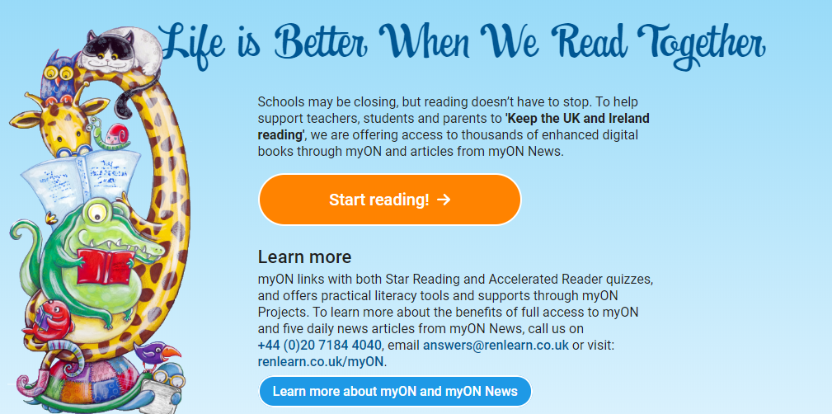
Visit http://readon.myon.co.uk

Slide 2

Choose an area that interests you or use the search option.

Slide 3
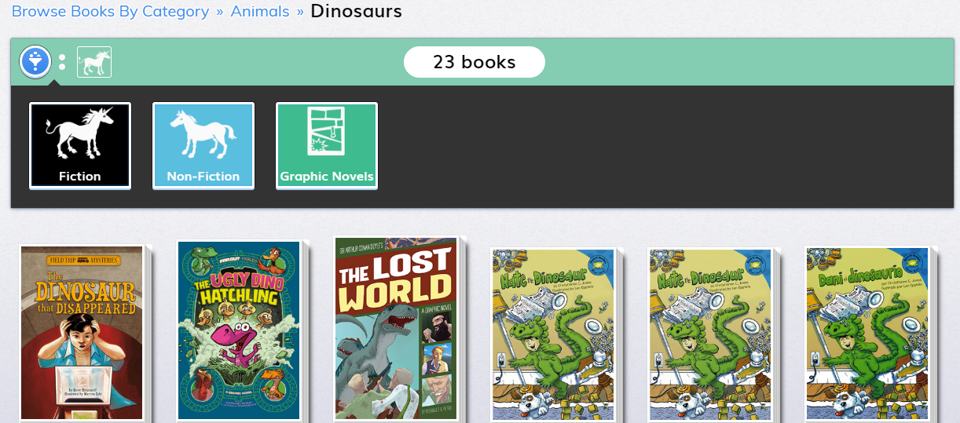
Select a book by clicking on it.

Slide 4
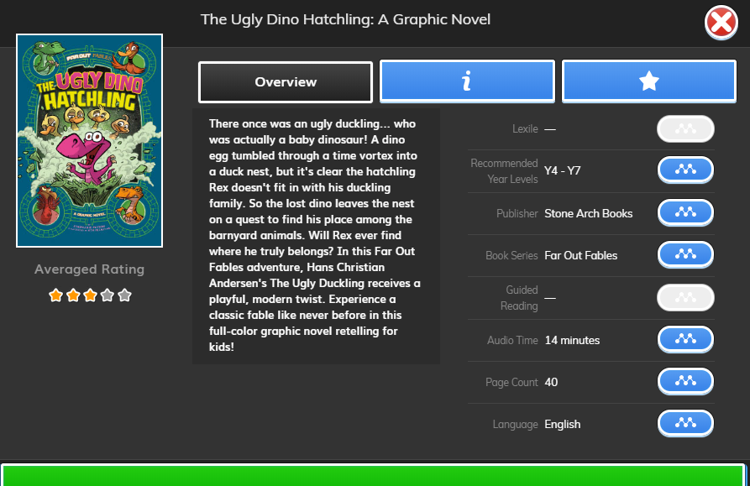
Read the overview to see if you like it and click the ‘i’ tab for more information.

Slide 5
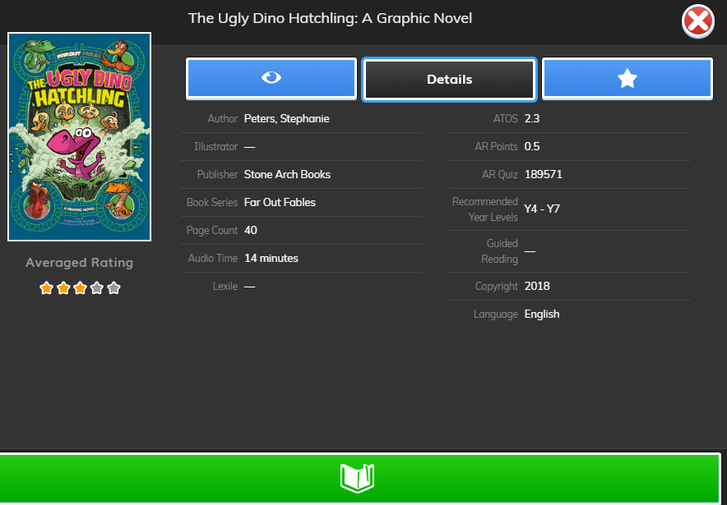
Make note of the quiz number so that your child can quiz on the book after on Accelerated Reader. (Not all books have a quiz).
Check that the book is in your child’s range (Not all books are levelled).
Click here to start reading the book.

