Slide 1

Hello and Welcome to Mrs Smith’s Phonics Group Week 11.
Wow! Where are the weeks going they are speeding by?!
I hope you are all well and staying safe. Even if you are not in school it’s nice when you give a wave and say hello if I see you out and about.
Nearly the summer holidays and then you will be in Year 2 in September! Remember to say hello and wave when you see me. I will miss you all you have been fantastic
This week we are going to learn the alternative spellings for the igh and f phoneme☺.
Why not start your phonics learning daily with our alphabet song or to get you moving BBC Super Movers with Naomi Wilkinson https://www.youtube.com/watch?v=jYeMpUdufNk
Work hard and have Fun.
Hope to see you soon
Love Mrs Smith xx

Slide 2
You could print this grid off and check what phonemes (sounds) to grapheme (written) you can recall daily. You could colour, tick or cover with counters, coins or pebbles the ones you can say using the PURE SOUND. If you don’t want to print it off you could point to each sound and say using the PURE SOUND.
This week I have made it trickier as I have muddled the sounds up on the grid! How did you do? Could you say all the sounds? Well Done
ng | d | oa | er | i | ee | sh
a | ch | oo | c | oi | ure | e
u | r | air | b | f | ff | l
y | ss | j | qu | w | x | ll
z | zz | v | g | m | th | s
ai | n | igh | t | o | ur | or
or | ow | k | ear | h | k | p
Practice the ones you are not sure of.

Slide 3
Phase 5c Week 11:
This week we are going to be learning the alternative spellings for the igh and f phonemes. These sound the same but are written differently. You may have spotted some already in our other phonics lessons.
Let’s find out more…..

Slide 4
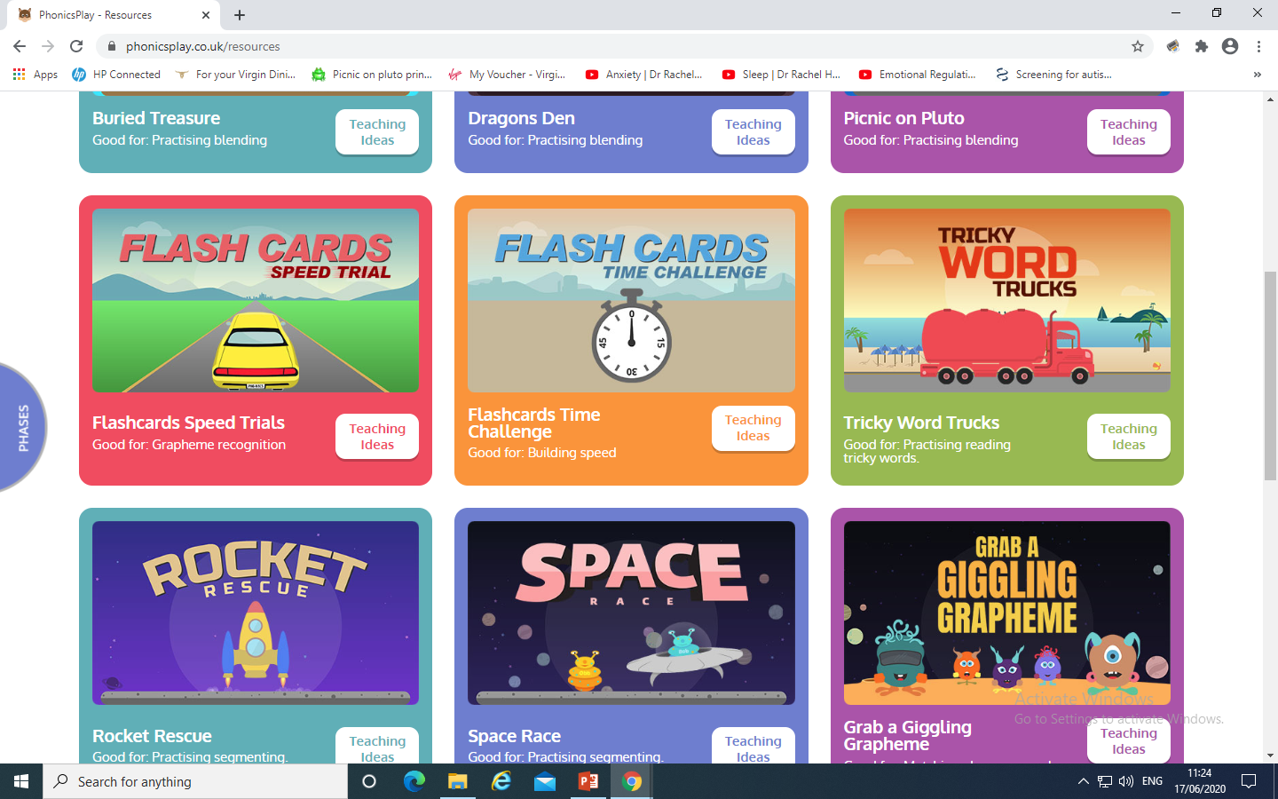
Phase 5c Week 11:
Monday: Practise the phonemes and graphemes on the sheet (slide 2) using the Pure Sound.
Play one of these games on Phonics Play

Slide 5
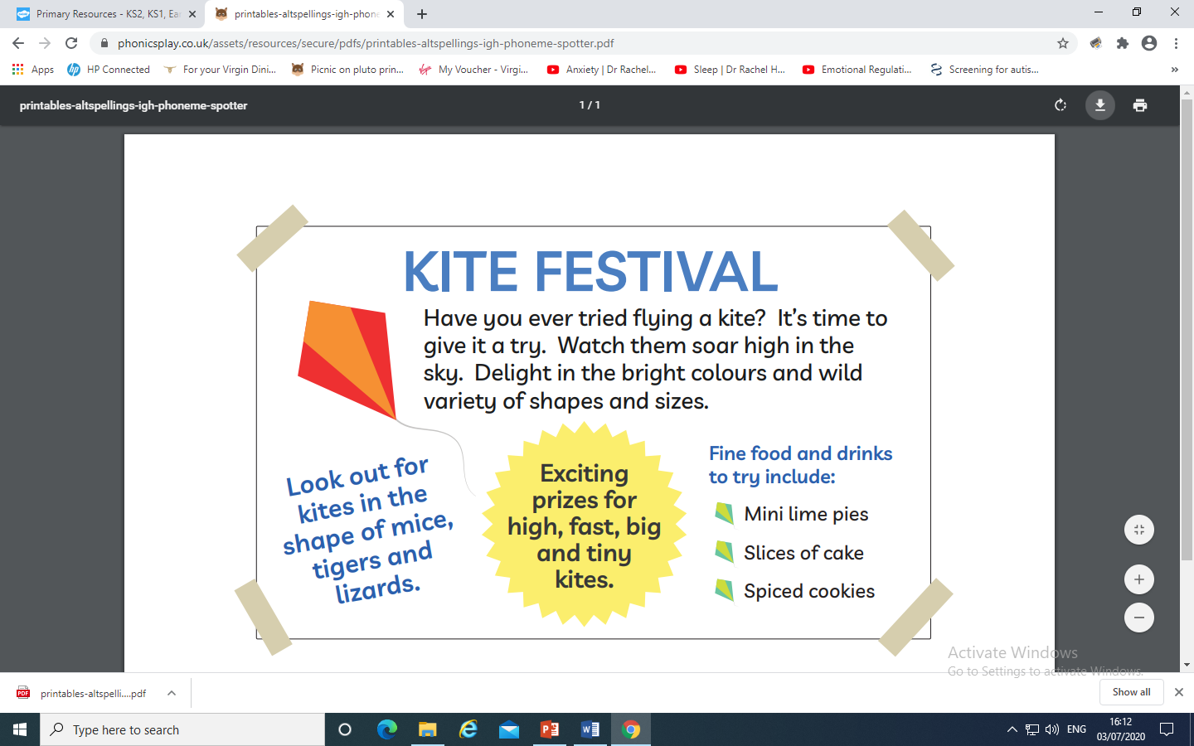
Today we are learning the alternative spellings for the igh phoneme.
Practise saying the igh phoneme
Play phoneme spotter.
Read the Phoneme Spotter text together.
Can you identify all the words that contain today’s phoneme.
Maybe you could highlight, circle or underline them. Discuss the alternative spellings you have found.
Check on the next slide if you were right

Slide 6
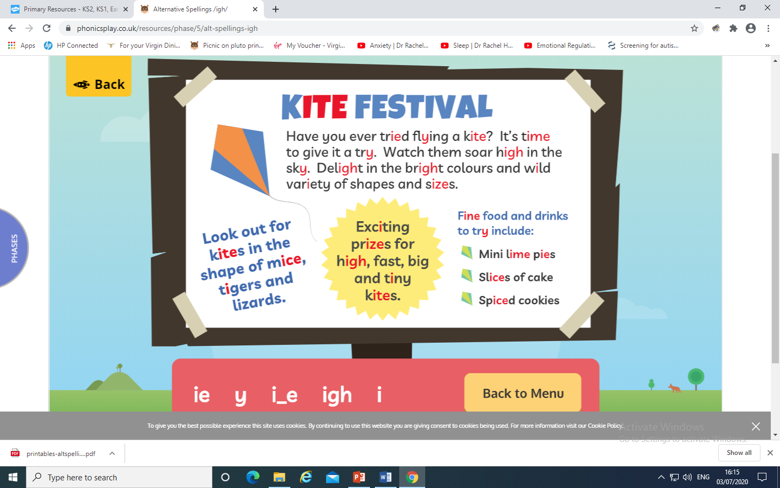
How did you do?

Slide 7
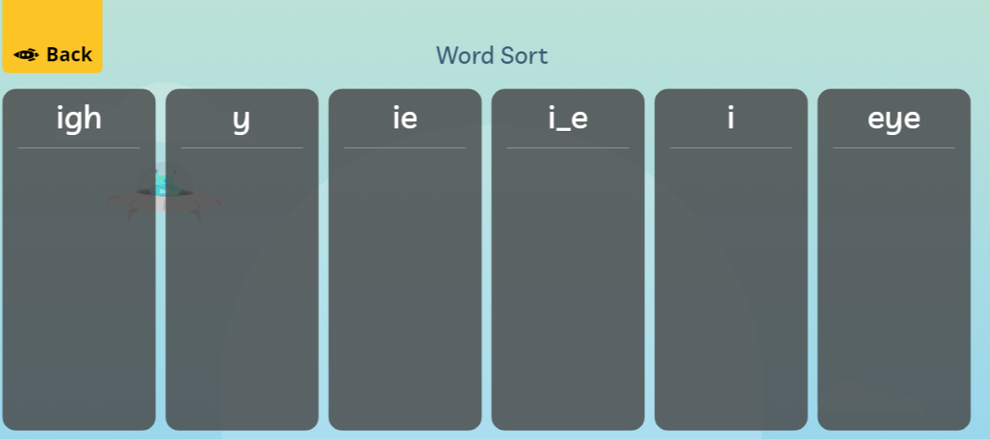
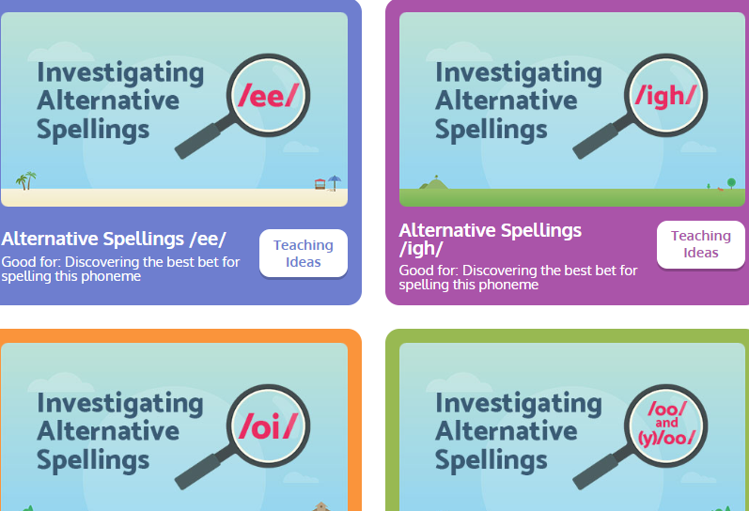
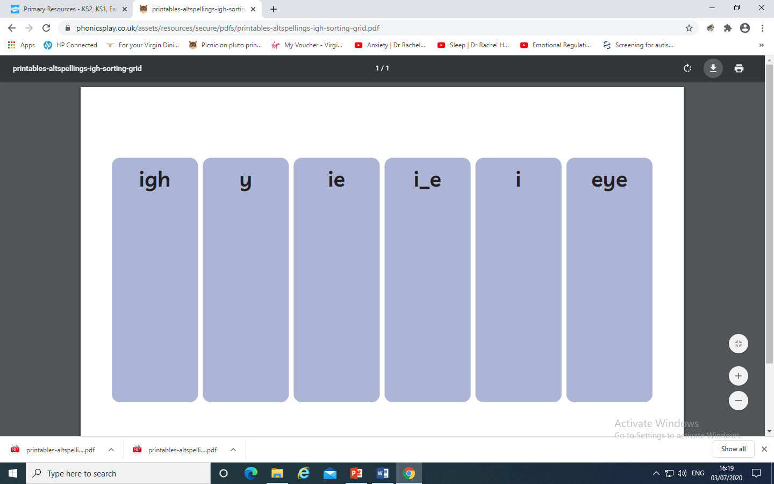
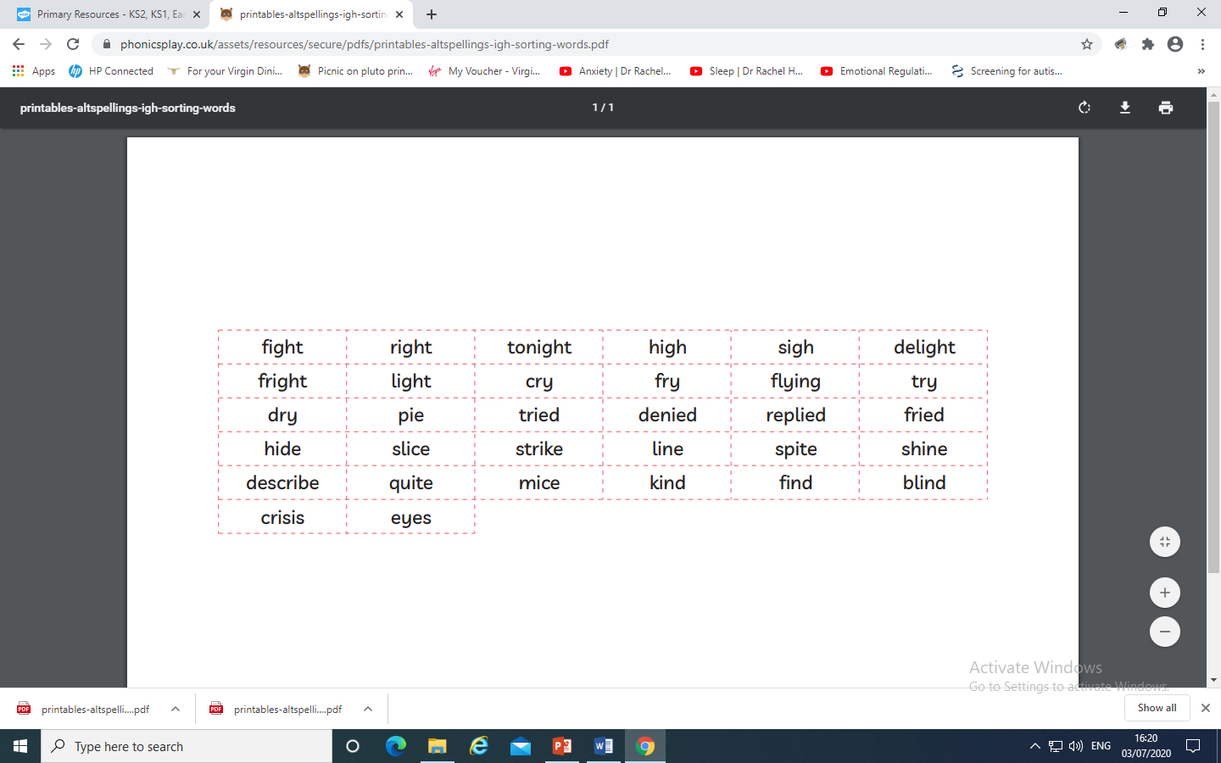
Investigate the alternative spellings on Phonics Play.
Play online or print out from the resource pack the sheet and cut and stick the
words in the correct column.

Slide 8
Tuesday: Practise the phonemes and graphemes on the sheet (slide 2) using the Pure Sound.
Today we are continuing to learn the alternative spellings for the igh phoneme.
First lets practise reading the tricky words
very, I’m, by, time

Slide 9
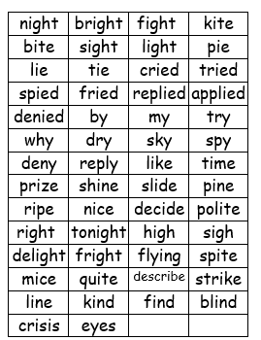
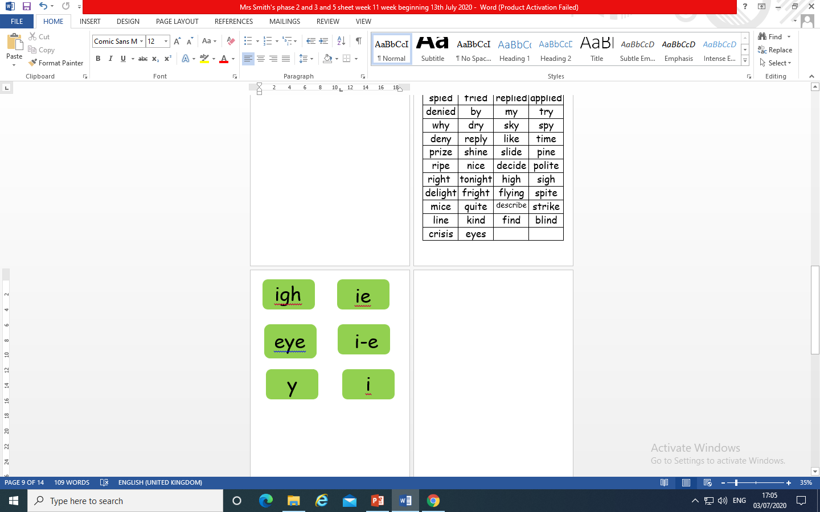
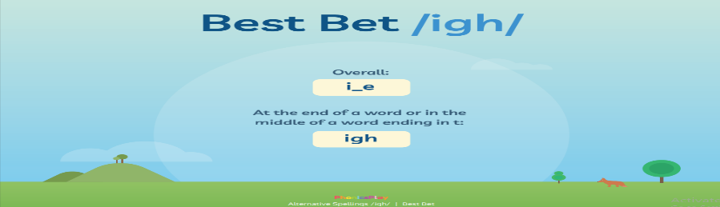
Place the alternative spellings of igh at the top.
You could place them on a wall inside or outside or on a table.
Cut up the words. Read the words and place under the correct spelling.
What do you notice? Where does each spelling sit in the word? At the beginning , middle or end? Check the Best Bet for
spelling words on Phonics
Which grapheme is the most popular? Can you see any patterns or rules?

Slide 10
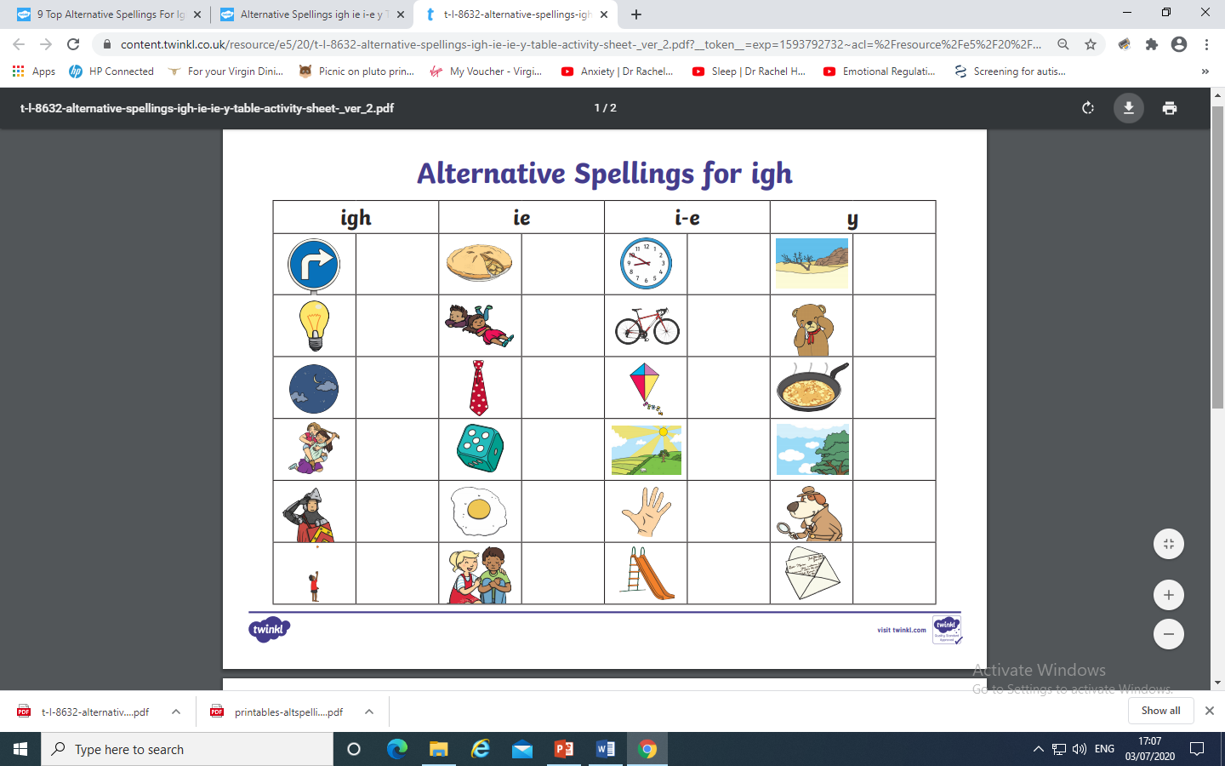
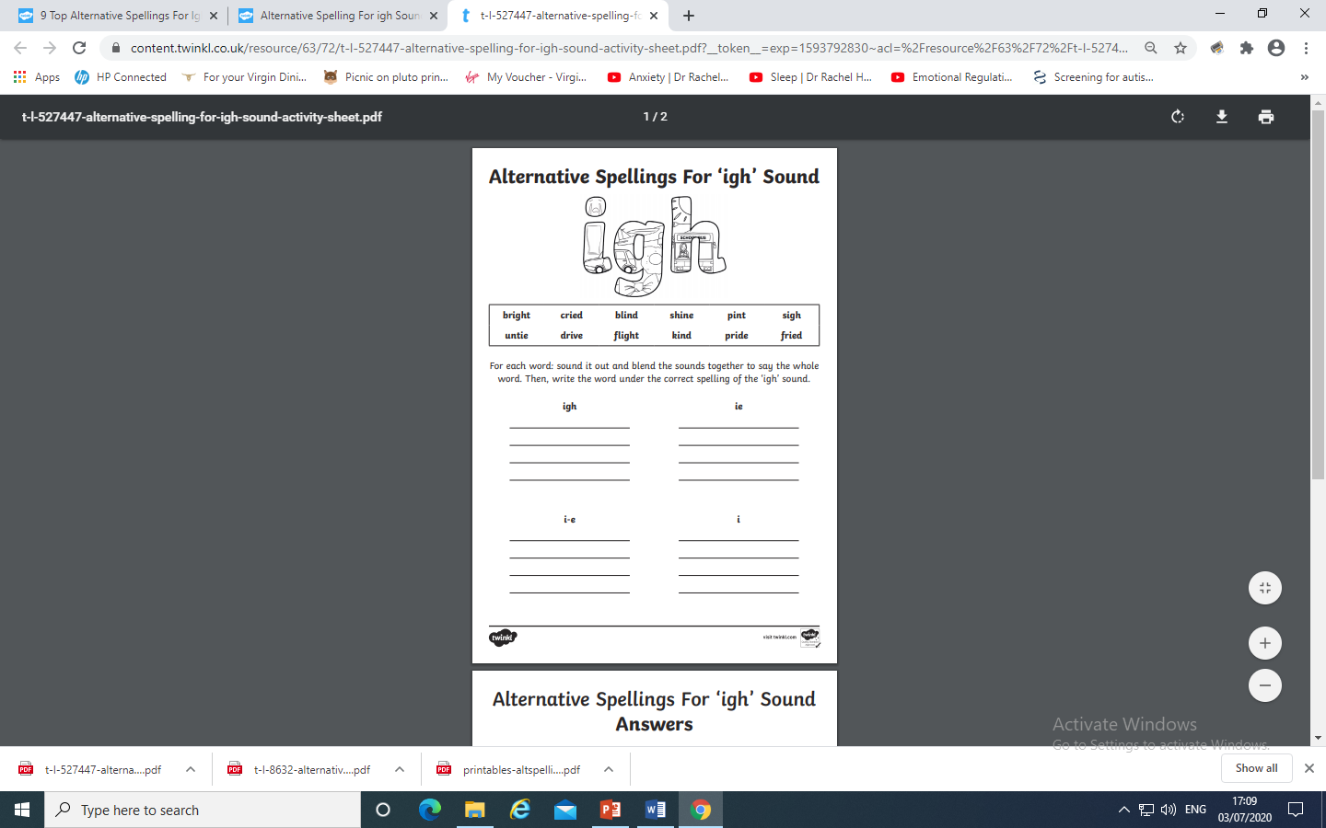
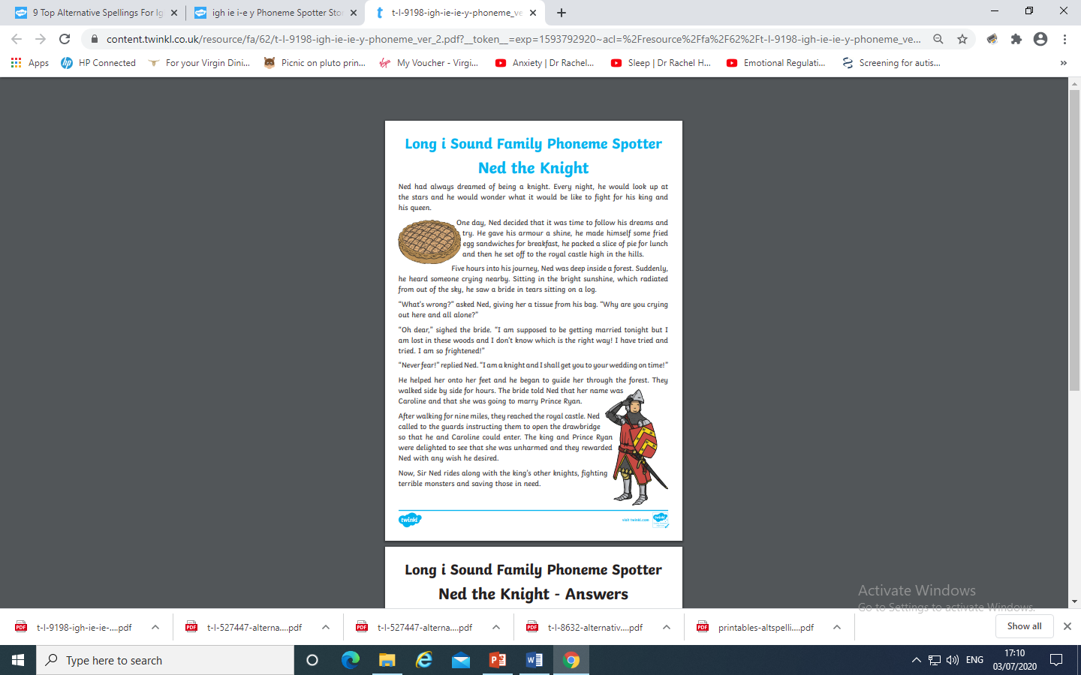
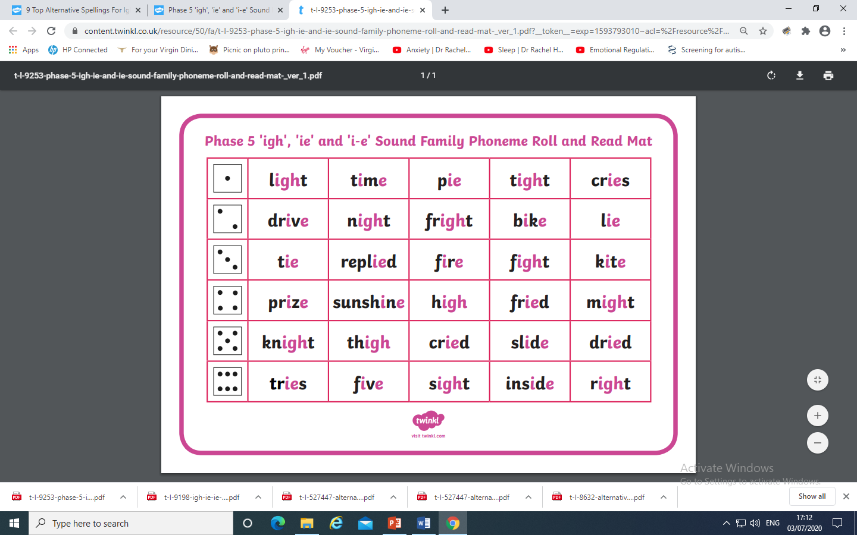
Why not try the activities here ?

Slide 11
Wednesday: Play Quickwrite Graphemes practise writing the
Graphemes on the sheet and slide 2.
Get your grown up or someone to say the sound and see if you can write the grapheme.
Can you write more than one grapheme for each phoneme?
e.g. a, ai ay, a-e, eigh ee, ey, ea, e, igh, y, ie, i-e, i, eye
How quick can you write them?
How many did you get right?
Which ones do you need to practise?

Slide 12
Practise your grapheme recognition with Flash Cards Speed Trial
on Phonics play.

Slide 13
Play word sort using either of these resources.
Remember the Best Bet for spelling !

Slide 14
Read the following sentences. Remember to sound out the words you are unsure
of (don’t guess) and then read the complete sentence.
We had a delightful time driving by my home.
Can tiny mice fly and sky dive?
Can a tiger be nice and kind?

Slide 15
Thursday: Practise the phonemes and graphemes on the sheet (slide 2) using the Pure Sound.
Today we are going to be learning the alternative spellings for the f phoneme.
First lets practise spelling the tricky words
some, come, who, were
Write the word on a piece of paper read the word, look at the letters. Cover it over and practise writing it. How did you do?

Slide 16
Write the words fix, cliff, phone, cough,
Read the words aloud and soundtalk them.
Which phoneme do these words all contain?
Soundtalk each word and draw the sound buttons.
Highlight the button which makes the f phoneme
gh makes the ph sound in a few unusual words. It makes sense to learn these as tricky words
Check on the next slide if you were right.

Slide 17
f i x c l i ff
●●● ●●●
p h o n e c o u gh
● ●●●

Slide 18
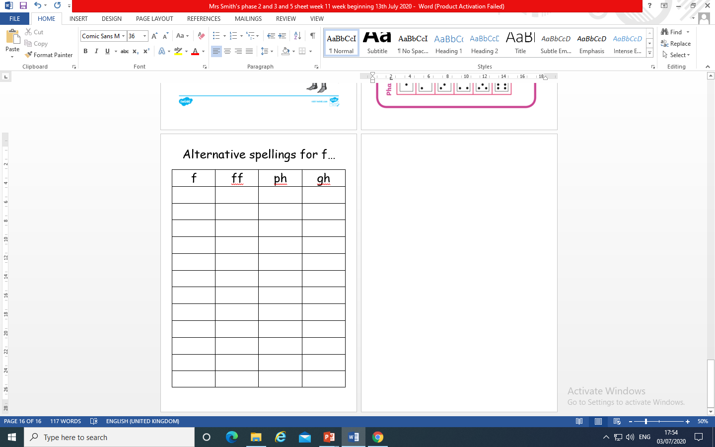
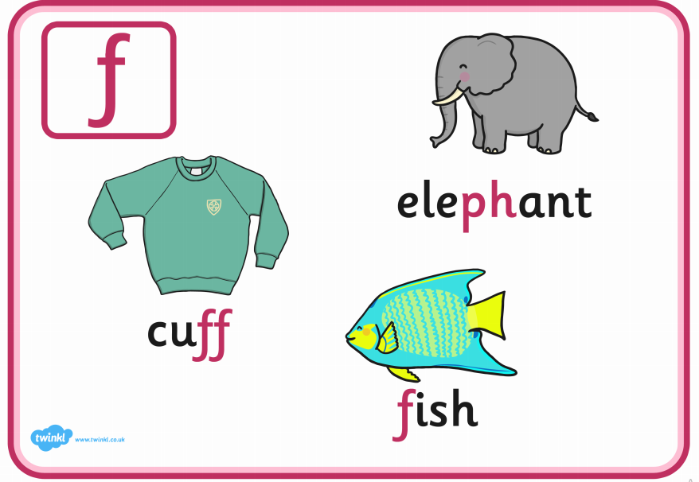
Why not have a go at this activity ? Have a go at putting the words fix, cliff, phone, cough in the correct column.
Do they all go in? Can you think of any more words to complete the table?

Slide 19
Together can you write the following sentences. Remember to sound out each word
The dolphin flaps his fins.
The fox huffs and puffs and coughs.
Get off the phone!

Slide 20
Friday:
Today we are continuing to learn the alternative spellings for the igh phoneme.
Play one of these games on Phonics Play to practise reading GPC’s ( grapheme-phoneme correspondence)

Slide 21
Can you remember the Best Bet when spelling words
containing igh phoneme?
Where in the words are the alternative spellings going to be?
Play Quickwrite. How quickly can you write the
following words:
Remember to think about the phonemes you know.
Then think about the tricky part of the word
might, bright, strike, kite, behind, cried,
dry, reply

Slide 22
Which phonemes can you hear when you soundtalk the words?
Which are the tricky parts of the word?
(the igh phoneme)

Slide 23
Read the following sentences. Remember to sound out the words you are unsure
of (don’t guess) and then read the complete sentence.
I might describe my eyes as light, bright and nice.
I got quite a fright when she tried to fight me.
Tonight, a slice of lime pie will be a delight.

Slide 24

Have fun and take care
Have fun and take care

