Slide 1

Home Learning
Year 1
Term 6 Week 7

Slide 2

Hello Year 1!
The last week of term is finally here! Time to start thinking about everything you have enjoyed in Year 1 and all the new things you are looking forward to in Year 2.
I will be very sad not to be your teacher any more but you are all too grown up for Year 1 now and I know how excited Mrs Clark and Mrs Unsworth are about having such a wonderful class next year!
Your Maths this week is more work about Time. You have various tasks for English and a final piece of Topic work about Hot and Cold Places.
If you still have school reading books at home please try to return them to school or else make sure you keep them safe until you can bring them back in September.
Love from
Mrs Child
xxx

Slide 3
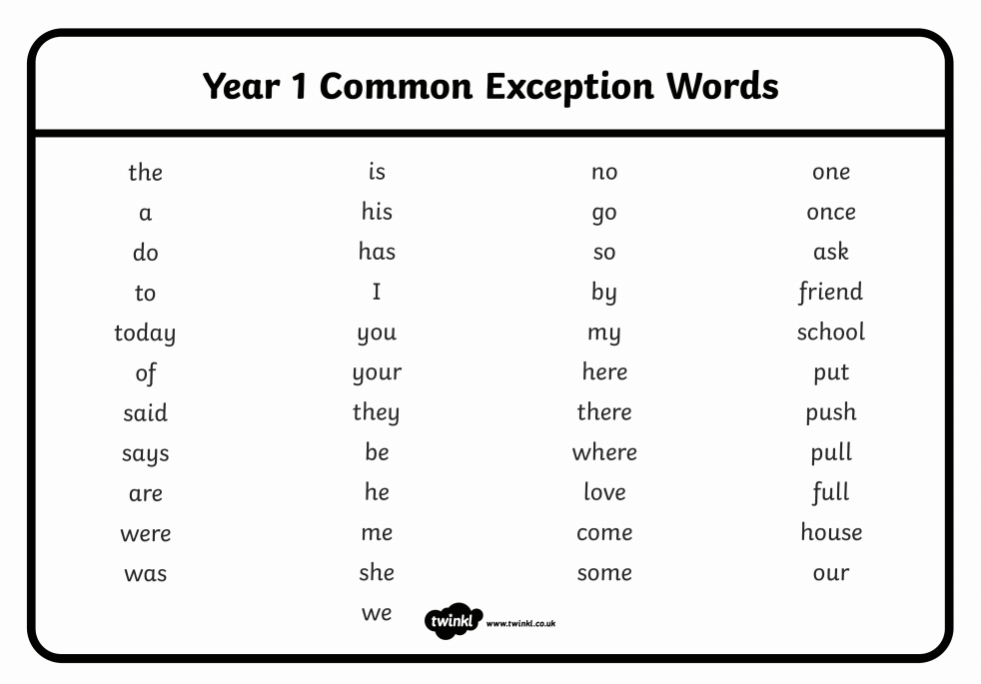
English Learning 1
By the end of Year 1, children should be able to read and write all of these 45 words.
Spend some time practising reading and spelling them.
Some helpful activities are attached on the Home Learning page of the website.

Slide 4

English Learning 2
It’s time to start thinking about leaving Year 1 and moving to Year 2.
Complete the following sheets to help Mrs Clark and Mrs Unsworth find out more about you, what you are good at and what you like to do.
(If you don’t want to print the sheets you could always make your own booklet or poster to tell your new teachers all about yourself. Use the sentence starters as a guideline.)

Slide 5
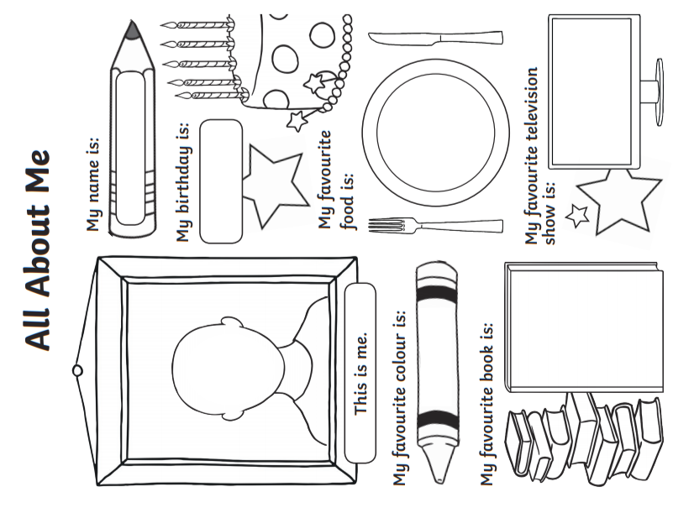

Slide 6
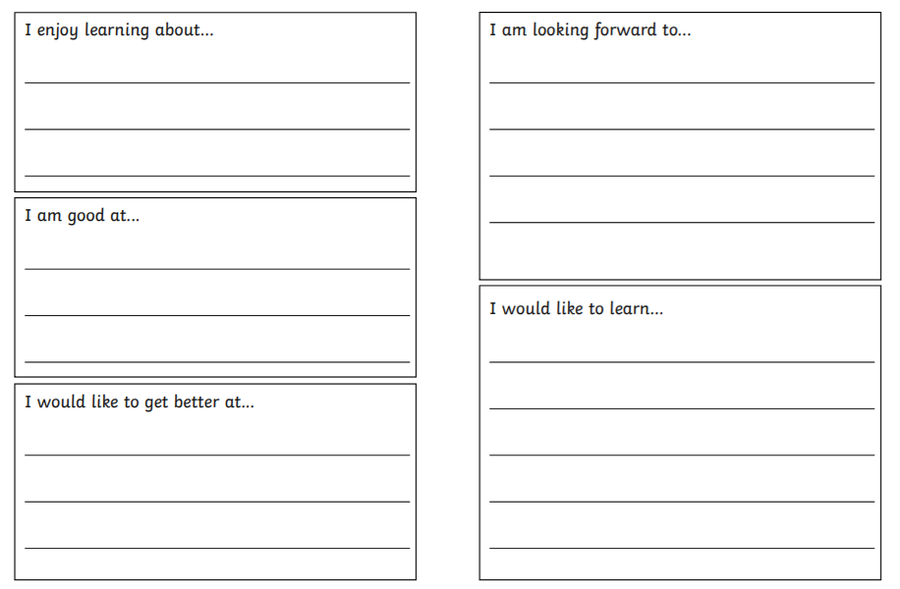

Slide 7
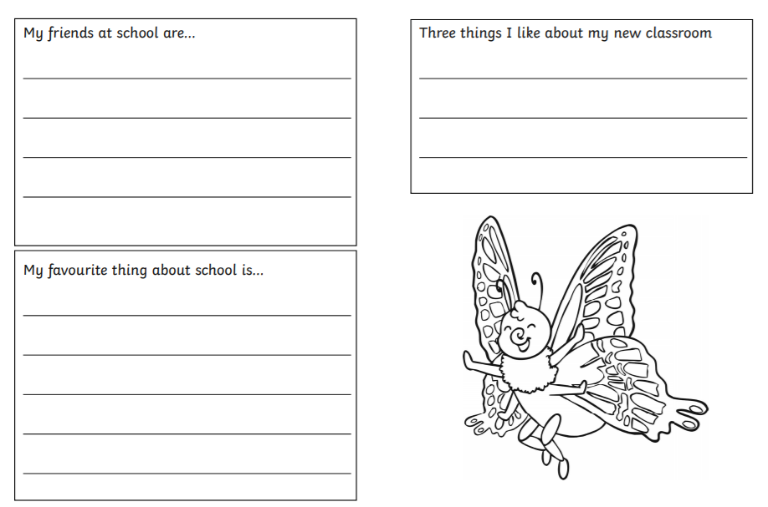
A question for my new teachers…
____________________________________
____________________________________
____________________________________
____________________________________

Slide 8

English Learning 3
On the last day of term we often get to watch a film. It can be hard to pick a film that everyone will like.
What was the last film you watched? Was it good?
Would you recommend it to the class?
Complete the Film Review sheet on the next slide.
We also do lots of cleaning and tidying in the classroom on the last day of term.
Ask your grown ups if there is any cleaning or tidying you can help with today.

Slide 9
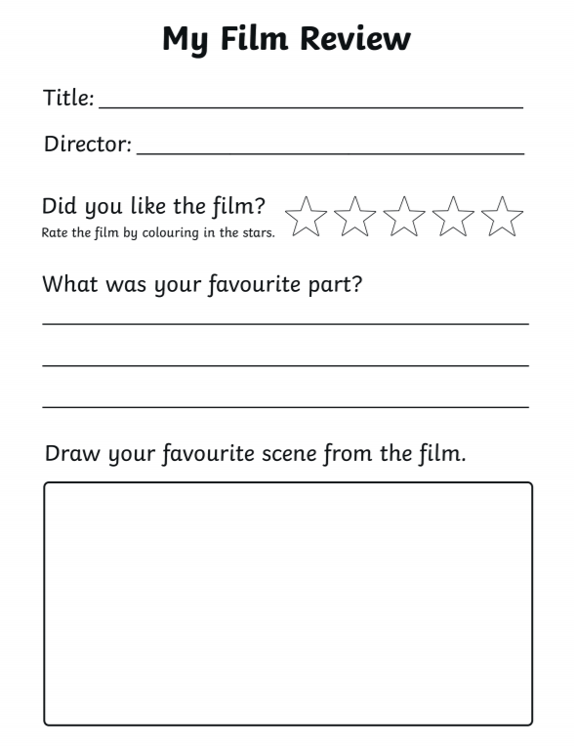
I would recommend this film to Year 1 because
________________________________________________________________________________________________________________________________________________
Some children in Year 1 might not like this film because
________________________________________________________________________________________________________________________________________________

Slide 10
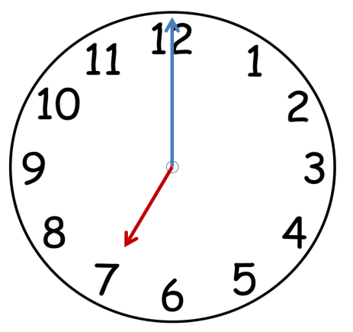
Maths Learning 1
Time to the half hour
Last week you learned to tell O’clock times.
Which is the minute hand?
What time is this clock showing?
How do you know?
Which is the hour hand?

Slide 11

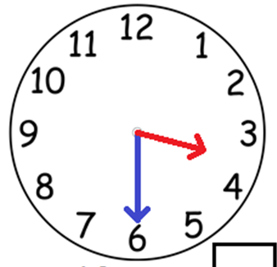
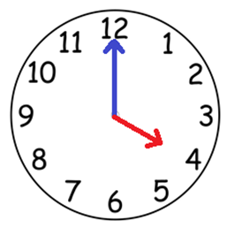
Maths Learning 1
Time to the half hour
Look at these three clocks.
What is the same and what is different about each one?
(If you made yourself a model clock last week, use it now to practice these times.)

Slide 12
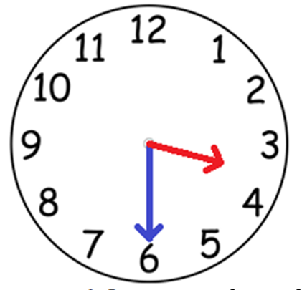
This clock is showing half past 3.
The minute hand has moved half way around the clock face and is pointing at the 6.
The hour hand is half way between 3 and 4.
The hands always move in this direction. It is called clockwise.

Slide 13
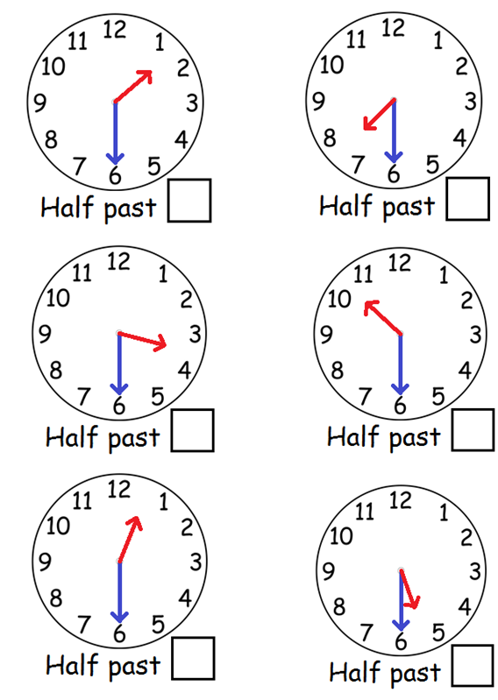
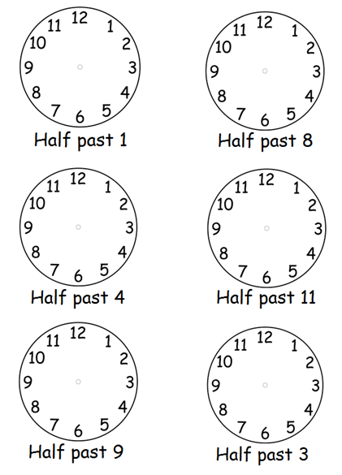
What time do these clocks show?
Can you show these times?

Slide 14
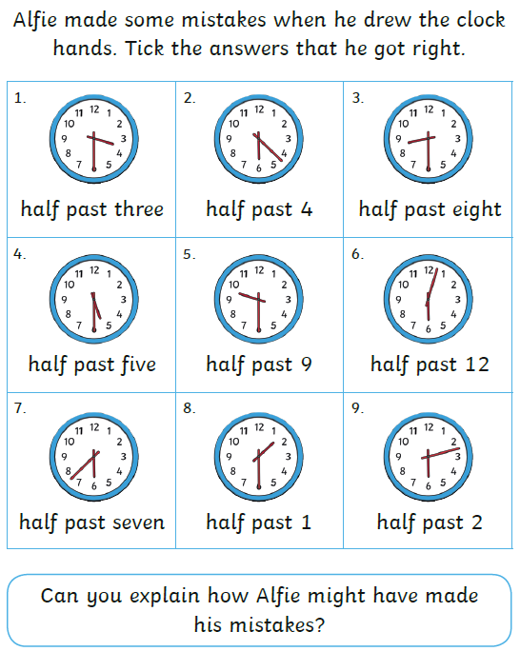
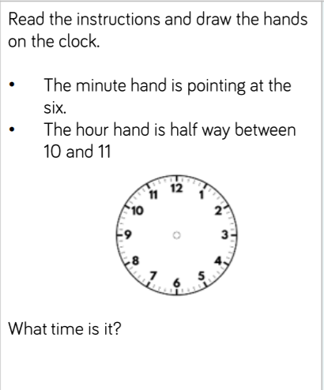

Slide 15
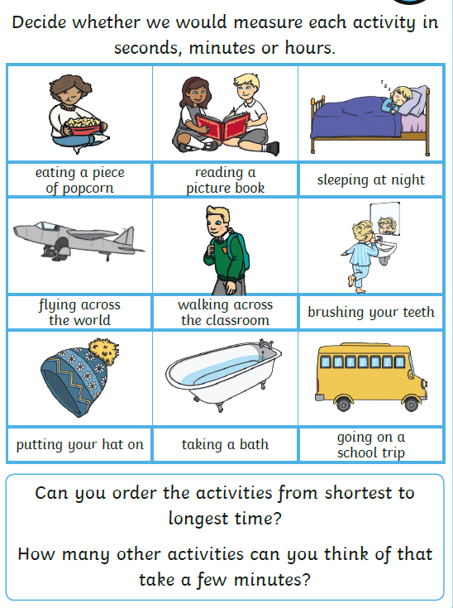
Maths Learning 2
Writing Time
Which is longest –
a minute,
a second or
an hour?
Watch the second hand moving on a clock. It takes 60 seconds for it to go all the way round. 60 seconds is called a minute. Practise counting seconds. Can you count for a minute with your eyes shut?

Slide 16
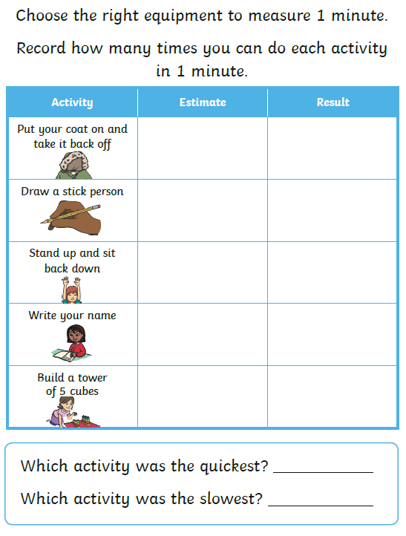
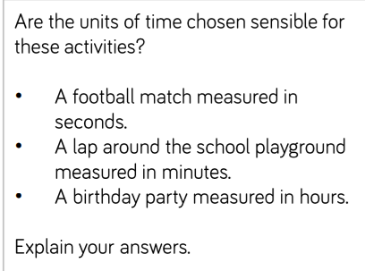
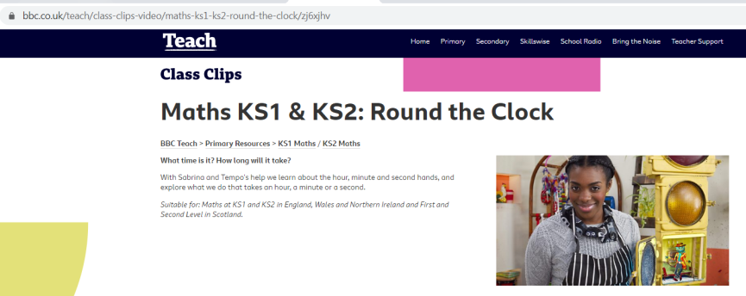
If you need further help understading measures of time, watch the BBC Round the Clock series.

Slide 17

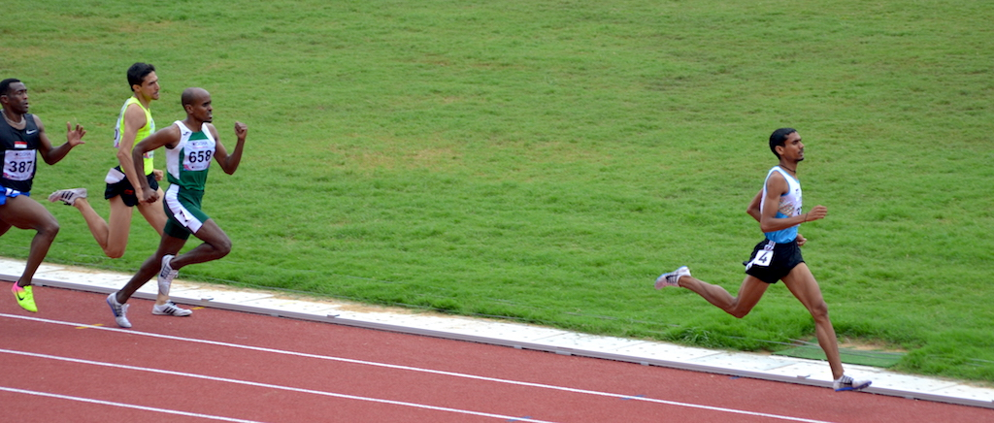
Maths Learning 3
Comparing Time
We need to know and be able to use the following words:
Longer
Shorter
Slower
Faster
Earlier
Later
If I finish first in a race, am I slower or faster than everyone else?
Did I take a longer or shorter time than everyone else?
Did I finish earlier or later than everyone else?

Slide 18
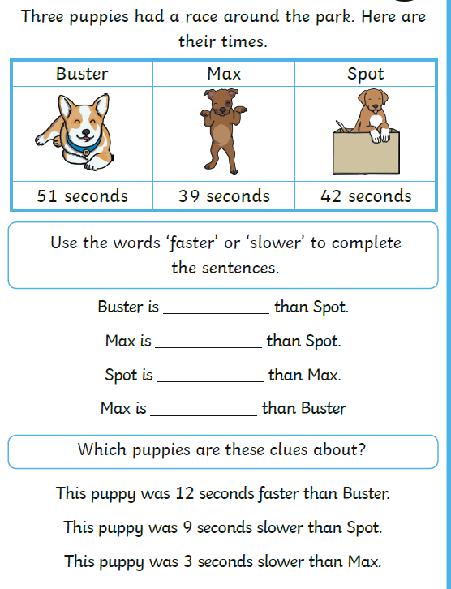
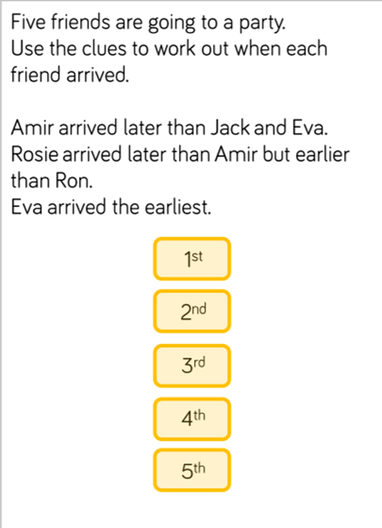

Slide 19
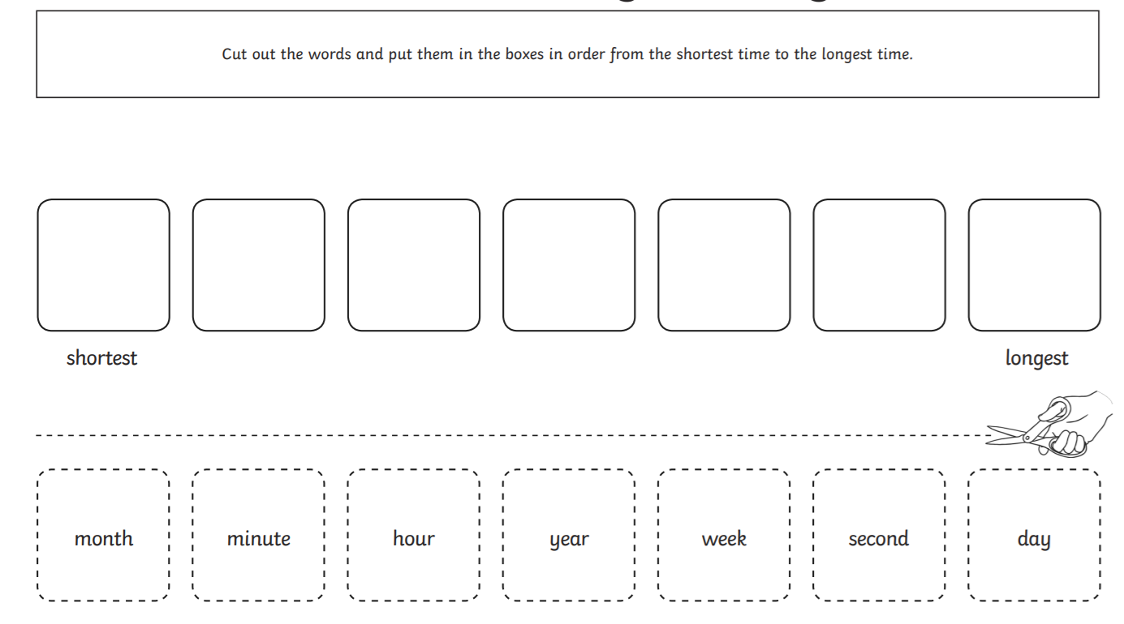

Slide 20
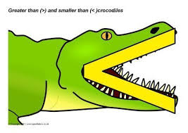
Complete the sentences using <, > or =
1 minute _____ 1 hour
30 seconds _____ 3 hours
2 seconds _____ 1 minute
60 minutes ______ 1 hour
3 minutes ______ 3 seconds
1 day ______ 4 hours
1 hour ______ 60 seconds

Slide 21

Topic
Listen to this story being read on YouTube at
https://www.youtube.com/watch?v=VADQiEg1040
Can you tell if the houses are in hot places or cold places?

Slide 22
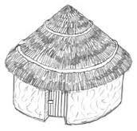
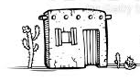
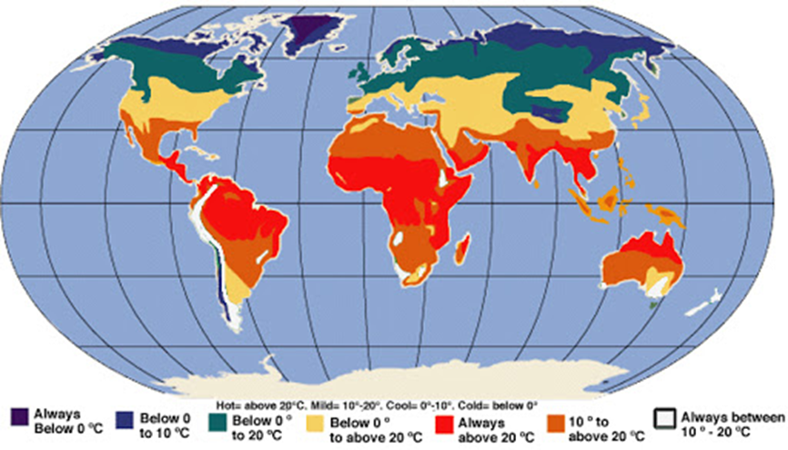

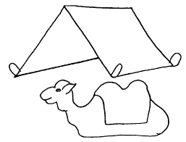

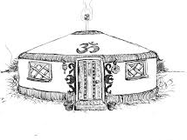
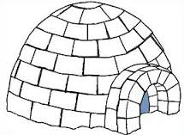
Where in the world might you find these houses?

Slide 23
Sort the houses – draw them or cut and stick.
dd
Homes from cold climates | Homes from hot climates
Draw a picture of the sort of house you would most like to live in.
I would like to live in this house because
……………………………………………………………………………………………………………………………………………………………………………………………….

Slide 24

Reading
For additional reading at your child’s level please use the Oxford Owl website where you can read books online and then complete comprehension activities about the books. Please continue to keep a record of the books they have read in their reading records.
www.oxfordowl.co.uk
Class login: temple20
Password: Bingbong
(If you are not sure of your child’s level, please check in their reading record book or look at the coloured stickers on the additional reading books that have been sent home.)

Slide 25

Phonics
Please use the games and activities on the Phonicsplay website to continue practsing Phonics.
www.phonicsplay.co.uk
Login: march20
Password: home
Mrs Child’s Phonics group are currently working on Phase 5c (alternative ways of writing sounds we already know e.g. ai, ay, a_e all make the same sound).
Mrs Smith’s group are working on Phase 4.
Additionally, there are many excellent Phonics resources on the Twinkl website(see below for how to get free access). Practising reading “alien words” is a particularly fun and valuable activity.

Slide 26

Writing
Your child has been provided with a writing journal. They are used to using them and know that they need to write the date, write a sentence (about anything they like), draw and colour a picture and then fill any spare lines with handwriting patterns.

Slide 27

P.E.
It is important to keep your children active. If it is safe to do so, ensure they have some time outside throughout the day. Please visit Joe Wicks YouTube channel (https://www.youtube.com/channel/UCAxW1XT0iEJo0TYlRfn6rYQ), which has lots of exercise videos for children. He will also be hosting a live P.E. lessons Monday to Friday at 9:00am.

Slide 28


Using My Maths
Children should know their way round My Maths but here are some reminders on how to access the lessons. Visit: www.mymaths.co.uk
bapchild
divide162

Slide 29

Using My Maths
Access any lesson based on what your child is learning in class or search the topic in the search bar.
Use the login portal to access specific homework and lessons that your teacher has set.

Slide 30

Maths – White Rose Home Leaning
In school we follow the White Rose scheme of learning. Their website has put together free lessons and resources that link to the learning taking place in school. Please visit: https://whiterosemaths.com/homelearning/

Slide 31

Accessing Twinkl
Many educational content providers are offering free access to their resources. Twinkl is a website that we use from time to time to resource our lessons to aid in teacher input and pupil activities.
We will be able to direct you towards activities and learning via this website based on lessons that may be missed due to absence. To access Twinkl please visit: www.twinkl.co.uk/offer
You will have to sign up and put in the offer code: UKTWINKLHELPS

Slide 32

Classroom Secrets
The site classroom secrets https://classroomsecrets.co.uk/free-home-learning-packs/ has free class packs which provide some great additional ideas and resources you can use.

