Slide 1

Hello and Welcome to Mrs Smith’s Phonics Group Week 10.
How are you all? I am getting to see a few more of you to wave at which is lovely. You are getting so tall and growing up fast!
Are you enjoying the hot weather? Are you going to the beach? Playing in the sea or a paddling pool?
I hope you are having lots of fun and still staying safe.
This week we are going to learn the alternative spellings for the ee and ch phoneme☺.
Why not start your phonics learning daily with our alphabet song or to get you moving BBC Super Movers with Naomi Wilkinson https://www.youtube.com/watch?v=jYeMpUdufNk
Work hard and have Fun.
Hope to see you soon
Love Mrs Smith xx

Slide 2
You could print this grid off and check what phonemes (sounds) to grapheme (written) you can recall daily. You could colour, tick or cover with counters, coins or pebbles the ones you can say using the PURE SOUND. If you don’t want to print it off you could point to each sound and say using the PURE SOUND.
This week I have made it trickier as I have muddled the sounds up on the grid! How did you do? Could you say all the sounds? Well Done
ng | d | oa | er | i | ee | sh
a | ch | oo | c | oi | ure | e
u | r | air | b | f | ff | l
y | ss | j | qu | w | x | ll
z | zz | v | g | m | th | s
ai | n | igh | t | o | ur | or
or | ow | k | ear | h | k | p
Practice the ones you are not sure of.

Slide 3
Phase 5c Week 10:
This week we are going to be learning the alternative spellings for the ee and ch phonemes. These sound the same but are written differently. You may have spotted some already in our other phonics lessons.
Let’s find out more…..

Slide 4
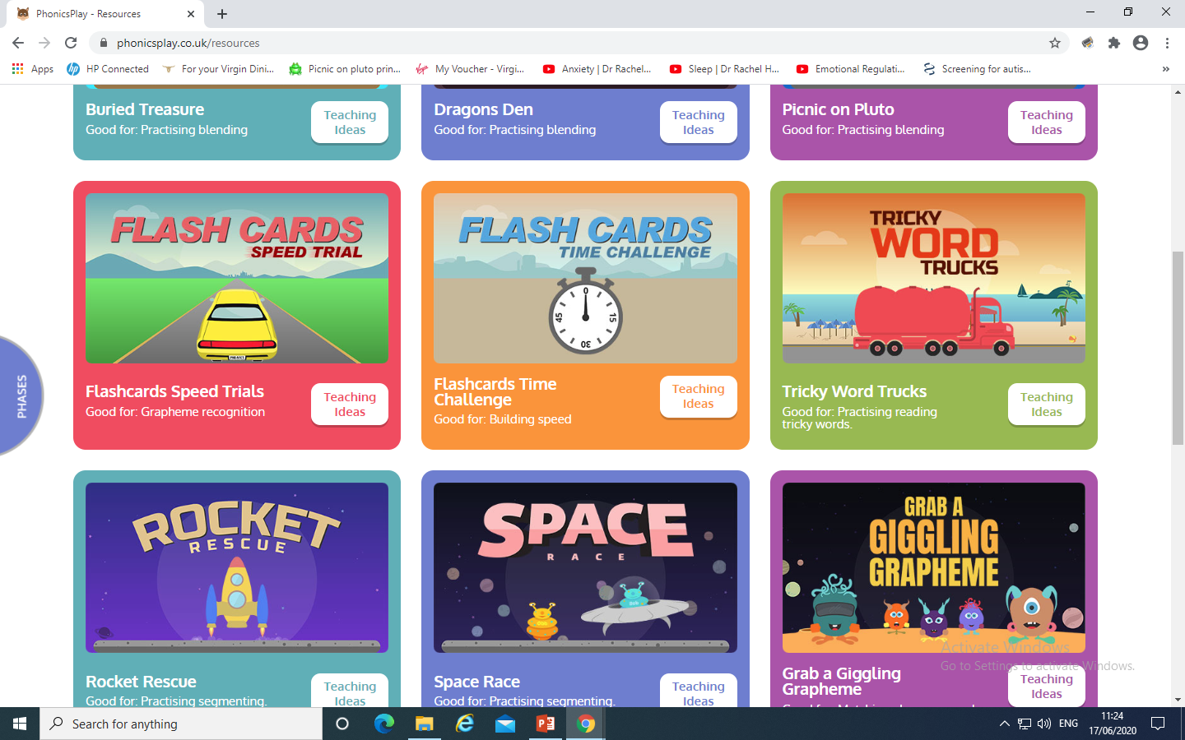
Phase 5c Week 10:
Monday: Practise the phonemes and graphemes on the sheet (slide 2) using the Pure Sound.
Play one of these games on Phonics Play

Slide 5
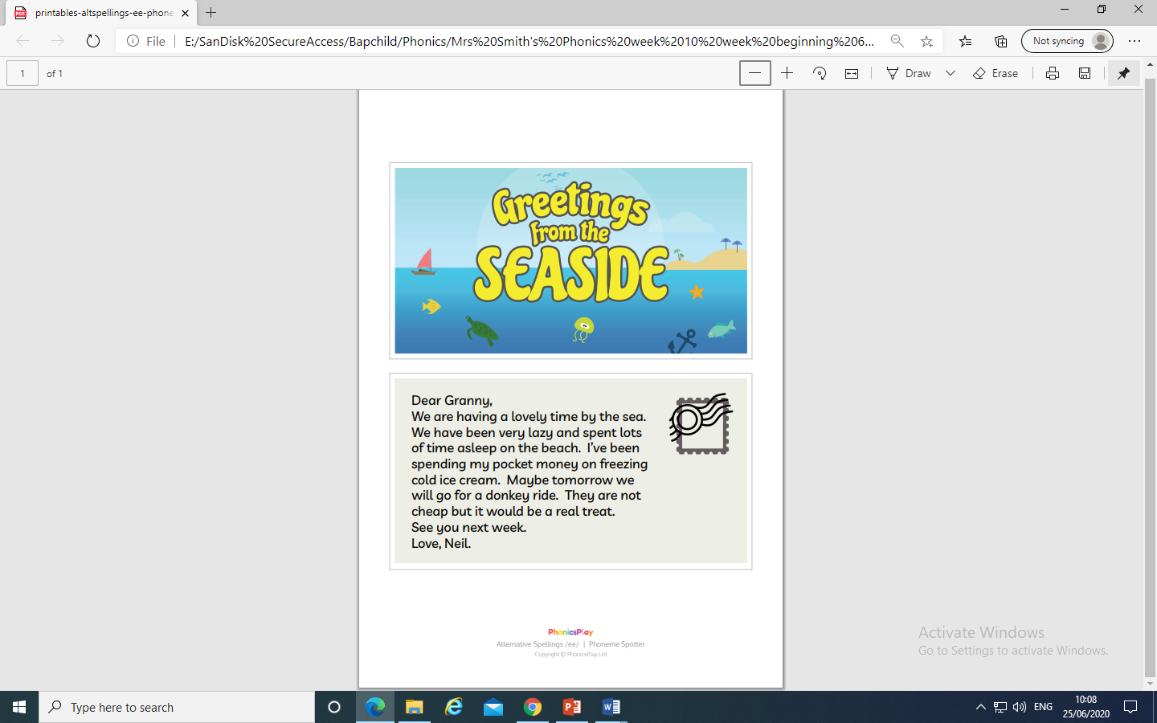
Today we are learning the alternative spellings for the ee phoneme.
Play phoneme spotter.
Read the Phoneme Spotter text together.
Can you identify all the words that contain today’s phoneme.
Maybe you could highlight, circle or underline them. Discuss the alternative spellings you have found.
Check on the next slide if you were right

Slide 6
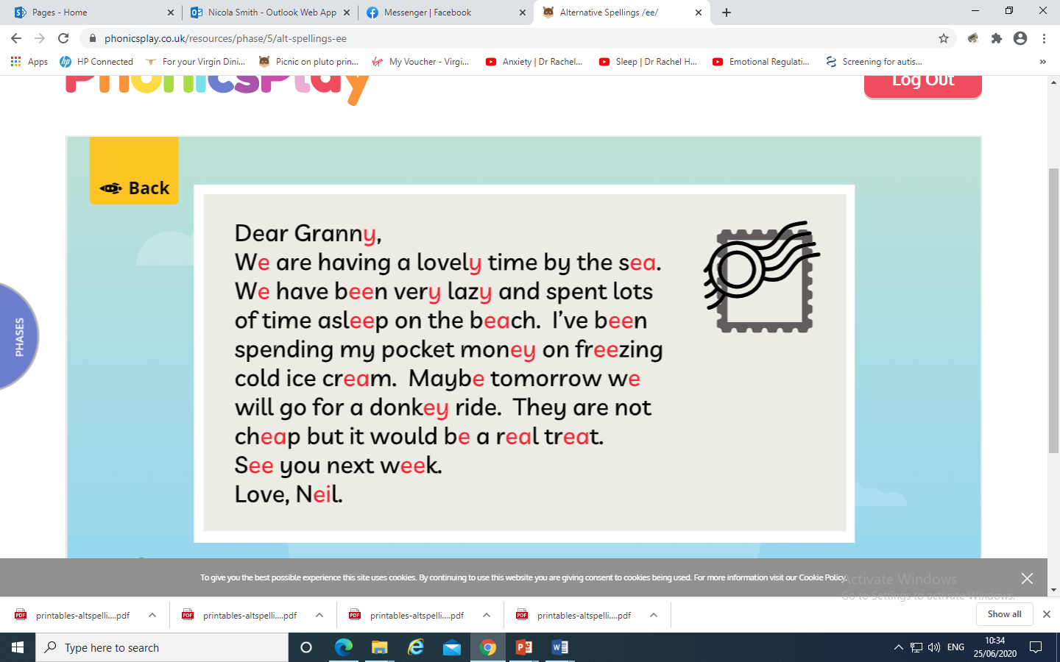

Slide 7
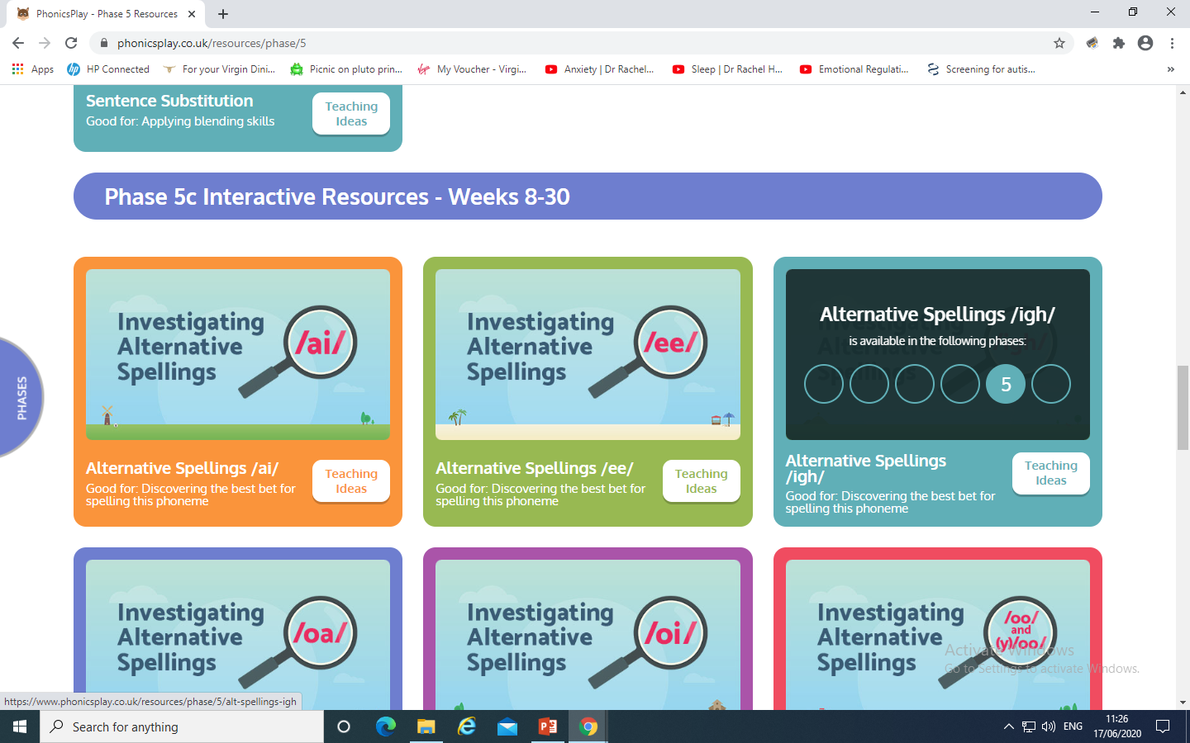
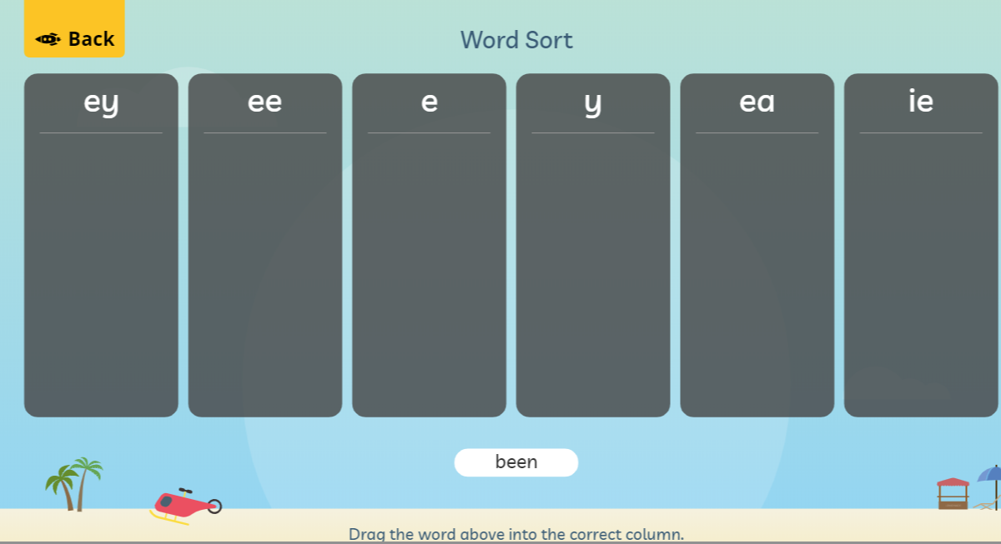
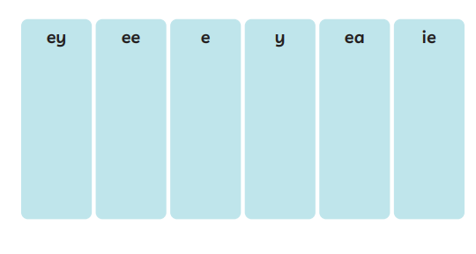
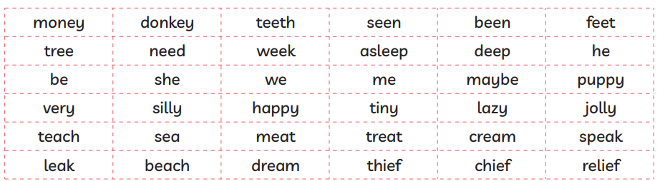
Investigate the alternative spellings on Phonics Play.
Play online or print out from the resource pack the sheet and cut and stick the
words in the correct column.

Slide 8
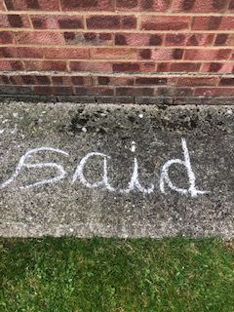
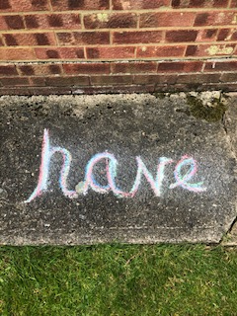
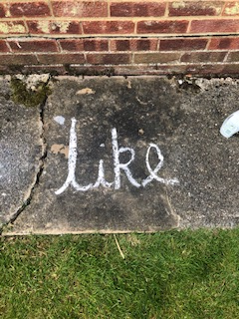
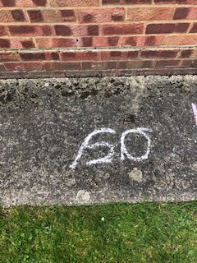
Tuesday: Practise the phonemes and graphemes on the sheet (slide 2) using the Pure Sound.
Today we are continuing to learn the alternative spellings for the ee phoneme.
First lets practise spelling the tricky words
said, so, have, like
You could practise using some of the ideas we have used
before.

Slide 9
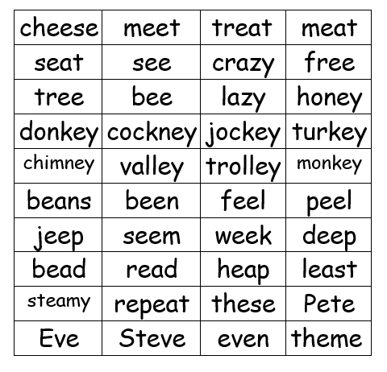
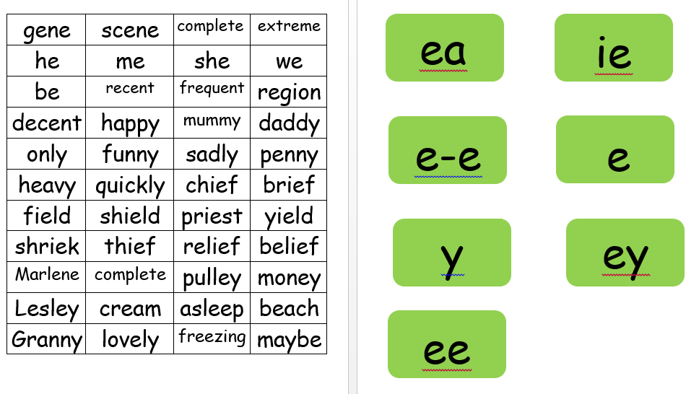
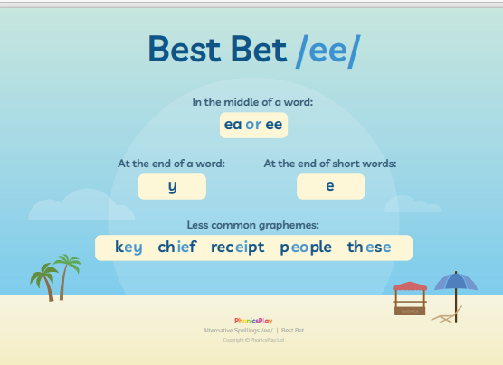
Place the alternative spellings of ee at the top.
You could place them on a wall inside or outside. Cut up the words. Read the words and place under the correct spelling.
What do you notice? Where does each spelling sit in the word? At the beginning , middle or end?
Check the Best Bet for
spelling words on Phonics Play
Which grapheme is the most popular? Can you see any patterns or rules?

Slide 10
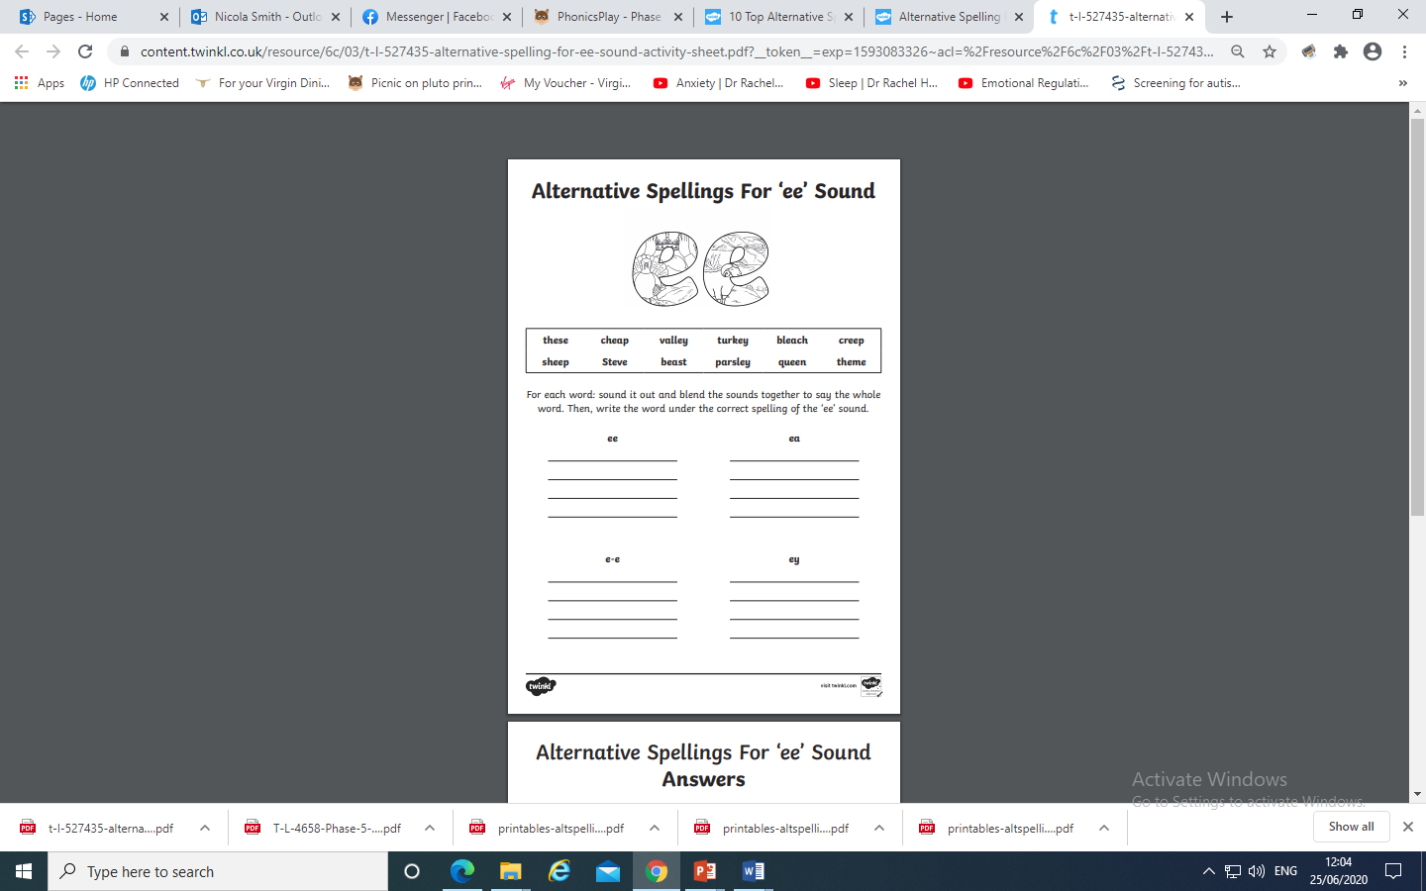
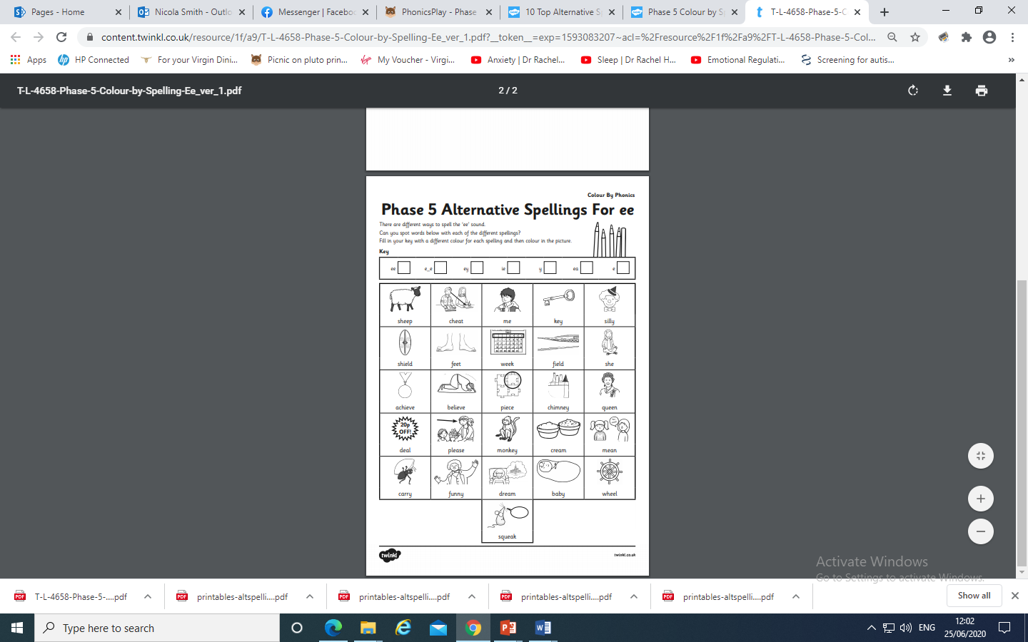
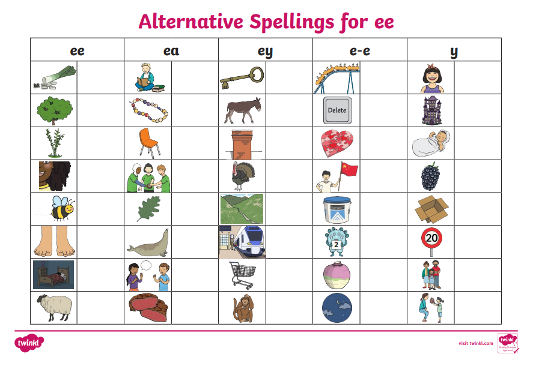
Why not try the activities here ?

Slide 11
Wednesday: Play Quickwrite Graphemes practise writing the
Graphemes on the sheet and slide 2.
Get your grown up or someone to say the sound and see if you can write the grapheme.
Can you write more than one grapheme for each phoneme?
e.g. a, ai ay, a-e, eigh ee, ey, ea, e
How quick can you write them?
How many did you get right?
Which ones do you need to practise?

Slide 12
Practise your grapheme recognition with Flash Cards Speed Trial
on Phonics play.

Slide 13
Play word sort using either of these resources.
Remember the Best Bet for spelling !

Slide 14
Read the following sentences. Remember to sound out the words you are unsure
of (don’t guess) and then read the complete sentence.
The chief jumped in the deep freezing sea with a squeak.
He had a dream about magic beans that made him scream.
The beast machine ate a feast of green peas?

Slide 15
Thursday: Practise the phonemes and graphemes on the sheet (slide 2) using the Pure Sound.
Today we are going to be learning the alternative spellings for the ch phoneme.
First lets practise spelling the tricky words
said, so, have, like
Write the word on a piece of paper read the word, look at the letters. Cover it over and practise writing it. How did you do?

Slide 16
Write the words rich, much, future, adventure, catch, stitch
Read the words aloud and soundtalk them.
Which phoneme do these words all contain?
Soundtalk each word and draw the sound buttons.
Highlight the button which makes the ch phoneme
Check on the next slide if you were right.

Slide 17
r i ch m u ch
●● ● ●
f u t ure a d v e n t ure
● ● ● ● ● ● ●● ●
c a t ch s t i t c h
● ●● ●●●●

Slide 18
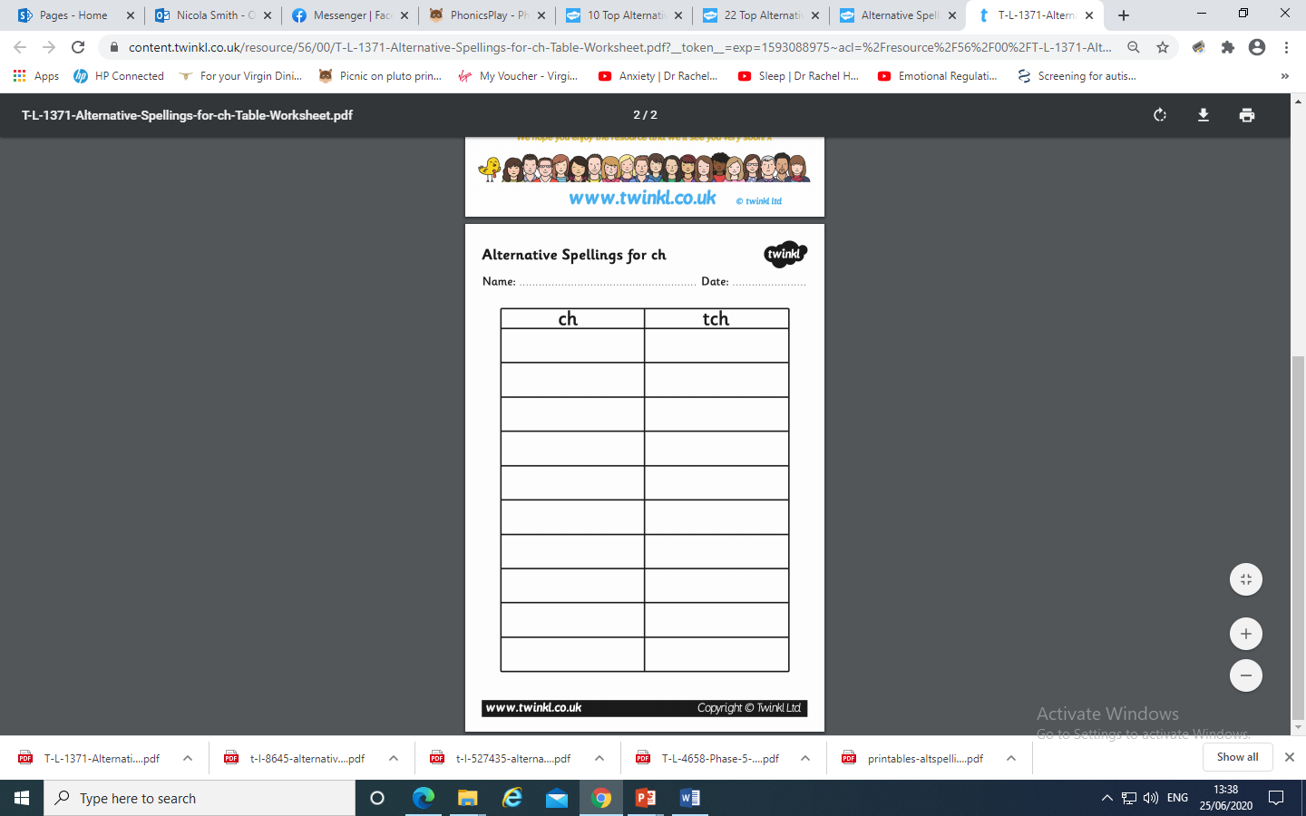
Why not have a go at this activity ? Have a go at putting the words rich, much, future, adventure, catch and stitch in the
correct column. Do they all go in? Can you think of any more words to complete the table?

Slide 19
Together can you write the following sentences. Remember to sound out each word
The witch in the picture is making such a messy mixture.
Watch out! The future will be such a big adventure.
Can you catch the cheeky creature from the kitchen?

Slide 20
Friday:
Today we are continuing to learn the alternative spellings for the ee phoneme.
Practise reading these decodable words
day
made
came
make

Slide 21
Can you remember the Best Bet when spelling words
containing ee?
Where in the words are the alternative spellings going to be?
Play Quickwrite. How quickly can you write the
following words:
Remember to think about the phonemes you know.
Then think about the tricky part of the word
tree, three, steam, happy, monkey, these, chief

Slide 22
Which phonemes can you hear when you soundtalk the words?
Which are the tricky parts of the word?
(the ee phoneme)

Slide 23
Read the following sentences. Remember to sound out the words you are unsure
of (don’t guess) and then read the complete sentence.
The lazy donkey went to sleep on the beach.
The sleepy puppy came to eat a meat treat by my feet.
Maybe the thief is jolly or maybe he’s mean.

