Slide 1

Home Learning
Year 1
Term 6 Week 6

Slide 2
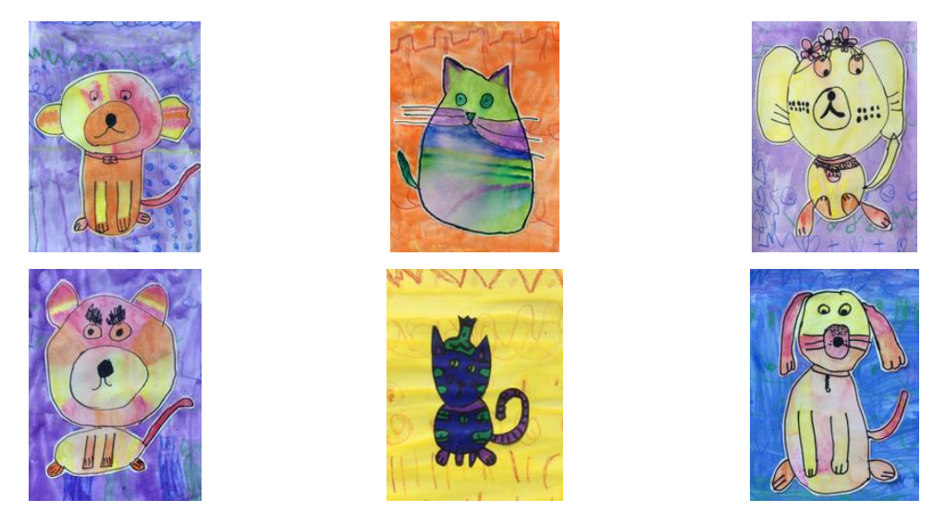
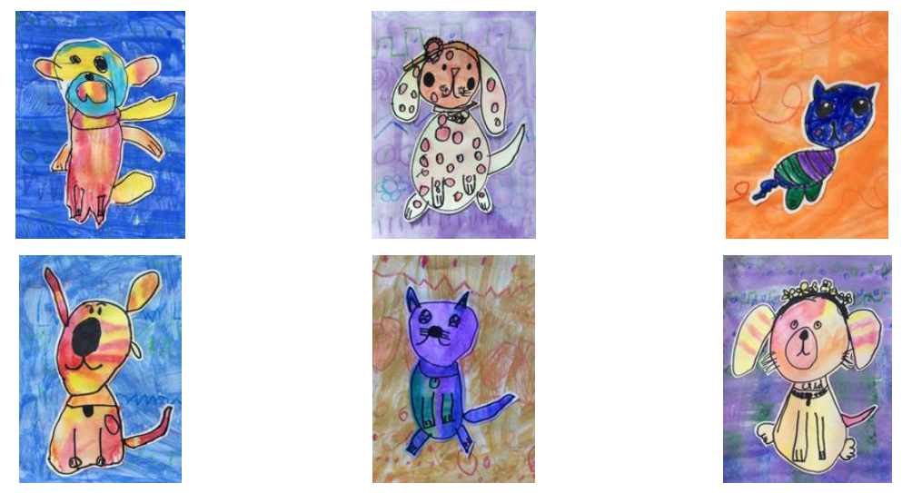
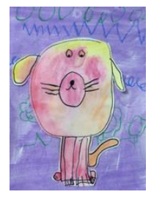
Hello Year 1!
Just two more weeks of Home Learning to go until the holidays and then hopefully, we’ll see you back at school in September! Hooray!
Your English this week is completing the work on your Tree-themed Information Text. Maths is about measuring Time. There is also a Science experiment that you can try to find out how Polar Bears keep warm.
Do you like these Hot Dogs and Cool Cats that the children who have been at school have made? If you would like to make one too there is a booklet attached to show you how.
Love from
Mrs Child
xxx

Slide 3
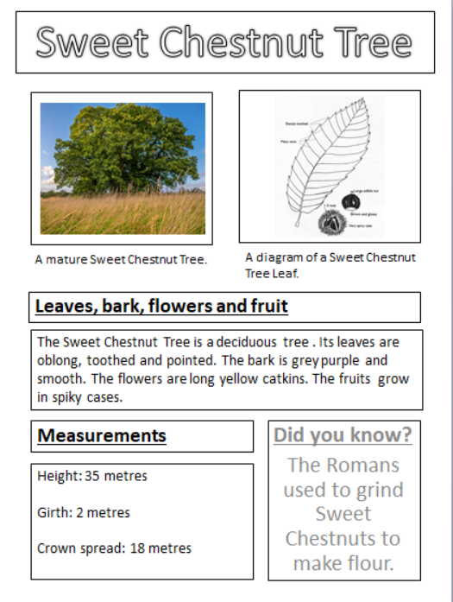
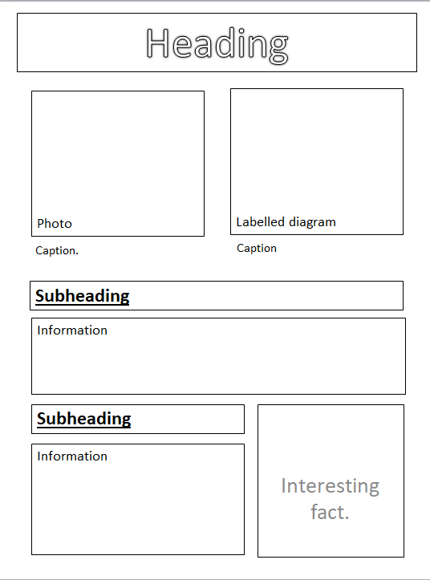
English Learning 1
Last week you identified the features of this information page.

Slide 4
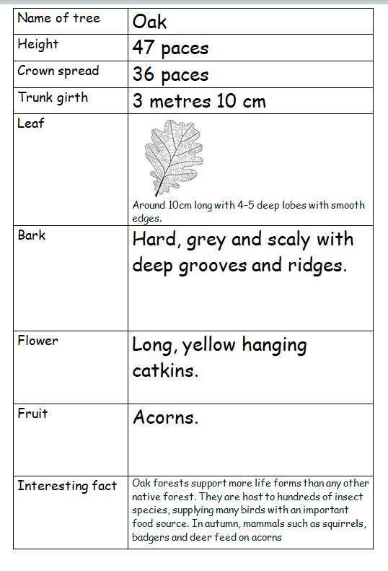
Hopefully you also completed your own version of this table with information about a tree of your choice. (If you didn’t manage to collect your own information you can use this one).
Your job today is to present this information as a fact page in the same style as we have been looking at (like the Sweet Chestnut Tree page). Either draw out your own page or use one of the templates on the following slides.

Slide 5


Slide 6
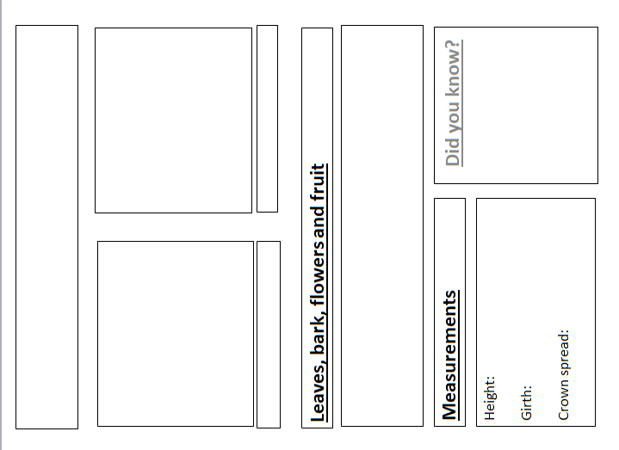

Slide 7
English Learning 2
Imagine we are going to make a class book of everyone’s tree fact pages. Can you put them in Alphabetical Order and create a Contents Page for the book?
For a recap on
Alphabetical Order, see the lesson on BBC Bitesize at https://www.bbc.co.uk/bitesize/articles/zsv6wnb
and for more practise, play the games at http://www.crickweb.co.uk
/ks1literacy.html
Elder
Silver Birch
Rowan
Sycamore
Holly
Field Maple
Hornbeam
Beech
Cherry
Oak
Yew
Willow
Ash

Slide 8
English Learning 3
Our book will also need a Glossary.
A glossary is found at the end of an Information book and is a list of tricky words from the book and what they mean.
Choose five of the words in this box, arrange them in Alphabetical Order and then write a definition for each of them, either using a dictionary or researching online.
What would the cover of our book look like? Perhaps you could design this too!
Crown
Trunk
Girth
Palmate
Pinnate
Lobed
Catkin
Pollinate
Deciduous
Evergreen
Blossom

Slide 9
Maths Learning 1
Time – Chronological order
We need to know and be able to use the following words:
Before
After
First
Next
Then
Finally
Morning
Afternoon
Evening
What are you going to do after this lesson?
What do you do before you go to bed?
When do you prefer to have a bath, in the morning or the evening?
If we are going to make some fairy cakes, what do we need to do first?

Slide 10
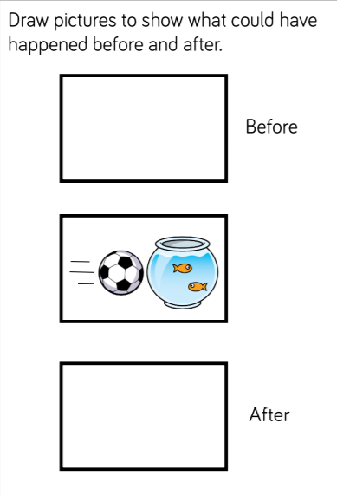
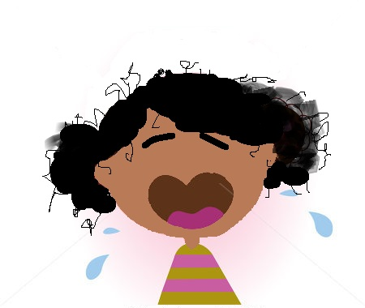

Slide 11
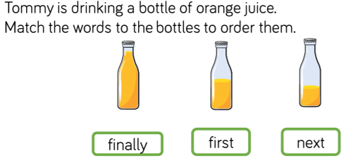
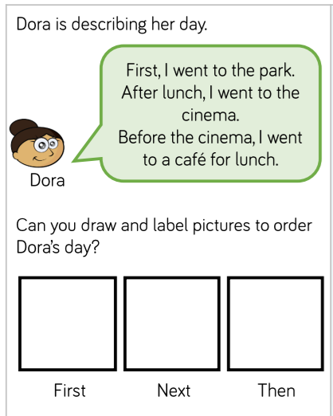

Slide 12
before after first next morning afternoon evening
Use a word from above to complete each sentence.
I won the race because I came ______________________.
I go to bed in the ________________________.
______________________I have my lunch I wash my hands.
We usually have Collective Worship in the ____________________.
We can have pudding ______________ we have eaten our dinner.
School finishes at quarter past three in the ______________________.

Slide 13
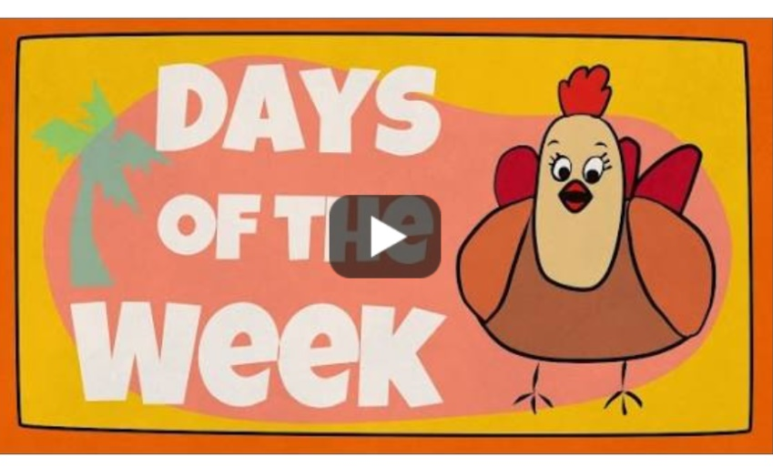
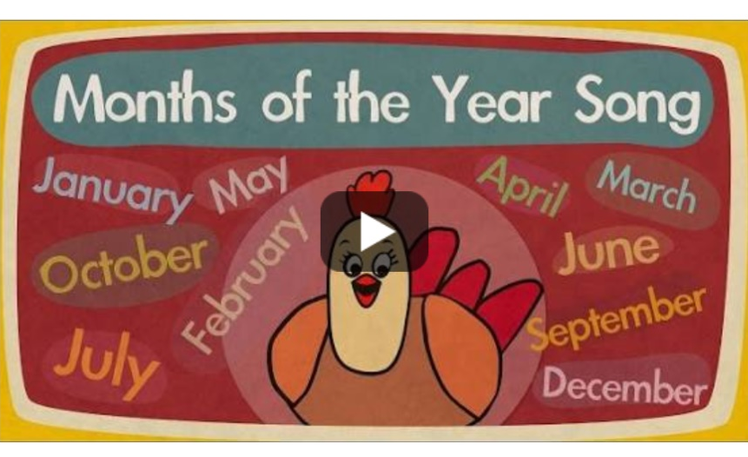
Maths Learning 2
Time - Dates
We need to know the Days of the Week
and the
Months of the Year.
We also need to know and use the words
Yesterday
Today
Tomorrow
Practise chanting and singing the Days of the Week and the Months of the Year. These songs from the Singing Walrus are good but there are many others.

Slide 14
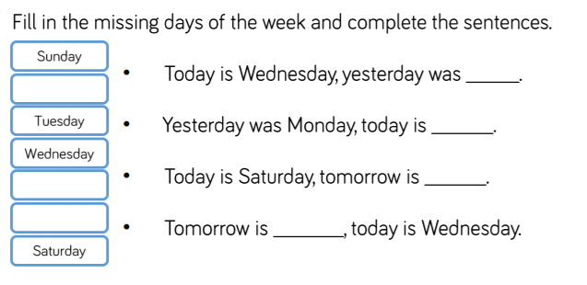
Which days are school days? Which days are the weekend?

Slide 15
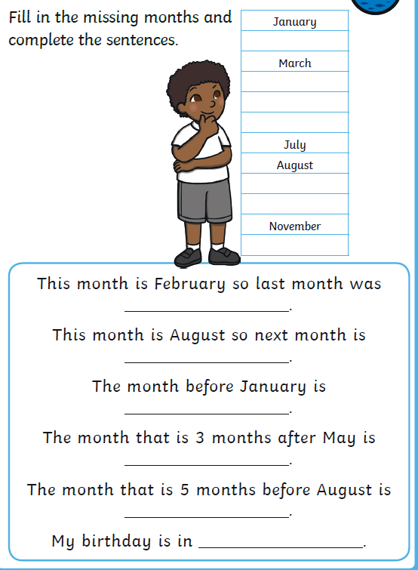
Fill in the missing months and complete the sentences.
January
March
July
August
November

Slide 16
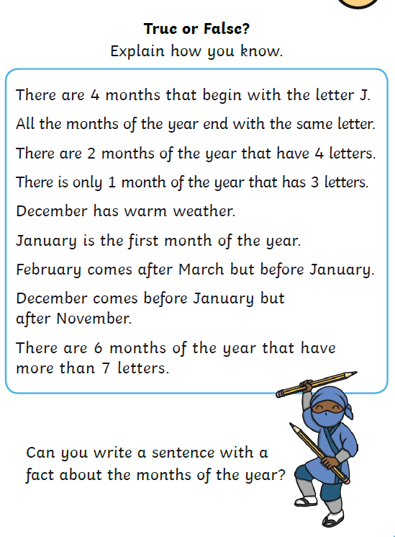

Slide 17
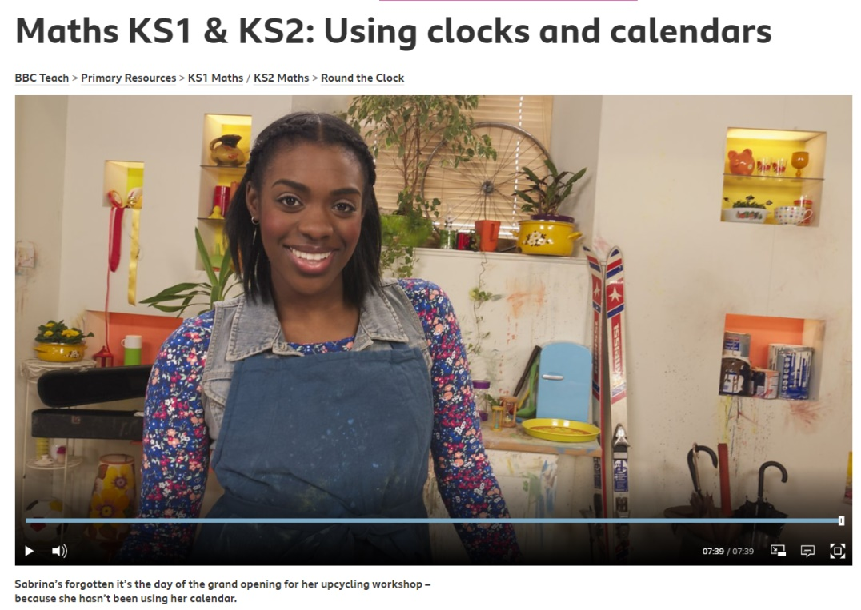
Maths Learning 3
Time to the hour
Watch this episode of Round the Clock to recap on yesterday’s learning and to begin thinking about clocks. https://www.bbc.co.uk/teach/class-clips-video/maths-ks1-ks2-using-clocks-and-calendars/z6gnvk7
Can you make your own model clock to practise telling O’clock times? Perhaps you could use a paper plate or chalk on the ground? Maybe you have a real clock that you are allowed to play with. You could use the template on the next slide. Use your model clock to help you complete the worksheet and the two reasoning questions.

Slide 18
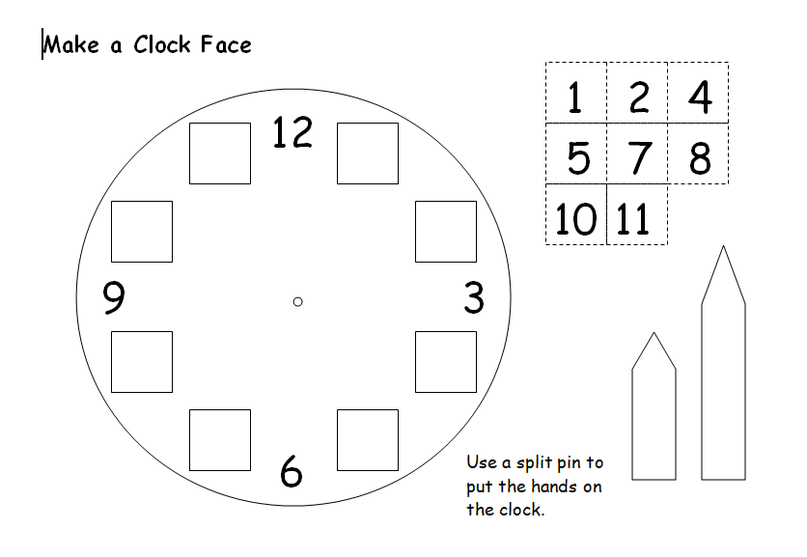

Slide 19
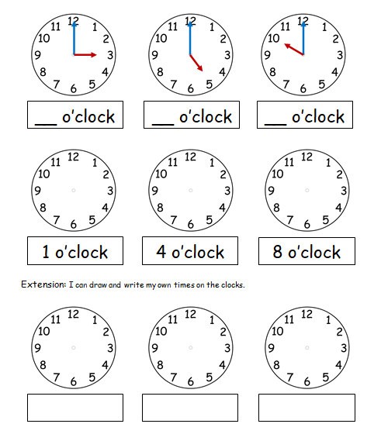
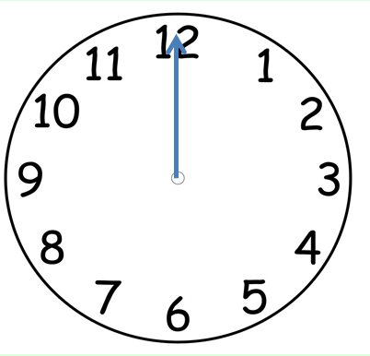
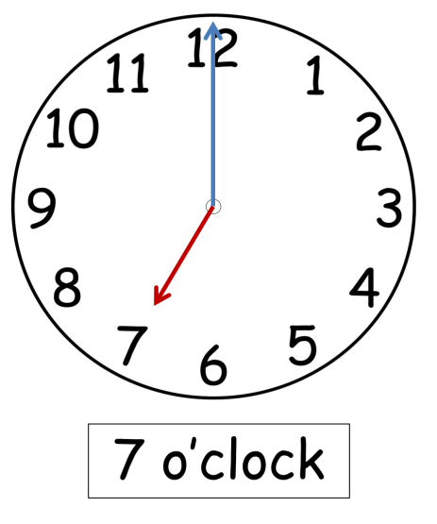
O’clock times
The big minute hand points straight up to the 12.
The little hour hand points to the hour.

Slide 20
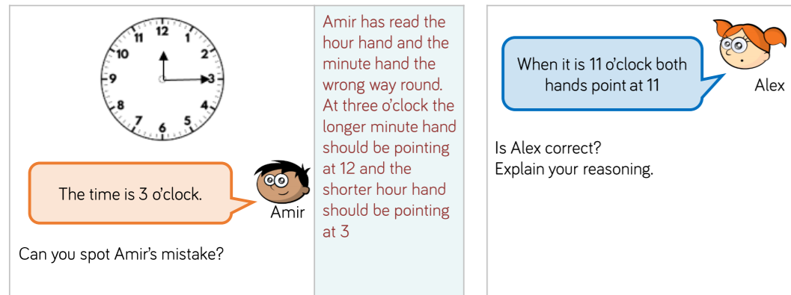

Slide 21
Topic/Science Learning
How do Polar Bears keep warm?
How can you find the answer to this question?
In a book, on the Internet, do an experiment?

Slide 22
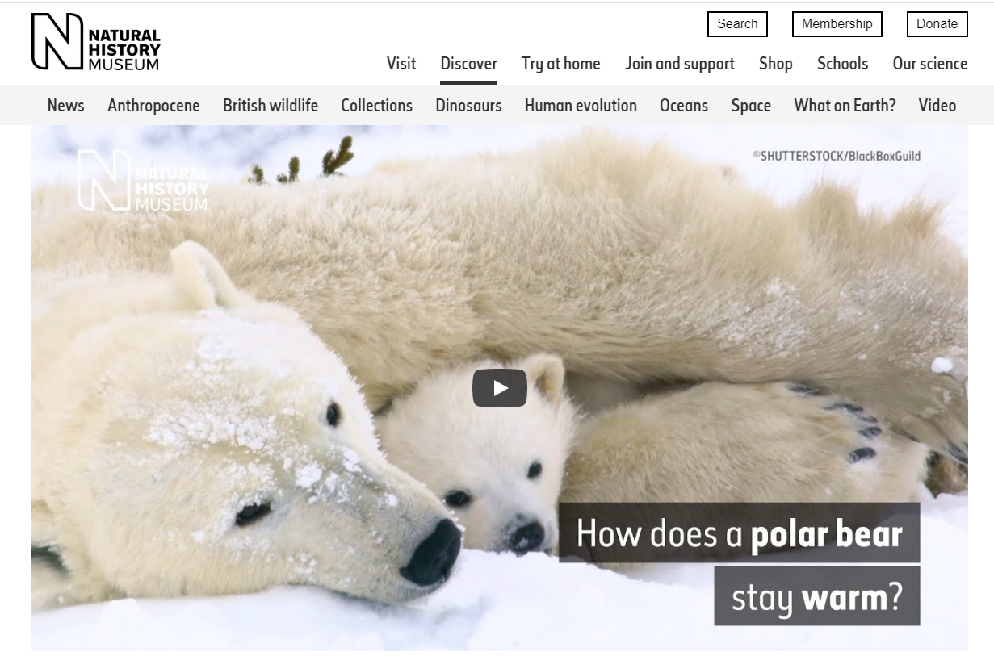
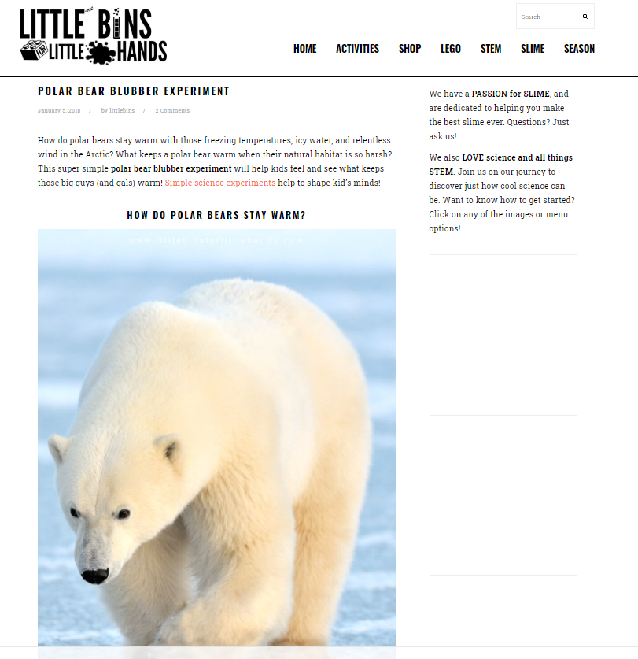
https://www.nhm.ac.uk/discover/how-do-polar-bears-stay-warm.html
This video has some answers but did you hear him mention the “thick layer of fat”?
Try the experiment below to find out more about this.
https://littlebinsforlittlehands.com/winter-polar-bear-blubber-science-experiment/
Use lard where it says shortening. If you don’t have the right sort of bags you could use disposable gloves or, if you don’t mind getting messy, just put the lard straight on your hands!

Slide 23

Reading
For additional reading at your child’s level please use the Oxford Owl website where you can read books online and then complete comprehension activities about the books. Please continue to keep a record of the books they have read in their reading records.
www.oxfordowl.co.uk
Class login: temple20
Password: Bingbong
(If you are not sure of your child’s level, please check in their reading record book or look at the coloured stickers on the additional reading books that have been sent home.)

Slide 24

Phonics
Please use the games and activities on the Phonicsplay website to continue practsing Phonics.
www.phonicsplay.co.uk
Login: march20
Password: home
Mrs Child’s Phonics group are currently working on Phase 5c (alternative ways of writing sounds we already know e.g. ai, ay, a_e all make the same sound).
Mrs Smith’s group are working on Phase 4.
Additionally, there are many excellent Phonics resources on the Twinkl website(see below for how to get free access). Practising reading “alien words” is a particularly fun and valuable activity.

Slide 25

Writing
Your child has been provided with a writing journal. They are used to using them and know that they need to write the date, write a sentence (about anything they like), draw and colour a picture and then fill any spare lines with handwriting patterns.

Slide 26

P.E.
It is important to keep your children active. If it is safe to do so, ensure they have some time outside throughout the day. Please visit Joe Wicks YouTube channel (https://www.youtube.com/channel/UCAxW1XT0iEJo0TYlRfn6rYQ), which has lots of exercise videos for children. He will also be hosting a live P.E. lessons Monday to Friday at 9:00am.

Slide 27


Using My Maths
Children should know their way round My Maths but here are some reminders on how to access the lessons. Visit: www.mymaths.co.uk
bapchild
divide162

Slide 28

Using My Maths
Access any lesson based on what your child is learning in class or search the topic in the search bar.
Use the login portal to access specific homework and lessons that your teacher has set.

Slide 29

Maths – White Rose Home Leaning
In school we follow the White Rose scheme of learning. Their website has put together free lessons and resources that link to the learning taking place in school. Please visit: https://whiterosemaths.com/homelearning/

Slide 30

Accessing Twinkl
Many educational content providers are offering free access to their resources. Twinkl is a website that we use from time to time to resource our lessons to aid in teacher input and pupil activities.
We will be able to direct you towards activities and learning via this website based on lessons that may be missed due to absence. To access Twinkl please visit: www.twinkl.co.uk/offer
You will have to sign up and put in the offer code: UKTWINKLHELPS

Slide 31

Classroom Secrets
The site classroom secrets https://classroomsecrets.co.uk/free-home-learning-packs/ has free class packs which provide some great additional ideas and resources you can use.

