Slide 1

Hello and Welcome to Mrs Smith’s Phonics Group Week 9.
How did you get on last week with practising your blending and reading. I bet you were amazing! ☺
This week we are going to learn the alternative spellings for the ai and c phoneme☺.
Why not start your phonics learning daily with our alphabet song or to get you moving BBC Super Movers with Naomi Wilkinson https://www.youtube.com/watch?v=jYeMpUdufNk
Work hard and have Fun.
Hope to see you soon
Love Mrs Smith xx

Slide 2
You could print this grid off and check what phonemes (sounds) to grapheme (written) you can recall daily. You could colour, tick or cover with counters, coins or pebbles the ones you can say using the PURE SOUND. If you don’t want to print it off you could point to each sound and say using the PURE SOUND. Are you getting quicker maybe you could time yourself. Let’s check what you know. Are you getting quicker?
s | a | t | p | i | n | m
d | g | o | c | k | ck | e
u | r | h | b | f | ff | l
ll | ss | j | v | w | x | y
z | zz | qu | ch | sh | th | ng
ai | ee | igh | oa | oo | ar | or
ur | ow | oi | ear | air | ure | er
ay | ou | ie | ea | oy | ir | ue
aw | wh | ph | ew | oe | au | ey
i-e | o-e | a-e | u-e | e-e
Practice the ones you are not sure of.

Slide 3
Phase 5c Week 8:
This week we are going to be learning the alternative spellings for the ai and c phonemes. These sound the same but are written differently. You may have spotted some already in our other phonics lessons.
Let’s find out more…..

Slide 4
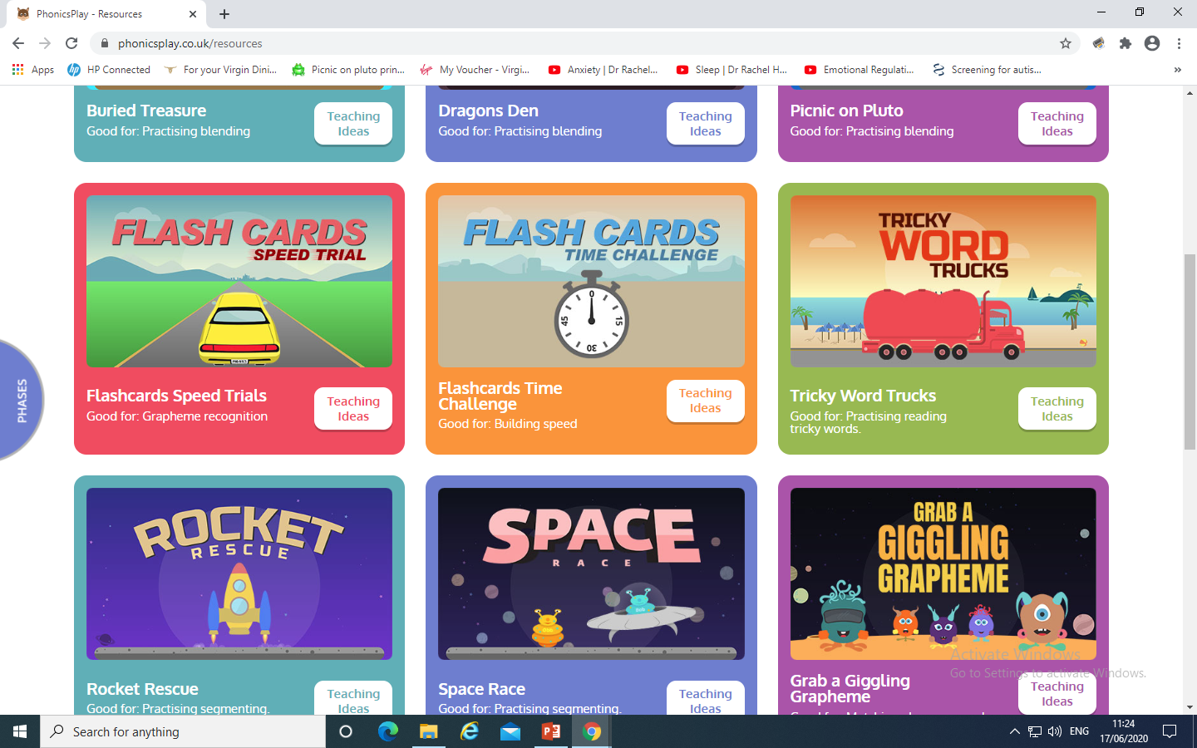
Phase 5c Week 8:
Monday: Practise the phonemes and graphemes on the sheet (slide 2) using the Pure Sound.
Play one of these games on Phonics Play

Slide 5
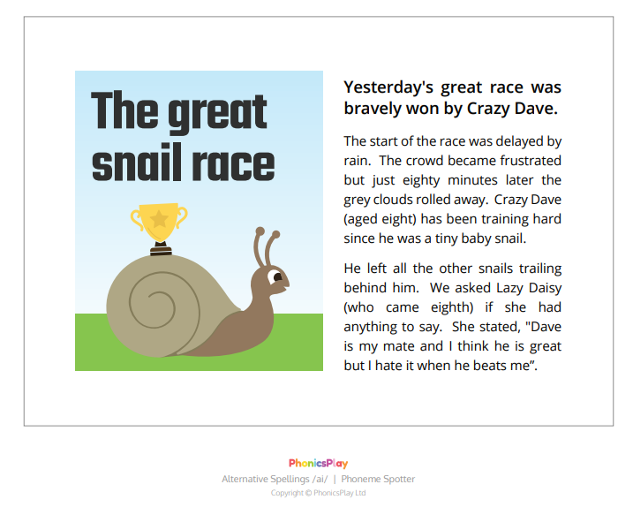
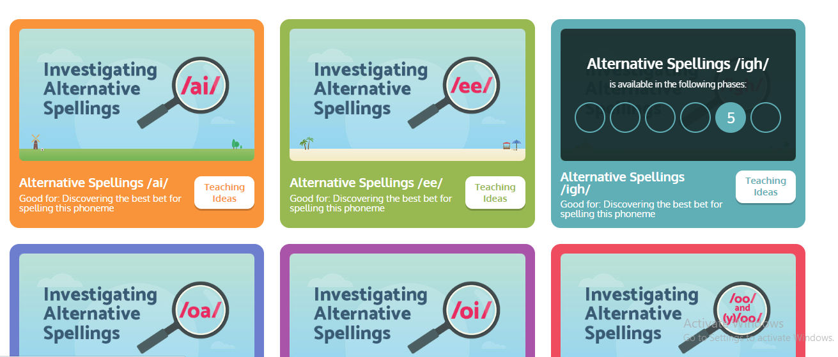
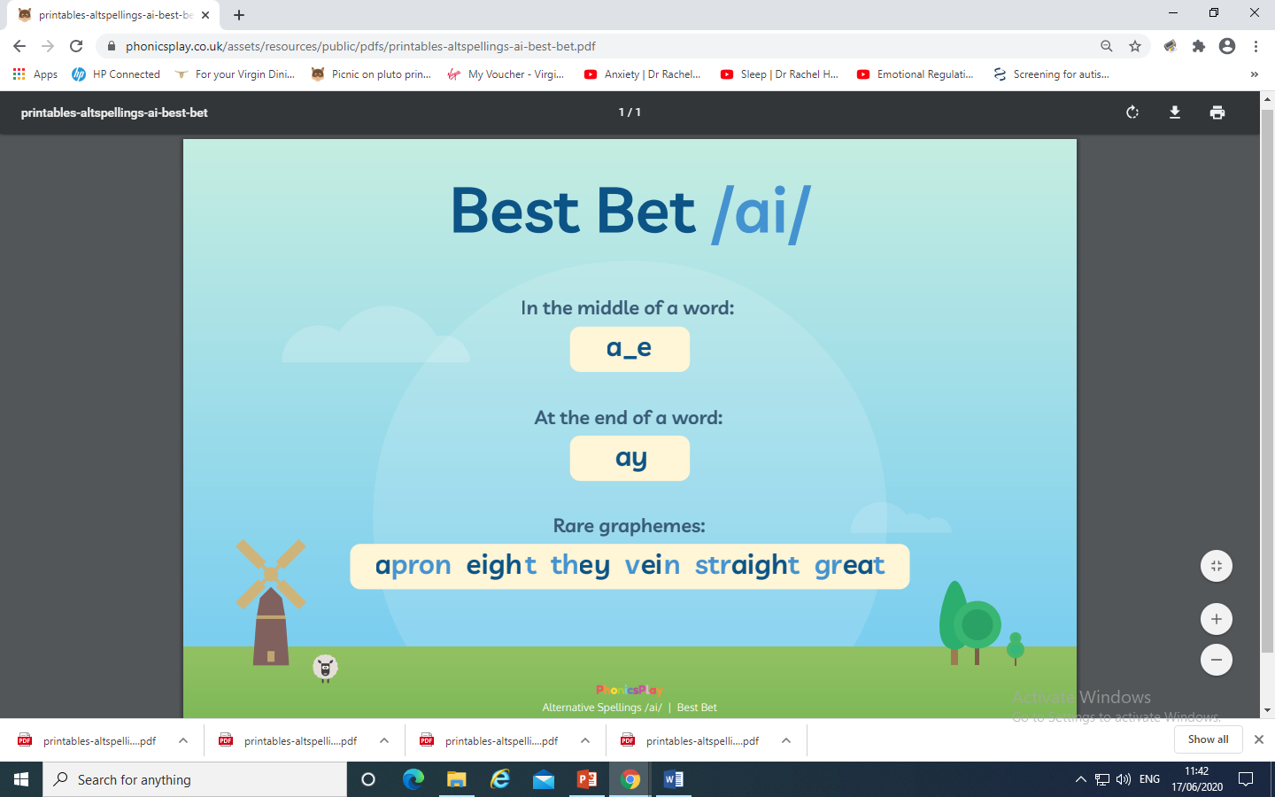
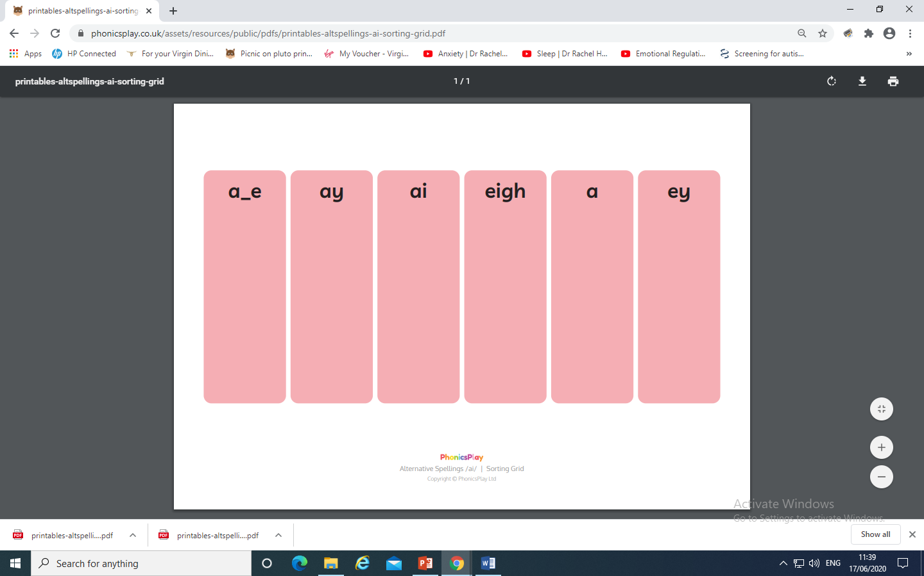
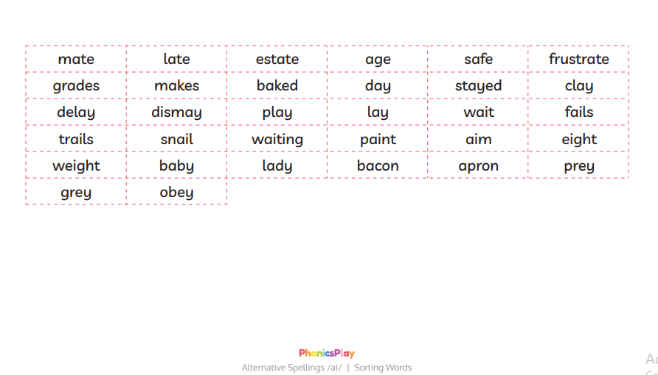
Today we are learning the alternative spellings for the ai phoneme.
There are 6 alternative spellings and ways to write the ai phoneme
a-e ay ai eigh a ey
Investigate the alternative spellings on Phonics Play. How many did you spot?

Slide 6
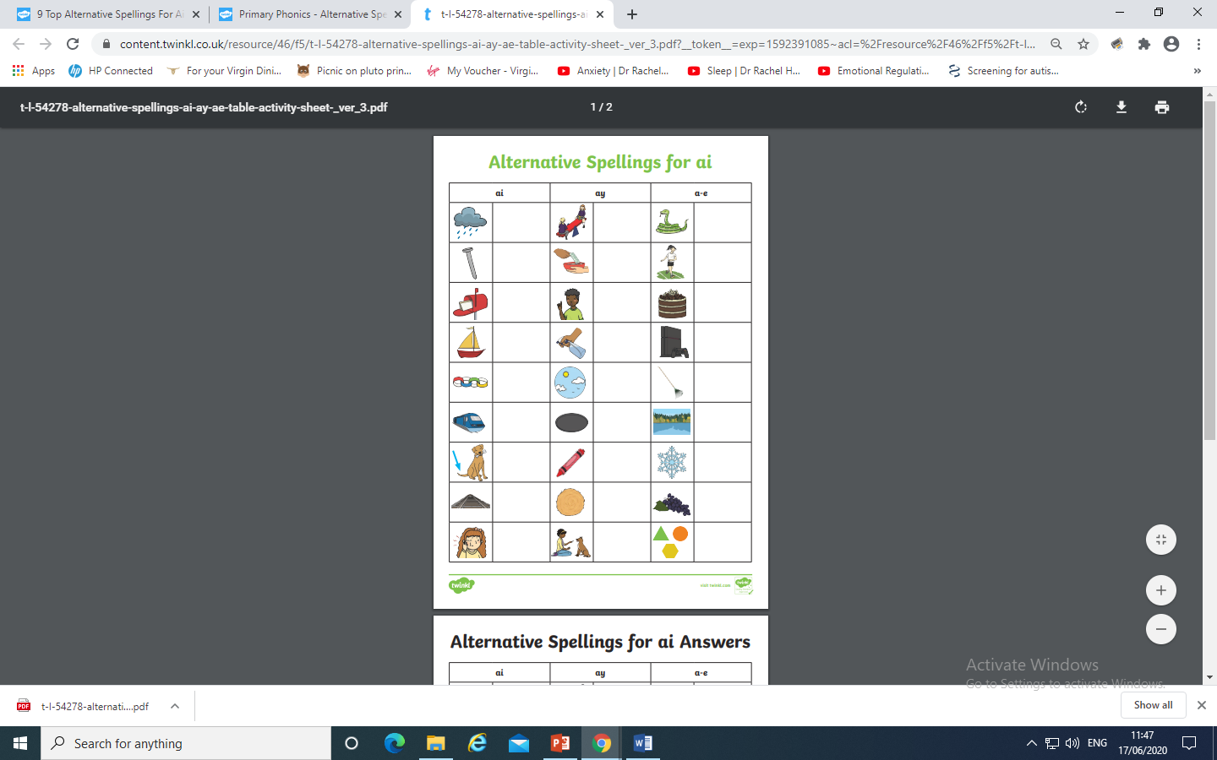
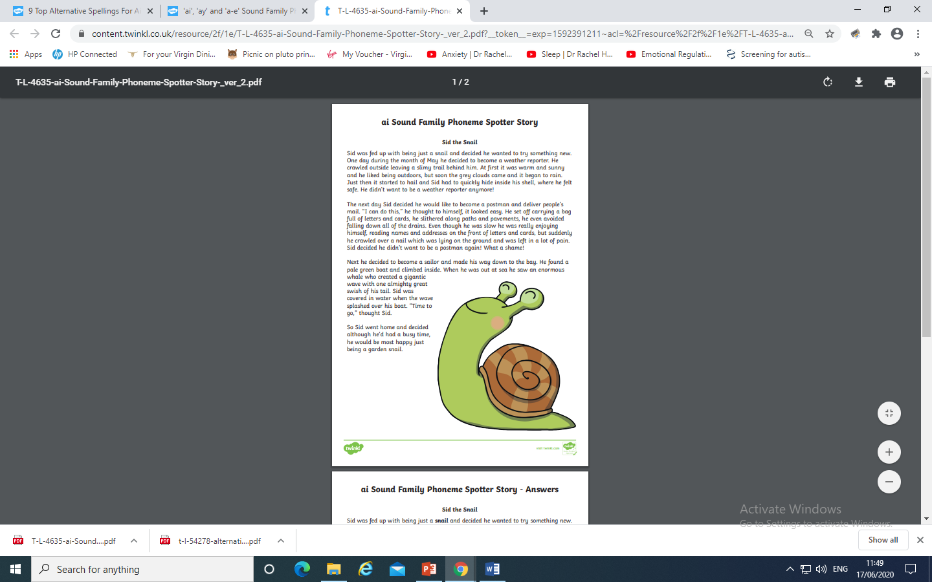
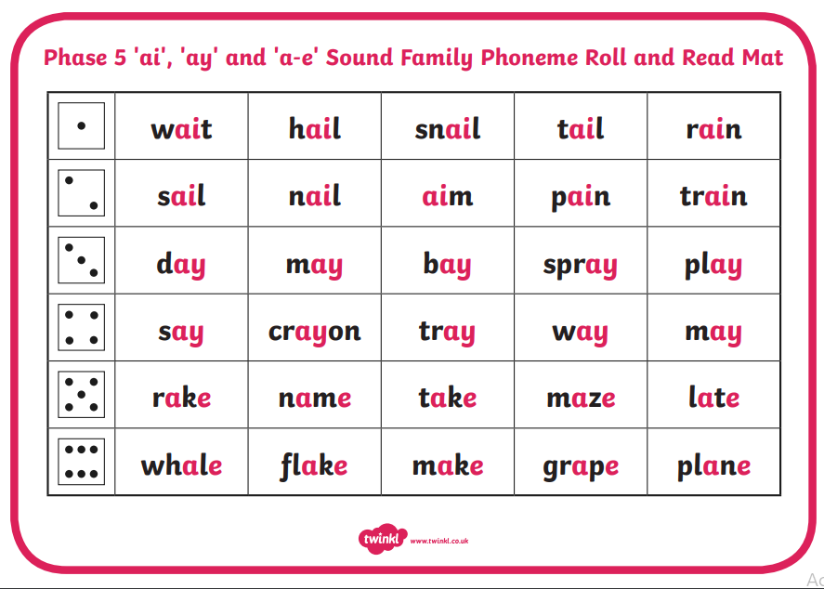
Why not try one or all of these activities?

Slide 7
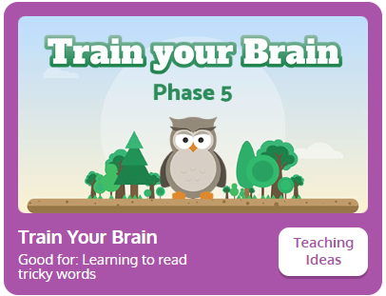
Tuesday: Practise the phonemes and graphemes on the sheet (slide 2) using the Pure Sound.
Today we are continuing to learn the alternative spellings for the ai phoneme.
First lets practise reading the tricky words
said, so, have, like
Play Train your Brain on
Phonics Play

Slide 8
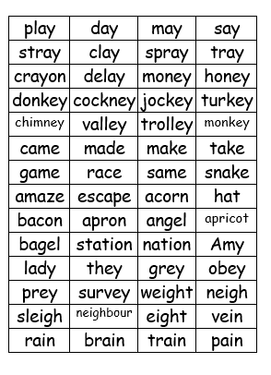
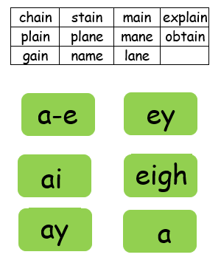
Place the alternative spellings of ai at the top.
You could place them on a wall inside or outside. Cut up the words. Read the words and place under the correct spelling.
What do you notice? Where does each spelling sit in the word? At the beginning , middle or end?
Check the Best Bet for
spelling words on Phonics Play

Slide 9
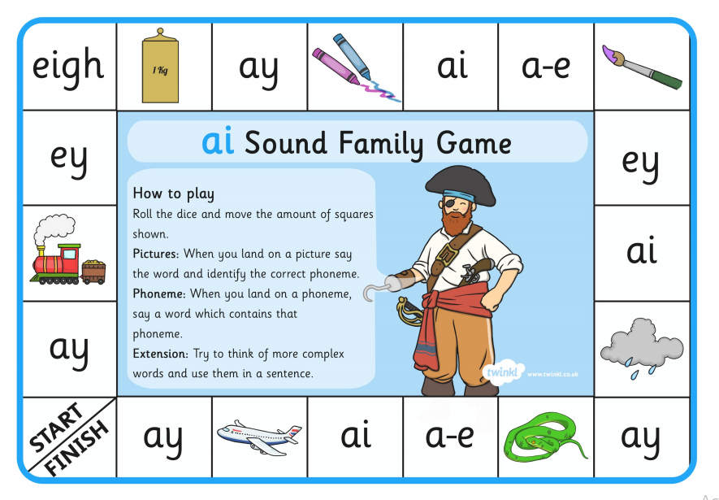
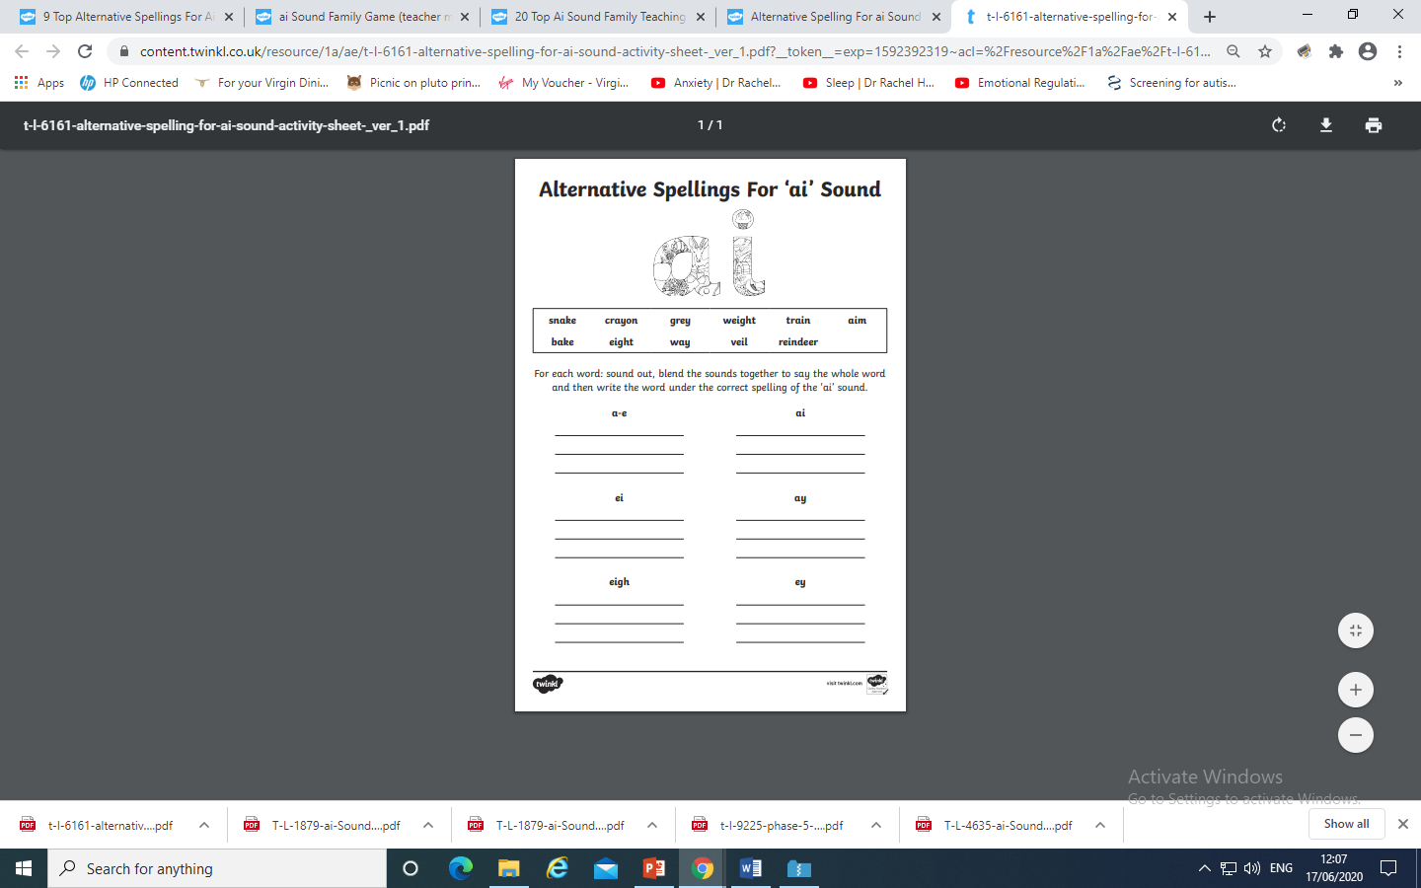
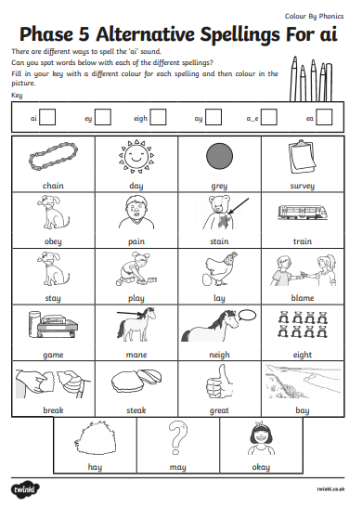
Why not try the activities here ?

Slide 10
Wednesday: Play Quickwrite Graphemes practise writing the
Graphemes on the sheet and slide 2.
Get your grown up or someone to say the sound and see if you can write the grapheme.
Can you write more than one grapheme for each phoneme?
How quick can you write them?
How many did you get right?
Which ones do you need to practise?

Slide 11
Practise your grapheme recognition with Flash Cards Speed Trial
on Phonics play.

Slide 12
Play word sort using either of these resources.
Remember the Best Bet for spelling !

Slide 13
Read the following sentences. Remember to sound out the words you are unsure
of (don’t guess) and then read the complete sentence.
Snakes and ladders is a good game to play.
If a lady, in a grey apron, is on a train that gets delayed, should she complain?
Can a snail get on a plane to go away on holiday?

Slide 14
Thursday: Practise the phonemes and graphemes on the sheet (slide 2) using the Pure Sound.
Today we are going to be learning the alternative spellings for c
First lets practise reading the tricky words
some, come, were, who
Play Train your Brain on
Phonics Play

Slide 15
Write the words cat, lick, box, school, fox, queen
Read the words aloud and soundtalk them.
Which phoneme do these words all contain?
Soundtalk each word and draw the sound buttons.
Highlight the button which makes the c phoneme
Check on the next slide if you were right.

Slide 16
c a t l i c k
● ● ● ●●
k i t b o x
● ● ● ● ● ●
s c h o o l f o x q u e e n
● ● ● ● ● ● ● ●

Slide 17
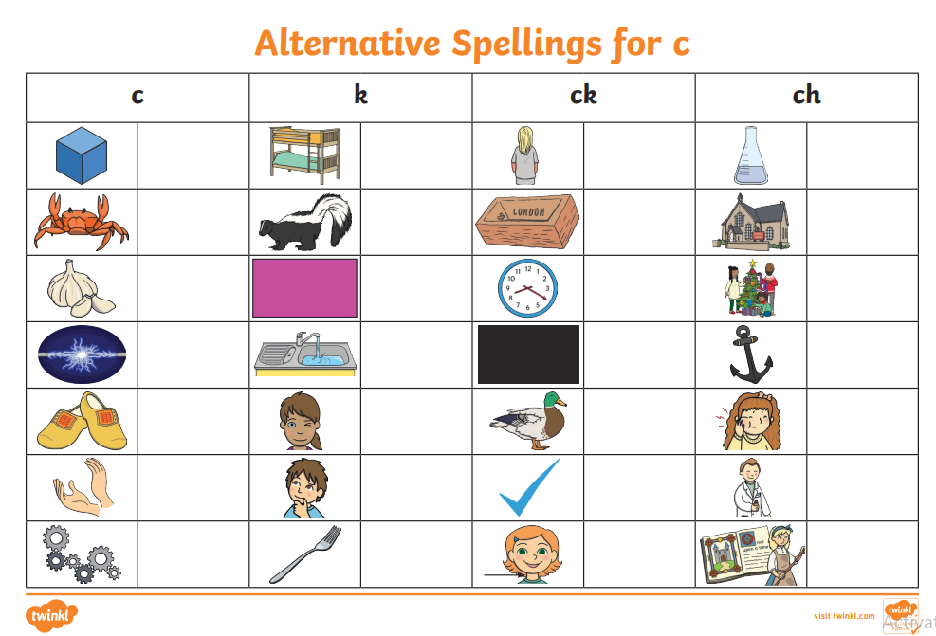
Why not try this worksheet ?

Slide 18
Can you write the following sentences. Remember to sound out each word
The quick fox kicks like a cat.
A box of cookies is quite cool.
Can a skunk quack like a duck?

Slide 19
Friday:
Today we are continuing to learn the alternative spellings for the ai phoneme.
Play one of these games on Phonics Play to
practise reading the GPC’s you have learnt.

Slide 20
Can you write the following words:
make, clay, snail, eight, grey, date, tray
Which phonemes can you hear when you soundtalk the
words?
Which are the tricky parts of the word?
(the ai phoneme)

Slide 21
Read the following sentences. Remember to sound out the words you are unsure
of (don’t guess) and then read the complete sentence.
I ate eight rashers of bacon today.
Should you always obey and do what your mates say?
How much do you think a whale’s brain would weigh?

