Slide 1

Home Learning
Year 1
Term 6 Week 5

Slide 2

Hello Year 1!
How have you been enjoying the hot weather? If you are lucky enough to have a paddling pool or sand pit in your garden it is the perfect time to practice the Maths concepts of Capacity and Volume – filling, emptying, pouring, estimating, measuring and ordering any cups or pots you have.
Our English this week is about Information Texts with the aim of making an information book about Trees. Maths is about comparing and ordering 2-digit numbers. There is also an art activity about the artist Andy Goldsworthy.
Looking forward to welcoming some more Year 1’s back into school this week.
Be good and stay safe
Love from Mrs Child
xxx

Slide 3
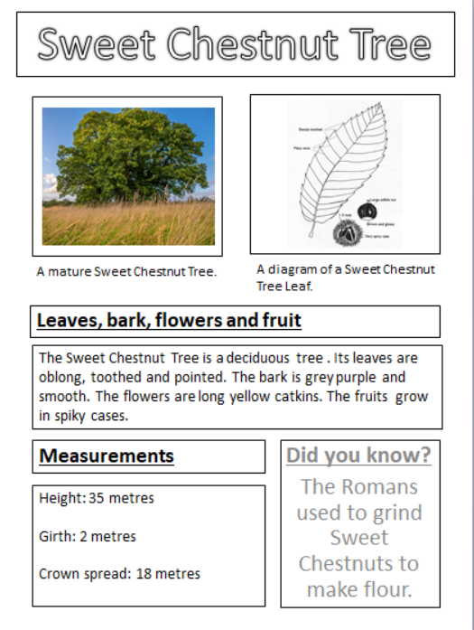
English Learning 1
This week we are thinking about Information Texts.
Can you remember the features of an Information text?
Look at this page of information about a
Sweet Chestnut Tree.
Can you see a title, a subheading, a diagram, a photograph and a caption?

Slide 4
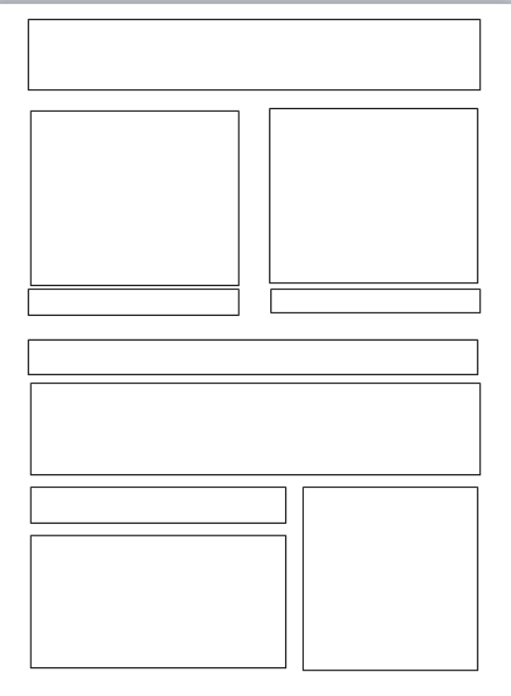
Label the features of an information text by matching the labels to the right boxes.
Caption Sub-heading Fact box Heading
Labelled diagram Information Photo

Slide 5
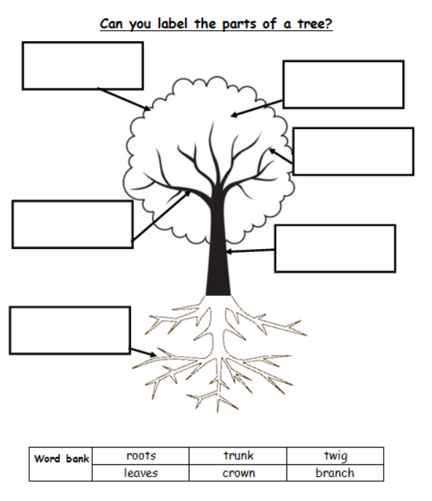
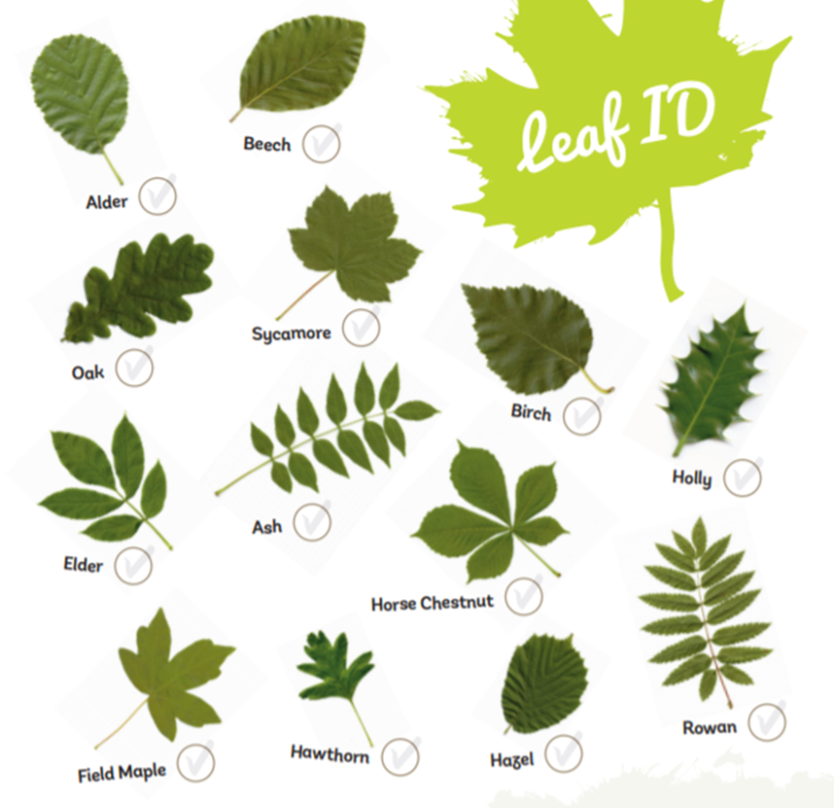
English Learning 2
Copy this diagram and label the parts correctly.
Practise identifying trees by looking closely at the shape and colours of their leaves and matching them with this Leaf ID sheet.
https://www.woodlandtrust.org.uk/media/48345/leaf-id-sheet.pdf

Slide 6
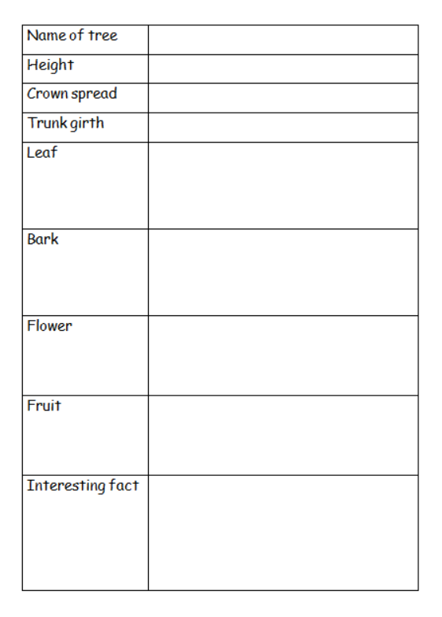
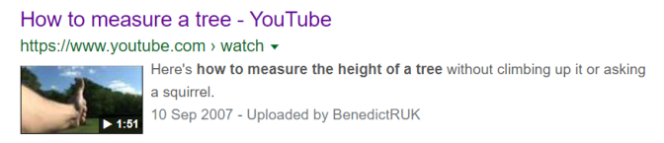
English Learning 3
We are each going to make our own information page about a tree which we could then combine to make a class book about trees. You need to find a tree and gather the information for this table.
Learn how to measure the height of a tree by watching this video.
https://www.youtube.com/watch?v=F6fltSqImFM
You can record your measurements in paces or footsteps rather than metres.
For the leaf, bark, flower and fruit sections you can draw, make rubbings or photograph instead of just writing if you prefer.
To find interesting facts, research your tree on this website from the
Woodland Trust.
https://www.woodlandtrust.org.uk/trees-woods-and-wildlife/british-trees/a-z-of-british-trees/

Slide 7
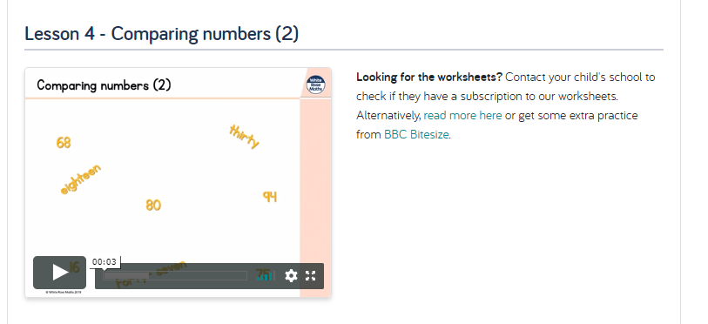
Maths Learning 1
Comparing numbers
Watch the White Rose Home Learning video lesson – Year 1 Summer Term – Week 9, Lesson 4
https://whiterosemaths.com/homelearning/year-1/
When you have completed the video lesson, try the questions on the following pages.

Slide 8
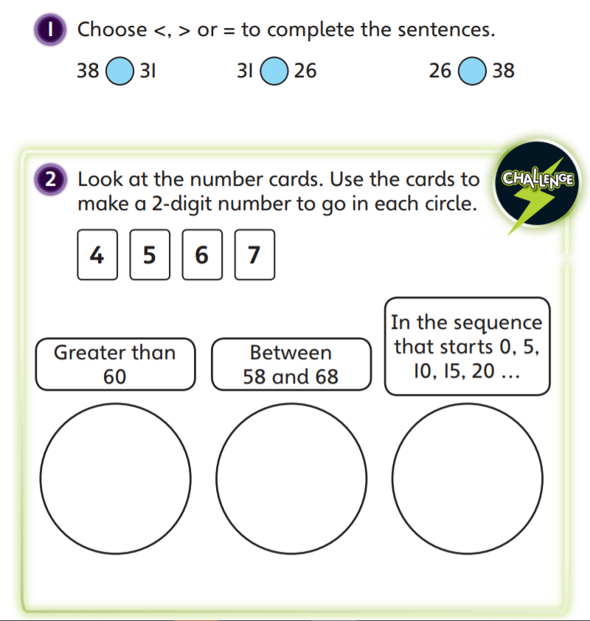

Slide 9
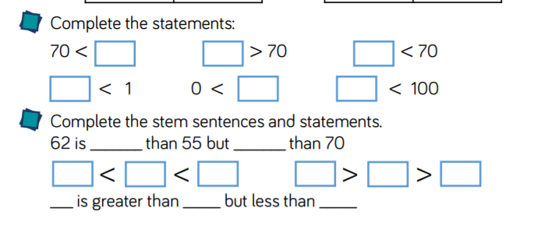
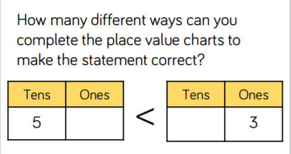

Slide 10
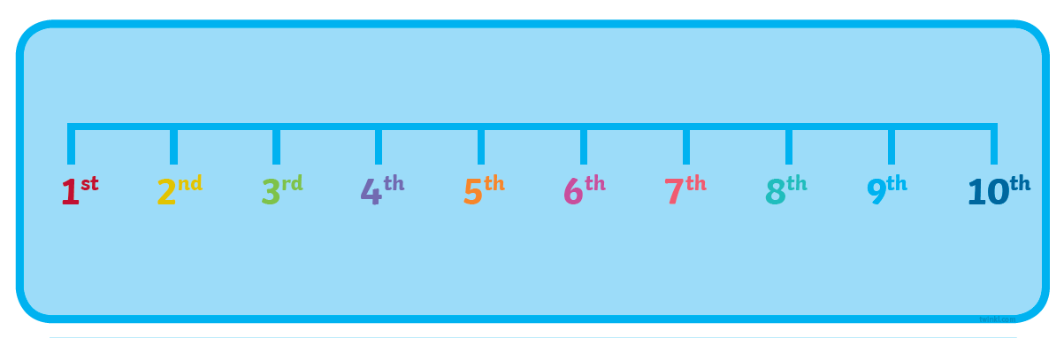
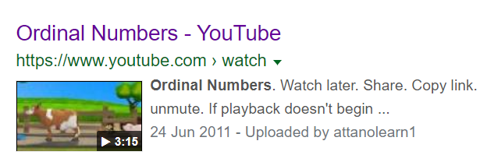
Maths Learning 2
Ordinal numbers
Watch this YouTube video that explains about ordinal numbers then complete one of the activities on the following slides to show your understanding. You don’t need to do them all just pick the one that suits you best as some need colouring and some need cutting and sticking. Look out for times you use these numbers in real life like when you are queuing, racing or playing a game. The last page has a couple of puzzles to try.
https://www.youtube.com/watch?v=fR8KyCt5XtA

Slide 11
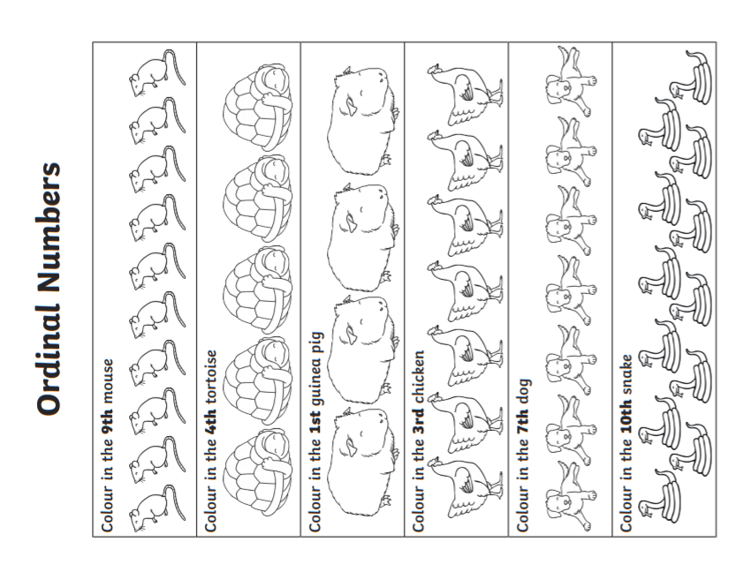

Slide 12
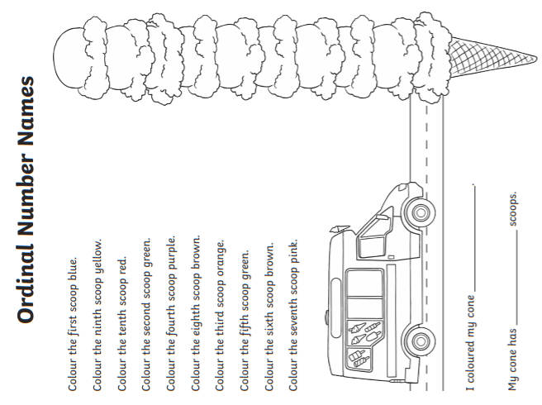

Slide 13
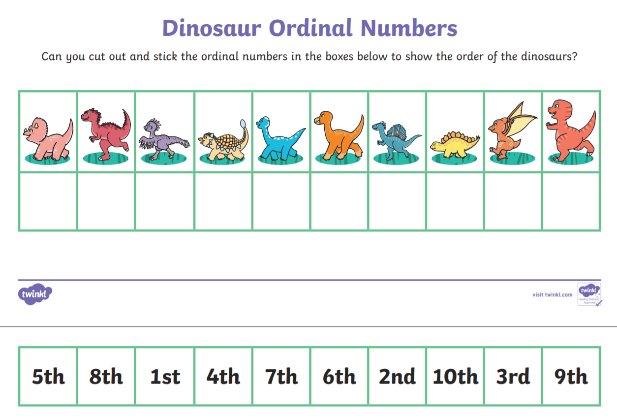

Slide 14
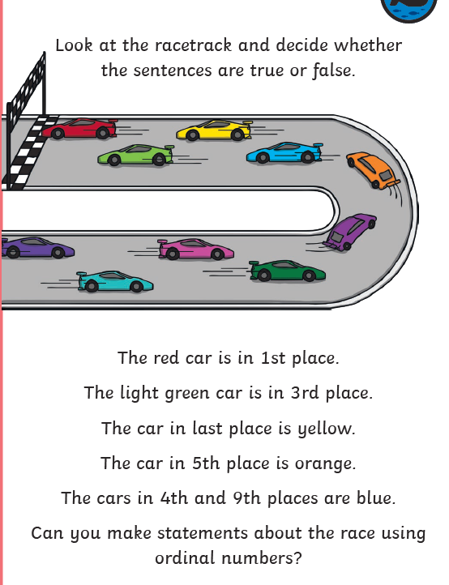
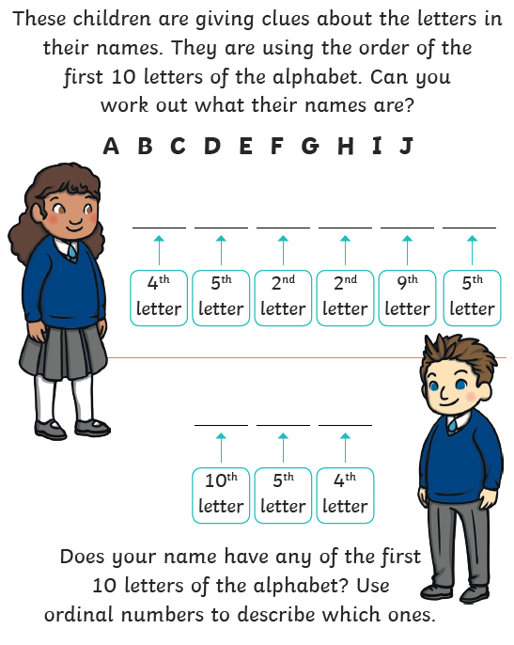

Slide 15
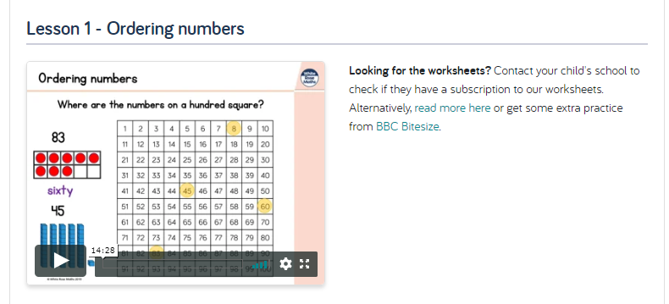
Maths Learning 3
Ordering numbers
Watch the White Rose Home Learning video lesson – Year 1 Summer Term – Week 10, Lesson 1
Watch the video then complete the following tasks.
https://whiterosemaths.com/homelearning/year-1/

Slide 16
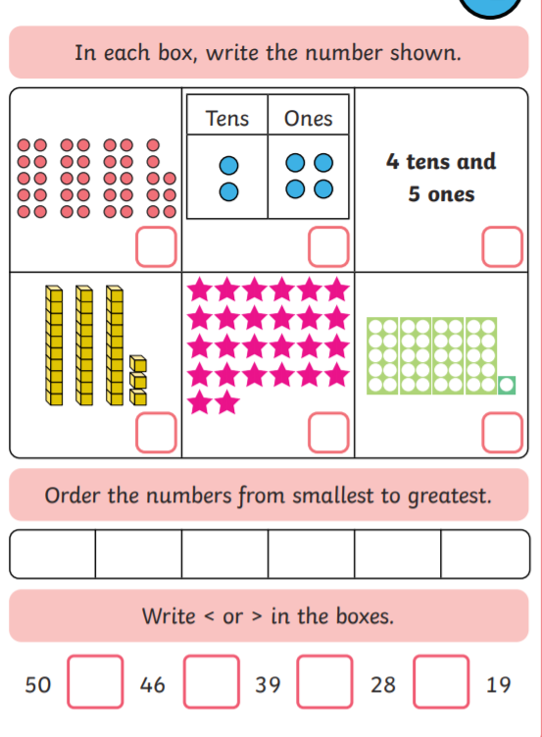
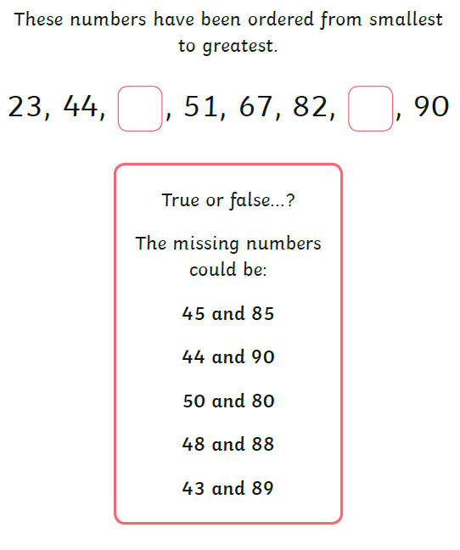

Slide 17
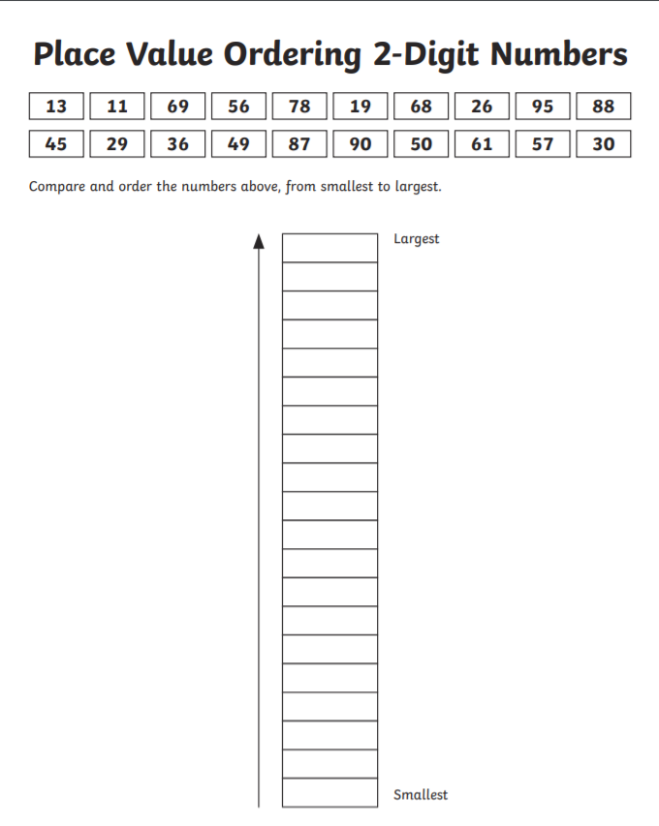
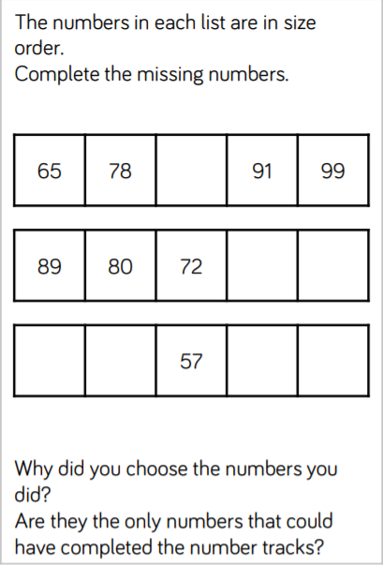

Slide 18
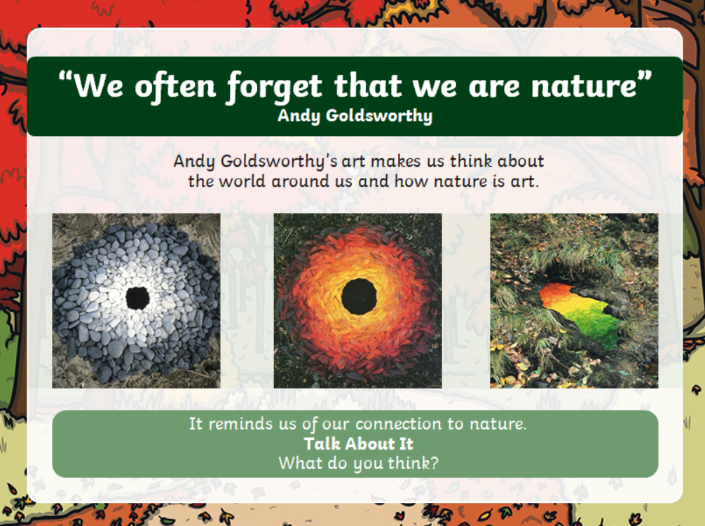
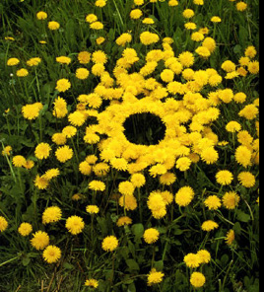
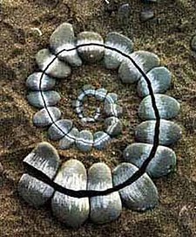
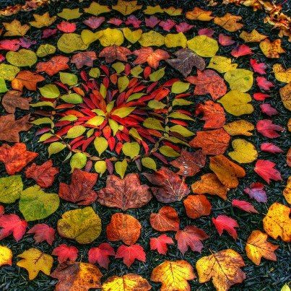
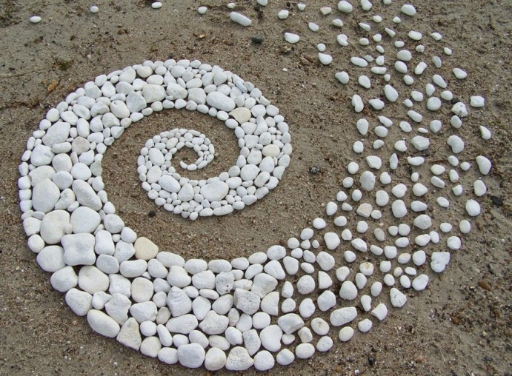
Art Learning
Look at these art works by Andy Goldsworthy.
Do you like them? What do you think they are made from? What shapes can you see?

Slide 19
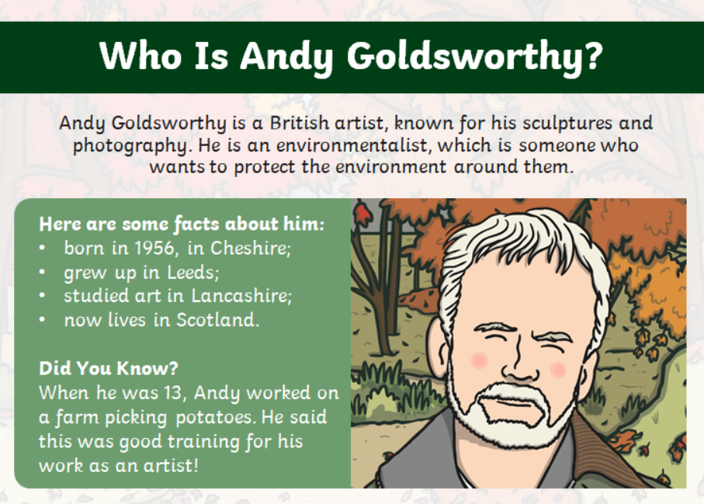

Slide 20
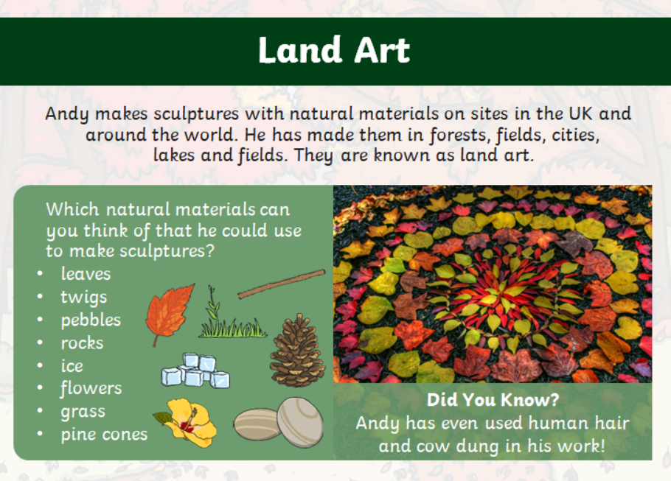

Slide 21
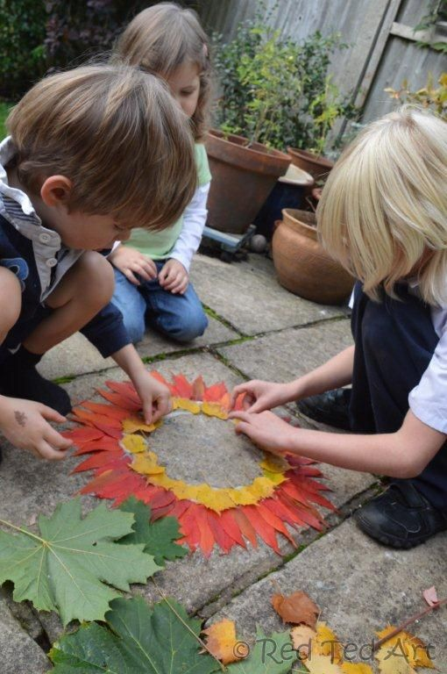
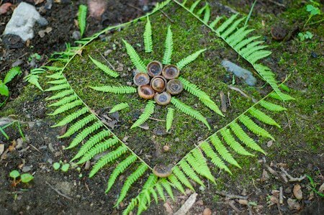
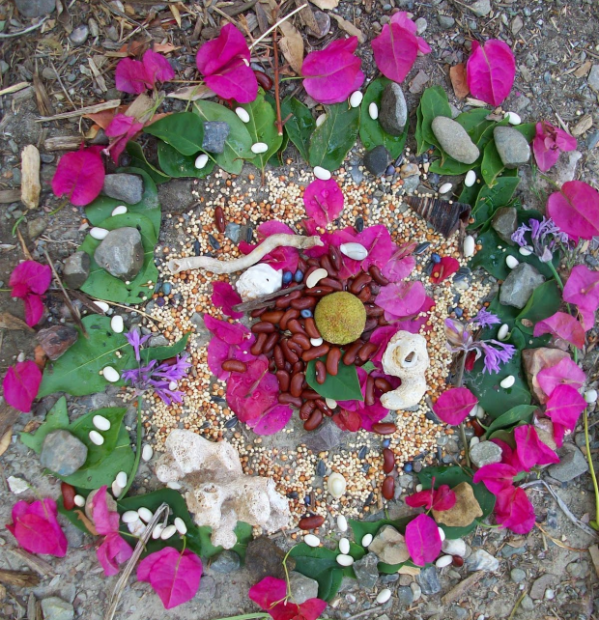
Have a go at making your own natural sculpture or land art like Andy Goldsworthy. Sometimes they last for a long time but sometimes only hours so you might need to take a photograph. He often makes spirals, circles, swirls and arches. You could use stones, shells, leaves, flowers, feathers, twigs or any other natural objects you can find.

Slide 22

Reading
For additional reading at your child’s level please use the Oxford Owl website where you can read books online and then complete comprehension activities about the books. Please continue to keep a record of the books they have read in their reading records.
www.oxfordowl.co.uk
Class login: temple20
Password: Bingbong
(If you are not sure of your child’s level, please check in their reading record book or look at the coloured stickers on the additional reading books that have been sent home.)

Slide 23

Phonics
Please use the games and activities on the Phonicsplay website to continue practsing Phonics.
www.phonicsplay.co.uk
Login: march20
Password: home
Mrs Child’s Phonics group are currently working on Phase 5c (alternative ways of writing sounds we already know e.g. ai, ay, a_e all make the same sound).
Mrs Smith’s group are working on Phase 4.
Additionally, there are many excellent Phonics resources on the Twinkl website(see below for how to get free access). Practising reading “alien words” is a particularly fun and valuable activity.

Slide 24

Writing
Your child has been provided with a writing journal. They are used to using them and know that they need to write the date, write a sentence (about anything they like), draw and colour a picture and then fill any spare lines with handwriting patterns.

Slide 25

P.E.
It is important to keep your children active. If it is safe to do so, ensure they have some time outside throughout the day. Please visit Joe Wicks YouTube channel (https://www.youtube.com/channel/UCAxW1XT0iEJo0TYlRfn6rYQ), which has lots of exercise videos for children. He will also be hosting a live P.E. lessons Monday to Friday at 9:00am.

Slide 26


Using My Maths
Children should know their way round My Maths but here are some reminders on how to access the lessons. Visit: www.mymaths.co.uk
bapchild
divide162

Slide 27

Using My Maths
Access any lesson based on what your child is learning in class or search the topic in the search bar.
Use the login portal to access specific homework and lessons that your teacher has set.

Slide 28

Maths – White Rose Home Leaning
In school we follow the White Rose scheme of learning. Their website has put together free lessons and resources that link to the learning taking place in school. Please visit: https://whiterosemaths.com/homelearning/

Slide 29

Accessing Twinkl
Many educational content providers are offering free access to their resources. Twinkl is a website that we use from time to time to resource our lessons to aid in teacher input and pupil activities.
We will be able to direct you towards activities and learning via this website based on lessons that may be missed due to absence. To access Twinkl please visit: www.twinkl.co.uk/offer
You will have to sign up and put in the offer code: UKTWINKLHELPS

Slide 30

Classroom Secrets
The site classroom secrets https://classroomsecrets.co.uk/free-home-learning-packs/ has free class packs which provide some great additional ideas and resources you can use.

