Slide 1

Hello and Welcome to Mrs Smith’s Phonics Group Week 8.
I hope you are all well.
This would be the time of year when the Phonics Screening Test would take place, so this week we are going to put into practice what you have learnt. Which is a lot as you are all fantastic!
Please find resources to explore sounds you have learnt and are confident with and those that you need more practise with. We will also be practising reading alien words and you could create your own alien.
You can find past Phonics Screening papers which can be found at https://www.gov.uk/government/collections/national-curriculum-assessments-practice-materials#phonics-screening-check-resources or if you have lots of ink in your printer there is a lovely booklet of “Monster Phonics Activities” attached (or can be found in the half term home learning week).
As always you could start your phonics learning daily with our alphabet song or to get you moving BBC Super Movers with Naomi Wilkinson https://www.youtube.com/watch?v=jYeMpUdufNk
Take Care and have Fun. Love Mrs Smith xx

Slide 2
You could print this grid off and check what phonemes (sounds) to grapheme (written) you can recall daily. You could colour, tick or cover with counters, coins or pebbles the ones you can say using the PURE SOUND. If you don’t want to print it off you could point to each sound and say using the PURE SOUND. Are you getting quicker maybe you could time yourself. Let’s check what you know. Are you getting quicker?
s | a | t | p | i | n | m
d | g | o | c | k | ck | e
u | r | h | b | f | ff | l
ll | ss | j | v | w | x | y
z | zz | qu | ch | sh | th | ng
ai | ee | igh | oa | oo | ar | or
ur | ow | oi | ear | air | ure | er
ay | ou | ie | ea | oy | ir | ue
aw | wh | ph | ew | oe | au | ey
i-e | o-e | a-e | u-e | e-e
Practice the ones you are not sure of.

Slide 3
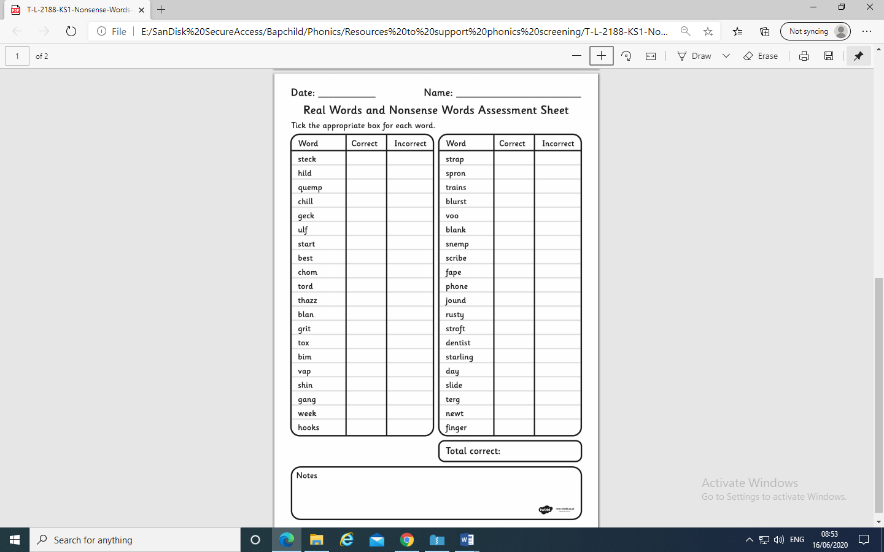
Week 8:
This week we are going to be putting into practise what you have learnt. You have already practised the phonemes on slide 2.
Now test your knowledge on past Phonics Screening papers
which can be found https://www.gov.uk/government/collections/national-curriculum-assessments-practice-materials#phonics-screening-check-resources or the attached Real Words and Nonsense
Words Assessment sheet. There is no
time limit just sound talk the words and
use your phonic knowledge.

Slide 4
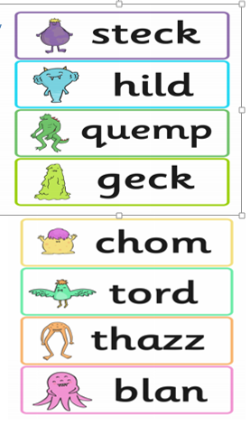
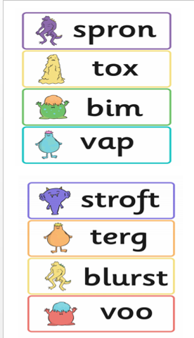

Attached are some Alien flash cards to help you practise your
sounding out reading Alien words.

Slide 5

The activities on the following 9 slides you may have already completed as I have borrowed them from Mrs Child’s half term home learning. If not have fun doing them.

Slide 6
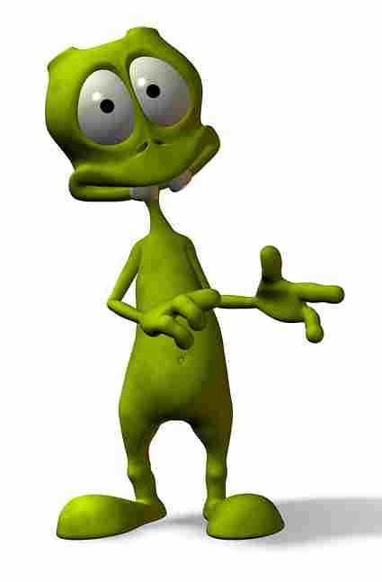



Create alien names using a beginning, middle and end sound and then draw what they look like.
Examples:
Blawsh
Beginning | Middle | End
Bl | oy | t
Cr | aw | ph
Fl | ow | m
Gr | ie | n
J | ue | f
Spl | ew | ch
Str | au | sh
You may have
already completed
this activity.
How many different aliens can you make?
Groych

Slide 7
If you can segment and blend all these alien names then you know all the sounds and have all the skills you need.
(Remember you can draw in the sound buttons or highlight the digraphs if it helps.)
Baid | Hayf | Gake | Deef
Heem | Plean | Quete | Narth
Vight | Twie | Yize | Blove
Croab | Proet | Jome | Phowt
Froomp | Cachue | Sprume | Aspew
Wormid | Fauster | Nawm | Voo
Shoit | Groys | Crouth | Og
Zoup | Rowz | Meeth | Umf
Yerpan | Jirlee | Hurck | Jair
Thrair | Scrust | Fowsp | Freesp
Kear | Dronk | Zaunch | Scrung
Dacture | Brist | Blurg | Trown

Slide 8
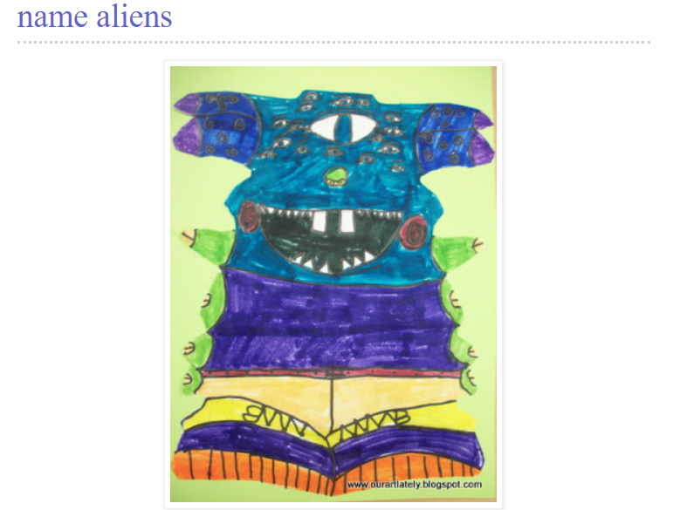
Have a go at making a symmetrical alien picture using your name. These instructions come from http://ourartlately.blogspot.com/2011/05/name-aliens.html

Slide 9
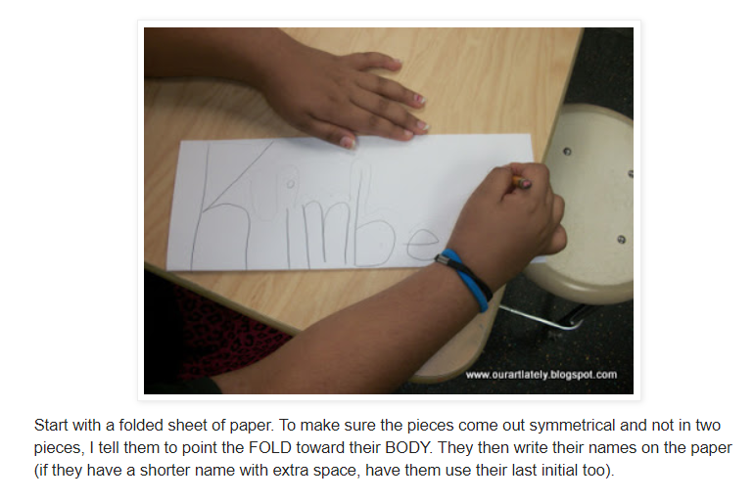

Slide 10
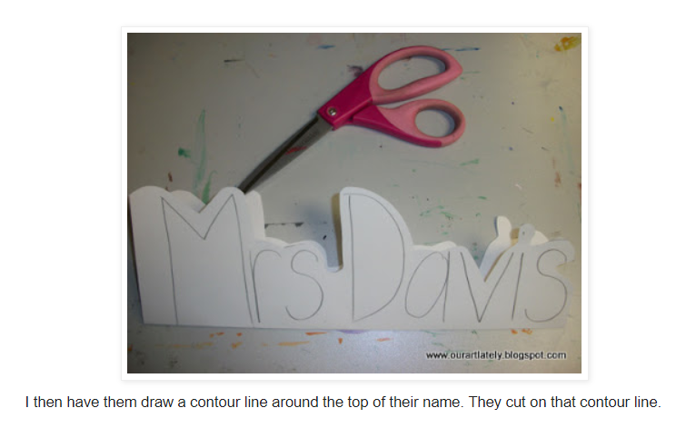

Slide 11
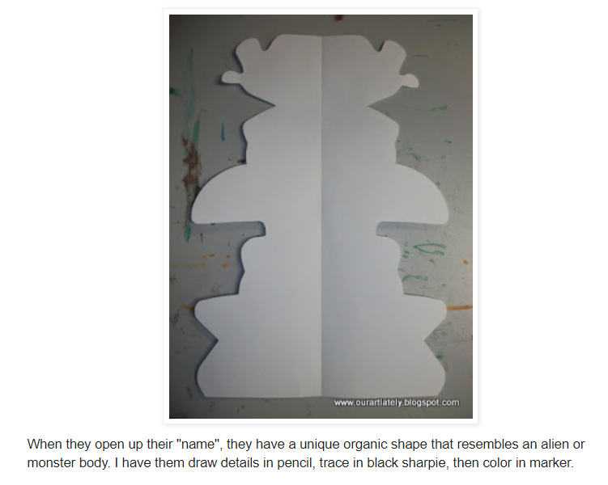
(Or you could paint or collage or use stickers - anything you have to hand.)

Slide 12
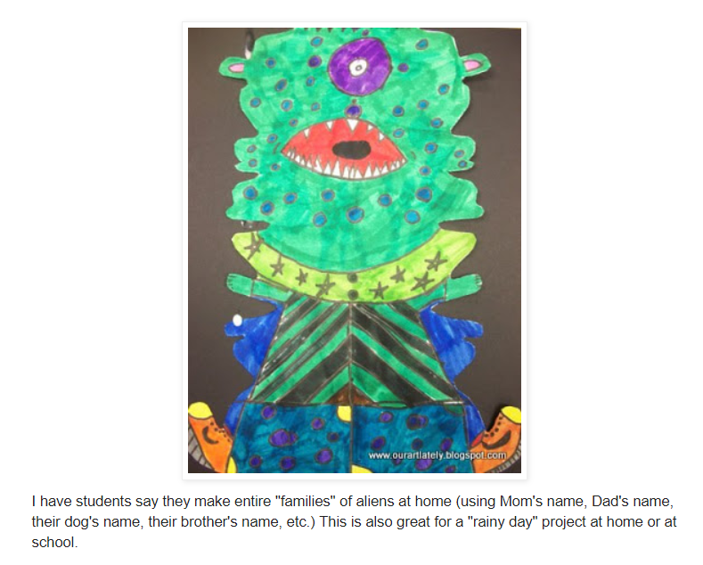

Slide 13
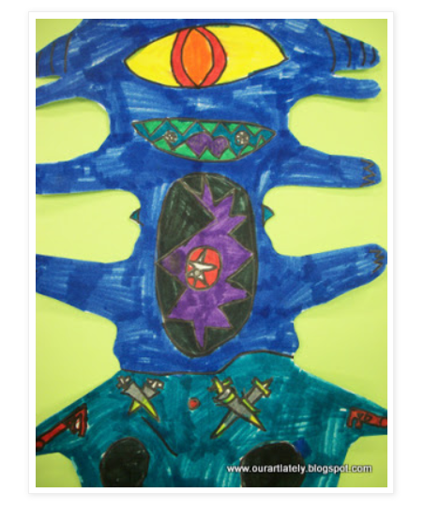
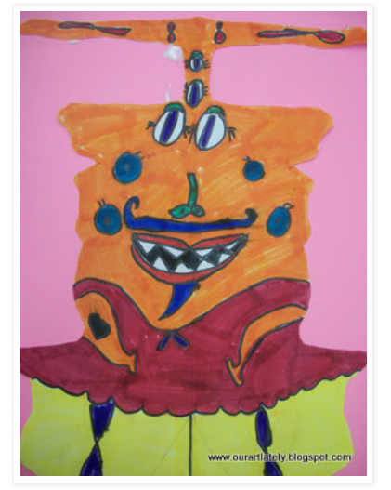
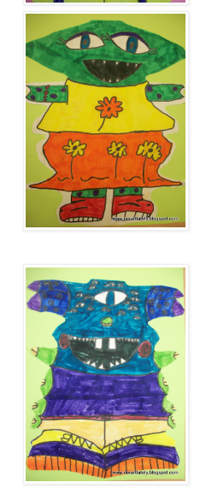
When you have finished your alien it will need a name.
Choose a name from the following list.

Slide 14
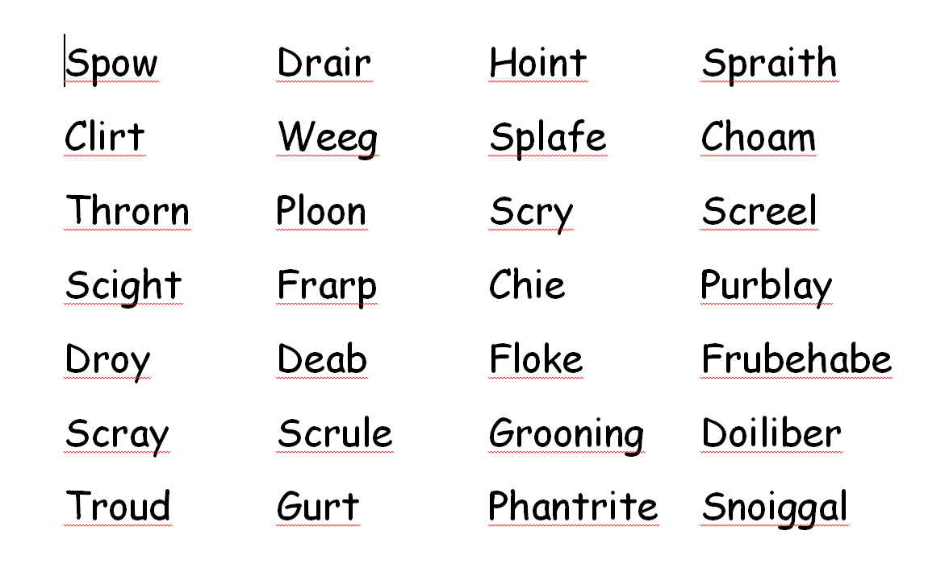

Slide 15
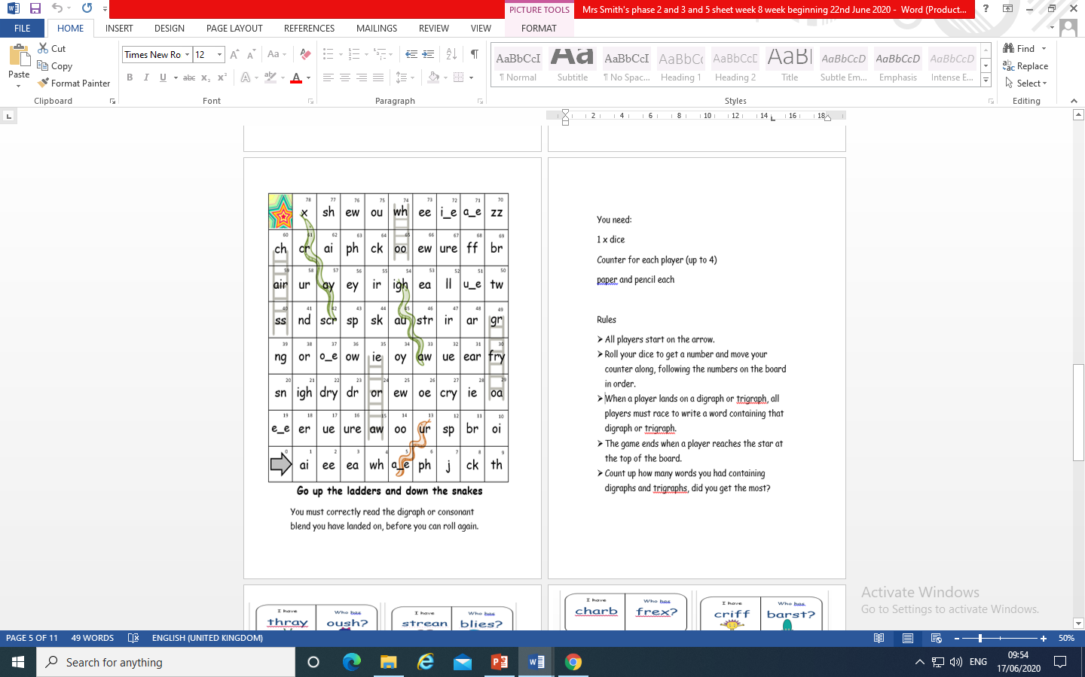
You could play Snakes and Ladders to help you practise your sounds.

Slide 16

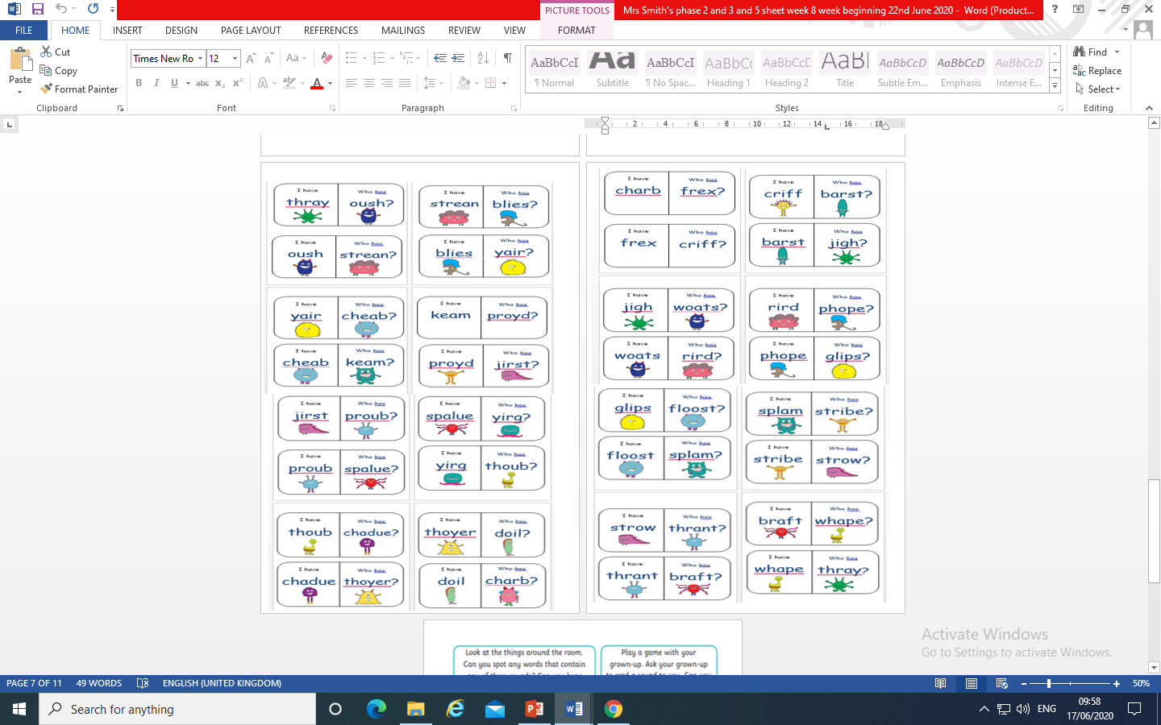
Why not play the I have .., Who has..? Game.
Print and cut out the dominoes and have fun playing.

Slide 17
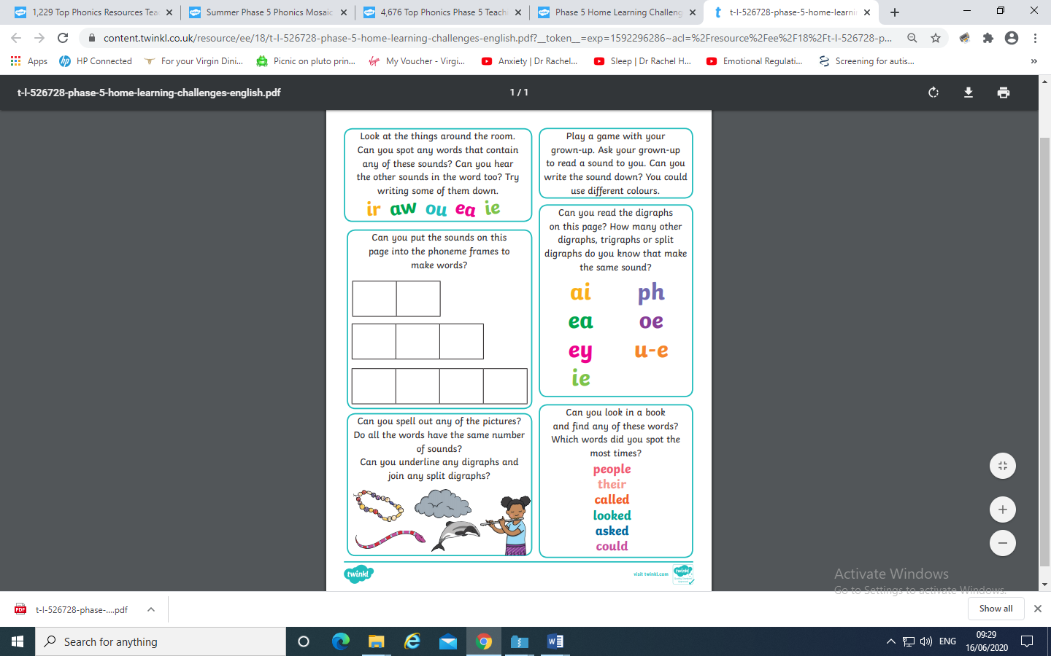
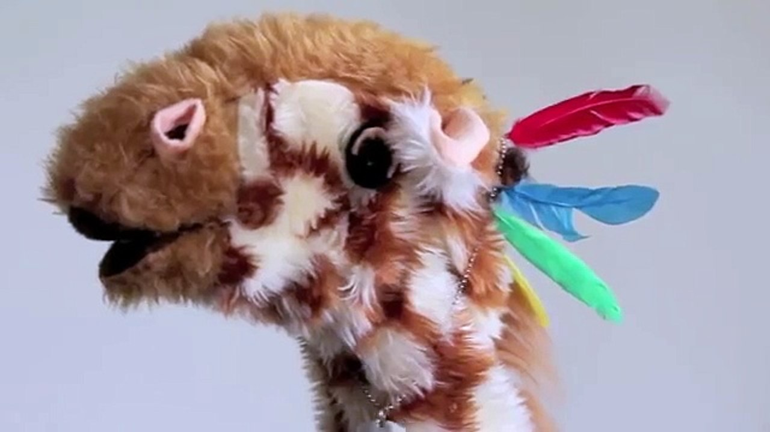
Have a go at this worksheet.
You could be like Geraldine
looking for objects around
the room or house?

Slide 18
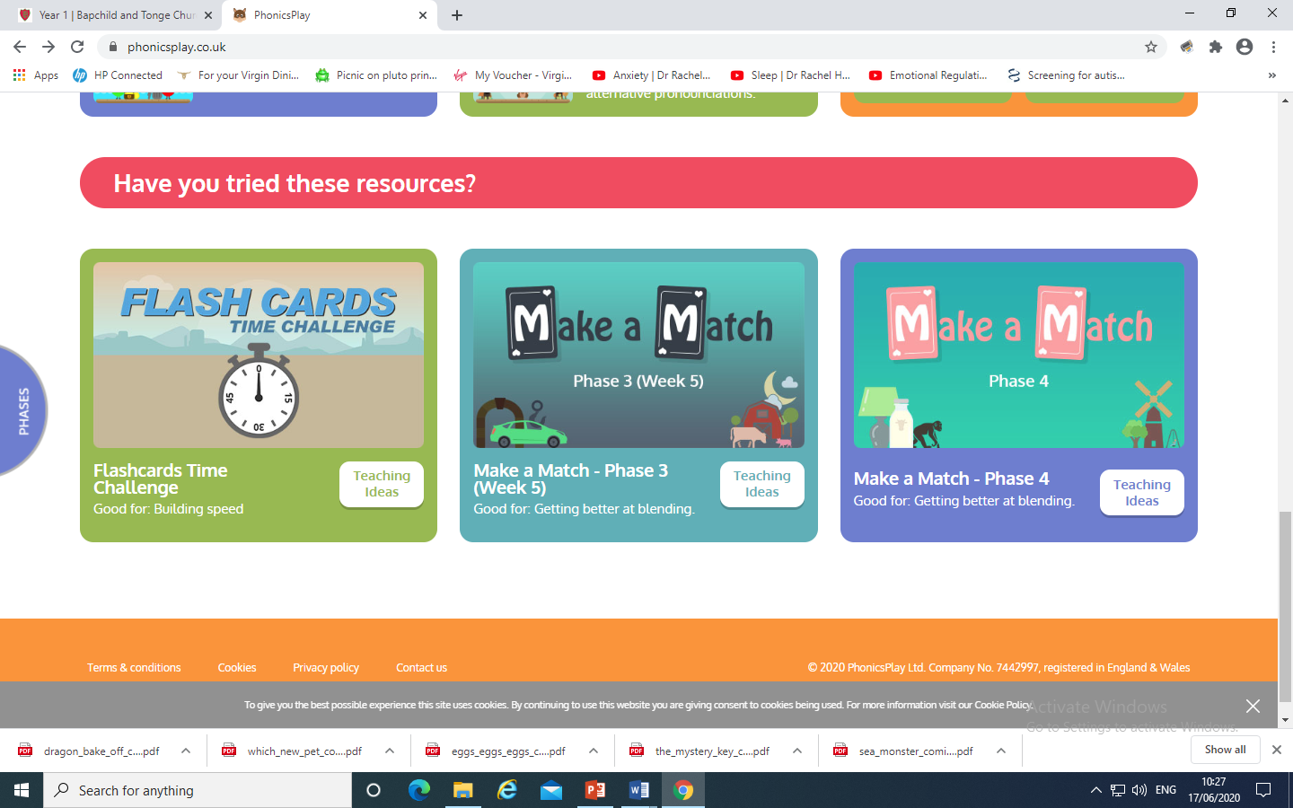
The following slides show resources on Phonics Play
you could access to help with blending and reading .

Slide 19
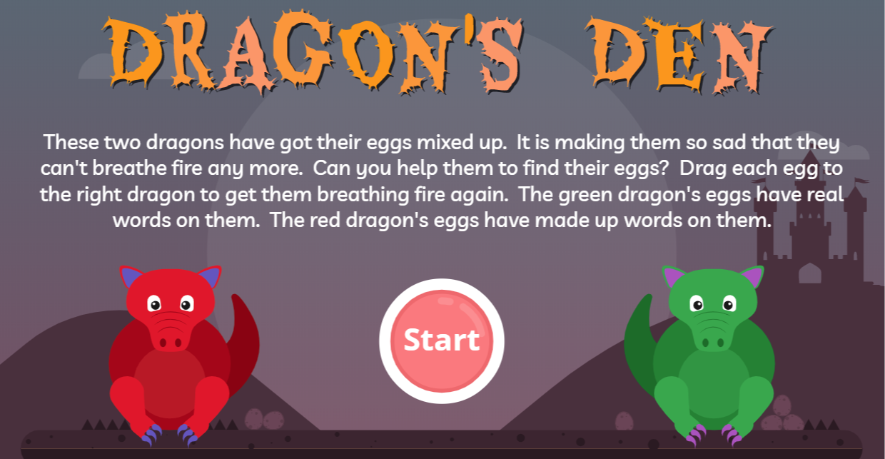

Slide 20
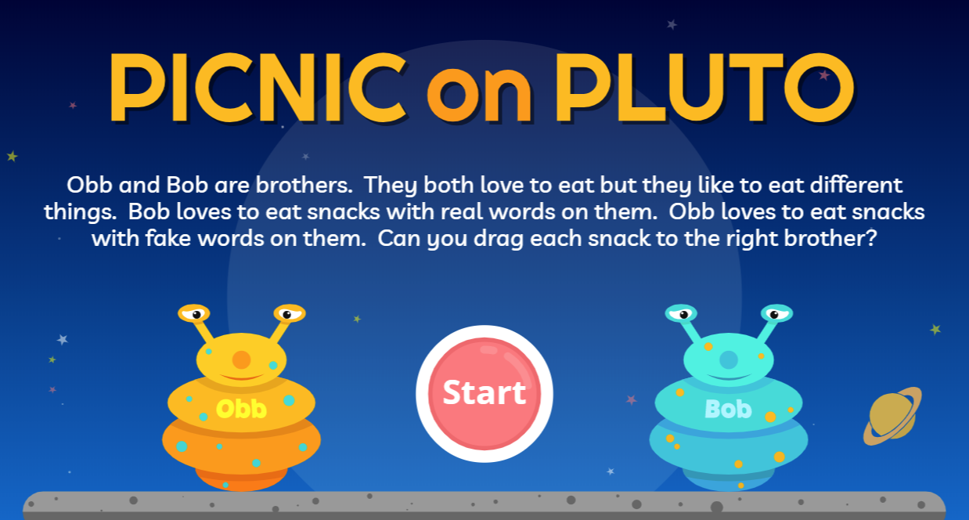

Slide 21
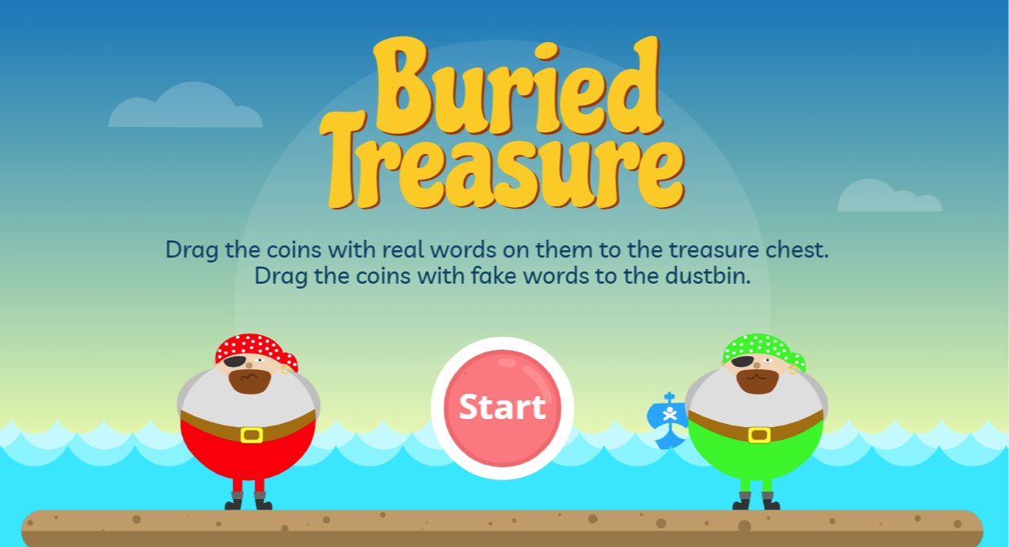

Slide 22
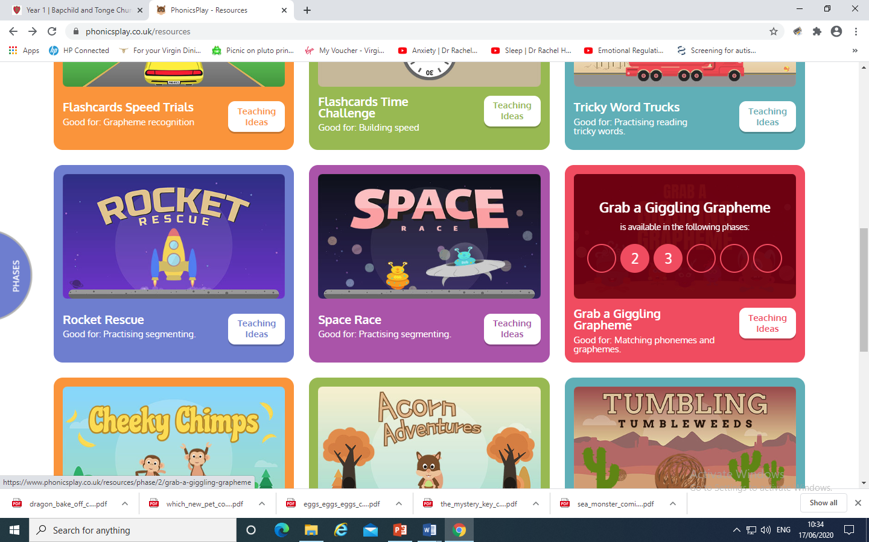

Slide 23
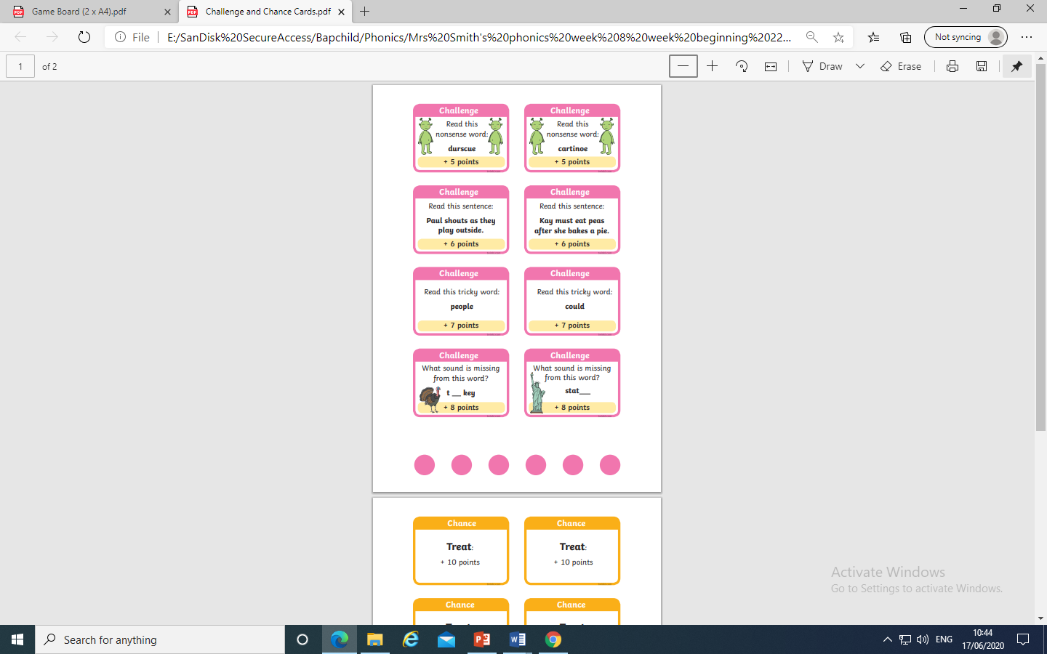
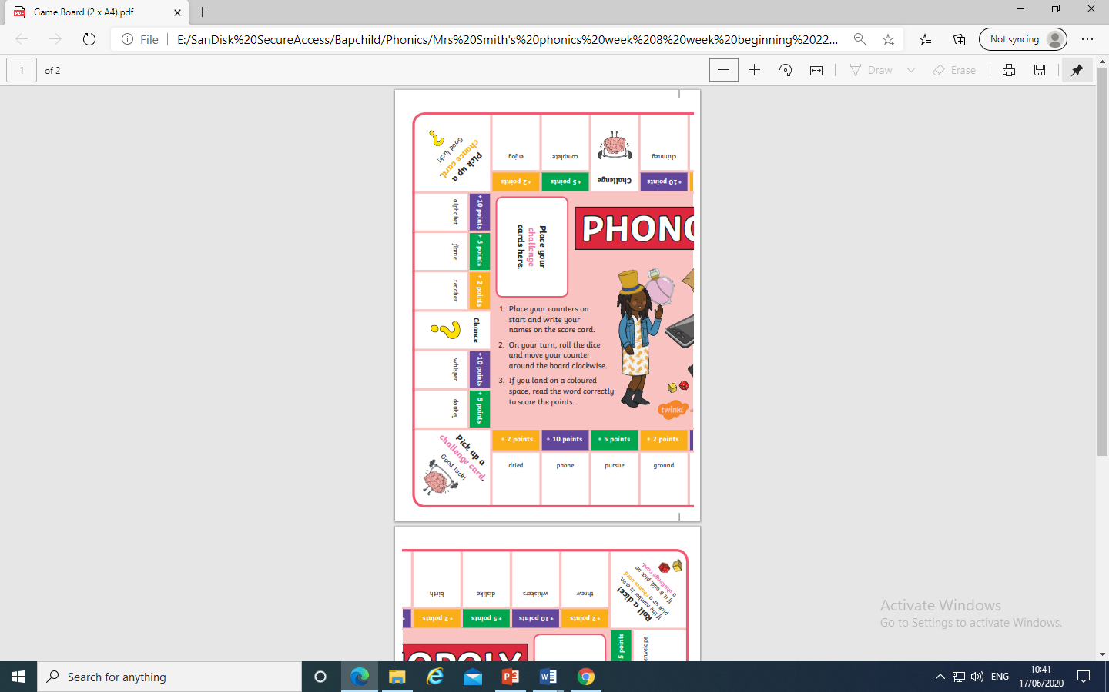
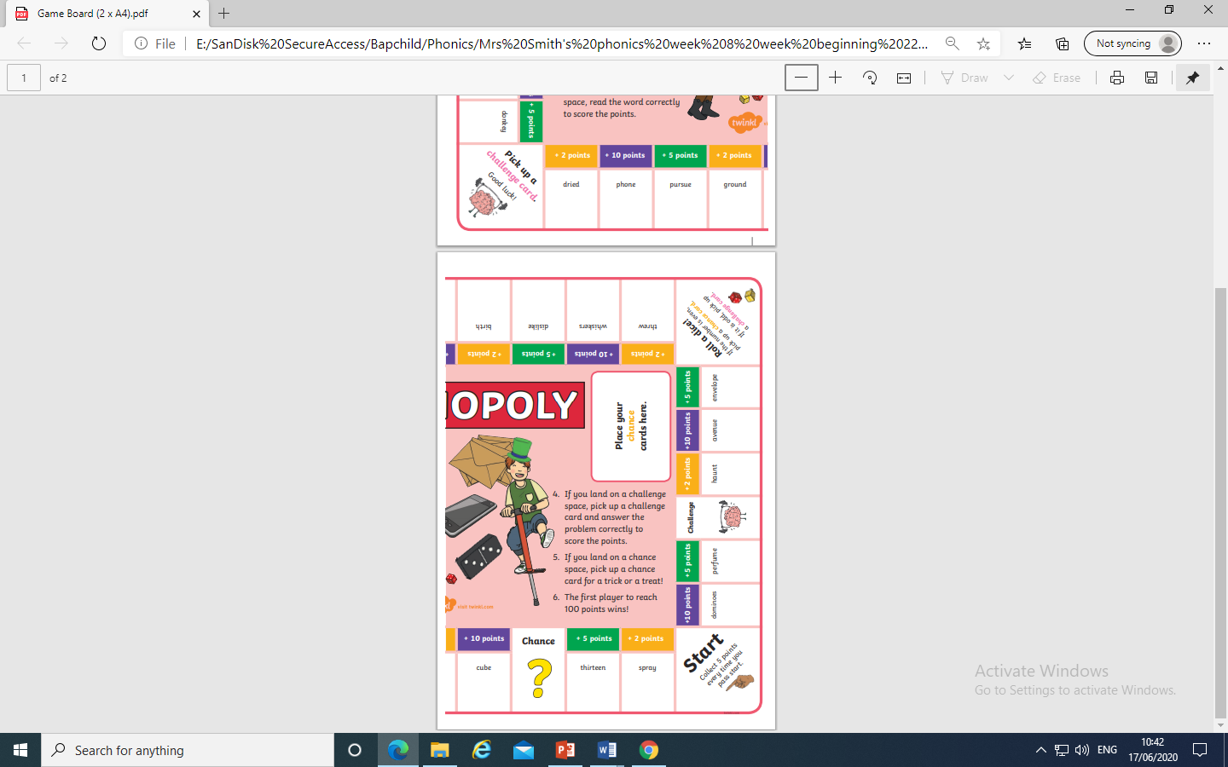
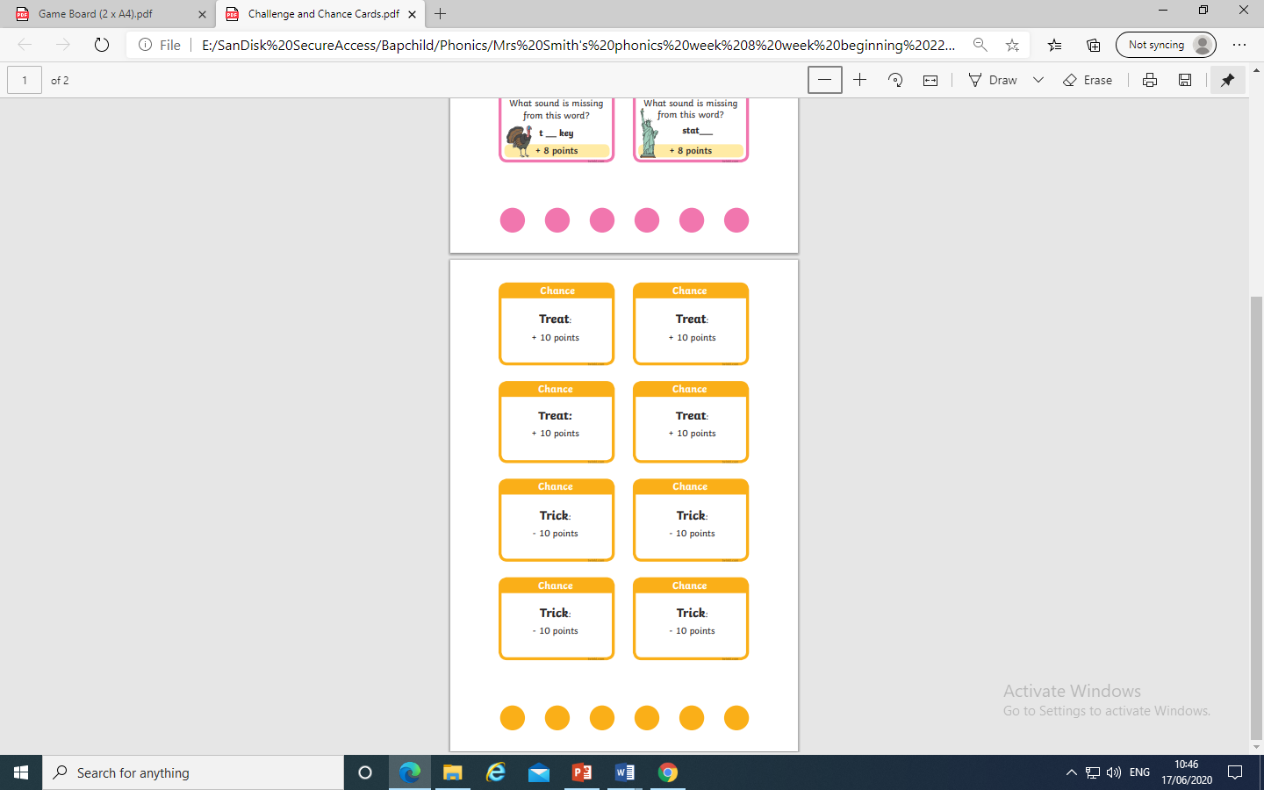
Why not play Phonopoly ?

Slide 24
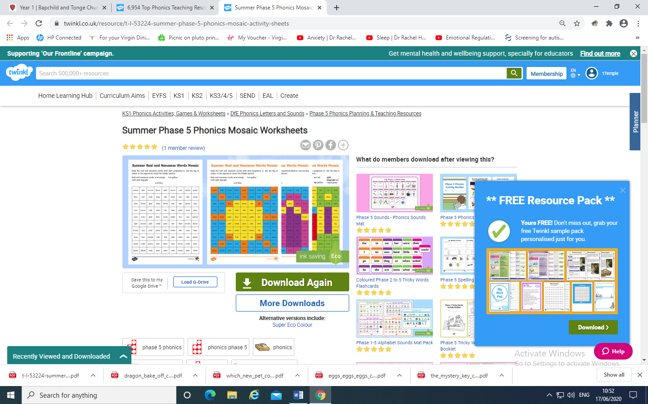
Why not check these activities out at Twinkl?

Slide 25
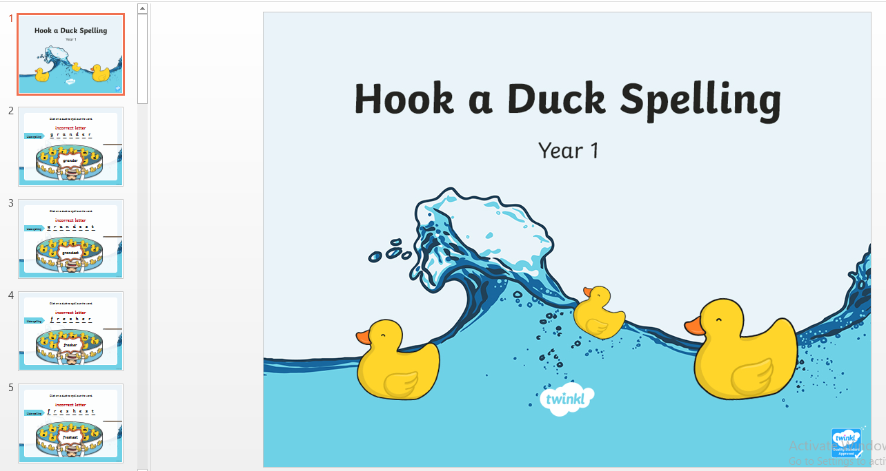

Have a good week

