Slide 1

Home Learning
Year 1
Term 6 Week 4

Slide 2
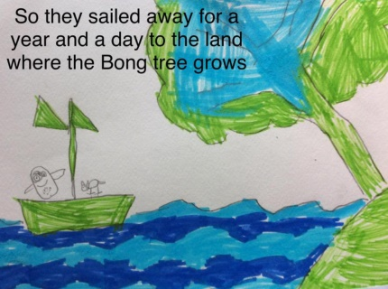
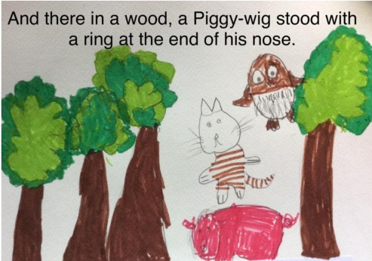
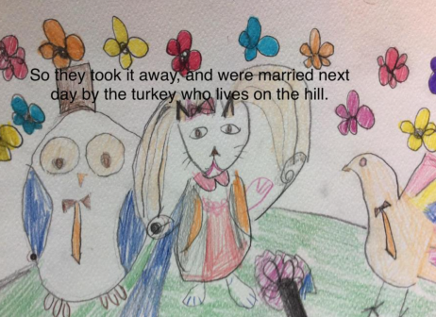
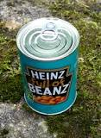
Hello Year 1!
I hope you have been enjoying “The Owl and the Pussycat” as we will continue working on this poem in English this week. Have a look at our class web page to see the illustrations the children at school did.
Maths this week is about counting to 100. I watched a television programme recently about baked beans which said that there are 465 baked beans in every tin. If you wanted to practice counting you could test if this is true!
Have a good week!
Love from Mrs Child
xxx

Slide 3
English Learning 1
Hopefully by now you know the words to “The Owl and the Pussycat” off-by-heart, but do you know what all the words mean? Answer the following comprehension questions to show that you do. Remember to write your answers as whole sentences, not just one word answers.
Who are the characters in the poem?
What colour was the boat?
Who was singing?
How long did they sail for?
Where did they go?
How much did they pay for the ring?
What did they eat for their dinner?
What do you think a “runcible spoon” is like?
What time of day is it in the poem? How do you know?
List three pairs of words from the poem that rhyme.

Slide 4
English Learning 2
Can you remember which words are nouns and which are adjectives in this verse from our poem?
The Owl and the Pussycat went to sea
In a beautiful, pea-green boat,
They took some honey and plenty of money,
Wrapped up in a five pound note.

Slide 5
The Owl and the Pussycat went to sea
In a beautiful, pea-green boat,
They took some honey and plenty of money,
Wrapped up in a five pound note.

Slide 6
We are going to compose our own verses in the style of The Owl and the Pussycat.
To do this we are going to swap all the nouns and adjectives for new ones.
Two animals
A place
The Owl and the Pussycat went to sea
In a beautiful, pea-green boat,
They took some honey and plenty of money,
Wrapped up in a five pound note.
Two adjectives
A vehicle
Two sorts of food that rhyme
An adjective
Any noun that rhymes with your vehicle

Slide 7
Fill in this table with your ideas for your poem.
Animal 1
Animal 2
A place
Adjective 1
Adjective 2
A vehicle
Food 1
A food that rhymes with Food 1
An adjective
A noun that rhymes with your vehicle

Slide 8
The ________ and the ________ went to __________
In a ___________ , ____________ ___________,
They took some ________, and plenty of _________,
Wrapped up in a _____________ __________.
Insert your ideas into this template. Try lots of ideas until you find the funniest. When you are happy with your verse, type it or write it out in your best handwriting and add illustrations. See some examples on the next slide.

Slide 9
The Mouse and the Donkey went to France
In a magical, supersonic rocket,
They took some cheese and plenty of peas,
Wrapped up in a golden locket .
The Frog and the Scorpion went to Tesco
On a sparkly, wobbly scooter,
They took some ham and plenty of jam,
Wrapped up in a very loud hooter .

Slide 10

English Learning 3
What do you think happened after the Owl and the Pussycat were married?
Did they have a honeymoon in the Land where the Bong tree grows?
Maybe they stayed there forever.
Did they have babies? What would their babies look like – owls or cats?
Edward Lear did begin writing a sequel to his poem but it was never finished or published. It was called “The Children of the Owl and the Pussycat” and it began like this:
Our mother was the Pussy-cat, our father was the Owl,
And so we’re partly little beasts and partly little fowl,
The brothers of our family have feathers and they hoot,
While all the sisters dress in fur and have long tails to boot.
We all believe that little mice,
For food are singularly nice.
Imagine you are one of these children and draw a picture of yourself and your family. Write some sentences to describe your picture. Afterwards, find out what Julia Donaldson thought happened next in the story by following this link to hear a version of her book “The Further Adventures of the Owl and the Pussycat”.
https://www.youtube.com/watch?v=IvmhjF0XamI

Slide 11
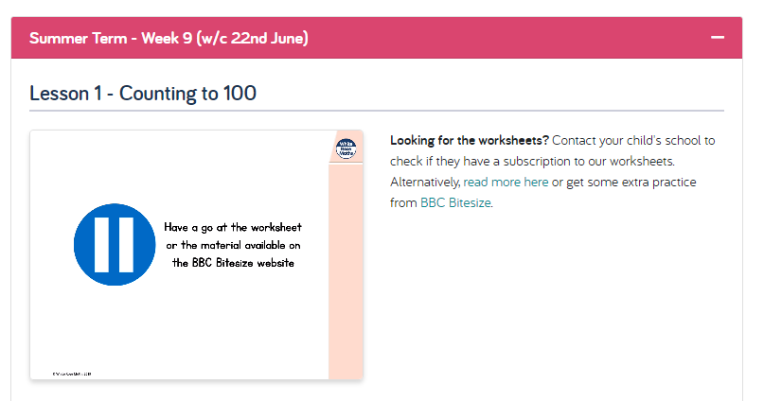
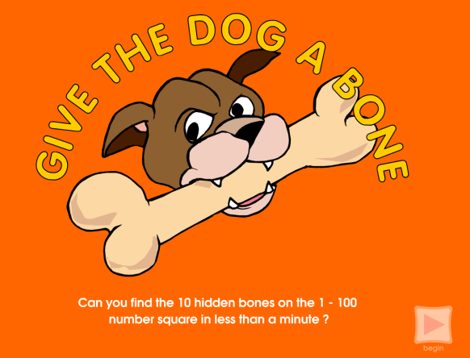
Maths Learning 1
Counting to 100
Watch the White Rose Home Learning video lesson – Year 1 Summer Term – Week 9, Lesson 1
https://whiterosemaths.com/homelearning/year-1/
Practise counting to 100 with Dot-to-dot puzzles like the one on the next page and by filling in the missing numbers on a hundred square (sample included). When you are feeling confident with how the hundred square works play the “Give the dog a bone” game at https://primarygames.co.uk/pg2/dogbone/gamebone.html

Slide 12
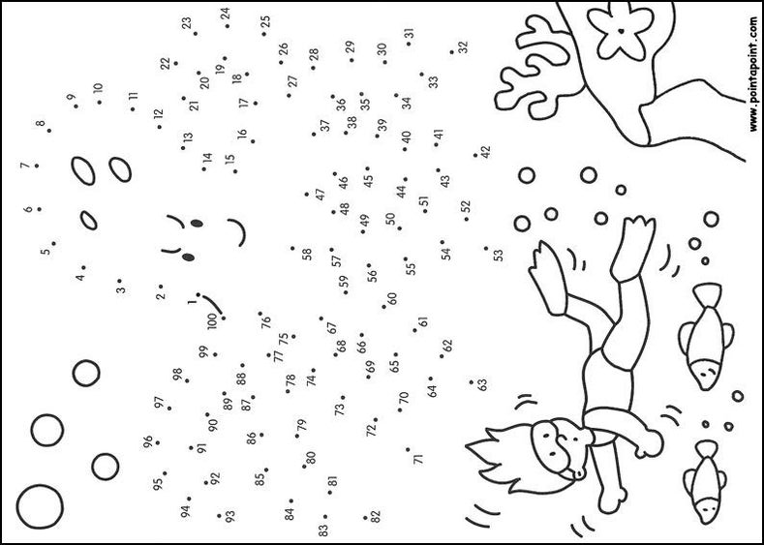

Slide 13
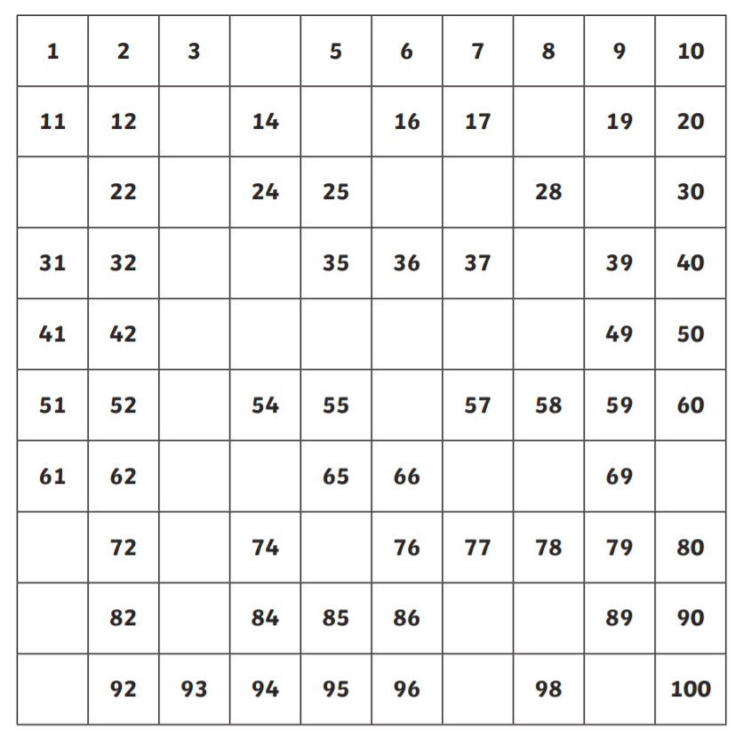

Slide 14
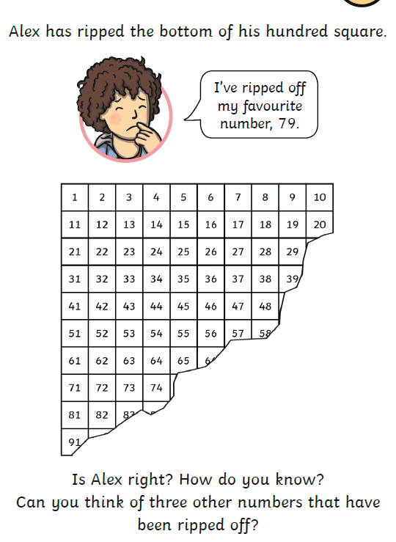
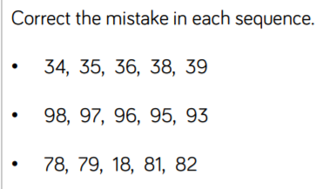
Extra challenges

Slide 15
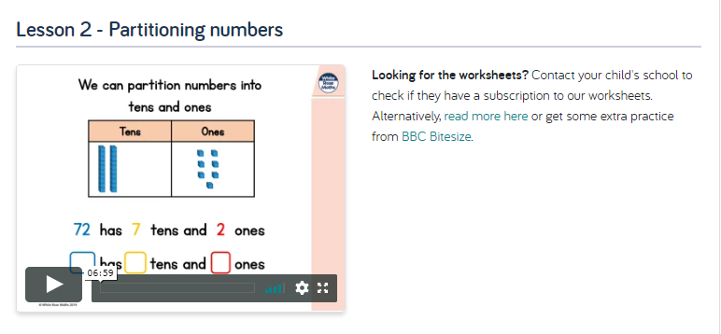
Maths Learning 2
Partitioning numbers
Watch the White Rose Home Learning video lesson – Year 1 Summer Term – Week 9, Lesson 2
https://whiterosemaths.com/homelearning/year-1/
When you have watched it, try completing the part-part-whole models on the next page (just copy them, no need to print) and then write out and complete the stem sentences on the following page.

Slide 16
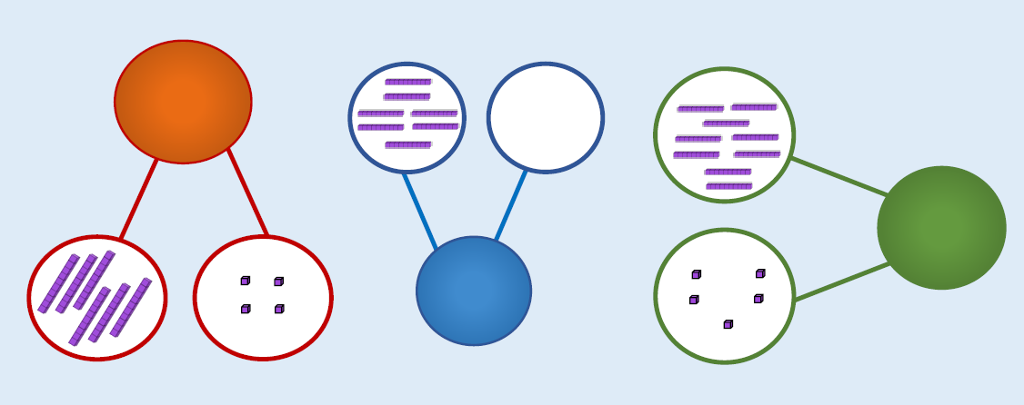
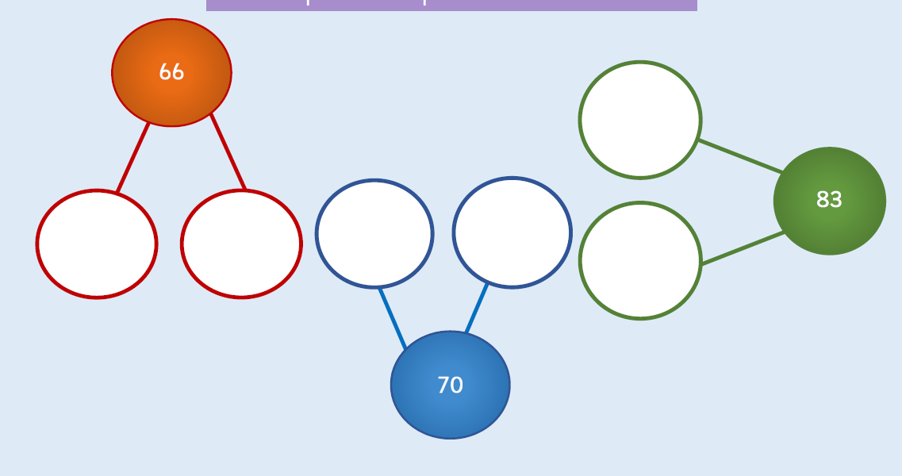

Slide 17
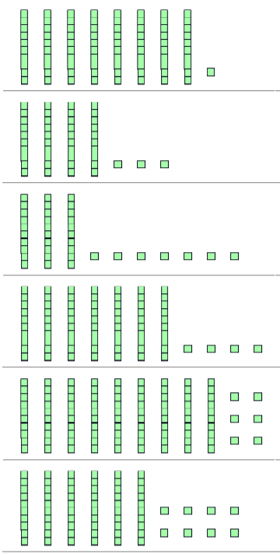
81 has 8 tens and 1 one
__ has __ tens and __ones
__ has __ tens and __ones
__ has __ tens and __ones
__ has __ tens and __ones
__ has __ tens and __ones

Slide 18
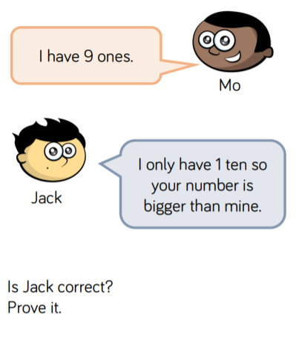
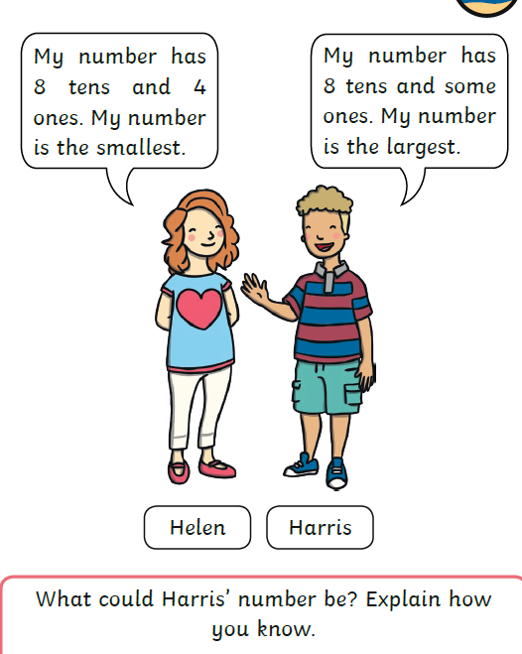
Reasoning

Slide 19
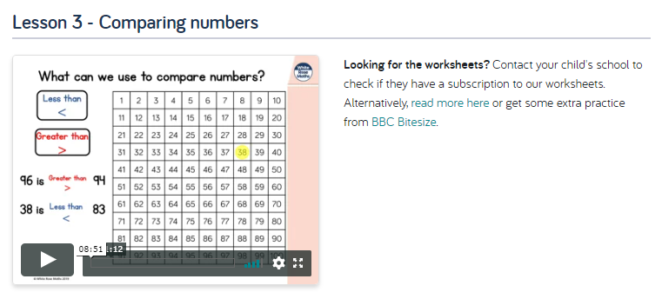
Maths Learning
Comparing numbers
Watch the White Rose Home Learning video lesson – Year 1 Summer Term – Week 9, Lesson 3
https://whiterosemaths.com/homelearning/year-1/
Look at the following questions and record your answers as comparison statements.
e.g. 45 > 32 16 < 61 29 < 78

Slide 20
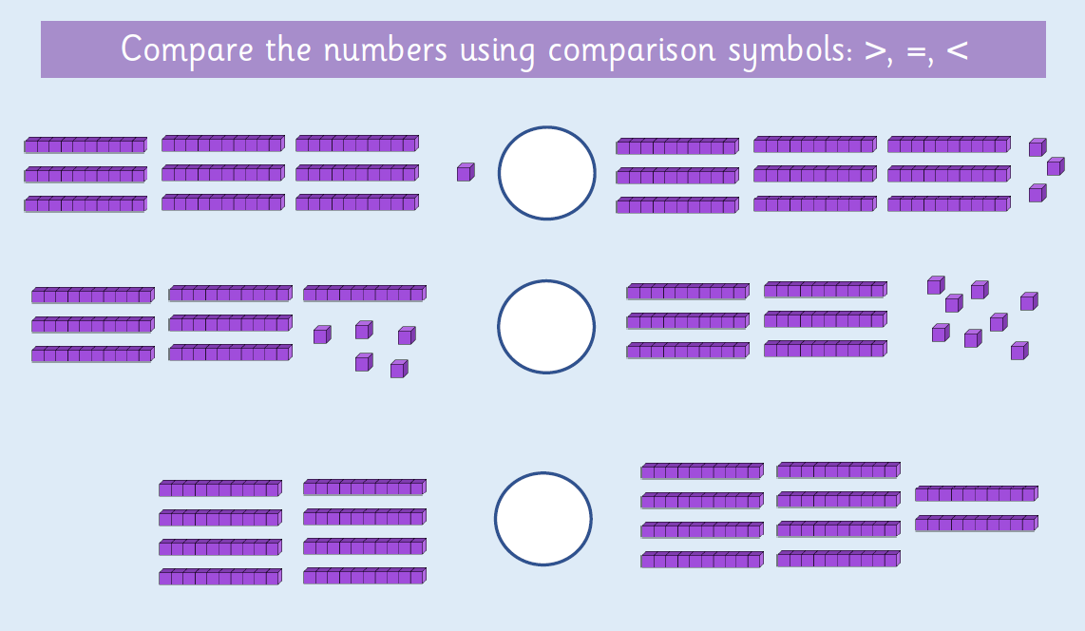

Slide 21
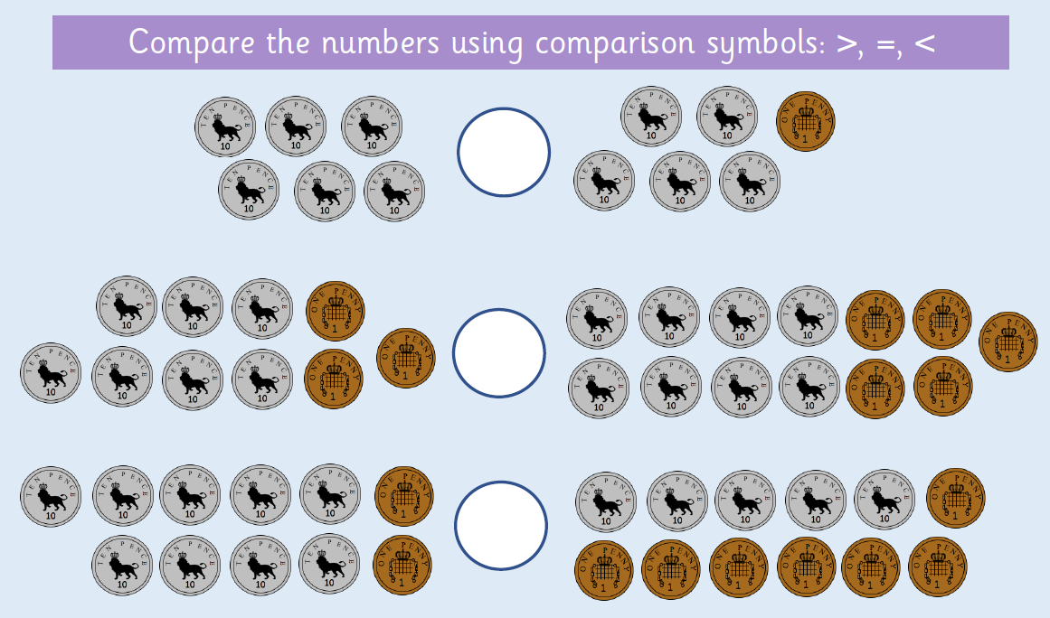

Slide 22
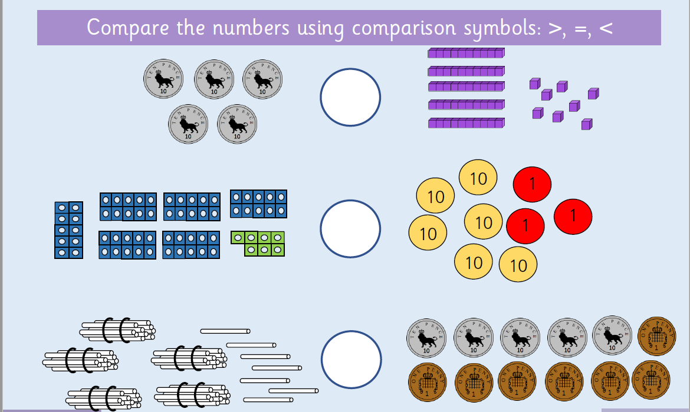

Slide 23
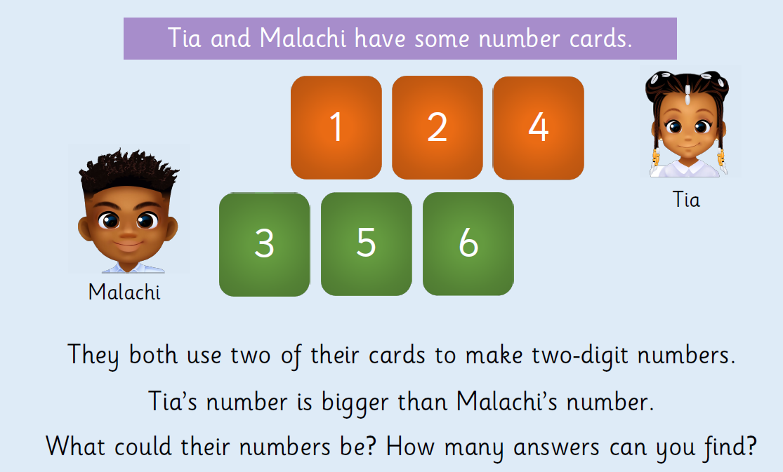
Reasoning

Slide 24
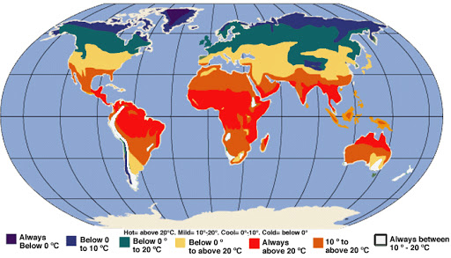
Geography Learning
Can you remember where in the world is hot and where in the world is cold?
Can you point to the North Pole, the South Pole and the Equator? Where do we live?

Slide 25
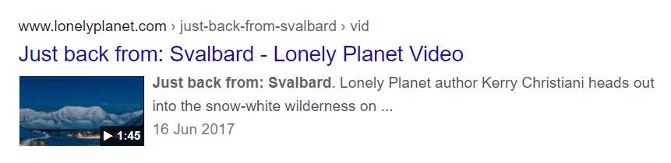
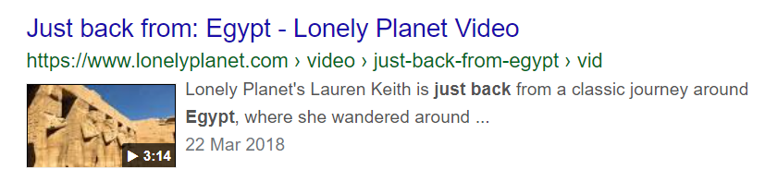
Would you rather go on holiday to Norway or Egypt?
Find where Norway and Egypt are on a World map. Which is a hot place and which is a cold place? Find out about each country and watch these videos from the Lonely Planet Website about people who have just been to these places.
https://www.lonelyplanet.com/video/just-back-from-svalbard/v/vid/344
https://www.lonelyplanet.com/video/just-back-from-egypt/v/vid/718

Slide 26


Discuss the pros and cons of each holiday destination and when you have decided which you would prefer, write an answer to the question
Your answer will begin with either
“I would rather go on holiday to Norway because….”
or
“I would rather go on holiday to Egypt because…”
When you have finished writing your answer, draw and label what you would need to take with you in your suitcase. There is a suitcase template on the next page and pictures of possible items to choose from.
Would you rather go on holiday to Norway or Egypt?

Slide 27


Slide 28
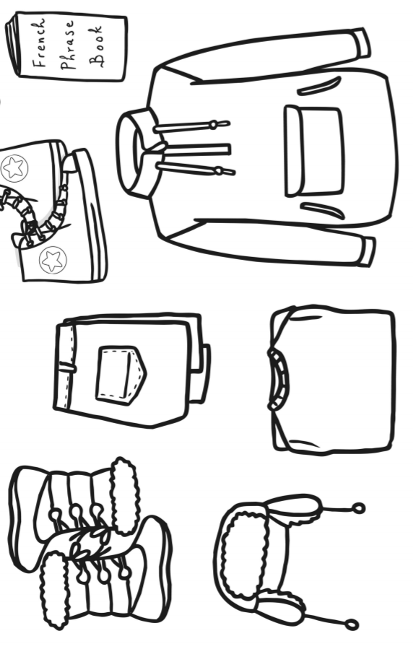
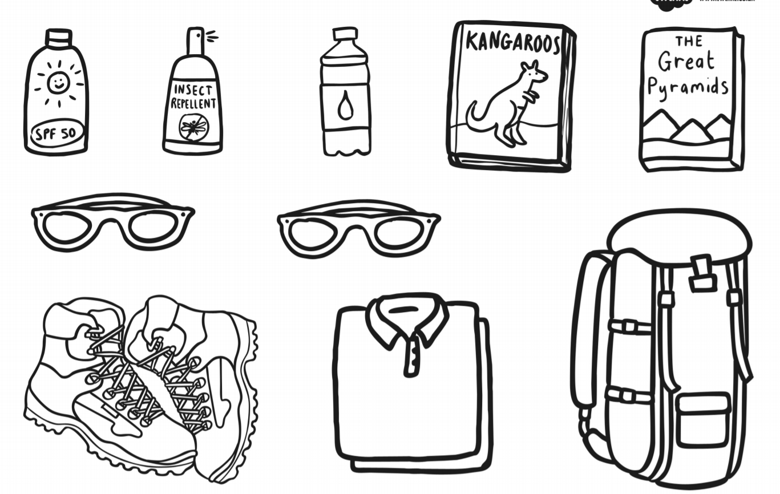

Slide 29
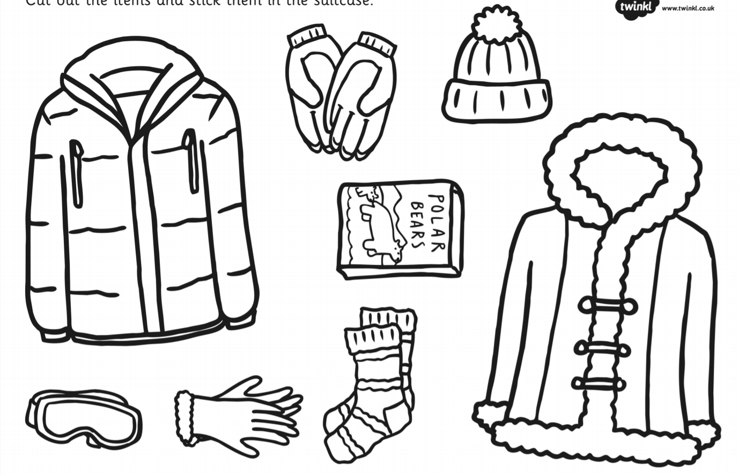
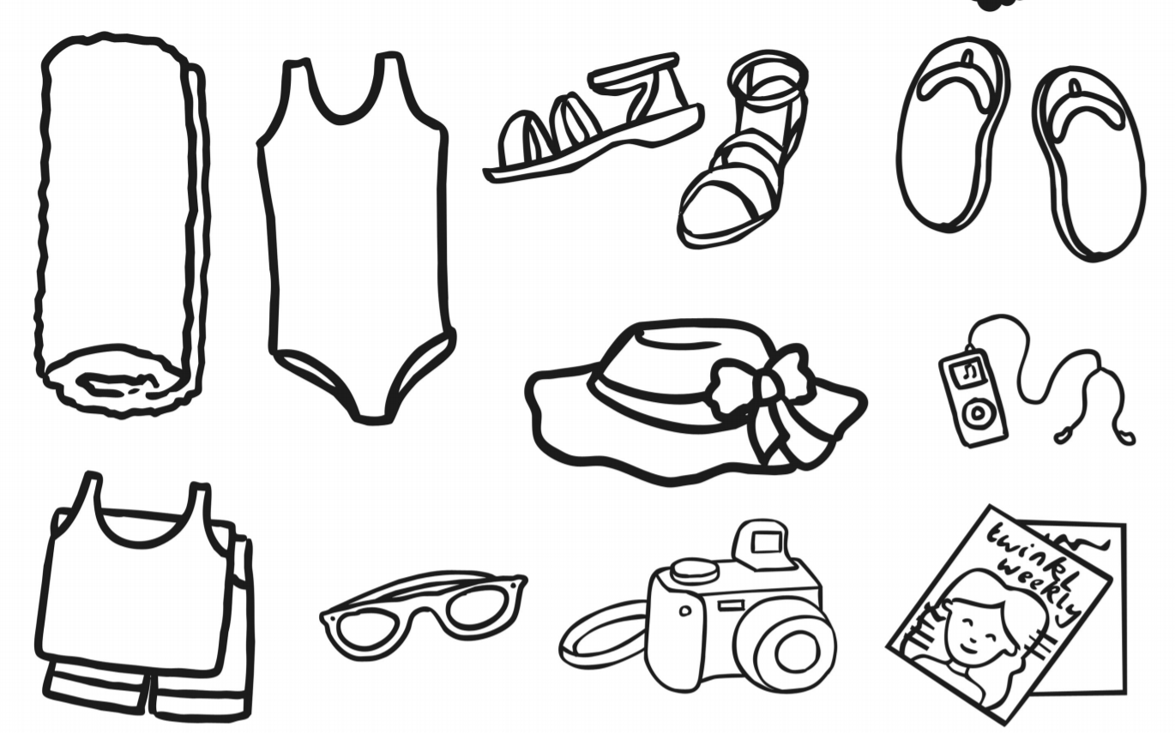

Slide 30

Reading
For additional reading at your child’s level please use the Oxford Owl website where you can read books online and then complete comprehension activities about the books. Please continue to keep a record of the books they have read in their reading records.
www.oxfordowl.co.uk
Class login: temple20
Password: Bingbong
(If you are not sure of your child’s level, please check in their reading record book or look at the coloured stickers on the additional reading books that have been sent home.)

Slide 31

Phonics
Please use the games and activities on the Phonicsplay website to continue practsing Phonics.
www.phonicsplay.co.uk
Login: march20
Password: home
Mrs Child’s Phonics group are currently working on Phase 5c (alternative ways of writing sounds we already know e.g. ai, ay, a_e all make the same sound).
Mrs Smith’s group are working on Phase 4.
Additionally, there are many excellent Phonics resources on the Twinkl website(see below for how to get free access). Practising reading “alien words” is a particularly fun and valuable activity.

Slide 32

Writing
Your child has been provided with a writing journal. They are used to using them and know that they need to write the date, write a sentence (about anything they like), draw and colour a picture and then fill any spare lines with handwriting patterns.

Slide 33

P.E.
It is important to keep your children active. If it is safe to do so, ensure they have some time outside throughout the day. Please visit Joe Wicks YouTube channel (https://www.youtube.com/channel/UCAxW1XT0iEJo0TYlRfn6rYQ), which has lots of exercise videos for children. He will also be hosting a live P.E. lessons Monday to Friday at 9:00am.

Slide 34


Using My Maths
Children should know their way round My Maths but here are some reminders on how to access the lessons. Visit: www.mymaths.co.uk
bapchild
divide162

Slide 35

Using My Maths
Access any lesson based on what your child is learning in class or search the topic in the search bar.
Use the login portal to access specific homework and lessons that your teacher has set.

Slide 36

Maths – White Rose Home Leaning
In school we follow the White Rose scheme of learning. Their website has put together free lessons and resources that link to the learning taking place in school. Please visit: https://whiterosemaths.com/homelearning/

Slide 37

Accessing Twinkl
Many educational content providers are offering free access to their resources. Twinkl is a website that we use from time to time to resource our lessons to aid in teacher input and pupil activities.
We will be able to direct you towards activities and learning via this website based on lessons that may be missed due to absence. To access Twinkl please visit: www.twinkl.co.uk/offer
You will have to sign up and put in the offer code: UKTWINKLHELPS

Slide 38

Classroom Secrets
The site classroom secrets https://classroomsecrets.co.uk/free-home-learning-packs/ has free class packs which provide some great additional ideas and resources you can use.

