Slide 1

Hello and Welcome to Mrs Smith’s Phonics Group Week 7.
I have seen some of you back in school and I hope to see the rest of you soon . Take care and stay safe.
I know you have been working hard learning and revising the sounds we already know and our new Phase 5 graphemes and phonemes GPCs. If you are finding that you don’t understand some of the
sounds or one week is tricky and difficult, that’s ok and repeat it.
We would do that in school until you are more confident. I am really proud of you all ☺.
You could start your phonics learning daily with our alphabet song or to get you moving BBC Super Movers with Naomi Wilkinson https://www.youtube.com/watch?v=jYeMpUdufNk
Do as much as you can and have Fun. Love Mrs Smith xx

Slide 2
You could print this grid off and check what phonemes (sounds) to grapheme (written) you can recall daily. You could colour, tick or cover with counters, coins or pebbles the ones you can say using the PURE SOUND. If you don’t want to print it off you could point to each sound and say using the PURE SOUND. Are you getting quicker maybe you could time yourself. Let’s check what you know. Are you getting quicker?
s | a | t | p | i | n | m
d | g | o | c | k | ck | e
u | r | h | b | f | ff | l
ll | ss | j | v | w | x | y
z | zz | qu | ch | sh | th | ng
ai | ee | igh | oa | oo | ar | or
ur | ow | oi | ear | air | ure | er
ay | ou | ie | ea | oy | ir | ue
aw | wh | ph | ew | oe | au | ey
i-e | o-e | a-e | u-e | e-e
Practice the ones you are not sure of.

Slide 3
Phase 5b Week 7:
This week we are going to be learning to explore alternative pronunciations of different graphemes. These sound the same but are written differently. You may have spotted some already!
Let’s find out more…..

Slide 4
Phase 5b Week 7:
Monday: Practise the phonemes and graphemes on the sheet (slide 2) using the Pure Sound.
Now let’s practice reading these tricky words
water, where, who, again, thought, through, work, mouse
See the next slide for resources.

Slide 5
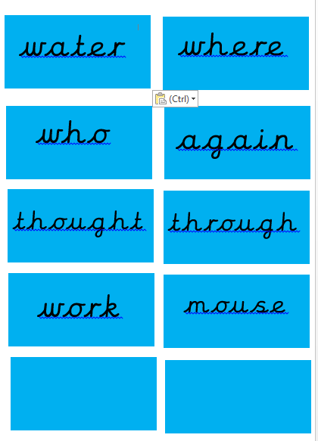
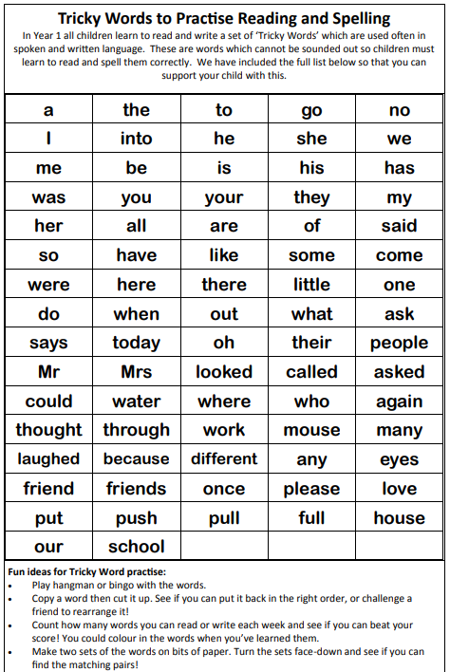
Tricky word flashcards

Slide 6
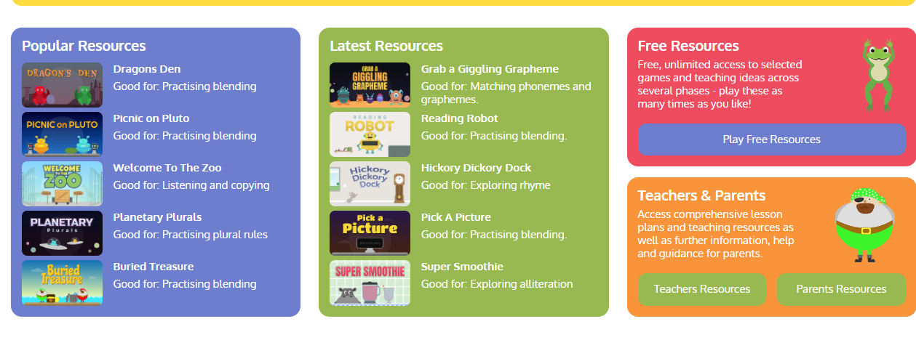
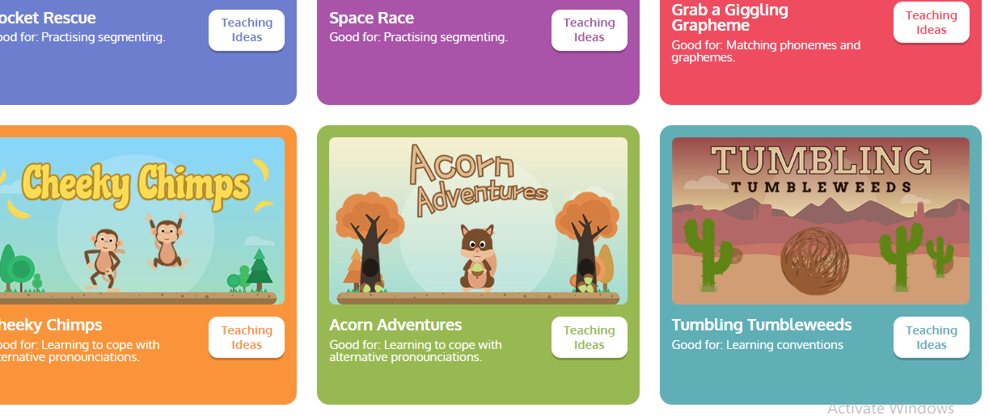
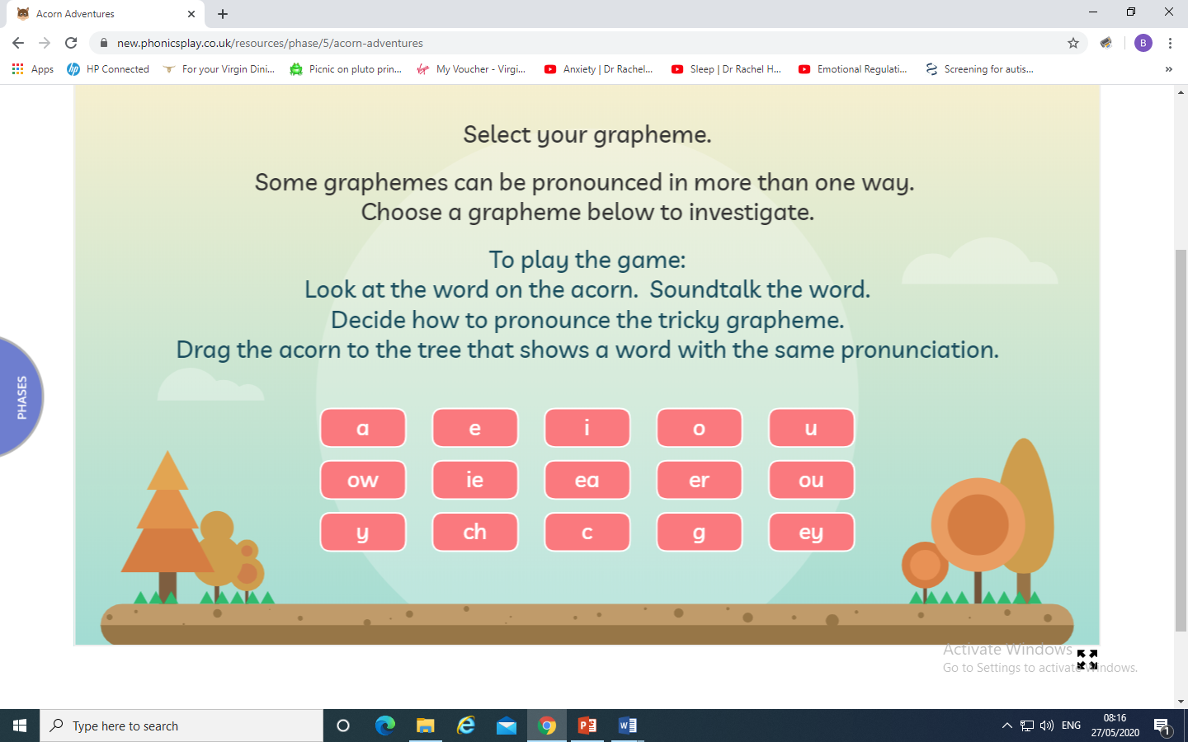
Today we are learning to explore the alternative pronunciation for the a grapheme
Play Acorn Adventures
on Phonics Play. The words change
so play more than once.

Slide 7
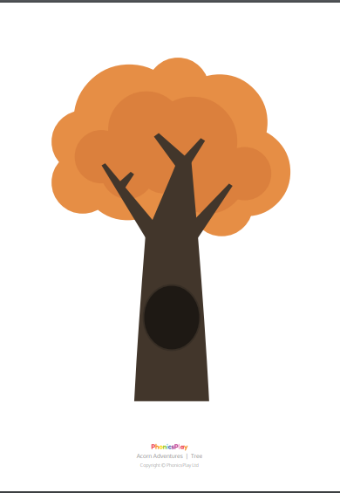
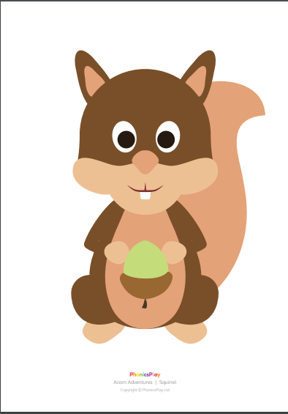
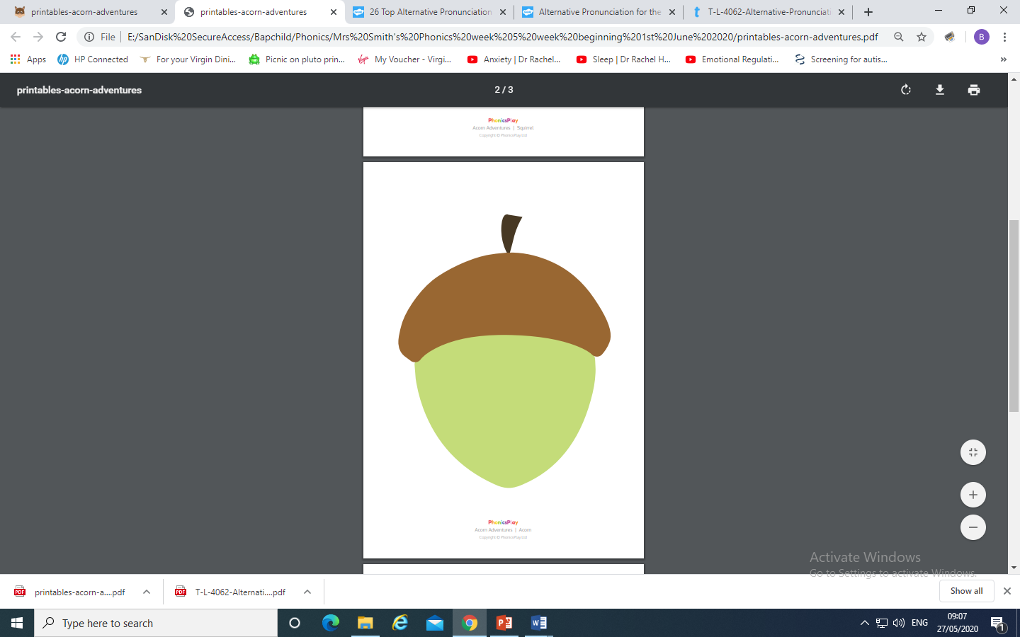
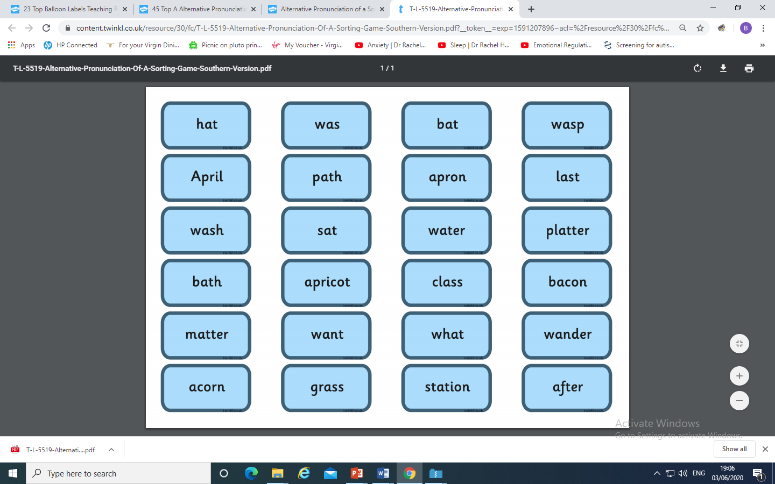
You could make your own Acorn Adventure
and place the a graphemes
under the correct pronunciation.
(Trees, squirrel, acorn and words are
in resource pack)

Slide 8
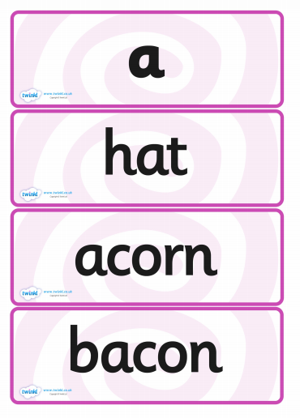
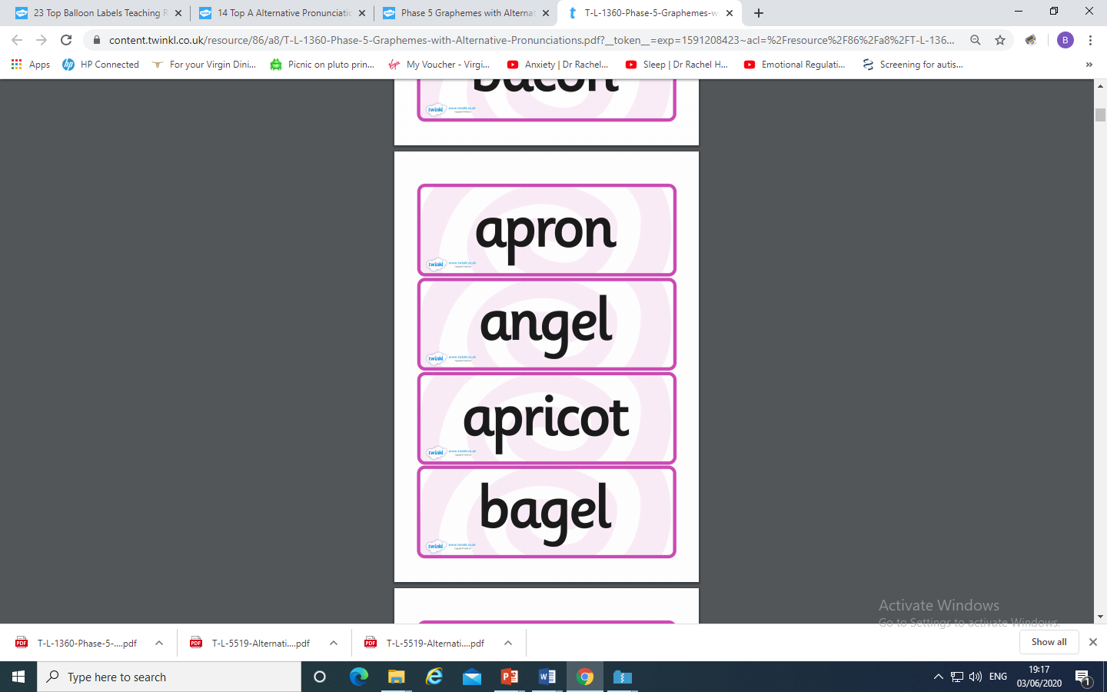
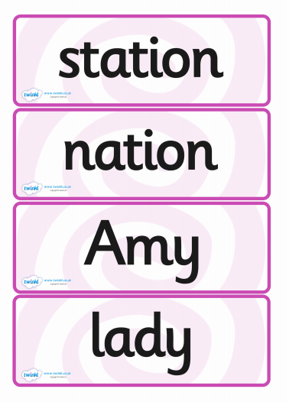
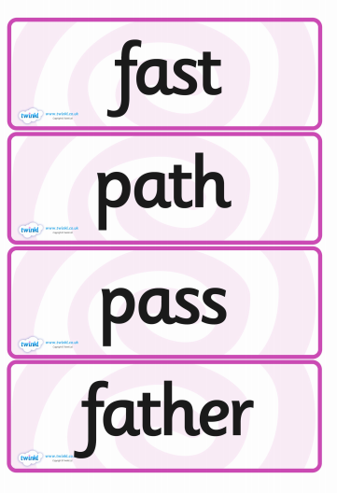
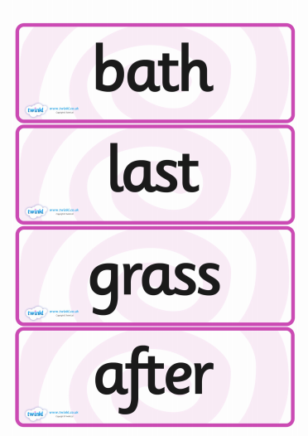
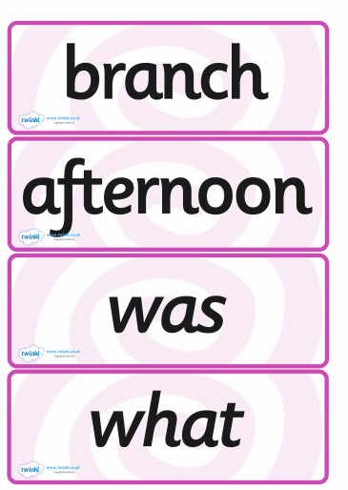
Flashcards

Slide 9
Play Buried Treasure on Phonics Play use the username and password provided. Revise all of Phase 5. How many did you get right?
Read the following sentences. Remember to sound out the words you are unsure of (don’t guess) and then read the complete sentence.
Will you wear a hat when you eat a bacon sandwich in the bath?
Can you watch a wasp sting a lady or will it be too fast?
Would an angel want to visit a bank in the afternoon?

Slide 10
Tuesday: Practise the phonemes and graphemes on the sheet (slide 2) using the Pure Sound.
Today we are learning to explore the alternative pronunciation for the y grapheme
Practice playing
Acorn Adventures
on Phonics Play. The words change
So play more than once.

Slide 11
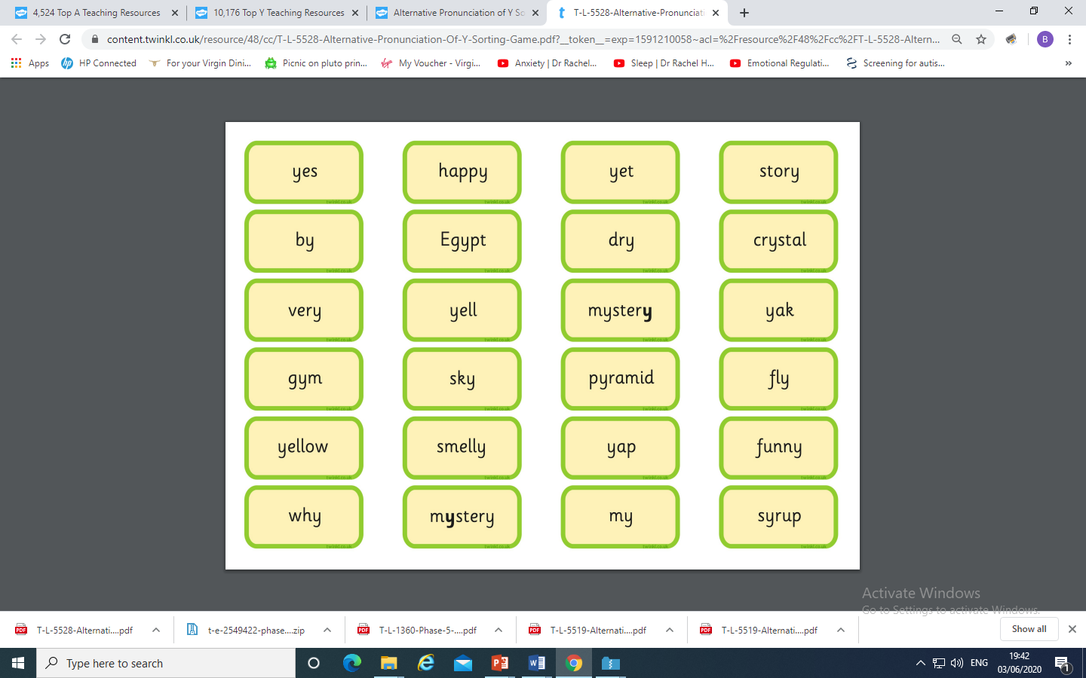
You could make your own Acorn Adventure
and place the o grapheme
under the correct pronunciation.

Slide 12
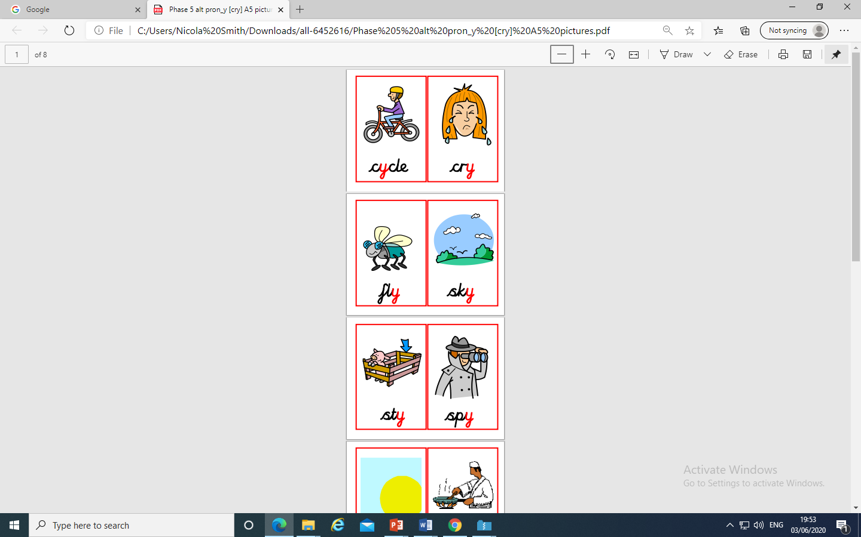
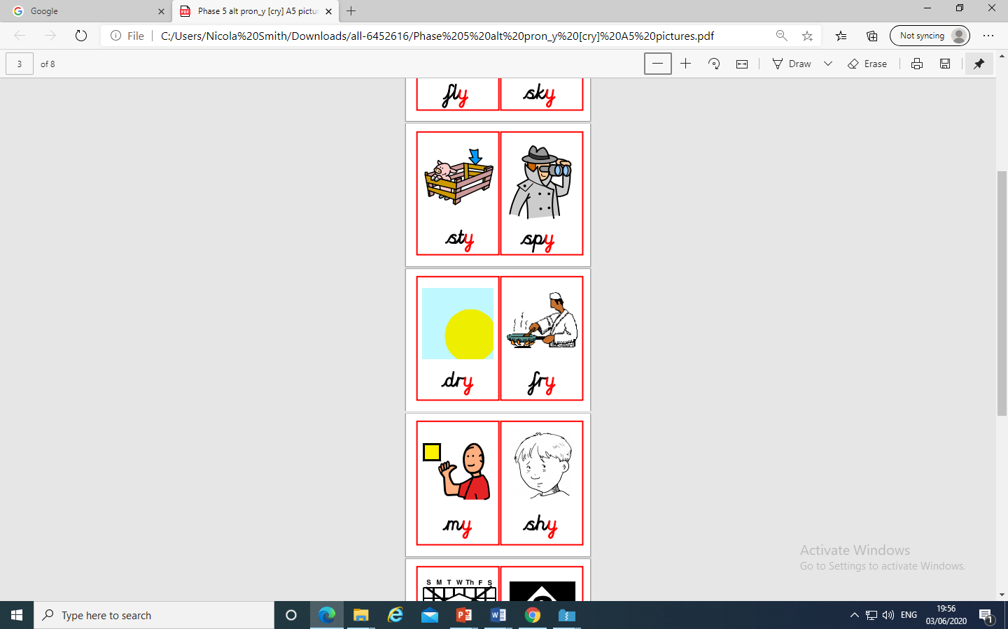
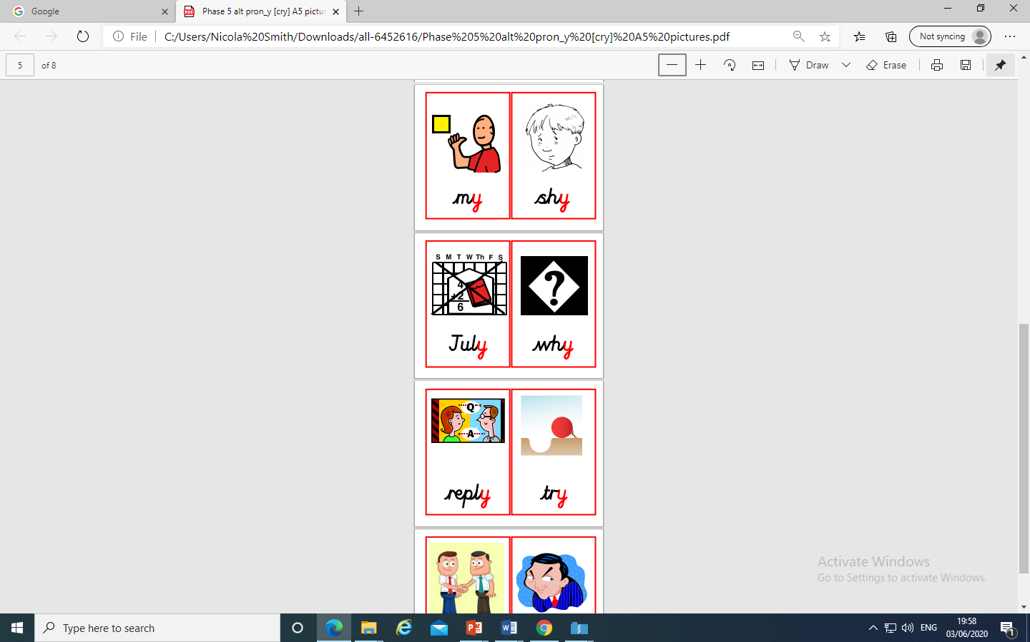
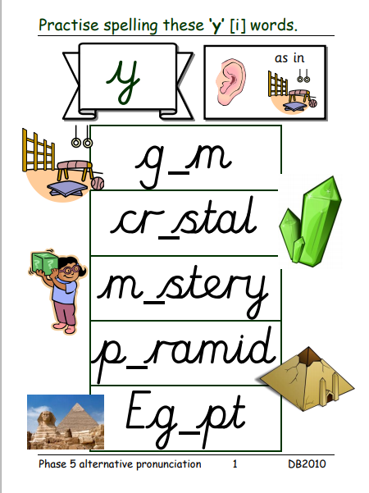
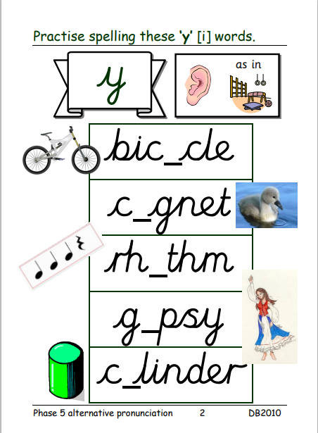
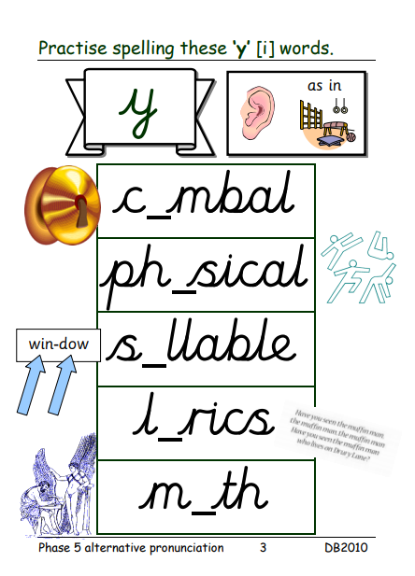
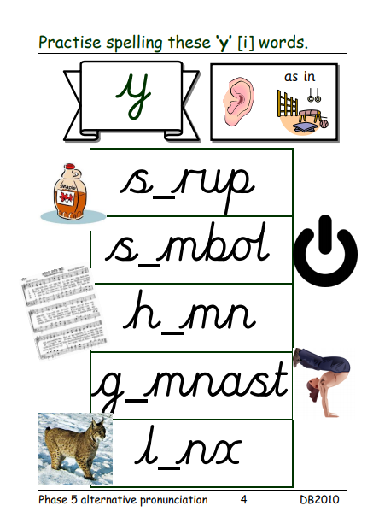
Flashcards maybe you could print two sets and play snap
and say the word.
Add the y and
read the word

Slide 13
Play Dragon’s Den on Phonics Play use the username and password provided.
Revise all Phase 5. How many did you get right?
Read the following sentences. Remember to sound out the words you are unsure
of (don’t guess) and then read the complete sentence.
Is the gym a happy place to be?
If you spy a mummy in Egypt, will it be dry, smelly and yellow?
Can a mystery story be funny?

Slide 14
Wednesday: Practise the phonemes and graphemes on the sheet (slide 2) using the Pure Sound. Play a game on Phonics Play to revise blending to read Phase 4 words. (Buried Treasure, Dragon’s Den, Picnic on Pluto)
Today we are learning to read the tricky words
many, laughed, because, different, any, eyes, friends, once, please
See the next slide for resources.

Slide 15
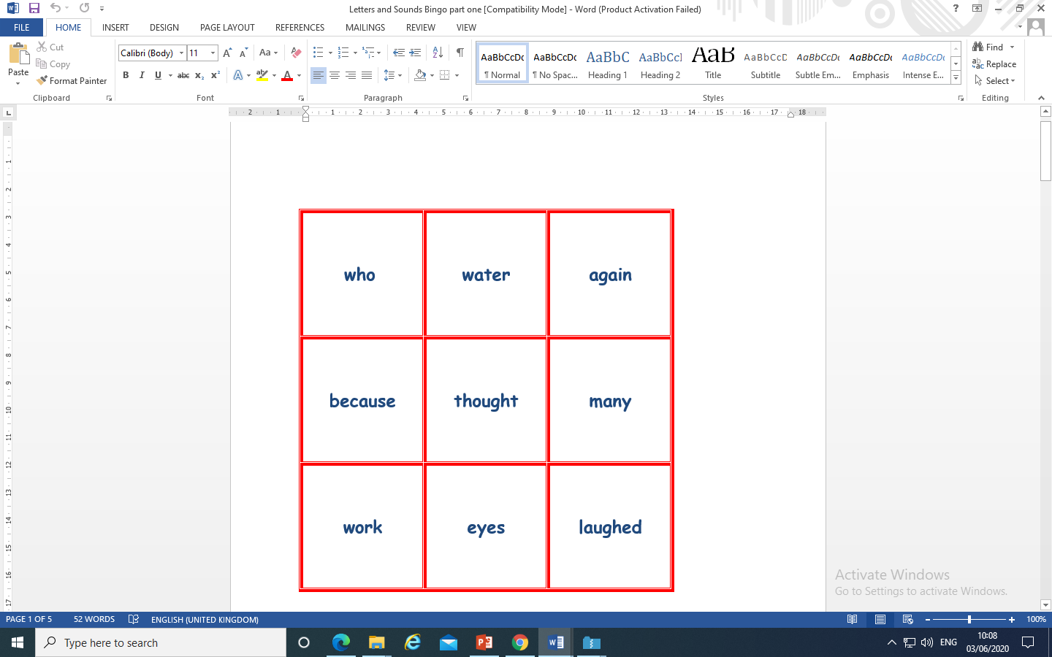
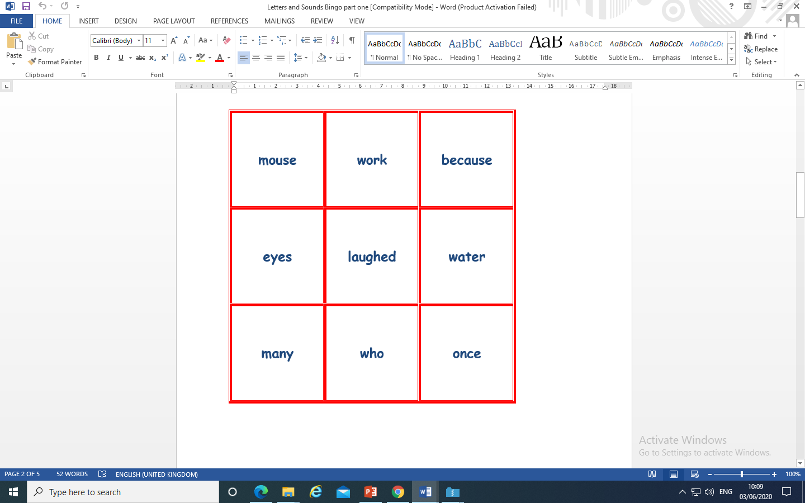
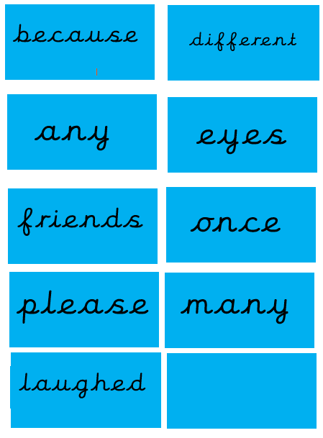
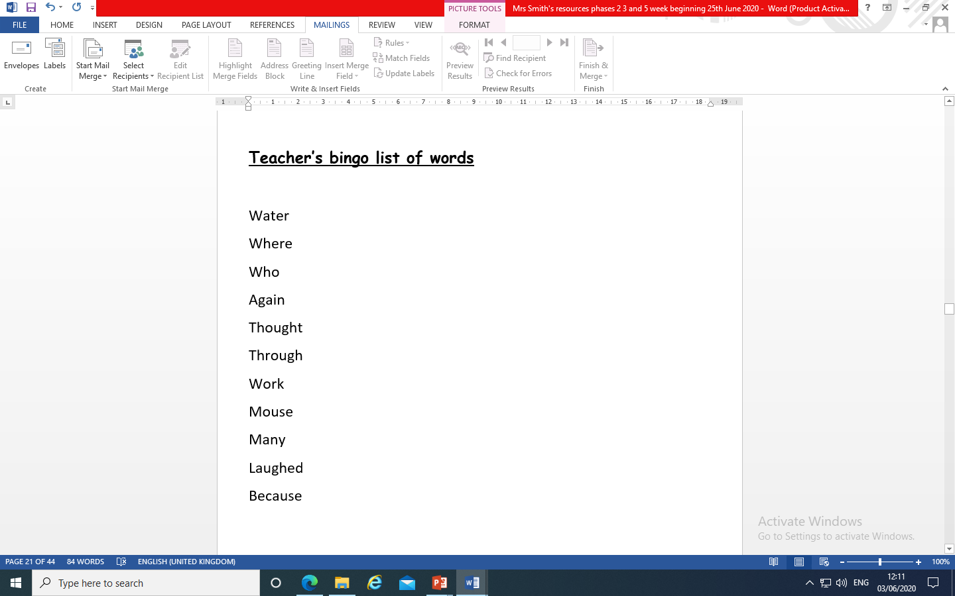
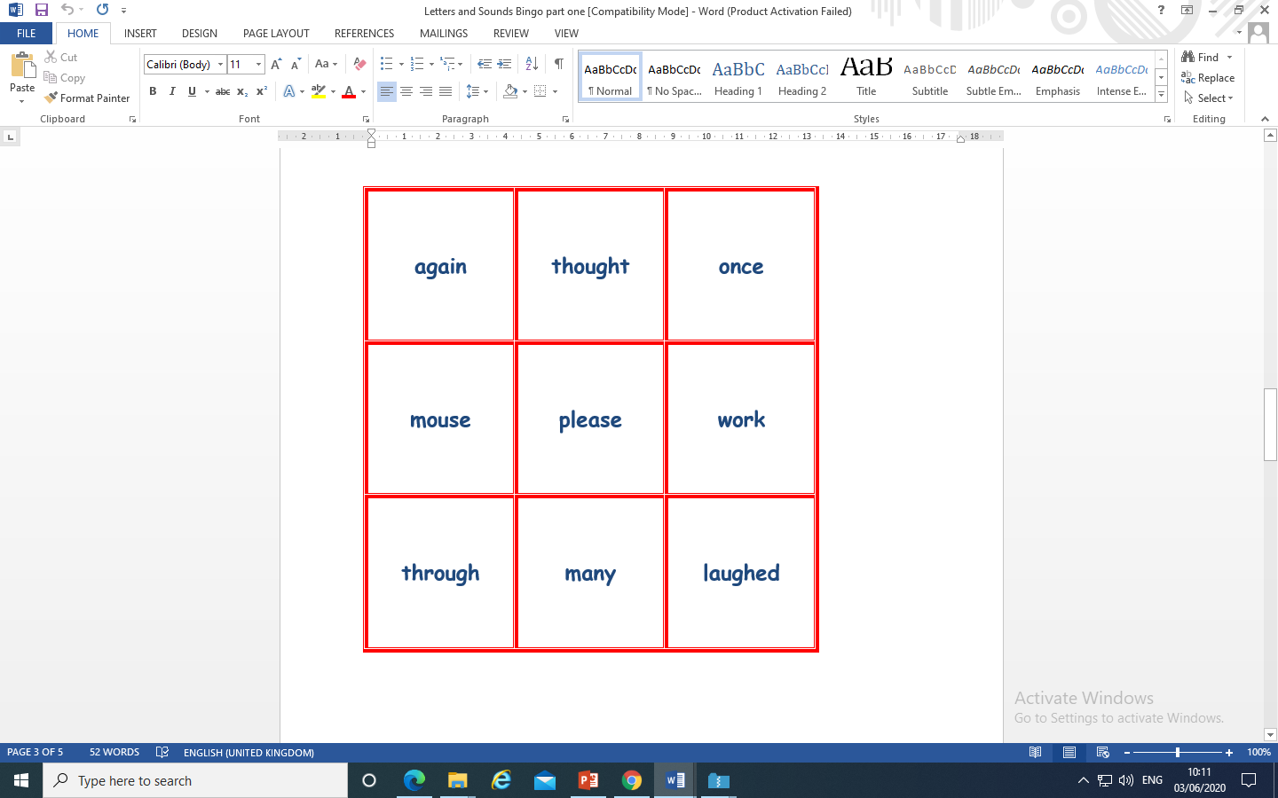
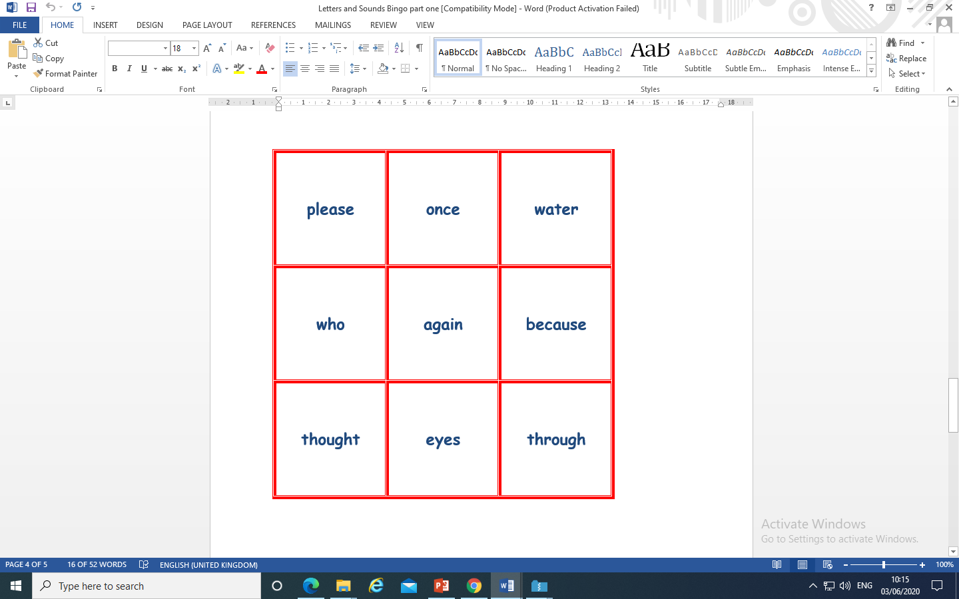
Flashcards

Slide 16
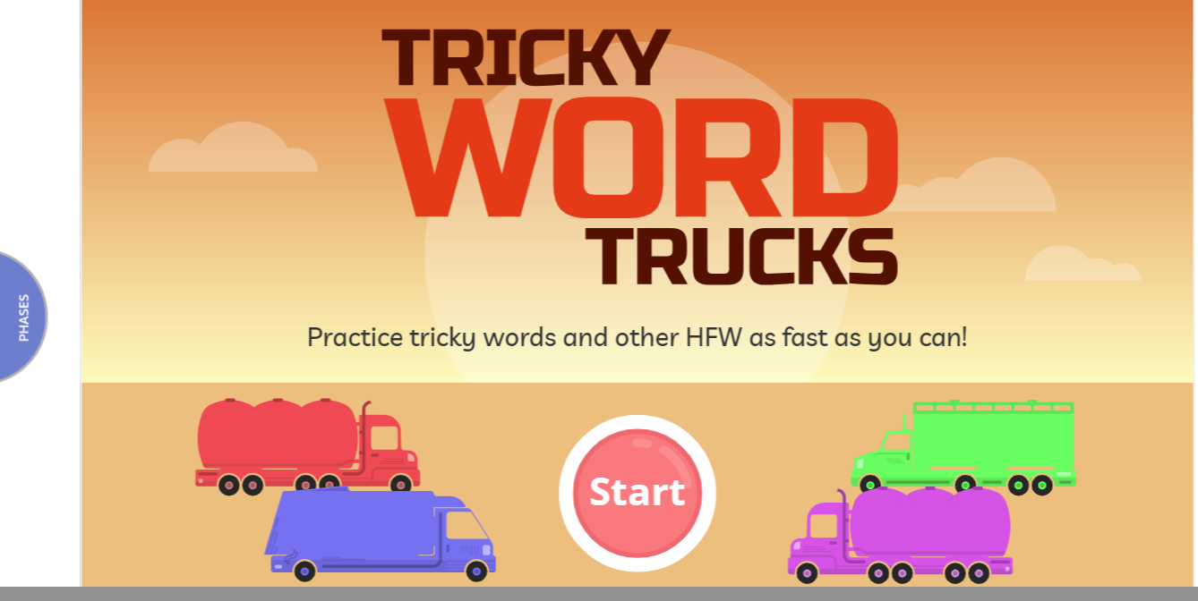
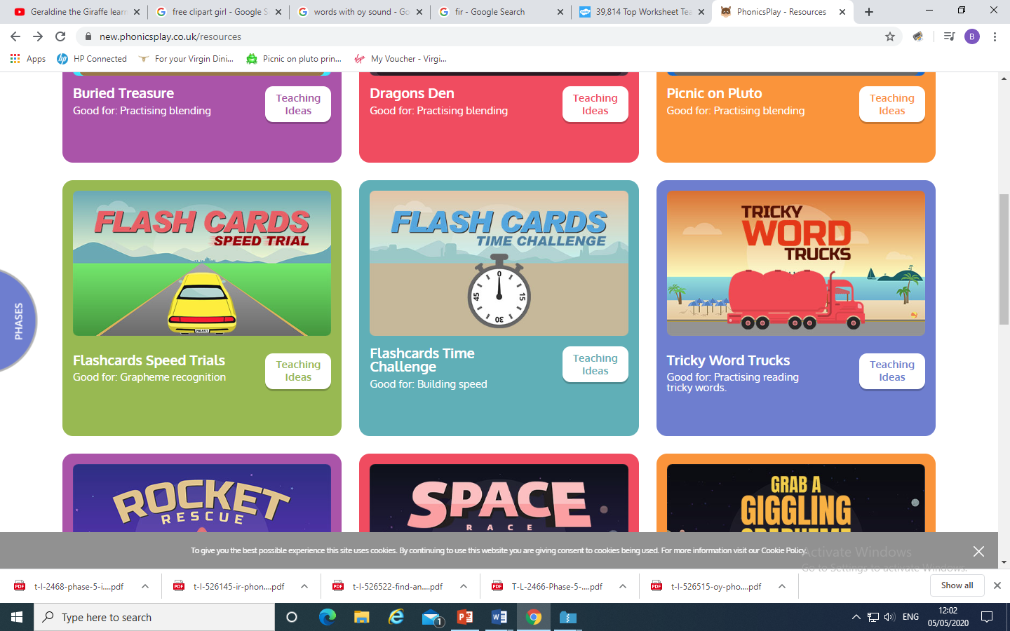
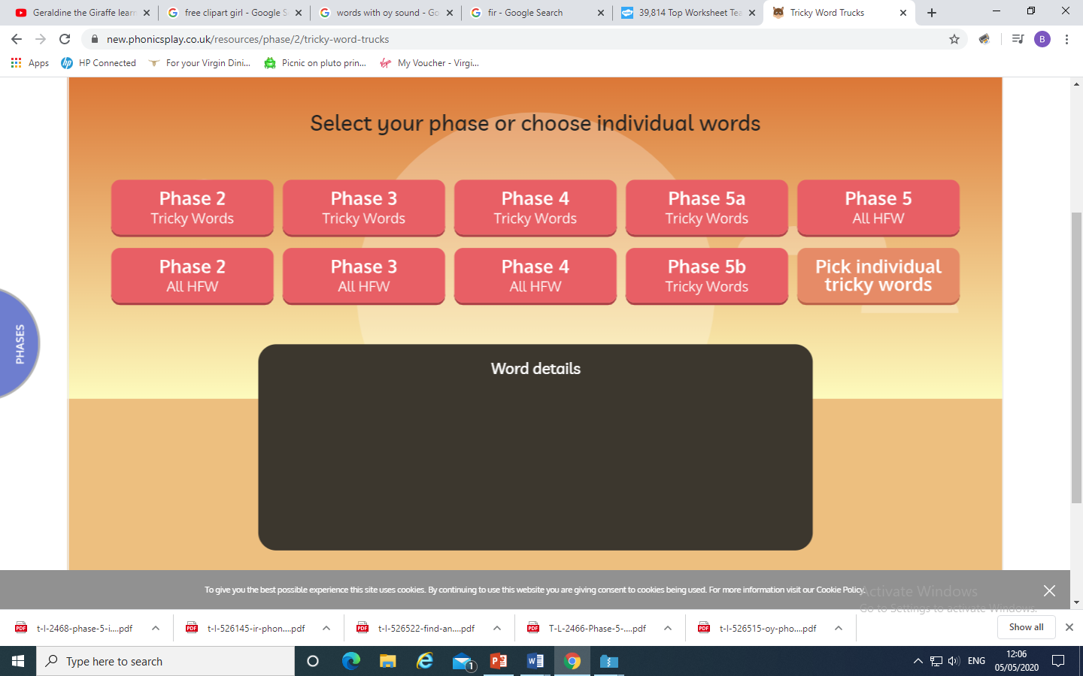
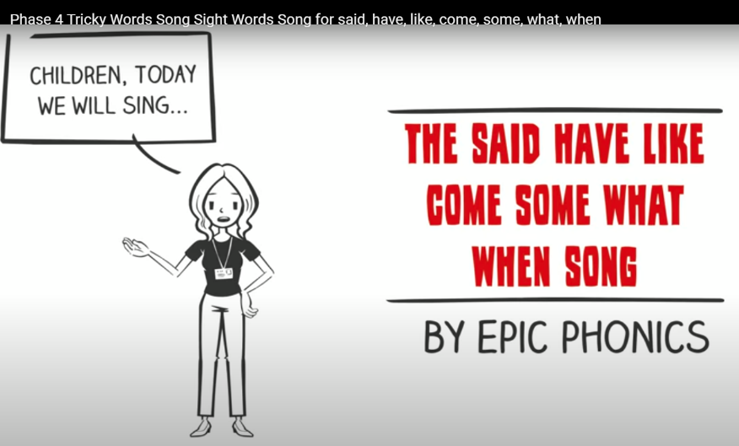
Play Tricky Trucks on Phonics Play and practise the other tricky words we have been learning.
Then follow the instructions - Choose A route
Truck type
Colour of truck
You could also sing the tricky word song
https://www.youtube.com/watch?v=3NOzgR1ANc4
https://www.youtube.com/watch?v=YPW-ZkhRUPY Phase 5

Slide 17
Read the following sentences.
Many of my friends laughed because I wore two different shoes.
I opened my eyes, laughed once and said please.
I don’t want any tea because I ate too many sweets.

Slide 18
Today we are learning to explore the alternative pronunciation for the ch grapheme
Practice playing
Acorn Adventures
on Phonics Play. The words change
So play more than once.

Slide 19
Thursday: Practise the phonemes and graphemes on the sheet (slide 2) using the Pure Sound.
Now let’s practice reading these tricky words
water, where, who, again, thought, through, work, mouse
Using the flash cards. Why not time yourself?
What was your time? Can you beat it?

Slide 20
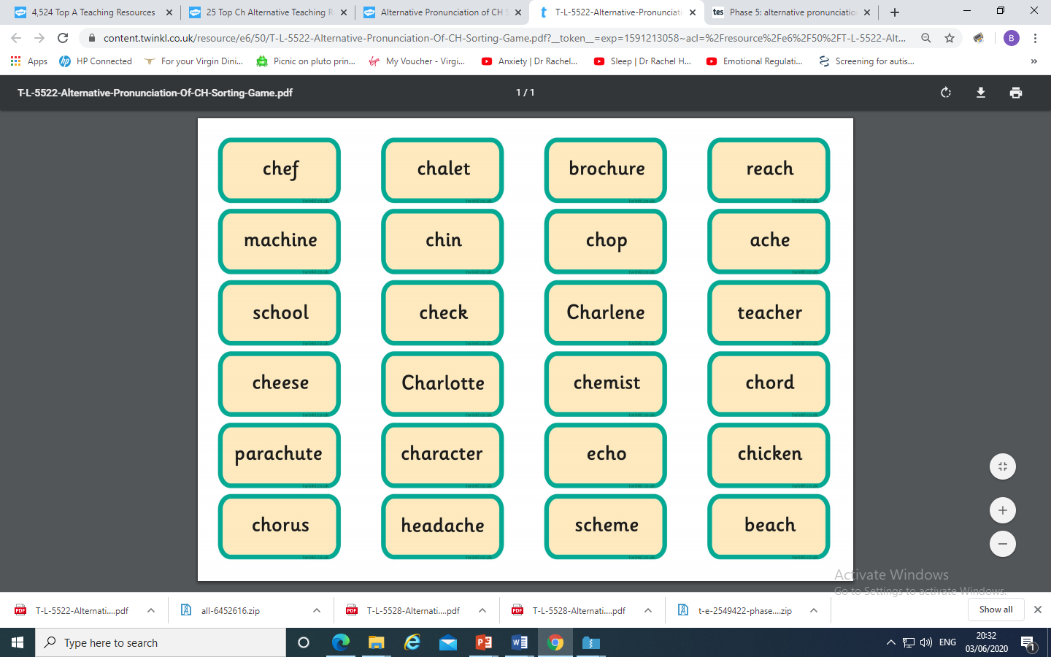
You could make your own Acorn Adventure
and place the ch graphemes
under the correct pronunciation.

Slide 21
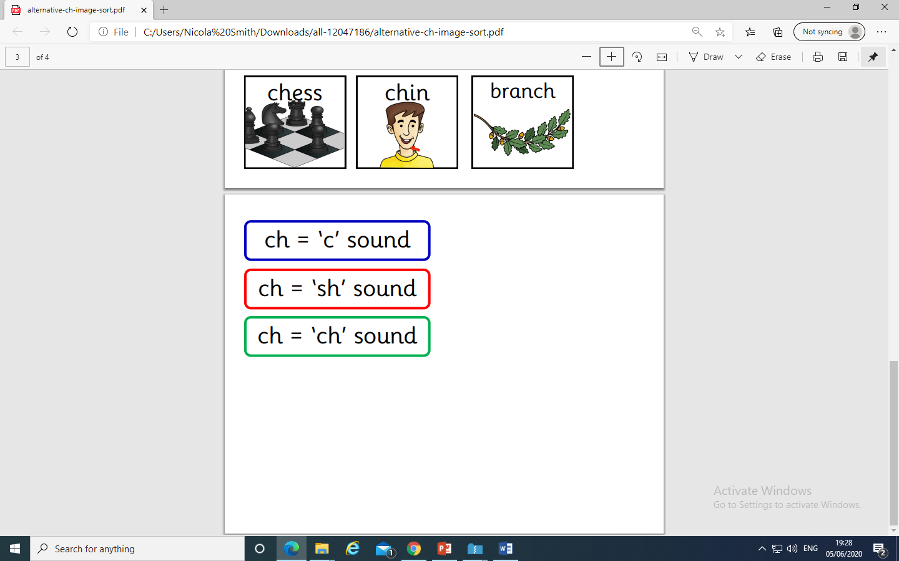
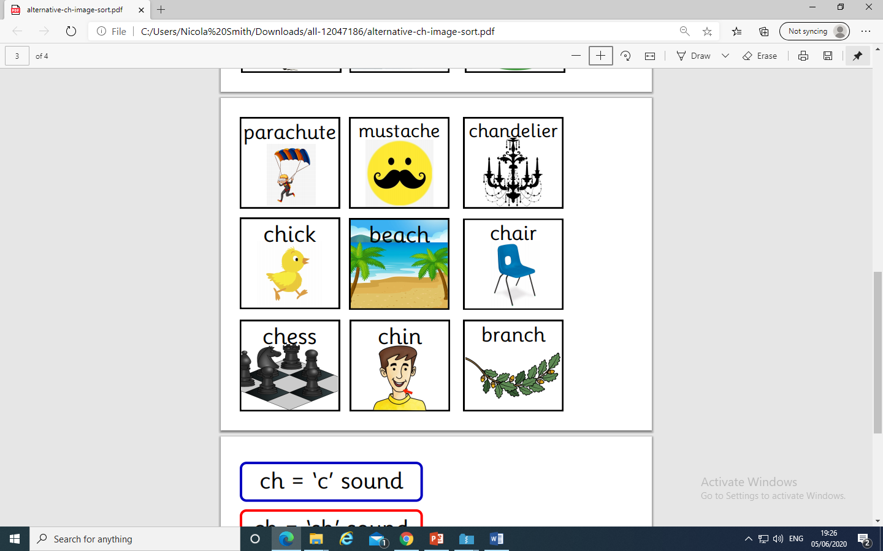
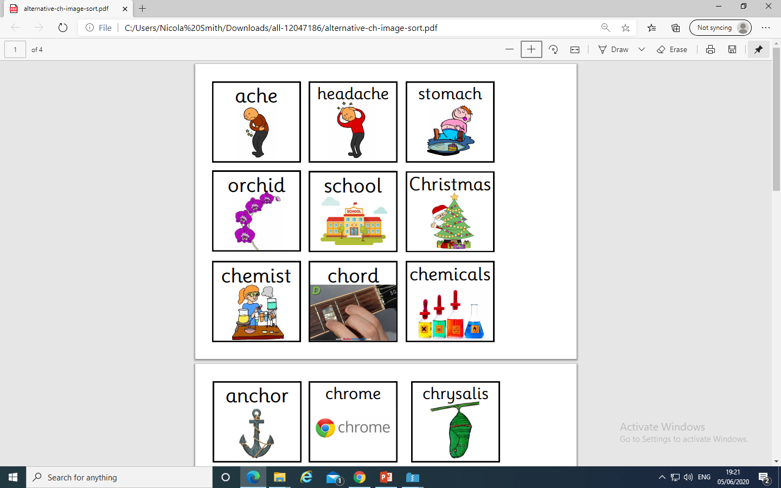
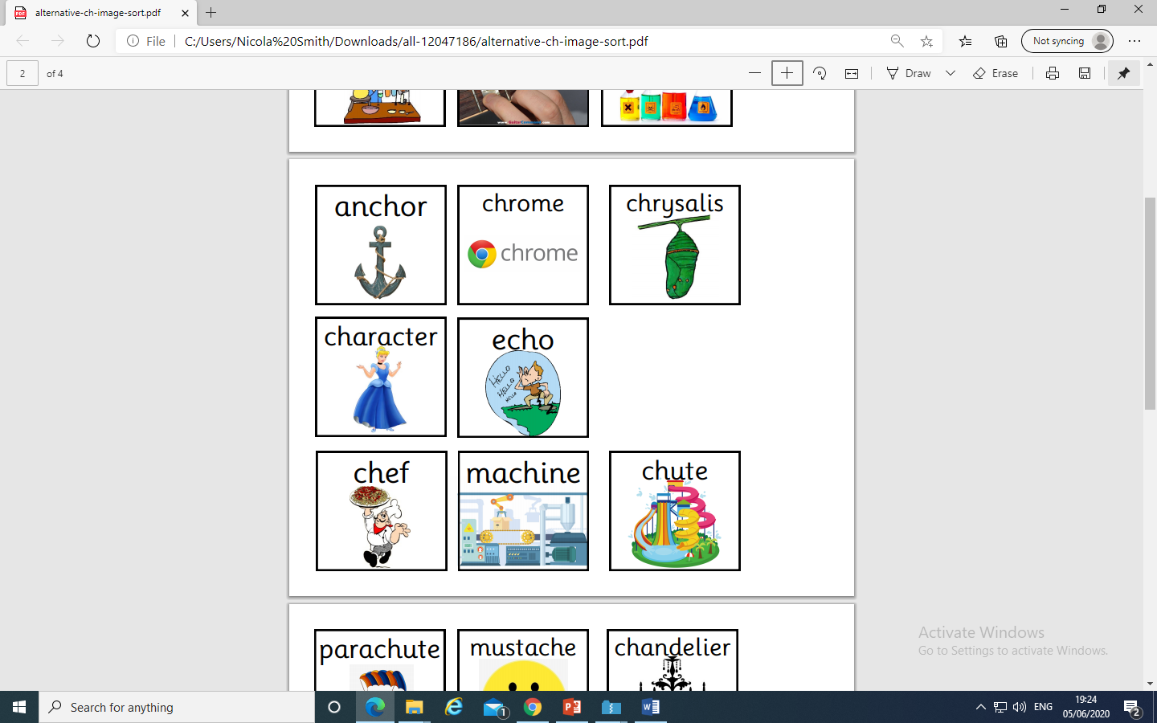
Read the word and place the
pictures under the correct
pronunciation.

Slide 22
Play Picnic on Pluto on Phonics Play use the username and password provided.
Revise all Phase 5. How many did you get right?
Read the following sentences. Remember to sound out the words you are unsure
of (don’t guess) and then read the complete sentence.
Will the chef cook chicken for school dinner?
Can a chuckling chicken sing in a chorus?
Will a chemist use a machine to check chemicals?

Slide 23
Friday: Practise the phonemes and graphemes on the sheet (slide 2) using the Pure Sound.
Today we are learning to explore the alternative pronunciation for the ou grapheme
Practice playing
Acorn Adventures
on Phonics Play. The words change
So play more than once.

Slide 24
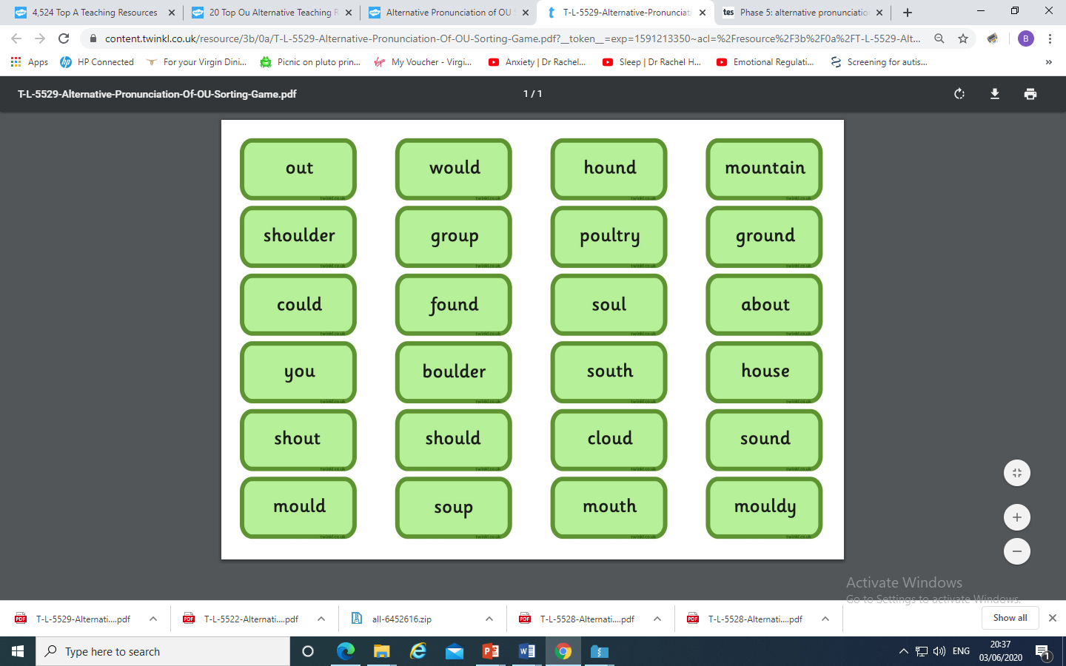
You could make your own Acorn Adventure
and place the u grapheme
under the correct pronunciation.

Slide 25
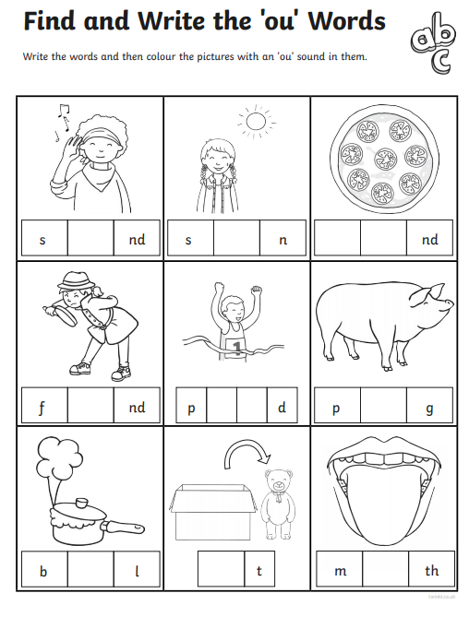

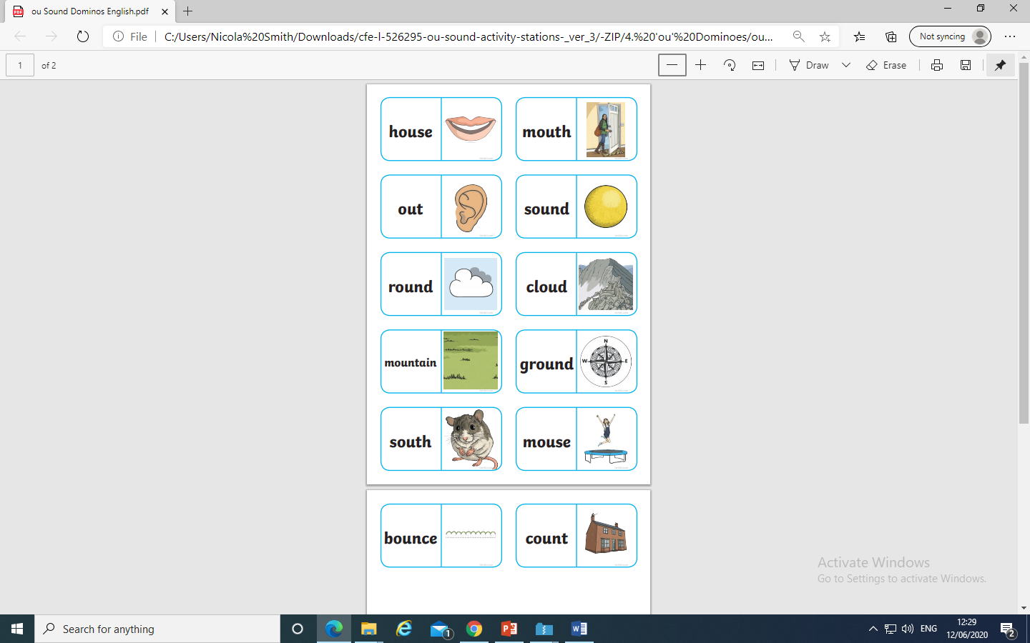
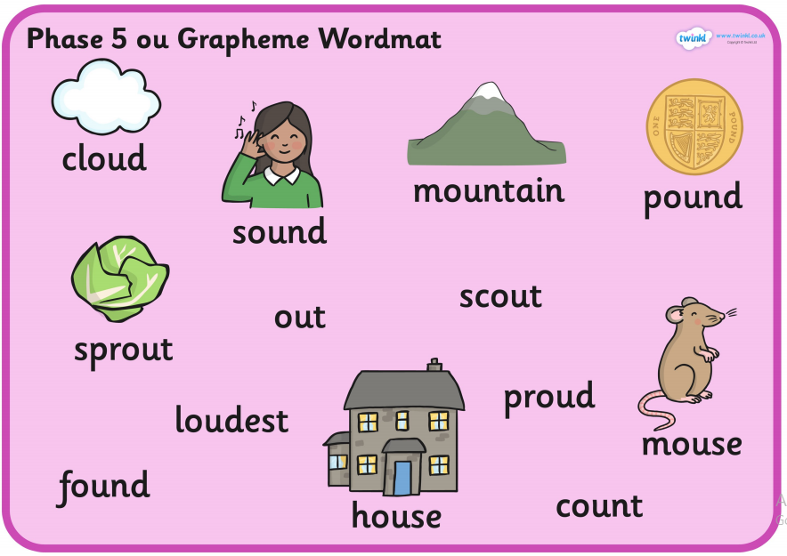
Play dominoes match the picture
to the correct word
Can you write sentences
using the sounds on the word mat? Can you use more than one in a sentence?
e.g. The mouse made a squeaking sound.
The cloud travelled over the mountain.
I found a pound on the ground.

Slide 26
Play Picnic on Pluto on Phonics Play use the username and password provided.
Revise all of Phase 5. How many did you get right?
Read the following sentences. Remember to sound out the words you are unsure
of (don’t guess) and then read the complete sentence.
Could you carry a boulder on your shoulder?
Would you eat soup with a trout?
Should you shout about a mouldy group of boulders that you have found?

