Slide 1

Home Learning
Year 1
Term 6 Week 3

Slide 2
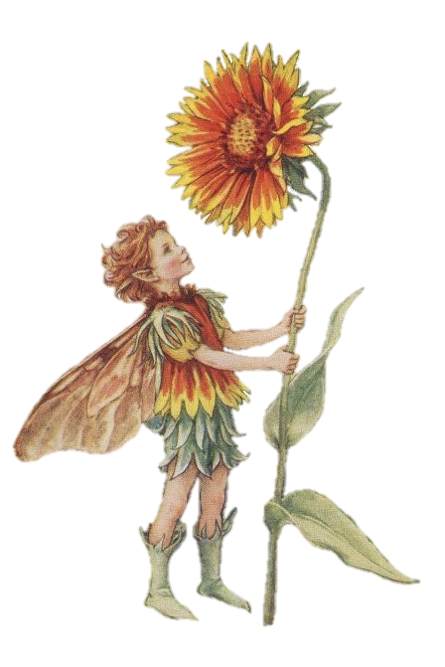

Hello Year 1!
How are you all doing?
I hope you are all safe and well and keeping up with your Home Learning.
It has been lovely to see how much progress the Year 1’s who have returned to school made while they were away, especially in Reading, and I’m sure you all have too if you have been reading everyday!
Have a good week!
Love from Mrs Child
xxx

Slide 3
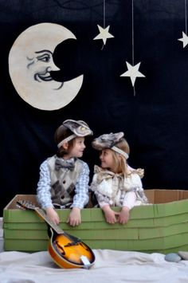
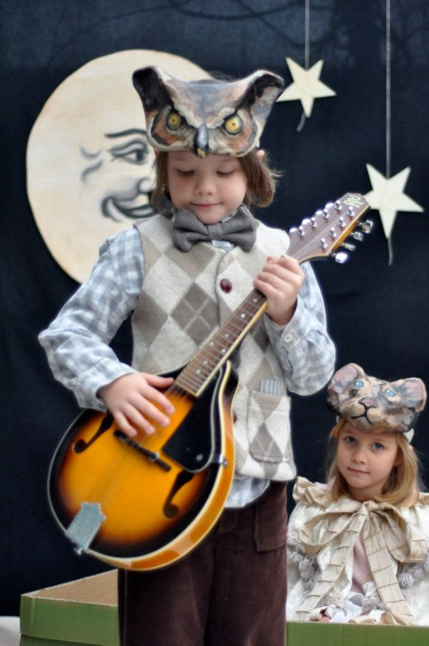
English Learning 1
Can you guess the poem that these children are acting out?

Slide 4
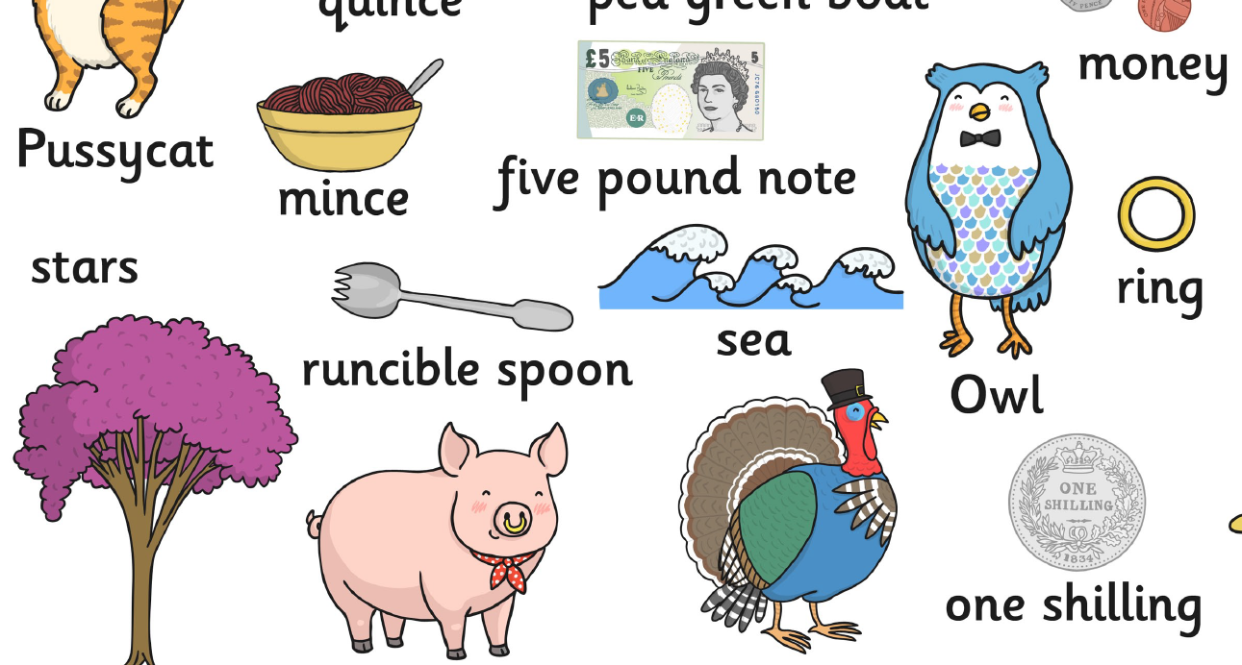
Here are some more clues.
Can you guess now?

Slide 5
If you guessed
“The Owl and the Pussycat” you were right! Well done!
It is a famous poem written by Edward Lear 150 years ago. Read the poem on the next slides and then find a YouTube version that you like. There are lots to choose from, some which sing the words of the poem, some with animations and some with real animals. See if you can join in with the words and gradually learn the poem off-by-heart. Pick your favourite line and copy it out and draw a picture to go with it.
(Or you could print out and colour the pictures on the next slides if you prefer).

Slide 6
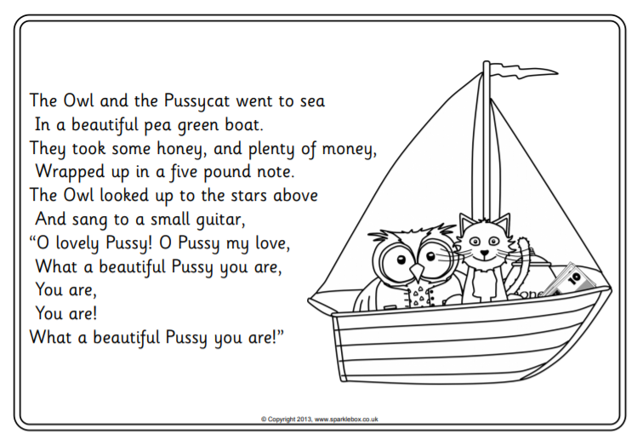

Slide 7
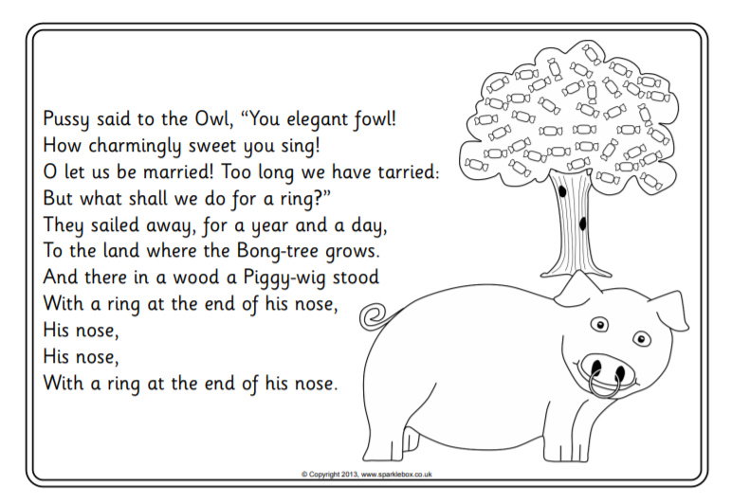

Slide 8
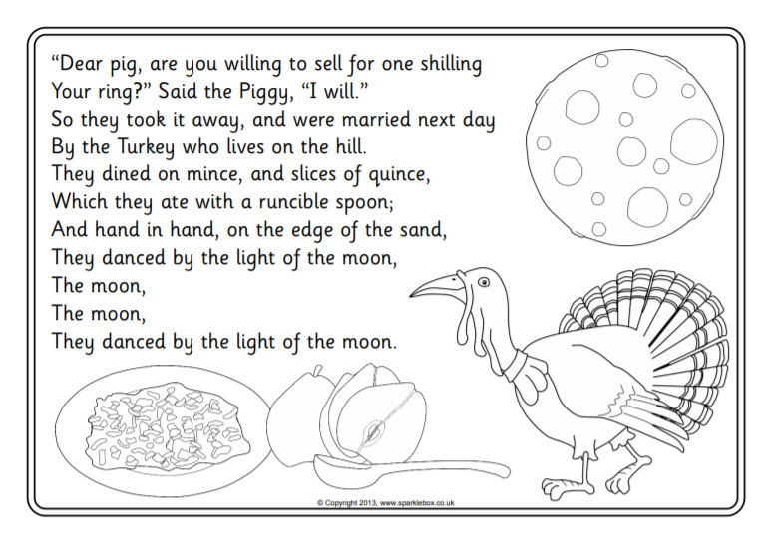

Slide 9
English Learning 2
How much of the poem can you remember?
Can you sing it to a tune?
We are going to think about nouns, verbs and adjectives today.
Nouns are words for things – if you can draw a picture of it or point to it, it is a noun.
Verbs are doing words – if you can act it out, it is a verb.
Adjectives are describing words.
Look on the next slides for some examples.
Your job today is to find examples of each type of word in our poem “The Owl and the Pussycat”. You could draw a table (or print the one below) and make lists of the different types of words, or you could print out a copy of the poem and highlight the words in different colours – you would need to decide which colour to use for nouns, which for verbs and which for adjectives and make yourself a key. Can you find them all?

Slide 10
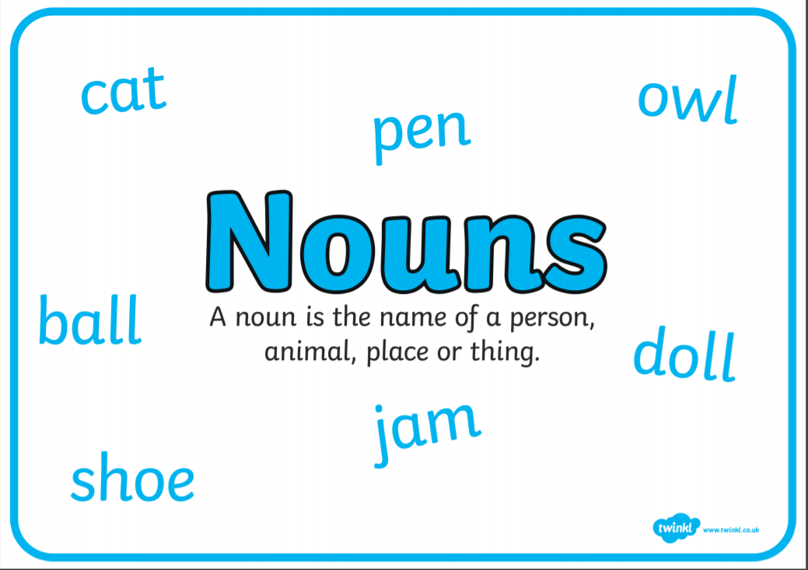

Slide 11


Slide 12
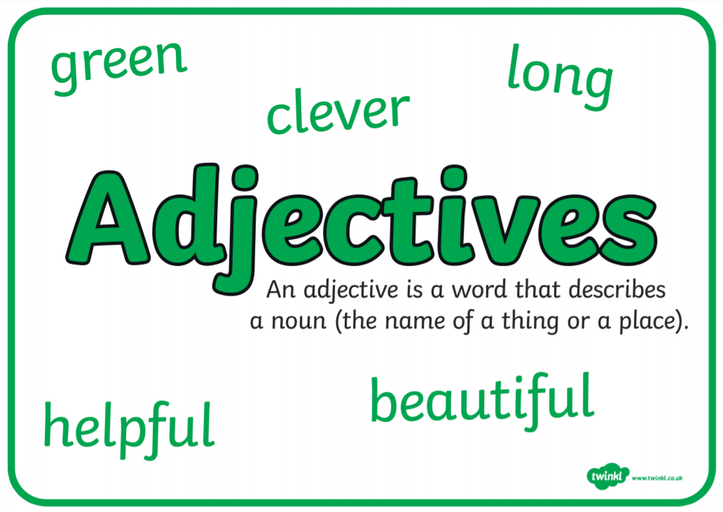

Slide 13
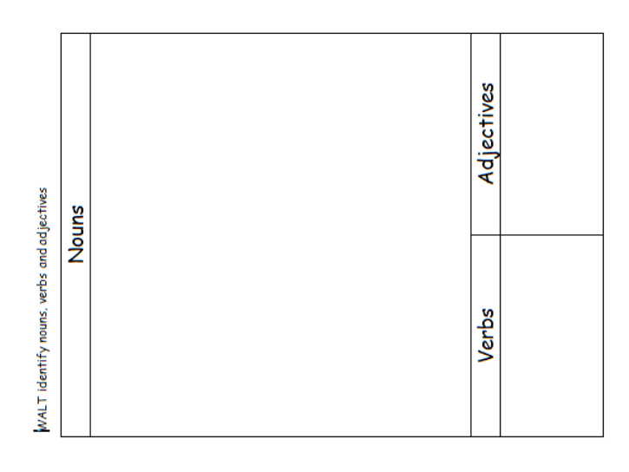

Slide 14
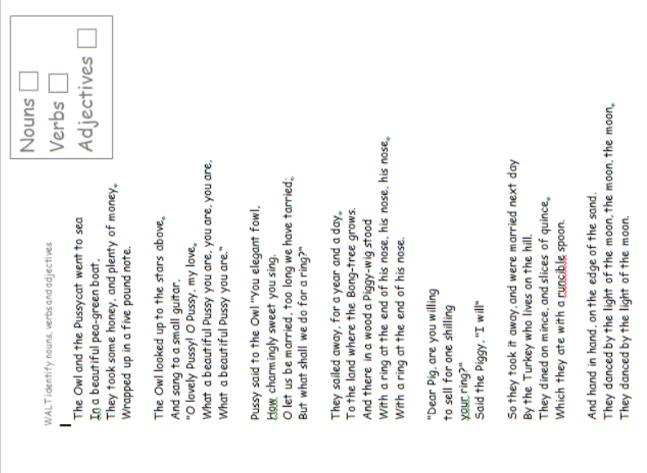

Slide 15
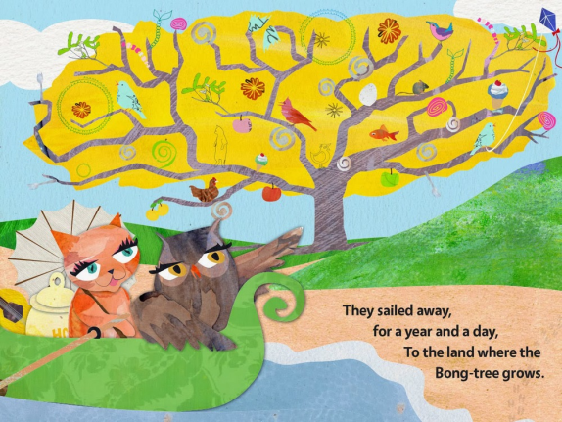
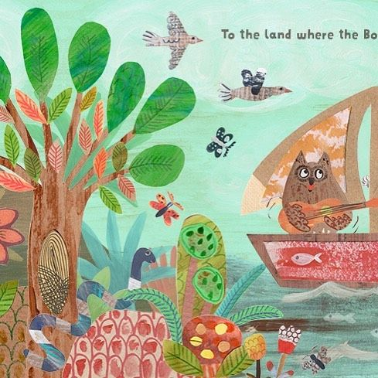
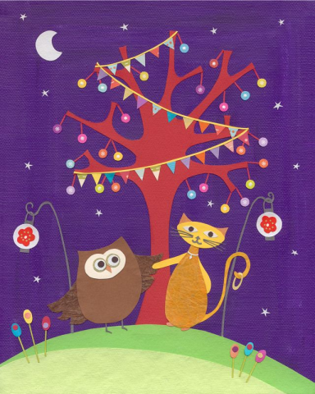
English Learning 3
In the poem, the Owl and the Pussycat travel to “the land where the Bong-tree grows.” Can you imagine what it is like there? What does a Bong-tree look like? It sounds magical. Maybe it is sparkly. Or fluffy. Or colourful. Or really bendy. Or maybe it grows feathers. Or sweets.
Make a picture of what you think “The Land where the Bong-tree grows” looks like. You could draw, paint or collage. Or you could build a model or use a computer painting programme.
As you are making your picture or model, think of some adjectives to describe it. When you have finished, write some sentences using your adjectives to describe “The Land where the Bong-tree grows”.

Slide 16
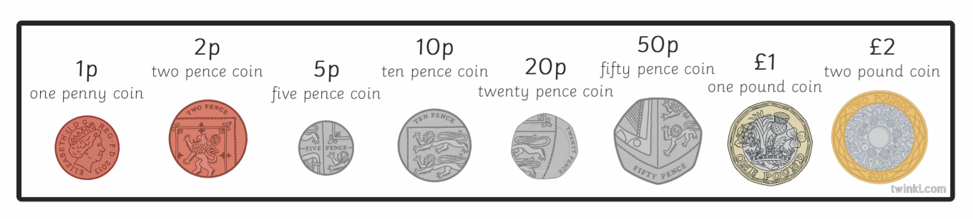
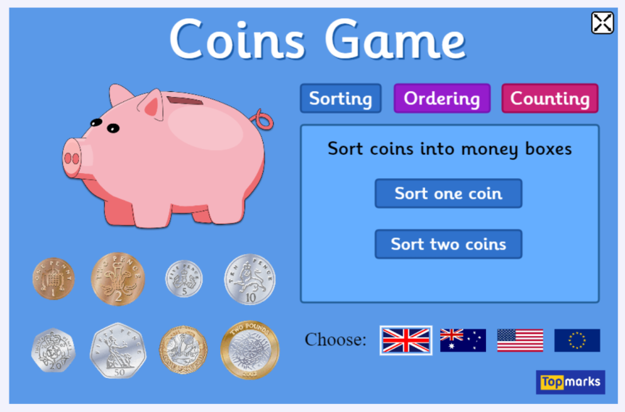
Maths Learning 1
Recognising coins
Try and collect one of each different UK coin. Look closely at them. How are they the same? How are they different? How could you sort them? Look at the colours. Look at the shapes. Try drawing them or making rubbings of them. Play “Kim’s game” with them. Play shopping. Try recognising them just by feeling rather than looking. How much is each worth? Is the biggest coin worth the most? When you are really familiar with the eight different coins, try the Sorting and Ordering games at
https://www.topmarks.co.uk/money/coins-game

Slide 17
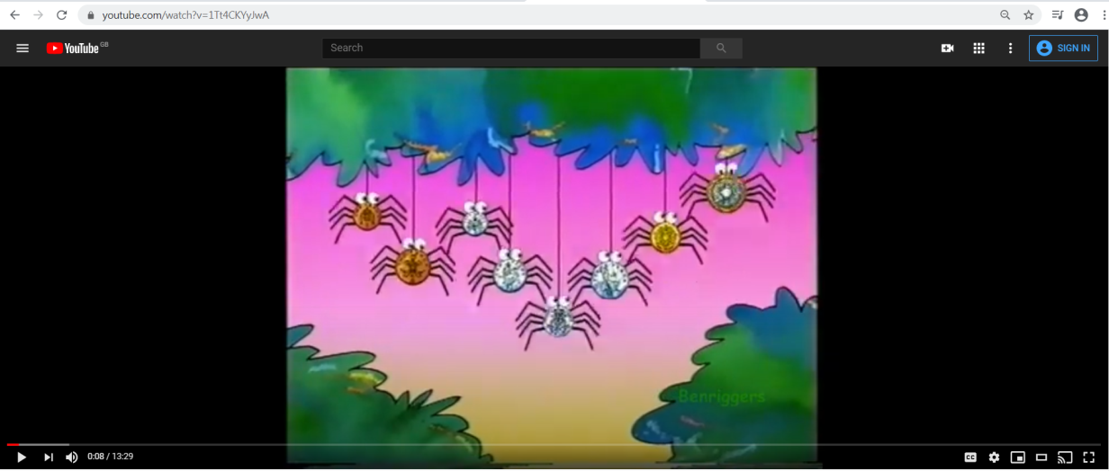
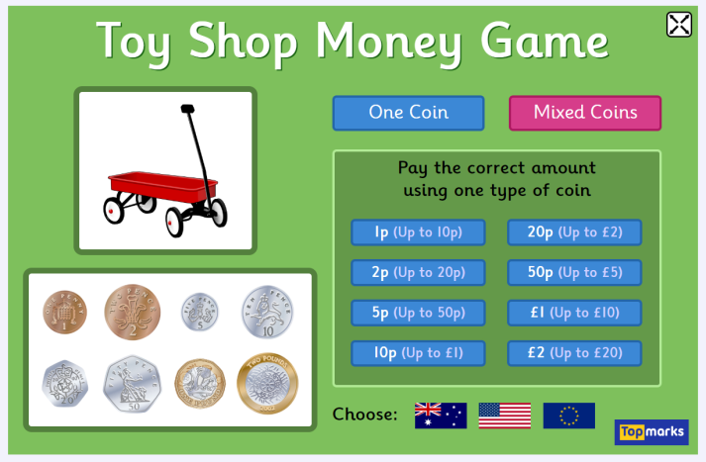
Maths Learning 2
Making amounts with coins
Watch this BBC Numbertime money episode at https://www.youtube.com/watch?v=1Tt4CKYyJwA . This will explain about the value of different coins and making amounts with coins.
Can you make different amounts using coins? Maybe you have some real coins or play money that you can use to practise. Don’t worry if you don’t, you can play the “Toy Shop Money Game” at https://www.topmarks.co.uk/money/toy-shop-money
Begin with Mixed Coins, Exact Money, Up to 20p.

Slide 18
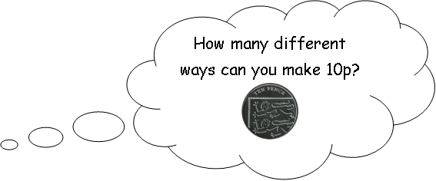
Extra challenge

Slide 19
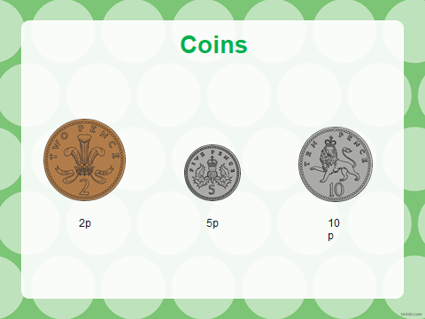
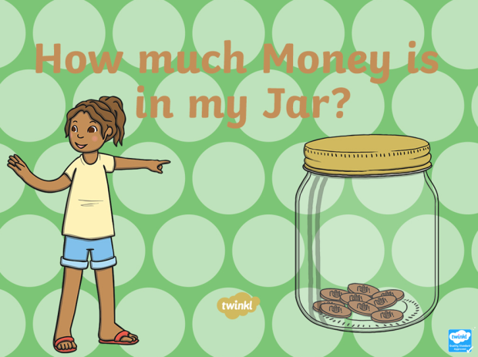
Maths Learning 3
Counting with coins
We can use our knowledge of counting in 2s, 5s and 10s to help us count money.
Practice with the attached Powerpoint
“How much money is in my jar?”
or play the Topmarks Coins game https://www.topmarks.co.uk/money/coins-game
– Counting, Single Coins to 10p.
Then try the reasoning problems on the next slide.

Slide 20
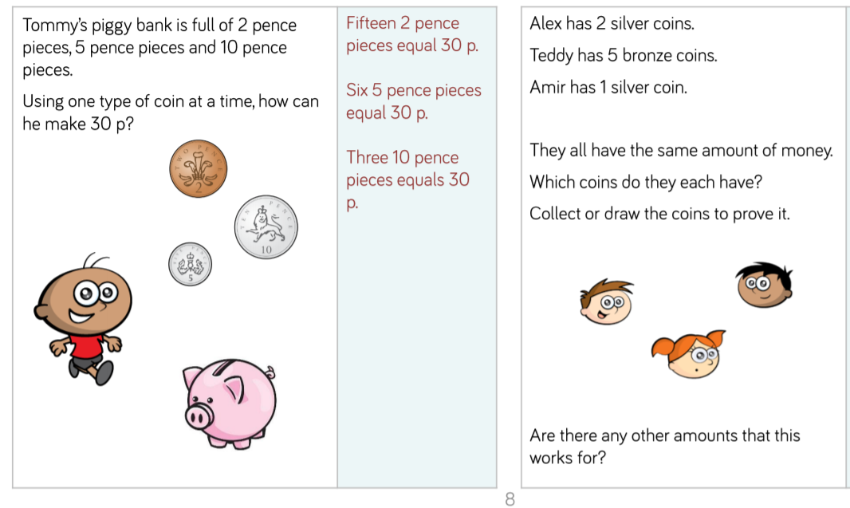

Slide 21
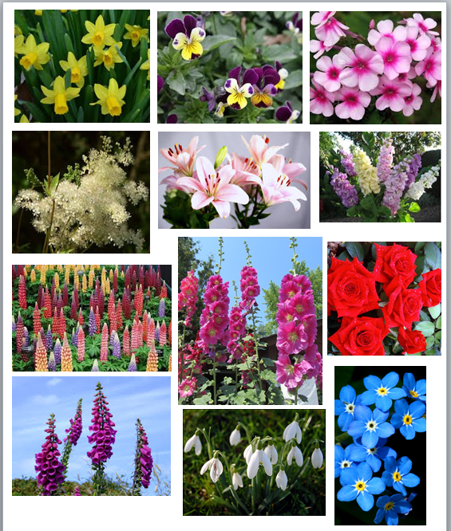



Science Learning
Identifying flowers
Do you know this song? I’m sure someone in your home will know the tune! Have you ever seen any of the flowers mentioned? Next time you go for a walk have a look and see if you can spot any. (Not snowdrops or daffodils because they are Spring flowers and it is Summer time now.)
How many gentle flowers grow in an English country garden?
I'll tell you now, of some that I know, and those I miss I hope you'll pardon.
Daffodils, hearts-ease and phlox, Meadowsweet and lilies, stocks,
Gentle lupins and tall hollyhocks,
Roses, fox-gloves, snowdrops,
forget-me-nots
In an English country garden.

Slide 22
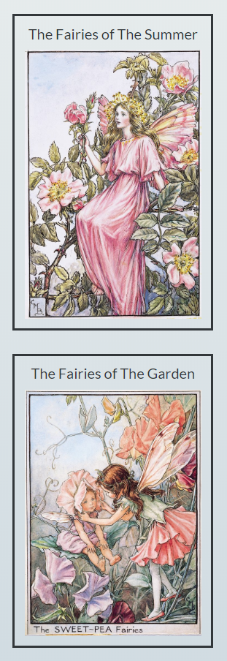
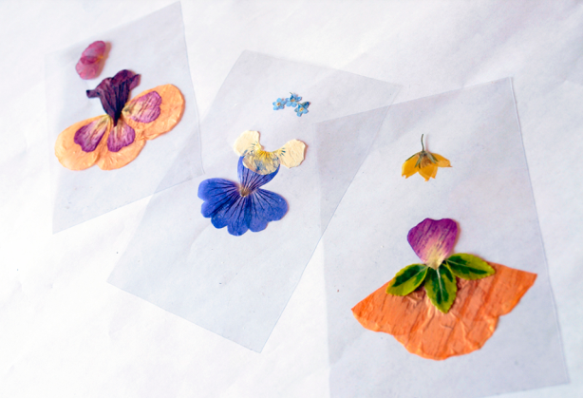
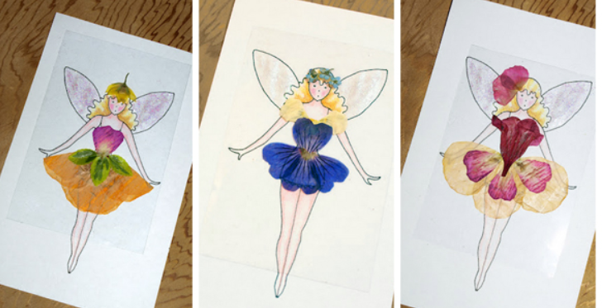
If you are lucky enough to have a garden try to draw some of the different flowers that are growing. Look really carefully at the shapes, colours and numbers of petals. See if you can find out their names. If you don’t have a garden, any flowers will do.
When I was your age I learned all about flower names because I loved the Flower Fairy books. You can meet all the Flower Fairies at www.flowerfairies.com and they can help with your identification. Try the Summer fairies or the Garden fairies (or the Wayside fairies if you found wild flowers when you were out and about).
If you get really inspired you could try making up some flower fairies of your own, or maybe make some fairy fashions from real flower petals.
(https://artful-kids.com/2012/03/28/flower-fairy-fashions/)

Slide 23

Reading
For additional reading at your child’s level please use the Oxford Owl website where you can read books online and then complete comprehension activities about the books. Please continue to keep a record of the books they have read in their reading records.
www.oxfordowl.co.uk
Class login: temple20
Password: Bingbong
(If you are not sure of your child’s level, please check in their reading record book or look at the coloured stickers on the additional reading books that have been sent home.)

Slide 24

Phonics
Please use the games and activities on the Phonicsplay website to continue practsing Phonics.
www.phonicsplay.co.uk
Login: march20
Password: home
Mrs Child’s Phonics group are currently working on Phase 5c (alternative ways of writing sounds we already know e.g. ai, ay, a_e all make the same sound).
Mrs Smith’s group are working on Phase 4.
Additionally, there are many excellent Phonics resources on the Twinkl website(see below for how to get free access). Practising reading “alien words” is a particularly fun and valuable activity.

Slide 25

Writing
Your child has been provided with a writing journal. They are used to using them and know that they need to write the date, write a sentence (about anything they like), draw and colour a picture and then fill any spare lines with handwriting patterns.

Slide 26

P.E.
It is important to keep your children active. If it is safe to do so, ensure they have some time outside throughout the day. Please visit Joe Wicks YouTube channel (https://www.youtube.com/channel/UCAxW1XT0iEJo0TYlRfn6rYQ), which has lots of exercise videos for children. He will also be hosting a live P.E. lessons Monday to Friday at 9:00am.

Slide 27


Using My Maths
Children should know their way round My Maths but here are some reminders on how to access the lessons. Visit: www.mymaths.co.uk
bapchild
divide162

Slide 28

Using My Maths
Access any lesson based on what your child is learning in class or search the topic in the search bar.
Use the login portal to access specific homework and lessons that your teacher has set.

Slide 29

Maths – White Rose Home Leaning
In school we follow the White Rose scheme of learning. Their website has put together free lessons and resources that link to the learning taking place in school. Please visit: https://whiterosemaths.com/homelearning/

Slide 30

Accessing Twinkl
Many educational content providers are offering free access to their resources. Twinkl is a website that we use from time to time to resource our lessons to aid in teacher input and pupil activities.
We will be able to direct you towards activities and learning via this website based on lessons that may be missed due to absence. To access Twinkl please visit: www.twinkl.co.uk/offer
You will have to sign up and put in the offer code: UKTWINKLHELPS

Slide 31

Classroom Secrets
The site classroom secrets https://classroomsecrets.co.uk/free-home-learning-packs/ has free class packs which provide some great additional ideas and resources you can use.

