Slide 1

Hello and Welcome to Mrs Smith’s Phonics Group Week 6.
Things are changing and I will have seen some of you back at school. Hopefully I will see you all soon take care and stay safe ☺.
I know you have been working hard learning and revising the sounds we already know and our new Phase 5 graphemes and phonemes GPCs. Have you noticed how some of the GPCs make the same sound. Well done if you have ☺
You could start your phonics learning daily with our alphabet song or to get you moving BBC Super Movers with Naomi Wilkinson https://www.youtube.com/watch?v=jYeMpUdufNk
Do as much as you can and have Fun. Love Mrs Smith xx
Please play this Power Point in slide show and keep clicking there are animations (it works better on a laptop than IPad).

Slide 2
You could print this grid off and check what phonemes (sounds) to grapheme (written) you can recall daily. You could colour, tick or cover with counters, coins or pebbles the ones you can say using the PURE SOUND. If you don’t want to print it off you could point to each sound and say using the PURE SOUND. Are you getting quicker maybe you could time yourself. Let’s check what you know. Are you getting quicker?
s | a | t | p | i | n | m
d | g | o | c | k | ck | e
u | r | h | b | f | ff | l
ll | ss | j | v | w | x | y
z | zz | qu | ch | sh | th | ng
ai | ee | igh | oa | oo | ar | or
ur | ow | oi | ear | air | ure | er
ay | ou | ie | ea | oy | ir | ue
aw | wh | ph | ew | oe | au | ey
i-e | o-e | a-e | u-e | e-e
Practice the ones you are not sure of.

Slide 3
Phase 5b Week 6:
This week we are going to be learning to explore alternative pronunciations of different graphemes. These sound the same but are written differently. You may have spotted some already!
Let’s find out more…..

Slide 4
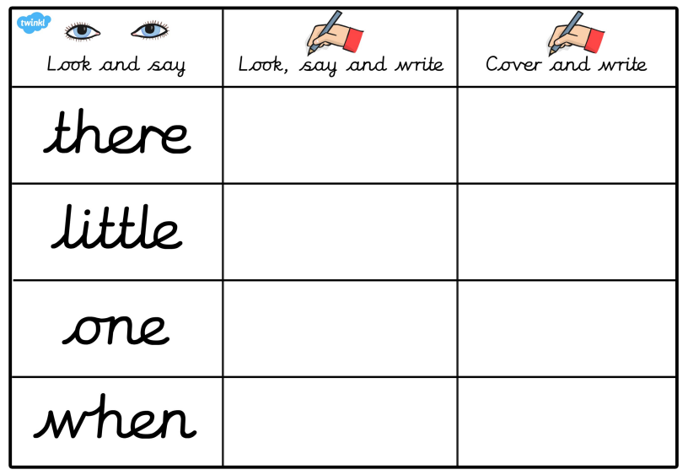
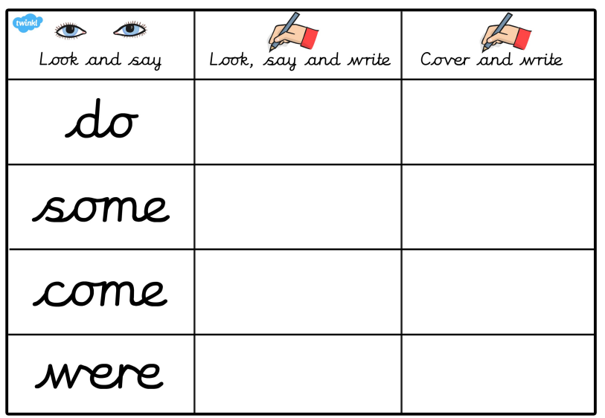
Phase 5b Week 6:
Monday: Practise the phonemes and graphemes on the sheet (slide 2) using the Pure Sound.
Now let’s practice writing the tricky words
little, one, do

Slide 5
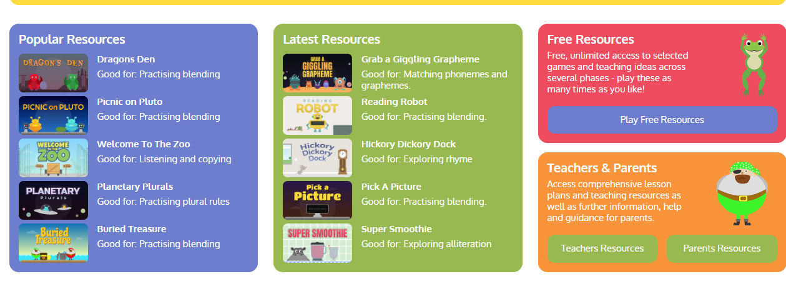
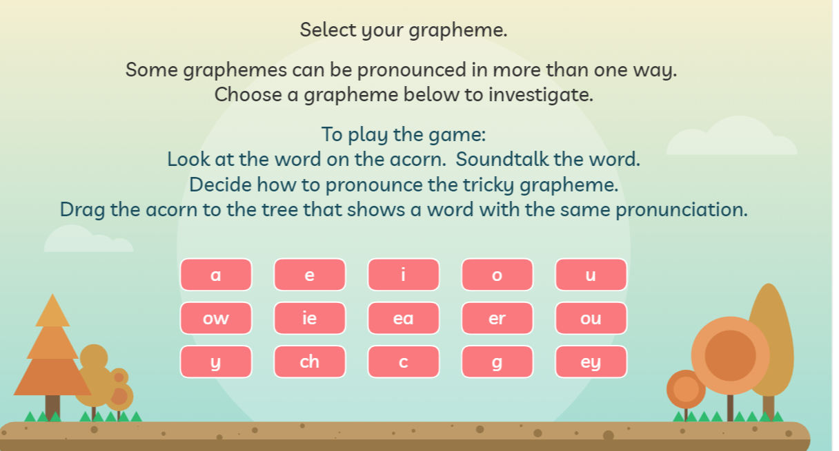
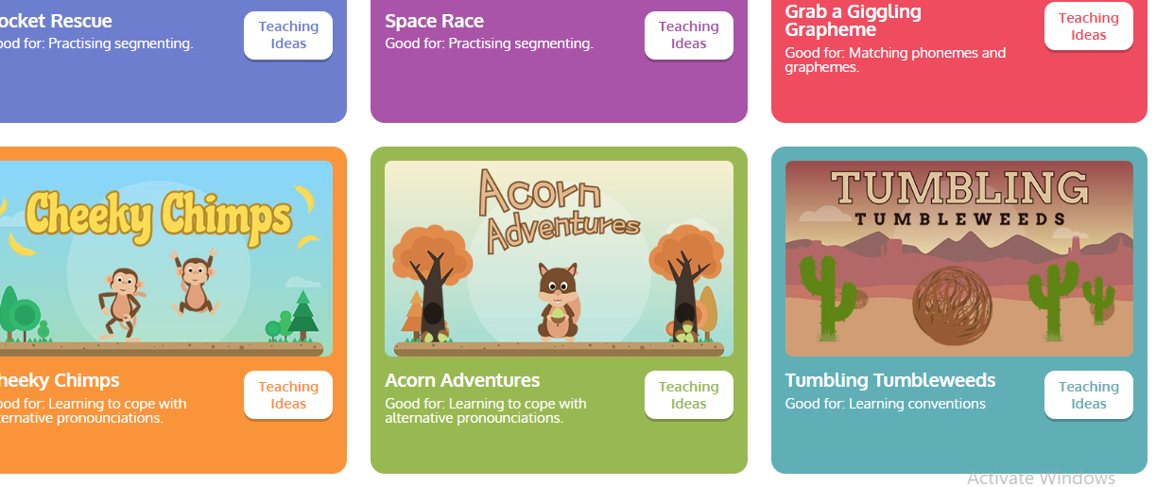
Today we are learning to explore the alternative pronunciation for the ow grapheme
Play Acorn Adventures
on Phonics Play. The words change
so play more than once.

Slide 6
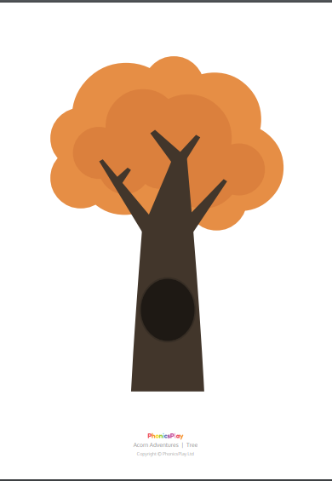
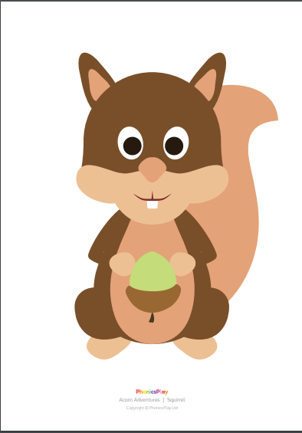
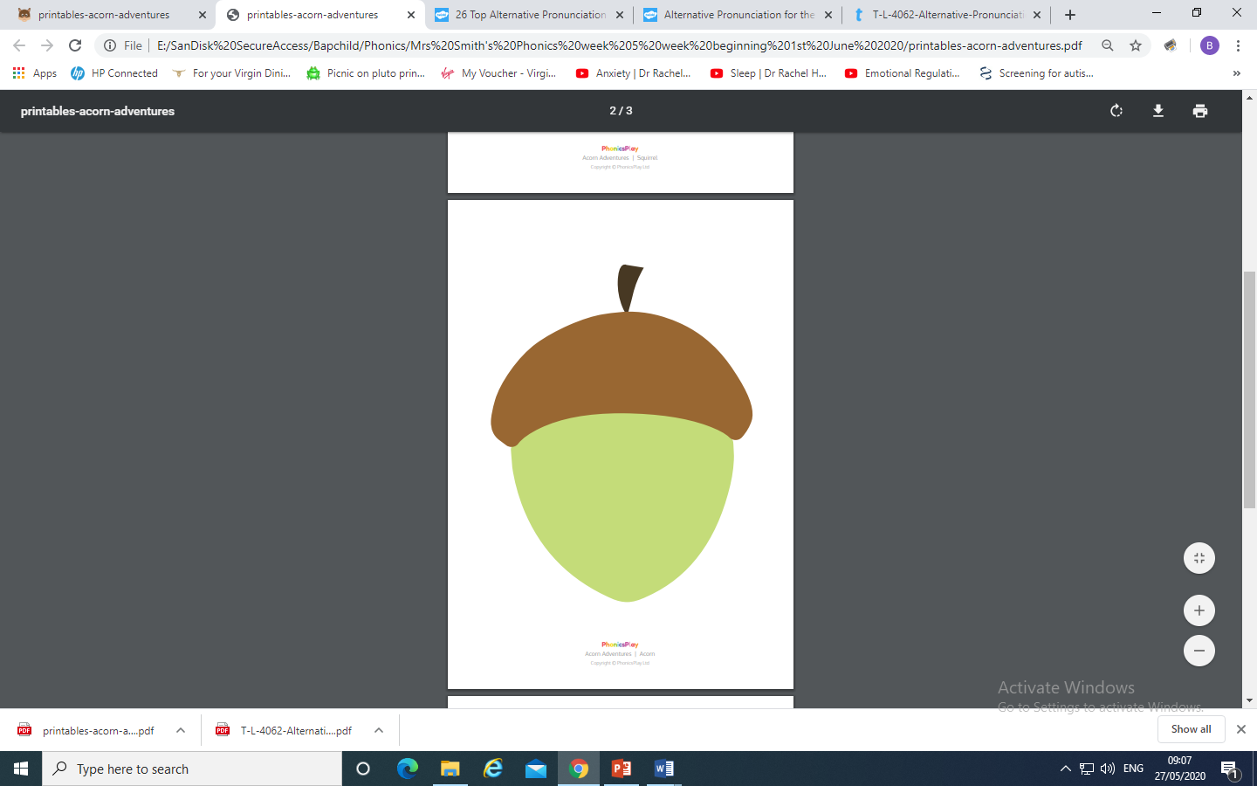
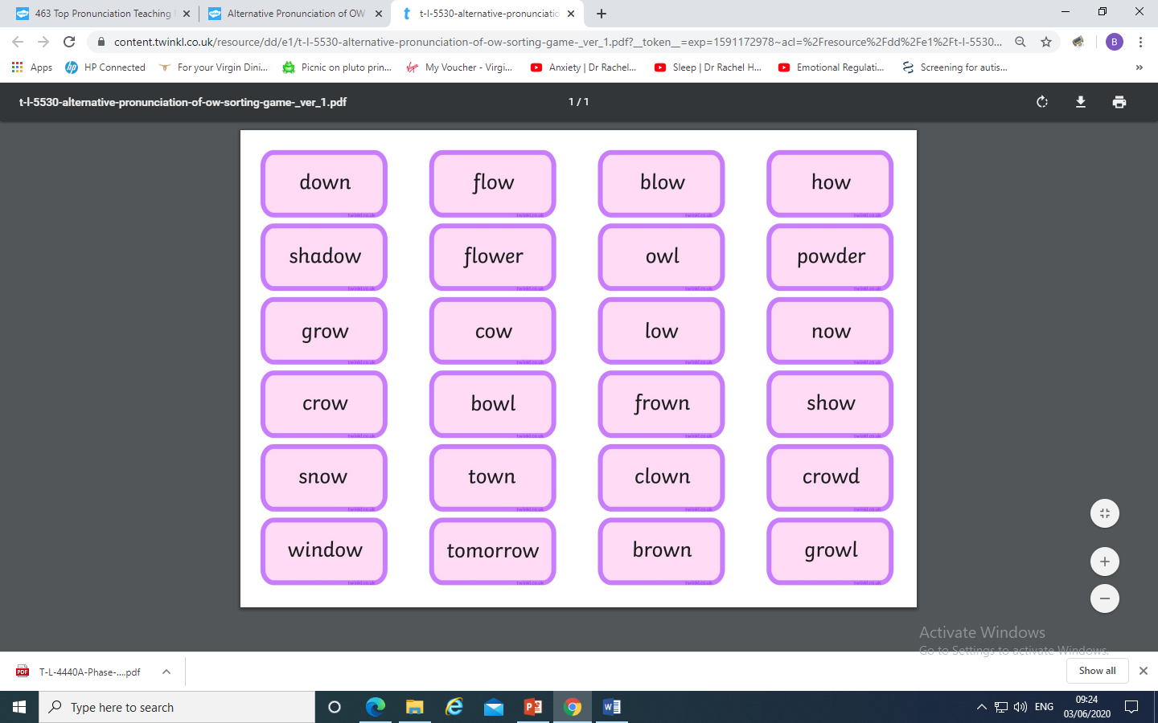
You could make your own Acorn Adventure
and place the ow graphemes
under the correct pronunciation.
(Trees, squirrel, acorn and words are
in resource pack)

Slide 7
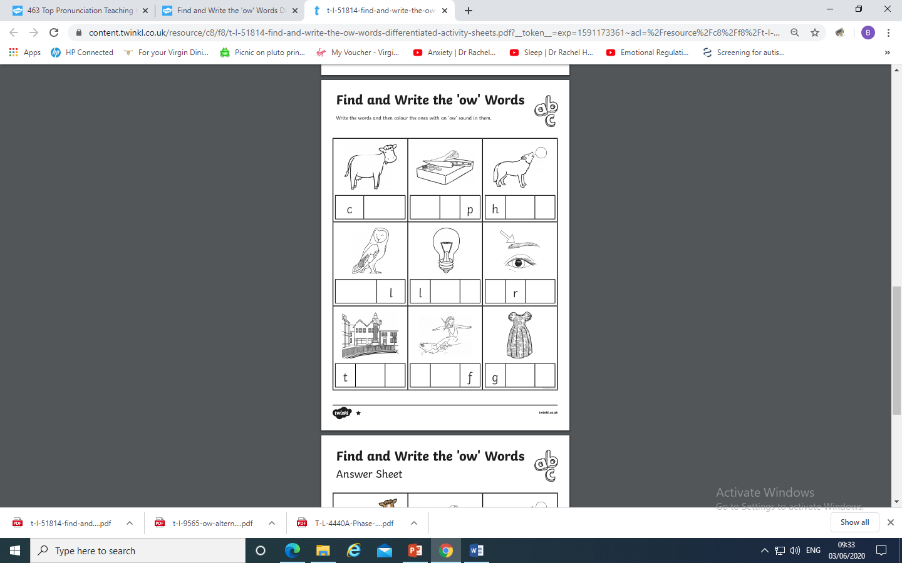
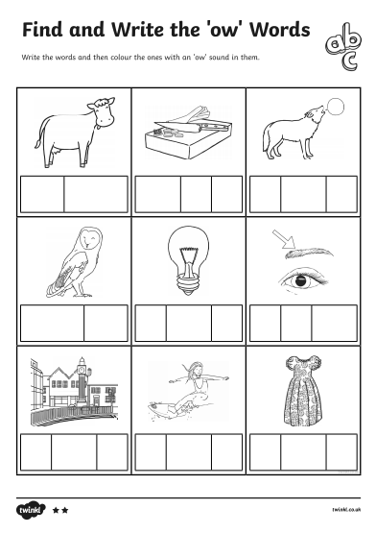
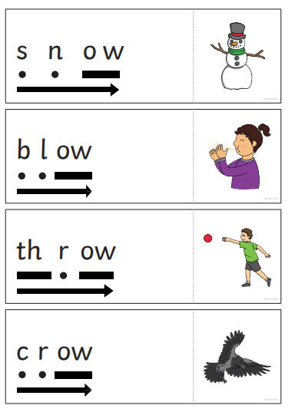
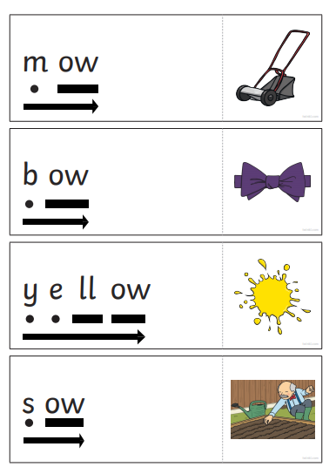
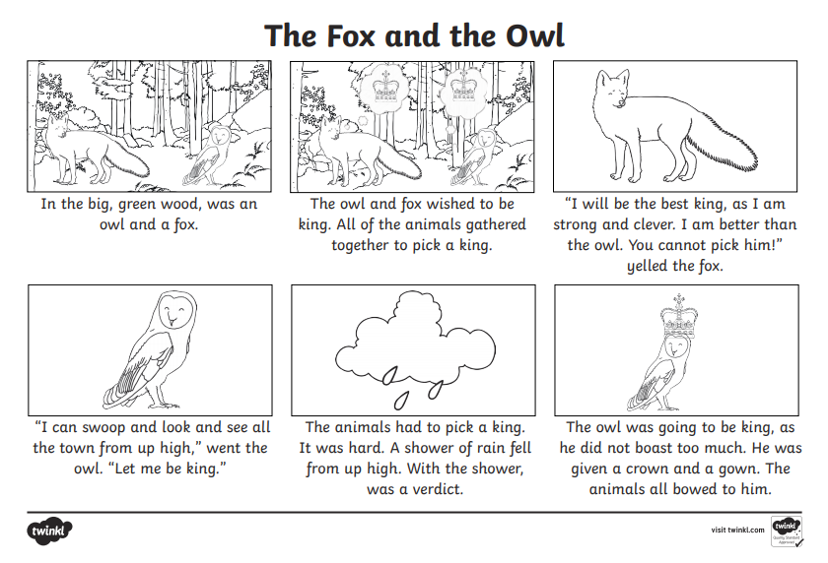
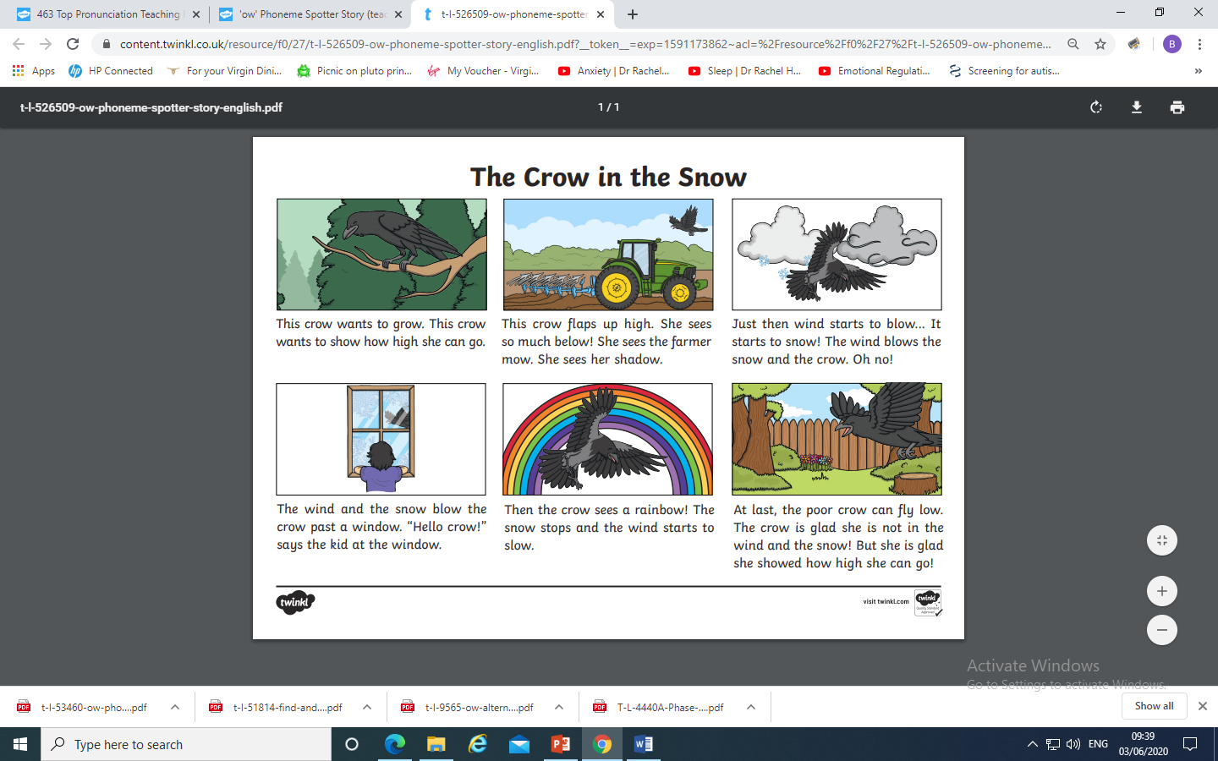
Read and reveal
Cut the cards
out fold along
the dotted
line to cover
the picture.
Read the word,
check if you
are right by
revealing the
picture.

Slide 8
Play Buried Treasure on Phonics Play use the username and password provided. Revise all of Phase 5. How many did you get right?
Read the following sentences. Remember to sound out the words you are unsure of (don’t guess) and then read the complete sentence.
Is a brown owl at the window?
Did the cow put his food in a bowl?
Can a shadow be brown?

Slide 9
Tuesday: Practise the phonemes and graphemes on the sheet (slide 2) using the Pure Sound.
Today we are learning to explore the alternative pronunciation for the ie grapheme
Practice playing
Acorn Adventures
on Phonics Play. The words change
So play more than once.

Slide 10
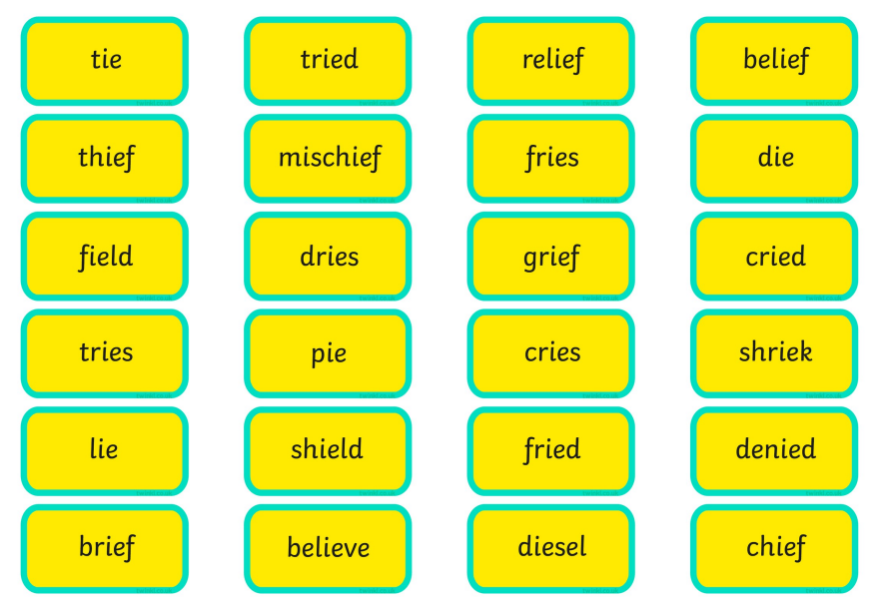
You could make your own Acorn Adventure
and place the ie graphemes
under the correct pronunciation.

Slide 11
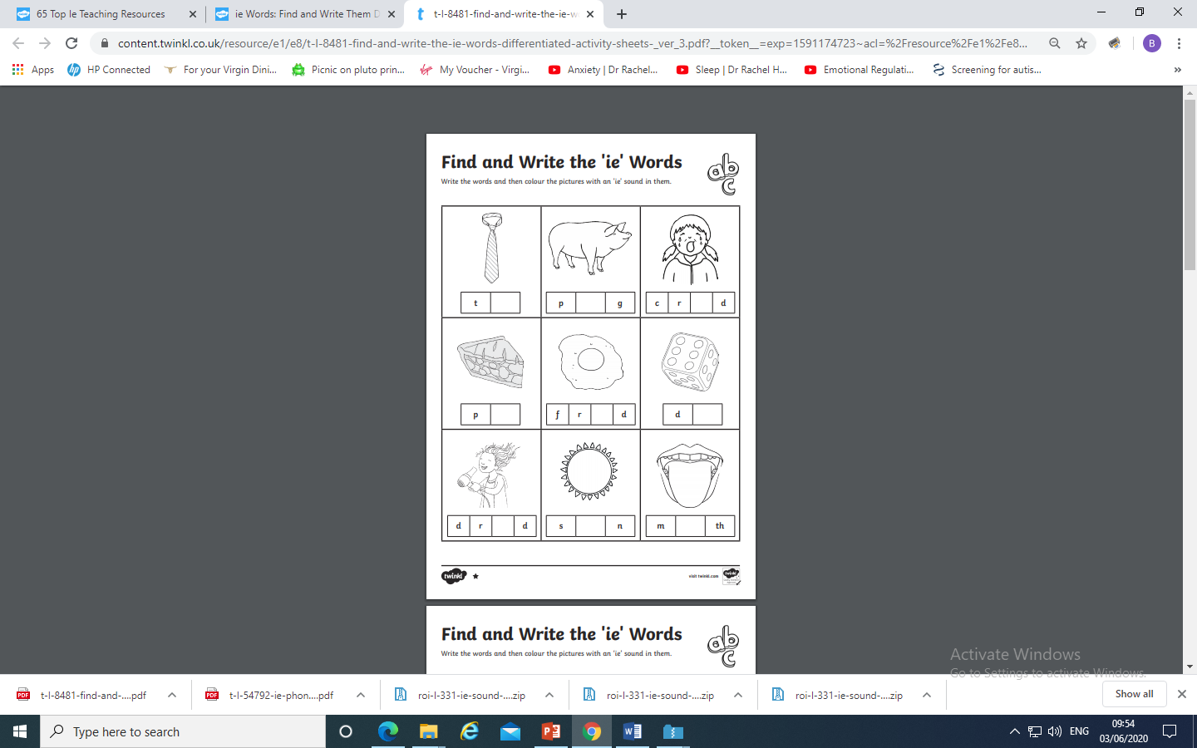
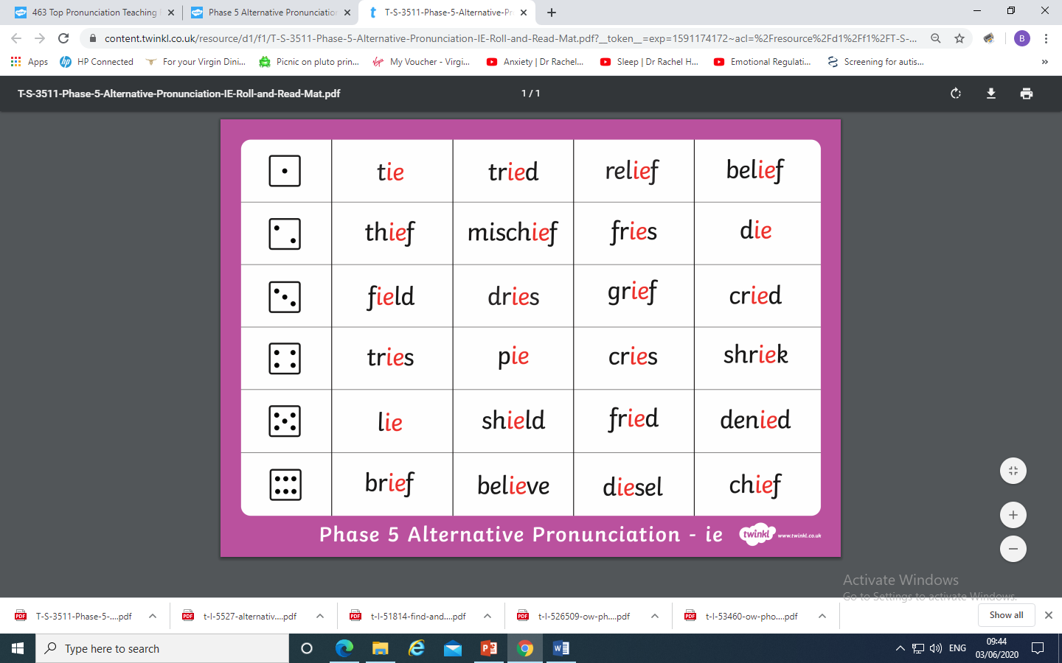
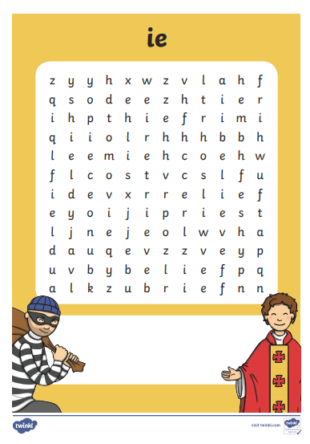
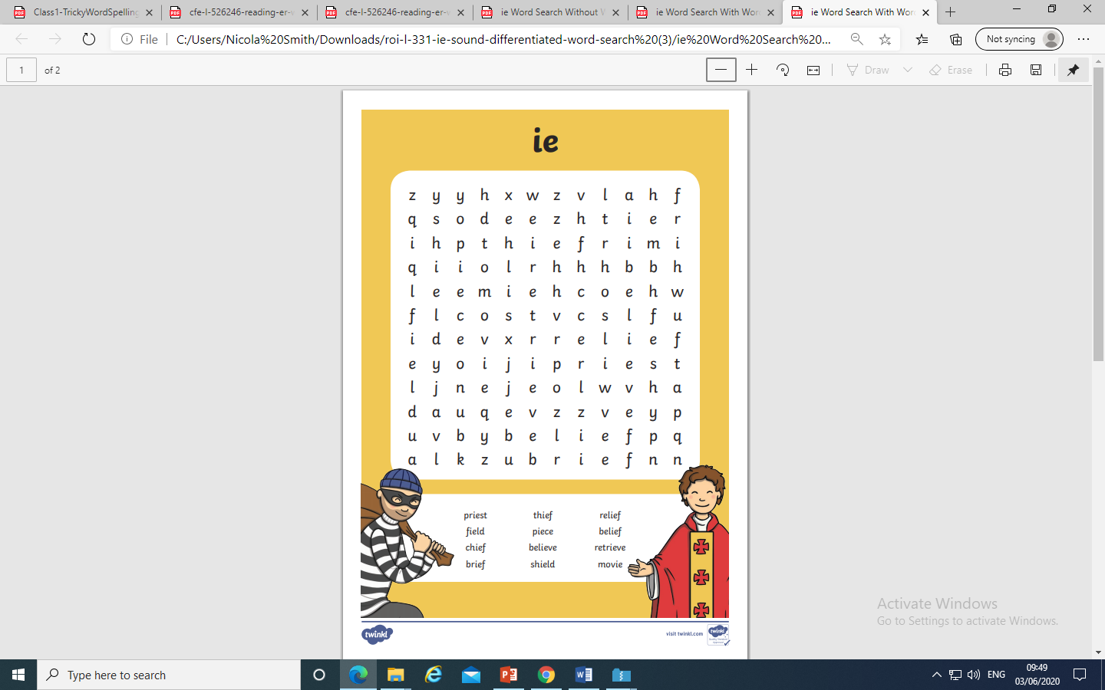
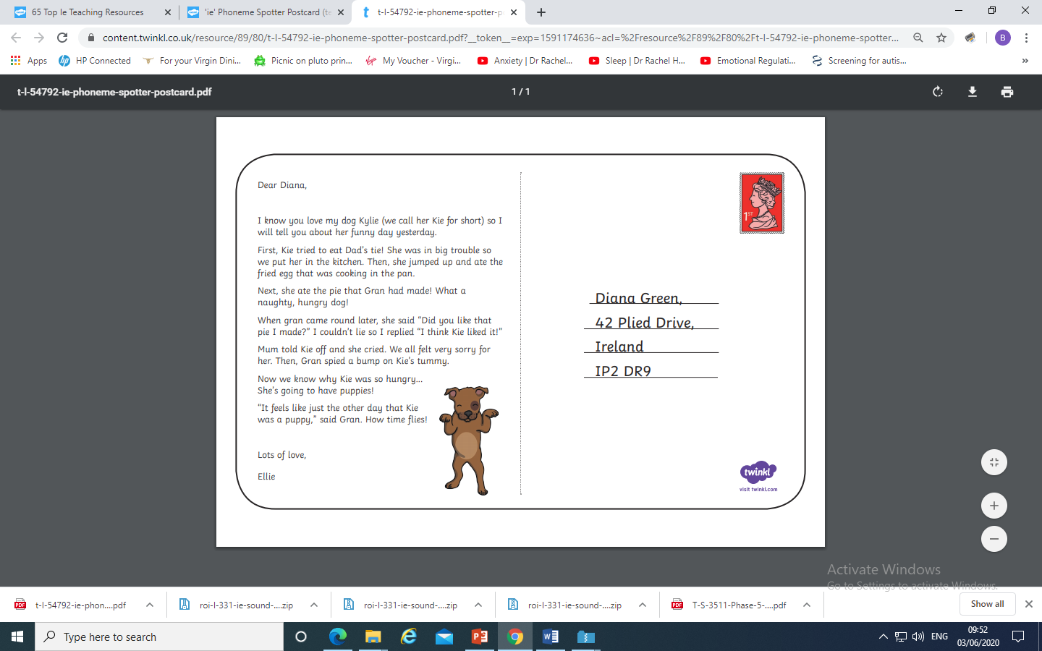
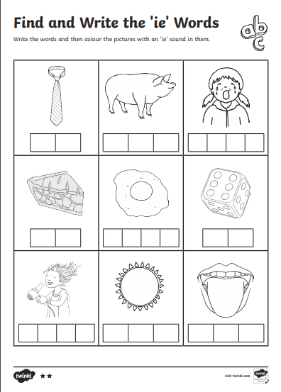

Slide 12
Play Dragon’s Den on Phonics Play use the username and password provided.
Revise all Phase 5. How many did you get right?
Read the following sentences. Remember to sound out the words you are unsure
of (don’t guess) and then read the complete sentence.
Will a chief shriek with relief in a field?
A thief cried and denied his crime.
A priest and a chief ate fried pies.

Slide 13
Wednesday: Practise the phonemes and graphemes on the sheet (slide 2) using the Pure Sound. Play a game on Phonics Play to revise blending to read Phase 4 words. (Buried Treasure, Dragon’s Den, Picnic on Pluto)
Today we are learning to read these words
water, where, who, again, thought, through, work, mouse
See the next slide for resources.

Slide 14
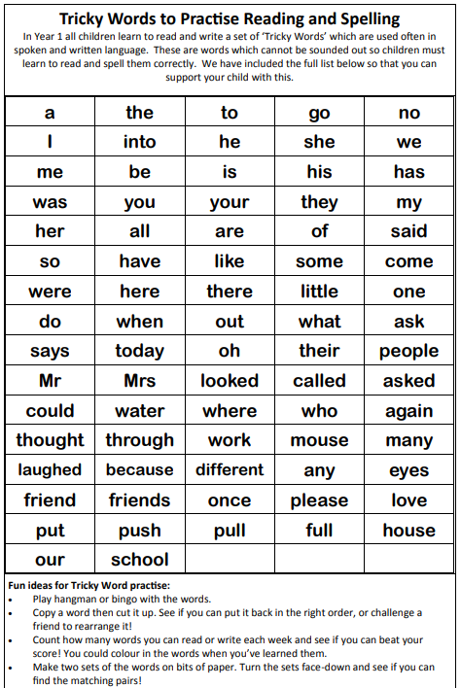
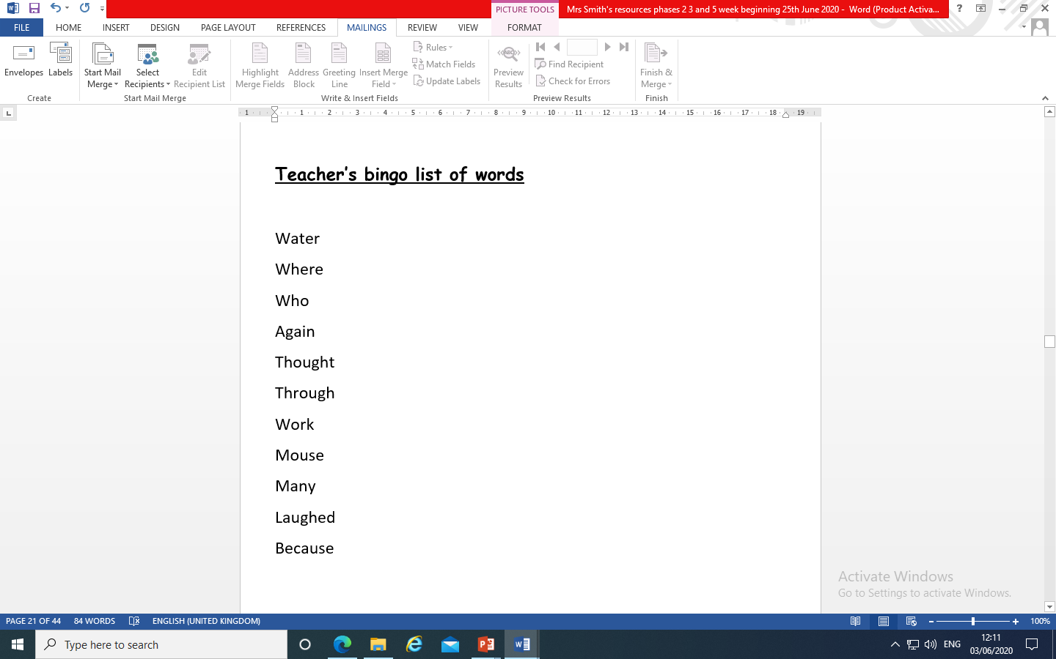
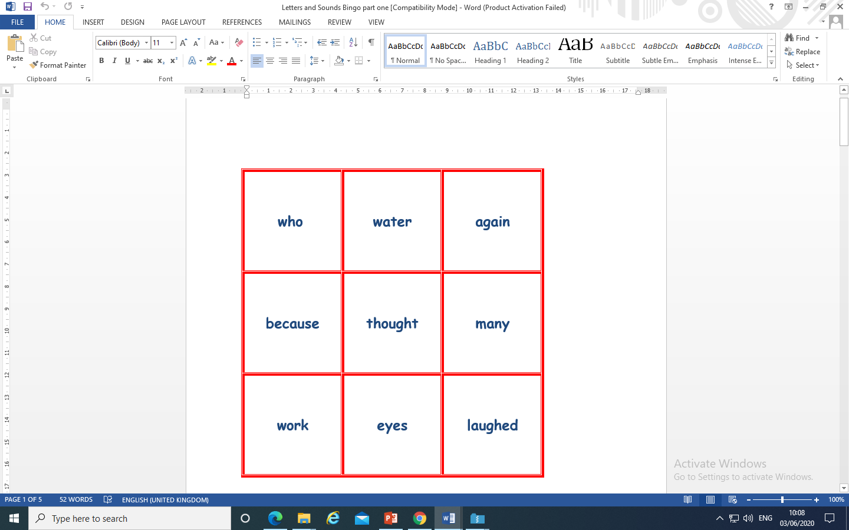
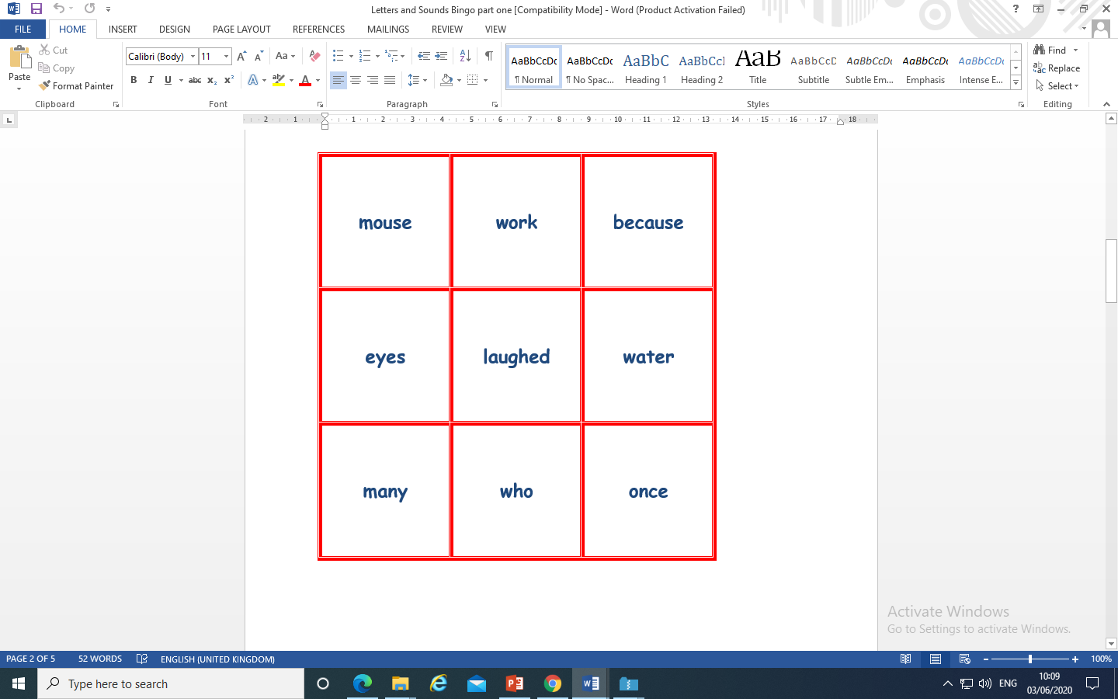
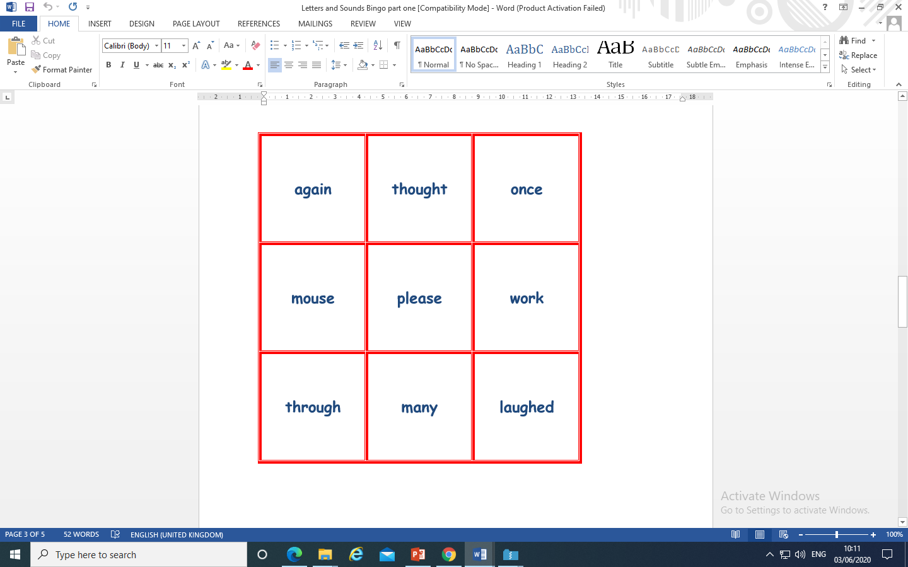
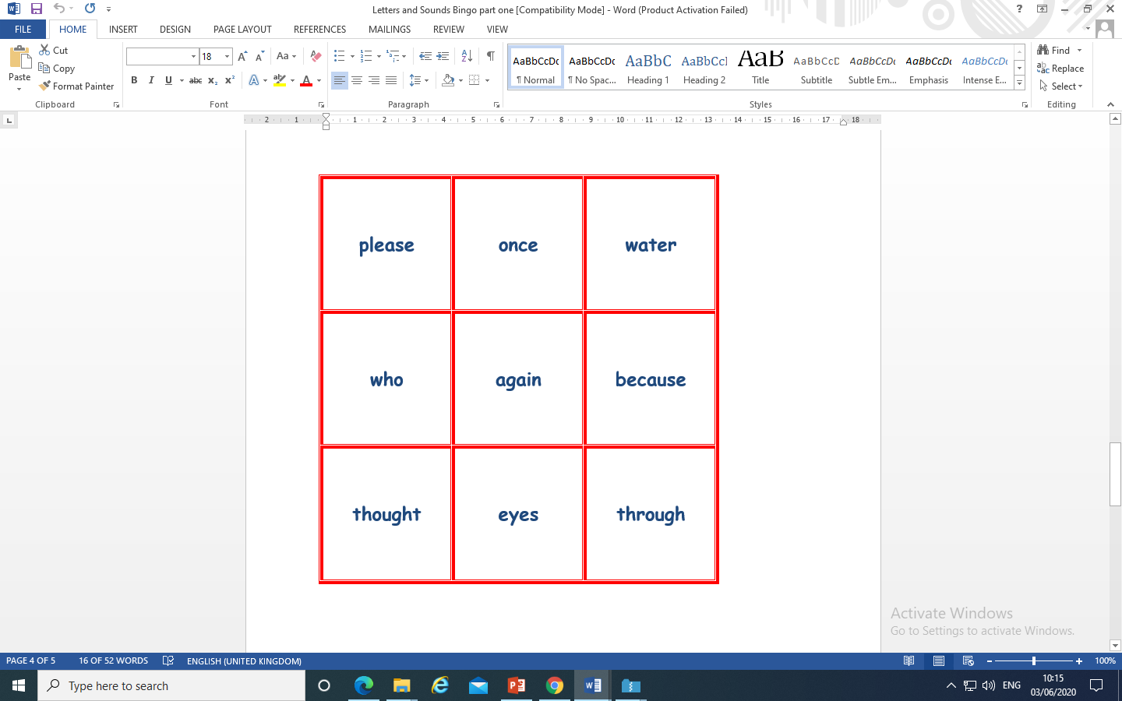
Bingo

Slide 15
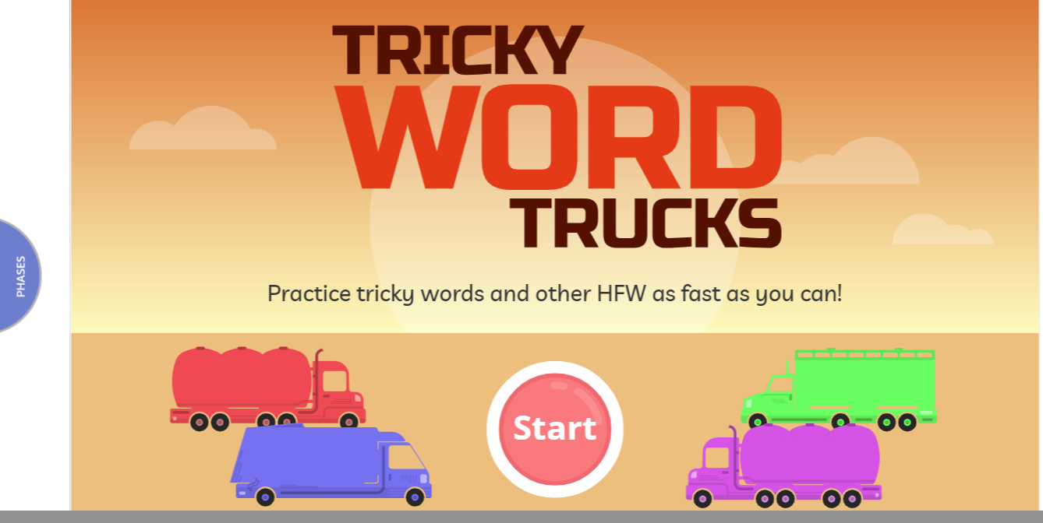
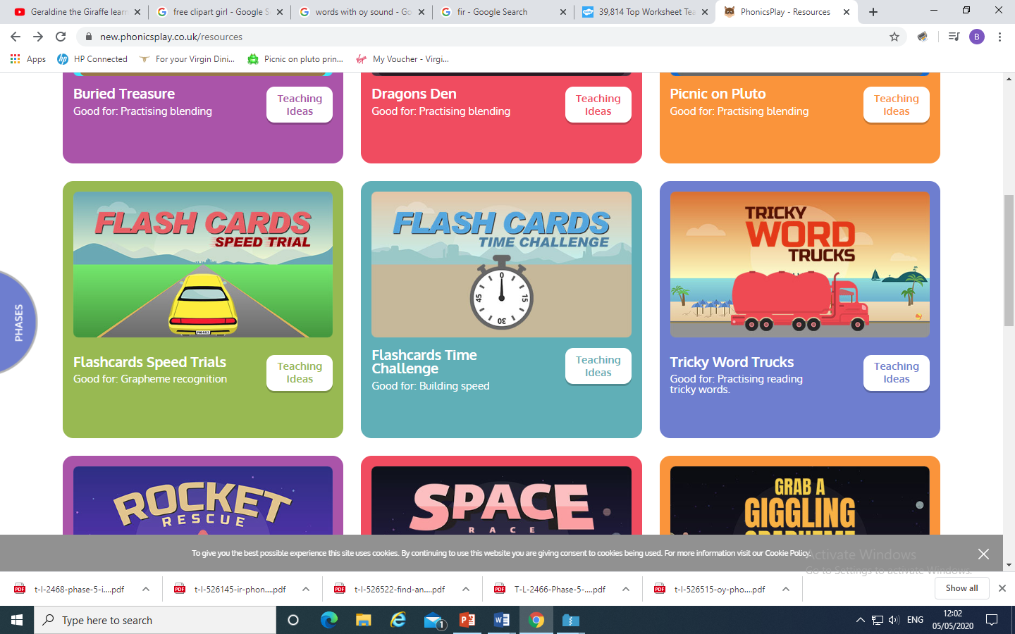
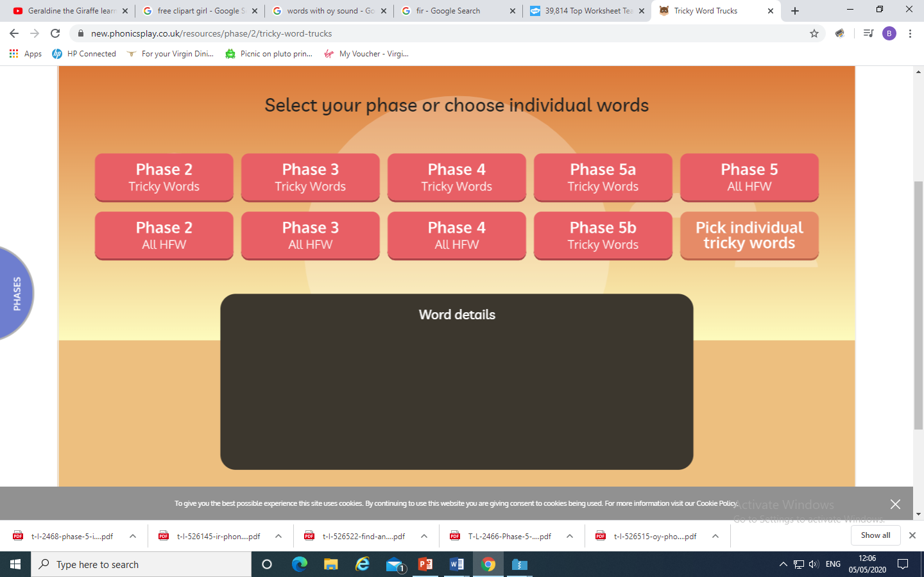
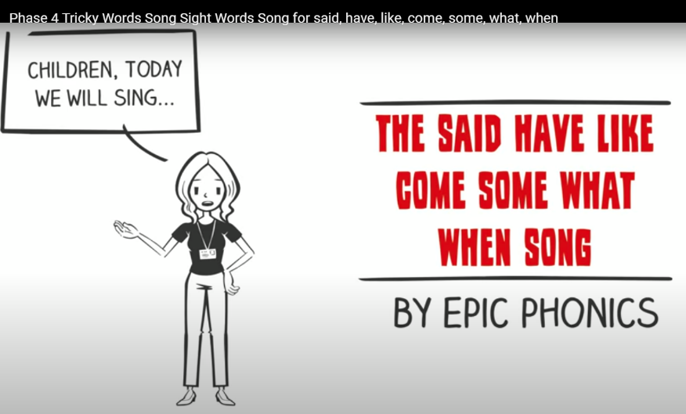
Play Tricky Trucks on Phonics Play and practise the other tricky words we have been learning.
Then follow the instructions - Choose A route
Truck type
Colour of truck
You could also sing the tricky word song
https://www.youtube.com/watch?v=3NOzgR1ANc4

Slide 16
Read the following sentences.
Who thought they saw a mouse swimming through the water again?
Where do you work?
Where is the little mouse who likes to splash?

Slide 17
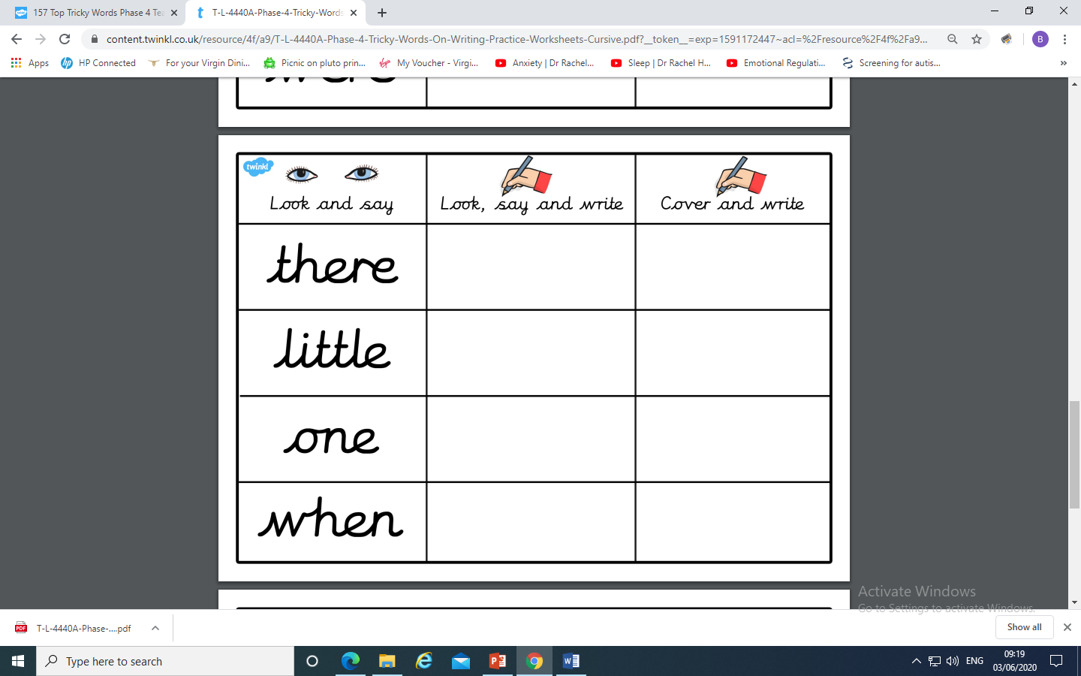
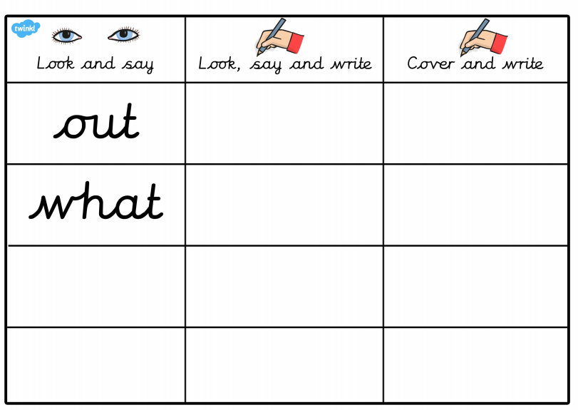
Thursday: Practise the phonemes and graphemes on the sheet (slide 2) using the Pure Sound.
Now let’s practice spelling the words
when, what, out
You could also use some of the other ideas we have done.

Slide 18
Today we are learning to explore the alternative pronunciation for the ea grapheme
Practice playing
Acorn Adventures
on Phonics Play. The words change
So play more than once.

Slide 19
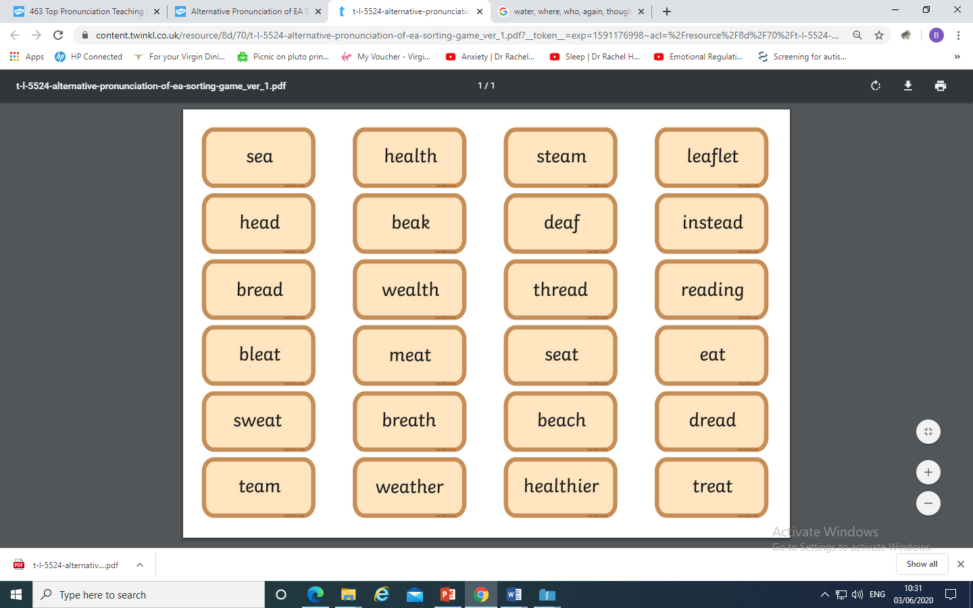
You could make your own Acorn Adventure
and place the ea graphemes
under the correct pronunciation.

Slide 20
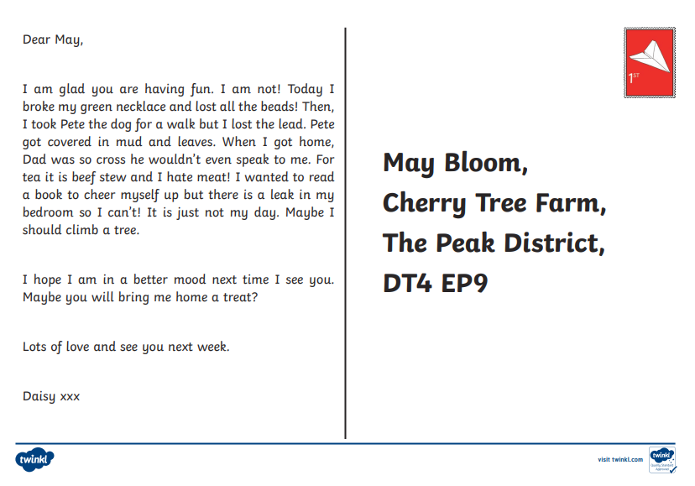
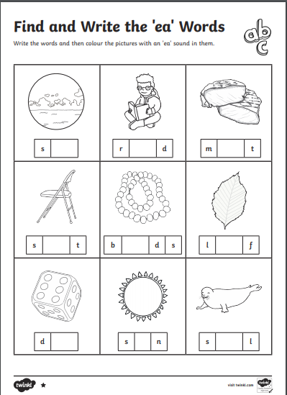
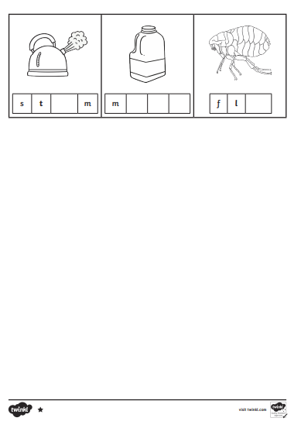
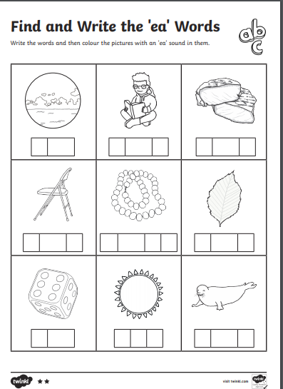
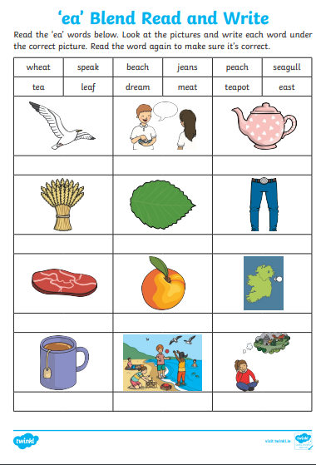
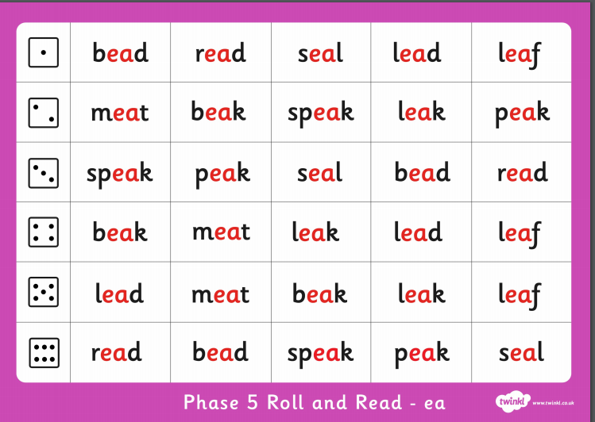
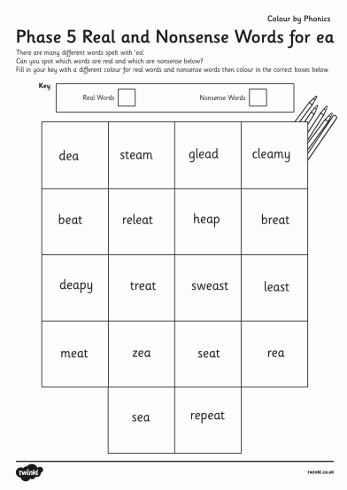
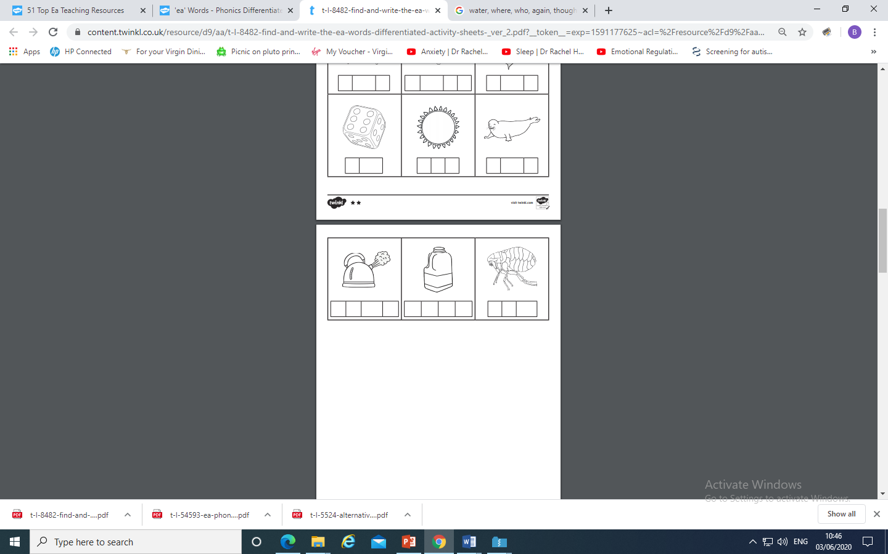
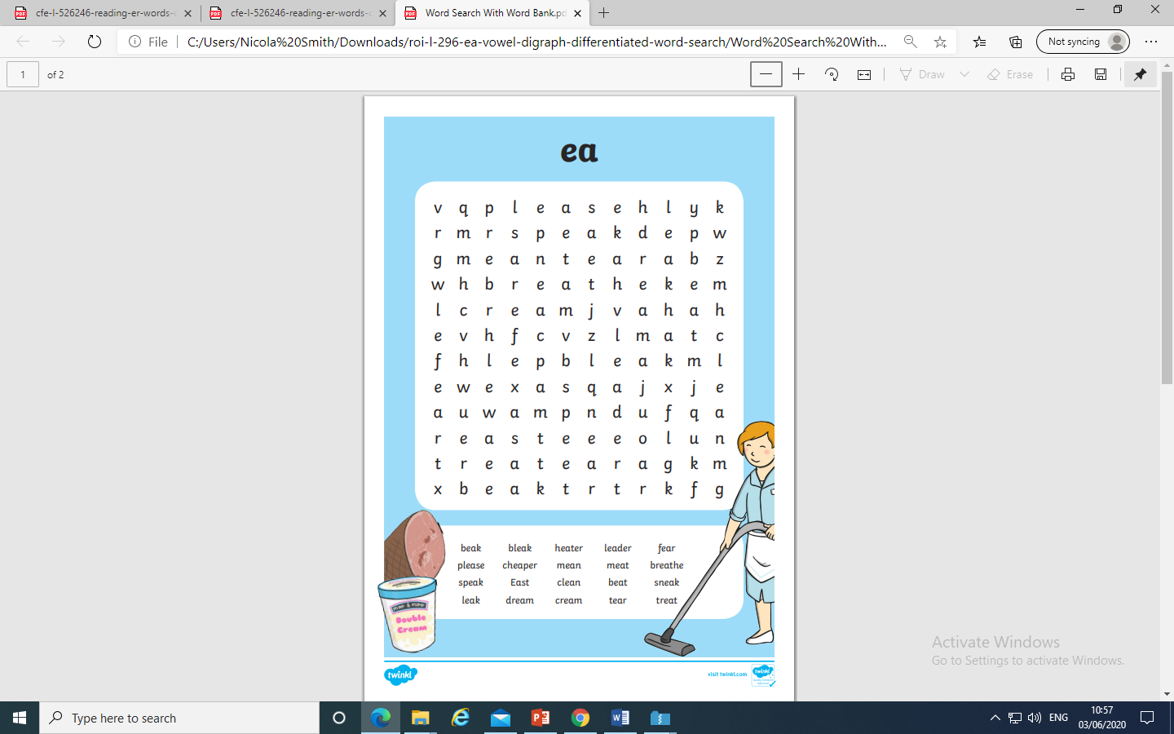
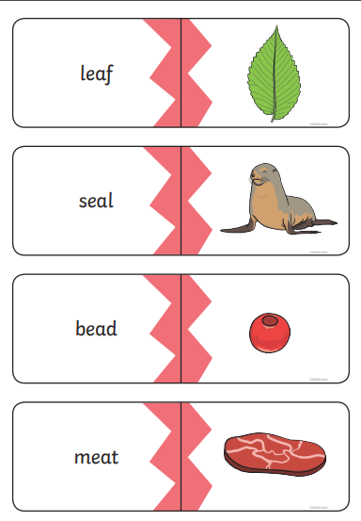
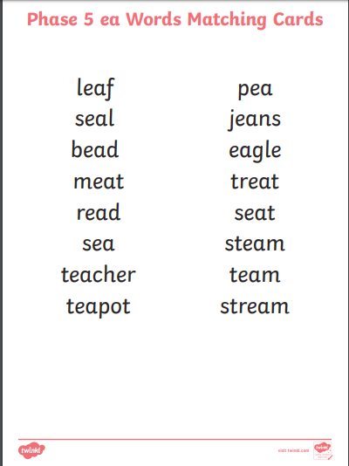

Slide 21
Play Picnic on Pluto on Phonics Play use the username and password provided.
Revise all Phase 5. How many did you get right?
Read the following sentences. Remember to sound out the words you are unsure
of (don’t guess) and then read the complete sentence.
Is bread a treat or do you dread it?
Will a deaf cat bleat to get treats?
Can reading a book freak you out?

Slide 22
Friday: Practise the phonemes and graphemes on the sheet (slide 2) using the Pure Sound.
Today we are learning to explore the alternative pronunciation for the er grapheme
Practice playing
Acorn Adventures
on Phonics Play. The words change
So play more than once.

Slide 23
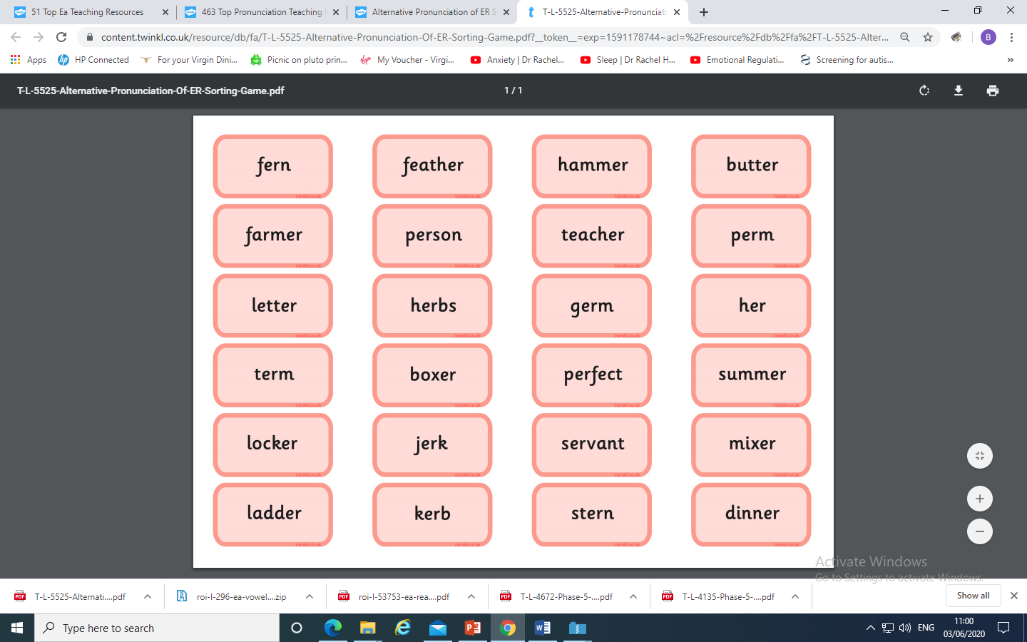
You could make your own Acorn Adventure
and place the er grapheme
under the correct pronunciation.

Slide 24
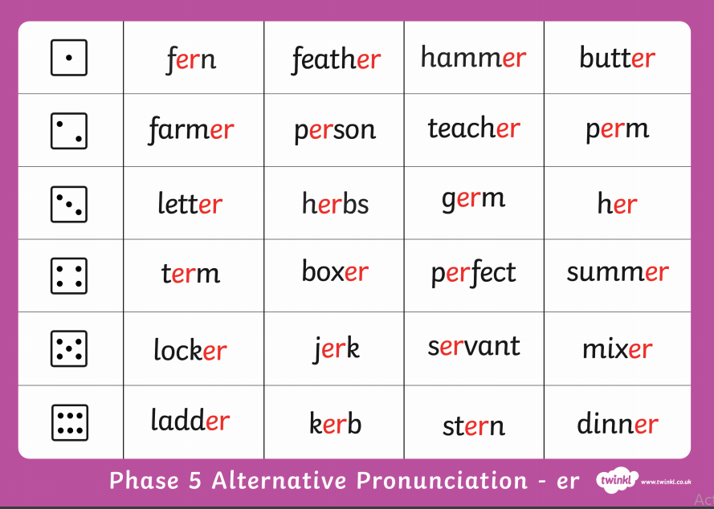
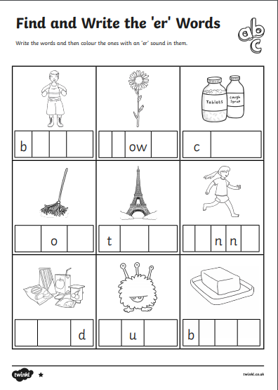
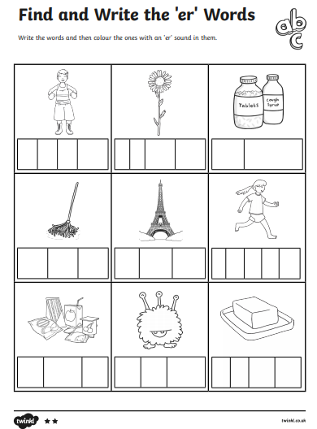




Cut the cards
out fold along
the dotted
line to cover
the picture.
Read the word,
check if you
are right by
revealing the
picture.

Slide 25
Play Picnic on Pluto on Phonics Play use the username and password provided.
Revise all of Phase 5. How many did you get right?
Read the following sentences. Remember to sound out the words you are unsure
of (don’t guess) and then read the complete sentence.
Can a farmer grow herbs?
Did a boxer hit a fern with a hammer?
Can a stern rocker get up a ladder?

