Slide 1

Home Learning
Year 1
Term 6 Week 2

Slide 2
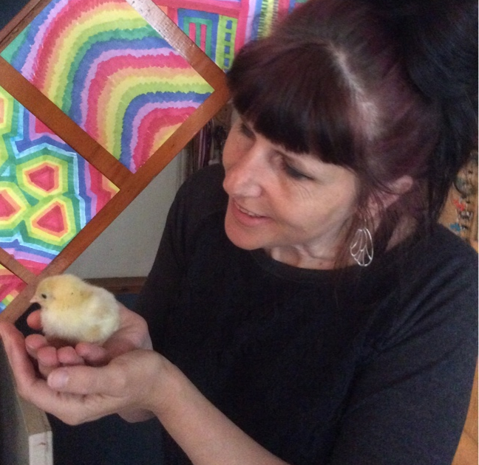
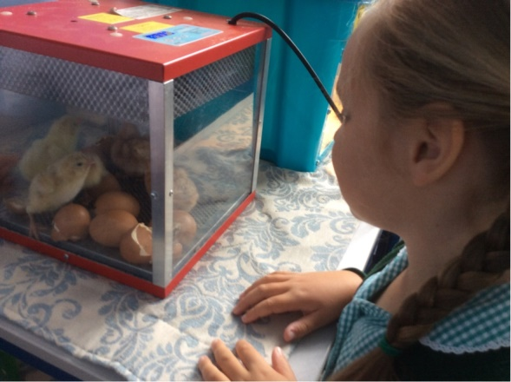
Hello Year 1!
It was lovely to have some Year 1 children back in class last week but it made me miss the rest of you even more. We thought of you often and wished you could have been there to see our eggs hatch and to hold our fluffy chicks.
Our English this week is about writing a newspaper report and our Maths is about the language of position and direction. You might have better, practical ideas about how to learn left, right, above, below, forwards, backwards and quarter turns – you could make up a dance or a game that uses all these words, or maybe direct someone to some hidden treasure by using the words in clues. Have fun with it! The last activity this week are some drawing exercises to help you draw some of the characters from our class book “Wild”.
Please continue with your regular reading, writing and phonics work as detailed in the slides below.
Have a good week!
Love from Mrs Child
xxx

Slide 3

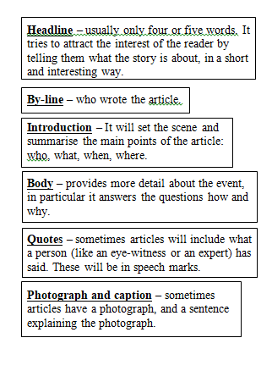
English Learning 1
I hope you enjoyed our new story “Wild”. We are going to be learning a bit about newspapers this week with the aim of writing our own newspaper reports about the story. First we will be identifying the features of a newspaper report.
Find a newspaper. (If you really can’t find one, use the page from First News (a children’s newspaper) on the next slide). Can you identify the headline? Can you see a by-line and an introduction? Are there any quotes? Are there photos and captions? You could circle them and label them or maybe use post-it notes or highlighter pens to identify all the features of a newspaper report.

Slide 4
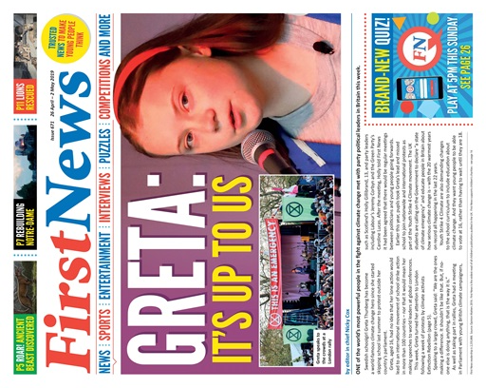

Slide 5
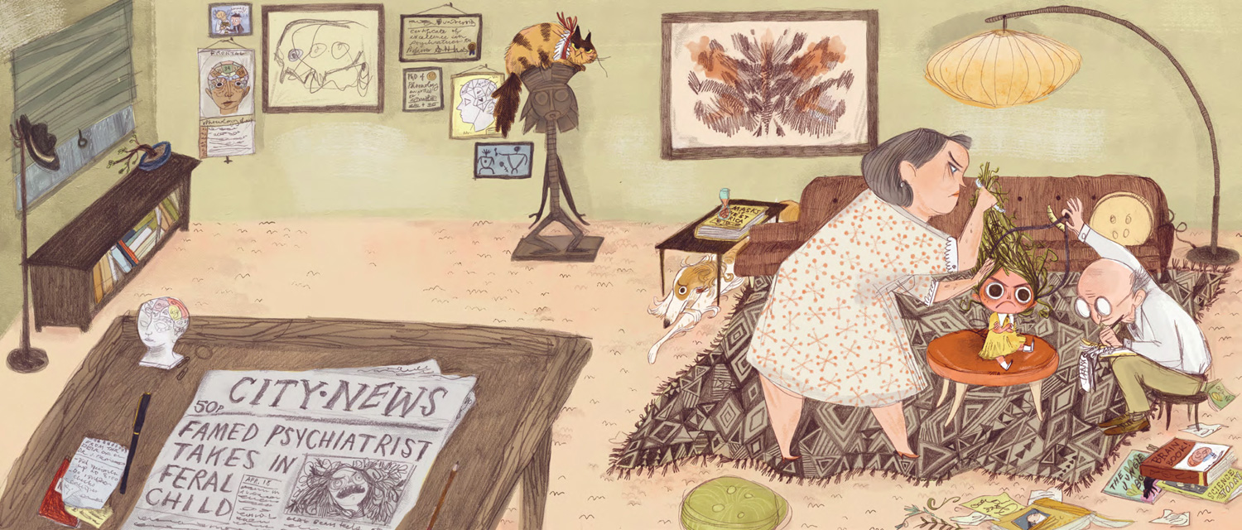
English Learning 2
Can you see the newspaper in this illustration from Wild? What is the headline? What does it mean? Find out what a psychiatrist is and what feral means? Headlines try to grab your attention and tell you what a report is about in as few words as possible. They often miss out words like “the” and “a”. Sometimes they have alliteration where the initial sounds are repeated (famed and feral).

Slide 6
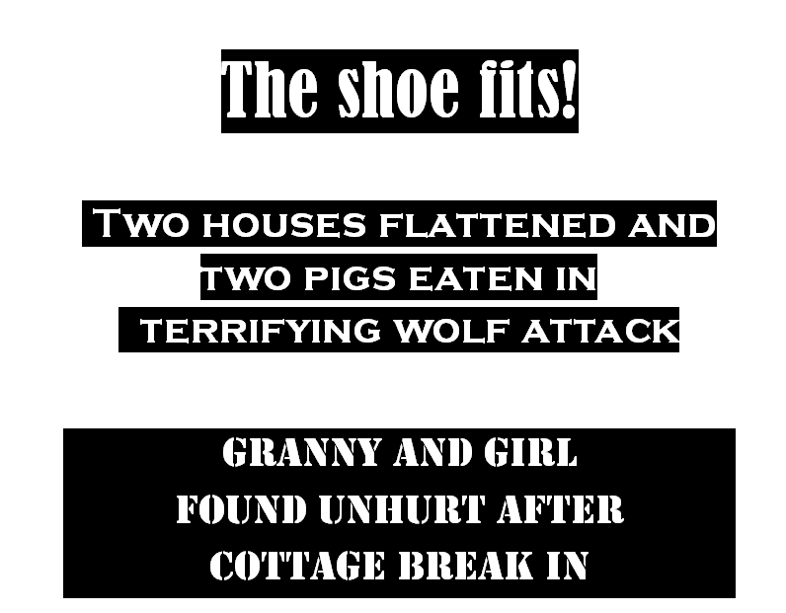

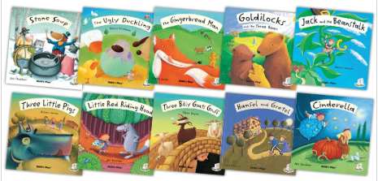
Read these headlines. Which Traditional Tales or Fairy Stories are they the headlines for?
Could you make up headlines
for some other traditional
stories?

Slide 7

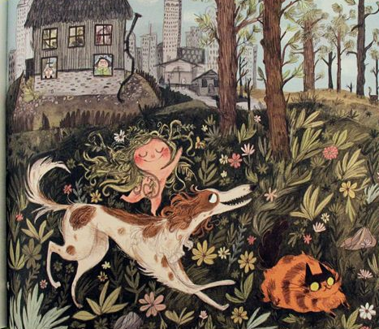
English Learning 3
Listen to the story again (there are lots of versions on YouTube). Look closely at this picture of when the girl leaves the house and goes back to the forest. You are going to write a short newspaper report for this part of the story? Can you think of a headline to go with it? And a caption for the picture? The by-line will be your name.
The introduction will need to be a sentence that explains who, what, where and when.
The body of the text will be a sentence or two that explains how she is leaving and why she is leaving. You could even include a quote from someone who saw her leaving.
You could use the guideline on the next slide to make your own newspaper report or print out the template on the following slide.
Everyone remembered how she left, and all knew it was right.
Because you cannot tame something so happily wild…

Slide 8
T e m p l e C l a s s N e w s
Headline
Written by ____________________________
Caption
Introduction (who, what, where, when) ________________________________________________________________________________________________________________________________________________
Main body of text (why, how)
________________________________________________________________________________________________________________________________________________________________________________________________________________________________________________

Slide 9
T e m p l e C l a s s N e w s
________________________________________________________________________________________________________________________________________________
________________________________________________________________________________________________________________________________________________________________________________________________________________________________________________

Slide 10
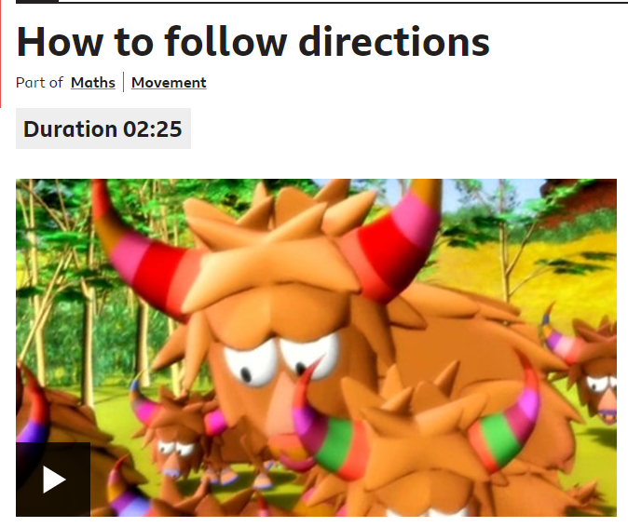
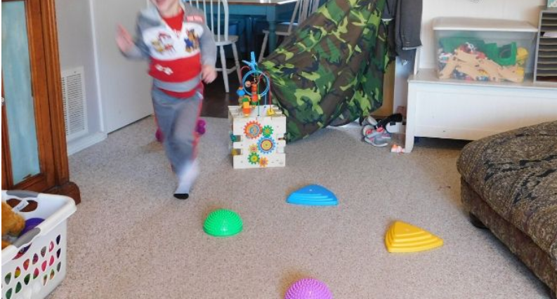
Maths Learning 1
Half, quarter and three quarter turns
Watch this video to begin thinking about giving directions involving half, quarter and three quarter turns.
https://www.bbc.co.uk/bitesize/clips/z7kwmp3
Can you give and follow directions which involve quarter, half and three quarter turns? Can you make an obstacle course on the ground and direct someone through it using quarter, half and three quarter turns. Maybe try it blindfolded!
Show your understanding with the sheet on the following slide – if you don’t want to print it out you could practise with real objects instead.

Slide 11
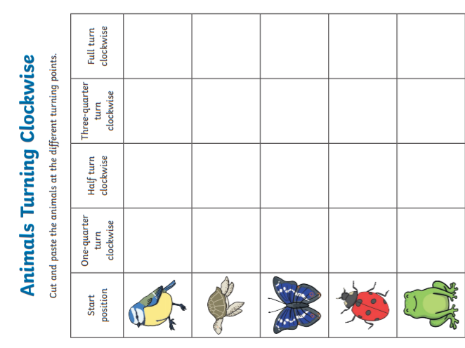

Slide 12
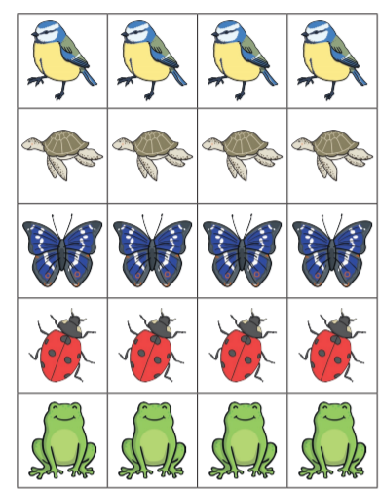
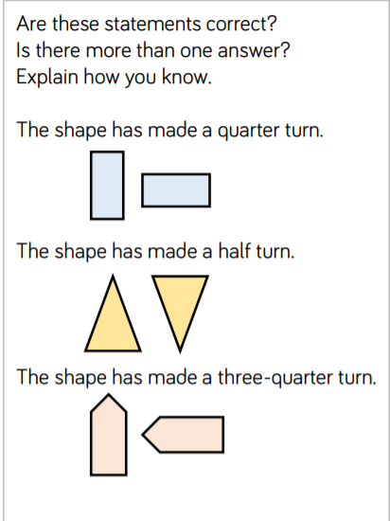

Slide 13
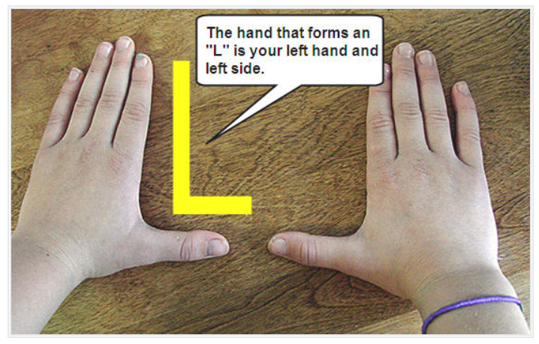
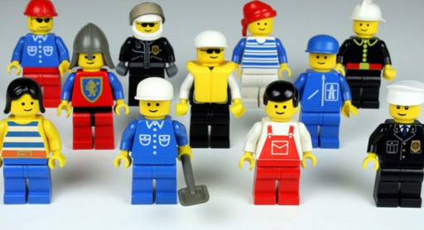
Maths Learning 2
Left, right, forwards and backwards
Recreate your obstacle course from yesterday. Can you direct someone through it by telling them to step forward, backward, left or right? What can you do to help you remember left and right? Are you right handed or left handed? How do other people in your house remember?
Print or draw the map on the next slide. Place a toy figure on the start position, facing forwards.
Follow the directions and write down where you land.
Take 3 steps right. Where are you?
Take 1 step right and 2 steps forward. Where are you?
Take 2 steps right and 1 step forward. Where are you?
Take 2 steps right and 4 steps forward. Where are you?
Take 2 steps right. 3 steps forward and 1 step right. Where are you?
Take 2 steps right, 4 steps forward and 2 steps left. Where are you?
Write your own directions to get to….
7. The party
8. The bus stop
9. The pool
Remember, you can’t go through the aliens!

Slide 14
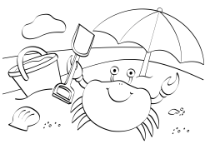
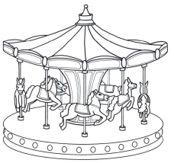
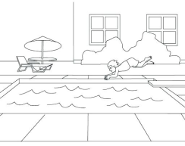
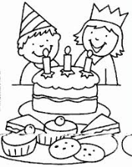



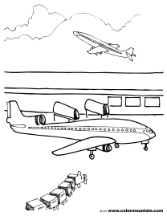
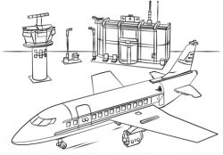
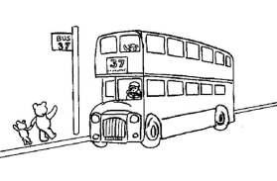
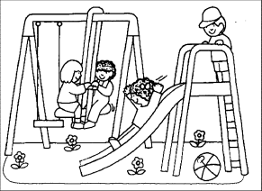


Beach |  | Fair |  | Pool
Party |  |  | Shop
 | Airport |  |  | Bus stop
 |  | Park
START |  |  | School
left
right
forward
backward

Slide 15
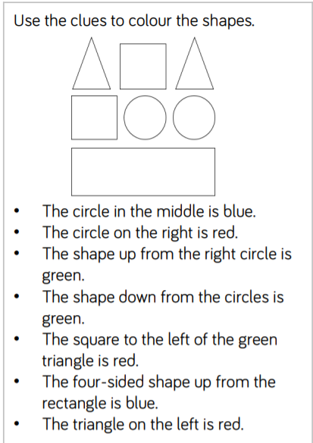
Extra challenge

Slide 16
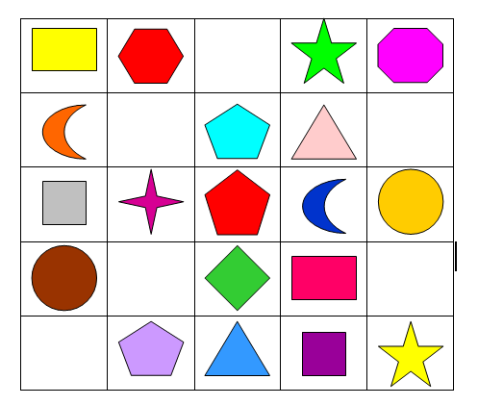
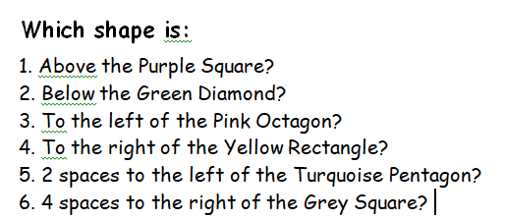
Maths Learning 3
Above and below

Slide 17
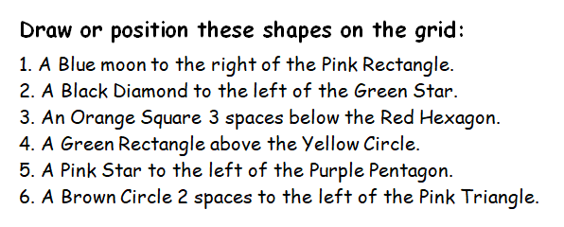
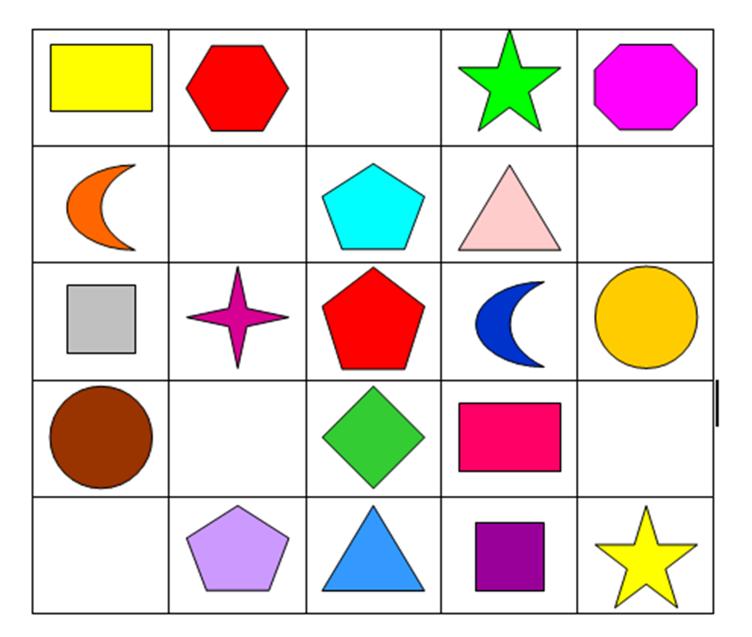


Slide 18
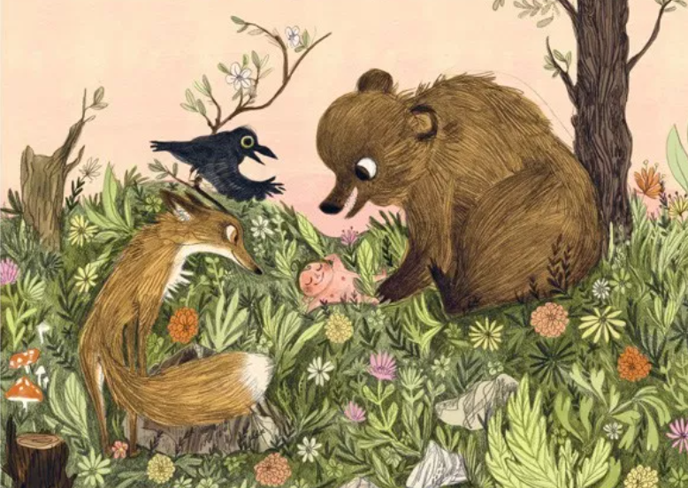
Art Learning
Learn to draw like Emily Hughes.
Use the instructions on the following slides to learn to draw a crow, a bear and a fox, just like the ones in Wild.
The last slide suggests you draw the animals in a forest party – you don’t need to print the picture if you don’t want to – you can just make your own forest party picture.

Slide 19
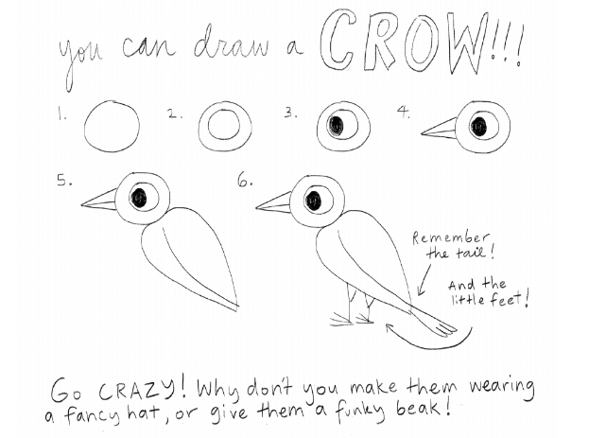

Slide 20
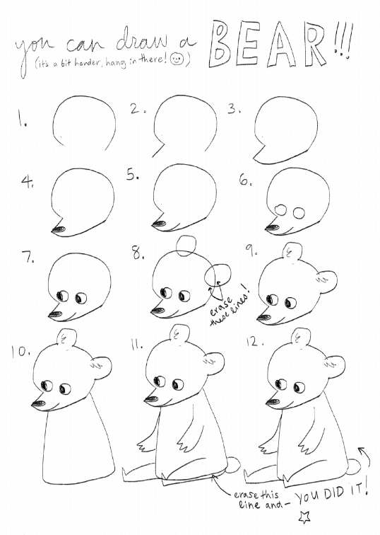

Slide 21
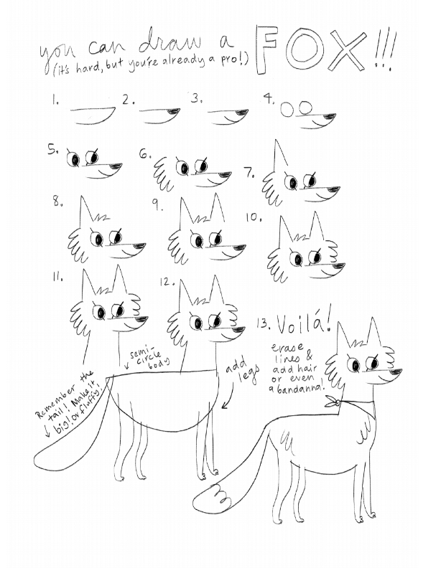

Slide 22
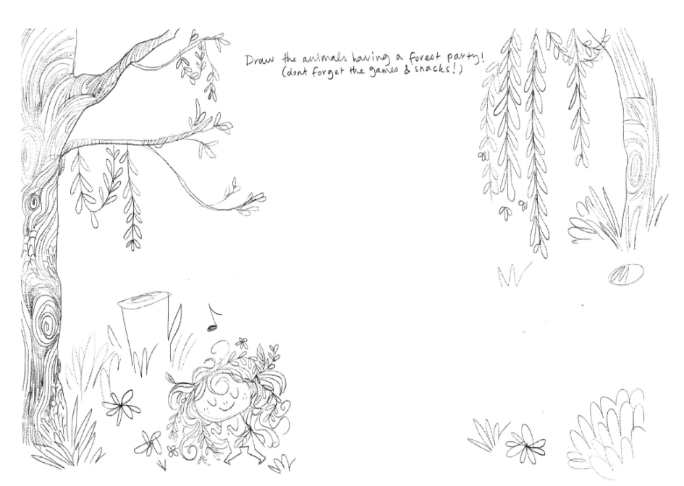

Slide 23

Reading
For additional reading at your child’s level please use the Oxford Owl website where you can read books online and then complete comprehension activities about the books. Please continue to keep a record of the books they have read in their reading records.
www.oxfordowl.co.uk
Class login: temple20
Password: Bingbong
(If you are not sure of your child’s level, please check in their reading record book or look at the coloured stickers on the additional reading books that have been sent home.)

Slide 24

Phonics
Please use the games and activities on the Phonicsplay website to continue practsing Phonics.
www.phonicsplay.co.uk
Login: march20
Password: home
Mrs Child’s Phonics group are currently working on Phase 5c (alternative ways of writing sounds we already know e.g. ai, ay, a_e all make the same sound).
Mrs Smith’s group are working on Phase 4.
Additionally, there are many excellent Phonics resources on the Twinkl website(see below for how to get free access). Practising reading “alien words” is a particularly fun and valuable activity.

Slide 25

Writing
Your child has been provided with a writing journal. They are used to using them and know that they need to write the date, write a sentence (about anything they like), draw and colour a picture and then fill any spare lines with handwriting patterns.

Slide 26

P.E.
It is important to keep your children active. If it is safe to do so, ensure they have some time outside throughout the day. Please visit Joe Wicks YouTube channel (https://www.youtube.com/channel/UCAxW1XT0iEJo0TYlRfn6rYQ), which has lots of exercise videos for children. He will also be hosting a live P.E. lessons Monday to Friday at 9:00am.

Slide 27


Using My Maths
Children should know their way round My Maths but here are some reminders on how to access the lessons. Visit: www.mymaths.co.uk
bapchild
divide162

Slide 28

Using My Maths
Access any lesson based on what your child is learning in class or search the topic in the search bar.
Use the login portal to access specific homework and lessons that your teacher has set.

Slide 29

Maths – White Rose Home Leaning
In school we follow the White Rose scheme of learning. Their website has put together free lessons and resources that link to the learning taking place in school. Please visit: https://whiterosemaths.com/homelearning/

Slide 30

Accessing Twinkl
Many educational content providers are offering free access to their resources. Twinkl is a website that we use from time to time to resource our lessons to aid in teacher input and pupil activities.
We will be able to direct you towards activities and learning via this website based on lessons that may be missed due to absence. To access Twinkl please visit: www.twinkl.co.uk/offer
You will have to sign up and put in the offer code: UKTWINKLHELPS

Slide 31

Classroom Secrets
The site classroom secrets https://classroomsecrets.co.uk/free-home-learning-packs/ has free class packs which provide some great additional ideas and resources you can use.

