Slide 1

Hello and Welcome to Mrs Smith’s Phonics Group Week 5.
Hope you had a lovely half term with your family and enjoyed the weather. Hopefully I will see you soon ☺.
I know you have been working hard learning and revising the sounds we already know and our new Phase 5 graphemes and phonemes GPCs. Have you noticed how some of the GPCs make the same sound. Well done if you have ☺
You could start your phonics learning daily with our alphabet song or to get you moving BBC Super Movers with Naomi Wilkinson https://www.youtube.com/watch?v=jYeMpUdufNk
Do as much as you can and have Fun. Love Mrs Smith xx
Please play this Power Point in slide show and keep clicking there are animations (it works better on a laptop than IPad).

Slide 2
You could print this grid off and check what phonemes (sounds) to grapheme (written) you can recall daily. You could colour, tick or cover with counters, coins or pebbles the ones you can say using the PURE SOUND. If you don’t want to print it off you could point to each sound and say using the PURE SOUND. Are you getting quicker maybe you could time yourself. Let’s check what you know. Are you getting quicker?
s | a | t | p | i | n | m
d | g | o | c | k | ck | e
u | r | h | b | f | ff | l
ll | ss | j | v | w | x | y
z | zz | qu | ch | sh | th | ng
ai | ee | igh | oa | oo | ar | or
ur | ow | oi | ear | air | ure | er
ay | ou | ie | ea | oy | ir | ue
aw | wh | ph | ew | oe | au | ey
i-e | o-e | a-e | u-e | e-e
Practice the ones you are not sure of.

Slide 3
Phase 5b Week 5:
This week we are going to be learning to explore alternative pronunciations of different graphemes. These sound the same but are written differently. You may have spotted some already!
Let’s find out more…..

Slide 4
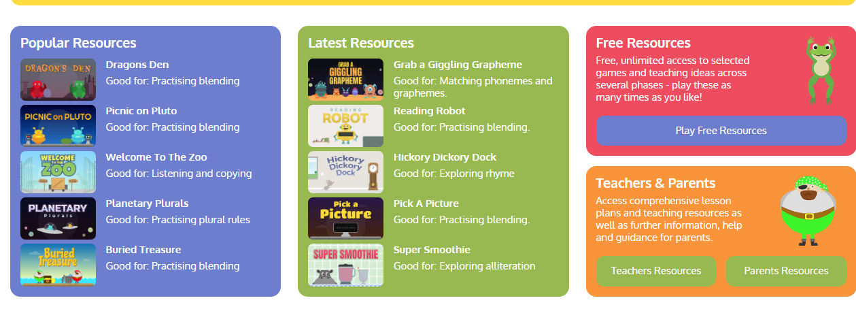
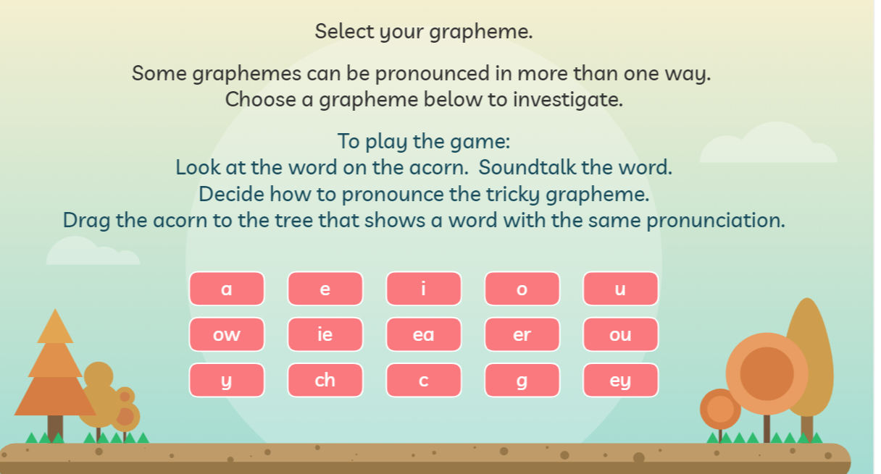
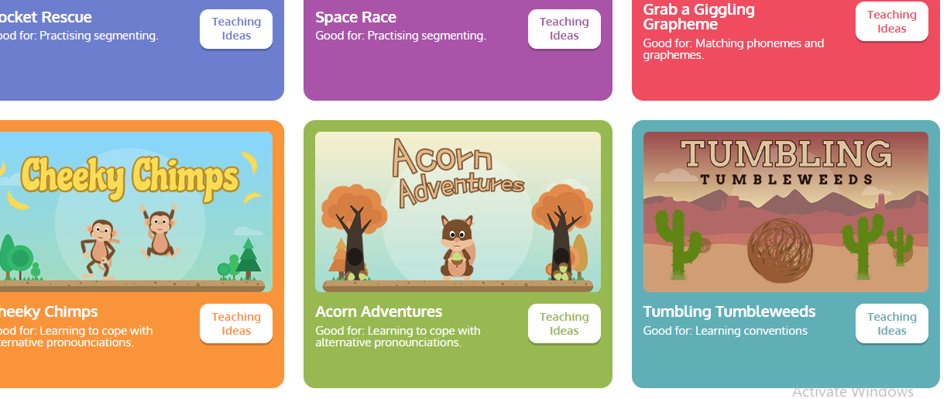
Phase 5b Week 5:
Monday: Practise the phonemes and graphemes on the sheet (slide 2) using the Pure Sound.
Today we are learning to explore the alternative pronunciation for the i grapheme
Play Acorn Adventures
on Phonics Play. The words change
so play more than once.

Slide 5
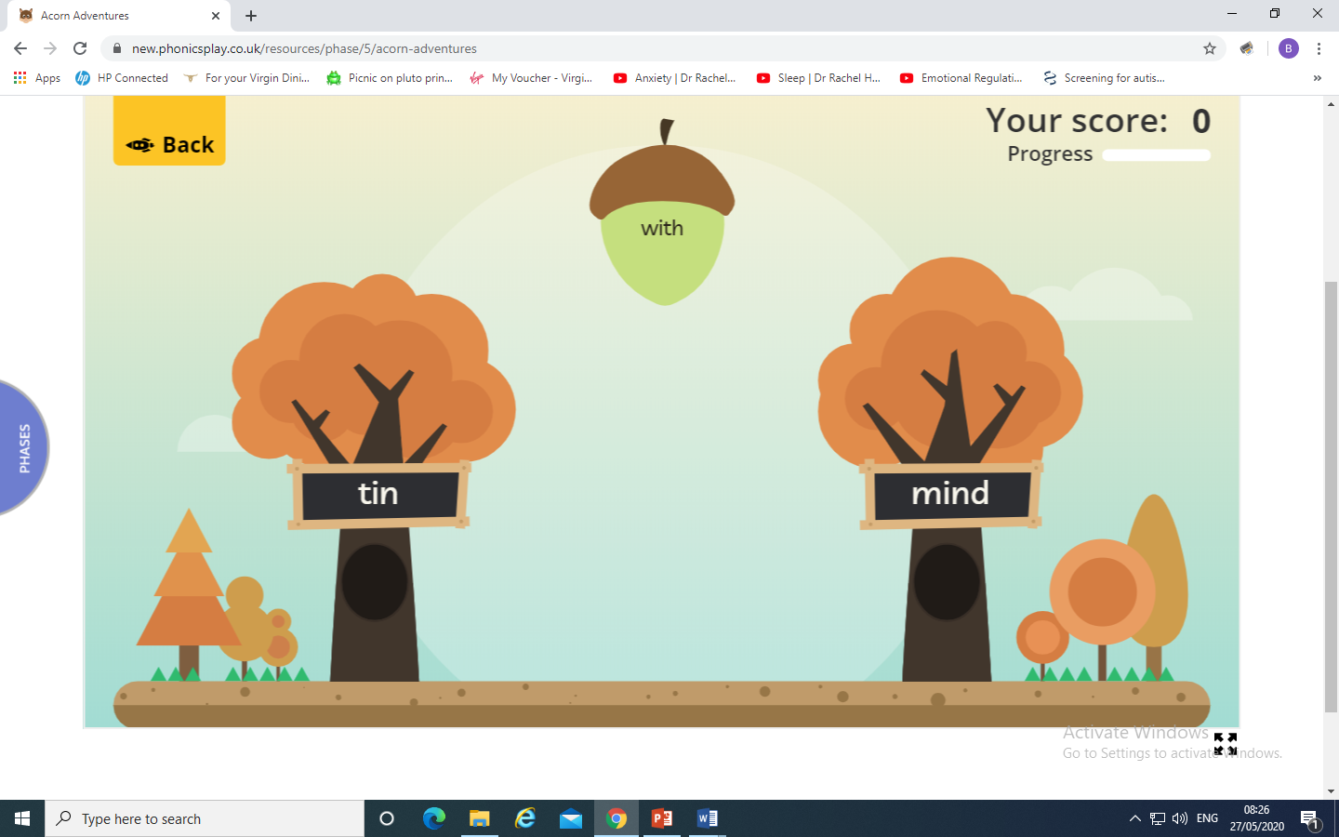
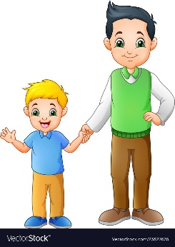

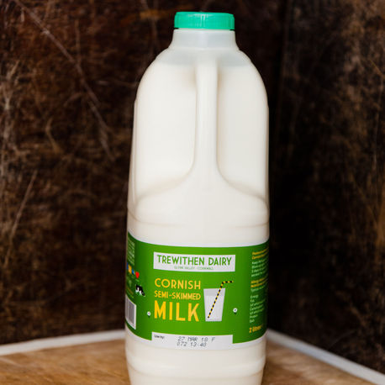
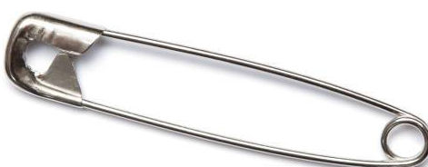
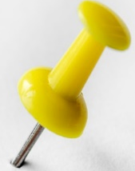
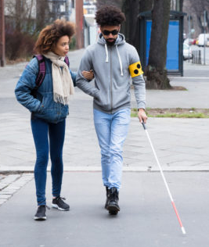
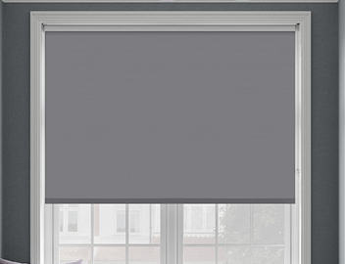

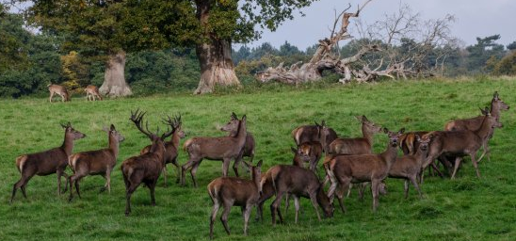
Sort these words in to the right list by how the i grapheme is pronounced
milk pin his mild
wild blind link

Slide 6
Were you right ? Let’s check.
milk mild
pin wild
his blind
link

Slide 7
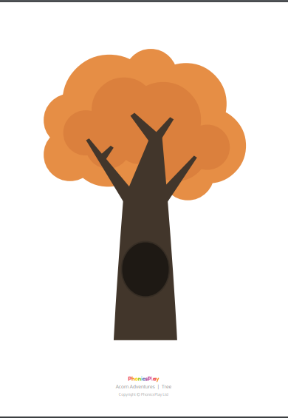
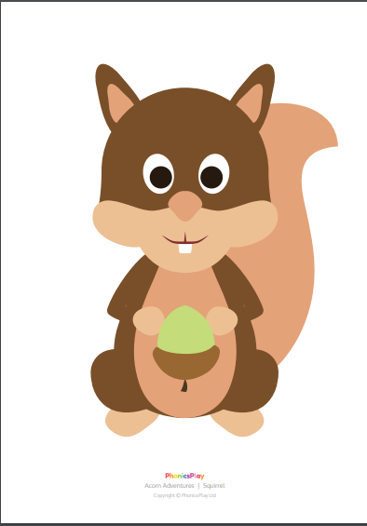
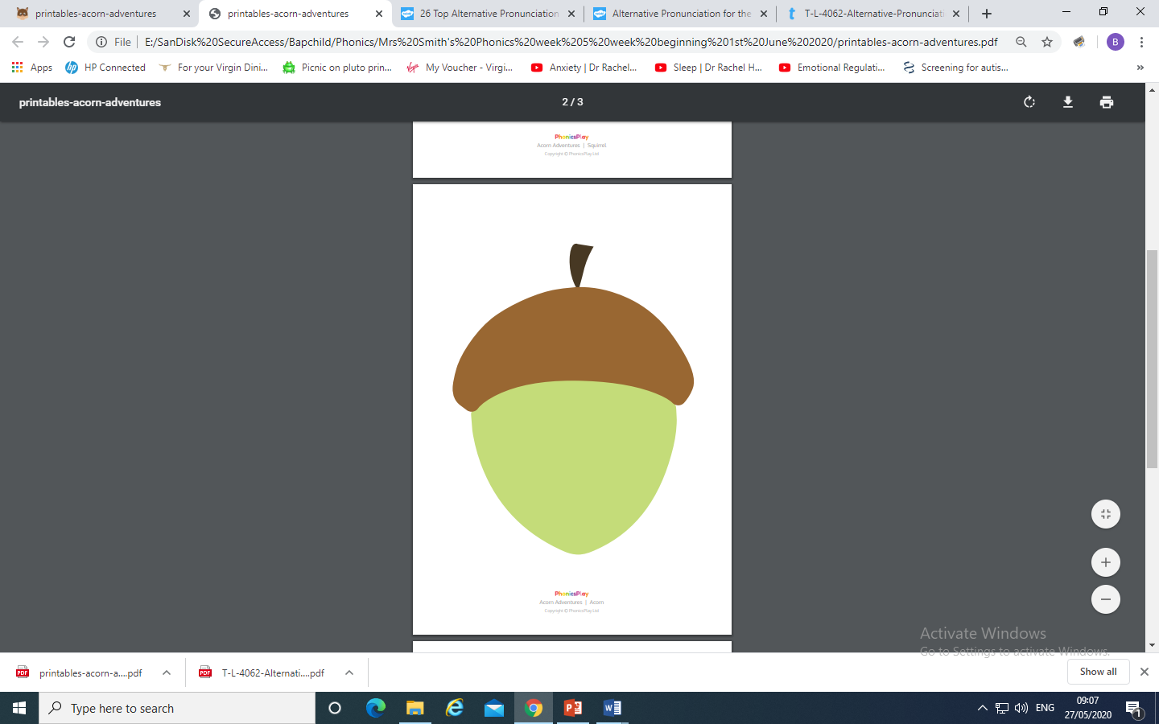
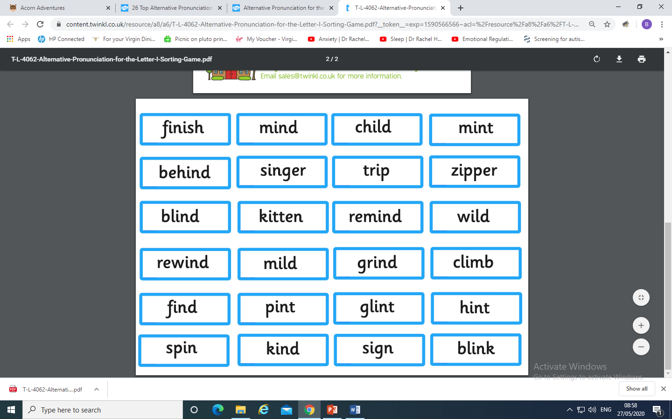
You could make your own Acorn Adventure
and place the i graphemes
under the correct pronunciation.
(Trees, squirrel, acorn and words are
in resource pack)

Slide 8
Play Buried Treasure on Phonics Play use the username and password provided. Revise all of Phase 5. How many did you get right?
Read the following sentences. Remember to sound out the words you are unsure of (don’t guess) and then read the complete sentence.
The wild child did a trick.
You will find a big stick behind the tree.
Remind me to stick things in my mind.

Slide 9
Phase 5b Week 5:
Tuesday: Practise the phonemes and graphemes on the sheet (slide 2) using the Pure Sound.
Today we are learning to explore the alternative pronunciation for the o grapheme
Practice playing
Acorn Adventures
on Phonics Play. The words change
So play more than once.

Slide 10
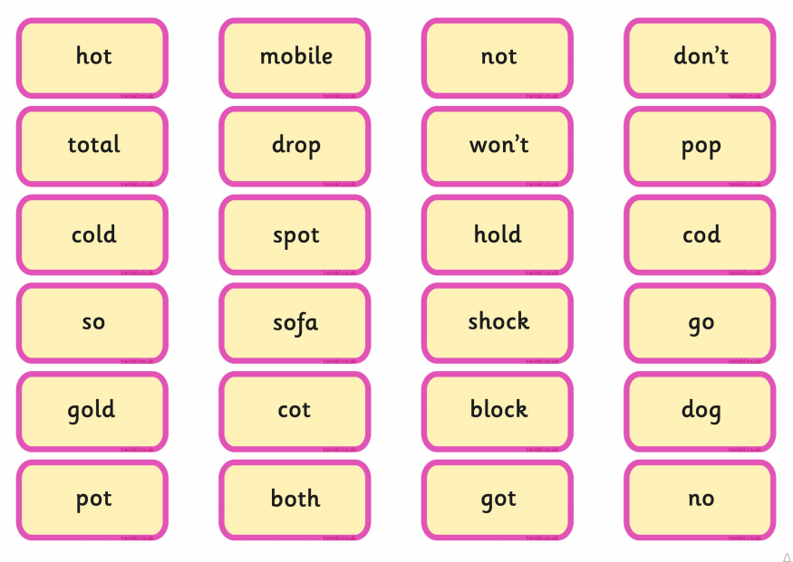
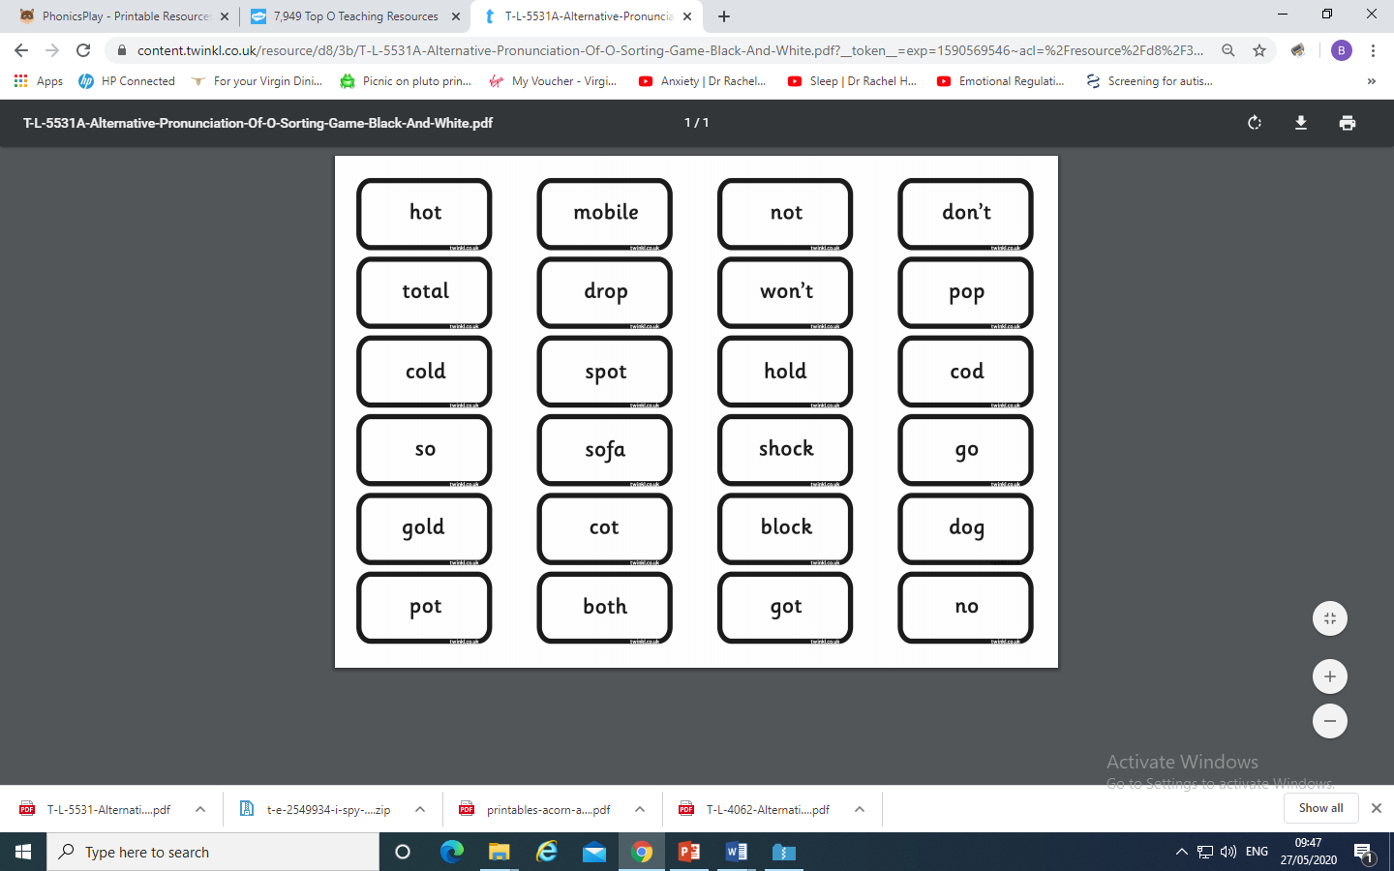
You could make your own Acorn Adventure
and place the o grapheme
under the correct pronunciation.

Slide 11
Play Dragon’s Den on Phonics Play use the username and password provided.
Revise all Phase 5. How many did you get right?
Read the following sentences. Remember to sound out the words you are unsure
of (don’t guess) and then read the complete sentence.
Don’t go to the hot spot.
Can we both hold the gold block?
Don’t get a shock if it is too cold or too hot.

Slide 12
Wednesday: Practise the phonemes and graphemes on the sheet (slide 2) using the Pure Sound. Play a game on Phonics Play to revise blending to read Phase 4 words. (Buried Treasure, Dragon’s Den, Picnic on Pluto)
Today we are learning to read the tricky words
little, one, do, when, what, out
Write each word on a piece of paper or with chalk on a blackboard or path or in sand with your finger or a paintbrush. Say the word and the write over it in rainbow writing see next slide for an example.

Slide 13
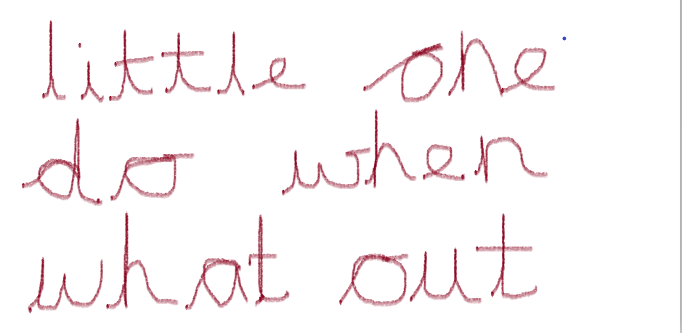
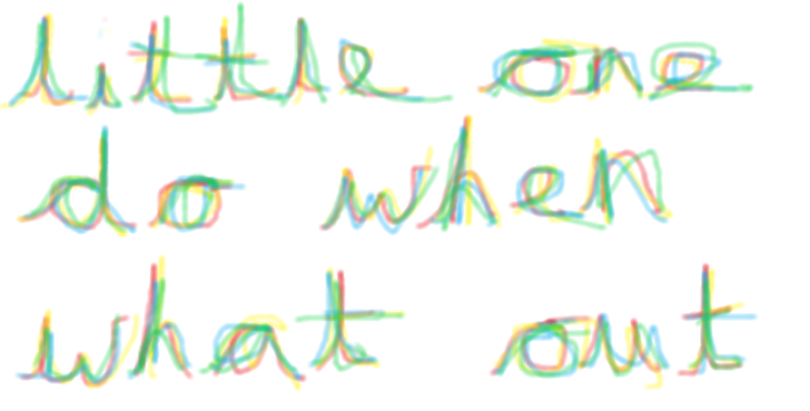
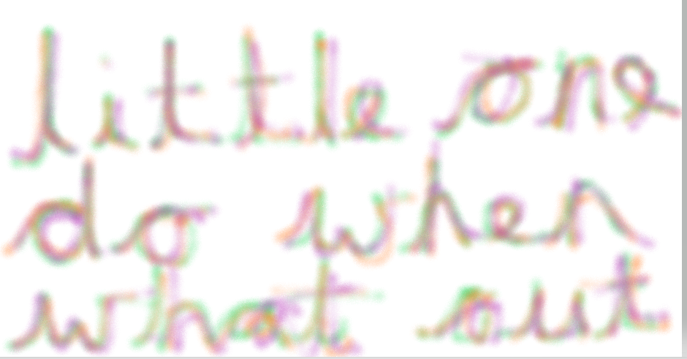
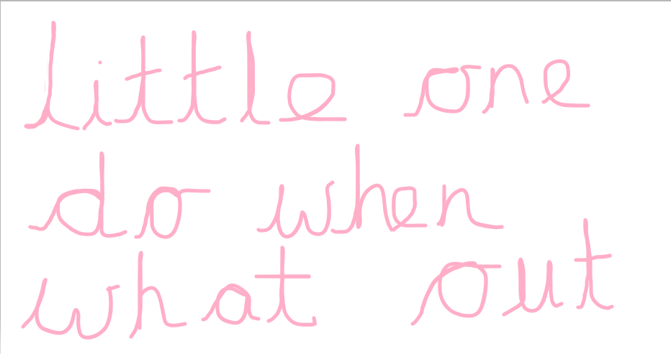

This week I used the paint programme on my computer and used pens, crayon, paint and marker pen. It’s up to you how you practice writing the tricky words.
Can you say or write sentences or questions using these tricky words?
For example – When will the little egg hatch?

Slide 14
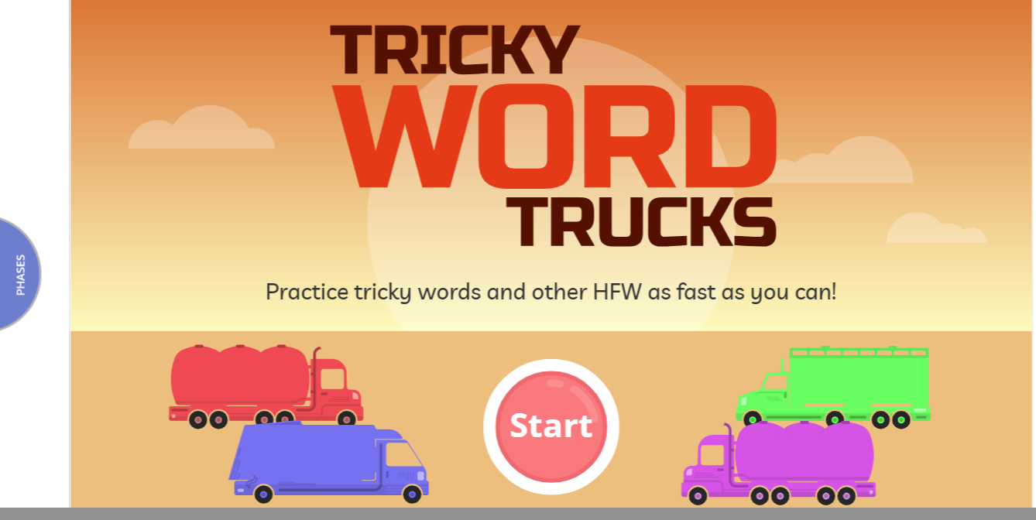
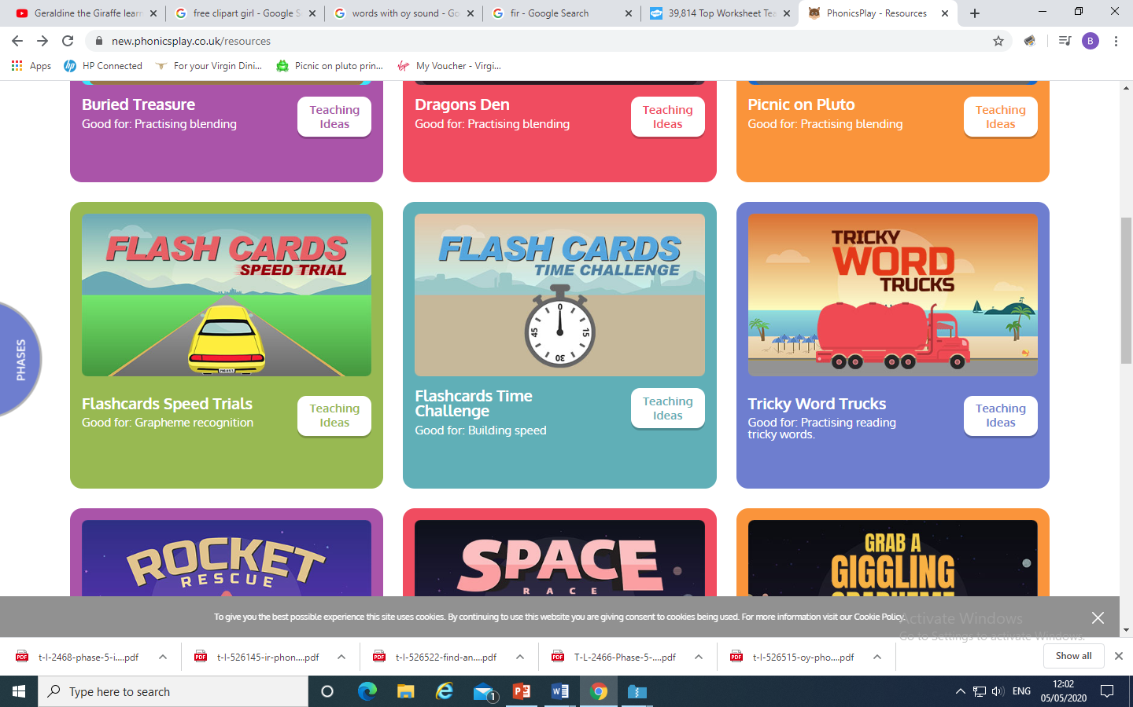
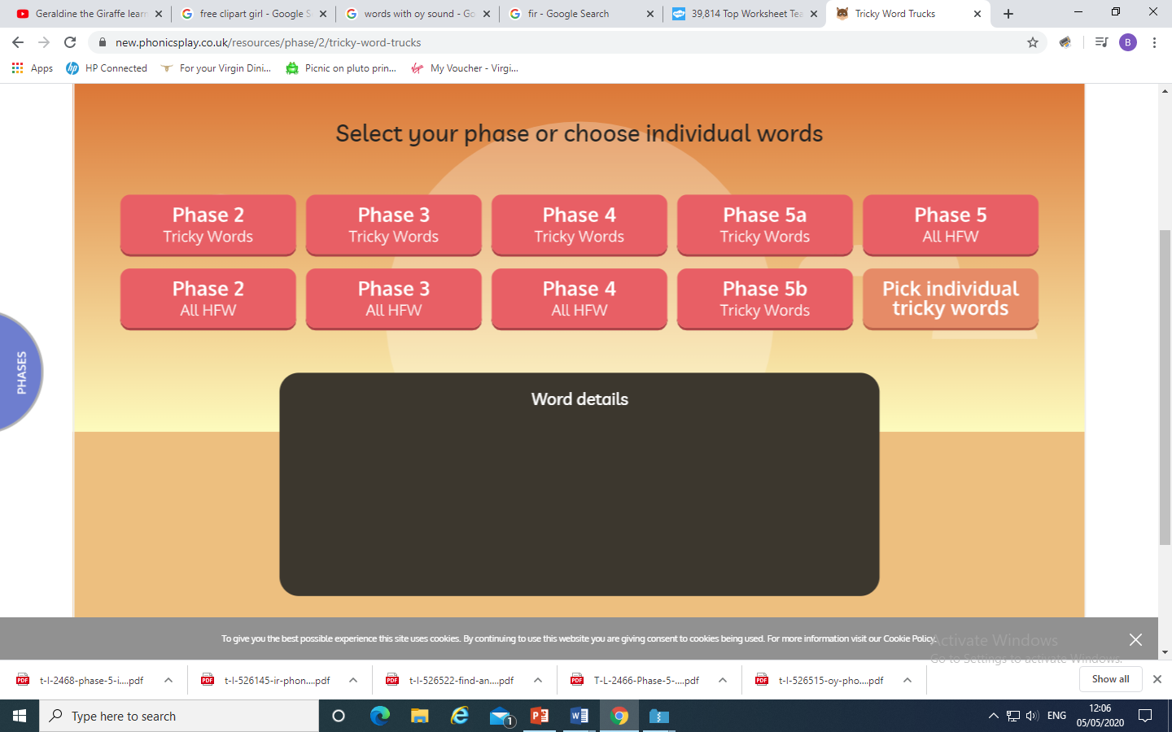
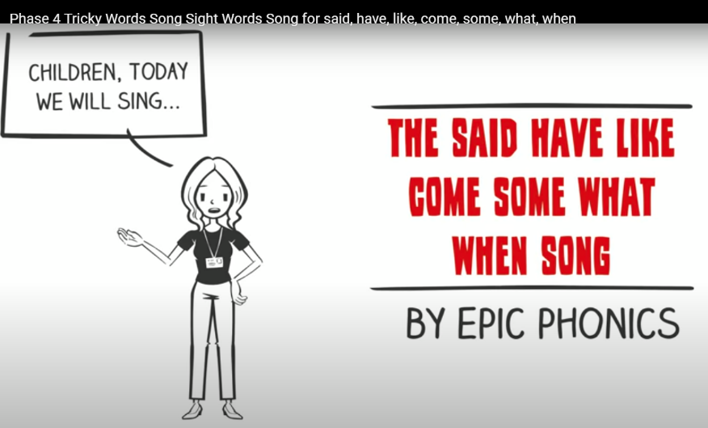
Play Tricky Trucks on Phonics Play and practise the other tricky words we have been learning.
Then follow the instructions - Choose A route
Truck type
Colour of truck
You could also sing the tricky word song
https://www.youtube.com/watch?v=3NOzgR1ANc4

Slide 15
Read the following sentences.
One little frog jumped in a pond.
He likes to do that when it gets hot.
What do you think will make him get out?

Slide 16
Phase 5b Week 5:
Thursday: Practise the phonemes and graphemes on the sheet (slide 2) using the Pure Sound.
Today we are learning to explore the alternative pronunciation for the g and c grapheme
Practice playing
Acorn Adventures
on Phonics Play. The words change
So play more than once.

Slide 17
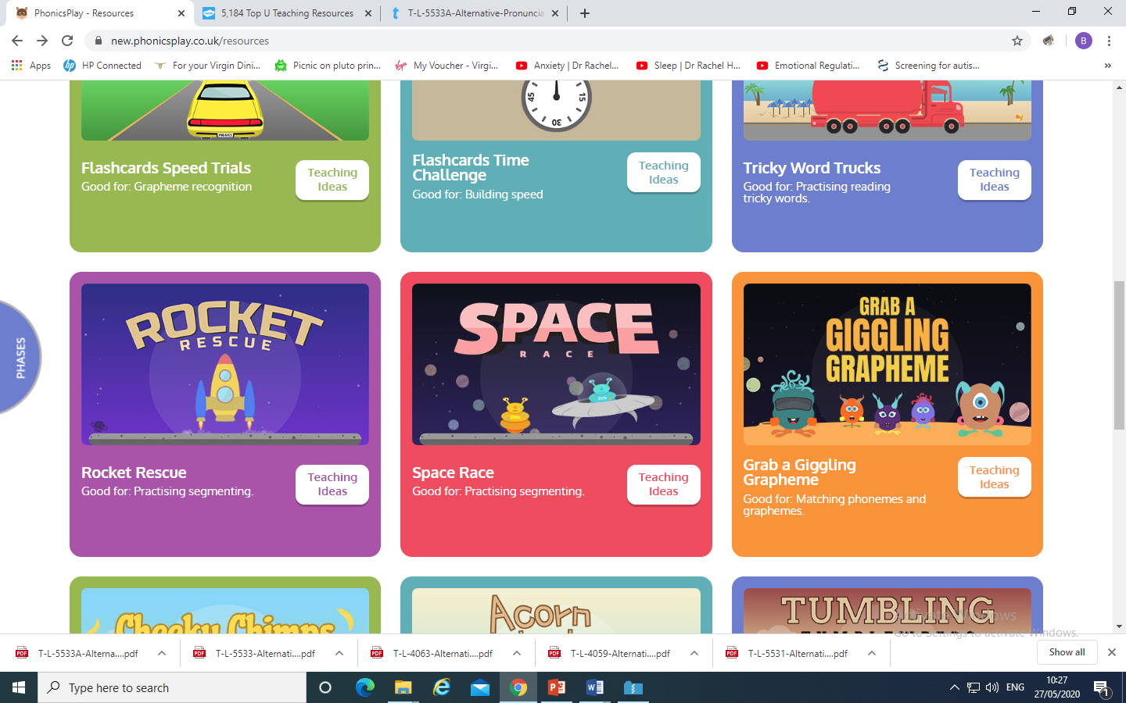
Revise segmenting to spell Phase 4 words.
Play Rocket Rescue or Space Race on Phonics Play

Slide 18
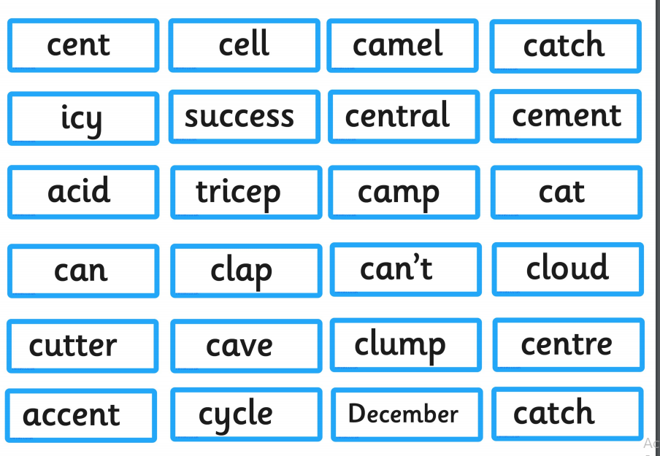
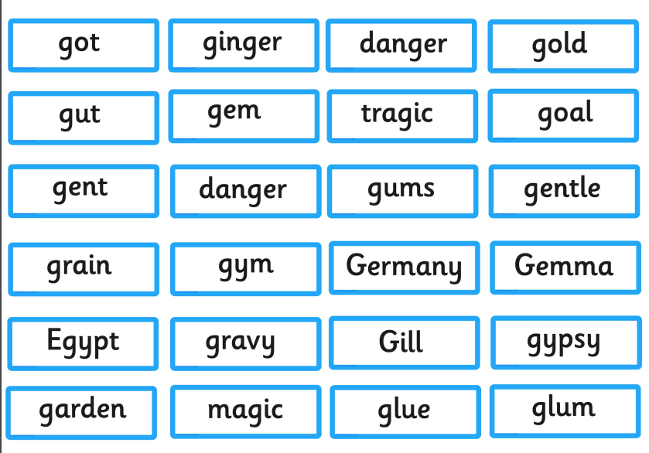
You could make your own Acorn Adventure
and place the c and g graphemes
under the correct pronunciation.

Slide 19
Play Picnic on Pluto on Phonics Play use the username and password provided.
Revise all Phase 5. How many did you get right?
Read the following sentences. Remember to sound out the words you are unsure
of (don’t guess) and then read the complete sentence.
Can you cycle and cling onto a clock?
Can an accent bring success?
Can you grow ginger in a magic garden?

Slide 20
Phase 5b Week 5:
Friday: Practise the phonemes and graphemes on the sheet (slide 2) using the Pure Sound.
Today we are learning to explore the alternative pronunciation for the u grapheme
Practice playing
Acorn Adventures
on Phonics Play. The words change
So play more than once.

Slide 21
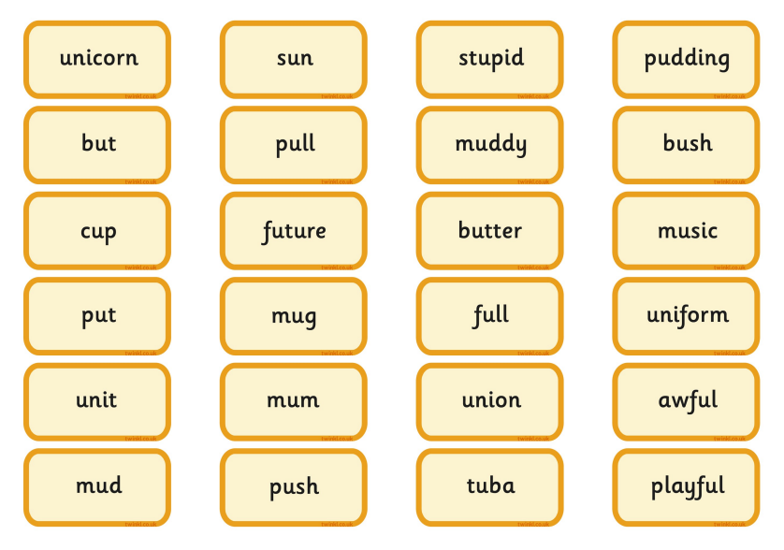
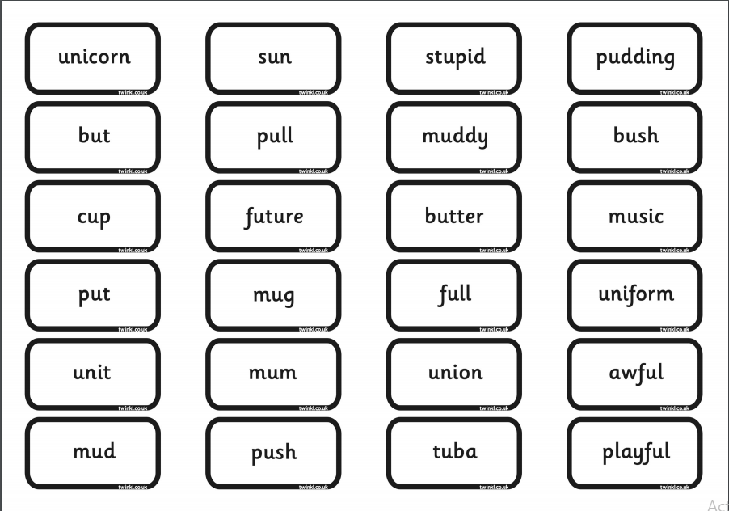
You could make your own Acorn Adventure
and place the u grapheme
under the correct pronunciation.

Slide 22
Play Picnic on Pluto on Phonics Play use the username and password provided.
Revise all of Phase 5. How many did you get right?
Read the following sentences. Remember to sound out the words you are unsure
of (don’t guess) and then read the complete sentence.
Can a unicorn play music on a tuba?
Will a stupid human get stuck in a pudding if they eat it sitting on a muddy cushion?
Will it be fun for a duck to use a computer?

Slide 23
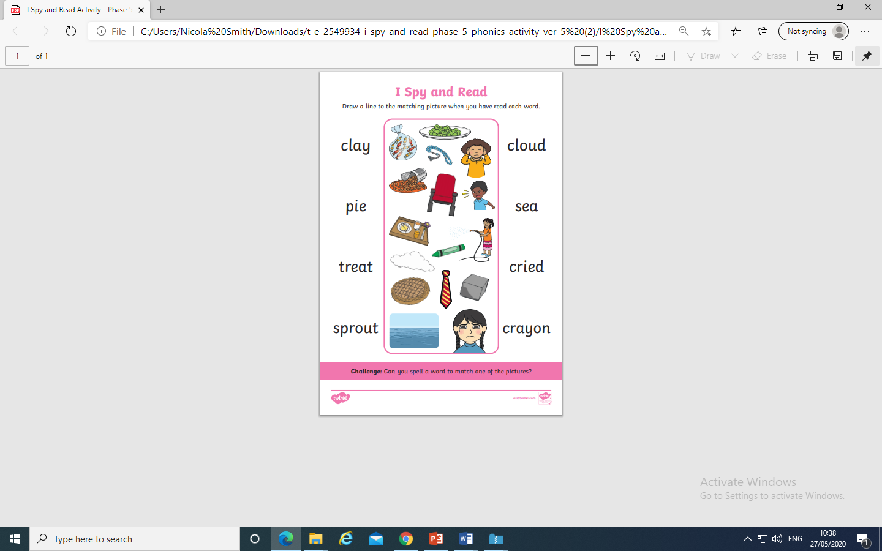
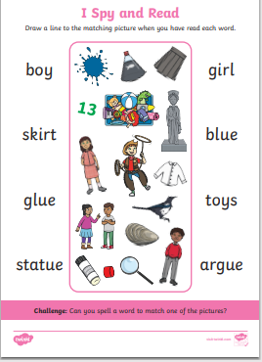
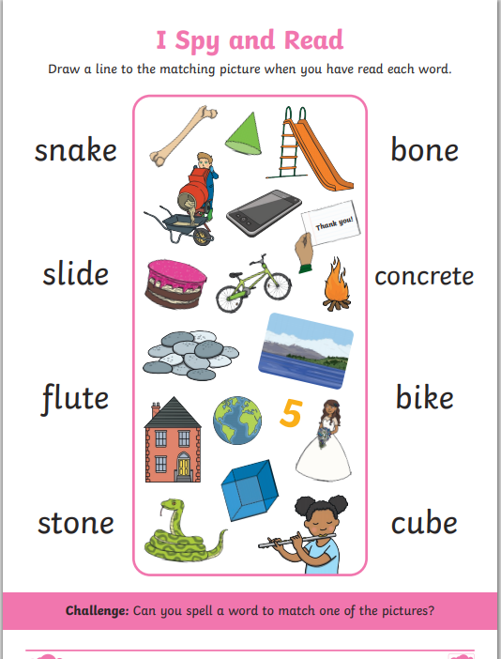
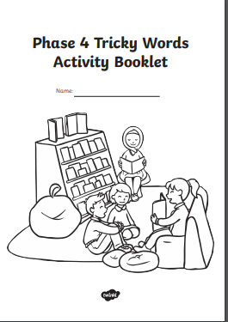
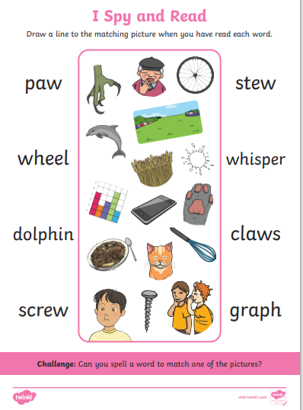
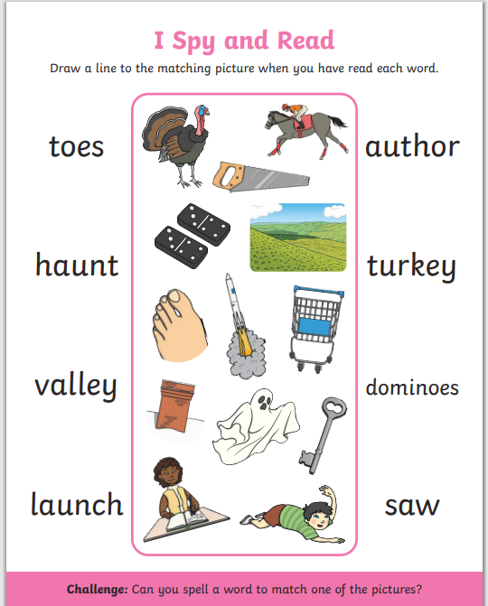
Why don’t you have a go at these resources . The I Spy and Read are attached on the resources.
Print Phase 4 Tricky word booklet from Twinkl using the password and username provided.

