Slide 1

Home Learning
Year 1
Term 6 Week 1

Slide 2

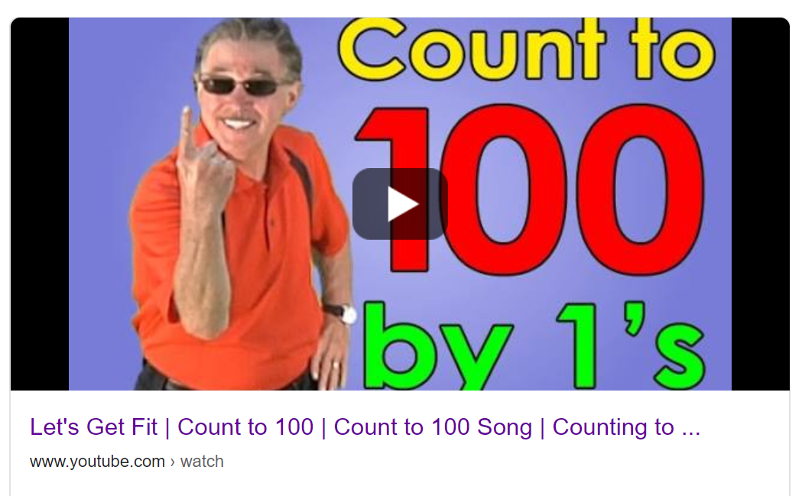
Hello Year 1!
How was Half Term? Maybe you managed to see some people you haven’t seen for a while now the Lockdown rules are changing a bit. It’s lucky the weather has been so sunny because I seem to spend quite a lot of my time standing in queues at the supermarket!
We have a lovely new book for our English lessons this week and we are doing a bit more about Addition and Subtraction in Maths. The last activity is a chance for you to think about how your life has been different to normal since the Lockdown began ten weeks ago.
You should still be reading everyday, practising your Phonics with www.phonicsplay.co.uk
(unless you are Mrs Smith’s Phonics Group, in which case please see the attached Powerpoint from Mrs Smith) and writing regularly in your writing journal/diary. It would also be good to count to 100 everyday too. Follow this link for the “Count to 100 everyday” song.
https://www.youtube.com/watch?v=0TgLtF3PMOc
Have a good week!
Love from Mrs Child
xxx

Slide 3

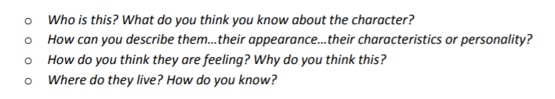
English Learning 1
We have a new book for the new term. It is called Wild and it is written and illustrated by Emily Hughes. Have a look at the cover (there is a bigger version on the next slide). Think about these questions as you look at it.
Have a go at drawing this character. Look carefully at the shape of her face and how big and round her eyes are. When you have finished your drawing annotate it with some of your thoughts, ideas or questions about the story.

Slide 5
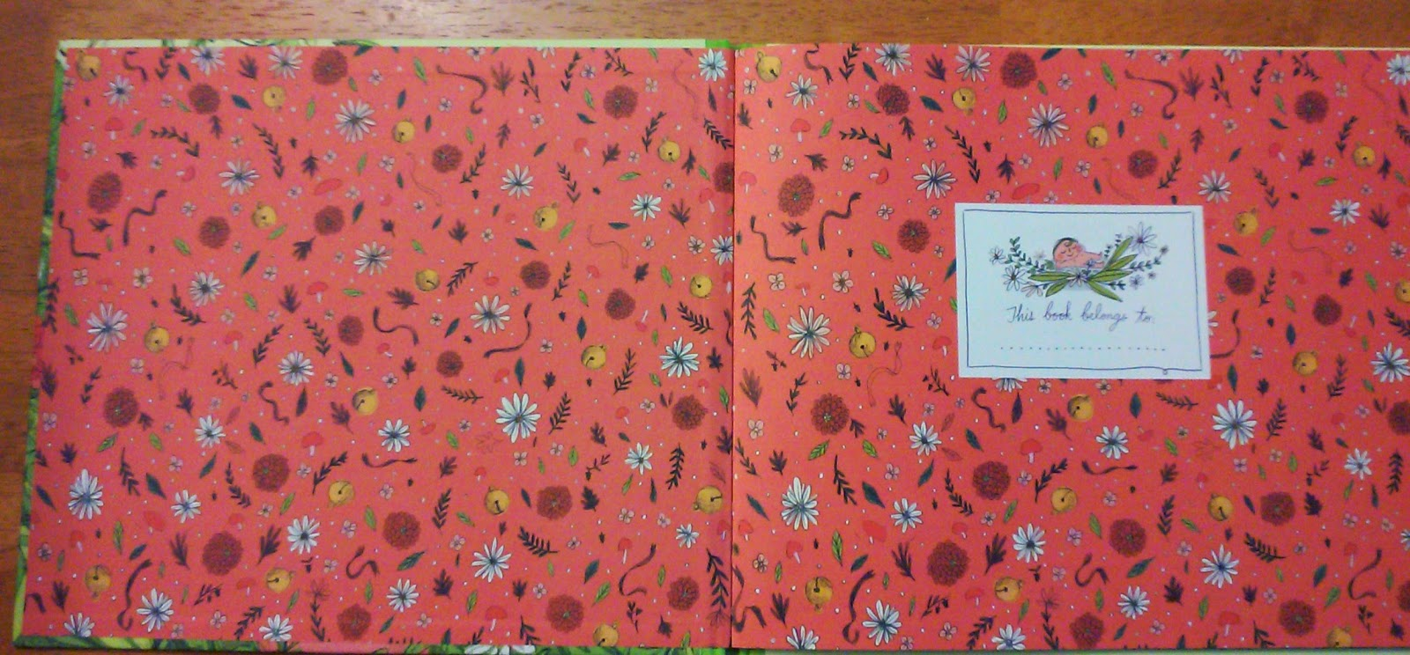
English Learning 1 (continued)
Here are the endpapers from the book.
Do they give you any more ideas about the story or the character?
(Don’t read the story yet or watch a video – we are just exploring the pictures first.)

Slide 6
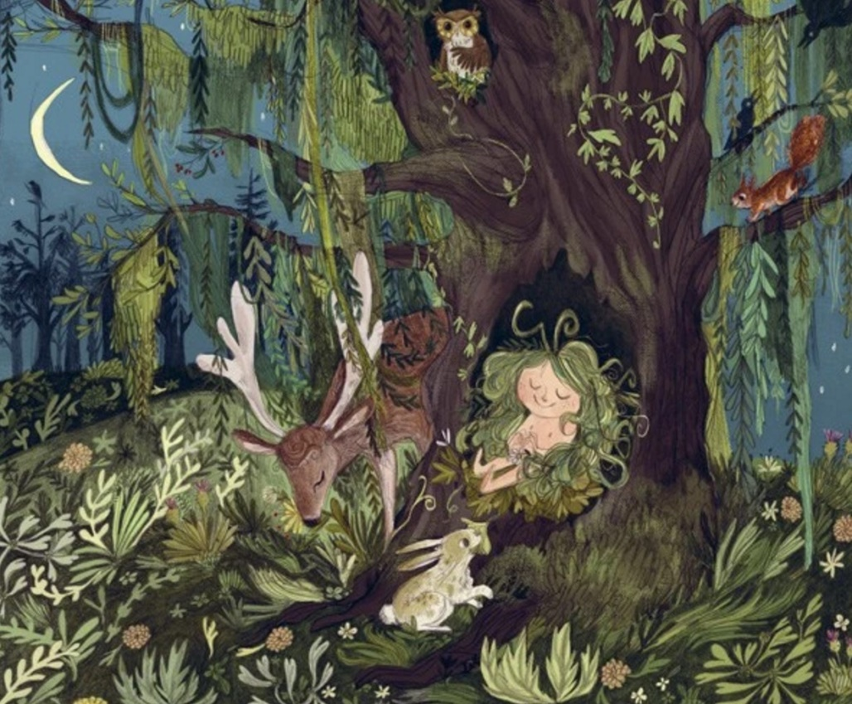
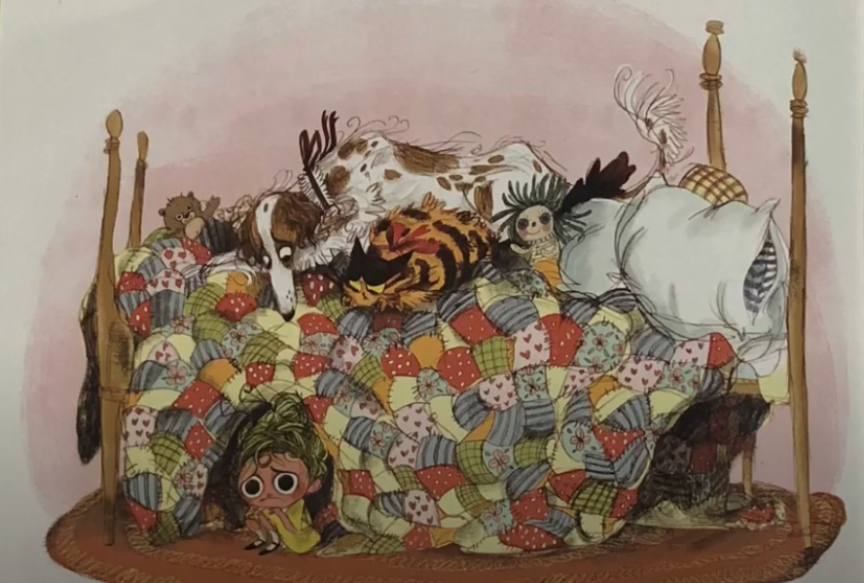
English Learning 2
Look closely at these two pictures from the story. What is the same and what is different? Can you compare how the girl is feeling in each one? What might have happened? How is she dressed in each picture and how might she feel about this? Look how she has made a hollow in the bedding like the hollow in the tree. How are the animals looking at her? What is the same and different about the animals in each picture?
Write a description for each picture. Try to write at least three sentences for each one. Some of you can write compound sentences and use lots of adjectives to make your writing more interesting. Always remember your capital letters, full stops and fingerspaces.

Slide 7
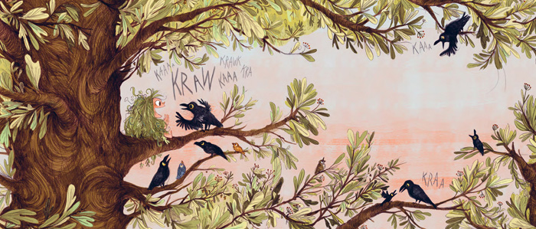
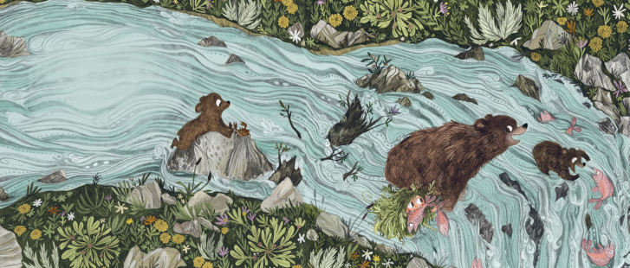
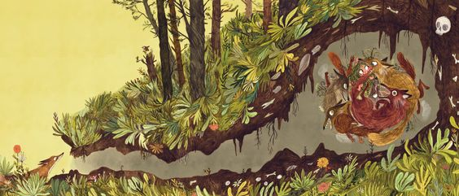
English Learning 3
You finally get to hear the whole story today. Watch Emily Hughes read her own book at https://www.youtube.com/watch?v=o9mamhbLZAE
but then watch another version at
https://www.youtube.com/watch?v=GKrs4VstrLo
where a child reads the book and adds her own commentary. In this version you can see the pictures in more detail and you will realise how the words only tell part of the story.
In the story, birds teach the girl to speak, bears teach her to eat and foxes teach her to play.
What would you like to learn from an animal? Would you like to do PE with a monkey? Would you like to dance with a flamingo? How about building with a beaver or singing with a songbird? Which animal would be the best teacher? Have a good think and then draw a picture (perhaps in the style of Emily Hughes) of your lesson with an animal. I’m sure you will come up with some wonderful ideas!

Slide 8
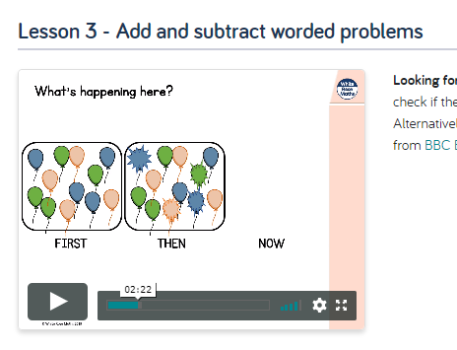
Maths Learning 1
We are continuing with our work on adding and subtracting within 20. For the first lesson this week, please go to the Year 1 Home Learning page on the White Rose website and watch the video lesson for Summer Term Week 4 Lesson 3 (it says w/c 11th May) https://whiterosemaths.com/homelearning/year-1/
When you have watched the lesson, use your preferred strategy to answer the following worded problems. Remember to write your answer as an addition or subtraction number sentence. Could you write your own worded problem for someone else to solve?

Slide 9
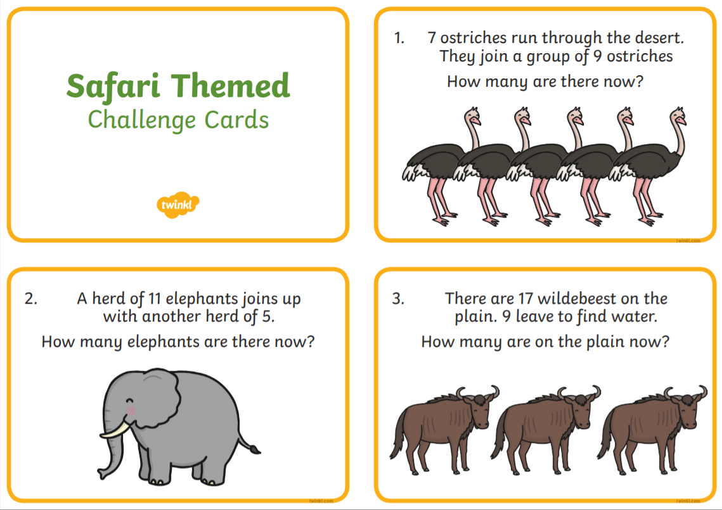

Slide 10
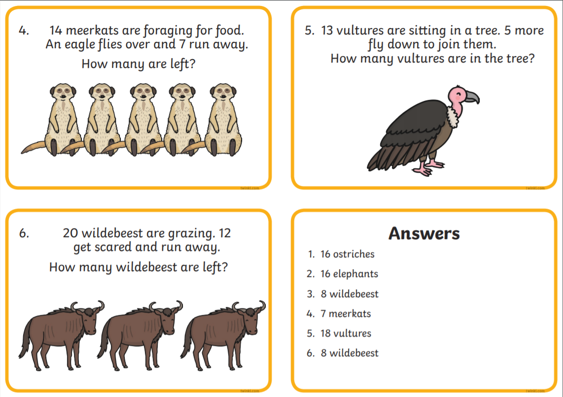

Slide 11
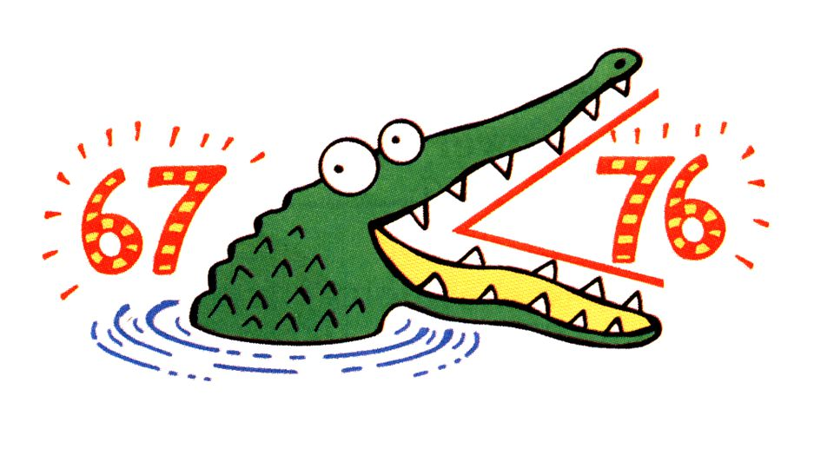
Maths Learning 2
The second lesson is about comparing number sentences. Please go to the Year 1 Home Learning Maths Lesson from 14th May on BBC Bitesize https://www.bbc.co.uk/bitesize/articles/zmf6hbk. There are two videos to watch and three activities. You only need to complete Activities 1 and 2 (but you can do Activity 3 if you want a challenge with bigger numbers). Remember when we have used the comparison symbols before we always think of them as greedy crocodiles who want to eat the biggest number.

Slide 12
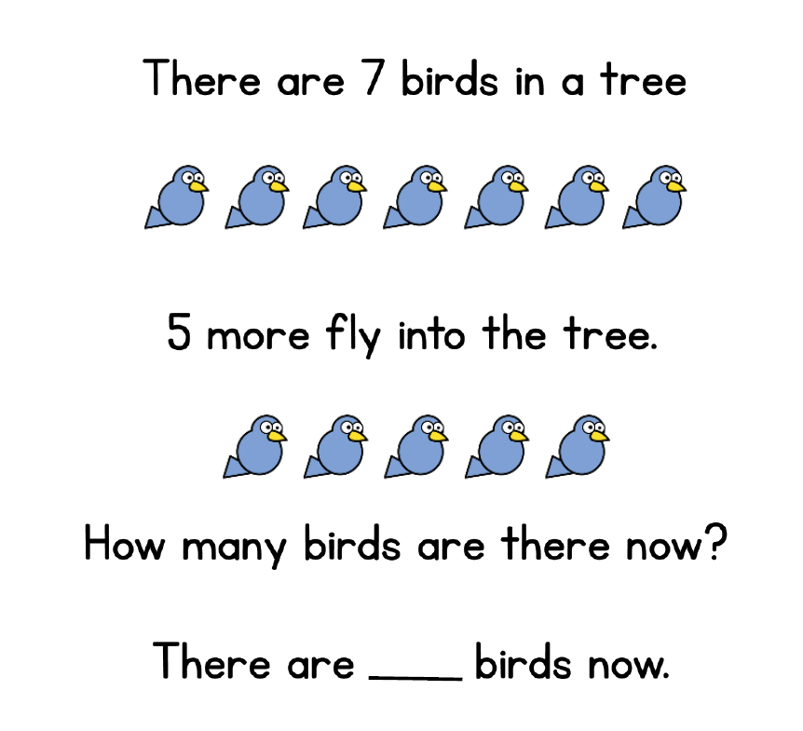
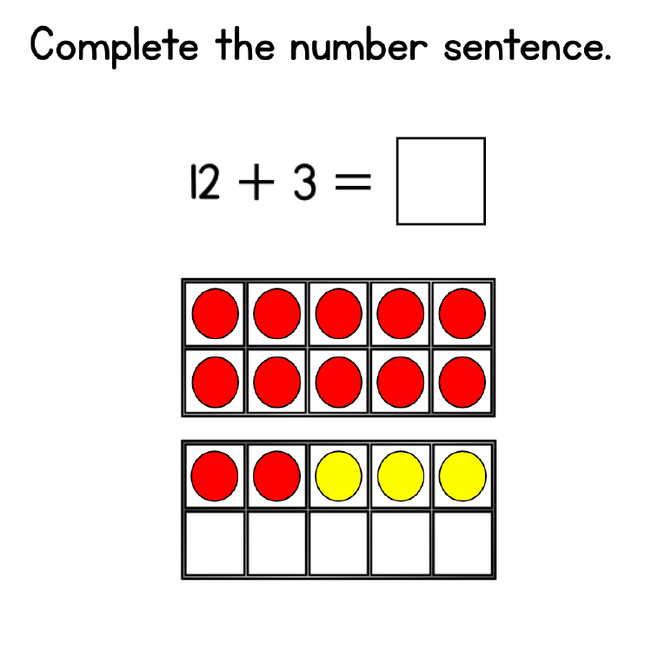
Maths Learning 3
How about a Maths test? We love Maths tests in Year 1! Have a go at the following questions to check how much you have learned about adding and subtracting within 20. An adult can read the questions to you and you can use any equipment or drawings that help you and take as much time as you need.

Slide 13
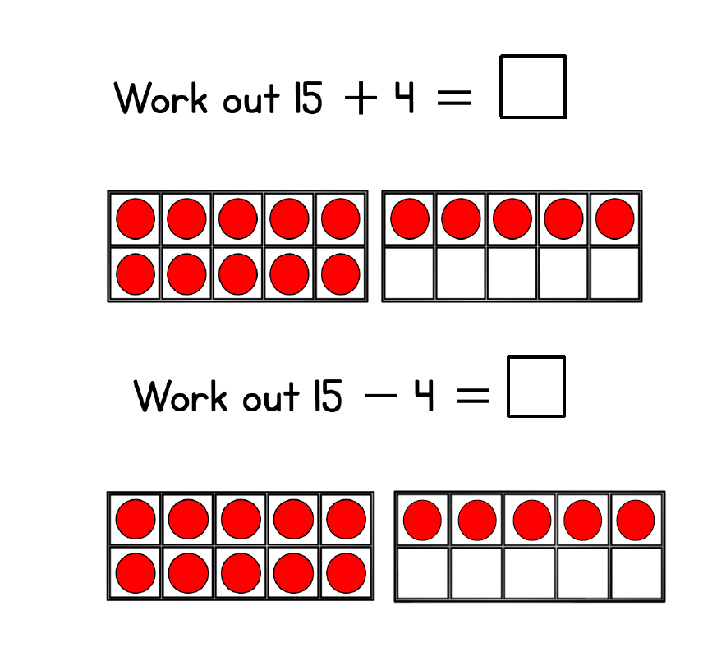
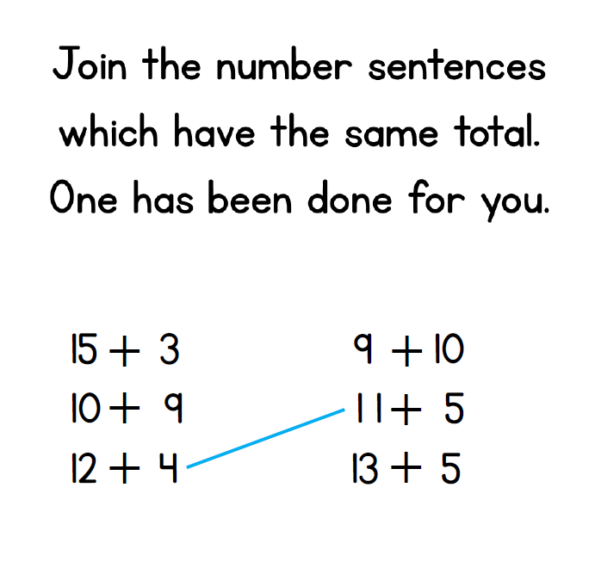

Slide 14
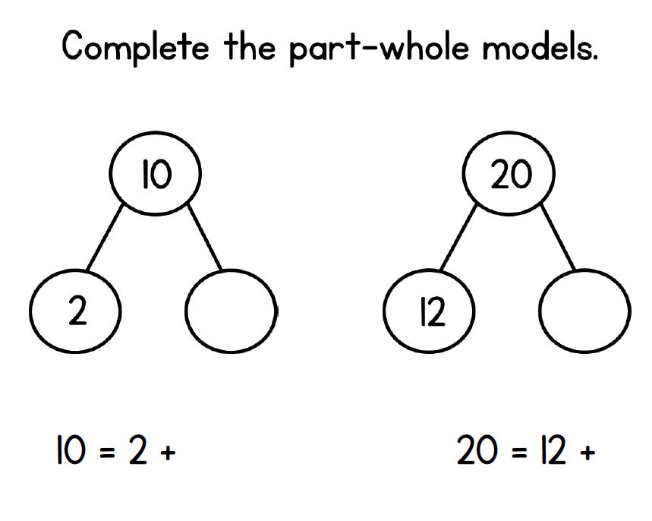
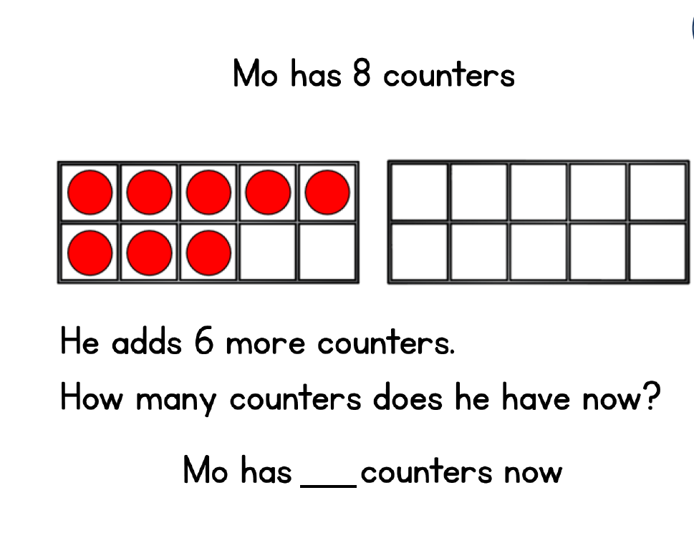
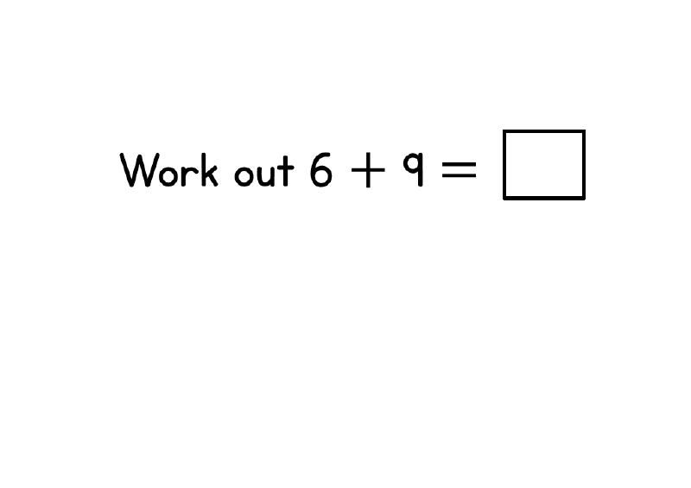
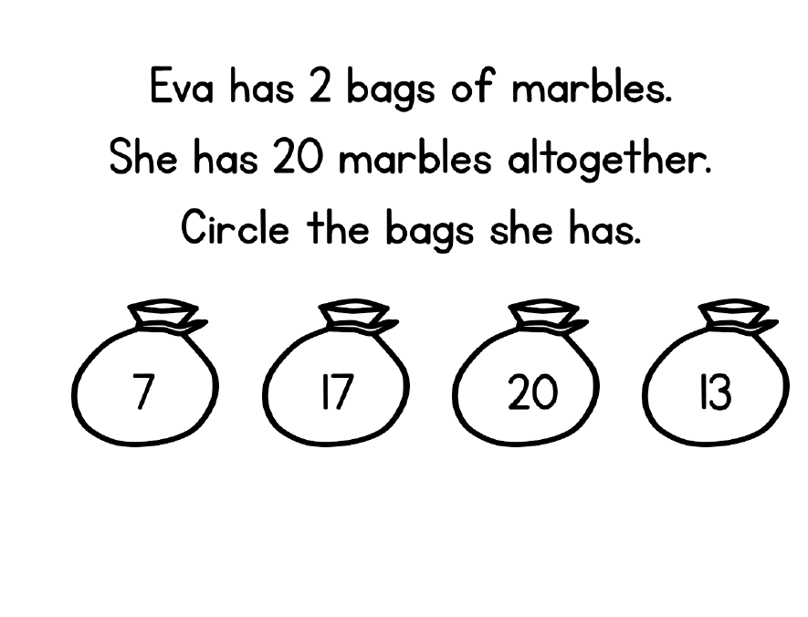

Slide 15
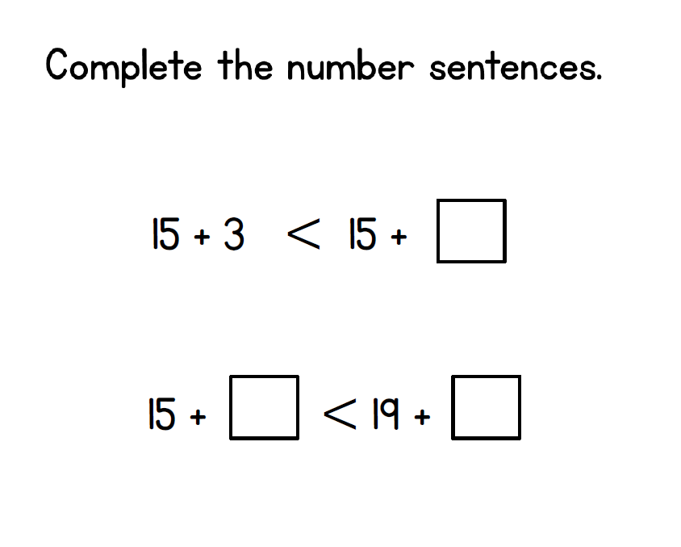
How did you do?
Don’t worry if you didn’t get it all right – it won’t be the last time you learn about addition and subtraction!

Slide 16
PSHE Learning
Lockdown reflections
Life has been very different for the last ten weeks.
No school. No playgrounds. No playing with friends.
Discuss these questions with the people you live with.
Do the grown ups have different answers to the children?
You could draw pictures or write a list of all the things you are looking forward to in the future, or maybe make a
“Things to Look Forward to Jar” – instructions on the next slide.
What have you enjoyed most about your time in Lockdown?
Have you celebrated any birthdays or special occasions during Lockdown?
Have you learned anything new about yourself or your family?
What has been the worst bit?
What are you most looking forward to when it is over?

Slide 17
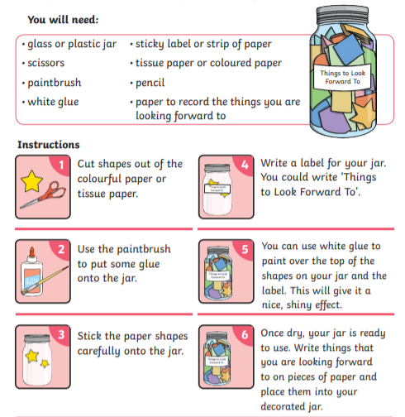
Maybe you have had days where you have felt a little sad or anxious during Lockdown. Having things to look forward to can make you feel happier and improve your wellbeing. Each time you think of something you are looking forward to doing in the future, write in on a piece of paper and place it inside your decorated jar.

Slide 18

Reading
For additional reading at your child’s level please use the Oxford Owl website where you can read books online and then complete comprehension activities about the books. Please continue to keep a record of the books they have read in their reading records.
www.oxfordowl.co.uk
Class login: temple20
Password: Bingbong
(If you are not sure of your child’s level, please check in their reading record book or look at the coloured stickers on the additional reading books that have been sent home.)

Slide 19

Phonics
Please use the games and activities on the Phonicsplay website to continue practsing Phonics.
www.phonicsplay.co.uk
Login: march20
Password: home
Mrs Child’s Phonics group are currently working on Phase 5c (alternative ways of writing sounds we already know e.g. ai, ay, a_e all make the same sound).
Mrs Smith’s group are working on Phase 4.
Additionally, there are many excellent Phonics resources on the Twinkl website(see below for how to get free access). Practising reading “alien words” is a particularly fun and valuable activity.

Slide 20

Writing
Your child has been provided with a writing journal. They are used to using them and know that they need to write the date, write a sentence (about anything they like), draw and colour a picture and then fill any spare lines with handwriting patterns.

Slide 21

P.E.
It is important to keep your children active. If it is safe to do so, ensure they have some time outside throughout the day. Please visit Joe Wicks YouTube channel (https://www.youtube.com/channel/UCAxW1XT0iEJo0TYlRfn6rYQ), which has lots of exercise videos for children. He will also be hosting a live P.E. lessons Monday to Friday at 9:00am.

Slide 22


Using My Maths
Children should know their way round My Maths but here are some reminders on how to access the lessons. Visit: www.mymaths.co.uk
bapchild
divide162

Slide 23

Using My Maths
Access any lesson based on what your child is learning in class or search the topic in the search bar.
Use the login portal to access specific homework and lessons that your teacher has set.

Slide 24

Maths – White Rose Home Leaning
In school we follow the White Rose scheme of learning. Their website has put together free lessons and resources that link to the learning taking place in school. Please visit: https://whiterosemaths.com/homelearning/

Slide 25

Accessing Twinkl
Many educational content providers are offering free access to their resources. Twinkl is a website that we use from time to time to resource our lessons to aid in teacher input and pupil activities.
We will be able to direct you towards activities and learning via this website based on lessons that may be missed due to absence. To access Twinkl please visit: www.twinkl.co.uk/offer
You will have to sign up and put in the offer code: UKTWINKLHELPS

Slide 26

Classroom Secrets
The site classroom secrets https://classroomsecrets.co.uk/free-home-learning-packs/ has free class packs which provide some great additional ideas and resources you can use.

