Slide 1

Home Learning
Year 1
Half Term

Slide 2

Hooray it’s half term!
Time for a break from routine!
Usually Year 1 children would have lots of Phonics work to practice over the half term holiday because the Year 1 Phonics Screening would be just weeks away. Luckily for you it has been cancelled this year even though you would all have done brilliantly! Just to prove it, here are a couple of “Alien Name” phonics activities you might like to try plus an Alien art activity. You also might enjoy practising past Phonics Screening papers which can be found at https://www.gov.uk/government/collections/national-curriculum-assessments-practice-materials#phonics-screening-check-resources or if you have lots of ink in your printer I have attached a lovely booklet of “Monster Phonics Activities”. Mrs Smith has also made a new Powerpoint for her Phonics group to complete over the week.
Fingers crossed that it won’t be too long now before we can all be together again.
Love from Mrs Child
xxx

Slide 3
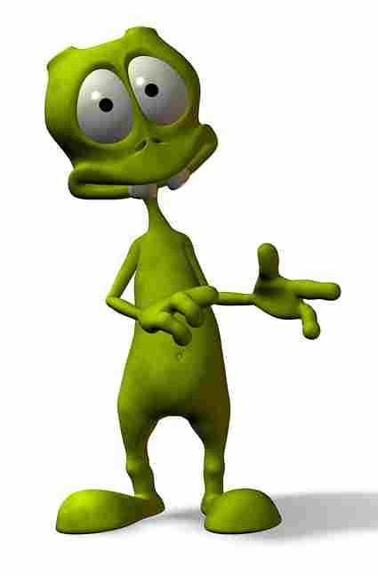



Create alien names using a beginning, middle and end sound and then draw what they look like.
Examples:
Blawsh
Beginning | Middle | End
Bl | oy | t
Cr | aw | ph
Fl | ow | m
Gr | ie | n
J | ue | f
Spl | ew | ch
Str | au | sh
How many different aliens can you make?
Groych

Slide 4
If you can segment and blend all these alien names then you know all the sounds and have all the skills you need.
(Remember you can draw in the sound buttons or highlight the digraphs if it helps.)
Baid | Hayf | Gake | Deef
Heem | Plean | Quete | Narth
Vight | Twie | Yize | Blove
Croab | Proet | Jome | Phowt
Froomp | Cachue | Sprume | Aspew
Wormid | Fauster | Nawm | Voo
Shoit | Groys | Crouth | Og
Zoup | Rowz | Meeth | Umf
Yerpan | Jirlee | Hurck | Jair
Thrair | Scrust | Fowsp | Freesp
Kear | Dronk | Zaunch | Scrung
Dacture | Brist | Blurg | Trown

Slide 5
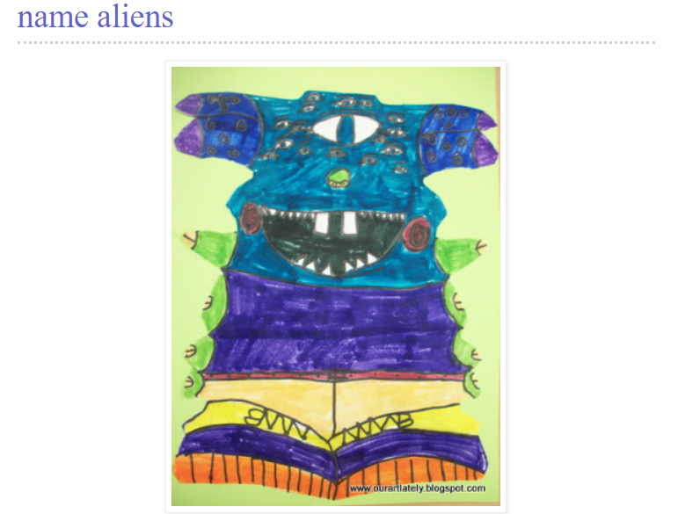
Have a go at making a symmetrical alien picture using your name. These instructions come from http://ourartlately.blogspot.com/2011/05/name-aliens.html

Slide 6
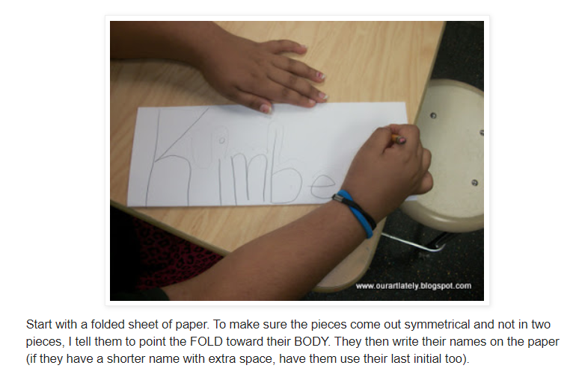

Slide 7
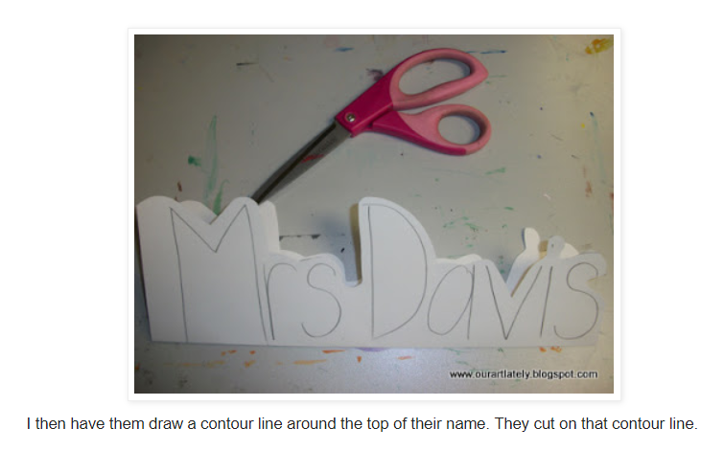

Slide 8
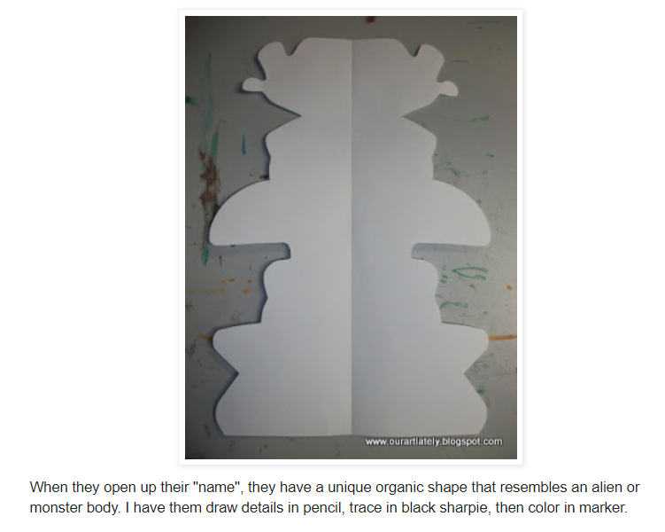
(Or you could paint or collage or use stickers - anything you have to hand.)

Slide 9
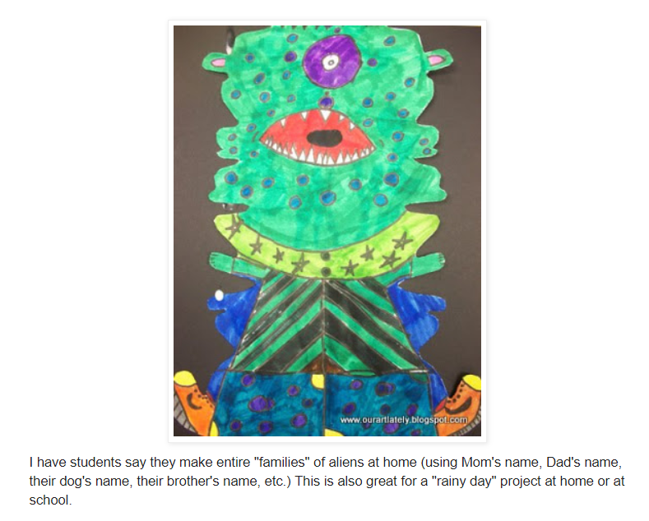

Slide 10
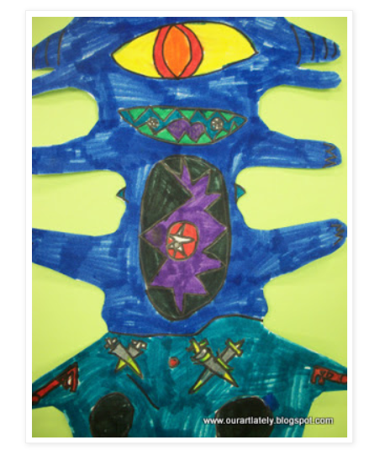
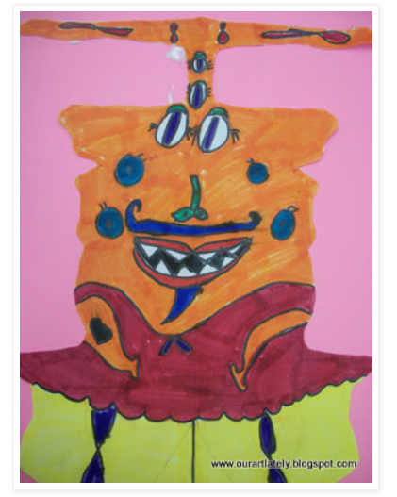
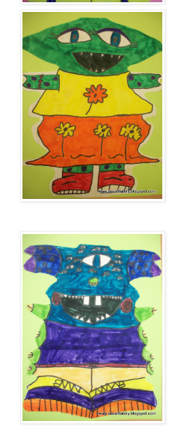
When you have finished your alien it will need a name.
Choose a name from the following list.

Slide 11


