Slide 1

Hello and Welcome to Mrs Smith’s Phonics Group Week 3 .
I hope you are all still staying safe, well and happy, I am missing you all.
I know you have been working hard learning and revising the sounds we already know and our new Phase 5 graphemes and phonemes GPCs.
You could start your phonics learning daily with our alphabet song or to get you moving BBC Super Movers with Naomi Wilkinson https://www.youtube.com/watch?v=jYeMpUdufNk
Do as much as you can and have Fun. Love Mrs Smith xx
Please play this Power Point in slide show and keep clicking there are animations (it works better on a laptop than IPad).

Slide 2
You could print this grid off and check what phonemes (sounds) to grapheme (written) you can recall daily. You could colour, tick or cover with counters, coins or pebbles the ones you can say using the PURE SOUND. If you don’t want to print it off you could point to each sound and say using the PURE SOUND. Are you getting quicker maybe you could time yourself.
s | a | t | p | i | n | m
d | g | o | c | k | ck | e
u | r | h | b | f | ff | l
ll | ss | j | v | w | x | y
z | zz | qu | ch | sh | th | ng
ai | ee | igh | oa | oo | ar | or
ur | ow | oi | ear | air | ure | er
ay | ou | ie | ea
Add new sounds during the week

Slide 3



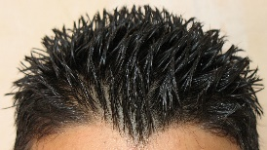
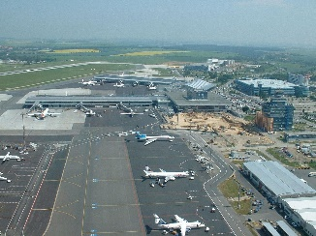


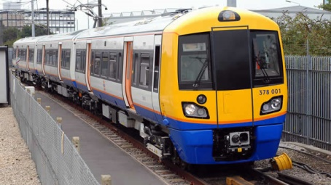
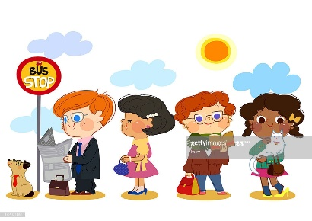

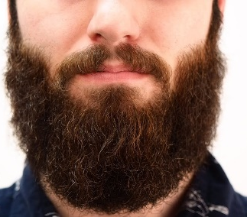
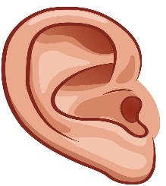
Revise these phonemes daily as they are tricky:
th as in thumb three tooth
air as in hair airport air
ai as in rain train wait
ear as in ear tear beard
hear

Slide 4
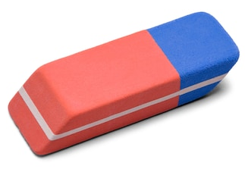
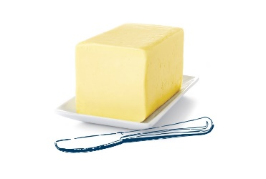
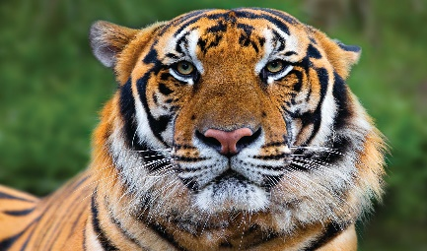
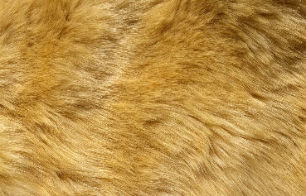

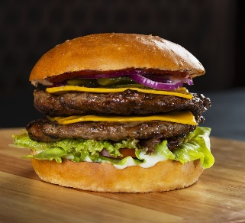
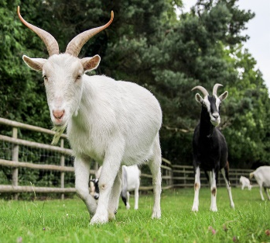

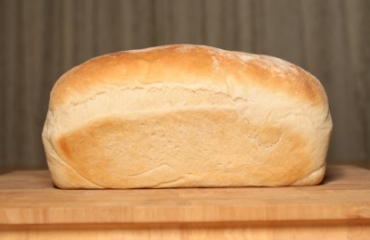
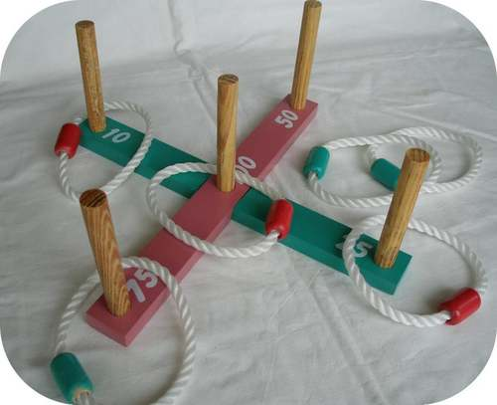
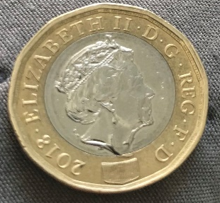
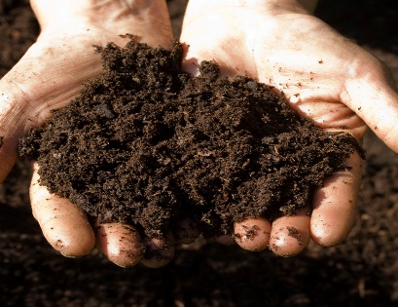



er as in eraser butter tiger
ur as in fur church burger
oa as in goat road loaf
oi as in quoits coin soil
igh as in light night right

Slide 5

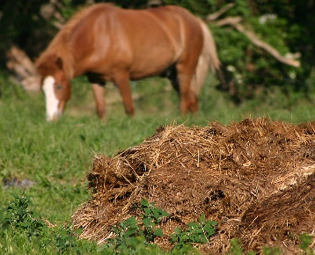
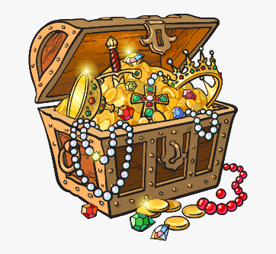

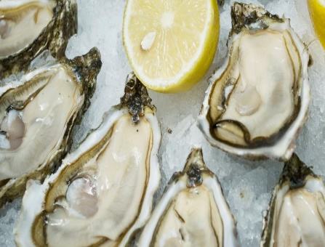
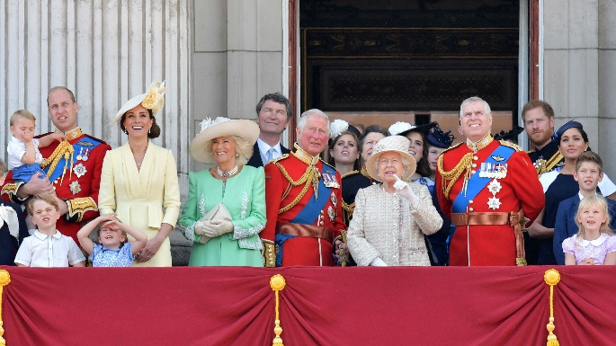
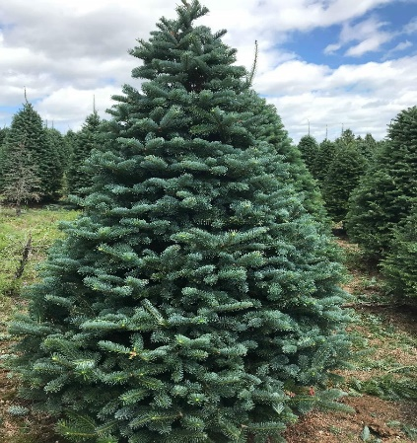

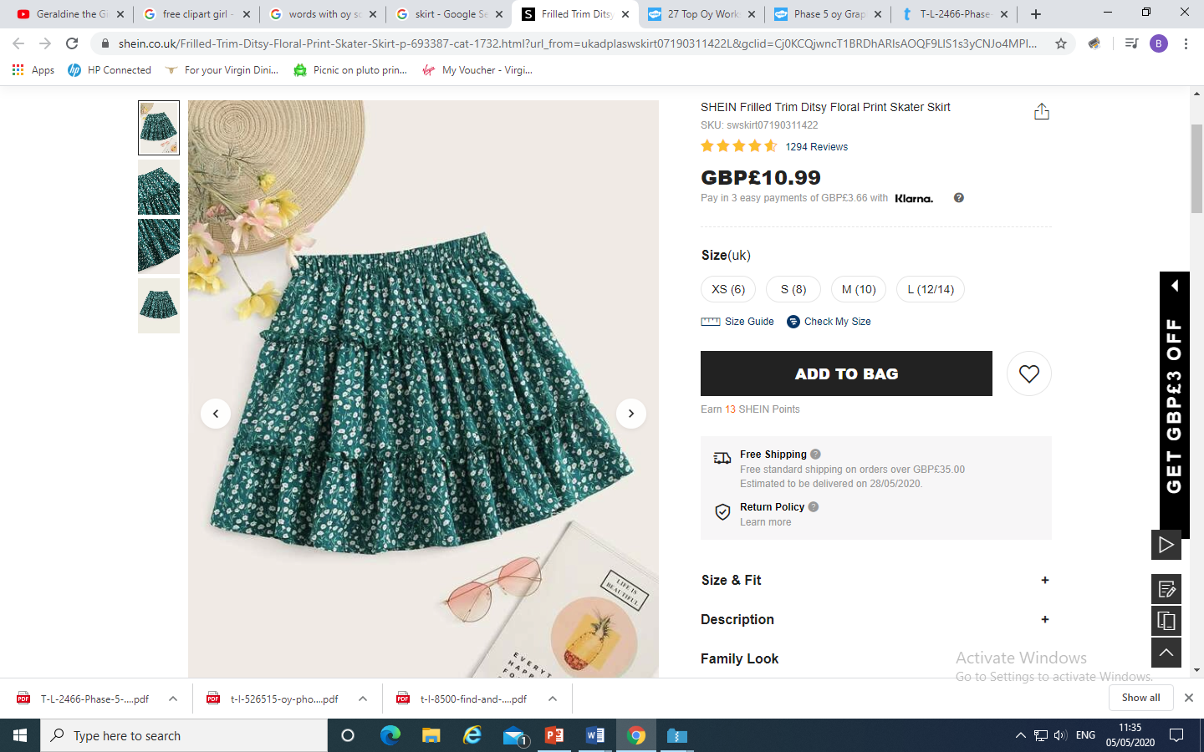
ure as in pure manure treasure
oy as in boy oyster royal
ir as in girl skirt fir

Slide 6
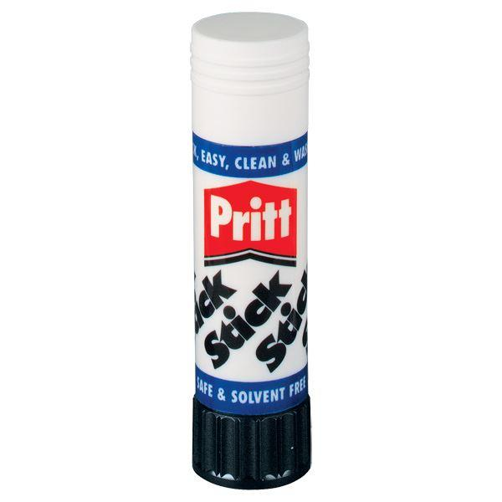

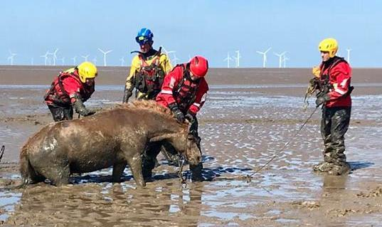
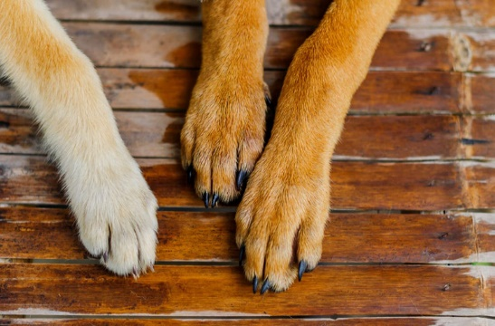
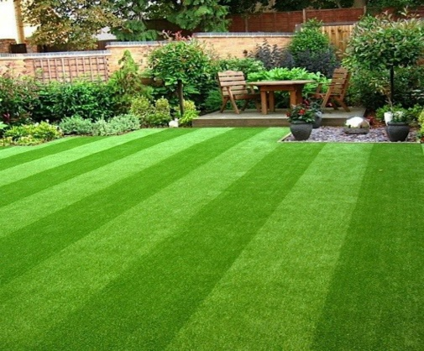
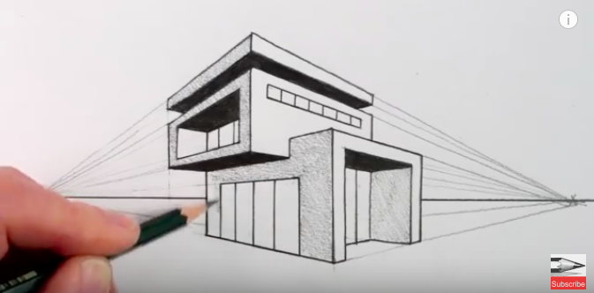
ue as in glue blue rescue
aw as in paw lawn
draw

Slide 7
Phase 5a Week 3:
Monday: Practise the phonemes and graphemes on the sheet (slide 2) using the Pure Sound and the tricky phonemes.
Today we are going learn to say the phonemes wh and ph and to practice writing them.
Write the phonemes wh and ph in the air or on your adult’s, brother’s or sister’s back using your finger.
Watch Geraldine the Giraffe
https://www.youtube.com/watch?v=vuYZVrh1iPc
https://www.youtube.com/watch?v=z1bseW0nI2k
Let’s see if we can find some other words with wh and ph in them.

Slide 8
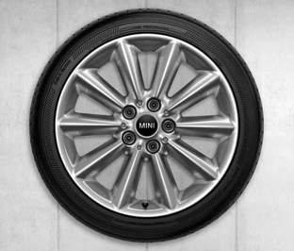
Look at each picture.
Say the word.
Sound Talk or Robot Talk the word and Count the phonemes (sounds).
Try writing it.
Then check if you are right by clicking.
How many
Phonemes?
3
w h e e l wheel
●

Slide 9
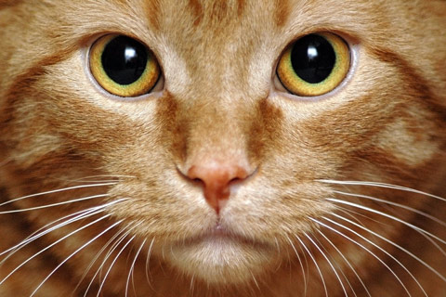
How many
Phonemes?
6
w h i s k e r s whiskers
●●● ●

Slide 10
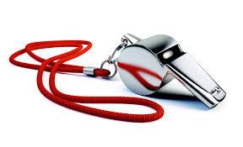
How many
Phonemes?
6
w h i s t l e whistle
●●●● ●

Slide 11
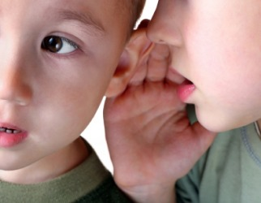
How many
Phonemes?
5
w h i s p e r whisper
●●●

Slide 12
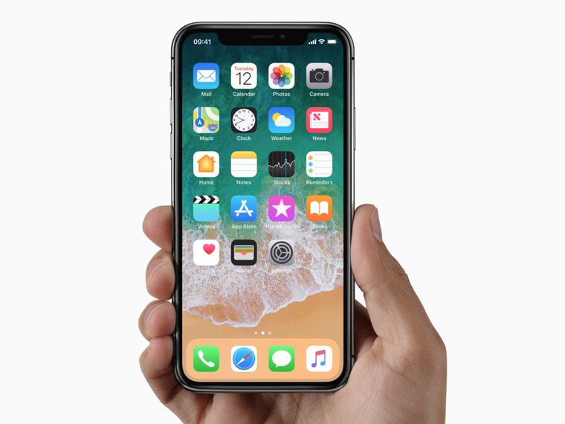
How many
phonemes?
3
p h o n e phone
●

Slide 13
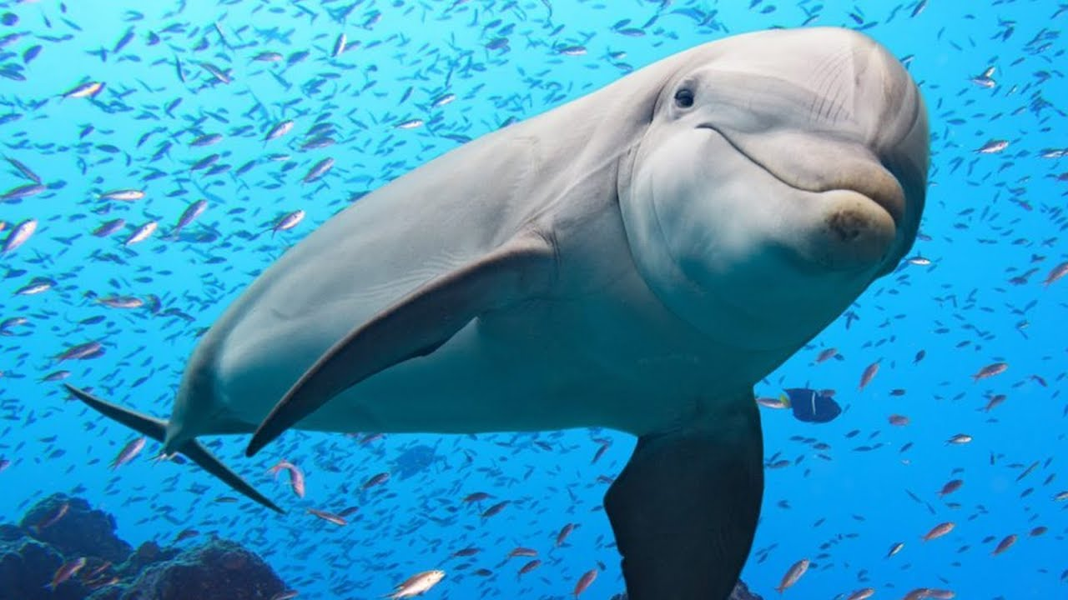
How many phonemes?
6
d o l p h i n dolphin
●● ● ● ●

Slide 14

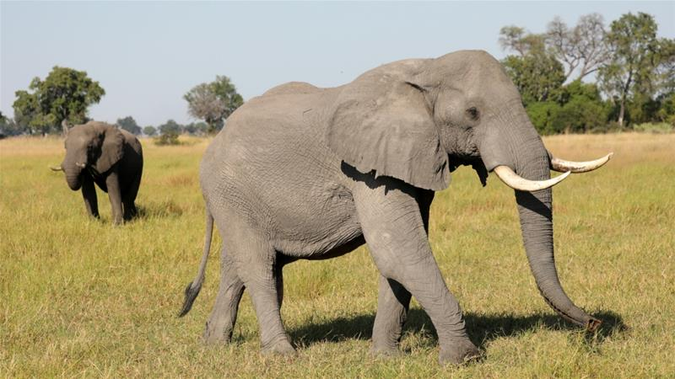
How many phonemes?
7
e l e p h a n t elephant
●●● ●●●

Slide 15
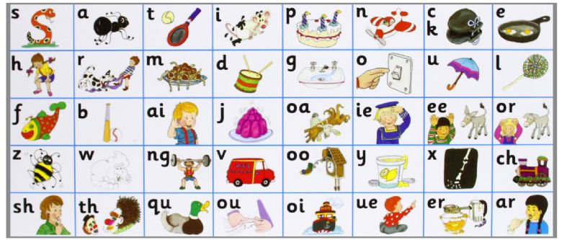
How many phonemes?
6
p h o n i c s phonics
●●● ●●

Slide 16
Play Buried Treasure on Phonics Play use the username and password provided. Phase 5 and select wh or ph. You could enter your own words - when, phen, which, phonics, wheck, graphics, wheel, whump, alphabet, craph, wheem, whisper, graph, braphics. How many did you get right?
Read the following sentences. Remember to sound out the words you are unsure of (don’t guess) and then read the complete sentence.
Which is a dolphin better at, jumping or swimming?
Phonics is about sounds. I can whisper them or say them loud.
When will you take a photo of a big wheel?

Slide 17
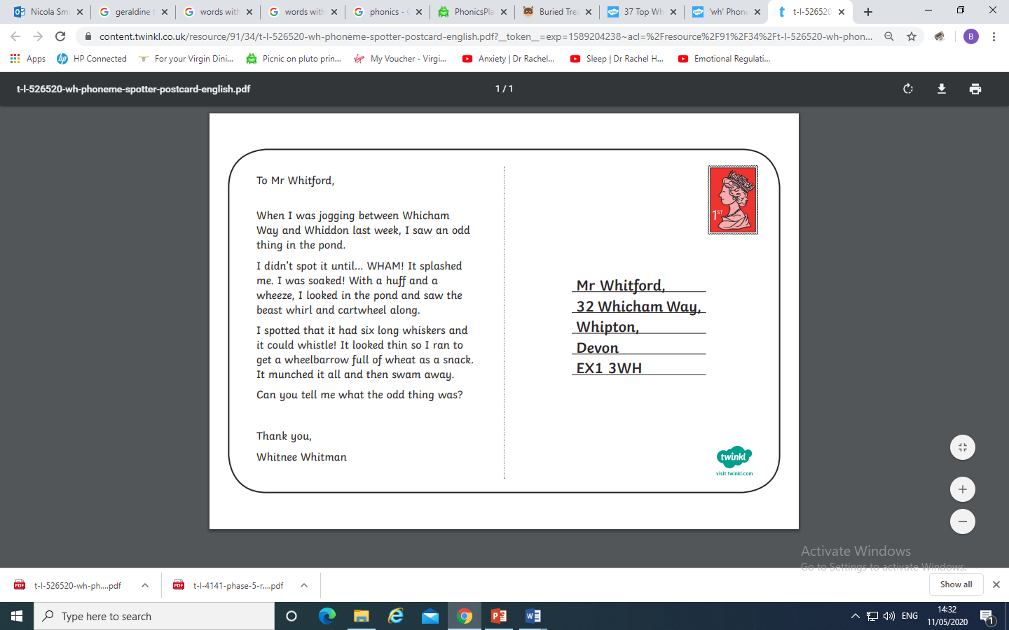
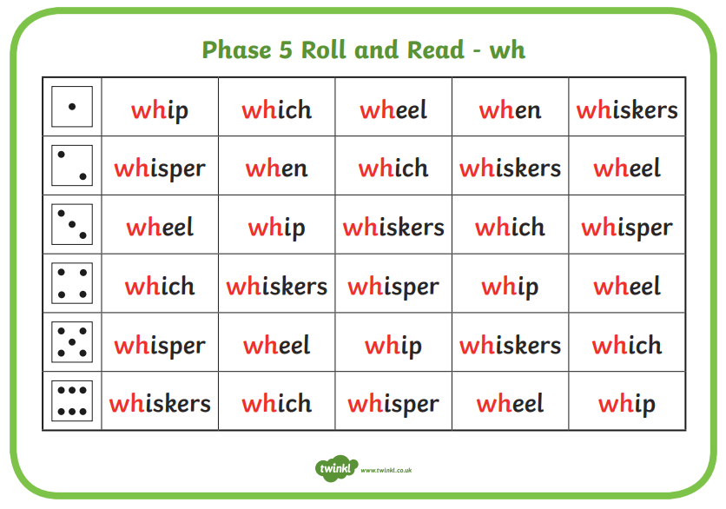
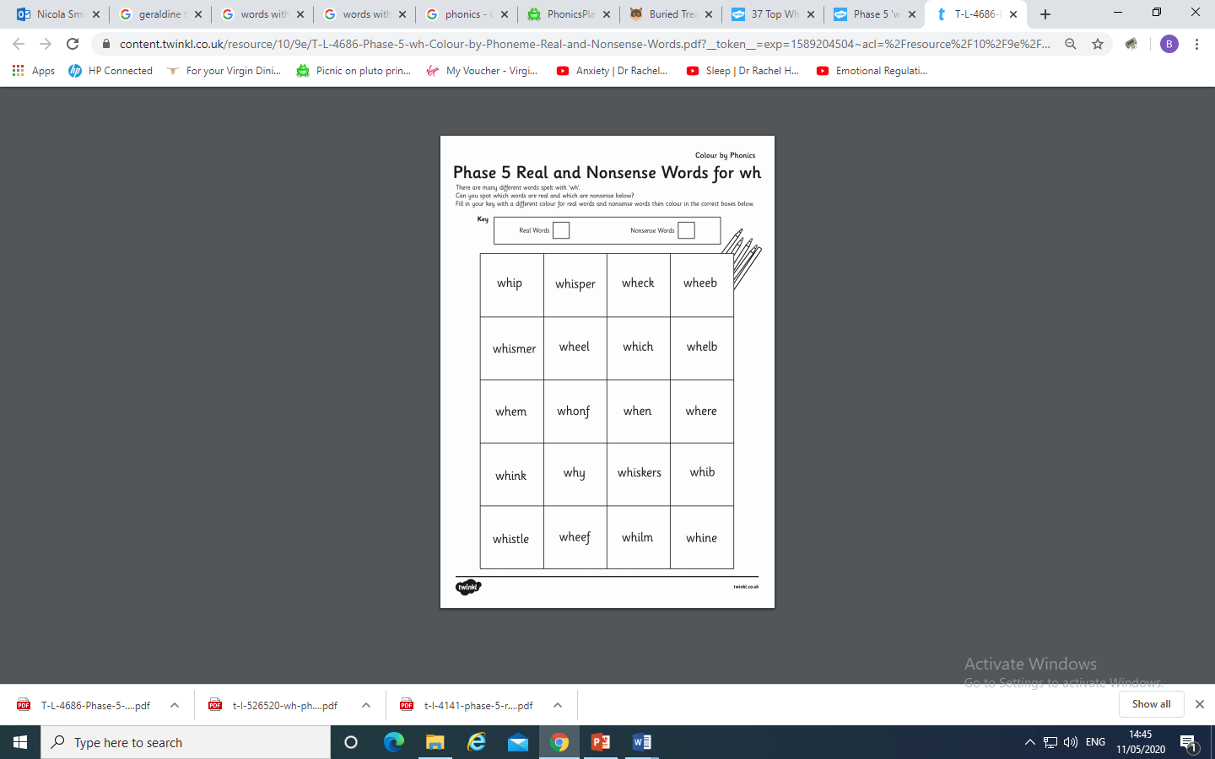
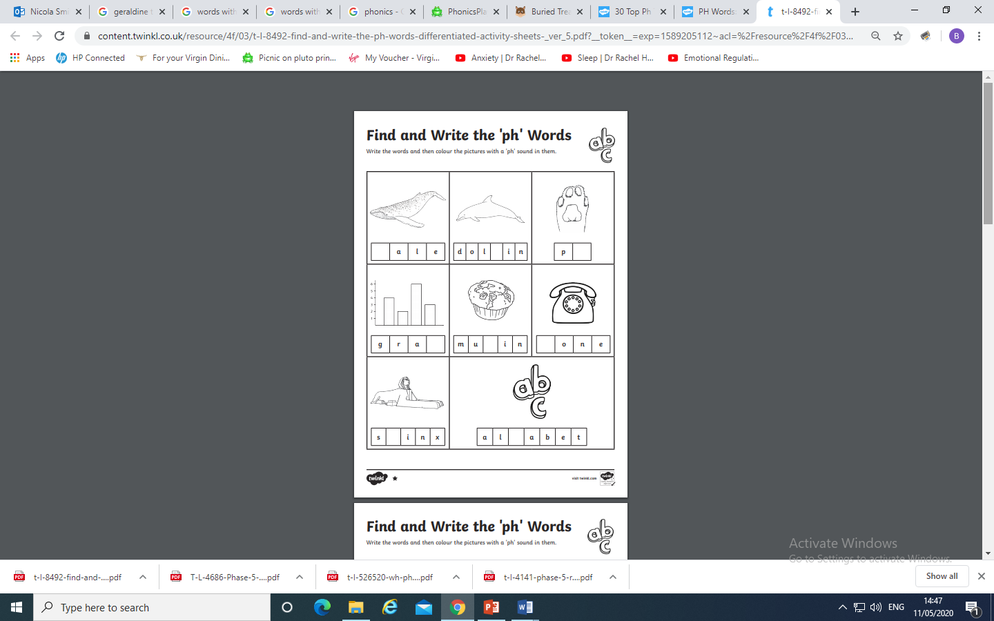
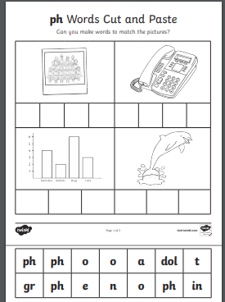
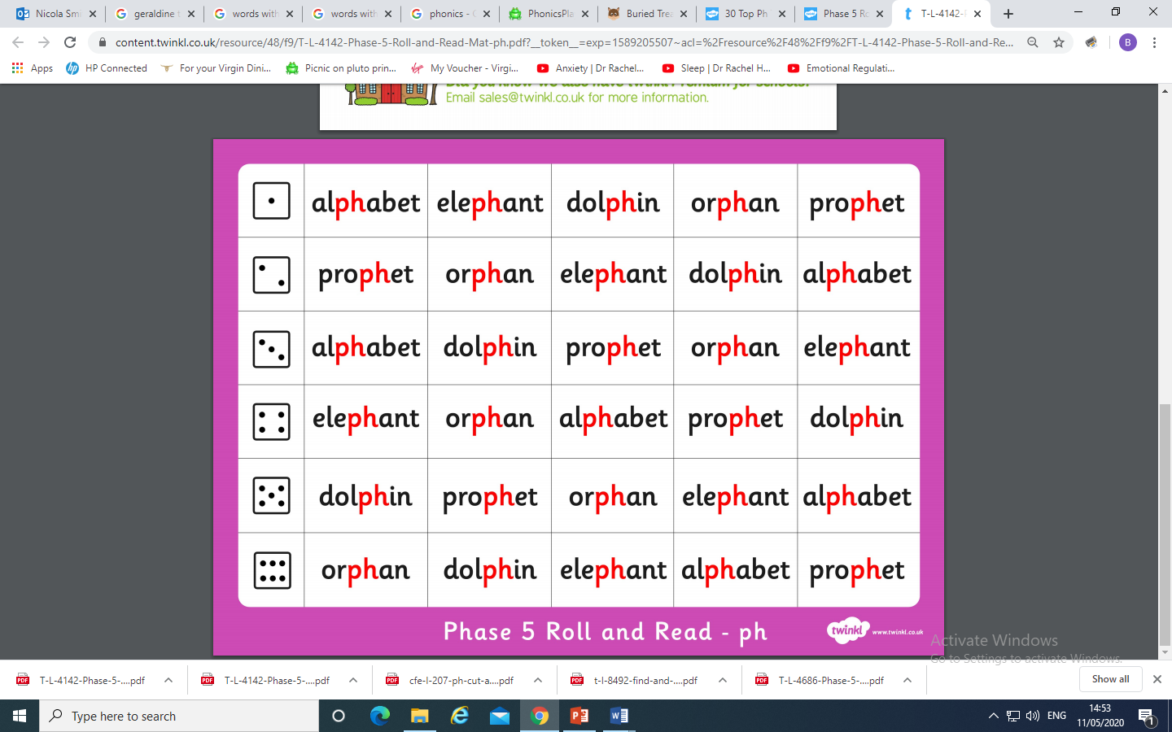
On Twinkl there are some worksheets for each sound if you want to carry
on learning. Look for sounds in your reading book or on signs .
For Example :
Underline, highlight or circle the wh phoneme.

Slide 18
Tuesday: Practise the phonemes and graphemes on the sheet (slide 2) using the Pure Sound and the tricky phonemes. Including yesterday’s GPC wh and ph
Today we are learning the grapheme ew.
Write the phoneme ew in the air or on your adult’s, brother’s or sister’s back using your finger.
Watch Geraldine the Giraffe
https://www.youtube.com/watch?v=ZojmFjUAGh4
Let’s see if we can find some other words with ew in them.

Slide 19
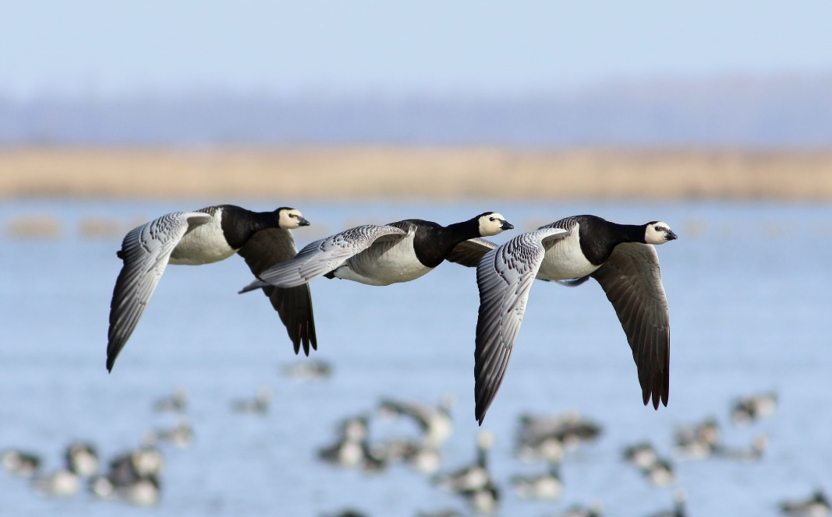
Look at each picture.
Say the word.
Sound Talk or Robot Talk the word and Count the phonemes (sounds).
Try writing it.
Then check if you are right by clicking.
How many
Phonemes?
3
f l e w flew
●●

Slide 20
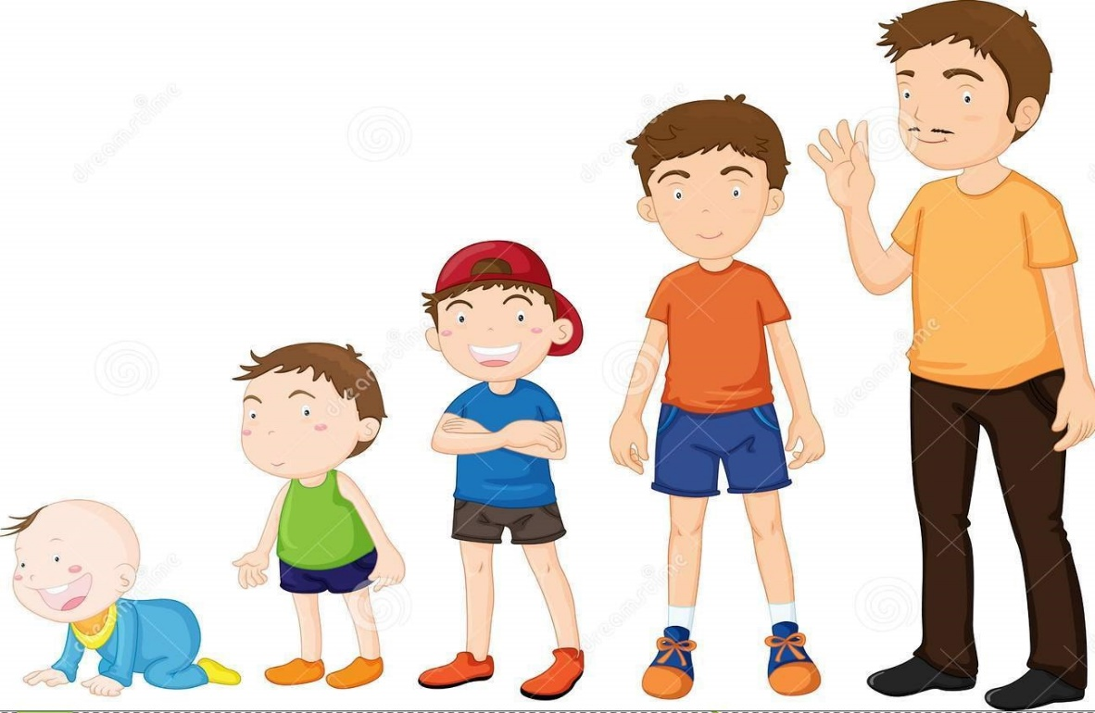
How many
phonemes?
3
g r e w grew
● ●

Slide 21
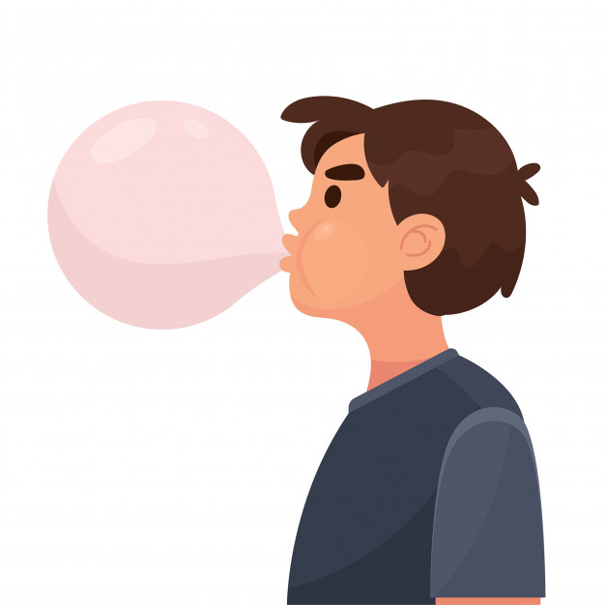
How many
phonemes?
3
b l e w blew
●●

Slide 22
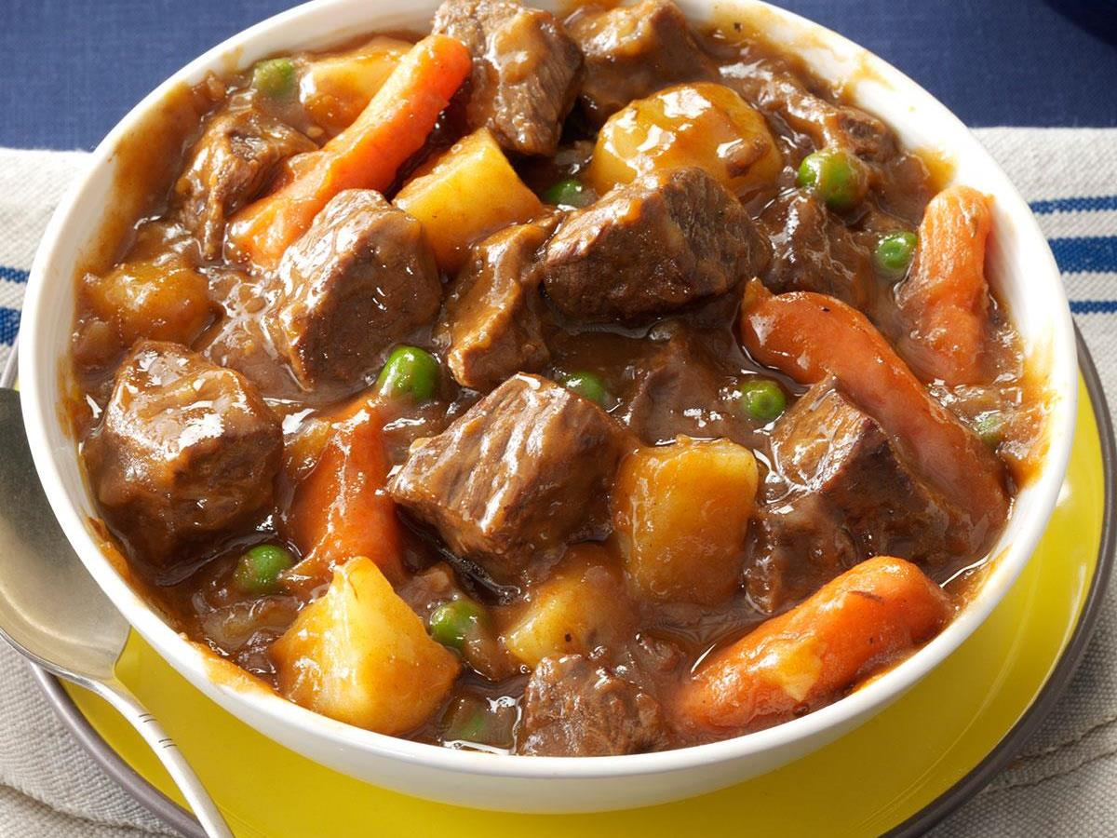
How many
phonemes?
3
s t e w stew
● ●

Slide 23
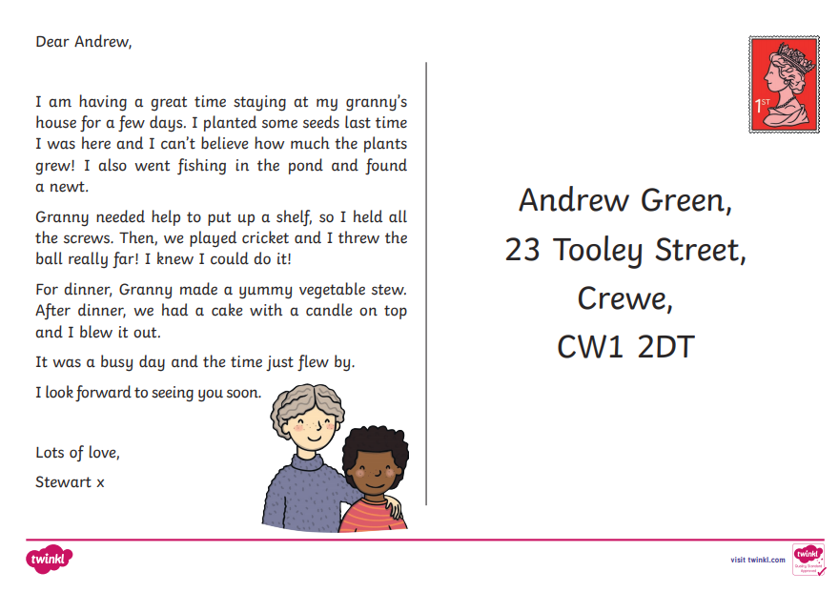
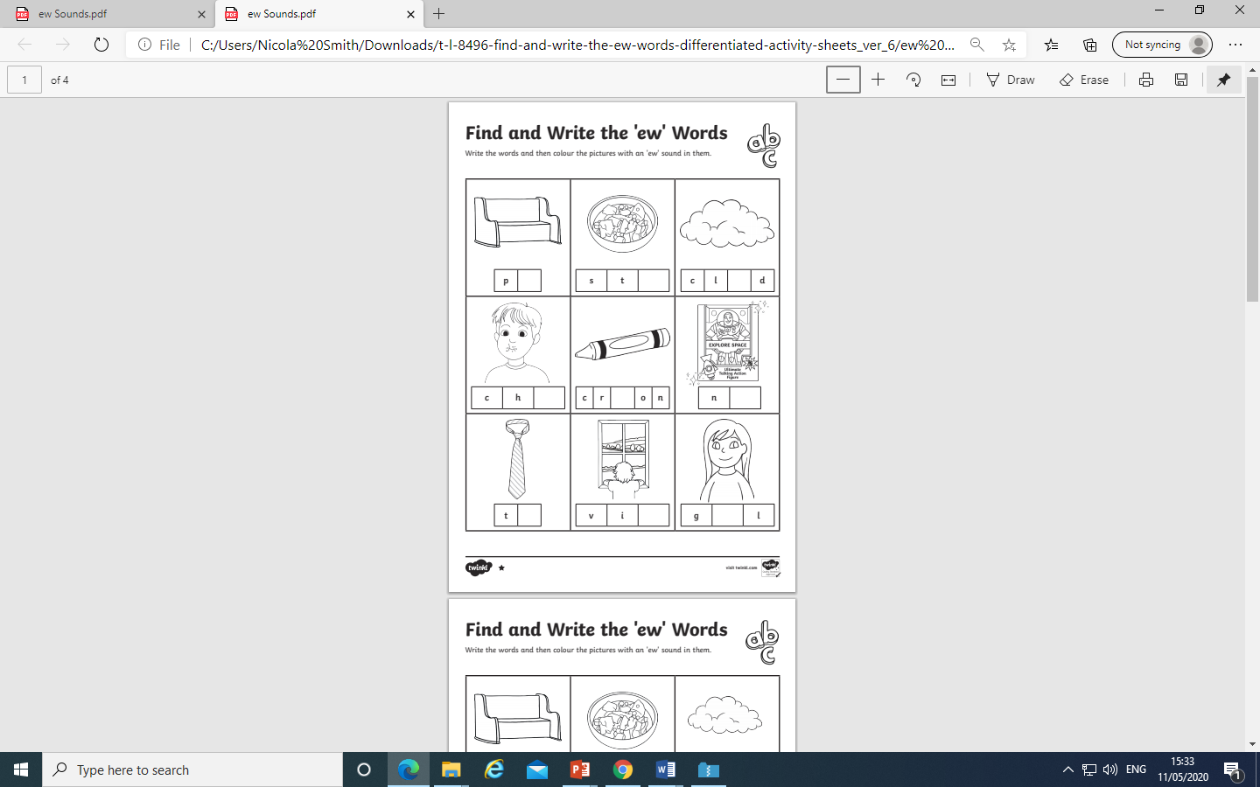
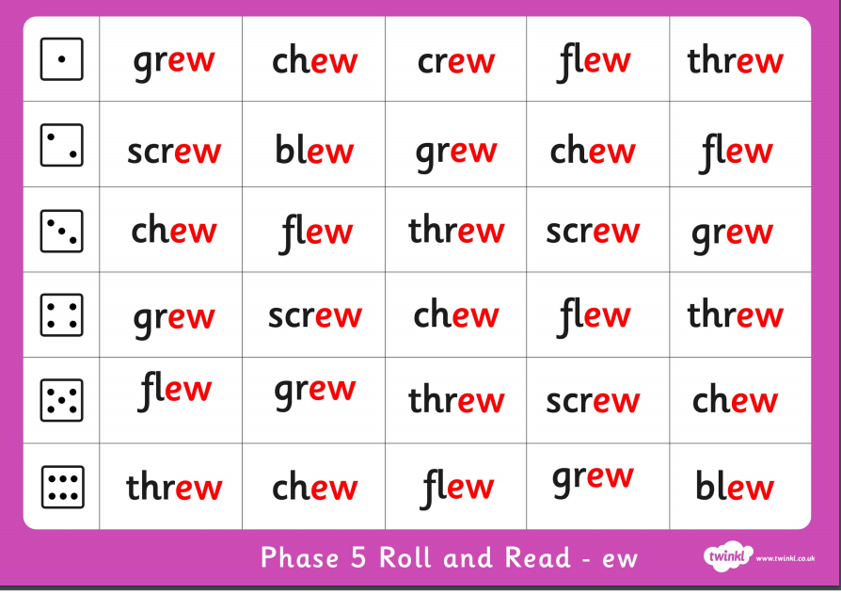
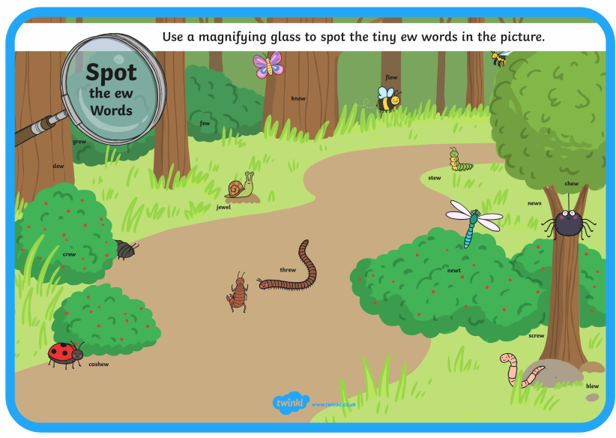
On Twinkl there are some worksheets for each sound if you want to carry
on learning. Look for sounds in your reading book or on signs.
For example:
Underline, highlight or
circle the ew phoneme.

Slide 24
Play Dragon’s Den on Phonics Play use the username and password provided.
Phase 5 and select ew. How many did you get right?
Read the following sentences. Remember to sound out the words you are unsure
of (don’t guess) and then read the complete sentence.
A balloon blew up in the air and flew away.
My nephew is called Drew.
What can you do if you find a screw in your stew?

Slide 25
Wednesday: Practise the phonemes and graphemes on the sheet (slide 2) using the Pure Sound and the tricky phonemes. Including GPCs wh, ph, ew.
Today we are learning to read the tricky words
said, so, have, like.
Write each word on a piece of paper or with chalk on a blackboard or path or in sand with your finger or a paintbrush. Say the word and the write over it in rainbow writing see next slide for an example.

Slide 26
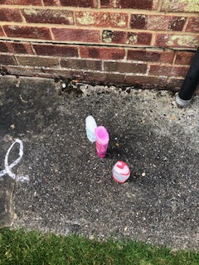










This week I used chalk outside on my path. I found an empty shampoo bottle, shower gel bottle and soap bottle and filled them with water. Once I had written the words I then wrote the high frequency words/ tricky words by squirting the water :-
Rainbow writing in chalk
The shampoo bottle didn’t really work
Experiment and have fun a washing up liquid bottle or a coke bottle with a hole in the lid may work. Have fun!

Slide 27




Play Tricky Trucks on Phonics Play and practise the other tricky words we have been learning.
Then follow the instructions - Choose A route
Truck type
Colour of truck
You could also sing the tricky word song
https://www.youtube.com/watch?v=3NOzgR1ANc4

Slide 28
Read the following sentences.
My nephew said the alphabet.
Will a dolphin whisper so that he can have a throat sweet?
An elephant said he flew like a bird. Do you think that this is true?

Slide 29
Thursday: Practise the phonemes and graphemes on the sheet (slide 2) using the Pure Sound and the tricky phonemes. Including GPCs wh, ph, ew.
Today we are learning the graphemes oe and au.
Write the phonemes oe and au in the air or on your adult’s, brother’s or sister’s back using your finger.
Watch Geraldine the Giraffe au
https://www.youtube.com/watch?v=dOHDkQGhku4
Let’s see what other words have oe or au in them.

Slide 30

Look at each picture.
Say the word.
Sound Talk or Robot Talk the word and Count the phonemes (sounds).
Try writing it.
Then check if you are right by clicking.
How many
phonemes?
3
t o e toe
●

Slide 31

How many
phonemes?
7
d o m i n o e s dominoes
● ● ●●● ●

Slide 32

How many
Phonemes?
5
h e r o e s heroes
●● ● ●

Slide 33

How many
phonemes?
7
t o m a t o e s tomatoes
● ● ● ●● ●

Slide 34

How many
phonemes?
4
a u t h o r author
●●

Slide 35

How many
phonemes?
4
l a u n c h launch
● ●

Slide 36

How many
phonemes?
5
A u g u s t August
● ●● ●

Slide 37

How many
phonemes?
6
h a u n t e d haunted
● ●● ● ●

Slide 38








On Twinkl there are some worksheets for each sound if you want to carry
on learning. Look for sounds in your reading book or on signs.
For example:

Slide 39
Play Picnic on Pluto on Phonics Play use the username and password provided.
Phase 5 and select oe or au. You could enter your own words – toe, goes, August, poe, troes, baunch, audunk. How many did you get right?
Read the following sentences. Remember to sound out the words you are unsure
of (don’t guess) and then read the complete sentence.
Can a toe be jaunty?
Can a rocket launch in August?
Will a haunted venue make you scream?

Slide 40
Friday: Practise the phonemes and graphemes on the sheet (slide 2) using the Pure Sound and the tricky phonemes. Including GPCs wh, ph, ew, oe, au.
Today we are learning the grapheme ey.
Write the phoneme ey in the air or on your adult’s, brother’s or sister’s back using your finger.
Watch Geraldine the Giraffe
https://www.youtube.com/watch?v=XDruUMOtzZw
Let’s see what other words have ey in them.

Slide 41

Look at each picture.
Say the word.
Sound Talk or Robot Talk the word and Count the phonemes (sounds).
Try writing it.
Then check if you are right by clicking.
How many
phonemes?
5
d o n k e y donkey
● ●● ●

Slide 42

How many
phonemes?
4
j o c k e y jockey
●●

Slide 43

How many
phonemes?
5
t r o l l e y trolley
●●●

Slide 44

How many
phonemes?
4
t u r k e y turkey
● ●

Slide 45

How many
phonemes?
2
k e y key
●

Slide 46





On Twinkl there are some worksheets for each sound if you want to carry
on learning. Look for sounds in your reading book or on signs.
For example:

Slide 47
Play Picnic on Pluto on Phonics Play use the username and password provided.
Phase 5 and select ey. How many did you get right?
Read the following sentences. Remember to sound out the words you are unsure
of (don’t guess) and then read the complete sentence.
Can a jockey win on a donkey?
Will a girl put a trolley in a turkey?
Did Santa get stuck up the chimney?

Slide 48



I have added some games with the sounds we are learning in Phase 5 on the resource pack.

