Slide 1

Home Learning
Year 1
Term 5 Week 6

Slide 2
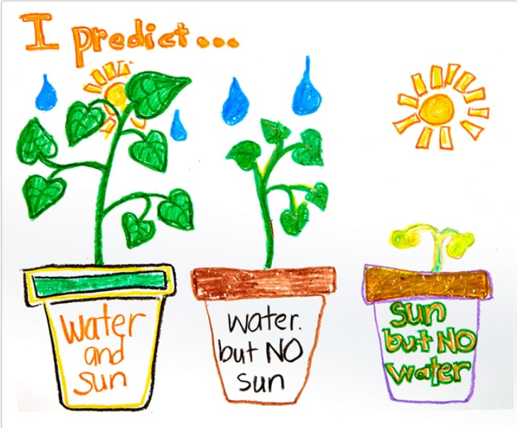
Hello Year 1!
I hope you enjoyed writing your animal poems last week – I’d love to see them one day so keep them safe!
Your English work this week is about comparative and superlative words and about the four different types of sentences. Maths continues with three lessons about Addition and Subtraction with some extra bits from the BBC Bitesize Home Learning Pages. The last activity is Science this week with the opportunity to do an experiment at home if you are able to get your hands on a few seeds.
You should still be reading everyday, practising your
Phonics and Tricky Words with www.phonicsplay.co.uk
(unless you are Mrs Smith’s Phonics Group, in which
case please see the attached Powerpoint from
Mrs Smith) and writing regularly in your writing
journal/diary. How’s your handwriting looking?
I hope you are always remembering to make your
letters sit on the lines and using the lead in and lead
out strokes that we use at school. Maybe some
of you have started making your letters join!
Have a good week!
Love from Mrs Child
xxx

Slide 3
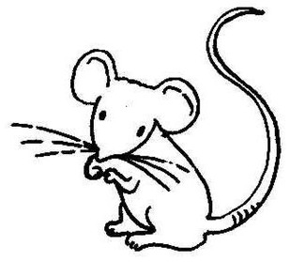


English Learning 1
This lesson is about adding the suffixes
–er and –est to make
comparative and superlative adjectives.
mouse
bee
ant
The mouse is small.
The bee is smaller than the mouse.
The ant is the smallest.

Slide 4
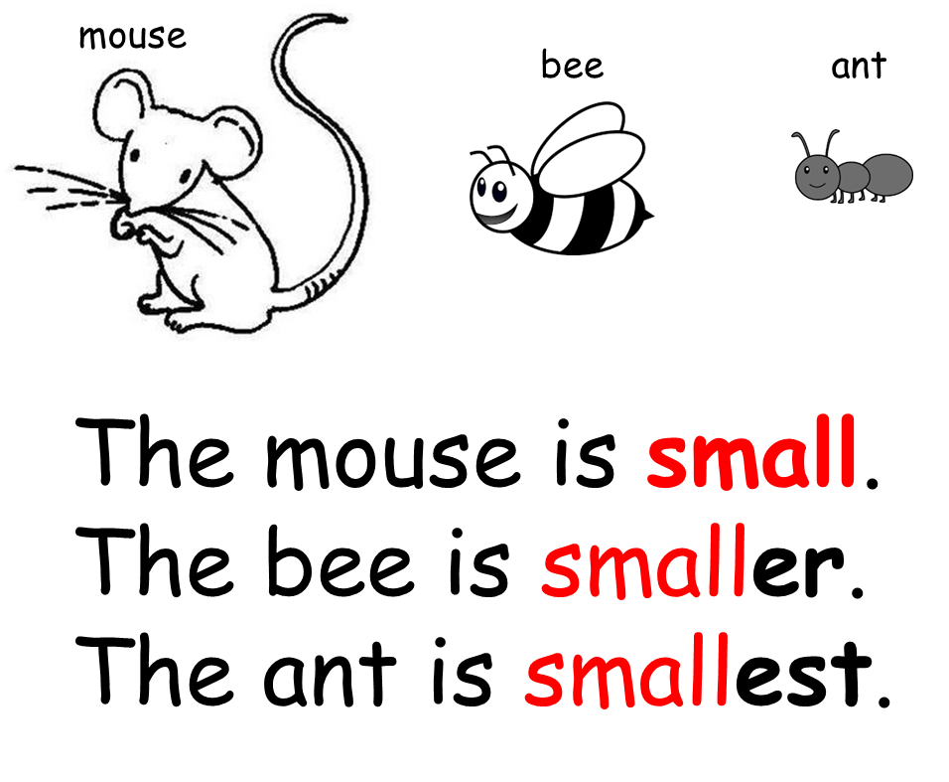
In this example small is the adjective and also the root word.
Smaller is the comparative.
The comparative compares two things to each other. The comparative is made by adding the suffix –er to the root word.
Smallest is the superlative.
The superlative compares a thing to all the others in the group to find the best (or most super).
The superlative is made by adding the suffix –est to the root word.

Slide 5



Look at the following groups of three pictures.
Each time the first sentence is given with the root word that you need to use.
Copy this sentence and then write two further sentences of your own, one with a comparative adjective (adding –er to the root word) and one with a superlative adjective (adding –est to the root word).
For example:
rain
snow
sleet
Rain is cold.
Rain is cold.
Sleet is colder.
Snow is coldest.

Slide 6



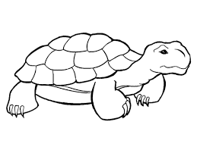


rabbit
dog
mouse
The mouse is fast.
tortoise
sloth
snail
The tortoise is slow.

Slide 7






Jen
Fay
Kate
Jen is short.
Jim
Ben
Tom
Tom is tall.

Slide 8






moon
star
sun
The moon is bright.
worm
eel
snake
The worm is long.

Slide 9
strong
smart
weak
green
dark
light
If you finish, you could try making up your own sentences with comparatives and superlatives using some of the adjectives in the box.

Slide 10
English Learning 2
Today we are going to practise asking and writing questions.
Can you remember the Five W question words?
Think hard before you watch this song to remind you…
https://www.youtube.com/watch?v=vXWK1-L41f0
When you know the Five W words, pick one of the pictures on the following slides and think of as many questions as you can about it. Write down your best one for each of the five different W question words. Don’t forget the question mark at the end of each of your questions. Maybe you could make up a story that answers all your questions.

Slide 11
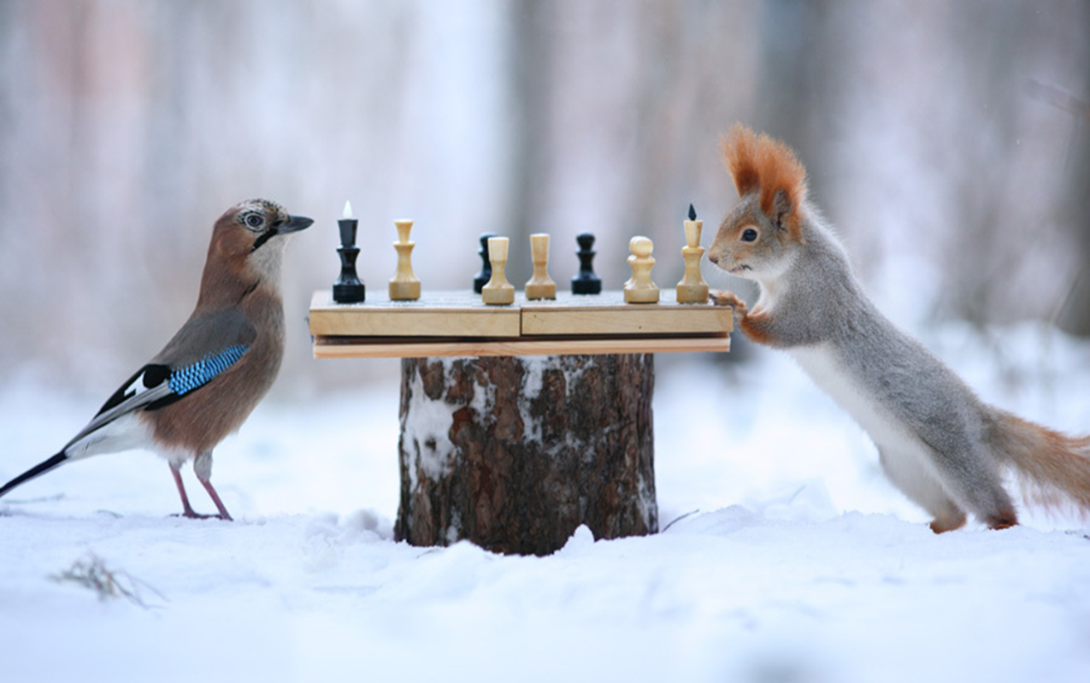
Example
Why are they playing together?
Who is going to win?
What sort of bird is that?
When will the game end?
Where is this happening?

Slide 12
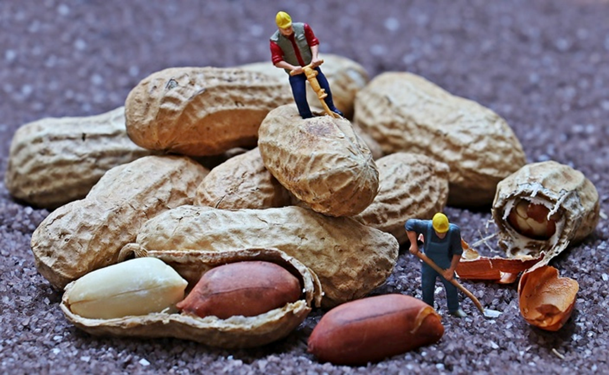

Slide 13
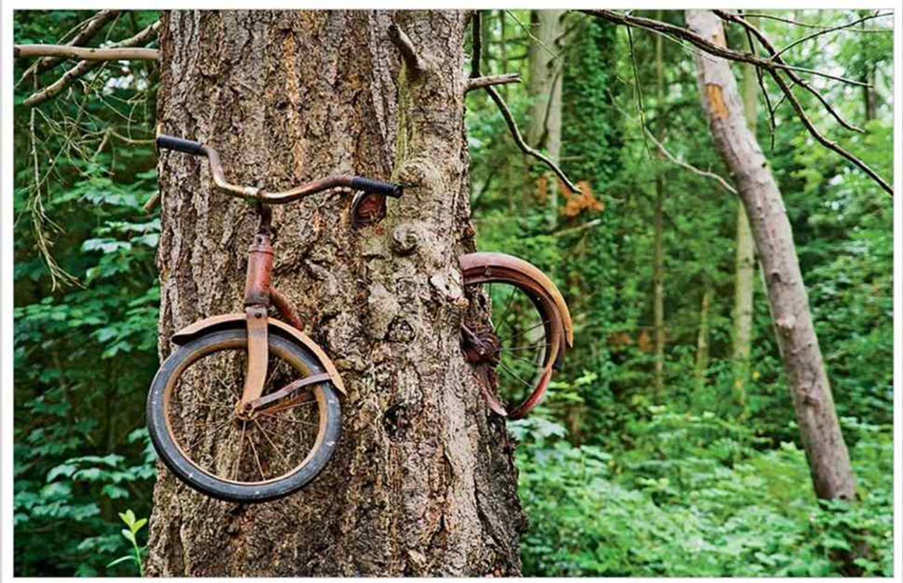

Slide 14
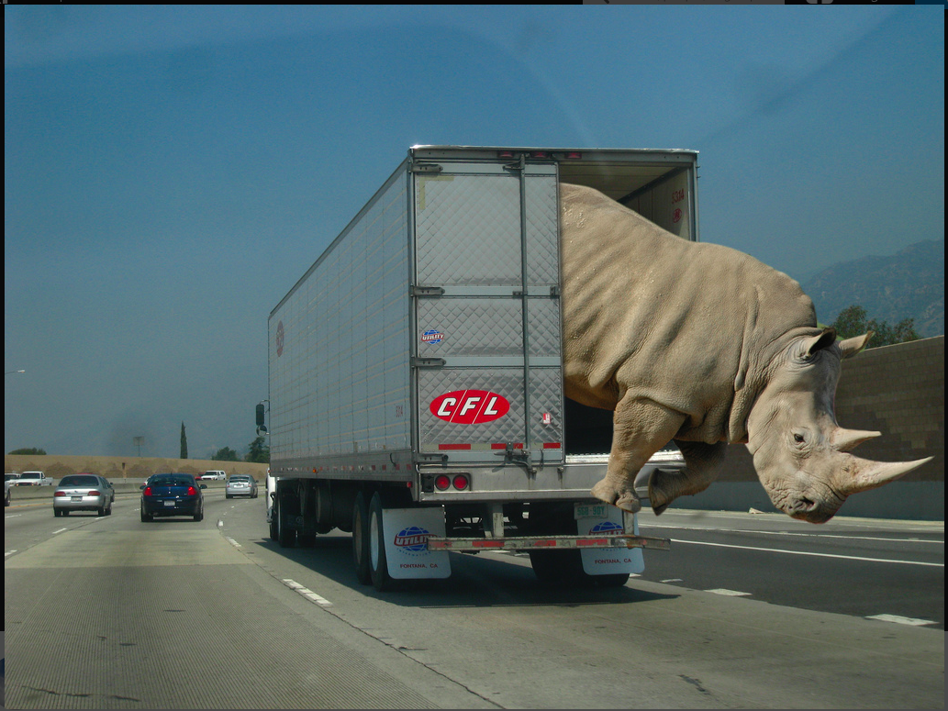

Slide 15
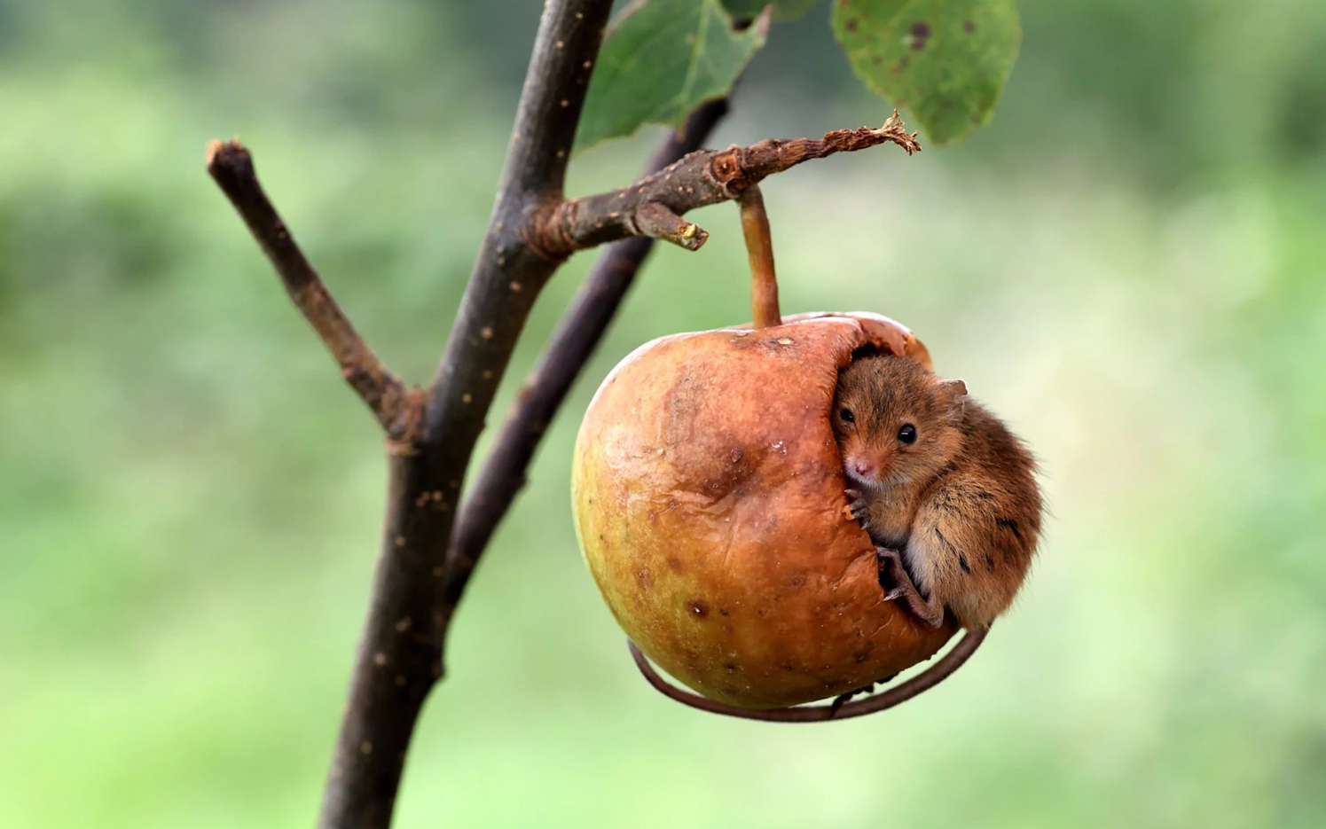

Slide 16

English Learning 3
This lesson is about the four different types of sentence.
Statements
Questions
Commands
Exclamations
You have already written statements and questions this week so you will be good at those already!

Slide 17
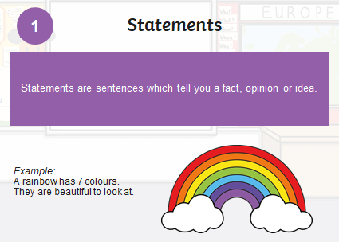

Slide 18
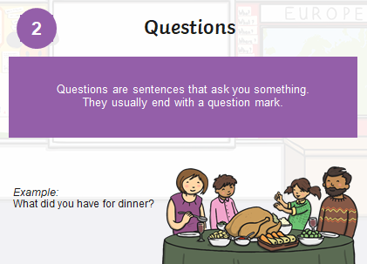

Slide 19
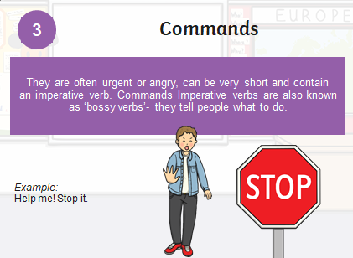

Slide 20
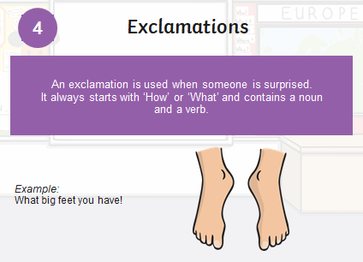

Slide 21


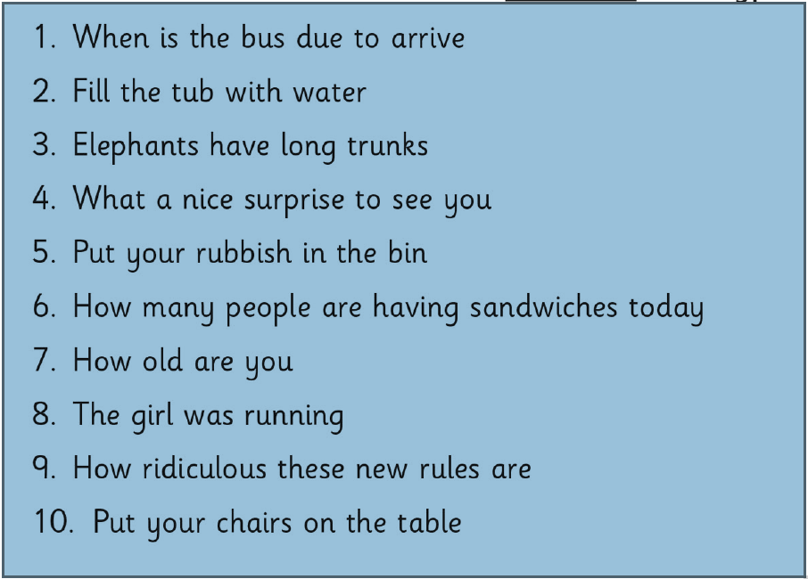

Read these sentences and see if you can work out if they are statements, questions, commands or exclamations. Copy them out and put the right punctuation at the end. You could use a different colour for each type of sentence.
How many question marks did you need? How many full stops? How many exclamation marks?
Look through one of your reading books and see if you can find an example of each type of sentence.

Slide 22
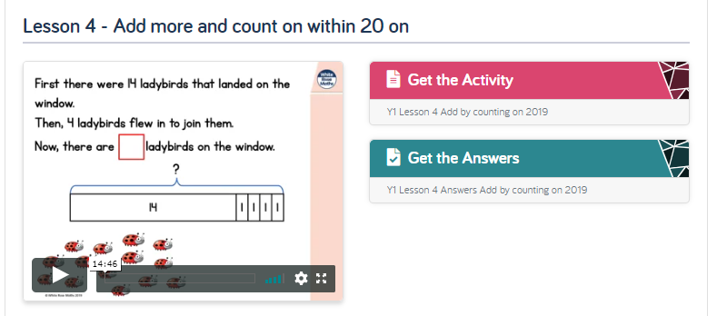
Maths Learning 1
We are continuing with our work on adding and subtracting within 20. For the first lesson, please go to the Year 1 Home Learning page on the White Rose website and complete Summer Term Week 3 Lesson 4 https://whiterosemaths.com/homelearning/year-1/

Slide 23
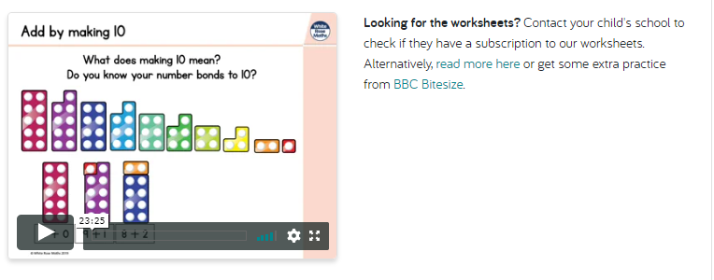
Maths Learning 2
For the second lesson, please go to the Year 1 Home Learning page on the White Rose website and watch the video for Summer Term Week 4 Lesson 1 https://whiterosemaths.com/homelearning/year-1/
When you have watched it, please follow the link to BBC Bitesize and find the “Add and subtract by making 10” lesson from the 11th May where there is an additional video, a worksheet to complete and a short quiz to check your understanding.

Slide 24
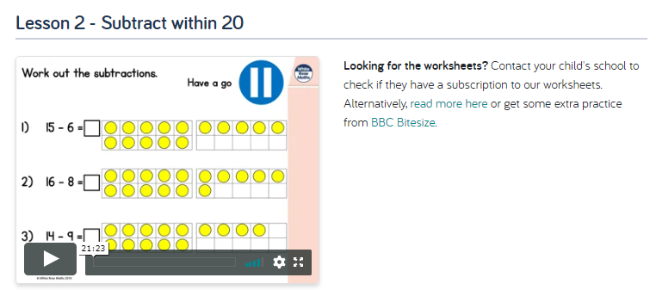
Maths Learning 3
For the third lesson, please go to the Year 1 Home Learning page on the White Rose website and watch the video for Summer Term Week 4 Lesson 2 https://whiterosemaths.com/homelearning/year-1/
When you have watched it, please follow the link to BBC Bitesize and find the “Subtract within 20” lesson from the 12th May where there is an additional video and three activities to complete.

Slide 25
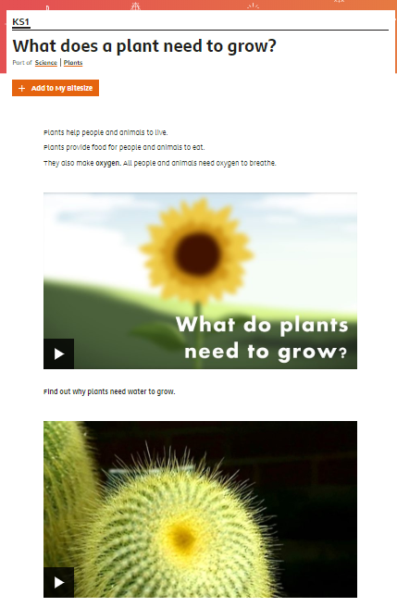
Science Learning
What do plants need to grow?
How are your sunflower plants getting along?
Maybe they are already taller than you!
To find out what plants need to grow,
watch the videos at BBC Bitesize https://www.bbc.co.uk/bitesize/topics/zpxnyrd/articles/zxxsyrd . (KS1 Science/Plants)
Try the quiz afterwards to test what you have learned.
What do you think would happen if a plant didn’t have light or water? Can you think of an experiment you could do to find out? If you have some seeds and four empty yoghurt pots perhaps you could actually do it. Cress would work well or beans or peas. Have a think about it. The recording sheet on the following slide might be useful.

Slide 26




Prediction
Results

Slide 27

Reading
For additional reading at your child’s level please use the Oxford Owl website where you can read books online and then complete comprehension activities about the books. Please continue to keep a record of the books they have read in their reading records.
www.oxfordowl.co.uk
Class login: temple20
Password: Bingbong
(If you are not sure of your child’s level, please check in their reading record book or look at the coloured stickers on the additional reading books that have been sent home.)

Slide 28

Phonics
Please use the games and activities on the Phonicsplay website to continue practsing Phonics.
www.phonicsplay.co.uk
Login: march20
Password: home
Mrs Child’s Phonics group are currently working on Phase 5c (alternative ways of writing sounds we already know e.g. ai, ay, a_e all make the same sound).
Mrs Smith’s group are working on Phase 4.
Additionally, there are many excellent Phonics resources on the Twinkl website(see below for how to get free access). Practising reading “alien words” is a particularly fun and valuable activity.

Slide 29

Writing
Your child has been provided with a writing journal. They are used to using them and know that they need to write the date, write a sentence (about anything they like), draw and colour a picture and then fill any spare lines with handwriting patterns.

Slide 30

P.E.
It is important to keep your children active. If it is safe to do so, ensure they have some time outside throughout the day. Please visit Joe Wicks YouTube channel (https://www.youtube.com/channel/UCAxW1XT0iEJo0TYlRfn6rYQ), which has lots of exercise videos for children. He will also be hosting a live P.E. lessons Monday to Friday at 9:00am.

Slide 31


Using My Maths
Children should know their way round My Maths but here are some reminders on how to access the lessons. Visit: www.mymaths.co.uk
bapchild
divide162

Slide 32

Using My Maths
Access any lesson based on what your child is learning in class or search the topic in the search bar.
Use the login portal to access specific homework and lessons that your teacher has set.

Slide 33

Maths – White Rose Home Leaning
In school we follow the White Rose scheme of learning. Their website has put together free lessons and resources that link to the learning taking place in school. Please visit: https://whiterosemaths.com/homelearning/

Slide 34

Accessing Twinkl
Many educational content providers are offering free access to their resources. Twinkl is a website that we use from time to time to resource our lessons to aid in teacher input and pupil activities.
We will be able to direct you towards activities and learning via this website based on lessons that may be missed due to absence. To access Twinkl please visit: www.twinkl.co.uk/offer
You will have to sign up and put in the offer code: UKTWINKLHELPS

Slide 35

Classroom Secrets
The site classroom secrets https://classroomsecrets.co.uk/free-home-learning-packs/ has free class packs which provide some great additional ideas and resources you can use.

