Slide 1

Hello and Welcome to Mrs Smith’s Phonics Group Week 2 .
I hope you are all still staying safe, well and happy, I am missing you all. I am looking after Geraldine she is eating lots of salad and chocolate cake!
I know you have been working hard learning and revising the sounds we already know and our new Phase 5 graphemes and phonemes GPCs.
You could start your phonics learning daily with our alphabet song or to get you moving BBC Super Movers with Naomi Wilkinson https://www.youtube.com/watch?v=jYeMpUdufNk
Do as much as you can and have Fun. Love Mrs Smith xx
Please play this Power Point in slide show and keep clicking there are animations.

Slide 2
You could print this grid off and check what phonemes (sounds) to grapheme (written) you can recall daily. You could colour, tick or cover with counters, coins or pebbles the ones you can say using the PURE SOUND. If you don’t want to print it off you could point to each sound and say using the PURE SOUND. Are you getting quicker maybe you could time yourself.
s | a | t | p | i | n | m
d | g | o | c | k | ck | e
u | r | h | b | f | ff | l
ll | ss | j | v | w | x | y
z | zz | qu | ch | sh | th | ng
ai | ee | igh | oa | oo | ar | or
ur | ow | oi | ear | air | ure | er
ay | ou | ie | ea
Add new sounds during the week

Slide 3
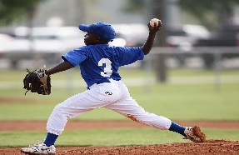


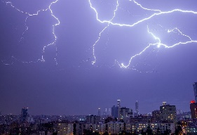


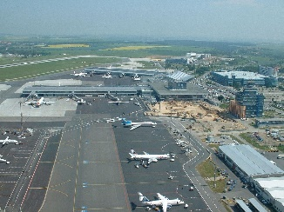
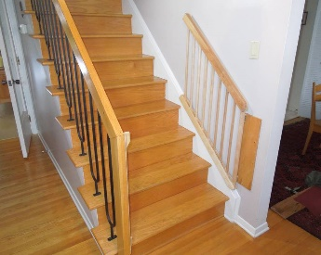
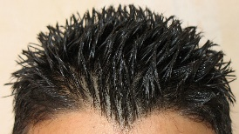
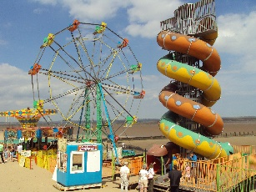
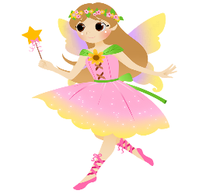

Revise these phonemes daily as they are tricky:
th as in thumb throw think
thunder three tooth
air as in hair airport stairs
fairground fairy air

Slide 4


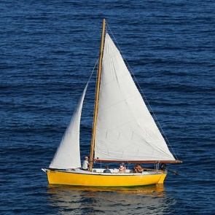
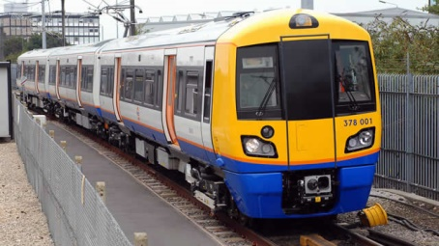
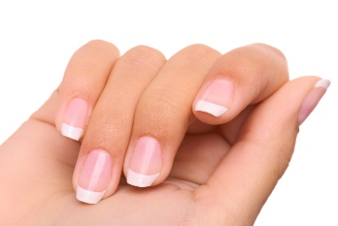
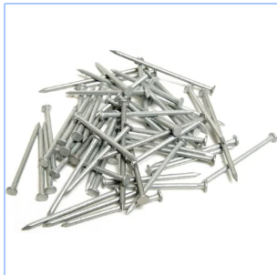
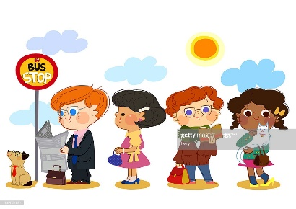

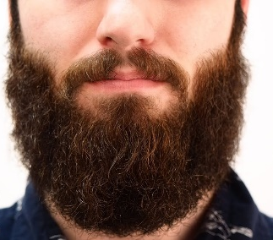

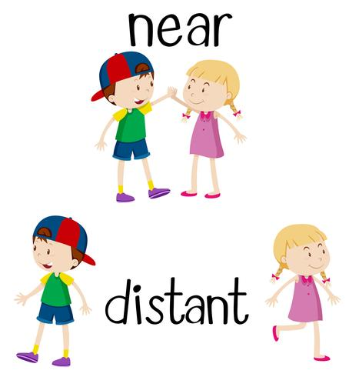
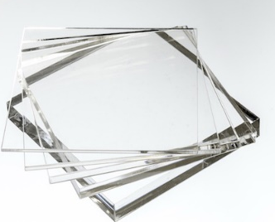

ai as in rain brain
sail train
nails wait
ear as in ear year beard
hear
tear near clear

Slide 5


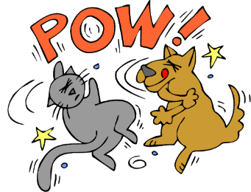





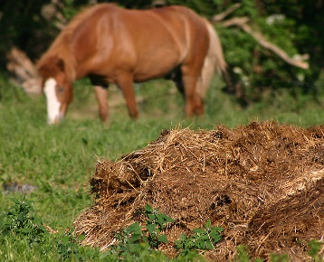
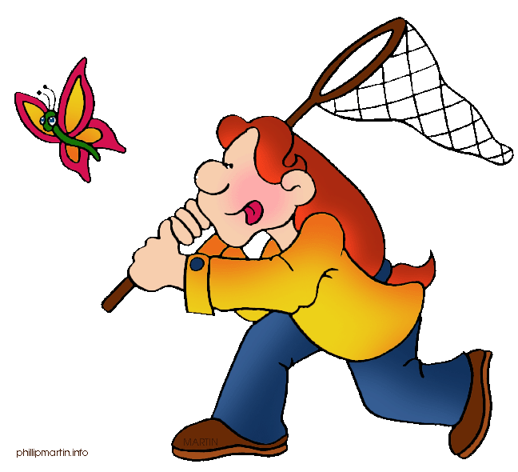

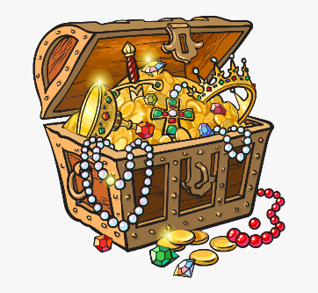
igh as in light night fight
right sight high
ure as in pure manure secure
capture fracture treasure

Slide 6
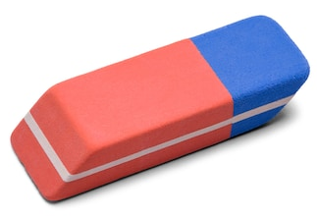
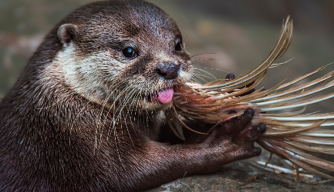
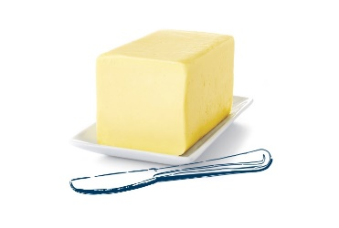

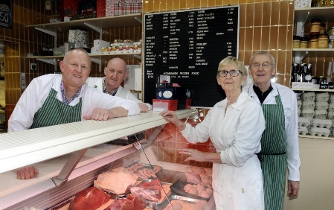
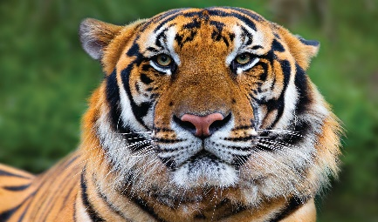

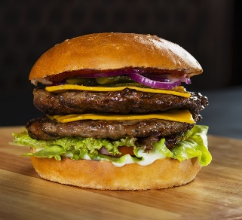
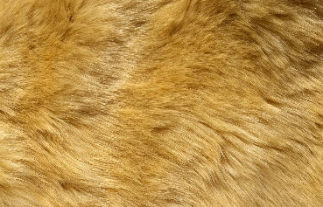

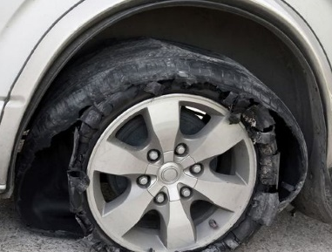

er as in eraser otter butter
ladder tiger butcher
ur as in fur church burger
curl burst nurse

Slide 7
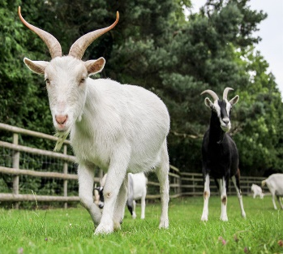
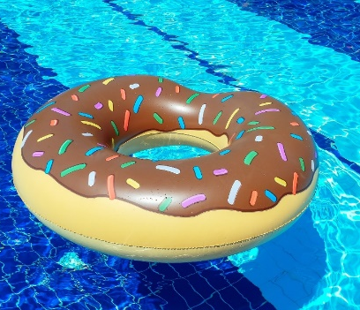


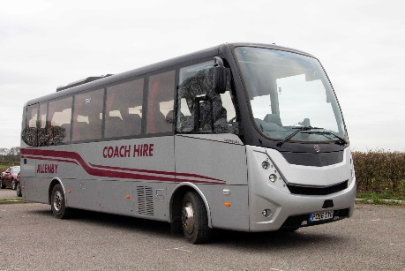
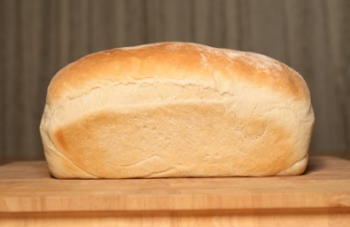
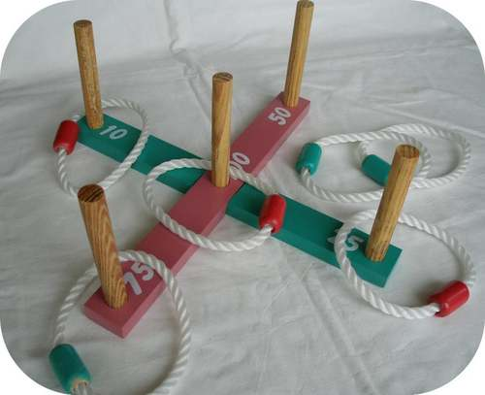

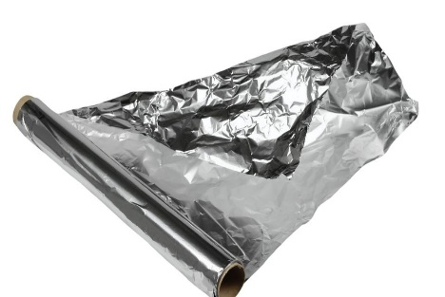
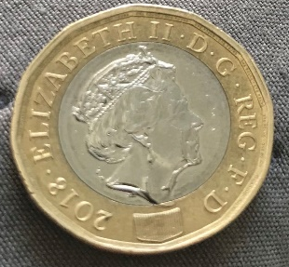
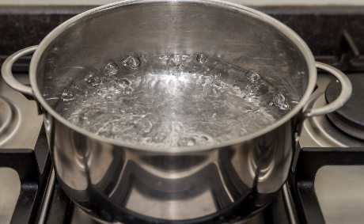
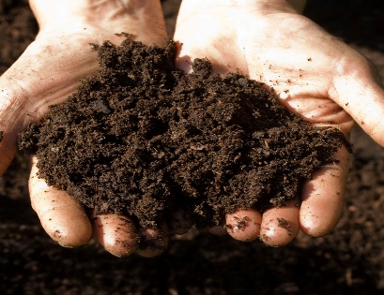
oa as in goat float boat
road loaf coach
oi as in quoits poison foil
coin boil soil

Slide 8
Phase 5a Week 2:
Monday: Practise the phonemes and graphemes on the sheet (slide 2) using the Pure Sound and the tricky phonemes.
Today we are going learn to say the phoneme oy and to practice writing it.
Write the phoneme oy in the air or on your adult’s, brother’s or sister’s back using your finger.
Watch Geraldine the Giraffe
https://www.youtube.com/watch?v=aodJQr-WJLk
Let’s see if we can find some other words with oy in them.

Slide 9

Look at each picture.
Say the word.
Sound Talk or Robot Talk the word and Count the phonemes (sounds).
Try writing it.
Then check if you are right by clicking.
How many
phonemes?
2
b o y boy
●

Slide 10
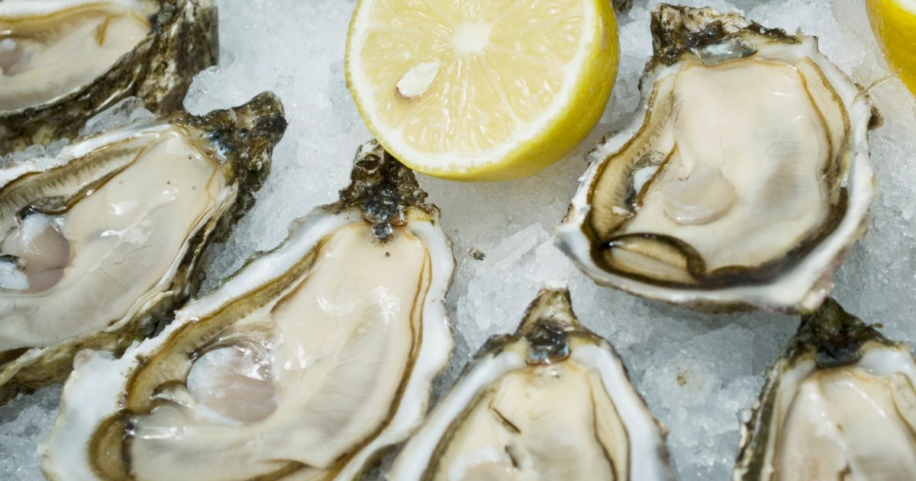
How many
Phonemes?
4
o y s t e r oyster
● ●

Slide 11
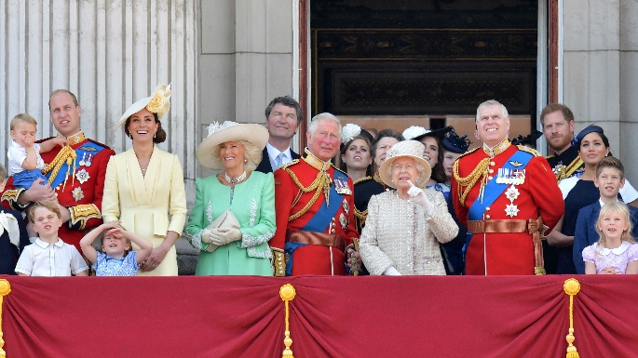
How many
Phonemes?
4
r o y a l royal
● ●●

Slide 12

How many
Phonemes?
2
J o y Joy
●

Slide 13
Play Buried Treasure on Phonics Play use the username and password provided. Phase 5 and select oy. How many did you get right?
Read the following sentences. Remember to sound out the words you are unsure of (don’t guess) and then read the complete sentence.
Can you annoy a boy?
Will a royal enjoy eating an oyster?
Will it be annoying if a boy destroys a toy?

Slide 14
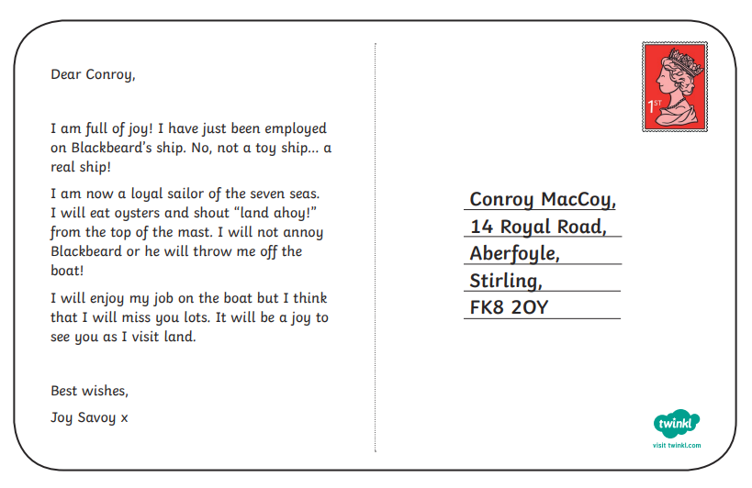
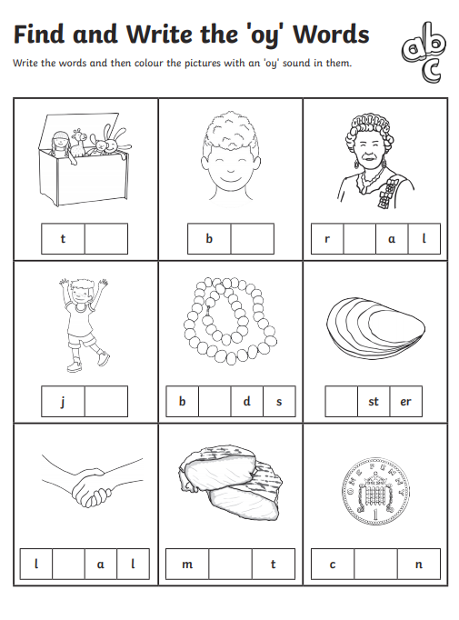
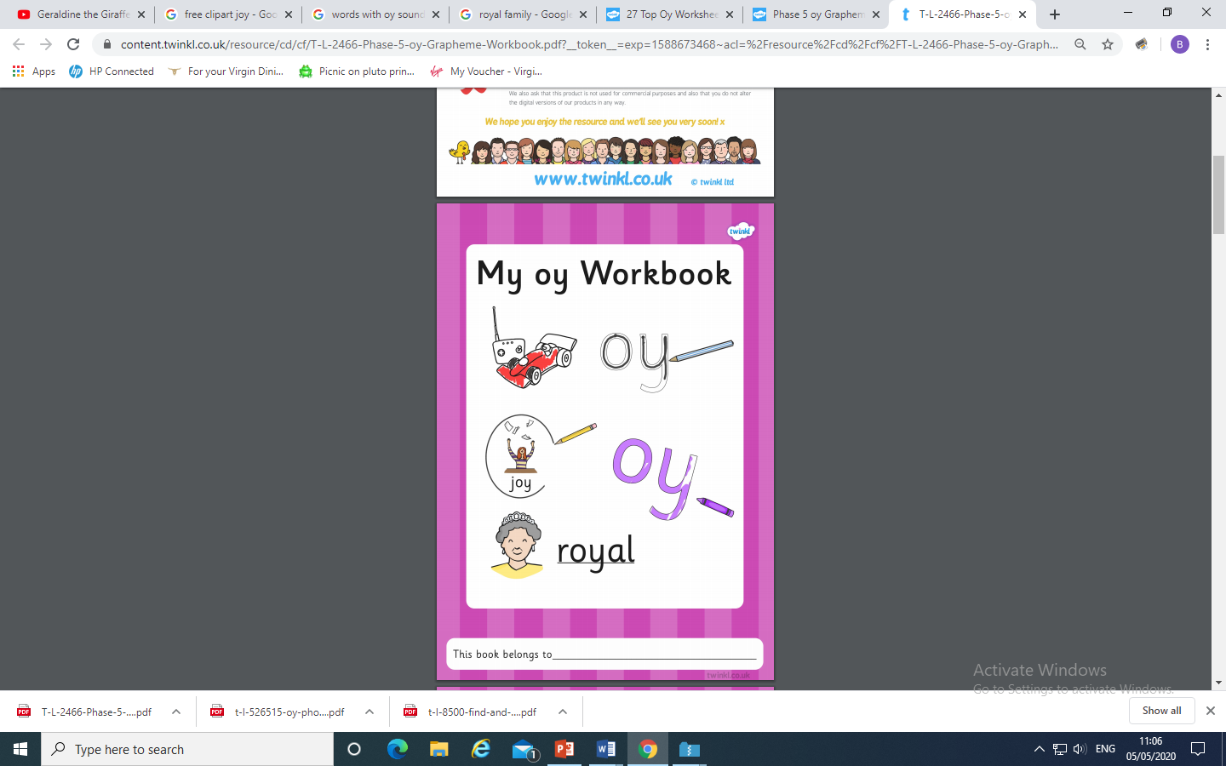
On Twinkl there are some worksheets for each sound if you want to carry
on learning. Look for sounds in your reading book or on signs .
For Example :
Underline, highlight or
circle with oy phoneme.

Slide 15
Tuesday: Practise the phonemes and graphemes on the sheet (slide 2) using the Pure Sound and the tricky phonemes. Including yesterday’s GPC oy
Today we are learning the grapheme ir.
Write the phoneme ir in the air or on your adult’s, brother’s or sister’s back using your finger.
Watch Geraldine the Giraffe
https://www.youtube.com/watch?v=7ta_KKUU-98
Let’s see if we can find some other words with ir in them.

Slide 16

Look at each picture.
Say the word.
Sound Talk or Robot Talk the word and Count the phonemes (sounds).
Try writing it.
Then check if you are right by clicking.
How many
Phonemes?
3
g i r l girl
● ●

Slide 17

How many
phonemes?
3
s h i r t shirt
●

Slide 18
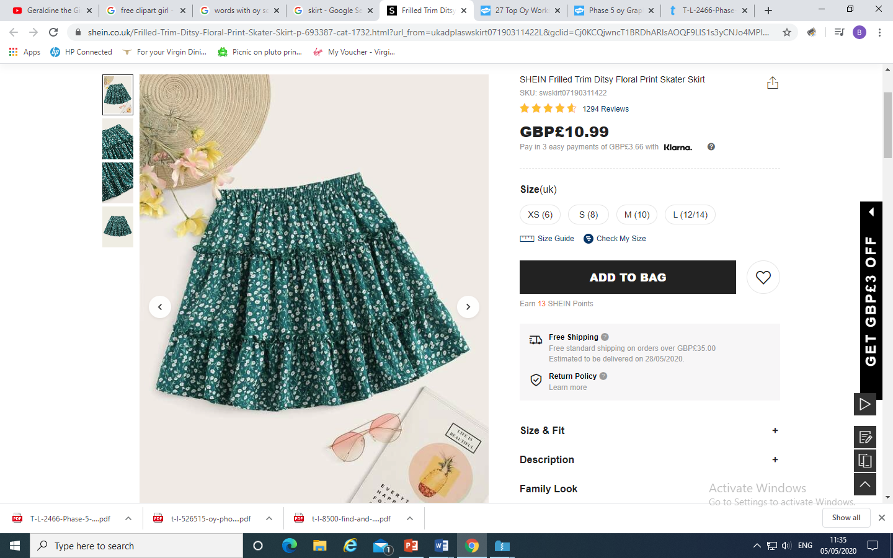
How many
phonemes?
4
s k i r t skirt
●● ●

Slide 19
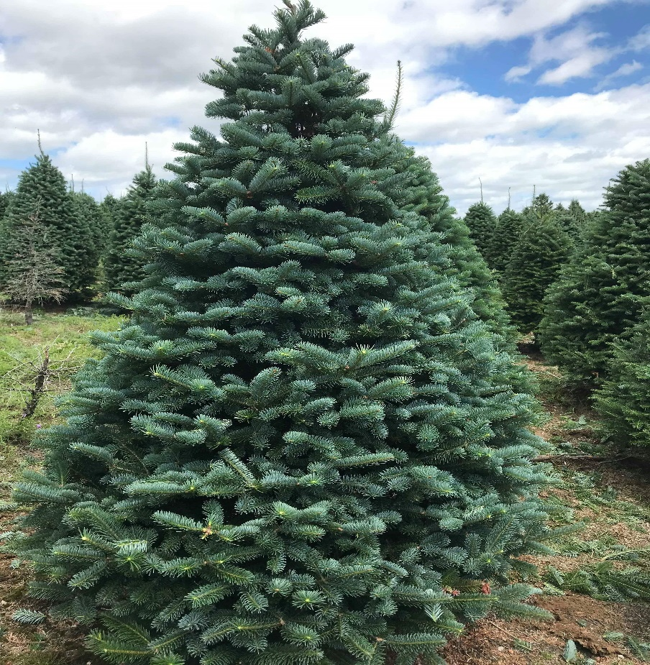
How many
phonemes?
3
f i r fir
●

Slide 20
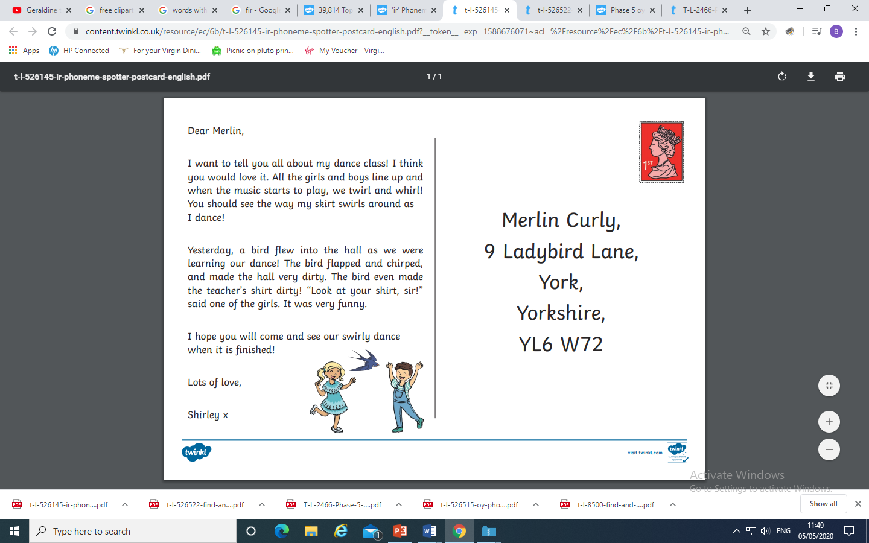
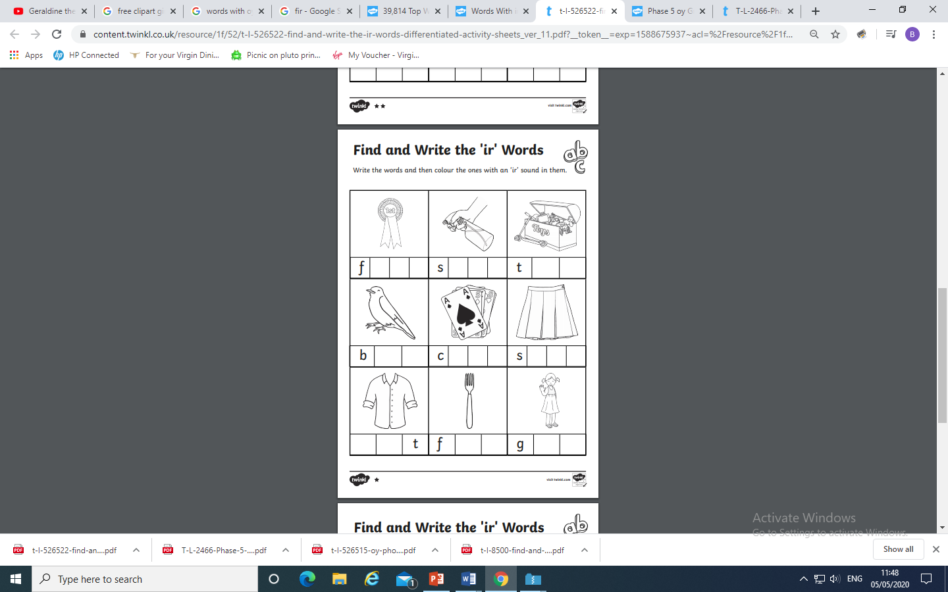
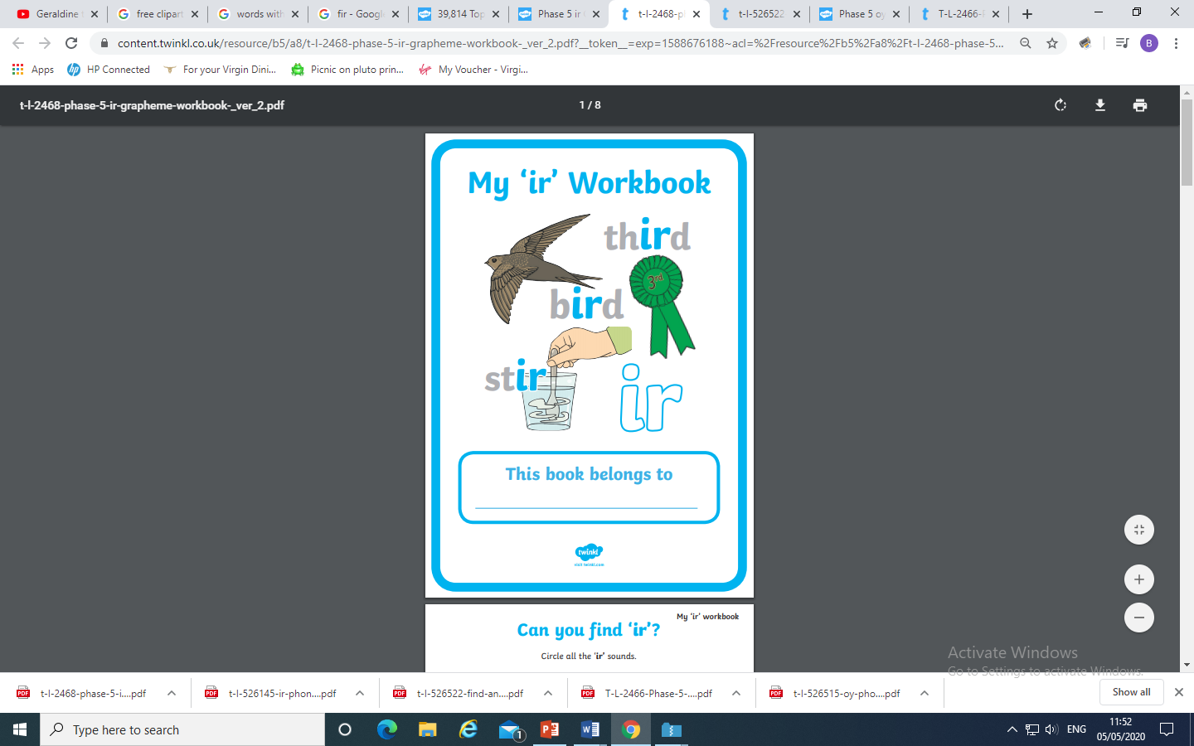
On Twinkl there are some worksheets for each sound if you want to carry
on learning. Look for sounds in your reading book or on signs.
For example:
Underline, highlight or
circle with ir phoneme.

Slide 21
Play Dragon’s Den on Phonics Play use the username and password provided.
Phase 5 and select ir. How many did you get right?
Read the following sentences. Remember to sound out the words you are unsure
of (don’t guess) and then read the complete sentence.
Can a girl put on a skirt that twirls?
Is your birthday the first or third?
Can a girl annoy a boy?

Slide 22
Wednesday: Practise the phonemes and graphemes on the sheet (slide 2) using the Pure Sound and the tricky phonemes. Including GPCs oy, ir.
Today we are learning to read the tricky words
Mr, Mrs, looked, called, asked
Write each word on a piece of paper or with chalk on a blackboard or path or in sand with your finger or a paintbrush. Say the word and the write over it in rainbow writing see next slide for an example.

Slide 23
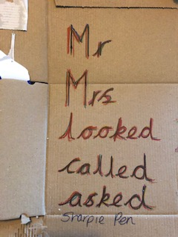
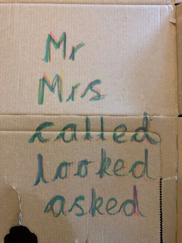
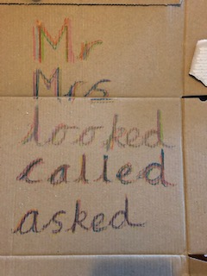
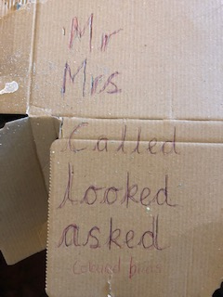


This week I used the inside of a cat food box and wrote the high frequency words/ tricky words using :-
Sharpie pens
Crayons
Highlighters
Chalk
Coloured biros

Slide 24



Play Tricky Trucks on Phonics Play and practise the other tricky words we have been learning.
Then follow the instructions - Choose A route
Truck type
Colour of truck

Slide 25
Read the following sentences.
Is it Mrs Brown’s birthday today?
Mr Green called today and asked if he can help.
Mr and Mr Smith look sad this morning.

Slide 26
Thursday: Practise the phonemes and graphemes on the sheet (slide 2) using the Pure Sound and the tricky phonemes. Including GPCs oy, ir.
Today we are learning the grapheme ue.
Write the phoneme ue in the air or on your adult’s, brother’s or sister’s back using your finger.
Watch Geraldine the Giraffe
https://www.youtube.com/watch?v=BCeE3B_tAq8
Let’s see what other words have ue in them.

Slide 27

Look at each picture.
Say the word.
Sound Talk or Robot Talk the word and Count the phonemes (sounds).
Try writing it.
Then check if you are right by clicking.
How many
phonemes?
3
g l u e glue
●●

Slide 28

How many
phonemes?
3
a r g u e argue
●

Slide 29

How many
Phonemes?
3
b l u e blue
●●

Slide 30

How many
phonemes?
5
r e s c u e rescue
●● ● ●

Slide 31



On Twinkl there are some worksheets for each sound if you want to carry
on learning. Look for sounds in your reading book or on signs.
For example:

Slide 32
Play Picnic on Pluto on Phonics Play use the username and password provided.
Phase 5 and select ue. How many did you get right?
Read the following sentences. Remember to sound out the words you are unsure
of (don’t guess) and then read the complete sentence.
Can you argue with a statue?
You need to queue until the bus is due.
Is it true that you can get blue glue?

Slide 33
Friday: Practise the phonemes and graphemes on the sheet (slide 2) using the Pure Sound and the tricky phonemes. Including GPCs oy, ir, ue.
Today we are learning the grapheme aw.
Write the phoneme aw in the air or on your adult’s, brother’s or sister’s back using your finger.
Watch Geraldine the Giraffe
https://www.youtube.com/watch?v=7xvdbR6g060
Let’s see what other words have aw in them.

Slide 34

Look at each picture.
Say the word.
Sound Talk or Robot Talk the word and Count the phonemes (sounds).
Try writing it.
Then check if you are right by clicking.
How many
phonemes?
3
d r a w draw
●●

Slide 35

How many
phonemes?
2
p a w paw
●

Slide 36

How many
phonemes?
2
j a w jaw
●

Slide 37

How many
phonemes?
3
l a w n lawn
● ●

Slide 38




On Twinkl there are some worksheets for each sound if you want to carry
on learning. Look for sounds in your reading book or on signs.
For example:

Slide 39
Play Picnic on Pluto on Phonics Play use the username and password provided.
Phase 5 and select aw. How many did you get right?
Read the following sentences. Remember to sound out the words you are unsure
of (don’t guess) and then read the complete sentence.
Can a paw also be a claw?
Do you stretch your jaw when you yawn?
If you go out on the lawn, will you need a shawl to help you stay warm?

