Slide 1

Home Learning
Year 1
Term 5 Week 5

Slide 2

Hello Year 1!
How are you all? Have you been able to enjoy the warm weather? Did you celebrate VE day on Friday? I am looking forward to celebrating the day when school will be open again!
Here is your work for the week. The English is about poetry and composing your own animal poem. The Maths is about using part-part-whole models to help with addition and subtraction facts. There is also another Geography activity about Hot and Cold places and some special work for Mrs Smith’s Phonics group.
You should still be reading everyday (if you’ve run out of books it could be recipes, shopping lists, game instructions or facts from websites), practising your Phonics and Tricky Words with PhonicsPlay.co.uk and writing regularly in your writing journal/diary.
Have a good week!
Love from Mrs Child
xxx

Slide 3

English Learning 1
Read this poem.
Do you like it?
Can you spot the rhymes?
Can you describe the pattern?
Can you pretend to be each animal?
Can you learn it off by heart?
Can you perform it with actions?
Can you copy it in your best handwriting and illustrate it?

Slide 4

English Learning 2
Plural
Adding –s or –es to make plurals
One frog Lots of frogs
One caterpillar Lots of caterpillars
One worm Lots of worms
One bug Lots of bugs
To make a plural word, we usually just add –s to the end to show there is more than one. If the word ends in a hissing, buzzing or shushing sound (x, ch, sh, ss or zz) we add –es.
One fox Lots of foxes
One cockroach Lots of cockroaches
One thrush Lots of thrushes
Make a list of ten animals – they could be your favourite animals or maybe a theme like farm animals, rainforest animals, desert animals or polar animals. Copy or print the table on the next slide and complete it. You might find some tricky animals where the plural is the same as the singular (one sheep, lots of sheep) or changes in a different way (one mouse, lots of mice, one butterfly, lots of butterflies).
If you need further practice, see the attached Twinkl powerpoint.
Singular

Slide 5
Adding –s or –es to make plurals
Singular (e.g. rabbit) | Plural (e.g. rabbits)

Slide 6
English Learning 3
Look at your list of ten animals that you made yesterday. Think about how each one moves. Does it squirm or flap? Does it dance or creep? Does it swoop or dive? Write a verb (or more) for each animal. There are some suggestions on the next slide to help you.
When you have thought of them have a look to see if any of your verbs rhyme. See if any of them have the same letters at the end (e.g. stomp and clomp, scurry and hurry, prowl and howl). Can you make rhyming pairs? You might need to change some of your verbs or animals to make it work.
When you have five rhyming pairs, write them as a poem in the style of Evelyn Beyer’s poem that we started with at the beginning of the week. Think about the best order for the pairs to make the best poem. How will you present you poem?

Slide 7
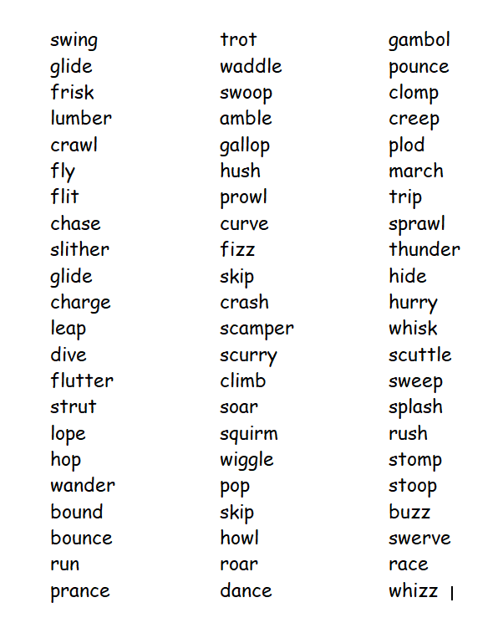

Slide 8
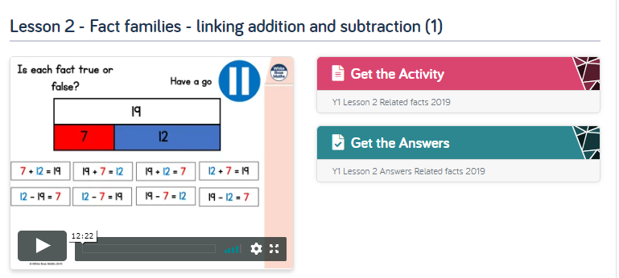
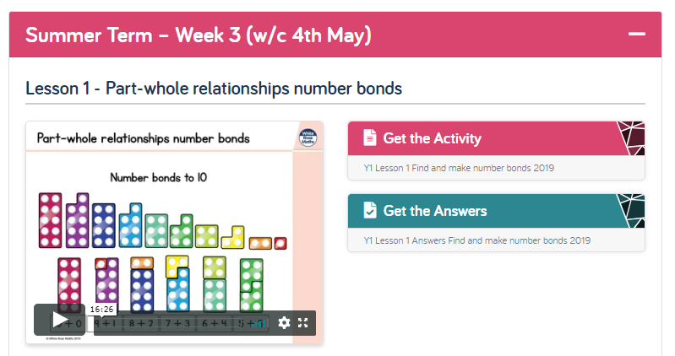
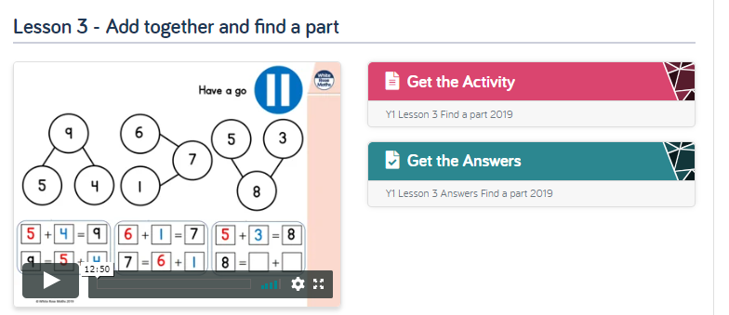
Maths Learning
I hope you all got to grips with halves and quarters last week. This week we are looking at part-part-whole models to help with our understanding of adding and subtracting within 20. Please go to the Year 1 Home Learning page on the White Rose website and complete Summer Term Week 3 Lessons 1, 2 and 3. https://whiterosemaths.com/homelearning/year-1/
Try making your own big part-part-whole models to play with. If you had some chalk you could draw one on the ground and use stones. Or maybe you have some hoops. Or plates or bowls would do. There are a few pictures to inspire you on the next slide.

Slide 9
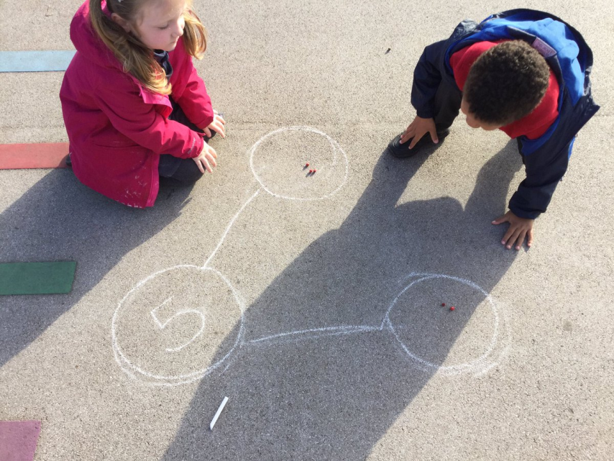
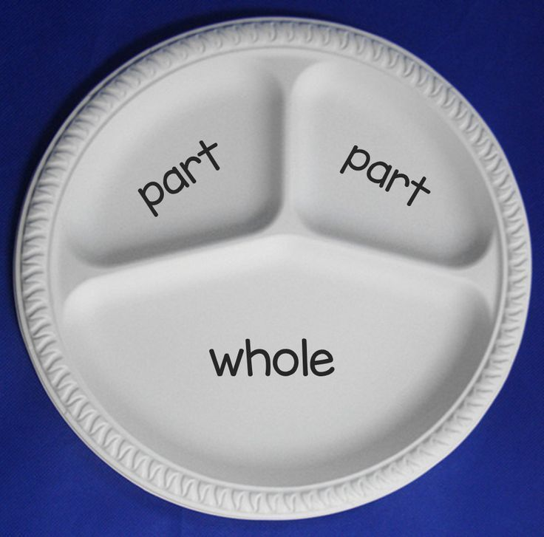
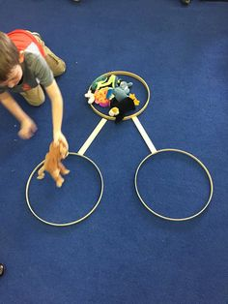
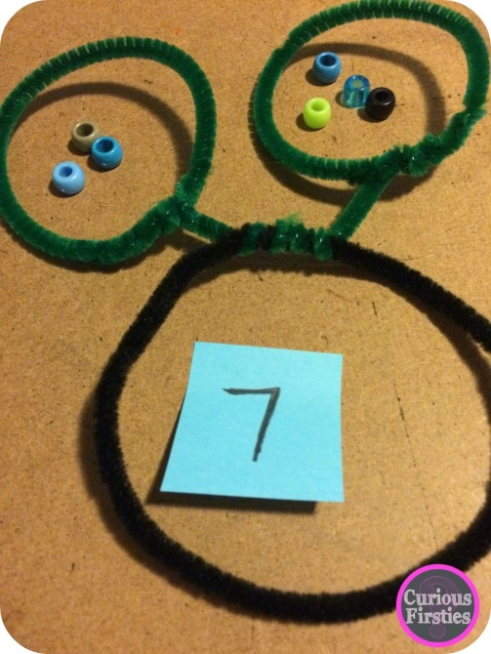
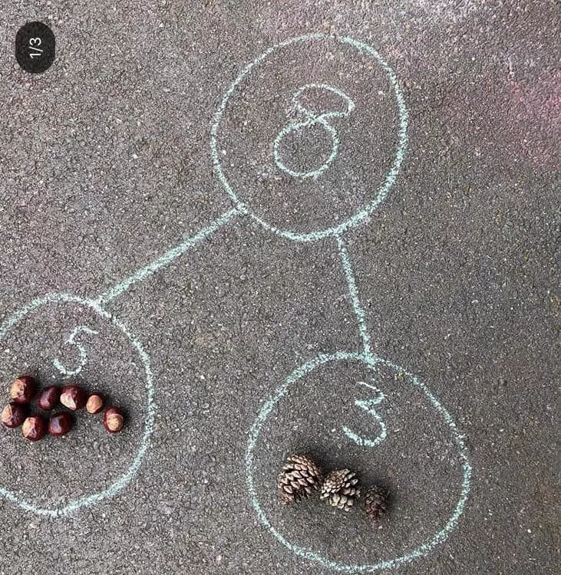
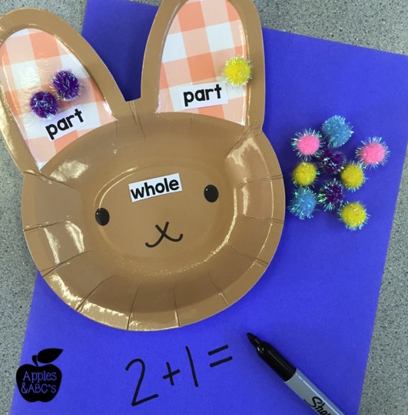
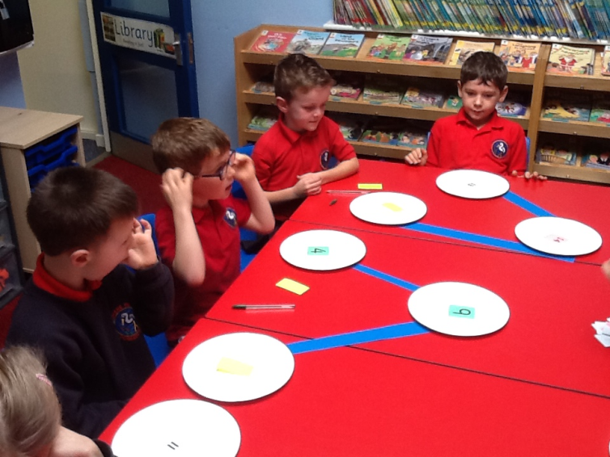

Slide 10
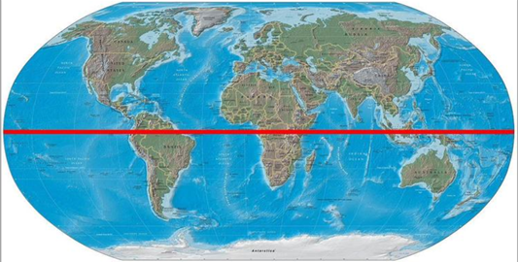
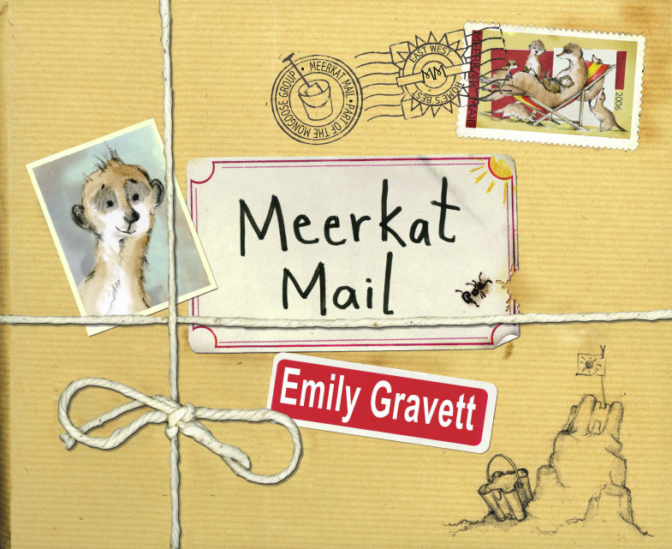
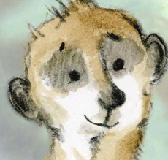
Geography Learning
Why can’t a meerkat live in the North Pole?
Can you remember where the Equator is? What about the North Pole? Can you point to them on a map or globe?
Listen to Miss Lee reading the story
“Meerkat Mail” by Emily Gravett at
https://www.youtube.com/watch?v=DcwuTRQ16MU
As you listen, think about the question
“Why does Sunny live in the Kalahari desert?”
Write your answer to the question by completing the following sentence.
I think Sunny lives in the Kalahari desert because…
Try to think of at least three good reasons.

Slide 11

Reading
For additional reading at your child’s level please use the Oxford Owl website where you can read books online and then complete comprehension activities about the books. Please continue to keep a record of the books they have read in their reading records.
www.oxfordowl.co.uk
Class login: temple20
Password: Bingbong
(If you are not sure of your child’s level, please check in their reading record book or look at the coloured stickers on the additional reading books that have been sent home.)

Slide 12

Phonics
Please use the games and activities on the Phonicsplay website to continue practsing Phonics.
www.phonicsplay.co.uk
Login: march20
Password: home
Mrs Child’s Phonics group are currently working on Phase 5c (alternative ways of writing sounds we already know e.g. ai, ay, a_e all make the same sound).
Mrs Smith’s group are working on Phase 4.
Additionally, there are many excellent Phonics resources on the Twinkl website(see below for how to get free access). Practising reading “alien words” is a particularly fun and valuable activity.

Slide 13

Writing
Your child has been provided with a writing journal. They are used to using them and know that they need to write the date, write a sentence (about anything they like), draw and colour a picture and then fill any spare lines with handwriting patterns.

Slide 14

P.E.
It is important to keep your children active. If it is safe to do so, ensure they have some time outside throughout the day. Please visit Joe Wicks YouTube channel (https://www.youtube.com/channel/UCAxW1XT0iEJo0TYlRfn6rYQ), which has lots of exercise videos for children. He will also be hosting a live P.E. lessons Monday to Friday at 9:00am.

Slide 15


Using My Maths
Children should know their way round My Maths but here are some reminders on how to access the lessons. Visit: www.mymaths.co.uk
bapchild
divide162

Slide 16

Using My Maths
Access any lesson based on what your child is learning in class or search the topic in the search bar.
Use the login portal to access specific homework and lessons that your teacher has set.

Slide 17

Maths – White Rose Home Leaning
In school we follow the White Rose scheme of learning. Their website has put together free lessons and resources that link to the learning taking place in school. Please visit: https://whiterosemaths.com/homelearning/

Slide 18

Accessing Twinkl
Many educational content providers are offering free access to their resources. Twinkl is a website that we use from time to time to resource our lessons to aid in teacher input and pupil activities.
We will be able to direct you towards activities and learning via this website based on lessons that may be missed due to absence. To access Twinkl please visit: www.twinkl.co.uk/offer
You will have to sign up and put in the offer code: UKTWINKLHELPS

Slide 19

Classroom Secrets
The site classroom secrets https://classroomsecrets.co.uk/free-home-learning-packs/ has free class packs which provide some great additional ideas and resources you can use.

