Slide 1

Hello and Welcome to Mrs Smith’s Phonics Group.
I hope you are all staying safe, well and happy, I am missing you all.
I know you have been working hard and that you are all amazing so we are going to start learning Phase 5.
You could start your phonics learning with our alphabet song or to get you moving BBC Super Movers with Naomi Wilkinson https://www.youtube.com/watch?v=jYeMpUdufNk
Do as much as you can and have Fun.

Slide 2
You could print this grid off and check what phonemes (sounds) to grapheme (written) you can recall daily. You could colour or tick the ones you can say using the PURE SOUND. If you don’t want to print it off you could point to each sound and say using the PURE SOUND.
s | a | t | p | i | n | m
d | g | o | c | k | ck | e
u | r | h | b | f | ff | l
ll | ss | j | v | w | x | y
z | zz | qu | ch | sh | th | ng
ai | ee | igh | oa | oo | ar | or
ur | ow | oi | ear | air | ure | er

Slide 3
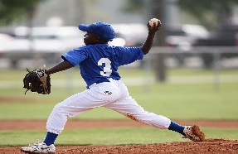


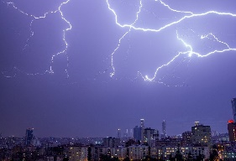


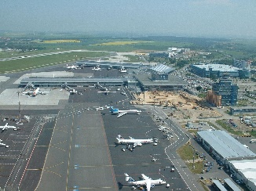
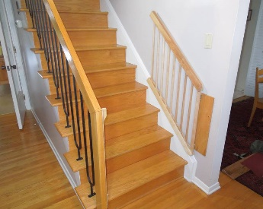
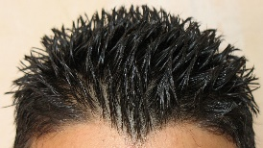
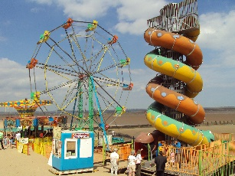
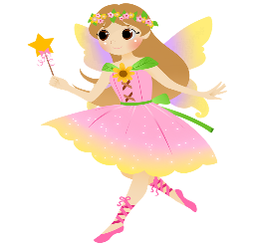

Let’s revise these phonemes as they are tricky:
th as in thumb throw think
thunder three tooth
air as in hair airport stairs
fairground fairy air

Slide 4

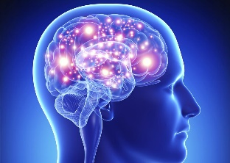
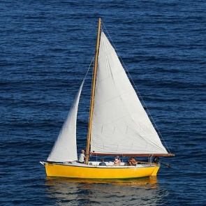
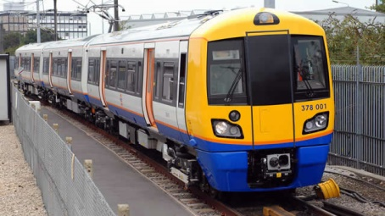
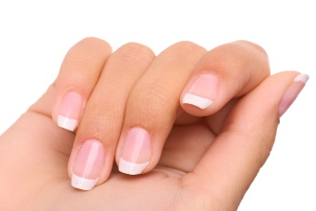
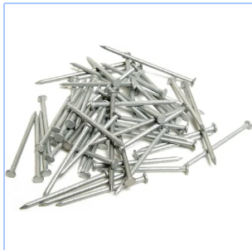
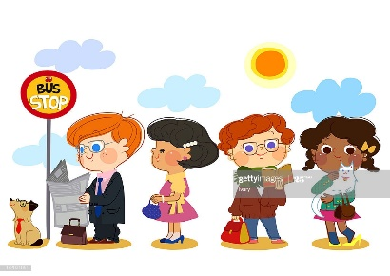

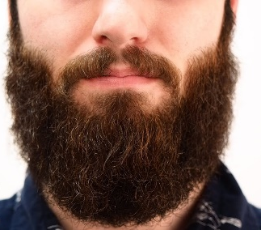
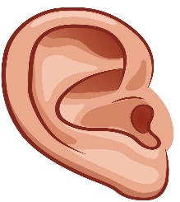
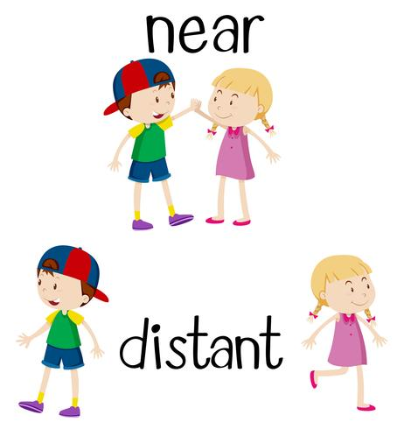

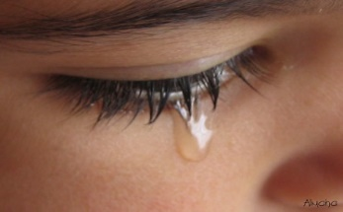
ai as in rain brain
sail train
nails wait
ear as in ear year beard
hear
tear near clear

Slide 5
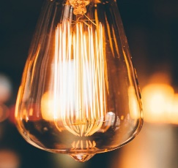

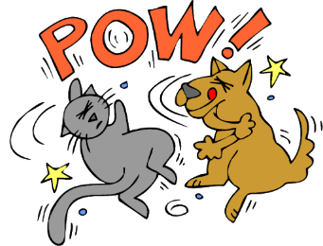





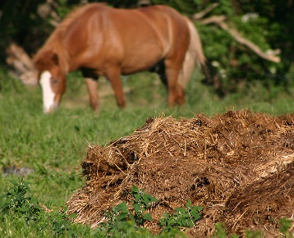
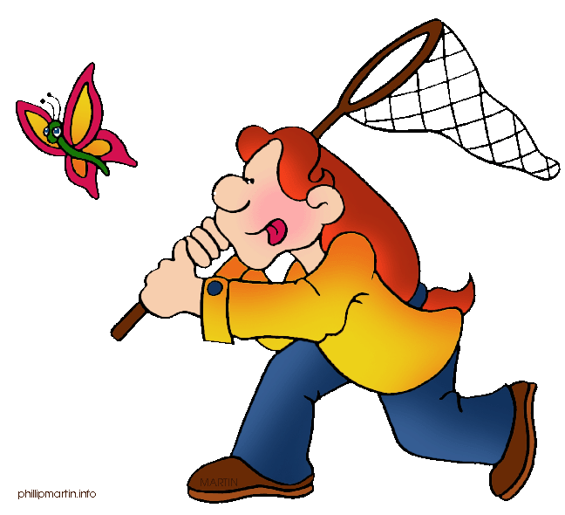

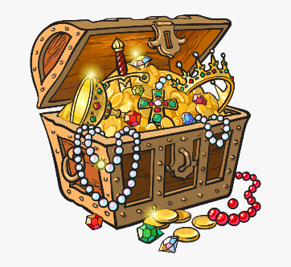
igh as in light night fight
right sight high
ure as in pure manure secure
capture fracture treasure

Slide 6
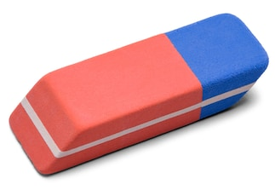
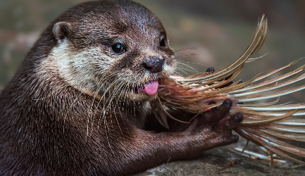
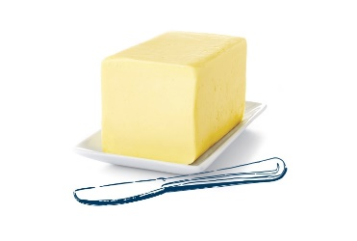
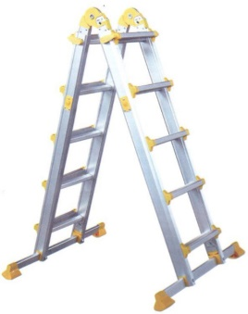
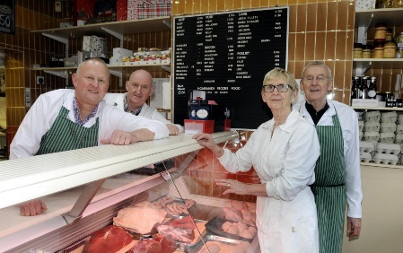
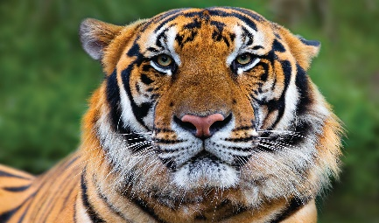
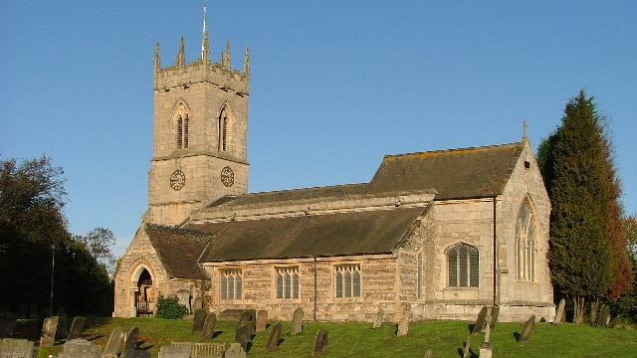
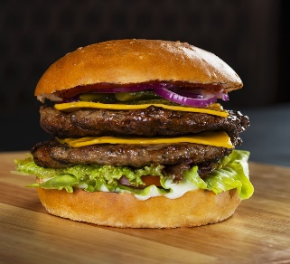
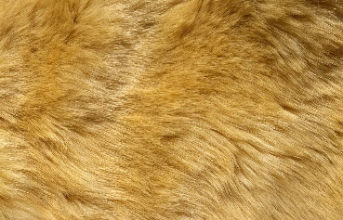
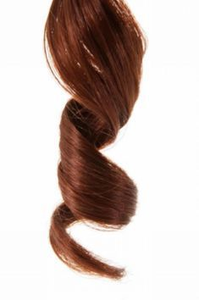
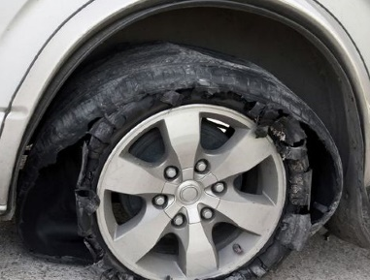

er as in eraser otter butter
ladder tiger butcher
ur as in fur church burger
curl burst nurse

Slide 7
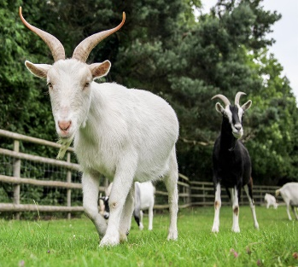
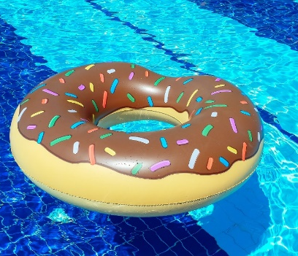

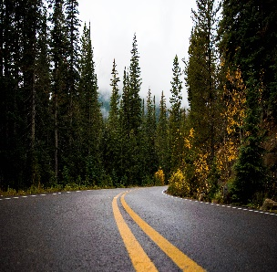
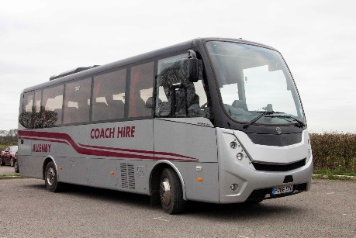
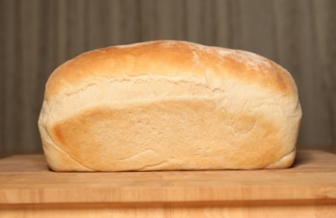
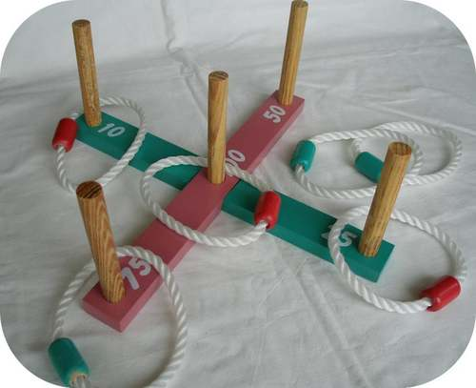

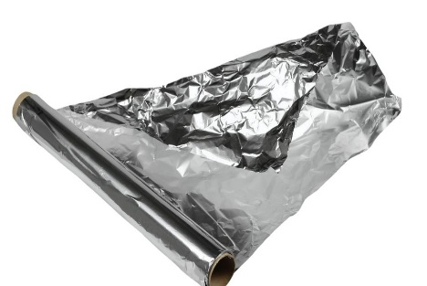
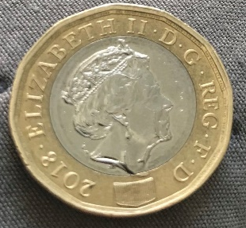
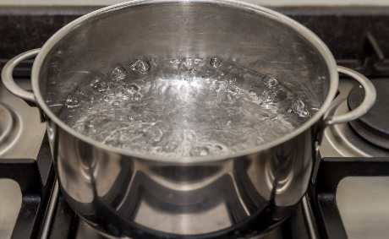
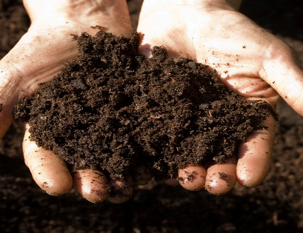
oa as in goat float boat
road loaf coach
oi as in quoits poison foil
coin boil soil

Slide 8
Phase 5a Week 1:
Monday: Practise the phonemes and graphemes on the sheet (slide 2) using the Pure Sound and the tricky phonemes.
Today we are going learn to say the phoneme ay and to practice writing it.
Write the phoneme ay in the air or on your adult’s, brother’s or sister’s back using your finger.
Watch Geraldine the Giraffe https://www.youtube.com/watch?v=MTCP8i4Nwgc
Let’s see if we can find some other words with ay in them.

Slide 9
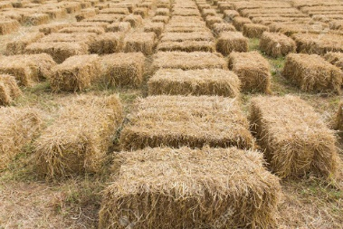
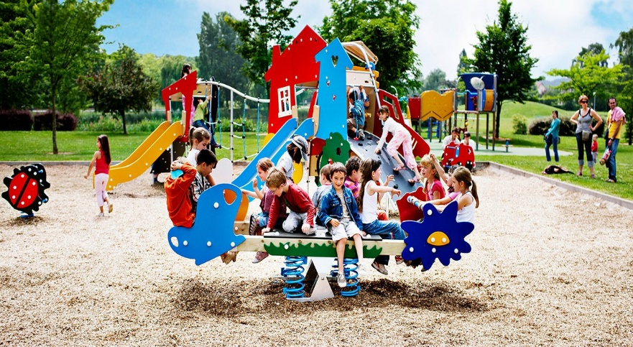
Look at each picture.
Say the word.
Sound Talk or Robot Talk the word and try writing it.
Then check by clicking.
h a y hay
●
p l a y play
● ●

Slide 10
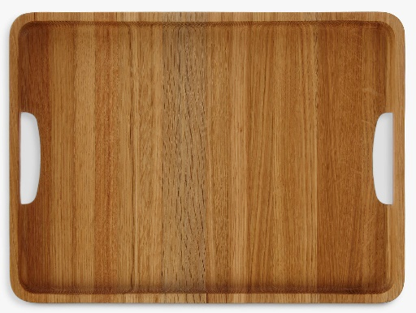
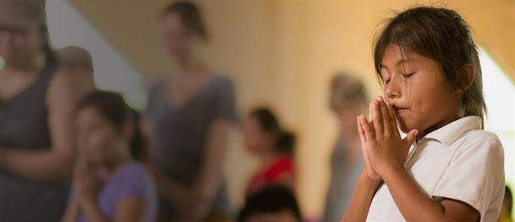
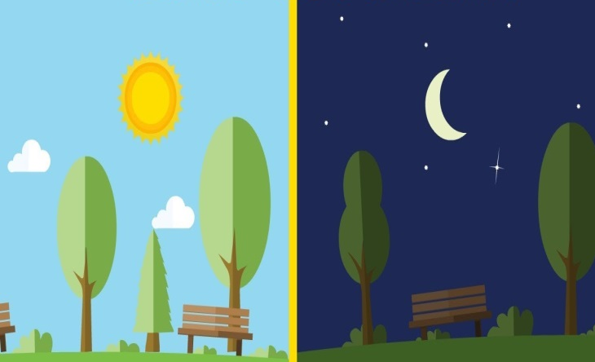
t r a y tray
p r a y pray
●●
d a y day
●
●
●

Slide 11
Play Buried Treasure on Phonics Play use the username and password provided. Phase 5 and select ay. How many did you get right?
Read the following sentences. Remember to sound out the words you are unsure of (don’t guess) and then read the complete sentence.
Can a crayon spray paint?
Can a stray cat play?
Do not delay unless you want to stay all day.

Slide 12
Tuesday: Practise the phonemes and graphemes on the sheet (slide 2) using the Pure Sound and the tricky phonemes. Including yesterday’s GPC ay
Today we are learning the grapheme ou.
Write the phoneme ou in the air or on your adult’s, brother’s or sister’s back using your finger.
Watch Geraldine the Giraffe
https://www.youtube.com/watch?v=-qtCB7CYH3I
Let’s see if we can find some other words with ou in them.

Slide 13
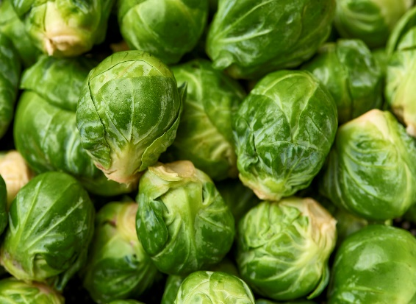

Look at each picture.
Say the word.
Sound Talk or Robot Talk the word and try writing it.
Then check by clicking.
s p r o u t s sprouts
●● ● ●●
c l o u d cloud
●● ●

Slide 14

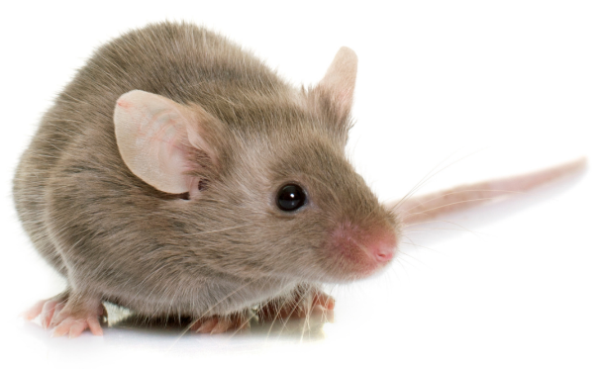

m o u t h mouth
●
m o u s e mouse
● ●●
s h o u t shout
●

Slide 15
Play Dragon’s Den on Phonics Play use the username and password provided.
Phase 5 and select ou. How many did you get right?
Read the following sentences. Remember to sound out the words you are unsure
of (don’t guess) and then read the complete sentence.
Will you see clouds in the mountains?
Can a sprout be proud?
What is the loudest sound around?

Slide 16
Wednesday: Practise the phonemes and graphemes on the sheet (slide 2) using the Pure Sound and the tricky phonemes. Including GPCs ay, ou.
Today we are learning to read the tricky words
oh, their, people
Write each word on a piece of paper or with chalk on a blackboard or path. Say the word and the write over it in rainbow writing see next slide for an example.

Slide 17




I used my computer and wrote the high frequency words/ tricky words using :-
Marker pen
Crayon
Paint
Pencil

Slide 18
Play Countdown either try writing the words or reading the words :
crayon, stray, spray, delay, tray, sound, ground, about, sprout, cloud.
Read the following sentences. Remember to sound out the words you are unsure
of (don’t guess) and then read the complete sentence.
Some people play loud sounds on horns.
Oh! I found a crayon.
Do people play with their sprouts?

Slide 19
Thursday: Practise the phonemes and graphemes on the sheet (slide 2) using the Pure Sound and the tricky phonemes. Including GPCs ay, ou.
Today we are learning the grapheme ie.
Write the phoneme ie in the air or on your adult’s, brother’s or sister’s back using your finger.
Watch Geraldine the Giraffe
https://www.youtube.com/watch?v=ZvvUHml1KQc
Let’s see what other words have ie in them.

Slide 20


Look at each picture.
Say the word.
Sound Talk or Robot Talk the word and try writing it.
Then check by clicking.
c r i e d cried
●● ●
p i e pie
●

Slide 21



t i e tie
●
f r i e d f r i e d fried
●● ●
l i e lie
●

Slide 22
Play Picnic on Pluto on Phonics Play use the username and password provided.
Phase 5 and select ie. How many did you get right?
Read the following sentences. Remember to sound out the words you are unsure
of (don’t guess) and then read the complete sentence.
Oh no, I spied a fried pie.
People denied that they had cried.
She replied that their cat had been found.

Slide 23


Friday: Today we are going to learn a new grapheme ea.
But first practise reading
people, their, oh Play Tricky Trucks on Phonics Play
How did you do? Try and beat your time.

Slide 24


Write the phoneme ea in the air or on your adult’s, brother’s or sister’s back using your finger.
Watch Geraldine the Giraffe
https://www.youtube.com/watch?v=L6F4KRdhqak
Let’s see if we can find some other words with ea in them.
c r e a m cream
● ● ●
d r e a m dream
● ● ●

Slide 25



t e a tea
●
m e a t meat
● ●
s t e a m steam
●
●
●

Slide 26
Play Countdown either try writing the words or reading the words :
fried, cried, replied, steam, repeat, dream, cream
Read the following sentences. Remember to sound out the words you are unsure
of (don’t guess) and then read the complete sentence.
We sit on a seat and read books near the sea.
Can a sheep repeat a bleat?
At least we can have meat as a good treat.

