Slide 1

Home Learning
Year 1
Term 5 Week 4

Slide 2
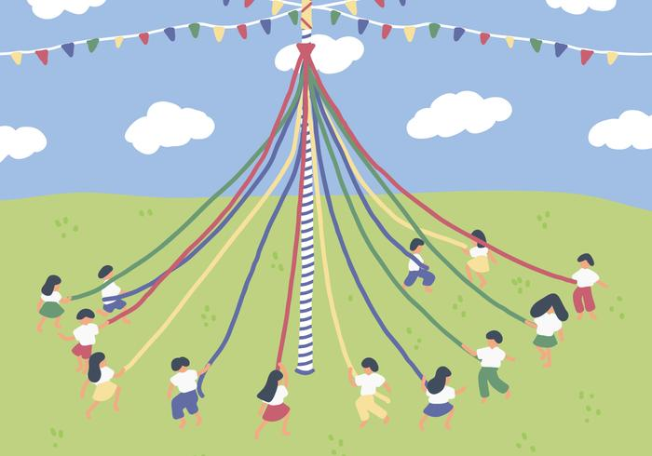
Hello Year 1!
How’s it been going for you all? I hope you are all well. Have you grown? Is your hair longer? Have you learned to do something new that you couldn’t do before?
I hope you enjoyed seeing all the teachers in the Bapchild Lockdown video!
Please make sure you are still reading everyday (either books you have at home or books from the Oxford Owl website) and writing regularly in your writing journal/diary. This week Mrs Smith has made some special slides for her Phonics group so have a look if you were in her group. My Phonics group should still be practising alternative graphemes for known phonemes (Phase 5c) using the PhonicsPlay website.
Please also find below three English tasks,
some White Rose Maths lessons and an Art Activity.
Have a good week!
Love from Mrs Child
xxx

Slide 3

English Learning 1
Time to write your very own Bog Baby adventure story. Hopefully you have planned your story and practiced telling it and that it has improved each time you have told it. Here are some tips to make sure your writing is really good:
As you write, make sure you say each sentence out loud first and listen hard to the sounds in the words and use your Phonics to write them down.
Remember to start each new sentence with a capital letter and end with a full stop (unless it needs a question mark or an exclamation mark).
Include adjectives to describe your Bog Baby and your Bog Baby’s habitat.
Try to use some compound sentences, joining ideas with “and” to make your writing more interesting.
Remember the –ed suffix for verbs in the past tense (even though is sometimes sounds like –t).
Can you use a word that starts with the prefix “un-”?
When you have finished, read through your writing very carefully to make sure it makes sense and you have included all the parts of the story.
When you are sure it is really good think about how you can present it. You could fold paper to make a little book and copy the story in your best handwriting and illustrate the different parts. Maybe you could copy your writing on a computer and illustrate it with photos. Maybe you could make a video of you reading your story out loud and showing the pictures. Remember to include a title page. Good luck!

Slide 4
English Learning 2
Read your wonderful Bog Baby story. How is your Bog Baby feeling in the different parts of your story?
Cut out or draw four thought bubbles and place them on your pictures and write what your Bog Baby is thinking at those different times.
happy nervous excited worried safe
loved cheeky playful homesick scared sad
comfortable anxious cross melancholy depressed

Slide 5
English Learning 3
Today you are going to write a diary entry from your Bog Baby’s point of view. Pretend to be your Bog Baby. Get someone to ask you questions about your adventures. Can you describe what happened in the right order? Use the words First, Next, Then, After that and Finally to help you sequence the events in time. Remember that you will be using the First Person and the past tense. E.g. “Fred picked me up. At first I was scared. I didn’t know where we were going. Then he put me in a sparkly bucket and gave me a fairy cake.”
When you have rehearsed the diary entry by talking, try writing the sentences down. Make sure you include time words and feelings words.

Slide 6
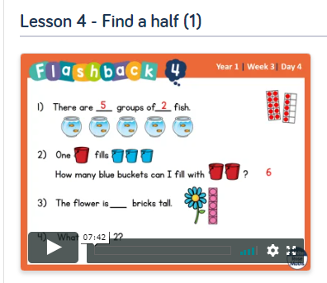
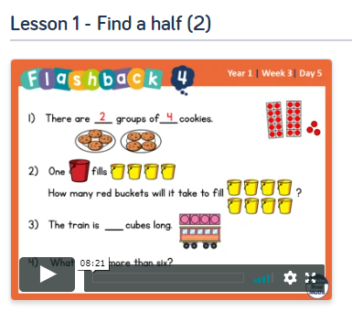
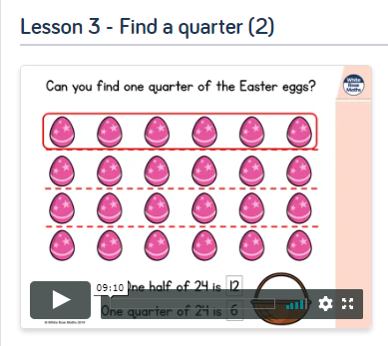
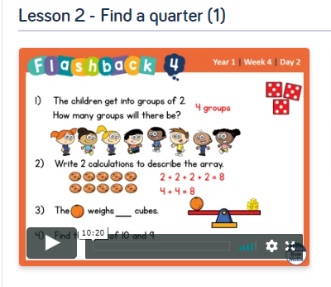
Maths Learning
This week we are learning to find a half and find a quarter. Please go to the Year 1 Home Learning page on the White Rose website and complete Summer Term Week 1 Lessons 4 (It says week beginning 20th April) and Week 2 Lessons 1, 2 and 3 (week beginning 27th April). https://whiterosemaths.com/homelearning/year-1/
Try to find practical opportunities to find halves and quarters such as cutting a sandwich, cake or piece of fruit, sharing sweets or folding, cutting or colouring different paper shapes into halves and quarters in different ways.
Also look out for other times we use the words half and quarter in everyday life – half term, half way there, half time, half past nine, quarterpounder burger.

Slide 7
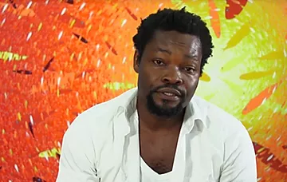

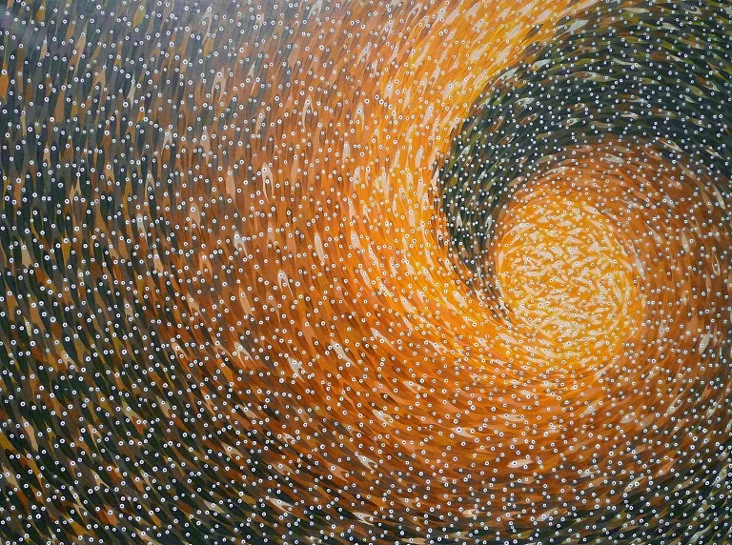
Art Learning
This is Kobina Nyarko. He is an artist from Ghana. He is 48 years old and lives in the city of Takoradi right next to the ocean. He paints huge paintings on canvas of thousands of fish. Take a look at these two paintings.
“Tunnel”
“Surfer’s Pride”

Slide 8
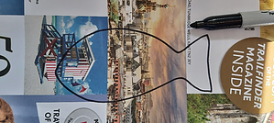
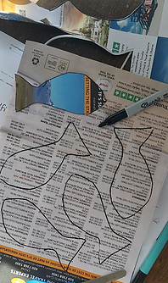
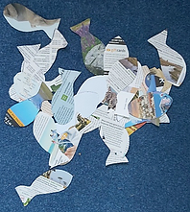
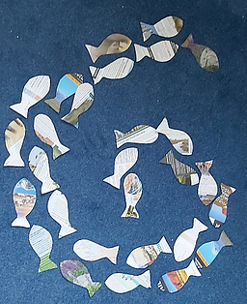
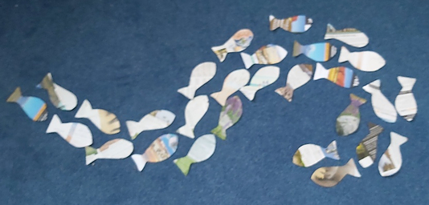
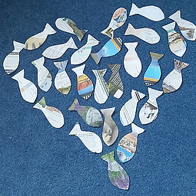
Draw and cut out a small fish on a piece of scrap paper,
old magazine or newspaper, like this.
Draw around this shape lots of times until you get lots of fish the same size. Cut them out. (You can get someone to help you do this as there will be a lot to cut out! Fold the paper to cut out lots at once.)
​
Now place them on the floor and make patterns out of them. Play with your fish. Take photos of them in different spiral and wave patterns.
If you have glue and big paper or recycled card, you can stick them down. Maybe you could even do your own version of a Kobina Nyarko painting.

Slide 9

Reading
For additional reading at your child’s level please use the Oxford Owl website where you can read books online and then complete comprehension activities about the books. Please continue to keep a record of the books they have read in their reading records.
www.oxfordowl.co.uk
Class login: temple20
Password: Bingbong
(If you are not sure of your child’s level, please check in their reading record book or look at the coloured stickers on the additional reading books that have been sent home.)

Slide 10

Phonics
Please use the games and activities on the Phonicsplay website to continue practsing Phonics.
www.phonicsplay.co.uk
Login: march20
Password: home
Mrs Child’s Phonics group are currently working on Phase 5c (alternative ways of writing sounds we already know e.g. ai, ay, a_e all make the same sound).
Mrs Smith’s group are working on Phase 4.
Additionally, there are many excellent Phonics resources on the Twinkl website(see below for how to get free access). Practising reading “alien words” is a particularly fun and valuable activity.

Slide 11

Writing
Your child has been provided with a writing journal. They are used to using them and know that they need to write the date, write a sentence (about anything they like), draw and colour a picture and then fill any spare lines with handwriting patterns.

Slide 12

P.E.
It is important to keep your children active. If it is safe to do so, ensure they have some time outside throughout the day. Please visit Joe Wicks YouTube channel (https://www.youtube.com/channel/UCAxW1XT0iEJo0TYlRfn6rYQ), which has lots of exercise videos for children. He will also be hosting a live P.E. lessons Monday to Friday at 9:00am.

Slide 13


Using My Maths
Children should know their way round My Maths but here are some reminders on how to access the lessons. Visit: www.mymaths.co.uk
bapchild
divide162

Slide 14

Using My Maths
Access any lesson based on what your child is learning in class or search the topic in the search bar.
Use the login portal to access specific homework and lessons that your teacher has set.

Slide 15

Maths – White Rose Home Leaning
In school we follow the White Rose scheme of learning. Their website has put together free lessons and resources that link to the learning taking place in school. Please visit: https://whiterosemaths.com/homelearning/

Slide 16

Accessing Twinkl
Many educational content providers are offering free access to their resources. Twinkl is a website that we use from time to time to resource our lessons to aid in teacher input and pupil activities.
We will be able to direct you towards activities and learning via this website based on lessons that may be missed due to absence. To access Twinkl please visit: www.twinkl.co.uk/offer
You will have to sign up and put in the offer code: UKTWINKLHELPS

Slide 17

Classroom Secrets
The site classroom secrets https://classroomsecrets.co.uk/free-home-learning-packs/ has free class packs which provide some great additional ideas and resources you can use.

