Slide 1



A big warm welcome to Bapchild and Tonge Primary School!
Here you will find a social story about what to expect when coming to school.
Look at it through the summer holidays to help your child become familiar with where they will be coming in September.

Slide 2


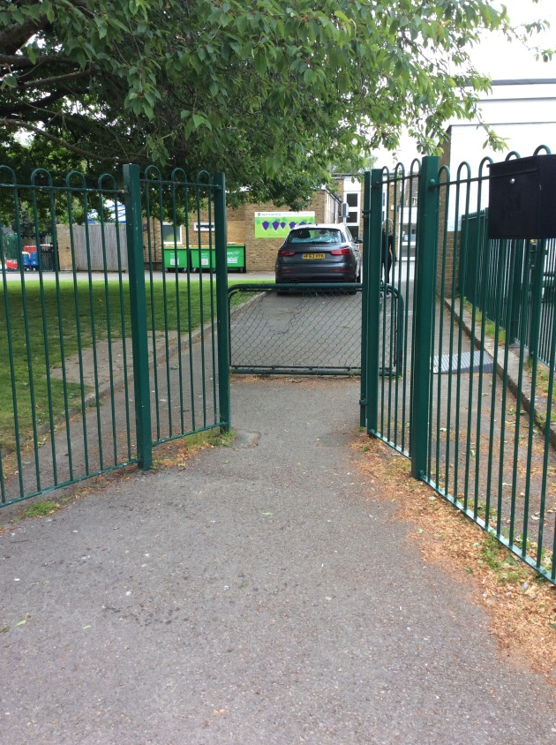
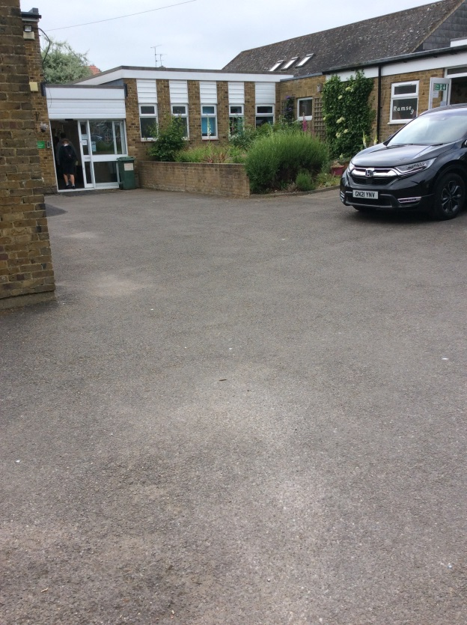
This is where you stand before you go into school.
When you arrive you will come through this gate.

Slide 3
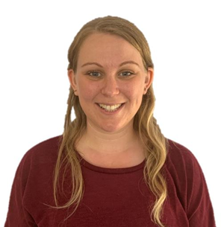
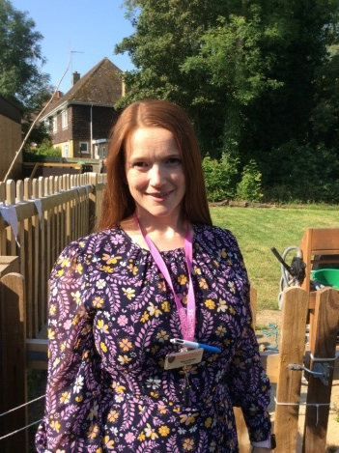
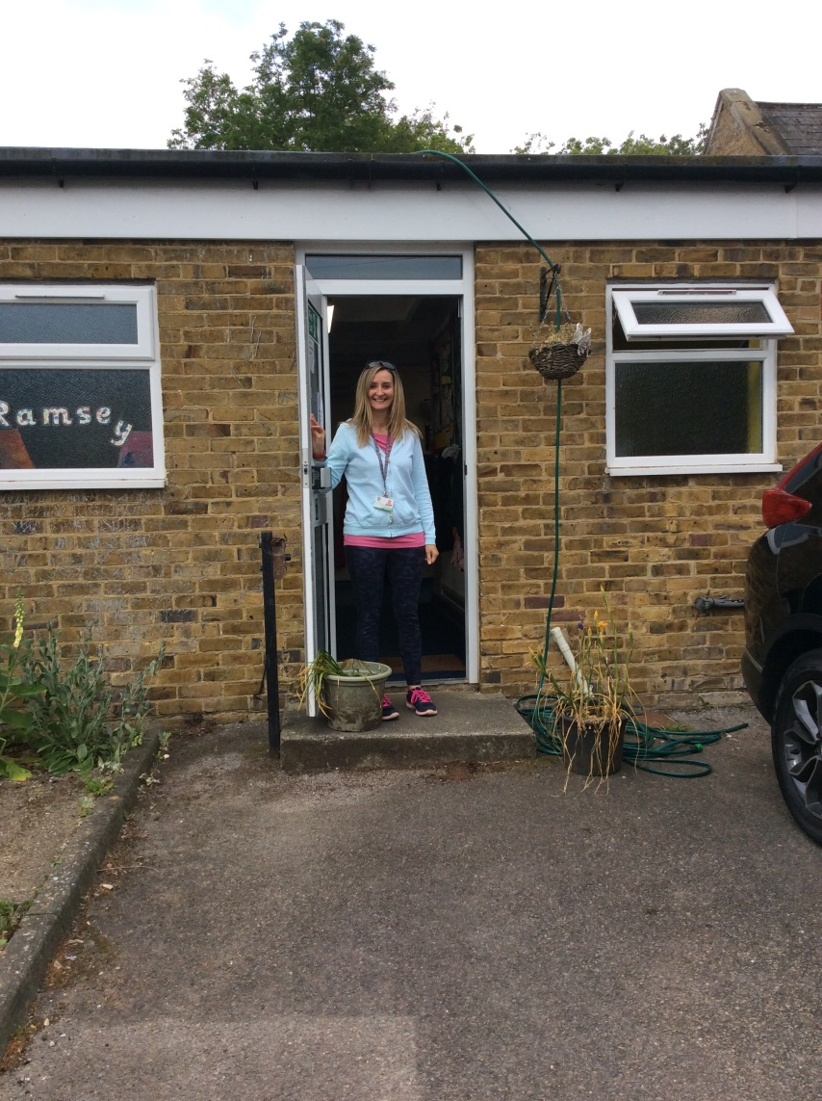
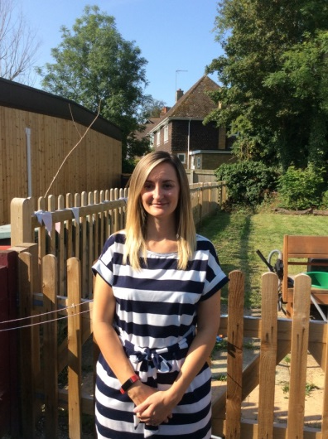
Your teachers will be ready to welcome you.
You will come in through this door.
Mrs Smith will be in the classroom Mondays and Tuesdays.
Mrs Freestone will be in the classroom all week.
Mrs Green will be in the classroom Wednesdays, Thursdays and Fridays.

Slide 4
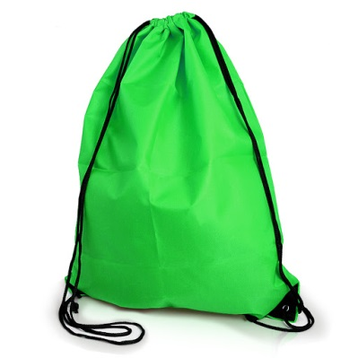
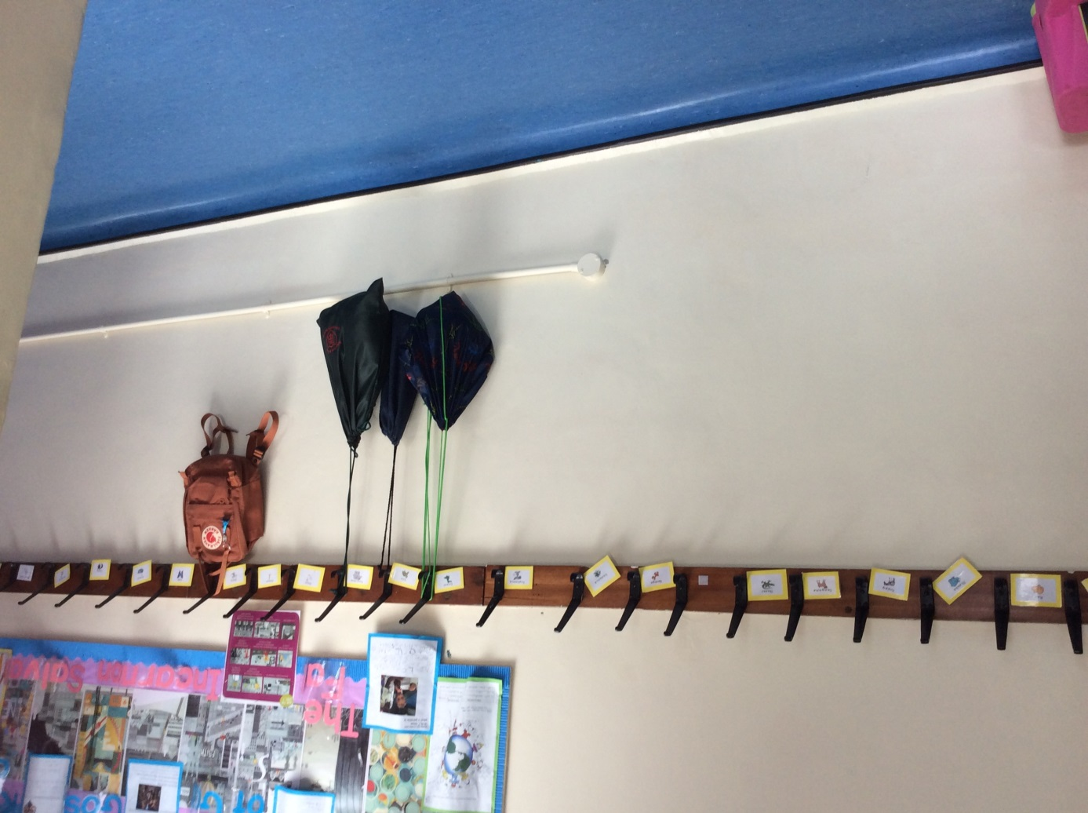
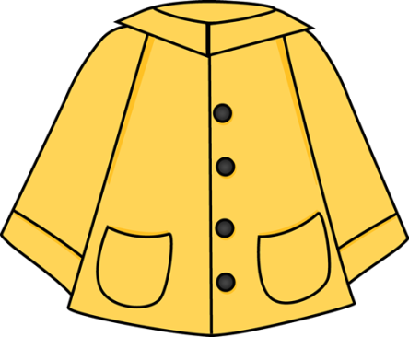

Once you come in, you can hang up your PE bags, coats and hats on your very own peg.

Slide 5
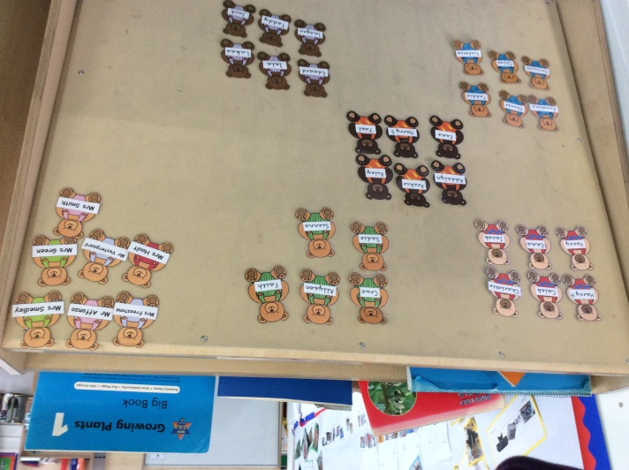
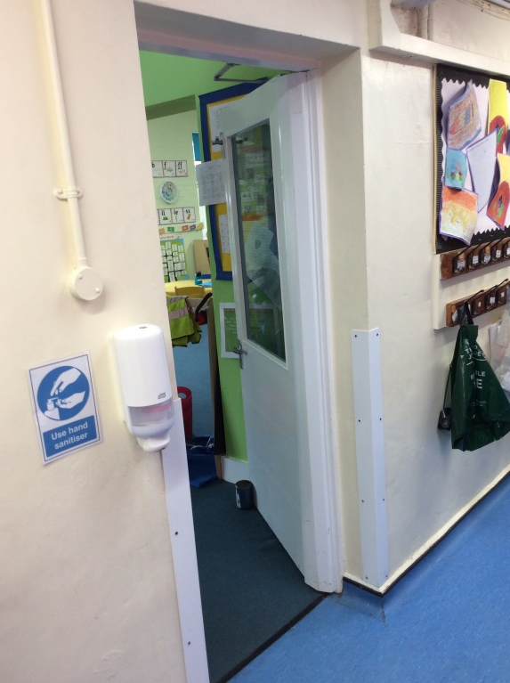
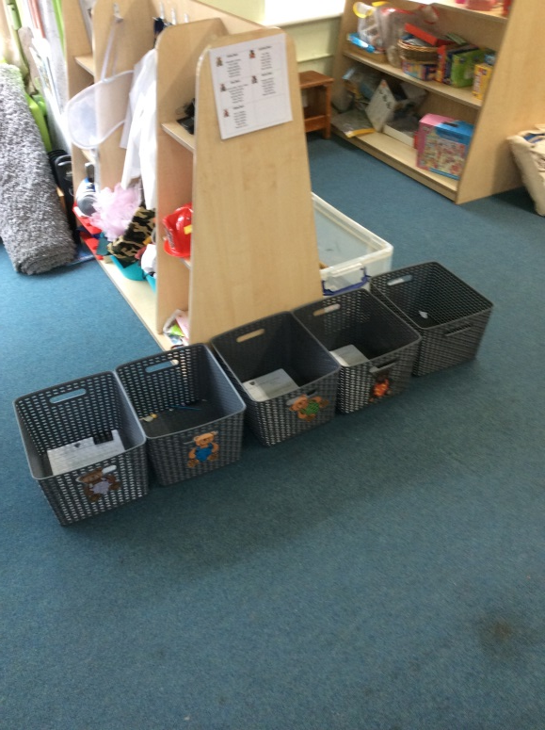
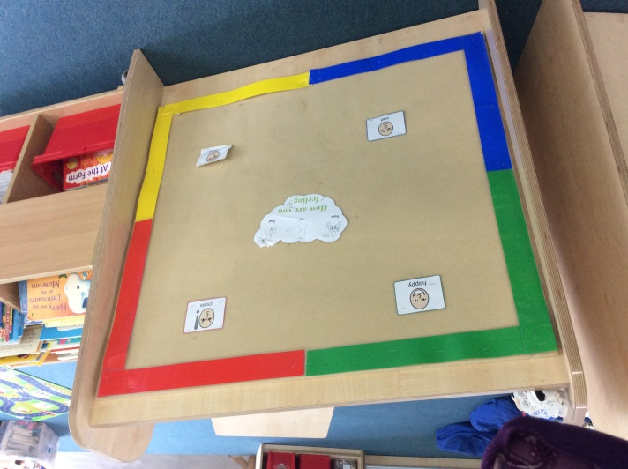
Once you’ve hung your coats and hats on your pegs, go through to the classroom.
Put your book bag into your groups box.
Come into the classroom door.
Put your bear on our register board

Slide 6
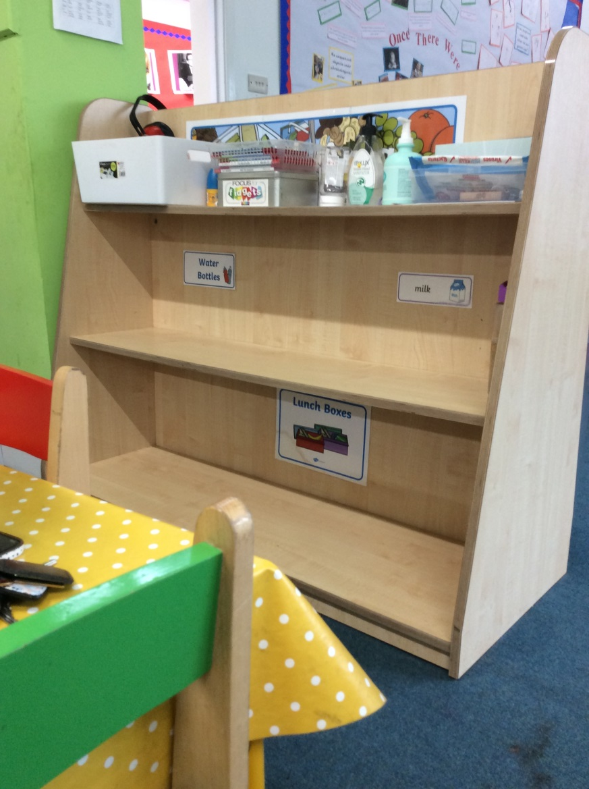

Put your water bottle on the shelf and if you have a pack lunch box put it on the bottom shelf.

Slide 7
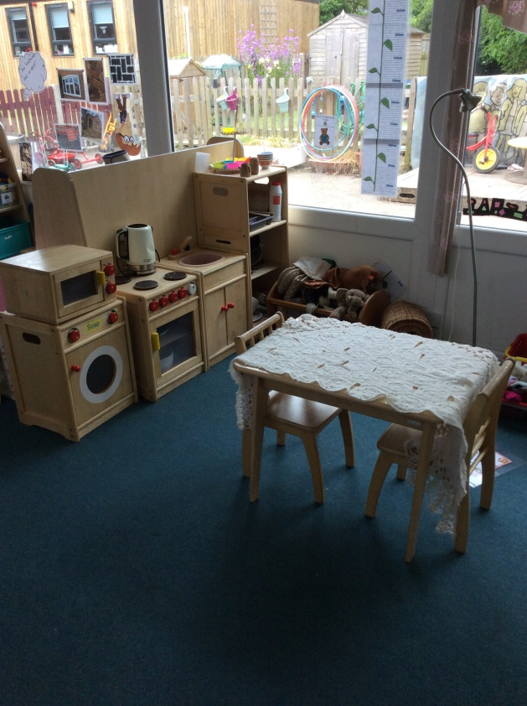
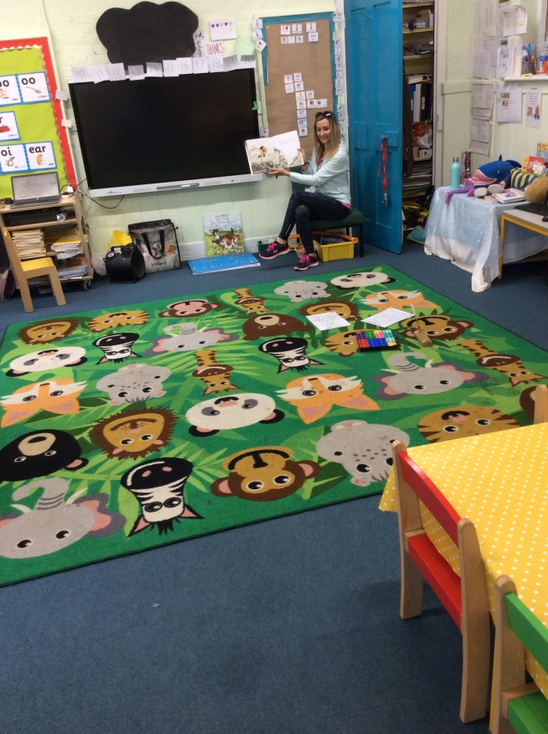
Your teacher might then read you a story or you might have something fun to go and do in the classroom.
This is the home corner. You can find lovely things to explore here.

Slide 8
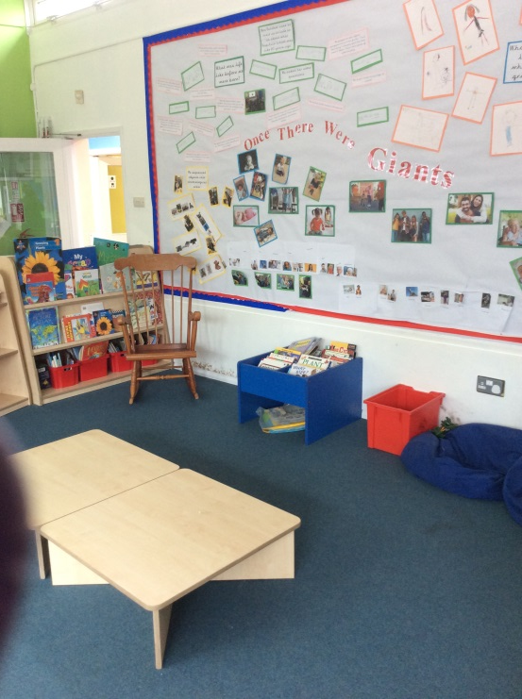
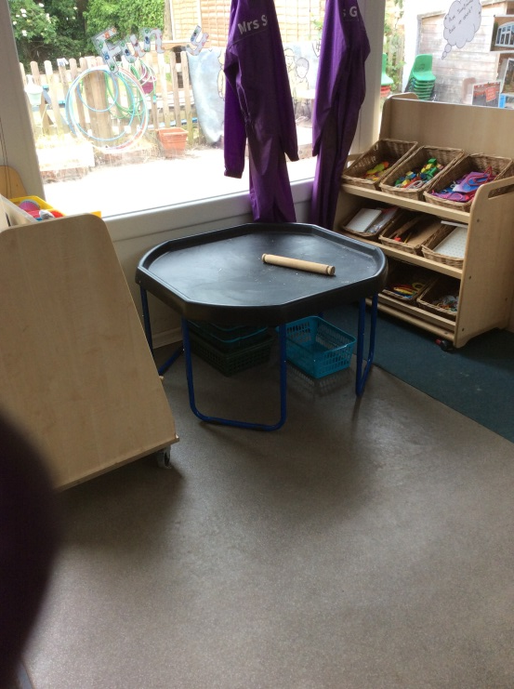
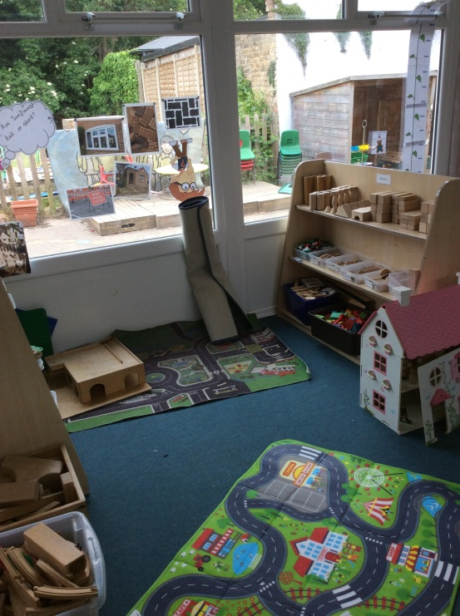
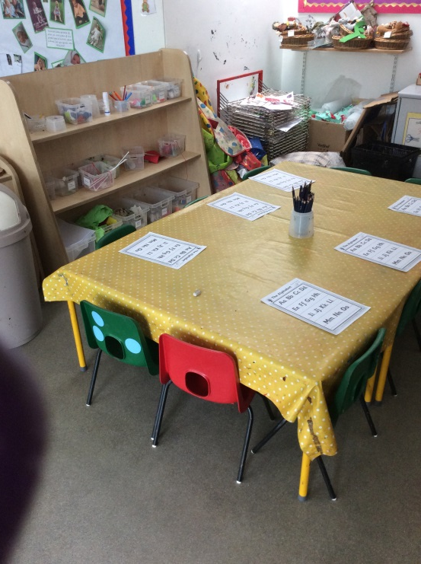
This is our construction area – we cant wait to see what you might build
This is our workshop – you will find lots of things to be creative with here.
This is our story space where you can explore marvellous stories and let your imagination run wild!
Our tuff spot is for you to make your wonderful creations on and a great space for some exploring!

Slide 9
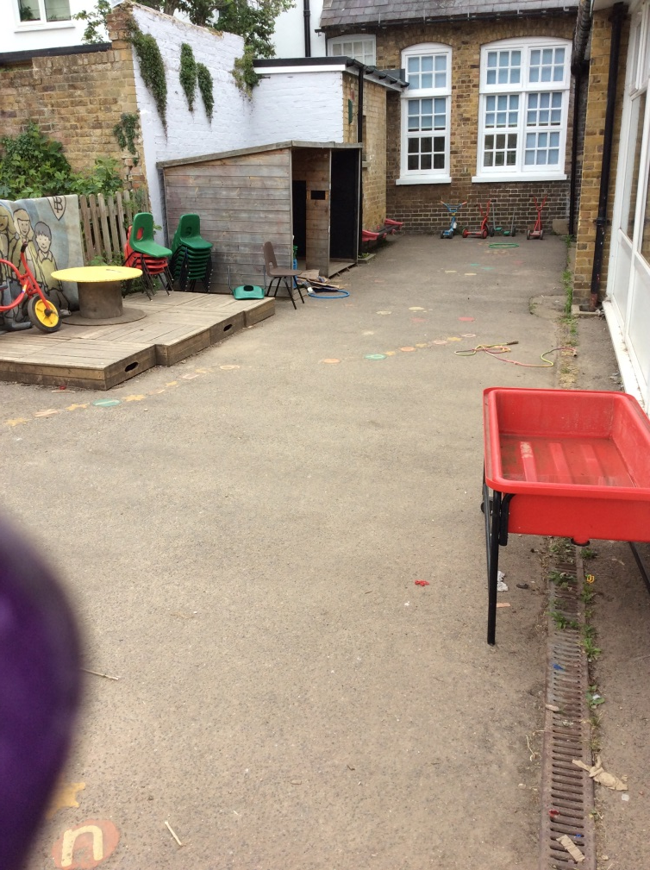
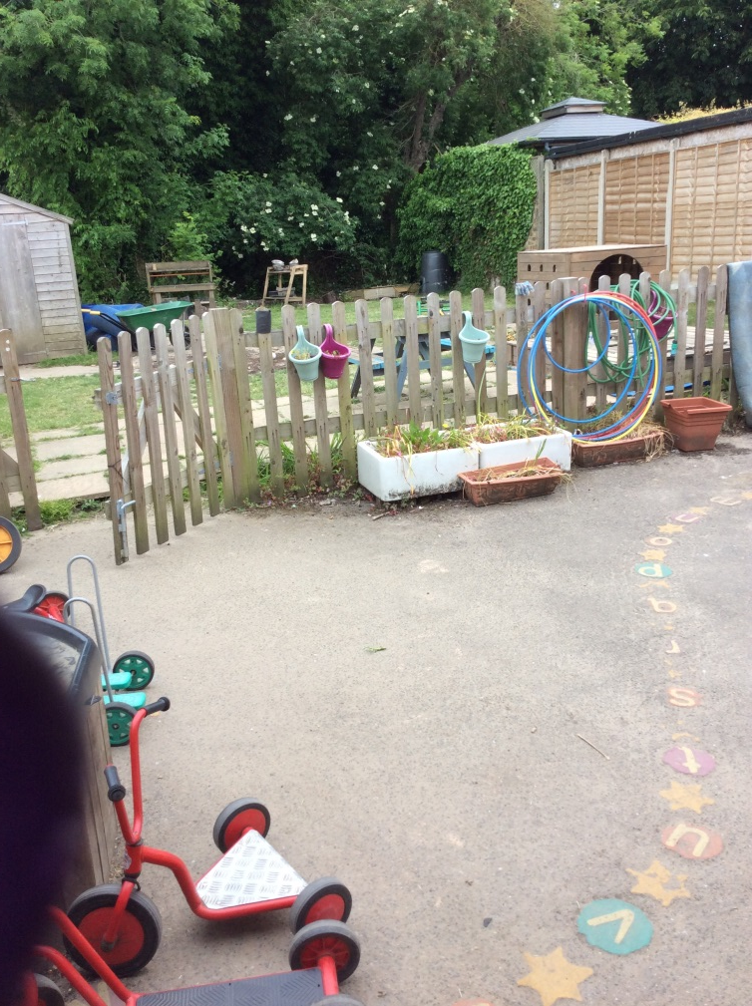
You can take your adventures outside to the outside area too!

Slide 10
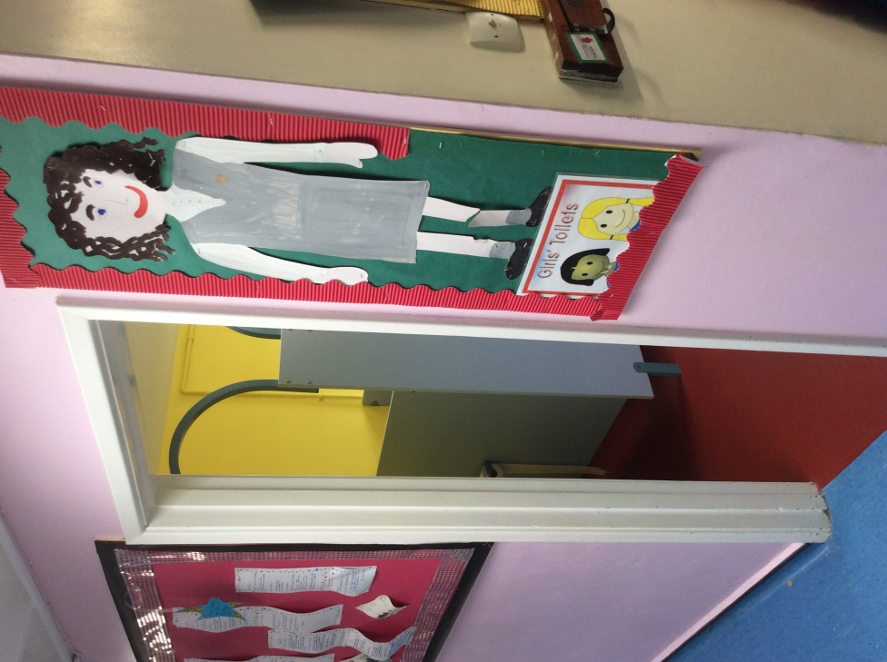
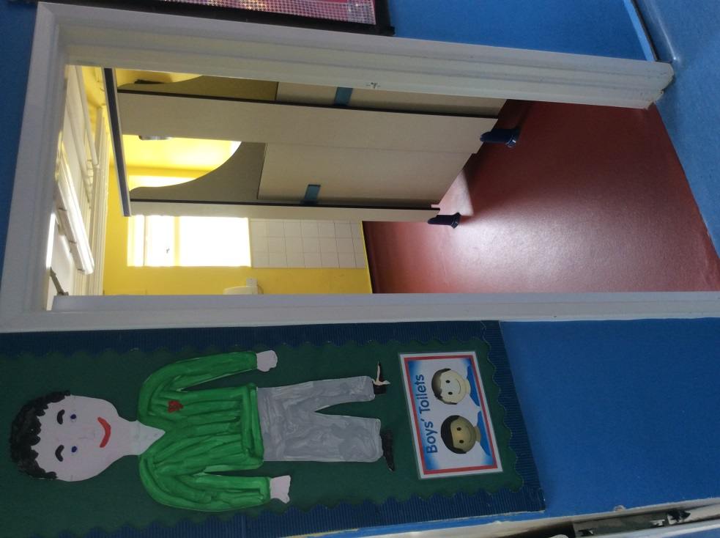

If you need to go to the toilet, or wash your hands for lunchtime, head over to the girls’ or boy’s toilets.

Slide 11
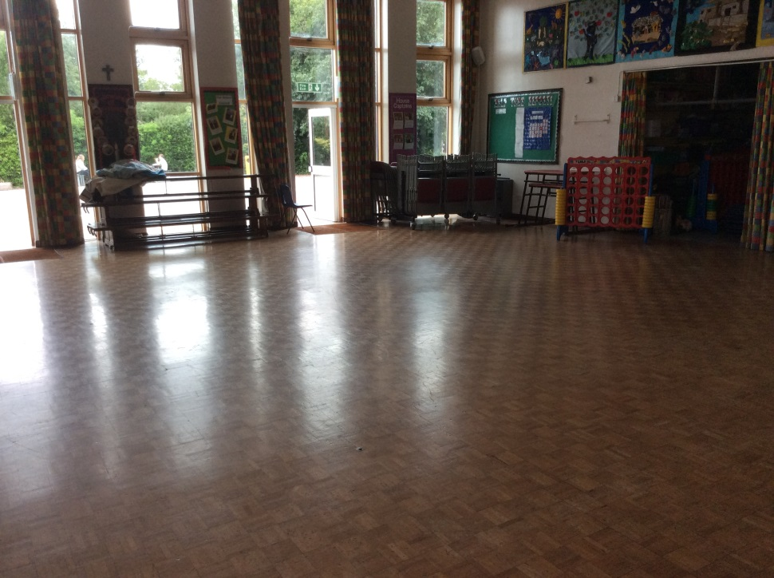
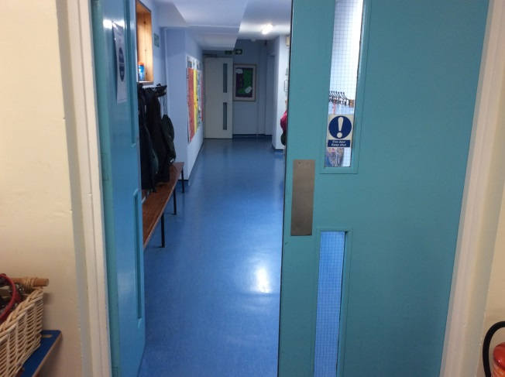
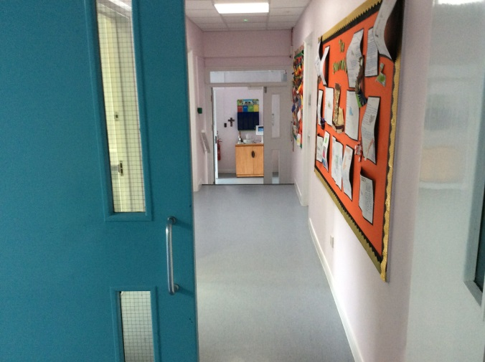
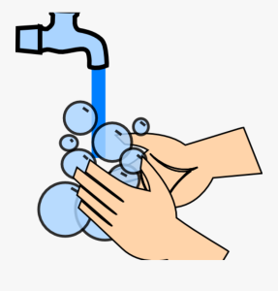
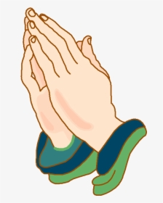
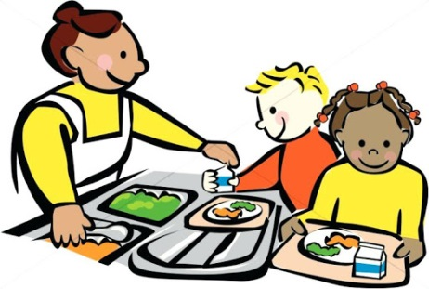
We will wash our hands and say the lunchtime prayer before we go down the corridors to the hall.
We will also go to the hall for worship and do PE.

Slide 12
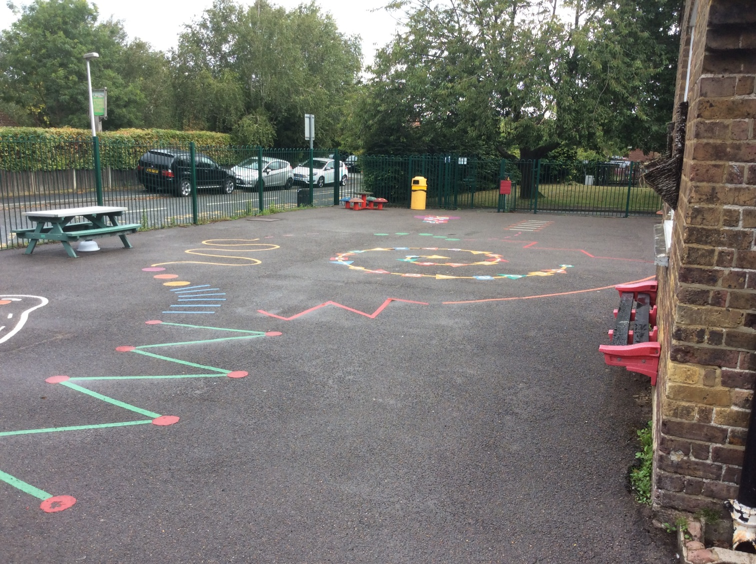

After a few weeks of settling in, this is the playground you will play on with the Year Ones and Twos.

Slide 13
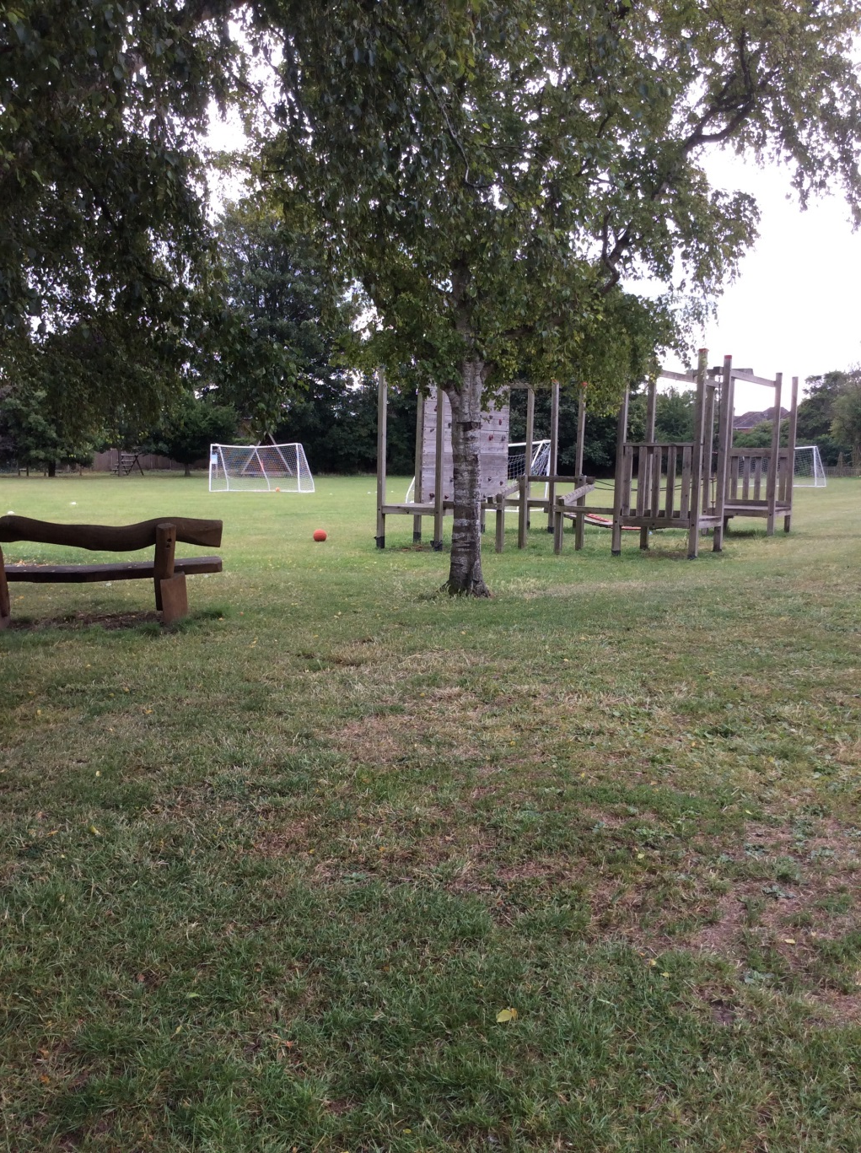
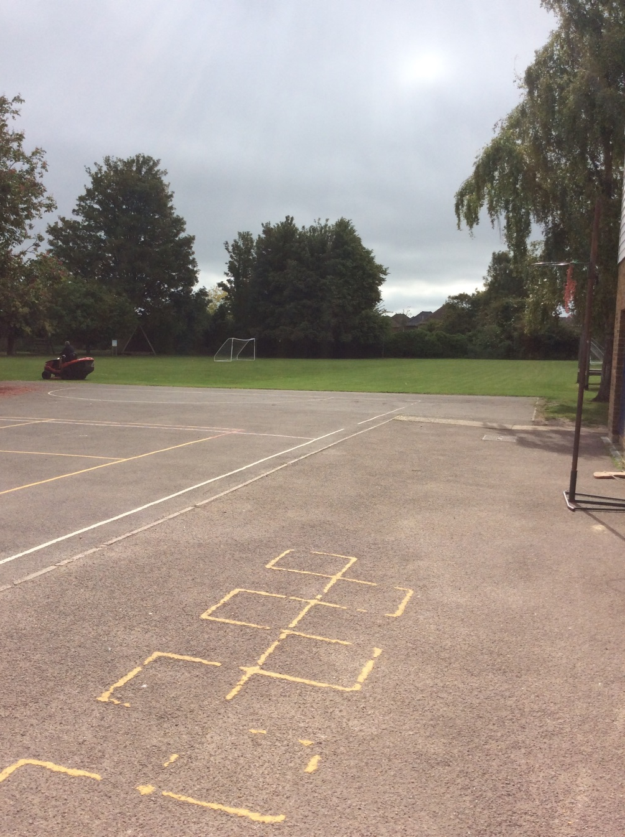
In the summer you get to play on ‘the big field’. You will do some PE lessons on here too.

Slide 14
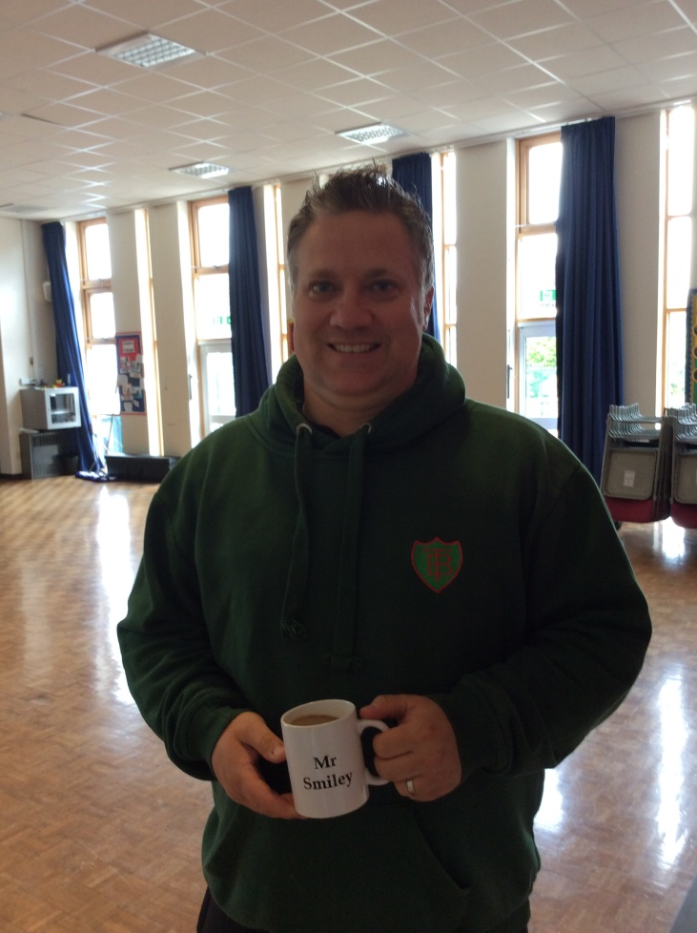
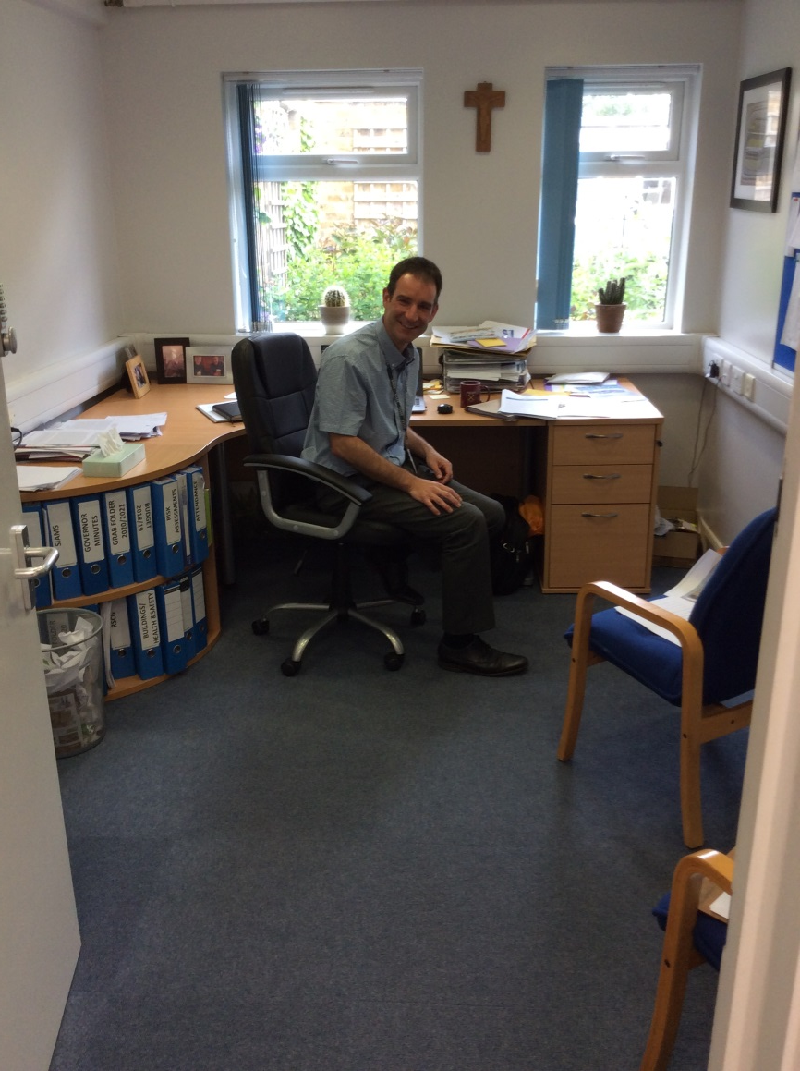
You might see Mr Kelly in his office or around school.
He is the Headteacher
You might see Mr Smiley in his office or around school.
He is the Deputy Headteacher

Slide 15
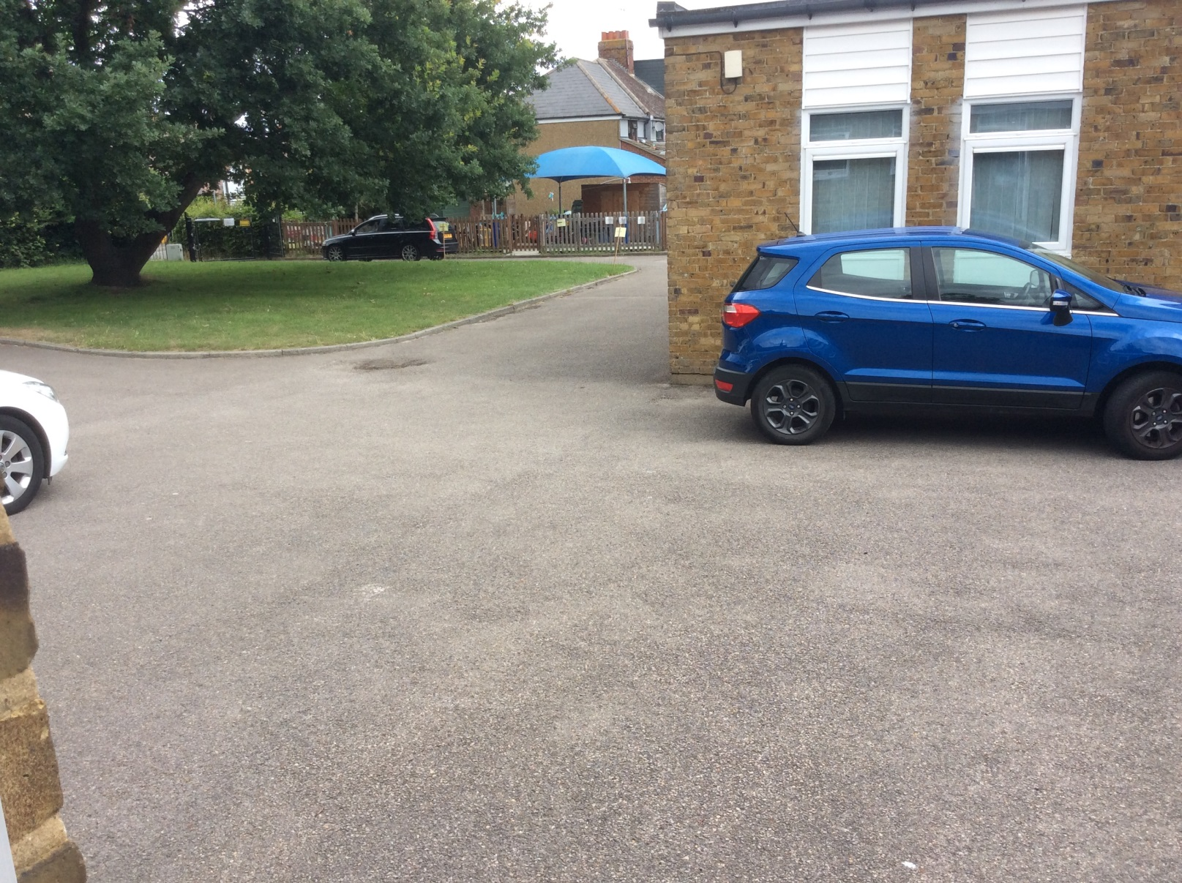

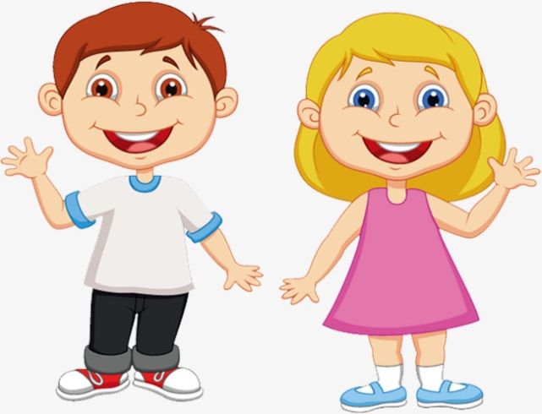
At home time, you will collect all your things and line up ready to go home.
We will go out to meet the grown ups who will be picking you up.

