Slide 1

Home Learning
Year 1
Term 5 Week 3

Slide 2
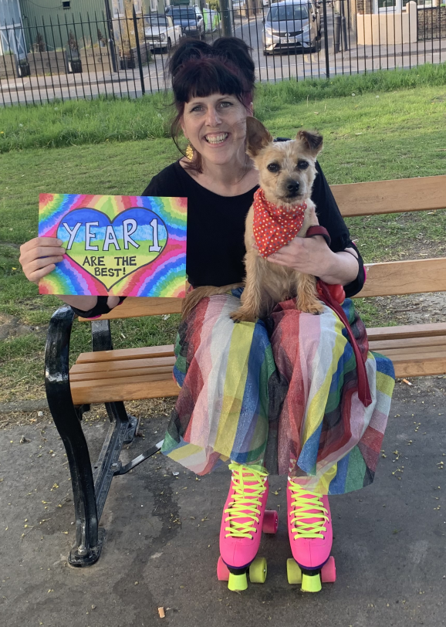
Hello Year 1!
Here are three more English tasks for you for the week, three White Rose Maths lessons to complete and a Geography activity about hot and cold places. Please make sure you are still reading everyday (either books you have at home or books from the Oxford Owl website) and practising your Phonics with the PhonicsPlay website. You should also be writing regularly in your writing journal/diary.
I am still really missing you all and am sad that I haven’t been able to read the Bog Baby story to you myself as it is one of my favourites. I have been for a walk in the bluebell woods near my house to look for real Bog Babies but I didn’t see any this time. I did see lots of very noisy frogs though, and a baby grass snake swimming in the water – quite exciting but not as exciting as a Bog Baby!

Slide 3

English Learning 1
Hopefully you have enjoyed playing with your Bog Baby and have shared many adventures with them which you can use when we write our own Bog Baby stories. Before we plan our stories we are going to practice some skills that you can use to make your writing more interesting. Today we are thinking about compound sentences.
Look at your Bog Baby habitat that you created (or use one of the pictures on the following slides if you haven’t been able to make your own). Think of adjectives to describe it. Is it watery? Squelchy? Damp? Murky? Magical? Sparkling?
Use your adjectives in simple sentences like these.
The mud is squelchy. The gravel is crunchy.
The water is murky. The stones are slippery.
The weed is wavy. The shells are spiky.
When you have written lots of simple sentences you are going to join pairs of sentences using “and” to make compound sentences.
The mud is squelchy and the water is murky.
The weed is wavy and the shells are spiky.
Try to write 4 or 5 really good sentences. Check that they only have a capital letter at the beginning and a full stop at the end and that you haven’t left any capital letters or full stops in the middle!
If you want a challenge you could try using “because”, “so” or “but” to create a compound sentence.
The stones are hard but the mud is soft.
The shells are sparkly because the water is clear.

Slide 4
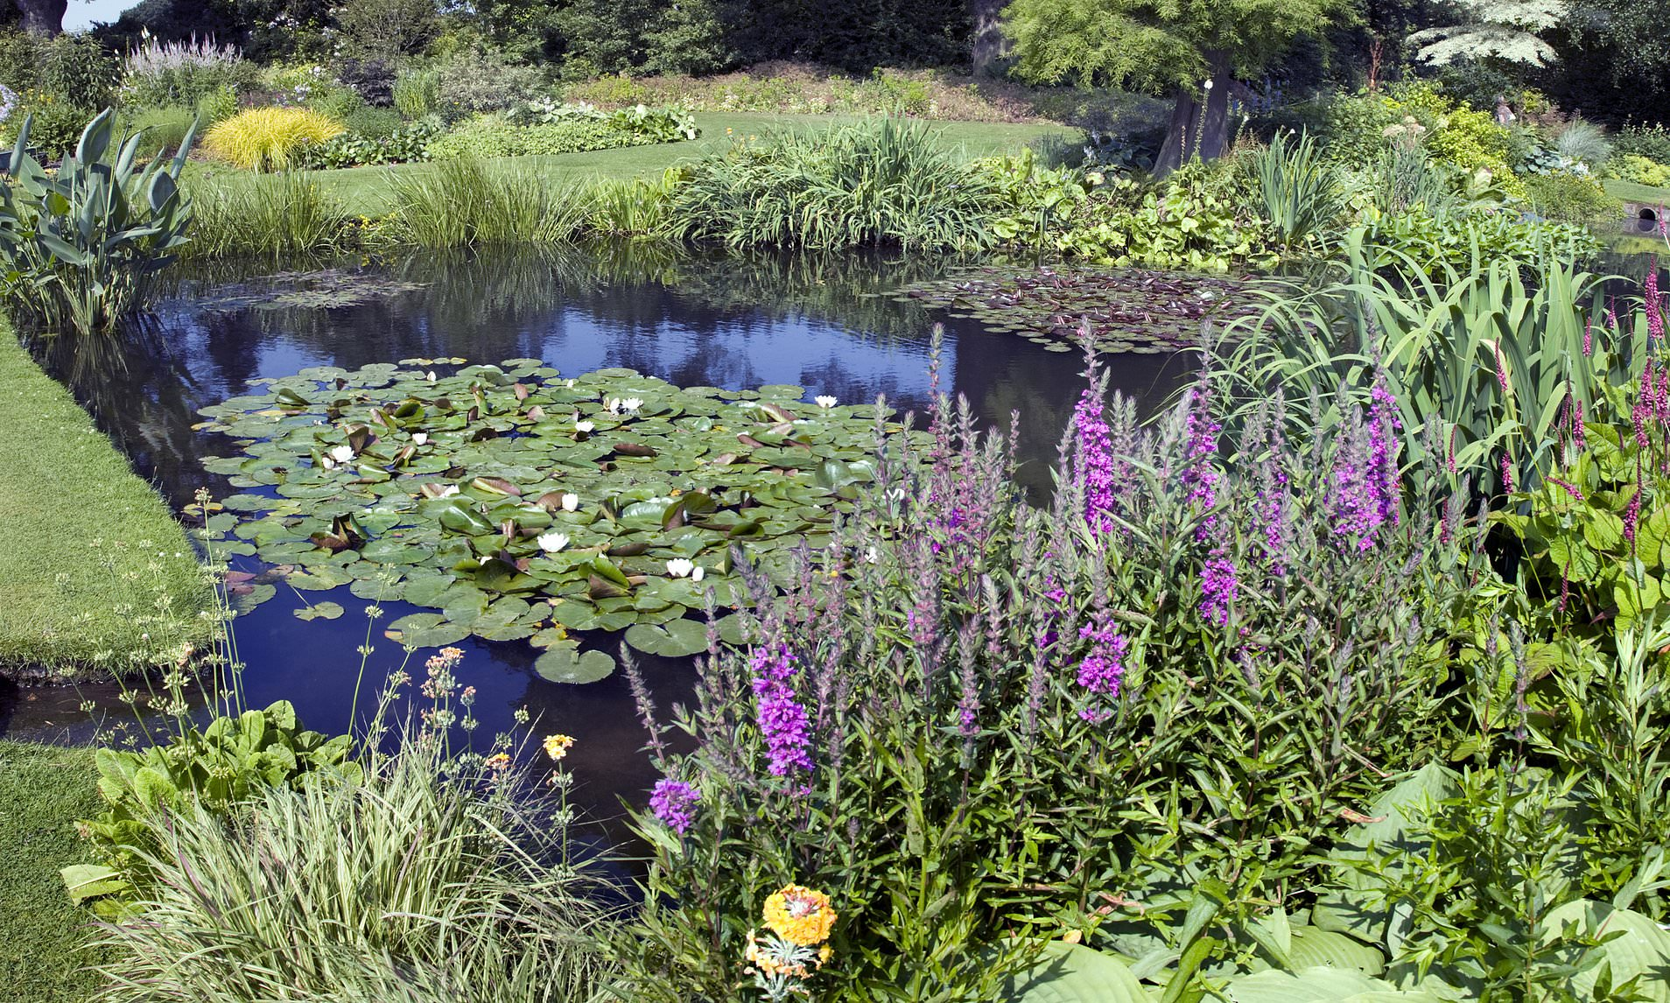

Slide 5
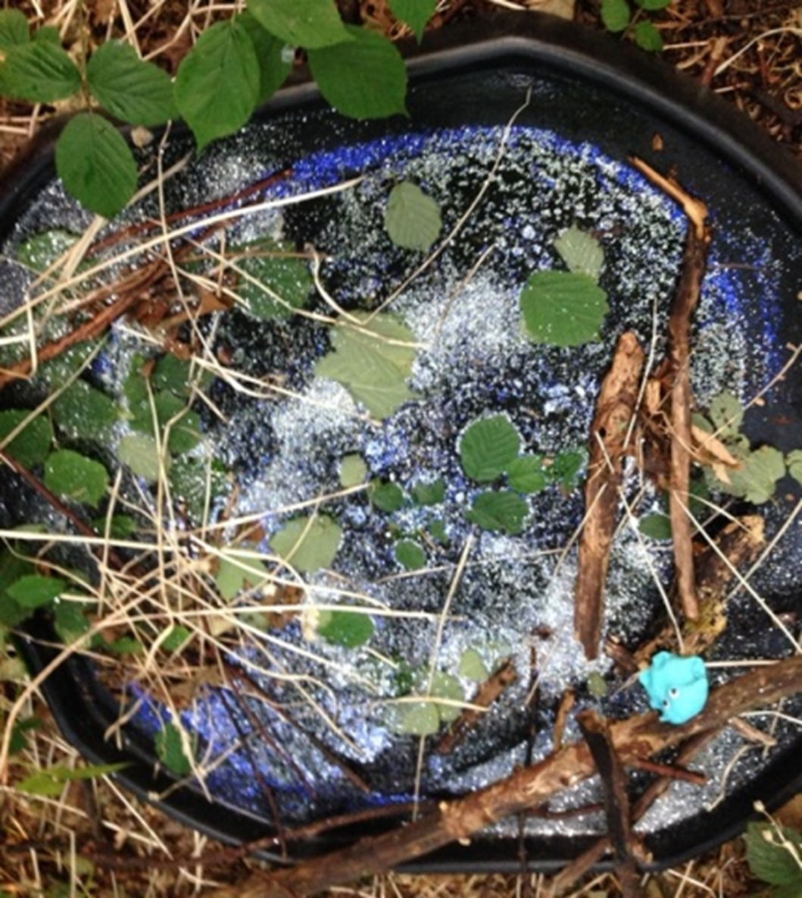

Slide 6
English Learning 2
In the story, why did the Bog Baby become
unhappy and unwell?
Were the girls unkind?
Have a think about these questions and then have a think about what “un” means?
Use the attached Twinkl powerpoint (or follow this link https://www.twinkl.co.uk/resource/t-l-2545-using-the-prefix-un-teaching-powerpoint)
to learn all about the prefix –un.
When you have finished it you can look in your reading books and make a list of any words you find that begin with the –un prefix.

Slide 7
English Learning 3
Time to start planning your own Bog Baby adventure story. Your story will need to have four parts.
1. A beginning where you find your bog baby and describe what it is like.
2. A part where you make a home for it and enjoy looking after it and playing with it.
3. A part where there is a problem, either it becomes unhappy or maybe a disaster happens.
4. An ending where the problem is sorted out.
You can choose to plan your story by drawing a story map like we often do at school or you could draw four more detailed pictures showing each part of the story (you could even try doing this with photos). When you have made your plan, practice telling your story to someone or maybe acting it out with your Bog Baby. Don’t write it yet though – save that for next week!

Slide 8
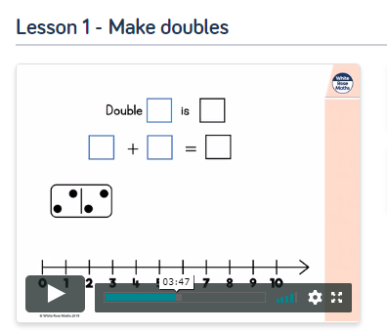
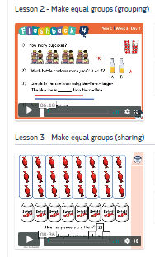
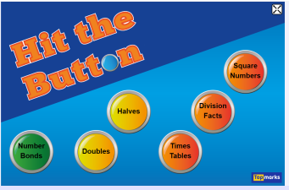
Maths Learning 1, 2 and 3
This week we are continuing to look at Multiplication and Division. Please go to the Year 1 Home Learning page on the White Rose website and complete Summer Term Week 1 Lessons 1, 2 and 3 (It says week beginning 20th April but this is what I’d like you to do this week). https://whiterosemaths.com/homelearning/year-1/
Where it says you need to use 30 counters this could be any small objects you have at home like pieces of pasta, small stones or beads.
And again, don’t feel you have to print the sheets out – the children can write the whole answers out or some of the questions just need discussion.
A fun way to practise doubles is with this Hit the Button game at https://www.topmarks.co.uk/maths-games/hit-the-button

Slide 9
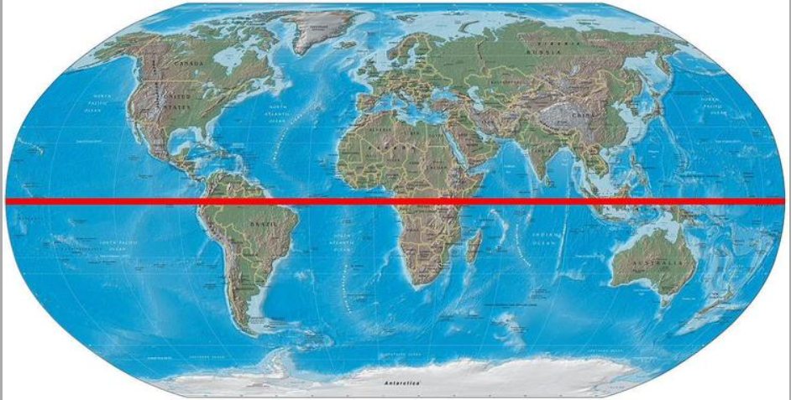
Geography Learning
Why can’t a meerkat live in the North Pole?
In Geography we are going to explore hot and cold places.
We are going to begin by learning the words
Equator, North Pole and South Pole.
The Equator is an imaginary circle around the Earth. It divides Earth into two equal parts and runs half way between the North Pole at the top and the South Pole at the bottom. It is always very hot at the Equator and always very cold at the North and South Poles. Can you find out why this is? This video might help. https://youtu.be/oUVtqTWnUI8. Maybe you could try the experiment yourself.
What is it like at the Equator? What is it like at the poles? Explore further with these resources. https://youtu.be/yNiBL8Jok4s https://youtu.be/X3uT89xoKuc https://youtu.be/LYK8ERKPnNM
Show your learning by colouring and labelling the globe on the next page. Also label a place on it where it is hot, a place where it is cold and a place where it is in between (sometimes hot and sometimes cold). Where would you prefer to visit and why?

Slide 10
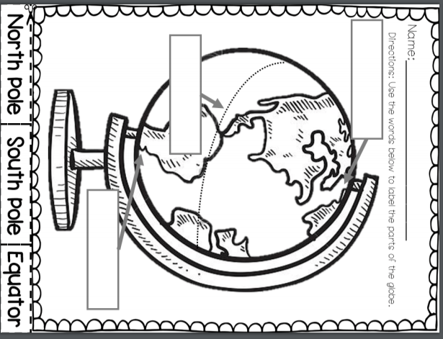

Slide 11
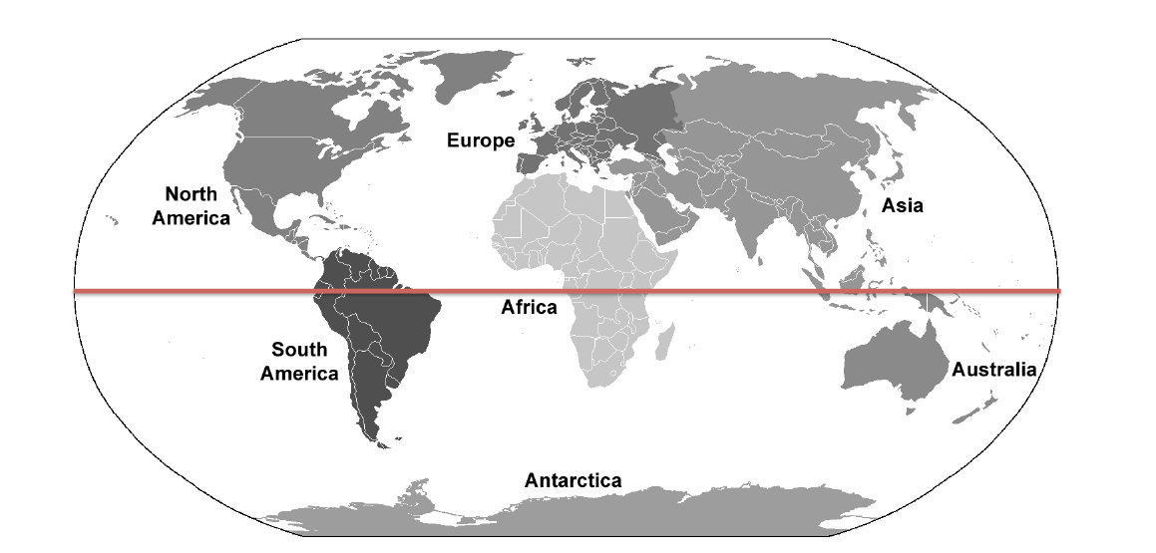

Slide 12

Reading
For additional reading at your child’s level please use the Oxford Owl website where you can read books online and then complete comprehension activities about the books. Please continue to keep a record of the books they have read in their reading records.
www.oxfordowl.co.uk
Class login: temple20
Password: Bingbong
(If you are not sure of your child’s level, please check in their reading record book or look at the coloured stickers on the additional reading books that have been sent home.)

Slide 13

Phonics
Please use the games and activities on the Phonicsplay website to continue practsing Phonics.
www.phonicsplay.co.uk
Login: march20
Password: home
Mrs Child’s Phonics group are currently working on Phase 5c (alternative ways of writing sounds we already know e.g. ai, ay, a_e all make the same sound).
Mrs Smith’s group are working on Phase 4.
Additionally, there are many excellent Phonics resources on the Twinkl website(see below for how to get free access). Practising reading “alien words” is a particularly fun and valuable activity.

Slide 14

Writing
Your child has been provided with a writing journal. They are used to using them and know that they need to write the date, write a sentence (about anything they like), draw and colour a picture and then fill any spare lines with handwriting patterns.

Slide 15

P.E.
It is important to keep your children active. If it is safe to do so, ensure they have some time outside throughout the day. Please visit Joe Wicks YouTube channel (https://www.youtube.com/channel/UCAxW1XT0iEJo0TYlRfn6rYQ), which has lots of exercise videos for children. He will also be hosting a live P.E. lessons Monday to Friday at 9:00am.

Slide 16


Using My Maths
Children should know their way round My Maths but here are some reminders on how to access the lessons. Visit: www.mymaths.co.uk
bapchild
divide162

Slide 17

Using My Maths
Access any lesson based on what your child is learning in class or search the topic in the search bar.
Use the login portal to access specific homework and lessons that your teacher has set.

Slide 18

Maths – White Rose Home Leaning
In school we follow the White Rose scheme of learning. Their website has put together free lessons and resources that link to the learning taking place in school. Please visit: https://whiterosemaths.com/homelearning/

Slide 19

Accessing Twinkl
Many educational content providers are offering free access to their resources. Twinkl is a website that we use from time to time to resource our lessons to aid in teacher input and pupil activities.
We will be able to direct you towards activities and learning via this website based on lessons that may be missed due to absence. To access Twinkl please visit: www.twinkl.co.uk/offer
You will have to sign up and put in the offer code: UKTWINKLHELPS

Slide 20

Classroom Secrets
The site classroom secrets https://classroomsecrets.co.uk/free-home-learning-packs/ has free class packs which provide some great additional ideas and resources you can use.

