Slide 1

Home Learning
Year 1
Term 5 Week 2

Slide 2
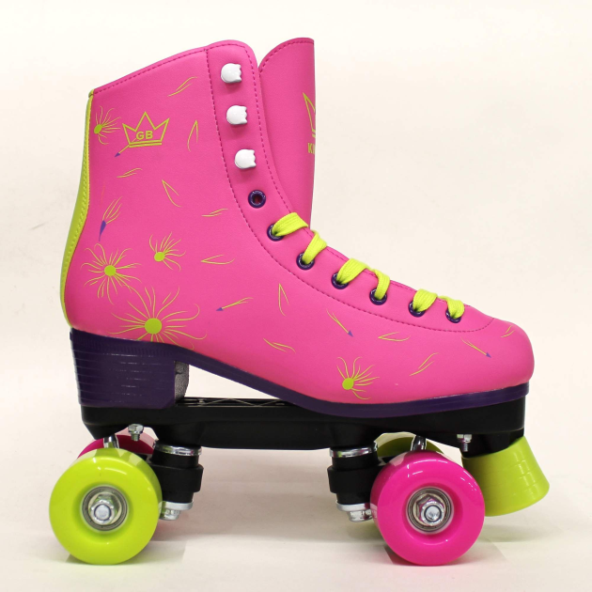
Hello Year 1!
I hope you have had a good weekend and are ready for this week’s learning. There are three English tasks, three White Rose Maths lessons to complete and an RE activity. Make sure you are also reading everyday (either books you have at home or books from the Oxford Owl website) and practising your Phonics with the PhonicsPlay website. You should also be writing regularly in your writing journal/diary.
It was my birthday this week and my best present was a pair of pink roller skates. I’m just off to the park to have a practice!
Love from Mrs Child

Slide 3

English Learning 1
I hope you enjoyed the story of
The Bog Baby.
Today we are thinking about verbs. Remember that verbs are doing words that you can act out. In this story, the verbs are in the past tense and many use the –ed suffix to show this. Make a list of as many verbs with the –ed suffix that you can find in the text. Try and use five of them in sentences of your own.
You can use the attached powerpoint version of the story to help you spot them.
(There are also past tense verbs in the story that do not use the –ed suffix – maybe you could spot some of these too.)
squeaked
floated
stroked

Slide 4
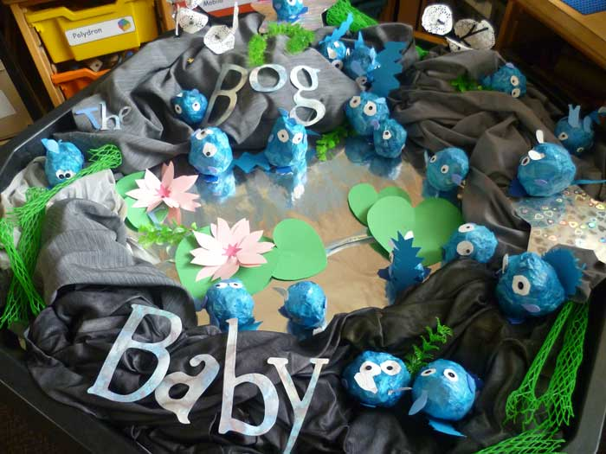
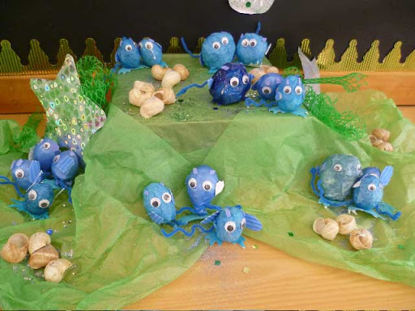
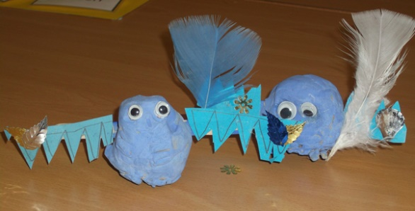
English Learning 2
Can you make your own Bog Baby?
You could use plasticine, playdough, salt dough, a pompom, papier-mache, crumpled paper or a balloon filled with flour. You can find lots of inspiration if you Google “make a bog baby” or you can look at the authors website at http://jeannewillis.com/BogText1.html .

Slide 5
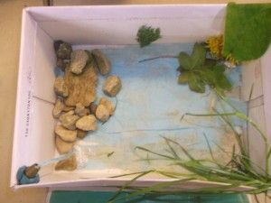
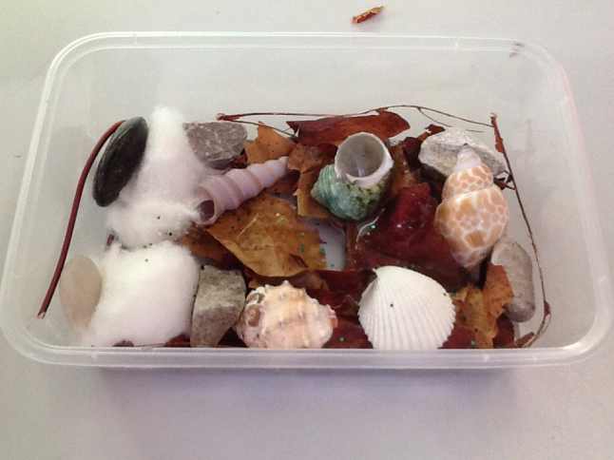
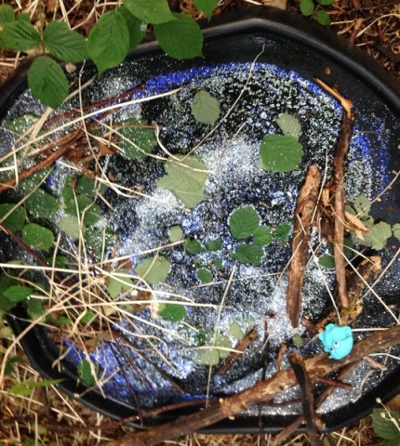
English Learning 3
Your Bog Baby will also need somewhere to live – this could be a bucket or a margarine tub like in the story or you might have your own idea like a shoe box or a washing up bowl. Create a habitat for your Bog Baby.
Look after your Bog Baby. What does yours like to eat? What games do they like? Where do they sleep? What is their character like? Can you act out the story of how you found your Bog Baby and how you care for it?

Slide 6
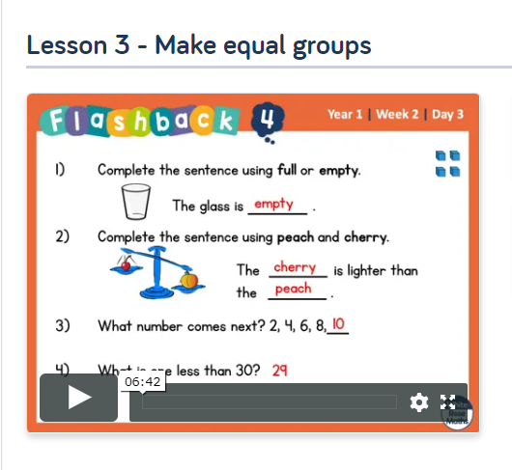
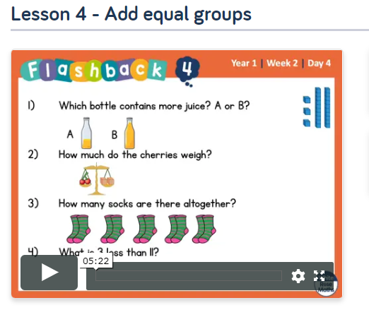
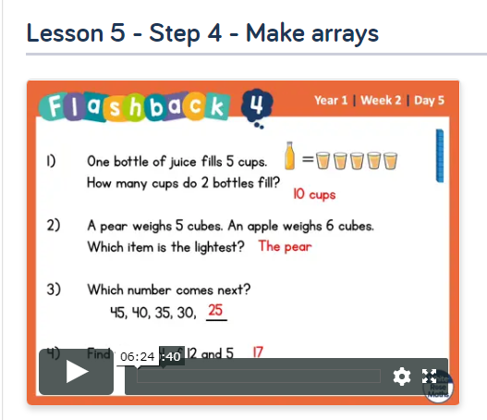
Maths Learning 1, 2 and 3
This week we are looking at Multiplication and Division. Please go to the Year 1 Home Learning page on the White Rose website and complete Week 2, Lessons 3, 4 and 5.
(Don’t feel you have to print out the worksheets, it won’t hurt the children to copy out the whole answers!)
If you need further practice you can also complete the Year 1 Multiplication Introduction lesson on MyMaths.

Slide 7
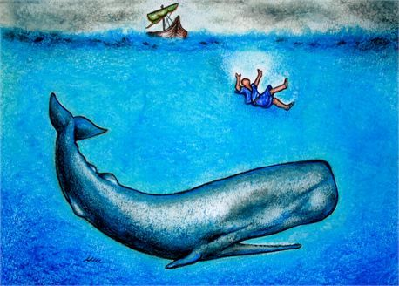
RE Learning
What do Christians believe that God is like?
Jonah and the Whale
Read the story of Jonah and the Whale from a children’s Bible or watch the story at:
https://www.youtube.com/watch?v=WOSadLyqshg
Questions for discussion:
How do we know Jonah was a good man?
Why did God want Jonah to go to Nineveh?
Why did Jonah not want to go?
What might it feel like to be in a boat during a storm?
Activities:
Draw the story of Jonah (you could use the Resource Sheet on the next page to help)
Sing along to the Jonah Song https://www.youtube.com/watch?v=RlvuWMqAPTQ
Make a Jonah and a whale using a range of media
Think of some questions you could ask Jonah about God.

Slide 8
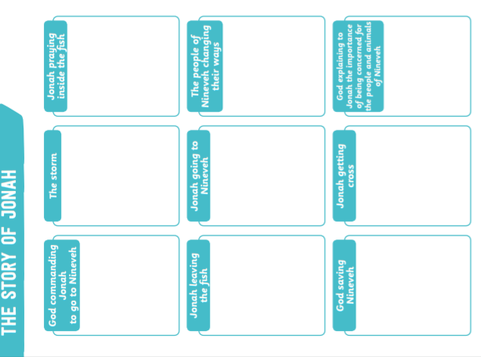

Slide 9

Reading
For additional reading at your child’s level please use the Oxford Owl website where you can read books online and then complete comprehension activities about the books. Please continue to keep a record of the books they have read in their reading records.
www.oxfordowl.co.uk
Class login: temple20
Password: Bingbong
(If you are not sure of your child’s level, please check in their reading record book or look at the coloured stickers on the additional reading books that have been sent home.)

Slide 10

Phonics
Please use the games and activities on the Phonicsplay website to continue practsing Phonics.
www.phonicsplay.co.uk
Login: march20
Password: home
Mrs Child’s Phonics group are currently working on Phase 5c (alternative ways of writing sounds we already know e.g. ai, ay, a_e all make the same sound).
Mrs Smith’s group are working on Phase 4.
Additionally, there are many excellent Phonics resources on the Twinkl website(see below for how to get free access). Practising reading “alien words” is a particularly fun and valuable activity.

Slide 11

Writing
Your child has been provided with a writing journal. They are used to using them and know that they need to write the date, write a sentence (about anything they like), draw and colour a picture and then fill any spare lines with handwriting patterns.

Slide 12

P.E.
It is important to keep your children active. If it is safe to do so, ensure they have some time outside throughout the day. Please visit Joe Wicks YouTube channel (https://www.youtube.com/channel/UCAxW1XT0iEJo0TYlRfn6rYQ), which has lots of exercise videos for children. He will also be hosting a live P.E. lessons Monday to Friday at 9:00am.

Slide 13


Using My Maths
Children should know their way round My Maths but here are some reminders on how to access the lessons. Visit: www.mymaths.co.uk
bapchild
divide162

Slide 14

Using My Maths
Access any lesson based on what your child is learning in class or search the topic in the search bar.
Use the login portal to access specific homework and lessons that your teacher has set.

Slide 15

Maths – White Rose Home Leaning
In school we follow the White Rose scheme of learning. Their website has put together free lessons and resources that link to the learning taking place in school. Please visit: https://whiterosemaths.com/homelearning/

Slide 16

Accessing Twinkl
Many educational content providers are offering free access to their resources. Twinkl is a website that we use from time to time to resource our lessons to aid in teacher input and pupil activities.
We will be able to direct you towards activities and learning via this website based on lessons that may be missed due to absence. To access Twinkl please visit: www.twinkl.co.uk/offer
You will have to sign up and put in the offer code: UKTWINKLHELPS

Slide 17

Classroom Secrets
The site classroom secrets https://classroomsecrets.co.uk/free-home-learning-packs/ has free class packs which provide some great additional ideas and resources you can use.

