Slide 1

Home Learning
Year 1
Term 5 Week 1

Slide 2
Hello Lovely Year 1!
I hope you are all OK and managed to have an enjoyable Easter holiday. I have been well and busy looking after my children and my mum and my dog. I have also been volunteering to help older people who live in my road with their shopping.
Please find below lots of useful information plus a new slide about PE and another useful resource called Classroom Secrets. The first three slides outline specific activities for our class and will be updated every week with three Maths tasks, three English tasks and one other Science or Topic activity. As this week is only two days there is only one Maths and one English task this time.
Remember to be kind to yourselves in these strange times and that you can only do your best.
Love from Mrs Child

Slide 3

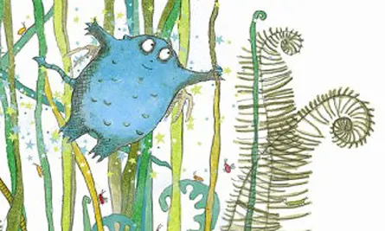
English Learning
Our new class book is The Bog Baby by Jeanne Willis. Please listen to the story being read at https://www.youtube.com/watch?v=nVuH4BdVQOQ.
What is a Bog Baby?
How could you describe it?
What does it look like and feel like? Where does it live?
What does it like to do?
Draw a picture of a Bog Baby and write adjectives around it. Can you use your adjectives in sentences to write a description of a Bog Baby?

Slide 4
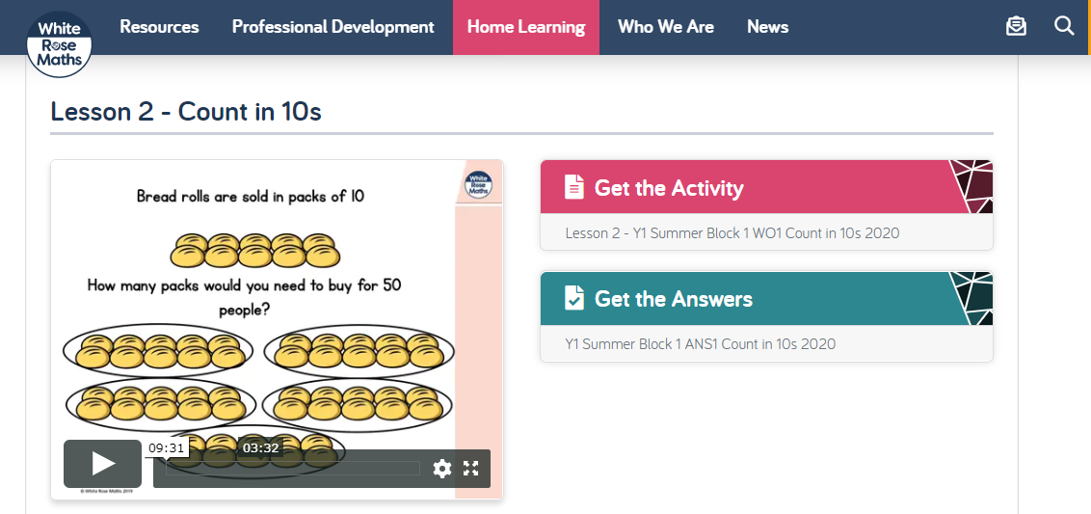
Maths Learning
For the next few weeks in Maths we will be looking at Multiplication and Division. Please go to the Year 1 Home Learning page on the White Rose website and complete Week 2, Lesson 2 about counting in tens. (Don’t feel you have to print out the worksheets, it won’t hurt the children to copy out the whole answers!)

Slide 5
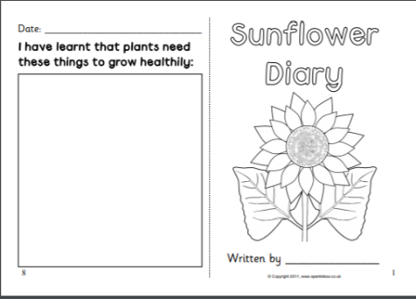
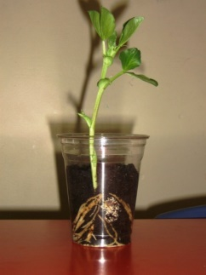
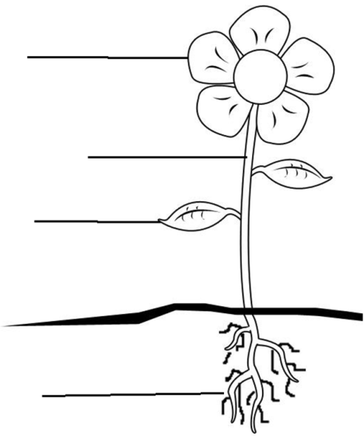
Science Learning
How are your sunflower seeds growing?
Some of them might be quite tall by now!
We need to learn to identify the parts of a plant including root, stem, leaf and flower.
Find a plant (even a weed) and draw and label a diagram of it. Can you find out what the different parts are for? (Lots of helpful resources for this on Twinkl.) When you have done one drawing you could do one of another plant and compare how the parts are the same and different.
When you are eating vegetables think about which part of the plant you are eating. For example, when you eat a carrot you are eating the root and if you eat celery you are eating the stem. Could you find an example of when you eat the leaves or the flowers of a plant? How could you show what you have learned?

Slide 6

Reading
For additional reading at your child’s level please use the Oxford Owl website where you can read books online and then complete comprehension activities about the books. Please continue to keep a record of the books they have read in their reading records.
www.oxfordowl.co.uk
Class login: temple20
Password: Bingbong
(If you are not sure of your child’s level, please check in their reading record book or look at the coloured stickers on the additional reading books that have been sent home.)

Slide 7

Phonics
Please use the games and activities on the Phonicsplay website to continue practsing Phonics.
www.phonicsplay.co.uk
Login: march20
Password: home
Mrs Child’s Phonics group are currently working on Phase 5c (alternative ways of writing sounds we already know e.g. ai, ay, a_e all make the same sound).
Mrs Smith’s group are working on Phase 4.
Additionally, there are many excellent Phonics resources on the Twinkl website(see below for how to get free access). Practising reading “alien words” is a particularly fun and valuable activity.

Slide 8

Writing
Your child has been provided with a writing journal. They are used to using them and know that they need to write the date, write a sentence (about anything they like), draw and colour a picture and then fill any spare lines with handwriting patterns.

Slide 9

P.E.
It is important to keep your children active. If it is safe to do so, ensure they have some time outside throughout the day. Please visit Joe Wicks YouTube channel (https://www.youtube.com/channel/UCAxW1XT0iEJo0TYlRfn6rYQ), which has lots of exercise videos for children. He will also be hosting a live P.E. lessons Monday to Friday at 9:00am.

Slide 10


Using My Maths
Children should know their way round My Maths but here are some reminders on how to access the lessons. Visit: www.mymaths.co.uk
bapchild
divide162

Slide 11

Using My Maths
Access any lesson based on what your child is learning in class or search the topic in the search bar.
Use the login portal to access specific homework and lessons that your teacher has set.

Slide 12

Maths – White Rose Home Leaning
In school we follow the White Rose scheme of learning. Their website has put together free lessons and resources that link to the learning taking place in school. Please visit: https://whiterosemaths.com/homelearning/

Slide 13

Accessing Twinkl
Many educational content providers are offering free access to their resources. Twinkl is a website that we use from time to time to resource our lessons to aid in teacher input and pupil activities.
We will be able to direct you towards activities and learning via this website based on lessons that may be missed due to absence. To access Twinkl please visit: www.twinkl.co.uk/offer
You will have to sign up and put in the offer code: UKTWINKLHELPS

Slide 14

Classroom Secrets
The site classroom secrets https://classroomsecrets.co.uk/free-home-learning-packs/ has free class packs which provide some great additional ideas and resources you can use.

