Slide 1


Two children are discussing how some objects have been sorted.
Dora
Jack
Who is correct? Convince me.
These objects have been sorted into cubes and counters.
These objects have been sorted into green and yellow.

Slide 2











How many different ways can the objects be grouped?

Slide 3



Eva has counted the toy cars.
Explain what mistake Eva could have made.
There are 3 cars.

Slide 4













How many different ways can you find to group the objects and find the total?

Slide 5


How many ways can you represent 6 glasses of apple juice?
How many ways can you show me less than 4 sweets?
How can you show me that there are more green cars than blue cars?

Slide 6

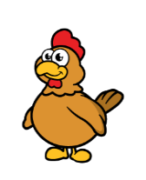







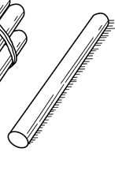




Which representation matches which group?
Explain how you know.

