Slide 1

Home Learning
Year 1
Term 1 Week 3

Slide 2


Hello Year 1!
Ready for another week of Home Learning?
There are three English tasks based on The Little Red Hen – one about identifying the parts of a story, one about capital letters and one about writing sentences using capital letters.
The Maths this week is about counting forwards and backwards and finding one more and one less. There are five video lessons from White Rose, four worksheets and some Reasoning and Problem solving questions.
The Science is about the Five Senses.
Please continue to read everyday as well as some daily Phonics, Handwriting practise and physical exercise.
Can’t wait to see you again soon. Keep in touch via Tapestry.
Love from
Mrs Child
XXX

Slide 3
English Learning 1
I hope you watched the Pie Corbett video last week and practised retelling the story of The Little Red Hen. Maybe you have made a story map to help you. Here is another version of the story. Can you read it by yourself?

Slide 4
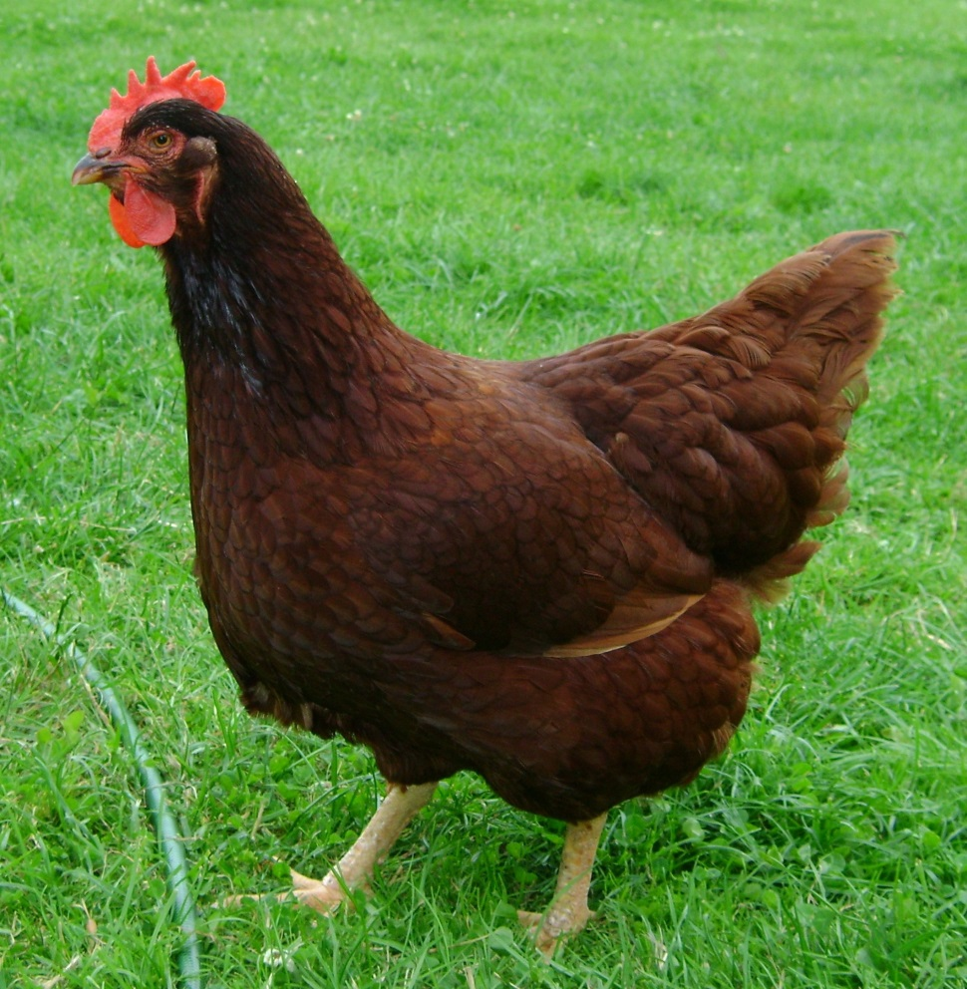
The Little Red Hen

Slide 5

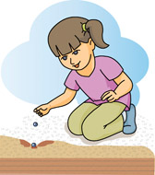
Once upon a time there was a little red hen who lived on a farm.
Early one morning she woke and went outside. There she found some corn.
“Who will help me plant the corn?”

Slide 6
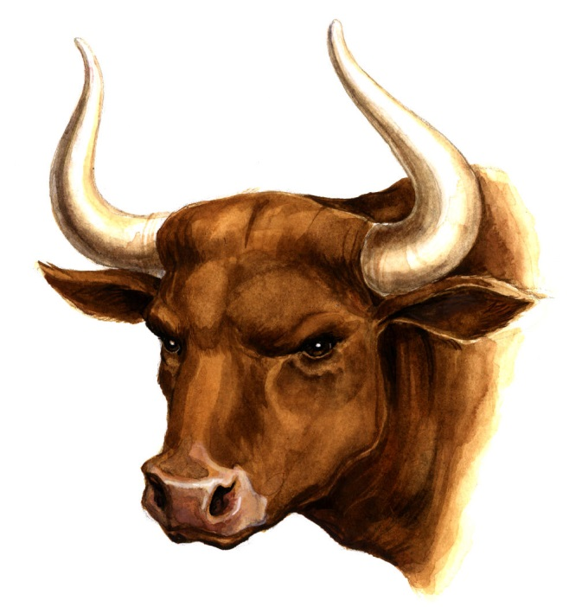
“Not I,” said the bull.
“Not I.”

Slide 7
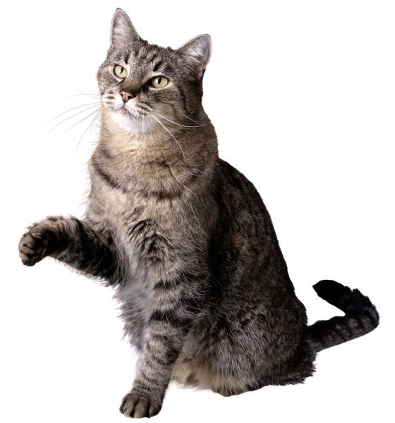
“Not I.”
“Not I,” said the cat.

Slide 8
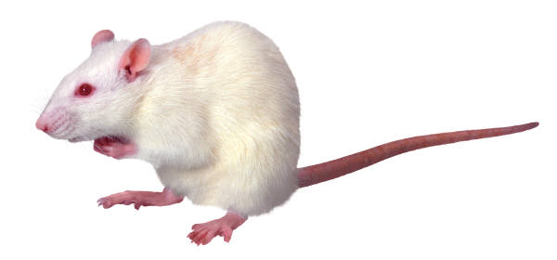
“Not I,” said the rat.
“Not I.”

Slide 9

Oh very well, I’ll do it myself,” said the little red hen – and so she did!

Slide 10

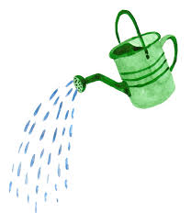
“Who will help me water the corn?” said the little red hen.

Slide 11
“Not I,” said the bull.
“Not I.”

Slide 12
“Not I.”
“Not I,” said the cat.

Slide 13
“Not I,” said the rat.
“Not I.”

Slide 14
“Oh very well, I’ll do it myself” said the little red hen – and so she did!

Slide 15

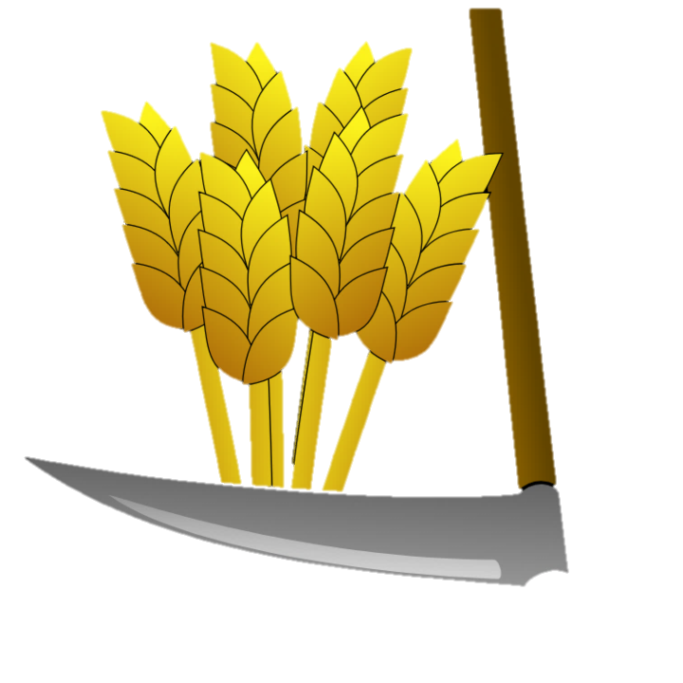
“Who will help me cut the corn?” said the little red hen.

Slide 16
“Not I,” said the bull
“Not I.”

Slide 17
“Not I.”
“Not I,” said the cat.

Slide 18
“Not I,” said the rat.
“Not I.”

Slide 19
“Oh very well, I’ll do it myself,” said the little red hen – and so she did!

Slide 20


“Who will help me carry the corn?” said the little red hen.

Slide 21
“Not I,” said the bull.
“Not I.”

Slide 22
“Not I.”
“Not I,” said the cat.

Slide 23
“Not I,” said the rat.
“Not I.”

Slide 24
“Oh very well, I’ll do it myself,” said the little red hen – and so she did!

Slide 25


“Who will help me grind the corn?” said the little red hen.

Slide 26
“Not I,” said the bull.
“Not I.”

Slide 27
“Not I.”
“Not I,” said the cat.

Slide 28
“Not I,” said the rat.
“Not I.”

Slide 29
“Oh very well, I’ll do it myself,” said the little red hen.

Slide 30

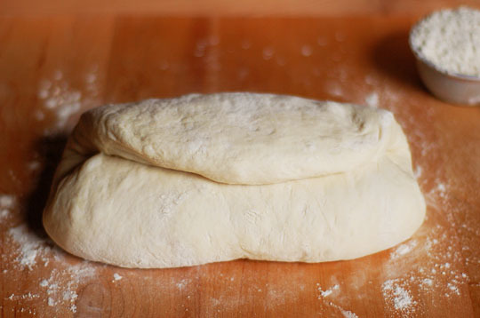
“Who will help me knead the bread?” said the little red hen.

Slide 31
“Not I,” said the bull.
“Not I.”

Slide 32
“Not I.”
“Not I,” said the cat.

Slide 33
“Not I”, said the rat.
“Not I.”

Slide 34
“Oh very well, I’ll do it myself,” said the little red hen – and so she did!

Slide 35

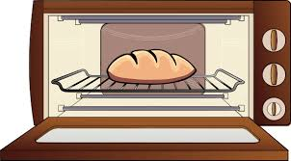
“Who will help me bake the bread?” said the little red hen.

Slide 36
“Not I,” said the bull.
“Not I.”

Slide 37
“Not I.”
“Not I,” said the cat.

Slide 38
“Not I,” said the rat.
“Not I.”

Slide 39
“Oh very well, I’ll do it myself,” said the little red hen.

Slide 40

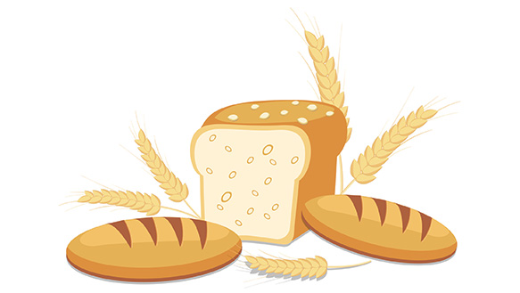
“Who will help me to eat the bread?” said the little red hen.

Slide 41
“I will,” said the bull
“I will.”

Slide 42
“I will.”
“I will,” said the cat.

Slide 43
“I will,” said the rat.
“I will.”

Slide 44
“Oh no you won’t. I’ll eat it myself,” said the little red hen – and so she did!

Slide 45
What is the setting of the story?
(Where does it happen?)
Who are the characters in the story?
What happens at the beginning of the story? What happens in the middle of the story? What happens at the end of the story?
Use the first sheet if you want to draw your answers to these questions or the second sheet if you want to write your answers.

Slide 46
The Little Red Hen
Setting
Characters
Beginning
Middle
End

Slide 47
Setting
Characters
Beginning
____________________________________________________________________________________________________________________
Middle
____________________________________________________________________________________________________________________
End
____________________________________________________________________________________________________________________

Slide 48
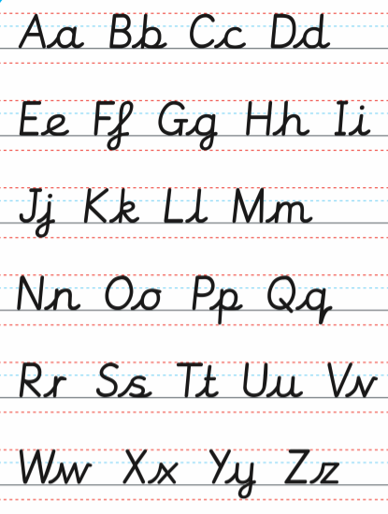
English Learning 2
Do you know your capital letters?
Can you match capital letters to their lower case letters? Play “Big Letter Bunnies” on ICT games to practise. Can you write capital letters?
When do we use capital letters?
Look in your reading books to see where they are used? Are they just used at the beginning of sentences or are they used in other places? Could you write a sentence explaining how capital letters are used?

Slide 49
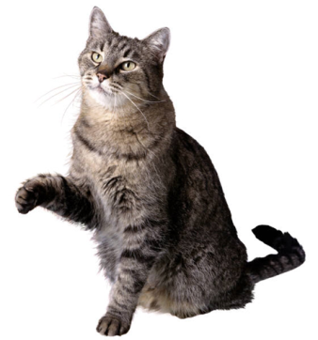
English Learning 3
dear little red hen
i am sorry i did not help you.
next time i will.
please can i have some bread?
love from
cat
The animals are sorry that they were lazy and didn’t help the Little Red Hen. The Cat has written a letter to apologise but she doesn’t know how to use capital letters. Can you see where the capital letters should be? (CLUE: there should be 12)

Slide 50
Rat and Bull also need to write sorry letters. Can you help them?
You can use the template on the next page or design your own writing paper to write a sorry letter from either Rat or Bull.
Make sure you use capital letters correctly.

Slide 51
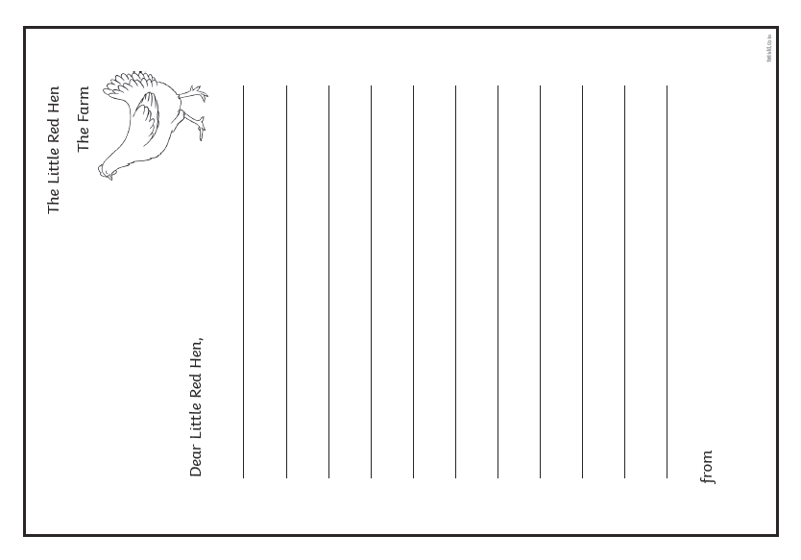

Slide 52
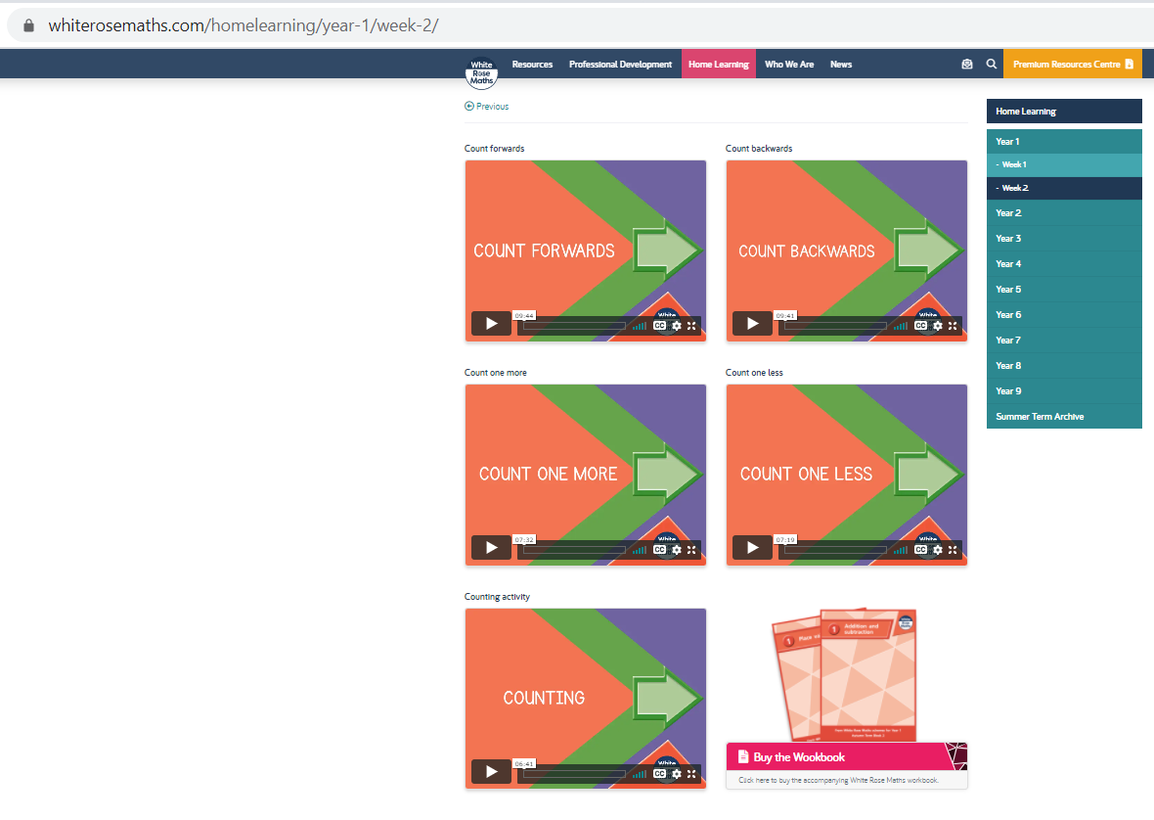
Maths Learning
In Maths this week we are learning about counting forwards and backwards and finding one more and one less. Please go to the White Rose website and find the Year 1 Week 2 Home Learning videos at https://whiterosemaths.com/homelearning/year-1/week-2/

Slide 53
The following slides have the accompanying worksheets for the first four lessons. As before, don’t feel you have to print the sheets out if you don’t want to – verbal answers are often enough or a drawing on paper.

Slide 54
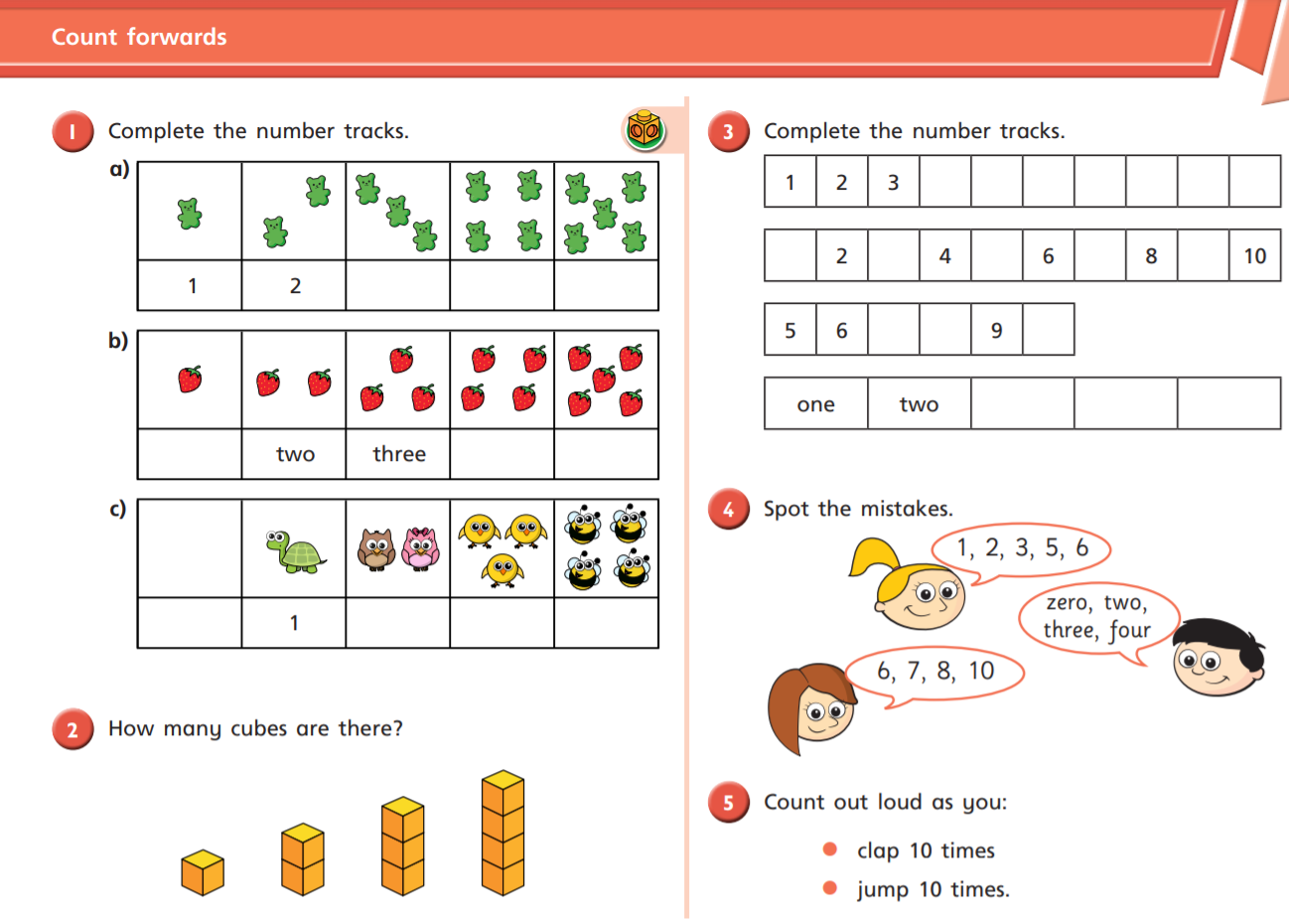

Slide 55
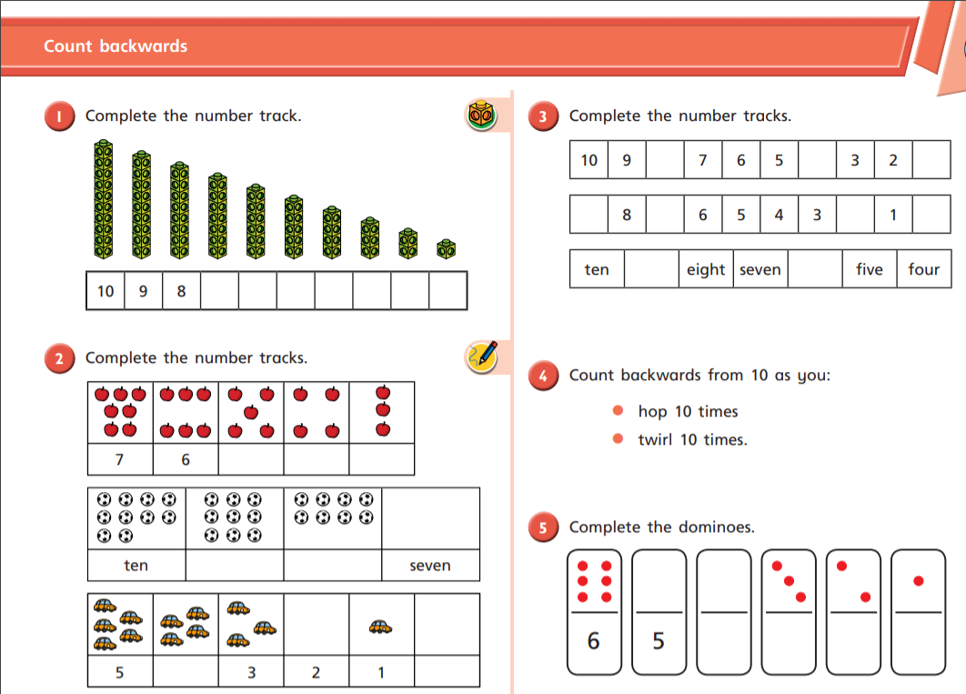

Slide 56
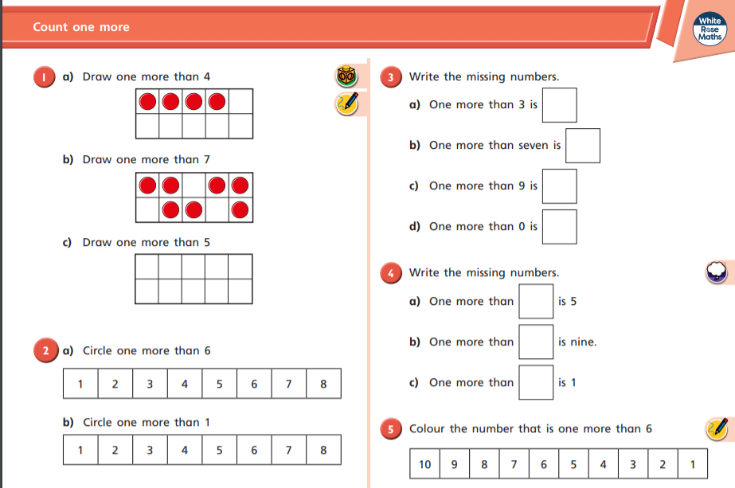

Slide 57
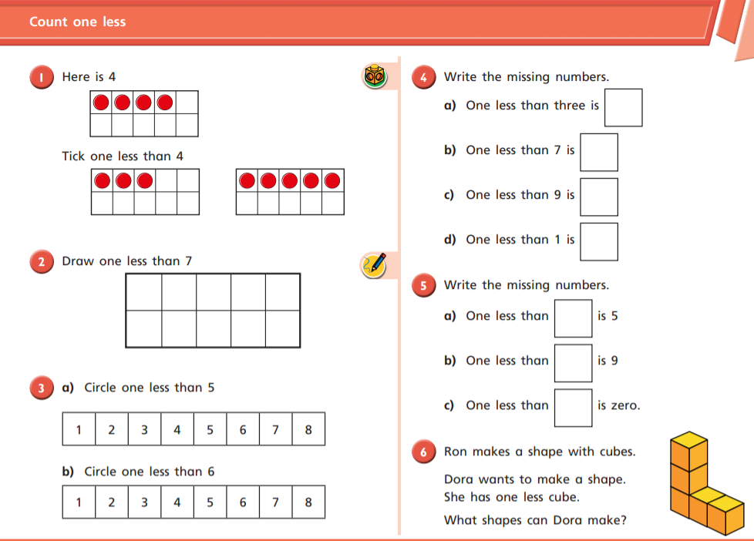

Slide 58
If you want a further challenge, the next slides have Problem Solving and Reasoning questions that will check children’s ability to apply what they have learned.
Further practice would involve singing counting songs, doing counting puzzles like dot-to-dots and playing games on a number track like ludo or snakes and ladders.

Slide 59


Spot the mistakes and correct the sequences.
0, 2, 3, 4, 5
0 1 2 3 4
1
2
3

Slide 60


Whitney says,
Do you agree?
Explain why.
0 | 1
1 | 2
When counting forwards, we always count from 0

Slide 61
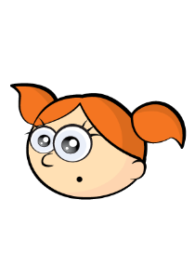
Alex is counting.
How do you know that Alex is counting backwards?
9, 8, 7, 6, 5
1 | 2

Slide 62
How many different starting points could you have if you wanted to count backwards and stop at 3?
 |  | 3

Slide 63
Using number cards 0 to 10, how many different ways can you complete the boxes below?
one more
10
0
2
9
6
8
3
7
5
1
4

Slide 64






Teddy rolls the number that is 1 more than the dice below.
He says that he rolls 2
Explain his mistake.

Slide 65
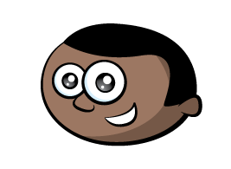
Mo says,
How old is Mo?
Who is the oldest?
Explain why.
I am one year older than my sister.
My sister is one year older than my brother.
My brother is 7

Slide 66
True or False?
One more than 7 is the same as one less than 9
Use a number track to help you.
Can you think of another statement like this?

Slide 67
Complete the sentence stems.
One less than 9 is ______
One less than ______ is 7
One less than ______ is 6
What pattern do you notice with the numbers?
What would the next sentence be?

Slide 68
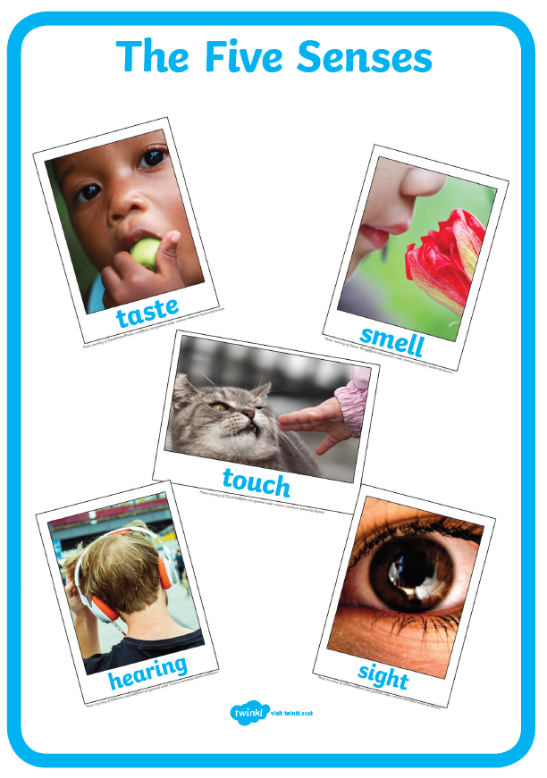
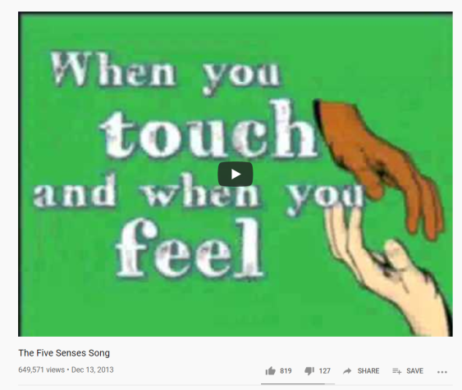
Science Learning
Do you know the Five Senses?
Which part of your body do you use for each sense?
https://www.youtube.com/watch?v=MtwV9Mi_aNk
This song on YouTube will help you with the answers.

Slide 69
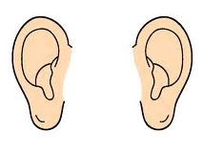
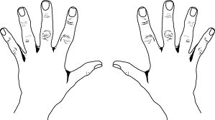



I hear with my____________.
I see with my_____________.
I smell with my____________.
I taste with my____________.
I touch with my____________.
Can you copy and complete these sentences with the right body part?
eyes ears hands nose tongue

Slide 70
Take some time to think about each of your senses in turn. What can you hear? What can you see? What can you taste, feel and smell?
Complete the table on the following slide. You can use words or pictures, whichever your prefer (or just draw a table of your own). If you have a garden it might be nice to do this outside.

Slide 71
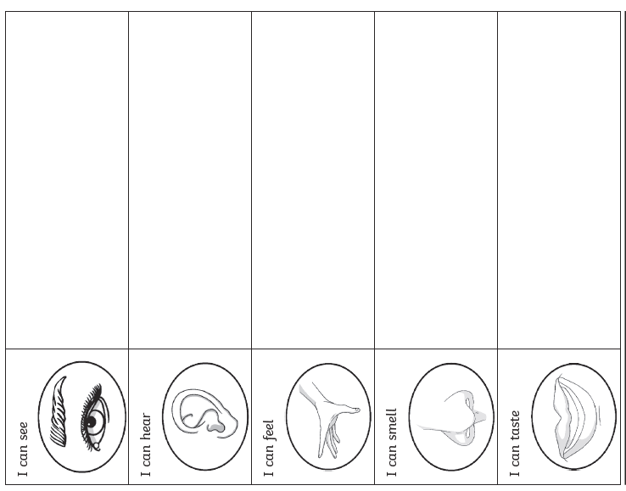
I can use my Five Senses

Slide 72
Fun extra activity – if you fancy…

Slide 73
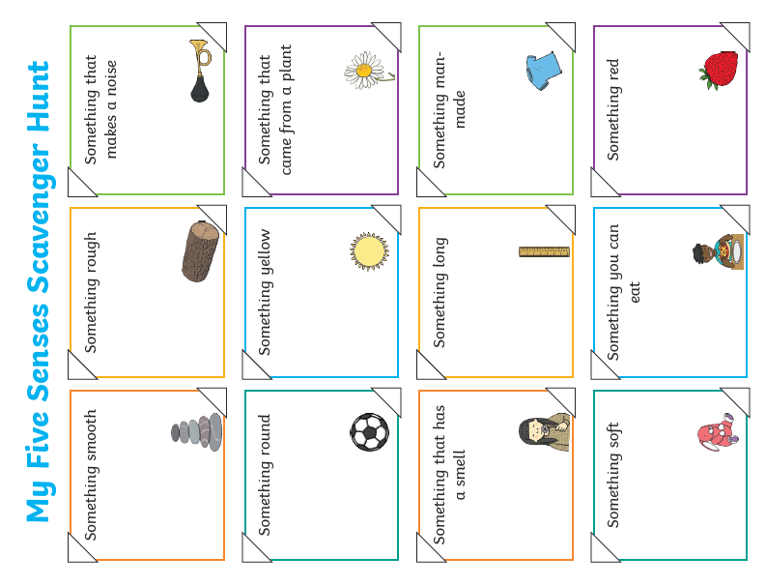

Slide 74

Reading
For additional reading at your child’s level please use the Oxford Owl website where you can read books online and then complete comprehension activities about the books. Please continue to keep a record of the books they have read in their reading records.
www.oxfordowl.co.uk
Class login: temple20
Password: Bingbong
(If you are not sure of your child’s level, please check in their reading record book or look at the coloured stickers on the reading books that have been sent home.)

Slide 75
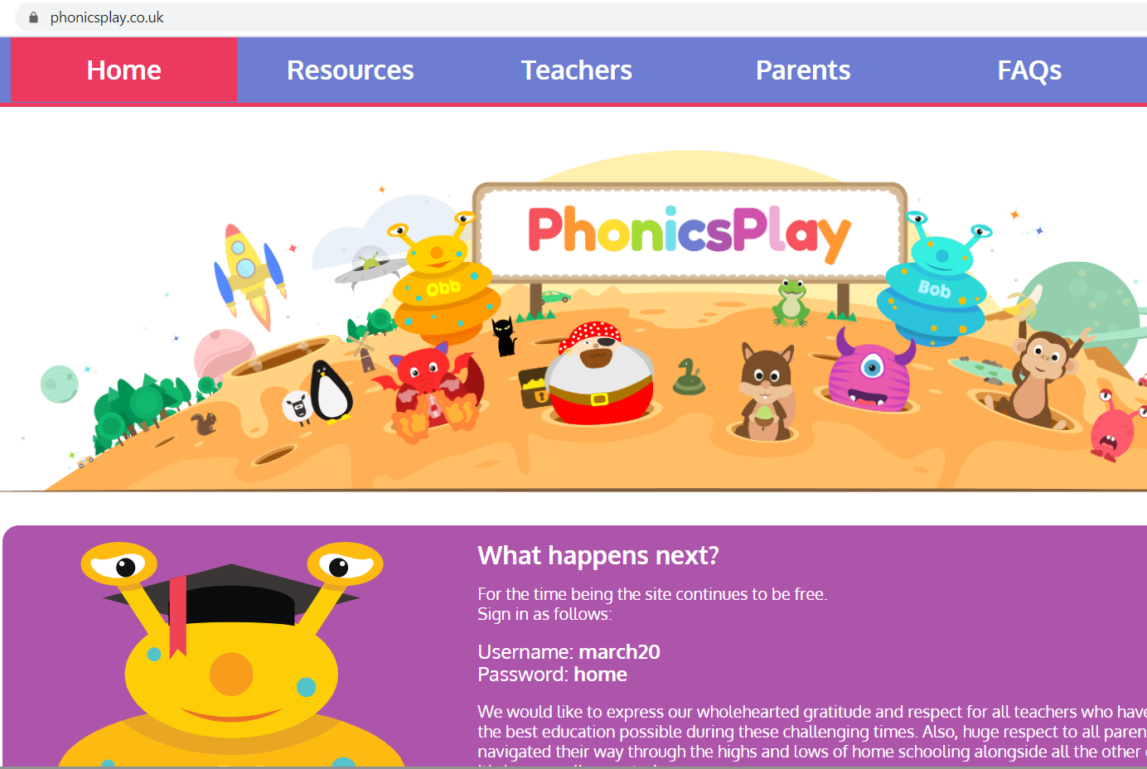
Phonics
Please use the games and activities on the Phonicsplay website to continue practising Phonics.
www.phonicsplay.co.uk
Login: march20
Password: home
Most of the children are working on Phase 3. There are a few children who are recapping Phase 2 and a few who are working on Phase 4.

Slide 76
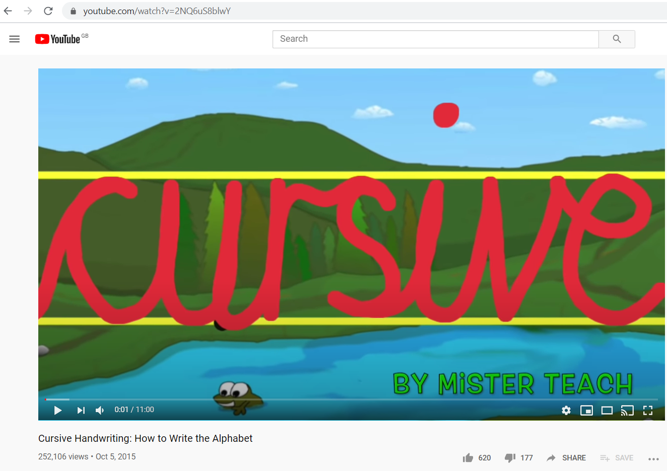
Handwriting practice
It is important in Year 1 that the children are writing on lines and that every letter begins on the line and the body of every letter sits on the line. For letter formation I recommend this video.
Search “cursive alphabet mister teach” (https://www.youtube.com/watch?v=2NQ6uS8blwY ).
Don’t try and practice all the letters at once – three or four at a time would be enough.
If you have some coloured pens or pencils at home try the “rainbow writing” as shown in the video where you trace over each letter in lots of different colours.

Slide 77
P.E.
It is important to keep your children active. If it is safe to do so, ensure they have some time outside throughout the day.
Have you tried the GoNoodle website?
www.gonoodle.com
It is full of all sorts of physical activities including relaxation and mindfulness.
Or the Cosmic Kids yoga stories are usually popular with Year 1.
www.cosmickids.com

