Slide 1

Home Learning
Year 1
Term 2 Week 4

Slide 2

Hello Year 1!
I hope you are all OK.
What a shame the school had to shut just when we
had started to think about Christmas!
On the following slides there is one English task,
two RE tasks and three Maths lessons. There is also
information about Reading, Phonics, Handwriting and PE.
I will miss you all so much. Keep in touch via Tapestry.
Love from
Mrs Child
XXX

Slide 3
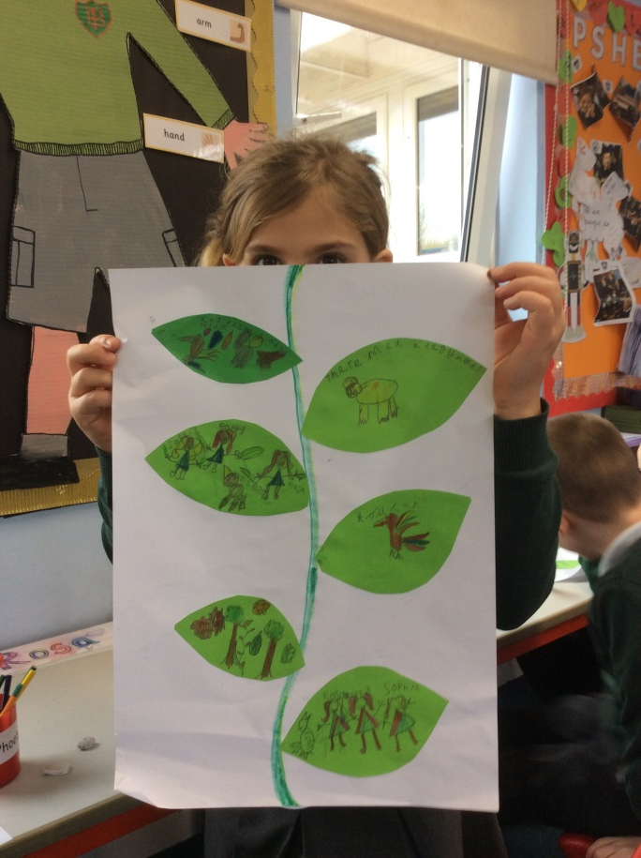
English Learning
Before the children went home on Monday we had just been writing our “Amazon Adventure Rainforest” stories. I have added photos of their plans onto our class web page. Have a look and encourage your child to retell their story to you. Can they make a cover for their story? It will need a title, the author’s name and an illustration.

Slide 4
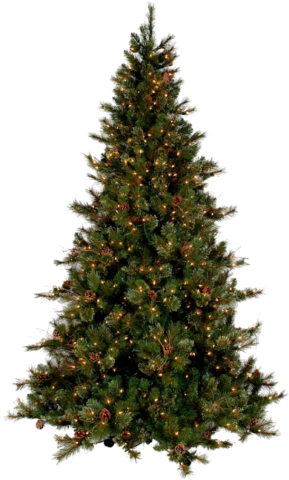
RE Learning 1
Why does Christmas matter to Christians?
Have you seen any signs that Christmas is coming?
In the shops?
On television?
In your house?
In your street?
Make a list of your observations. Remember the rules for lists – one numbered item on each line.
Signs I have seen that Christmas is coming
1. _______________
2. _______________
3. _______________
4. _______________
5. _______________

Slide 5

RE Learning 2
This week we would have begun preparing for our Nativity presentation. Due to the circumstances I can’t say what form this will take but it is still worth becoming familiar with the story. Please share the following version with your child (or maybe you have a story book at home or would prefer to watch a video). Discuss the various events and characters and encourage your child to respond creatively, either through role play (could be with puppets or small toys or maybe brothers or sisters could be encouraged to join in!) or by making a picture or model of the Nativity Scene. Have a look at the website www.whychristmas.com There are lots of different ways here to explore the story including an online “Build a Nativity Scene” activity plus other resources that might help you such as Nativity figure templates and colouring sheets.

Slide 7
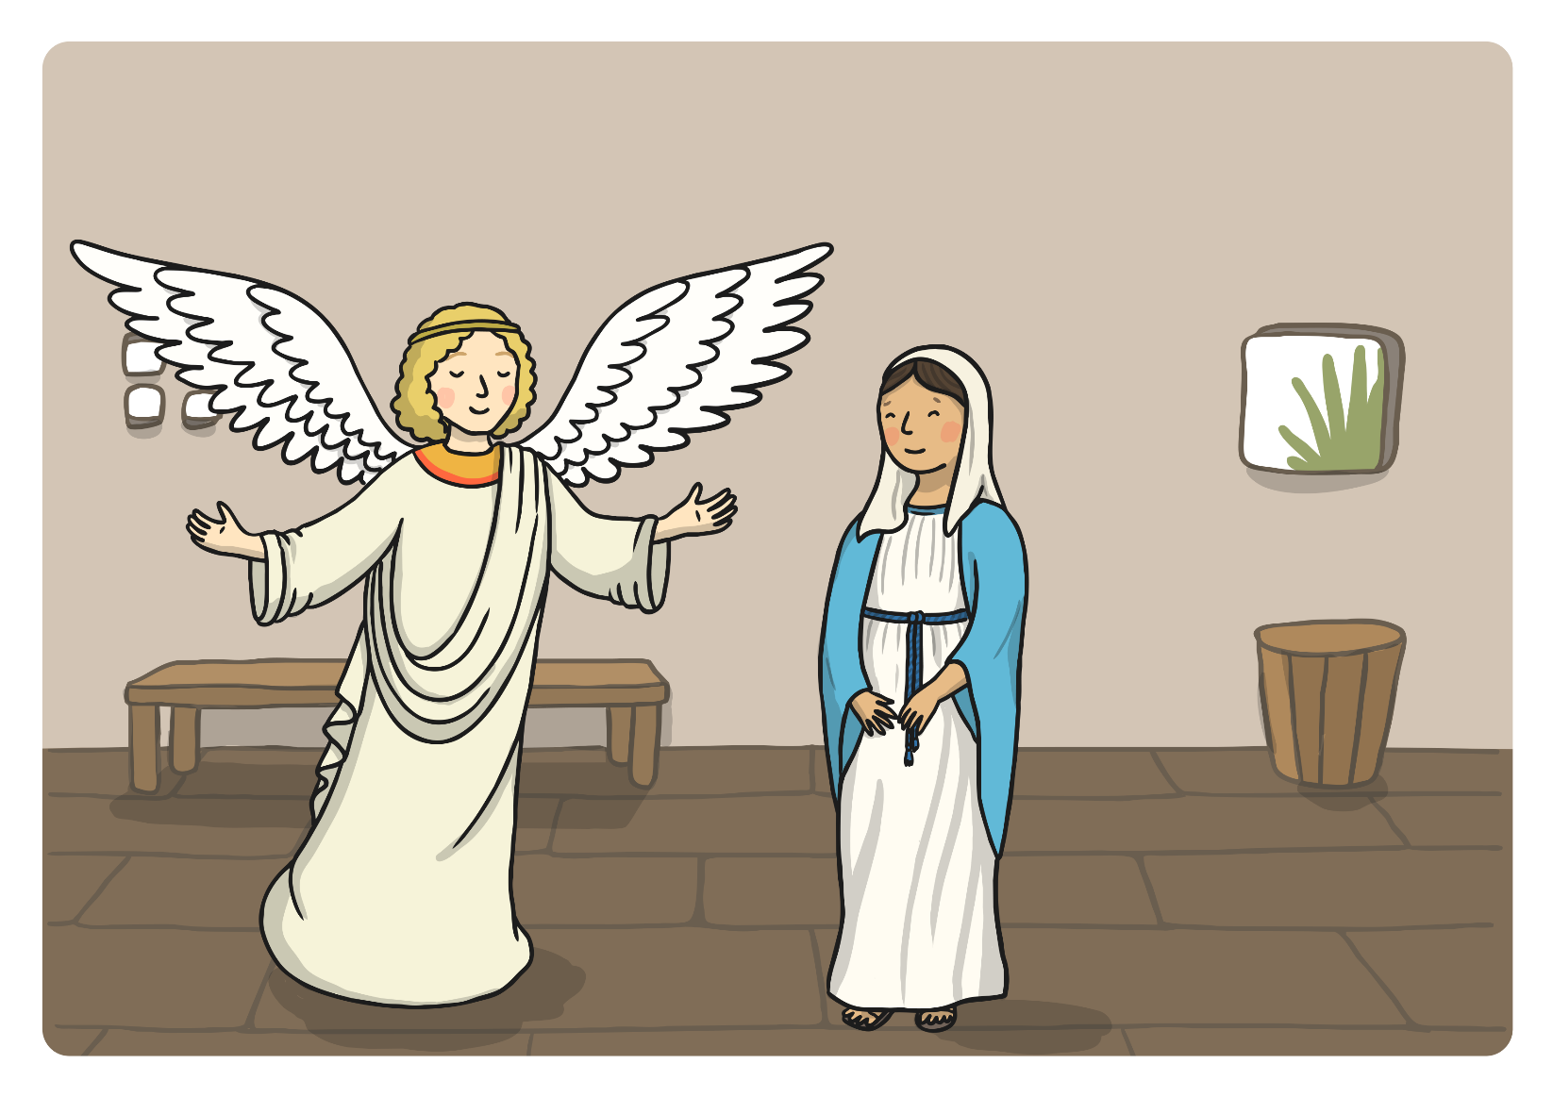
The Angel Gabriel visited Mary and told her she was going to have a baby called Jesus. The baby would be God’s son.

Slide 8
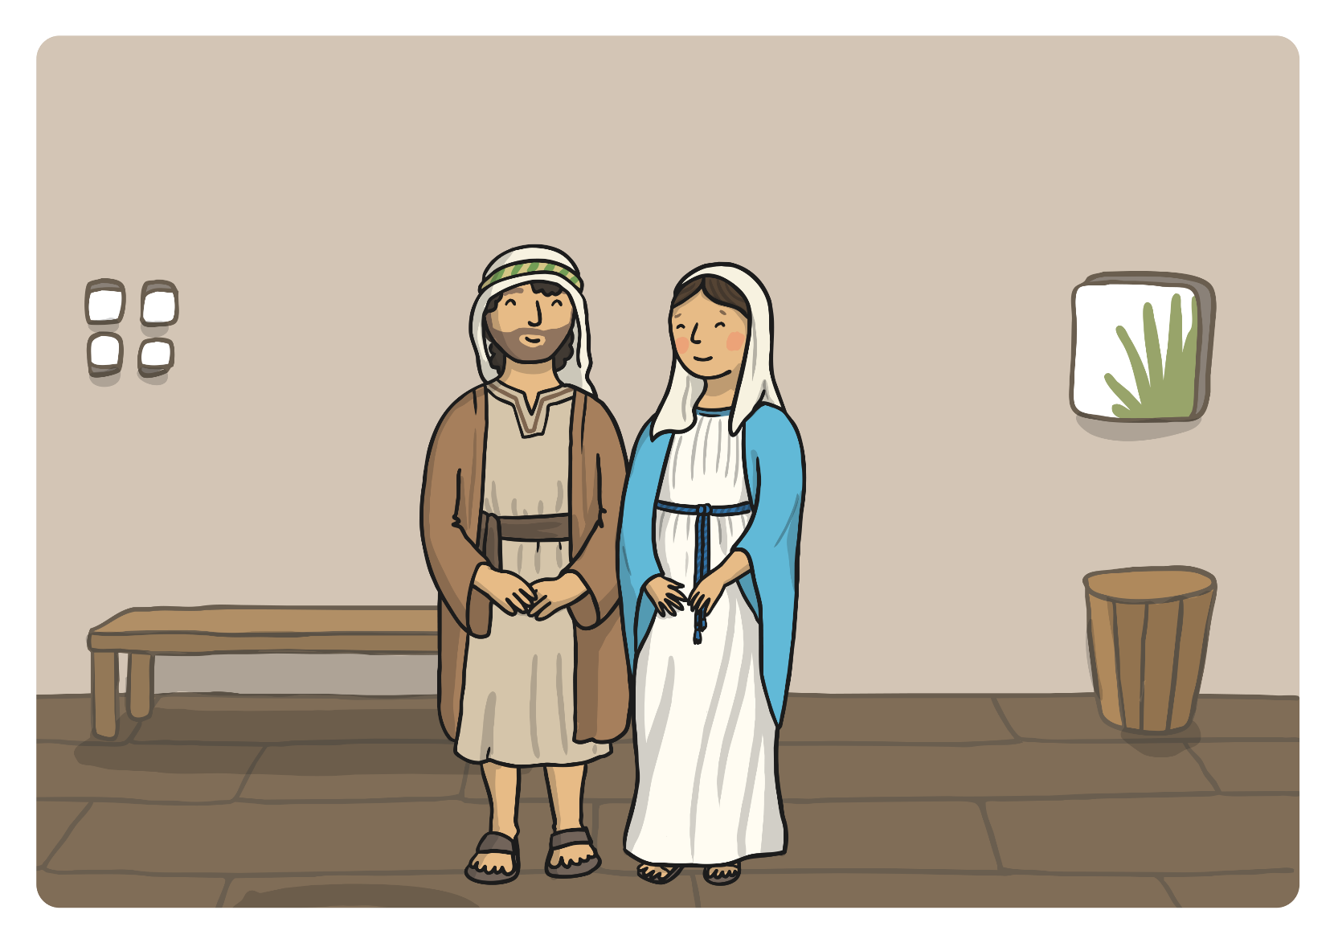
Mary told Joseph what Gabriel had told her; they prepared for the arrival of the special baby.

Slide 9
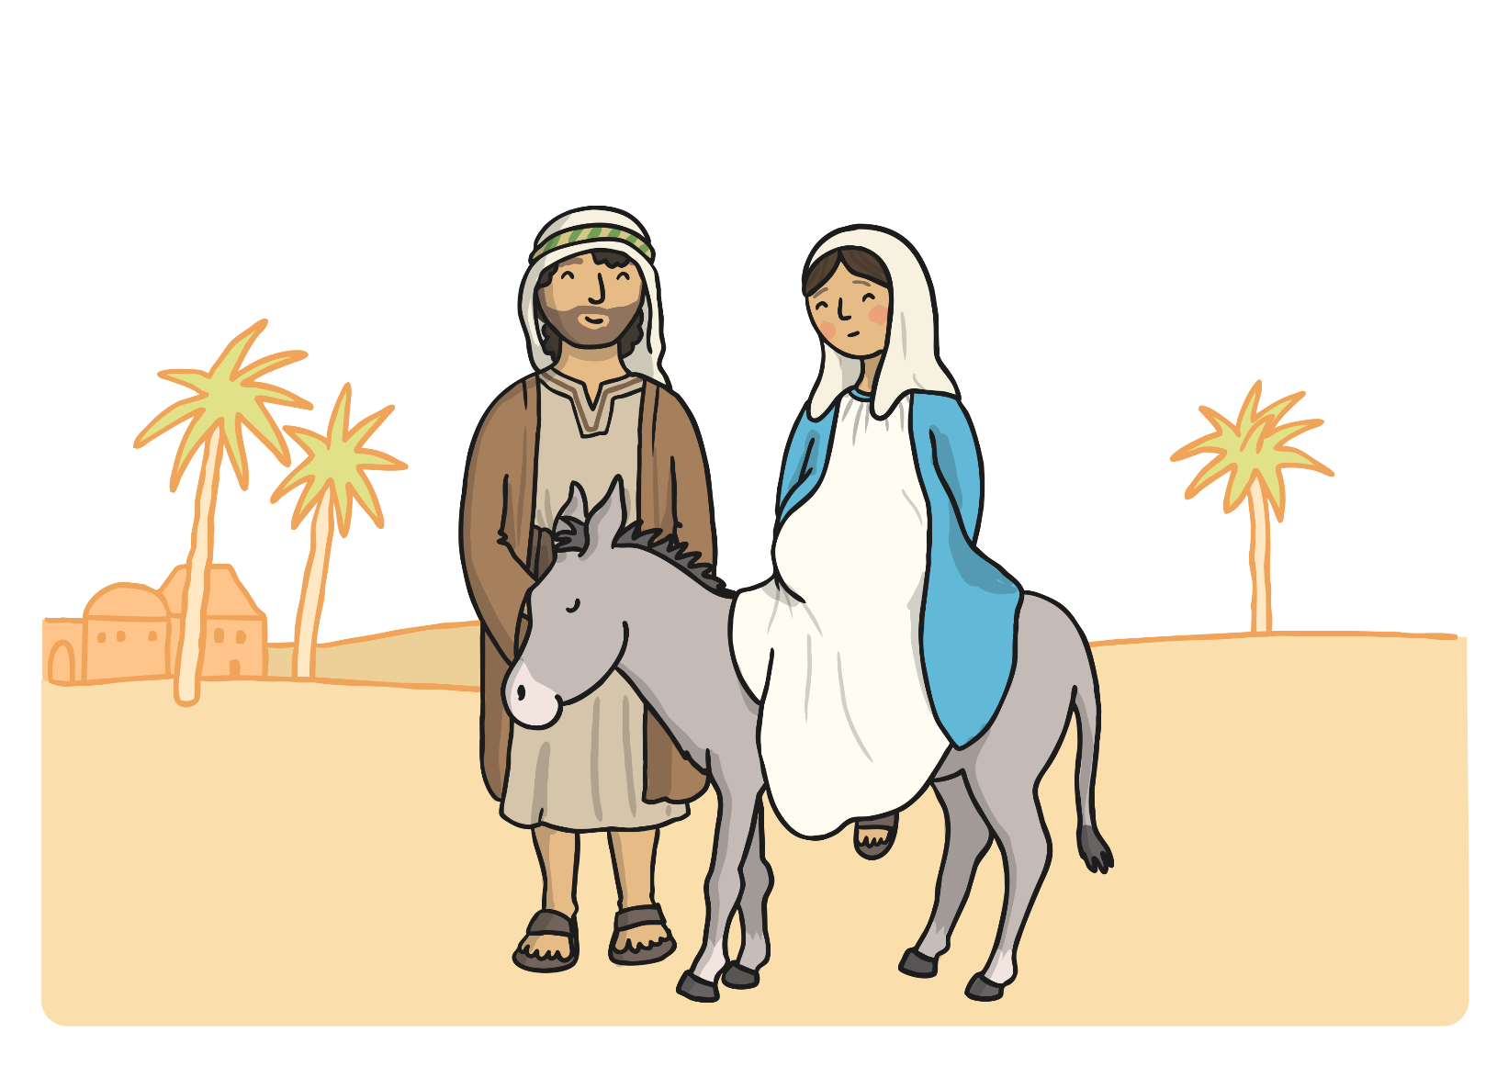
Mary and Joseph had to travel to Bethlehem to register in a census.

Slide 10
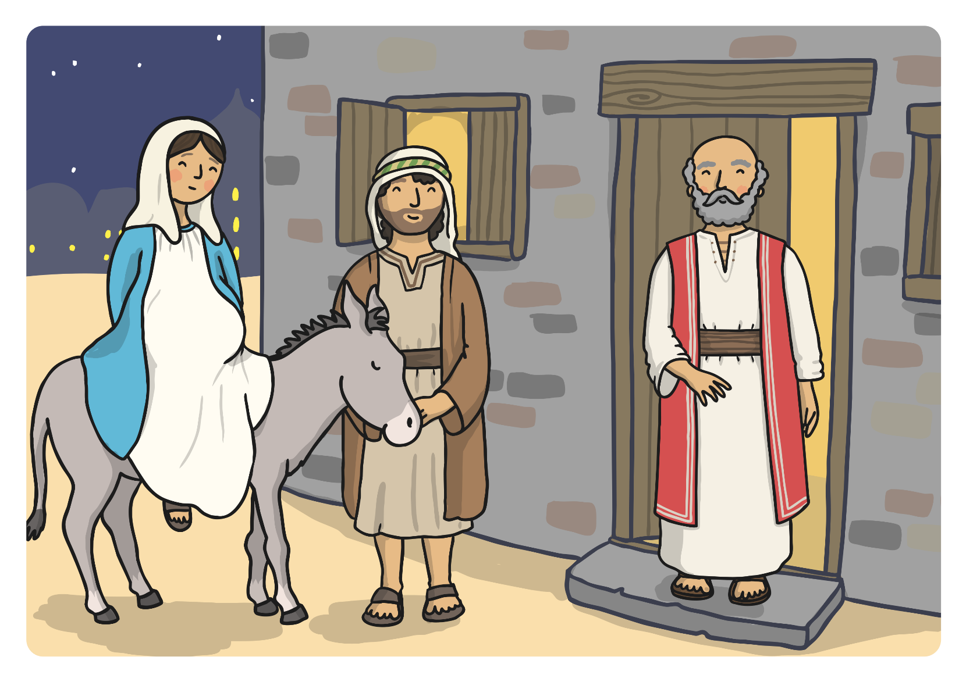
A kind innkeeper in Bethlehem let Mary and Joseph stay in his stable for the night.

Slide 11
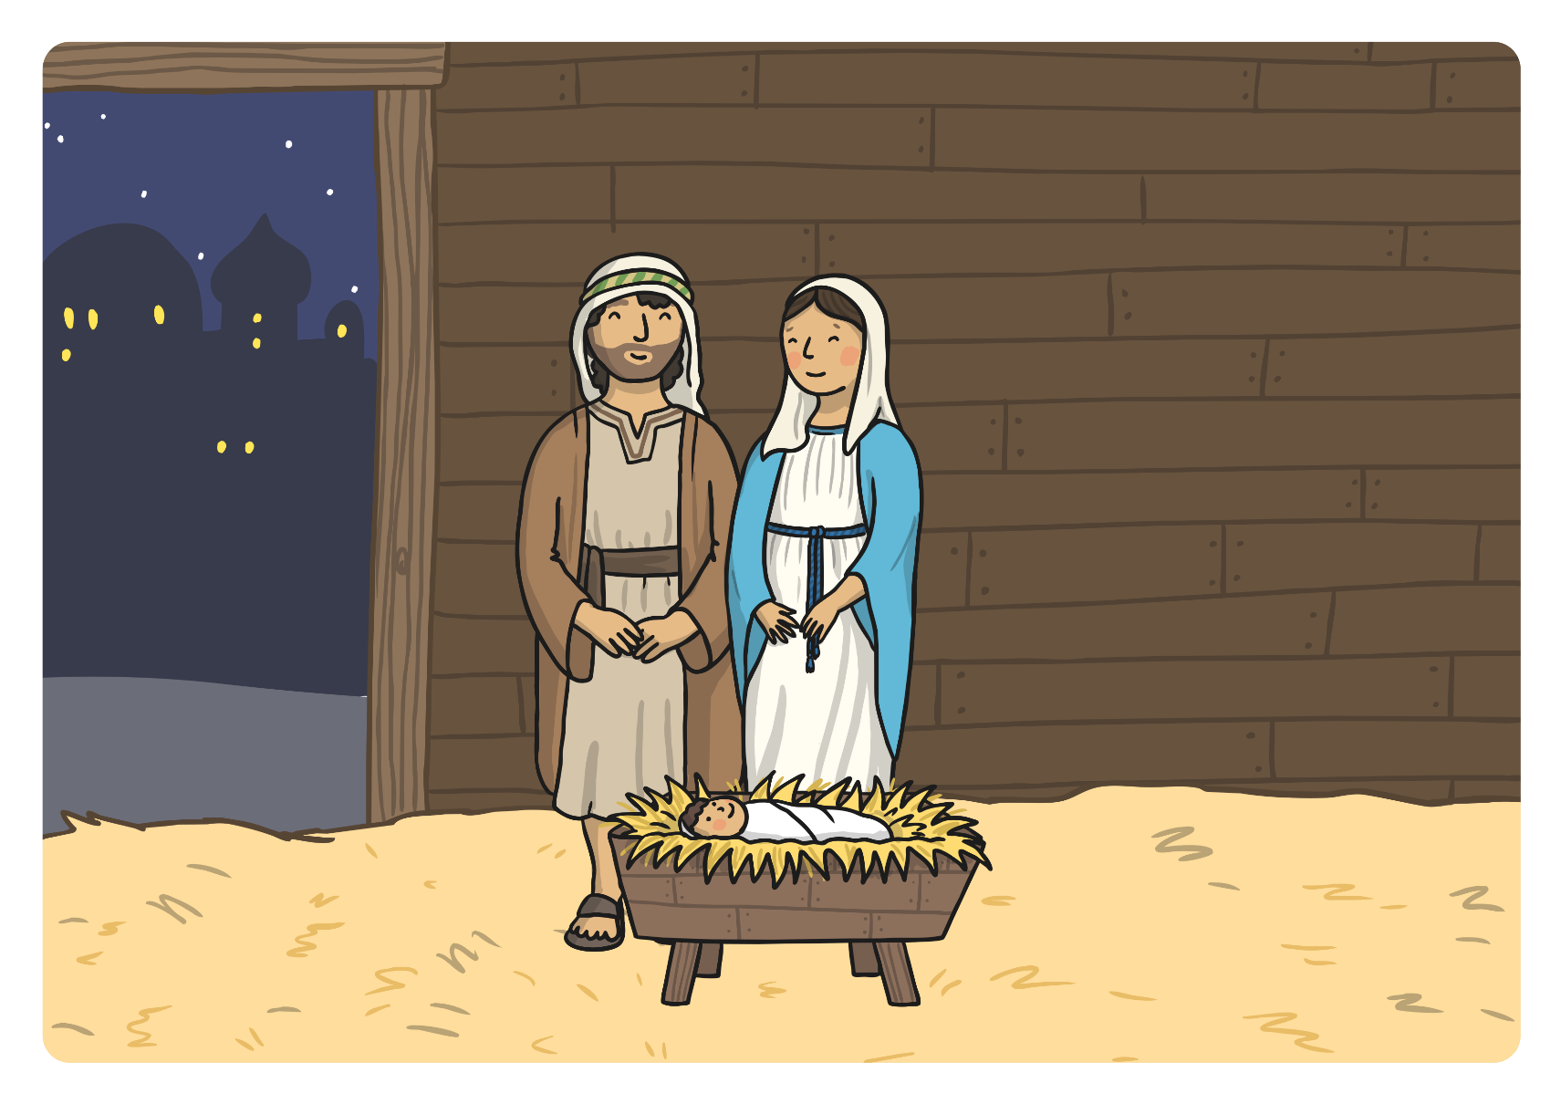
Baby Jesus was born in the stable.

Slide 12
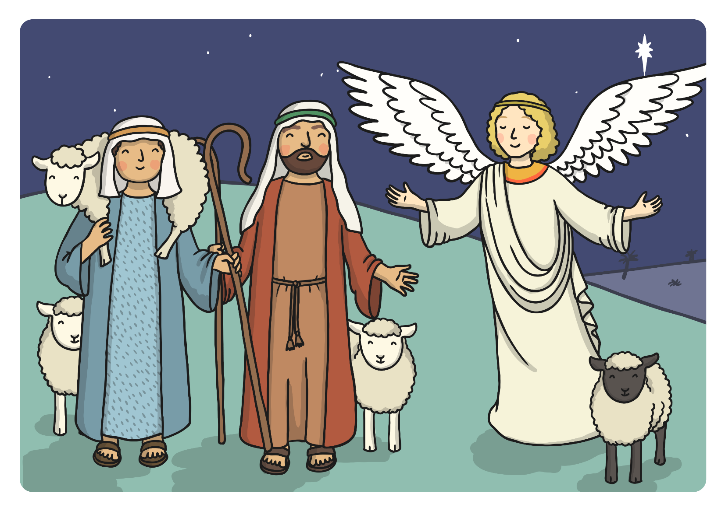
At the same time, an angel appeared to some shepherds. The angel told them that the son of God had been born in Bethlehem.

Slide 13
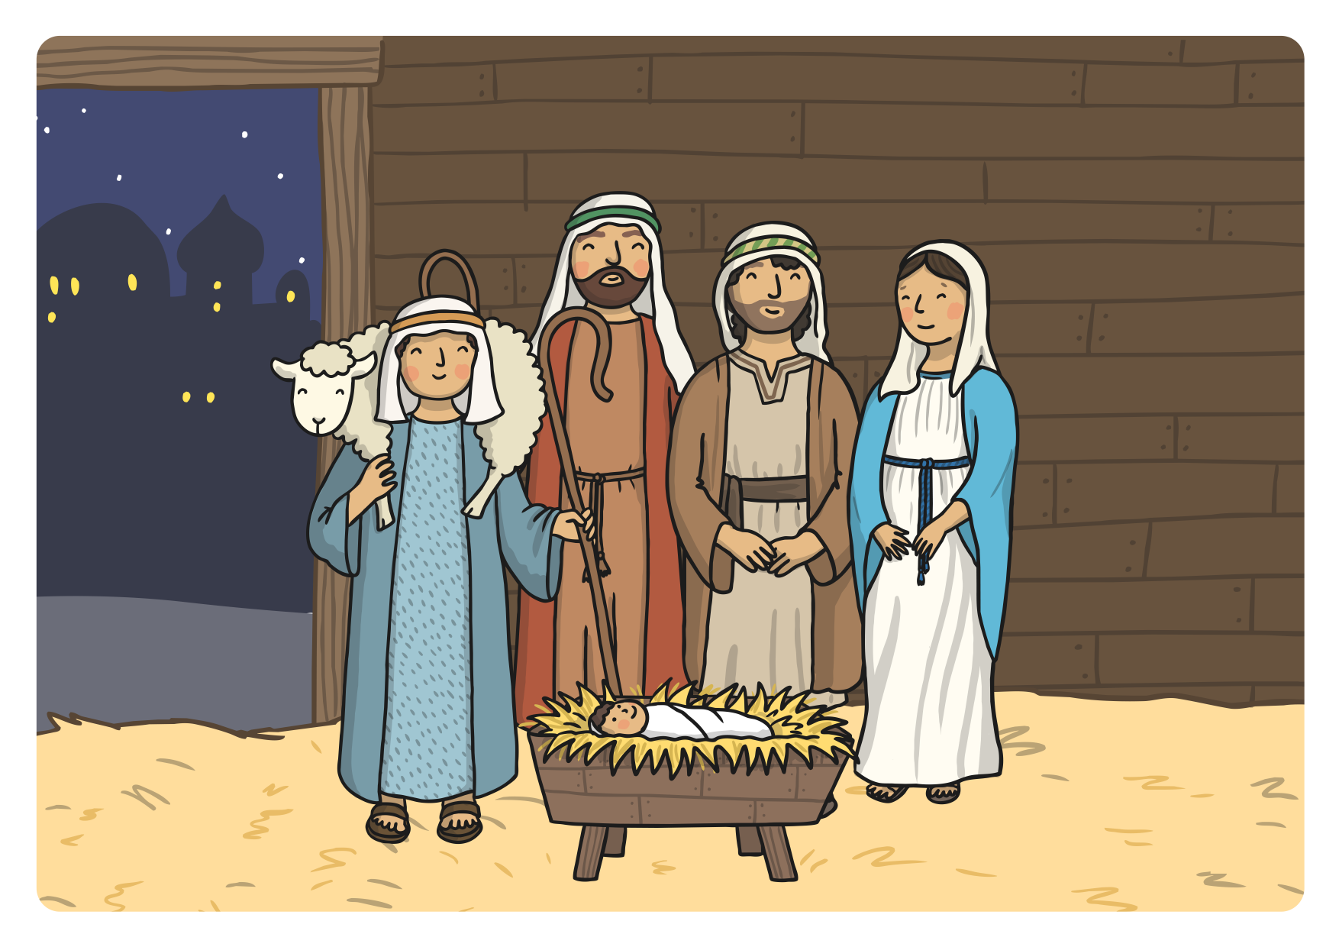
The shepherds walked to Bethlehem to visit the baby Jesus.

Slide 14
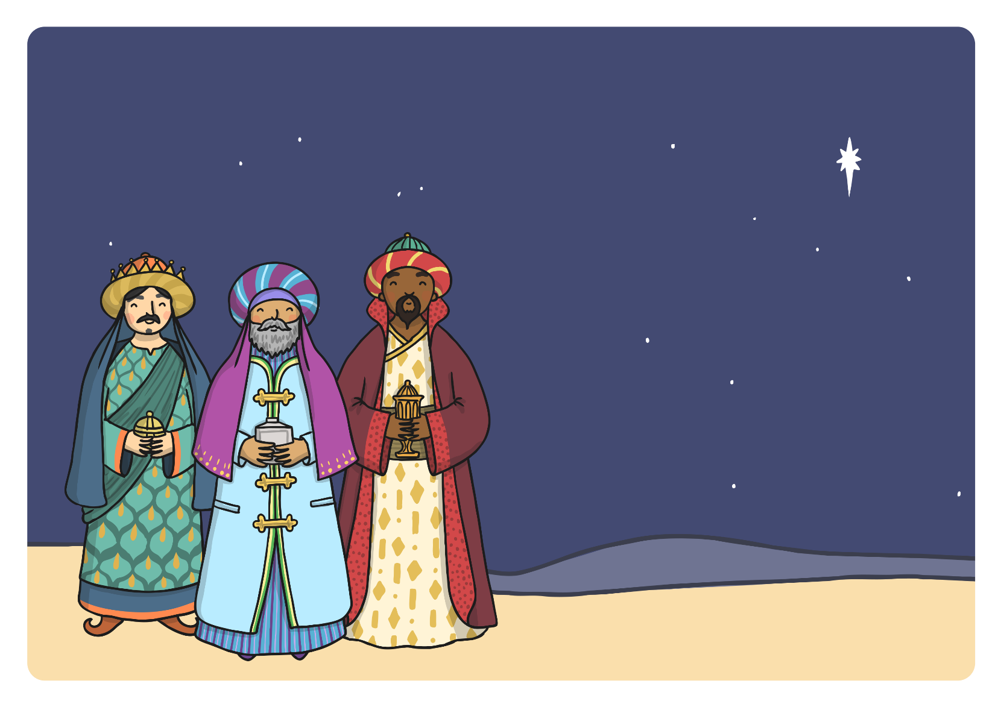
Far away in the East, wise men saw a bright star in the sky. They knew it meant that a new king had been born and followed the star.

Slide 15
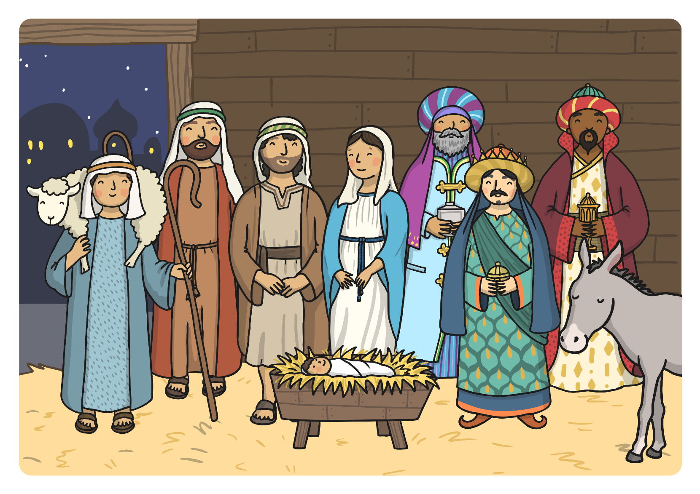
The wise men reached Bethlehem. They gave Jesus gifts of gold, frankincense and myrrh.

Slide 17
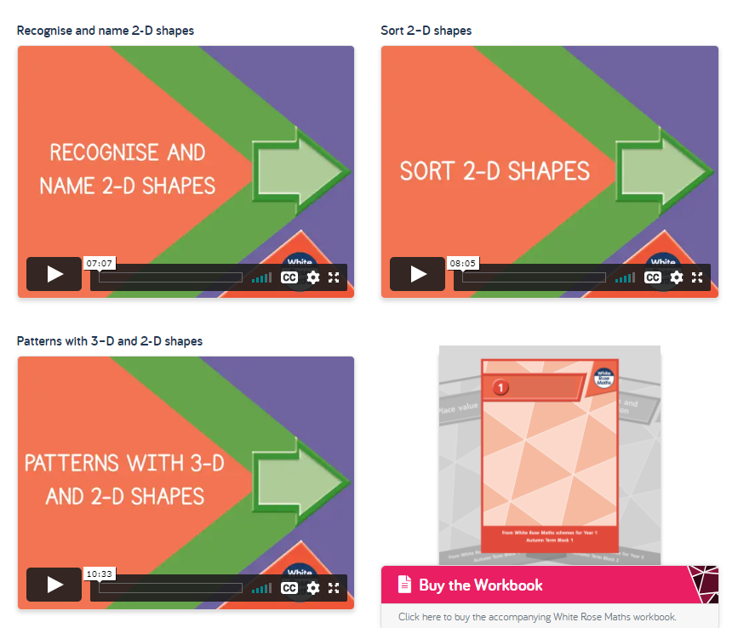
Maths Learning 1, 2 and 3
In Maths this week we are learning about 2D shapes. Please go to the White Rose website and find the Year 1 Week 10 Home Learning videos at https://whiterosemaths.com/homelearning/year-1/week-10-geometry-shape/. We have already completed the work on 3D shapes so it is just lesson 3, 4 and 5 for this week.

Slide 18
The following slides have the accompanying worksheets for the lessons. As before, don’t feel you have to print the sheets out if you don’t want to – verbal answers are often enough or a drawing on paper.

Slide 19
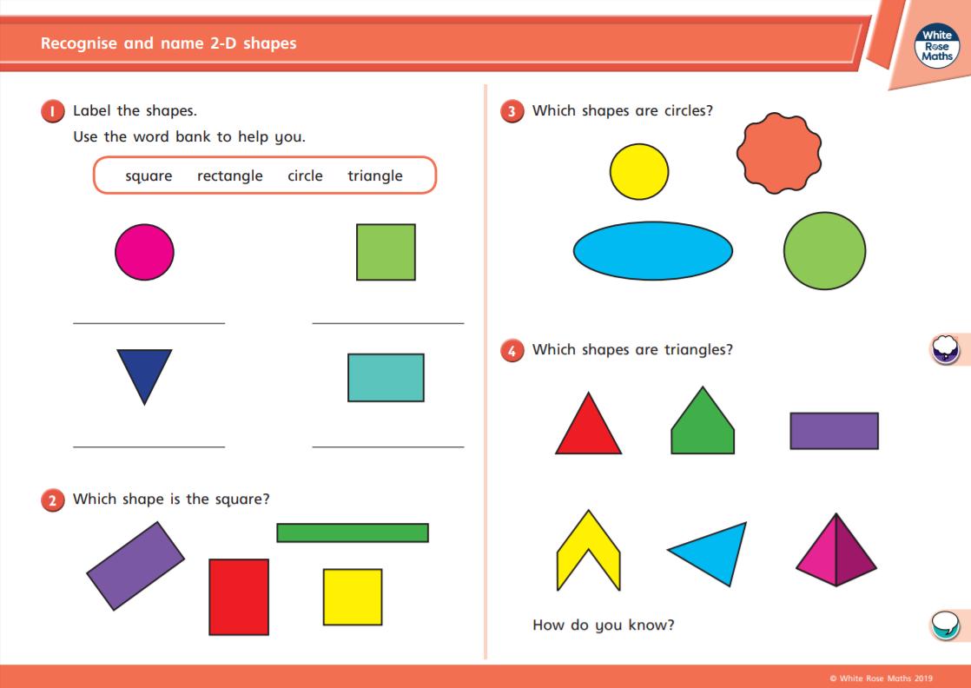

Slide 20
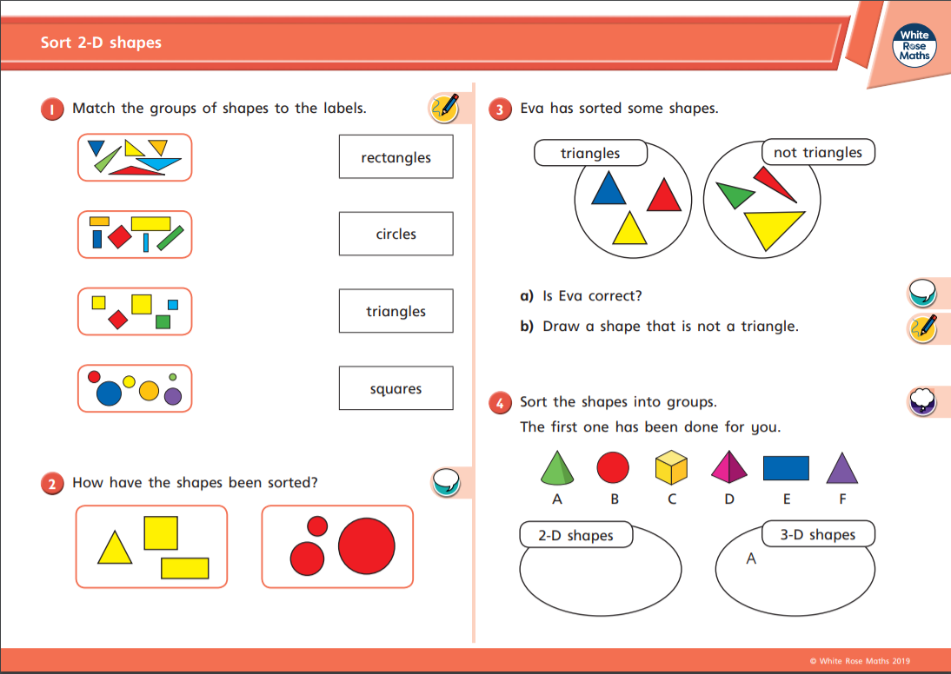

Slide 21
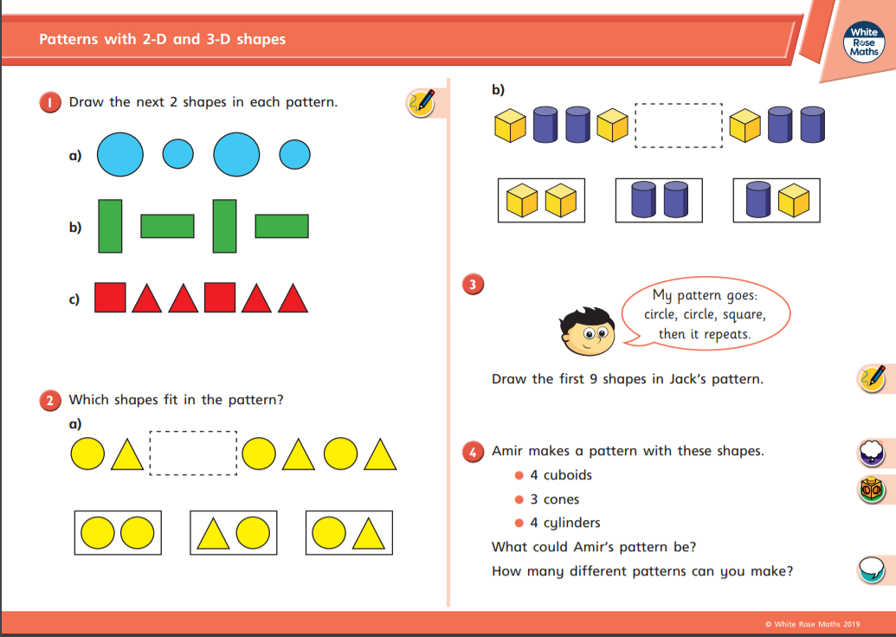

Slide 22
If you want a further challenge, the next slides have Problem Solving and Reasoning questions that will check children’s ability to apply what they have learned.
Further practice would involve making patterns and pictures with shapes, printing the sides of 3d shapes or cutting different boxes up to see what 2d shapes they are made from, going on a shape hunt around the house to find examples in the environment or trying some of the “colour by shape” sheets that I will attach separately.

Slide 23

Part of a shape is hidden.
What shape could it be?
Is there more than one possibility?
Explain your thinking.

Slide 24

Here is part of a shape.
How many different ways can you complete the shape using one or more straight lines?
Compare your shape with a partner.
What is the same and what is different?

Slide 25

Use a selection of triangles, rectangles, squares and circles.
Put your shapes into groups.
Ask a partner to label your groups.
How many different groups can you create?

Slide 26
Tommy says that all shapes with 4 sides are squares.
Is Tommy correct?
Prove it.

Slide 27
Eva has sorted some shapes.
Squares Not Squares
Has she sorted them correctly?
Explain how you know.

Slide 28



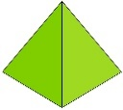

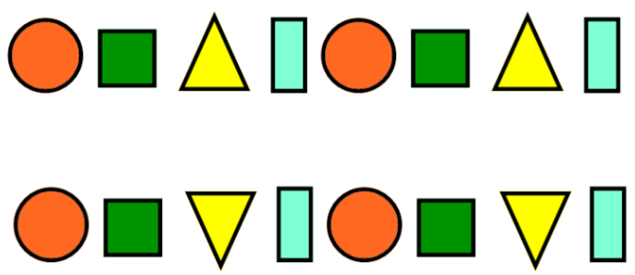


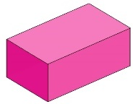


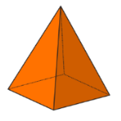



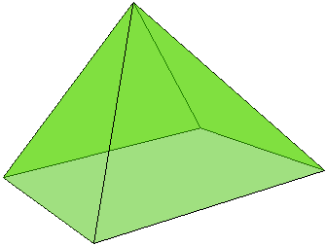
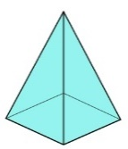



Amir and Eva are making patterns.
Eva -
Amir -
Who do you agree with?
Explain your answer.
Our patterns are exactly the same.
Our patterns are different.

Slide 29



Whitney is making a pattern in a circle.
Is Whitney’s pattern correct?
Explain why.
Can you make your own circular pattern using 3-D shapes?

Slide 30

Reading
For additional reading at your child’s level please use the Oxford Owl website where you can read books online and then complete comprehension activities about the books. Please continue to keep a record of the books they have read in their reading records.
www.oxfordowl.co.uk
Class login: temple20
Password: Bingbong
(If you are not sure of your child’s level, please check in their reading record book or look at the coloured stickers on the reading books that have been sent home.)

Slide 31
Phonics
Use the sound mats on the next three slides to check which sounds your child knows. Begin at Phase 2 and work your way through (there are no new sounds at Phase 4). When you get to a sound your child struggles with, pick that for your
“Sound of the Day”.
Get your child to practise hearing it, saying it, reading it and writing it. Look for words that use it in their reading books. Think of words with it in. Put those words into sentences. Play games with it. Have fun with it!

Slide 32
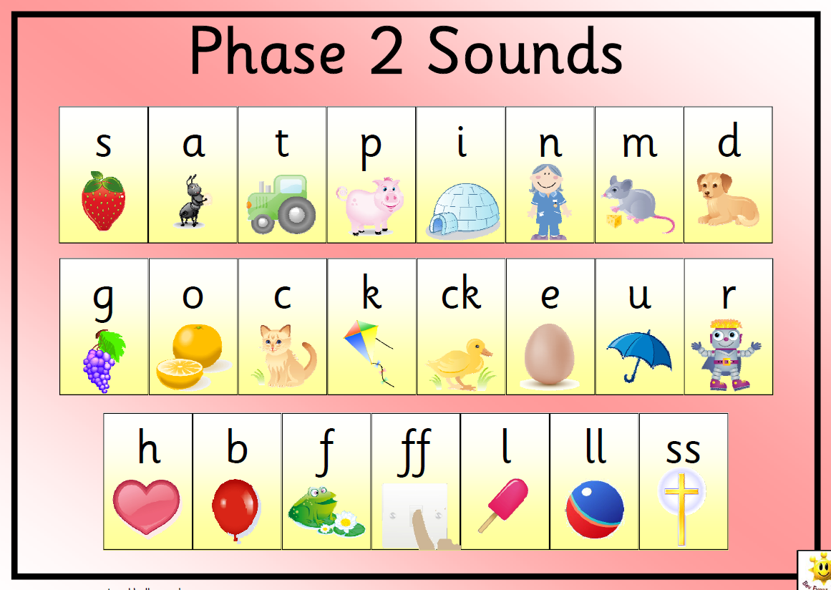

Slide 33
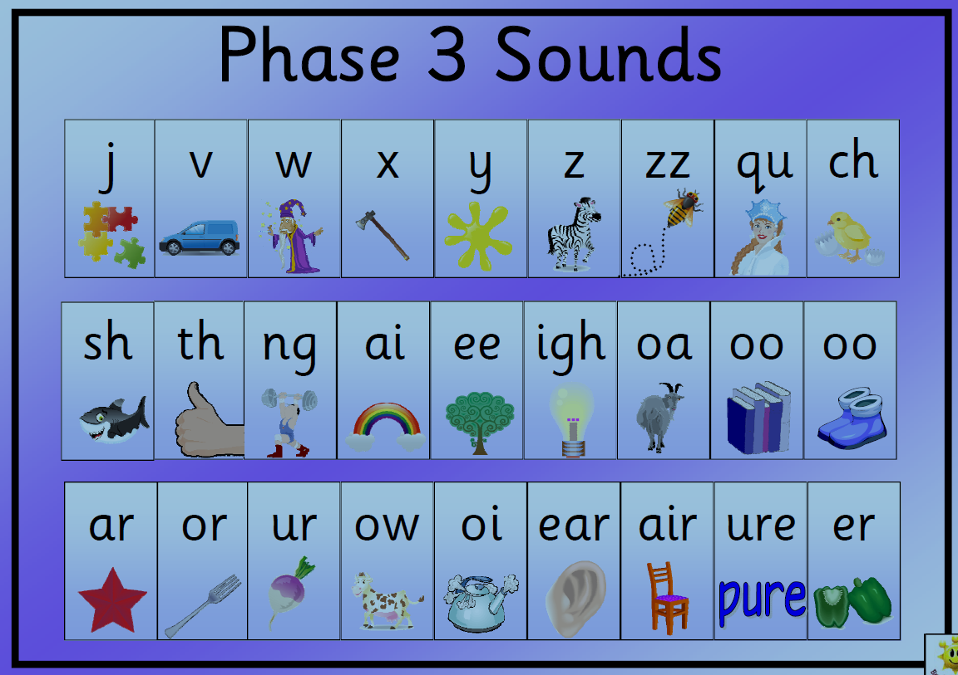

Slide 34
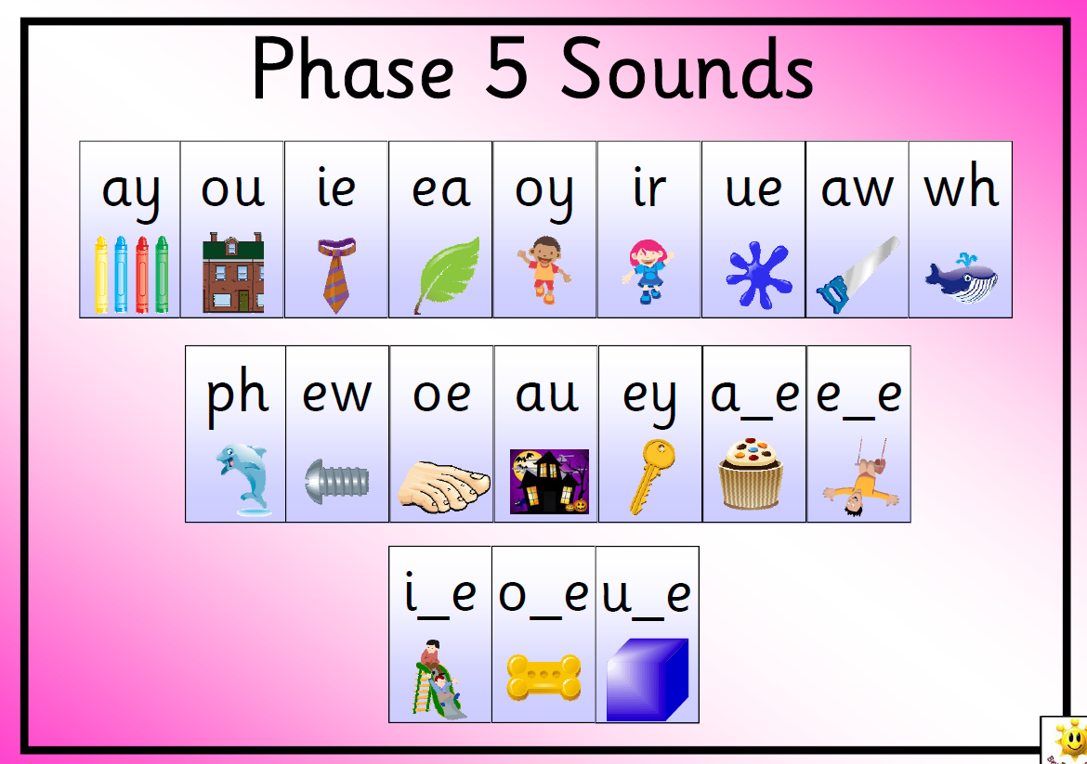

Slide 35
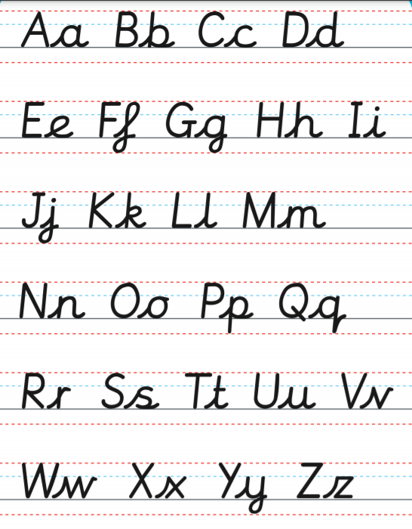
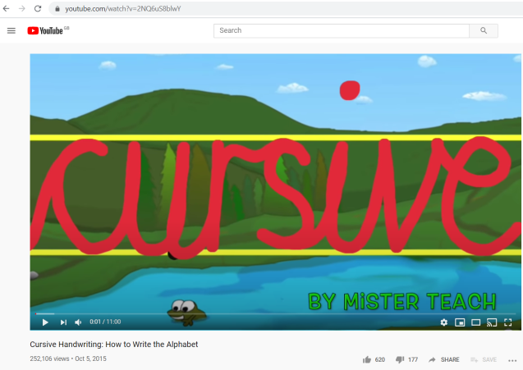
Handwriting practice
It is important in Year 1 that the children are writing on lines and that every letter begins on the line and the body of every letter sits on the line. Capital letters have no lead-in and lead-out strokes and should be twice the height of lower case letters. For letter formation I recommend this video. Search “cursive alphabet mister teach” (https://www.youtube.com/watch?v=2NQ6uS8blwY ).

Slide 36
P.E.
It is important to keep your children active. If it is safe to do so, ensure they have some time outside throughout the day.
If you are indoors, these websites have some fun physical activities.
www.gonoodle.com
www.cosmickids.com
Or try the BBC Let’s Move radio programmes available on the BBC website.

