Slide 1

Home Learning
Year 5 Term 6 Week 7

Slide 2
Message from the class teacher
We’ve made it – the final week of home learning before the end of the academic year!
It’s been lovely to see so many of you over the past few weeks and I hope we can pop in and say hello to each other when more of you are in for transition day on the 20th!
Whilst we didn’t get the full year together that we were hoping for, I just wanted to say thank you for being an excellent class and you’ve done a great job in welcoming me into Bapchild School. I’m very proud of all that you’ve achieved and can’t wait to see you all flourish in year 6.
Have a great week everyone.
Miss Horton ☺

Slide 3

Reading
Hopefully you have access to books at home, but we have sent home extra books with your child.
Accelerated Reading
Home quizzing is not always recommended but in this case we have adjusted the settings to allow quizzing to happen at home.
If your child wants to read a book from home, please check that there is a quiz available for the book and that the book level (BL) is within or near to your child’s reading range. Also take note of the quiz number for future reference.
To check books please visit: https://www.arbookfind.co.uk/
Go to the next page for how to quiz.

Slide 4



AR quizzing at home.
To log into AR to take a quiz please visit: https://ukhosted27.renlearn.co.uk/2240835/
Your child should know what to do from here and should know their login details. If they are not aware, most details are written in their reading record.
Click on Accelerated reader.
Type in the name the book or the quiz number.
We advise students complete quizzes unaided. If parents/carers wish to support their child, they can do so in the following ways:
Discuss the book with your child as the book is being read
Ask your child to read the question out loud
Re-word questions for your child, if necessary
Ask your child which answers are not correct

Slide 5

Visit http://readon.myon.co.uk

Slide 6

Choose an area that interests you or use the search option.

Slide 7


Using My Maths
Children should know their way round My Maths but here are some reminders on how access the lessons. Visit: www.mymaths.co.uk
bapchild
divide162

Slide 8

Using My Maths
Access any lesson based on what your child is learning in class or search the topic in the search bar.
Use the login portal to access specific homework and lessons that your teacher has set.

Slide 9

Maths – White Rose Home Learning
In school we follow the White Rose scheme of learning. Their website has put together free lessons and resources that link to the learning taking place in school. Please visit: https://whiterosemaths.com/homelearning/

Slide 10



TT Rockstars
To access TT Rockstars please visit: https://play.ttrockstars.com/auth/school
Start typing in the school name or the post code (ME99NL)
Pupils type in their username and password, usually written in their reading record.
Pupils can practice all tables but Year 2 should be practicing 2, 5, and 10’s
Year 3: 2,5,10,3,4,8’s
Year 4,5,6: all tables

Slide 11

Accessing Twinkl
Many educational content providers are offering free access to their resources. Twinkl is a website that we use from time to time to resource our lessons to aid in teacher input and pupil activities.
We will be able to direct you towards activities and learning via this website based on lessons that may be missed due to absence. To access Twinkl please visit: www.twinkl.co.uk/offer
You will have to sign up and put in the offer code: UKTWINKLHELPS

Slide 12
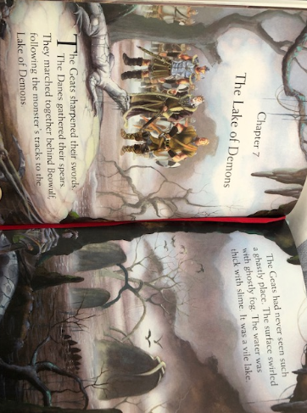

Slide 13
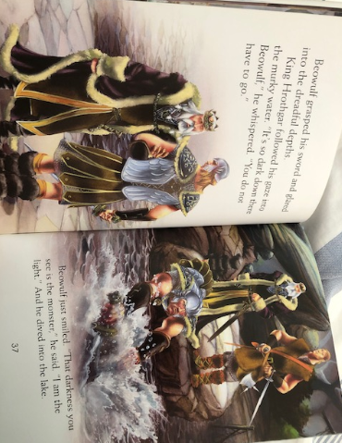

Slide 14
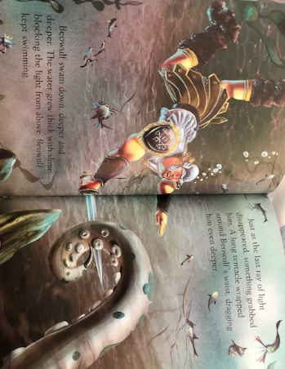

Slide 15
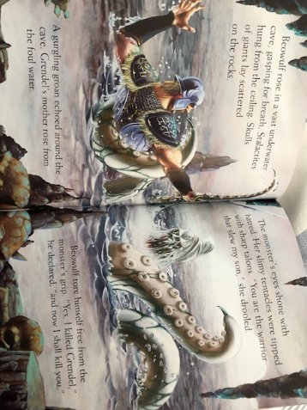

Slide 16
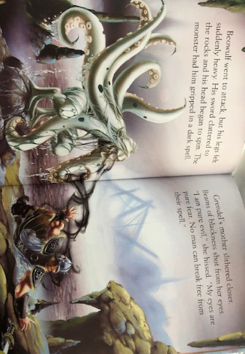

Slide 17
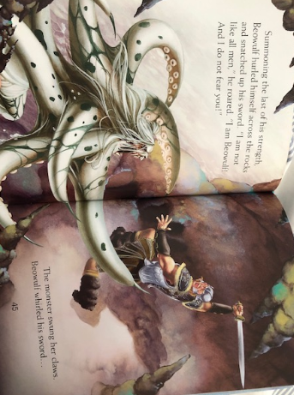

Slide 18
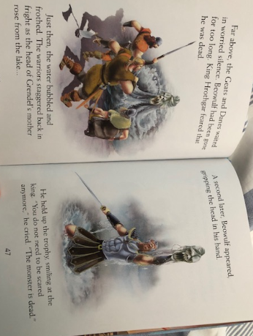

Slide 19
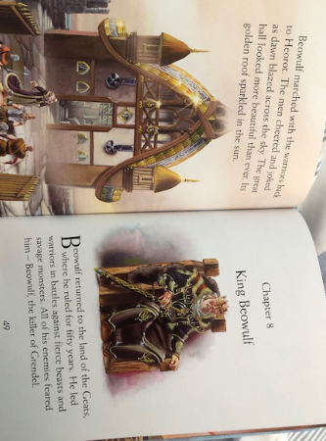

Slide 20
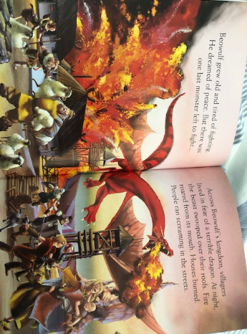

Slide 21
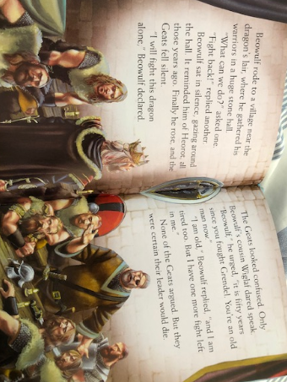

Slide 22
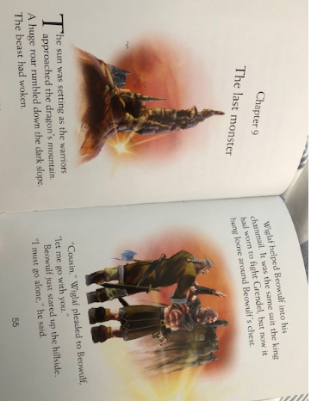

Slide 23
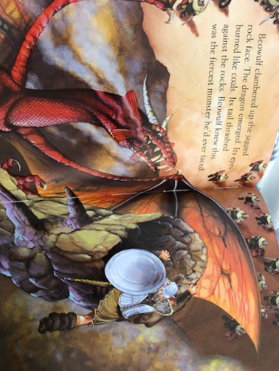

Slide 24
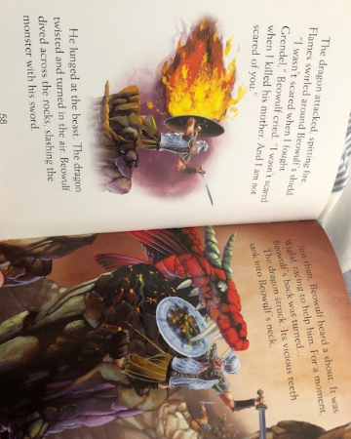

Slide 25
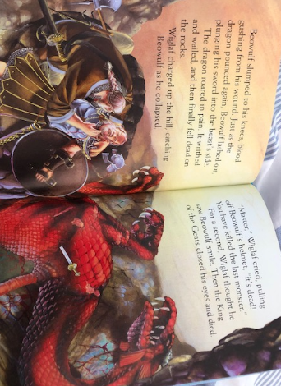

Slide 26
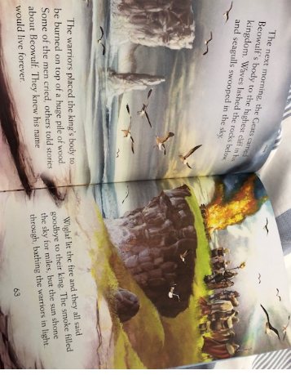

Slide 27

English Learning – Task 1
Use the comic strip below to summarise the story of Beowulf! Use the small boxes to write a short description and the larger boxes to create an image to go with it!

Slide 28
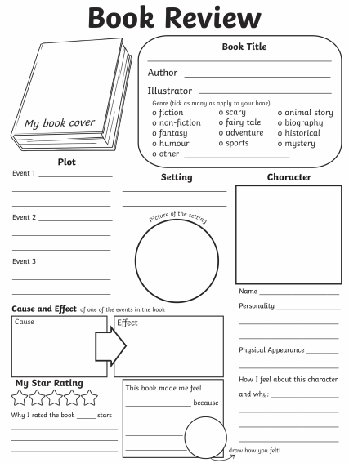
English Learning – Task 2
Complete the book review about Beowulf! Think really in detail about what happened and your opinion of the reason, giving reasons why you thought this!

Slide 29
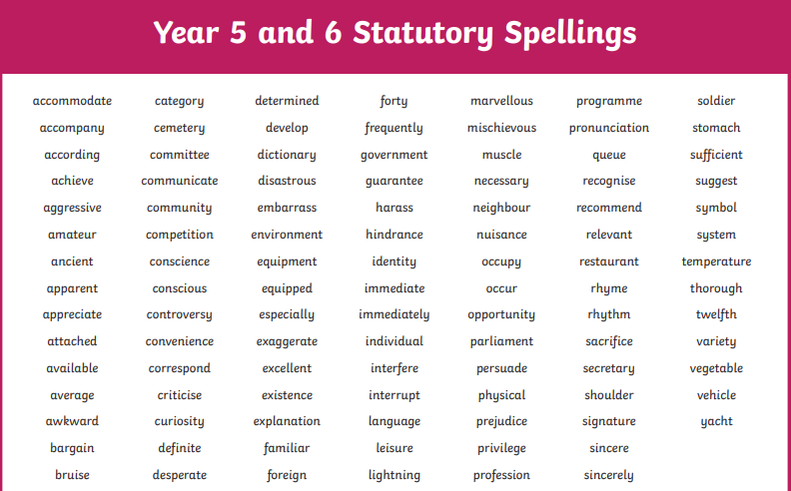
English Learning – Task 3
Test yourself on the Year 5/6 spelling words – perhaps do 10 at a time (completely up to you!). Make a note of the ones you know how to spell, can roughly spell but need prompting, cannot spell and need to learn. This will help for year 6!

Slide 30
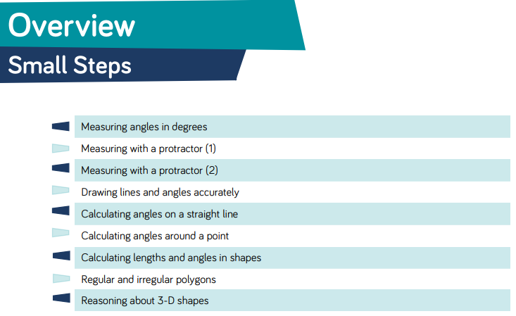
Here are the new small steps for this area for maths!

Slide 31
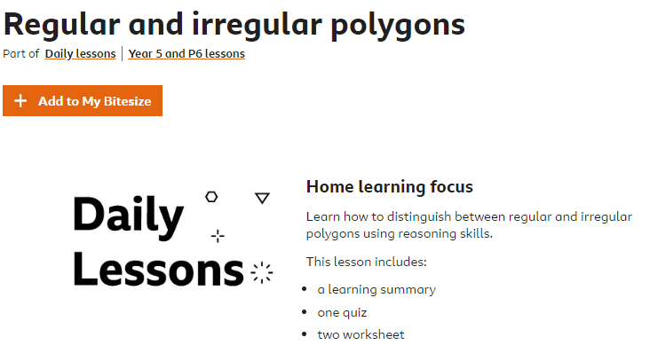
Maths Learning – Task 1
https://www.bbc.co.uk/bitesize/articles/zgmcf82

Slide 32
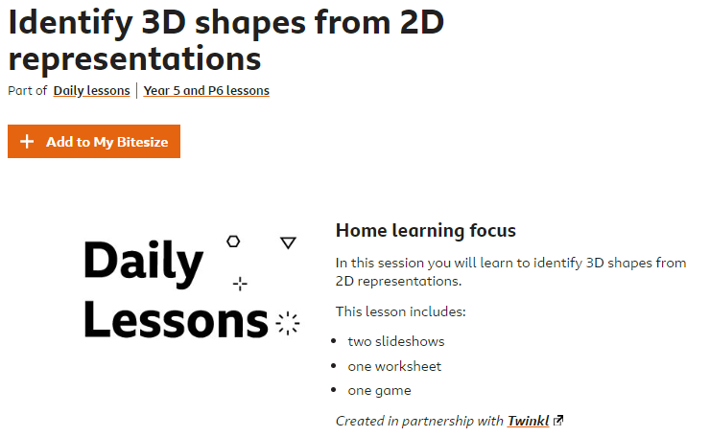
Maths Learning - Task 2
https://www.bbc.co.uk/bitesize/articles/zwq4ydm

Slide 33
Maths Learning – Task 3
https://wrm-13b48.kxcdn.com/wp-content/uploads/2019/04/Year-5-Properties-of-Shape.pdf
Here is the end of block paper for the ‘properties of shape’ topic we’ve now finished in maths.
Let the children have a go at this and see what they have learned. Perhaps even get them to talk through it with you after so they can explain what they have had to do for the questions – this is a key area in assessing maths.
Please remind the children to not be too disheartened if they don’t get every single question correct – they haven’t have their usual environment in which to learn this topic so ensure they go easy on themselves!
https://wrm-13b48.kxcdn.com/wp-content/uploads/2019/04/Year-5-Properties-of-Shape-Answers.pdf (Here is the answers!)

Slide 34
Maths Learning – BONUS
I’ve provided a small bonus task here that will be beneficial to the children going forward into year 6. On the next slides, I’ve posted all of the curriculum aims for them for year 5 maths. Get your child to go through each one and give it a red/amber/green rating for how they feel about doing these things – it’s a bit of a self audit!
By the children being able to self-assess themselves, they’ll be much more confident in identifying what they need further support with next year.
Similar to the previous task – please don’t let them worry if a lot of it is amber or red – this can be a positive thing as it’s makes us clearly aware of what they need further help with!

Slide 35
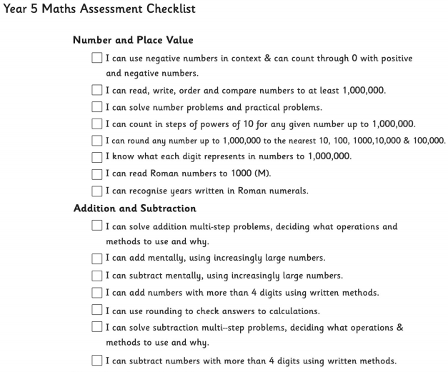
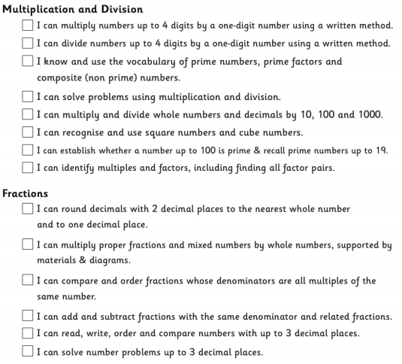

Slide 36
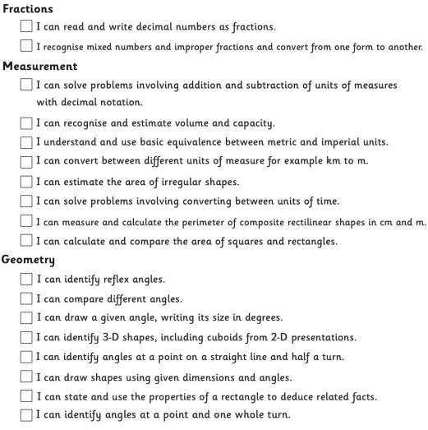

Slide 37
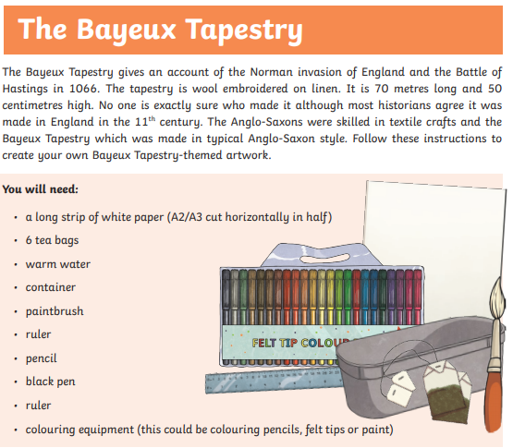
Topic/Art

Slide 38
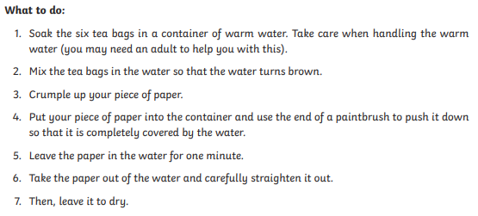

Slide 39
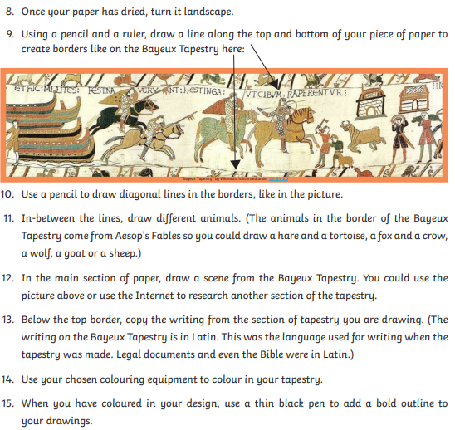

Slide 40

P.E.
It is important to keep your children active. If it is safe to do so, ensure they have some time outside throughout the day. Please visit Joe Wicks YouTube channel (https://www.youtube.com/channel/UCAxW1XT0iEJo0TYlRfn6rYQ), which has lots of exercise videos for children. He will also be hosting a live P.E. lessons Monday to Friday at 9:00am.

Slide 41

Classroom Secrets
The site classroom secrets https://classroomsecrets.co.uk/free-home-learning-packs/ has free class packs which provide some great additional ideas and resources you can use.

