Slide 1

Home Learning
Year 5 Term 6 Week 6

Slide 2
Message from the class teacher
Another week down and not many left until this academic year is over!
It was so lovely to see more of your smiling faces back in class and I’m looking forward to seeing you again this week.
I hope you continue to enjoy your home learning and are still working hard!
Have a great week everyone.
Miss Horton ☺

Slide 3

Reading
Hopefully you have access to books at home, but we have sent home extra books with your child.
Accelerated Reading
Home quizzing is not always recommended but in this case we have adjusted the settings to allow quizzing to happen at home.
If your child wants to read a book from home, please check that there is a quiz available for the book and that the book level (BL) is within or near to your child’s reading range. Also take note of the quiz number for future reference.
To check books please visit: https://www.arbookfind.co.uk/
Go to the next page for how to quiz.

Slide 4



AR quizzing at home.
To log into AR to take a quiz please visit: https://ukhosted27.renlearn.co.uk/2240835/
Your child should know what to do from here and should know their login details. If they are not aware, most details are written in their reading record.
Click on Accelerated reader.
Type in the name the book or the quiz number.
We advise students complete quizzes unaided. If parents/carers wish to support their child, they can do so in the following ways:
Discuss the book with your child as the book is being read
Ask your child to read the question out loud
Re-word questions for your child, if necessary
Ask your child which answers are not correct

Slide 5

Visit http://readon.myon.co.uk

Slide 6

Choose an area that interests you or use the search option.

Slide 7


Using My Maths
Children should know their way round My Maths but here are some reminders on how access the lessons. Visit: www.mymaths.co.uk
bapchild
divide162

Slide 8

Using My Maths
Access any lesson based on what your child is learning in class or search the topic in the search bar.
Use the login portal to access specific homework and lessons that your teacher has set.

Slide 9

Maths – White Rose Home Learning
In school we follow the White Rose scheme of learning. Their website has put together free lessons and resources that link to the learning taking place in school. Please visit: https://whiterosemaths.com/homelearning/

Slide 10



TT Rockstars
To access TT Rockstars please visit: https://play.ttrockstars.com/auth/school
Start typing in the school name or the post code (ME99NL)
Pupils type in their username and password, usually written in their reading record.
Pupils can practice all tables but Year 2 should be practicing 2, 5, and 10’s
Year 3: 2,5,10,3,4,8’s
Year 4,5,6: all tables

Slide 11

Accessing Twinkl
Many educational content providers are offering free access to their resources. Twinkl is a website that we use from time to time to resource our lessons to aid in teacher input and pupil activities.
We will be able to direct you towards activities and learning via this website based on lessons that may be missed due to absence. To access Twinkl please visit: www.twinkl.co.uk/offer
You will have to sign up and put in the offer code: UKTWINKLHELPS

Slide 12
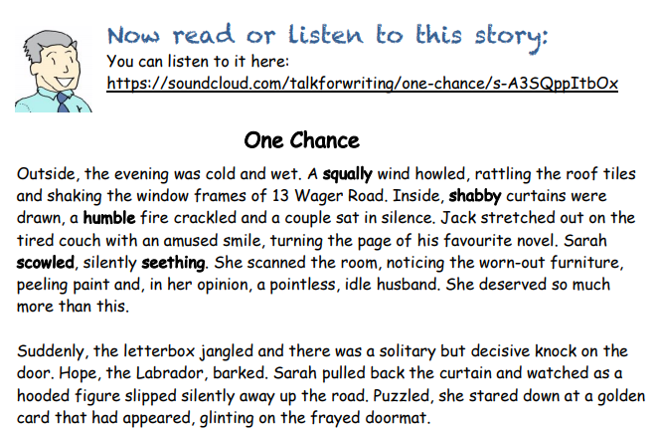

Slide 13
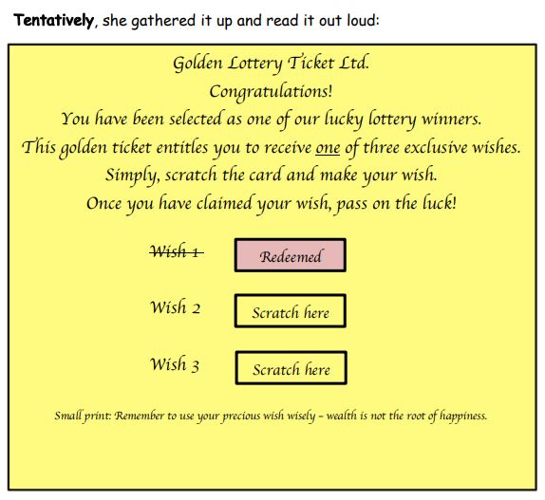

Slide 14
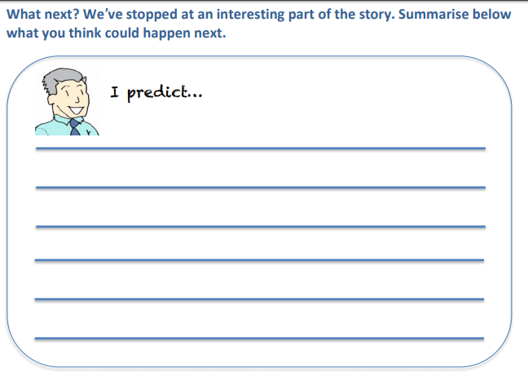
English Learning – Task 1

Slide 15
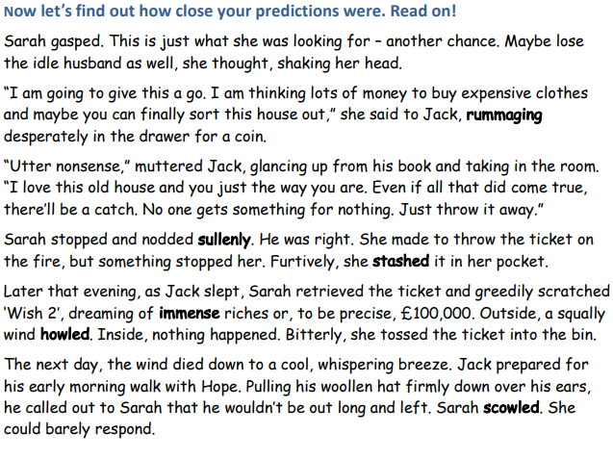

Slide 16
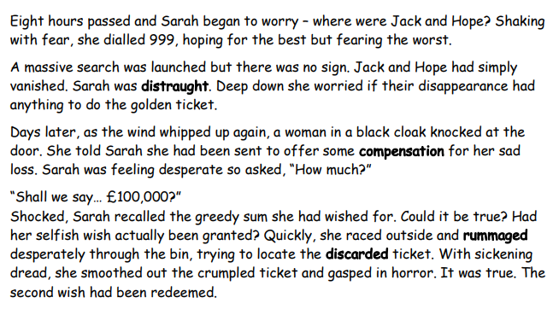

Slide 17
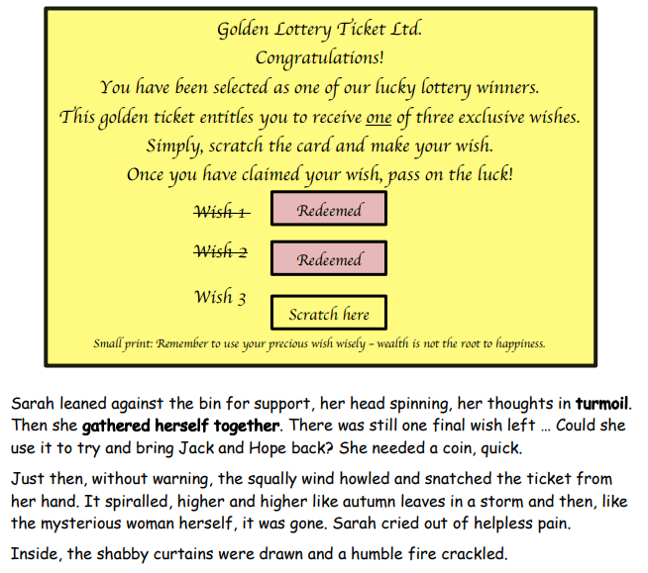

Slide 18
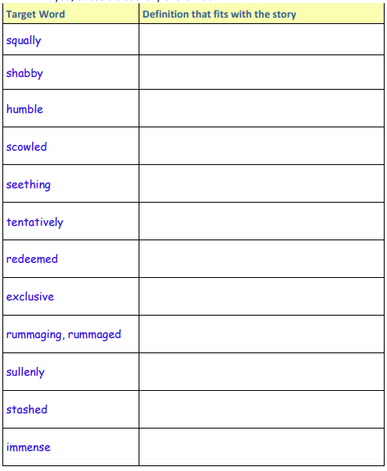
English Learning – Task 2
Have a look back at the story. All of the words below are in bold.
See if you can work out what they mean from the context of the story and jot your ideas down here.
If you are stuck, there is a list of matching words below to help you.
If you are still stuck, you could ask someone else in your home to tell you, or use a dictionary or the web.

Slide 19
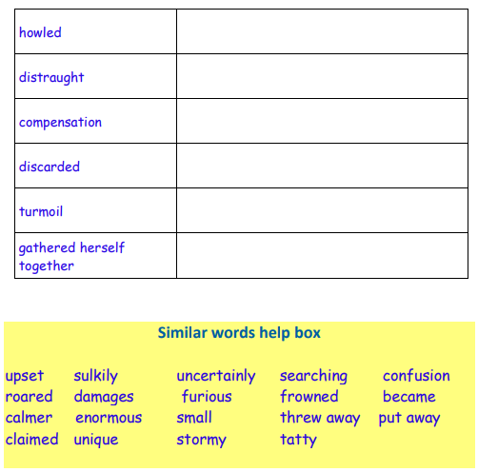
English Learning – Task 2
Have a look back at the story. All of the words below are in bold.
See if you can work out what they mean from the context of the story and jot your ideas down here.
If you are stuck, there is a list of matching words below to help you.
If you are still stuck, you could ask someone else in your home to tell you, or use a dictionary or the web.

Slide 20
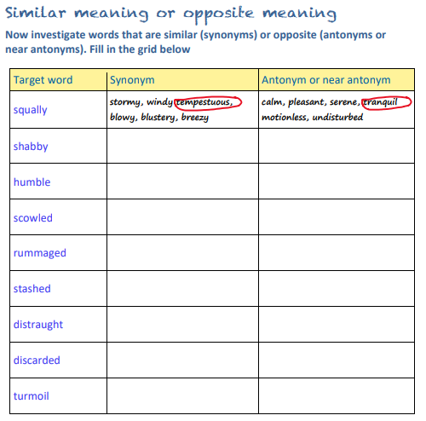
English Learning – Task 3

Slide 21
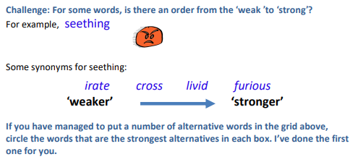

Slide 22
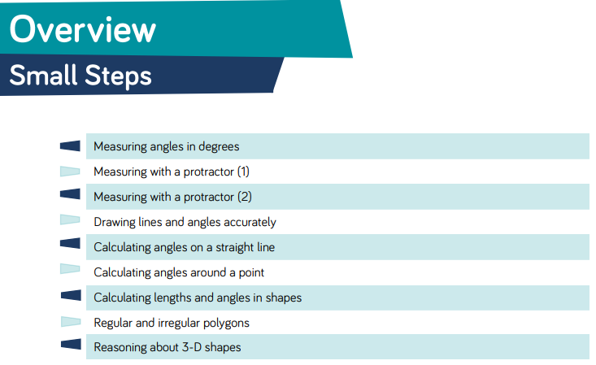
Here are the new small steps for this area for maths!

Slide 23
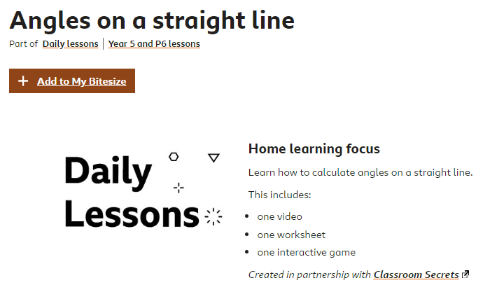
Maths Learning - Task 1
https://www.bbc.co.uk/bitesize/articles/zrvm8hv

Slide 24
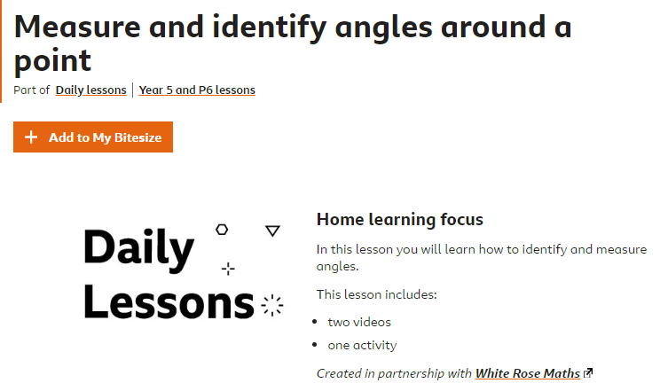
Maths Learning – Task 2
https://www.bbc.co.uk/bitesize/articles/zdp8bqt

Slide 25
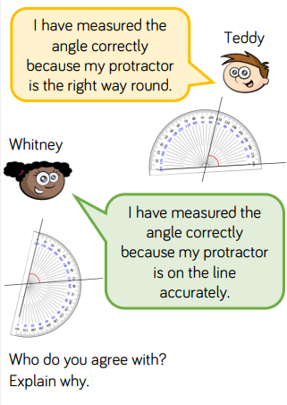
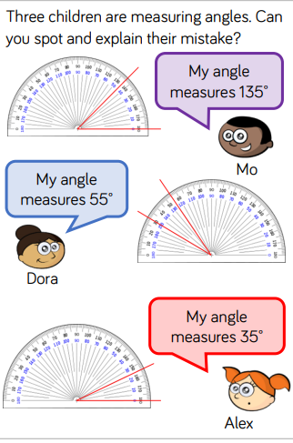
Maths Learning - Task 2

Slide 26
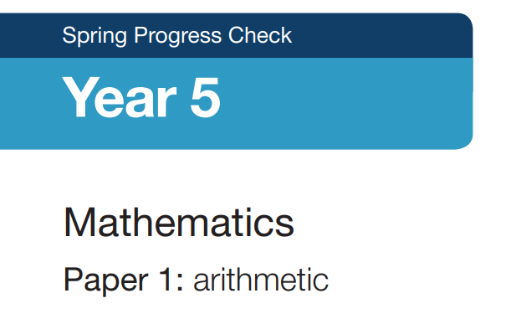
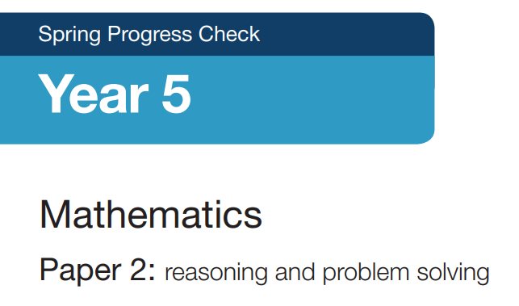
Maths Learning – Task 3
I have uploaded the arithmetic and reasoning/problem solving papers for the end of Spring terms. We completed most of this in class so it should be accessible to the children.
You can just do one or two it is up to you. You can print it out or just complete on paper from the screen. It might be best to work with your child next to you, one question at a time.
Otherwise, you can just let them get on with it and go through it with them at the end. It is important that the children show their workings out and are able to explain how they got to the answer.

Slide 27
Topic
RESEARCH FOCUS:
Create a poster, leaflet, powerpoint (whichever format you like!) to explain the Bayeux Tapestry. Below are some starting questions to focus on, but you may have your own to direct your research.
What is the Bayeux Tapestry?
Where can it be found?
Who made it?
What is it made from?
Why is it important?

Slide 28

P.E.
It is important to keep your children active. If it is safe to do so, ensure they have some time outside throughout the day. Please visit Joe Wicks YouTube channel (https://www.youtube.com/channel/UCAxW1XT0iEJo0TYlRfn6rYQ), which has lots of exercise videos for children. He will also be hosting a live P.E. lessons Monday to Friday at 9:00am.

Slide 29

Classroom Secrets
The site classroom secrets https://classroomsecrets.co.uk/free-home-learning-packs/ has free class packs which provide some great additional ideas and resources you can use.

