Slide 1

Home Learning
Year 5 Term 6 Week 5

Slide 2
Message from the class teacher
Hello again, Fisher! It’s been brilliant hearing from lots of you over the past few weeks. Please don’t be worried if I haven’t called yet – it’s usually quite busy when I’m in school with the key worker children, but I will be in touch this week.
Something very exciting is happening this week… some of us will be reunited in class! I’m really looking forward to seeing those children who are coming in on Friday and it’ll be great to talk about your home learning and other exciting things you’ve been up to. If you aren’t joining us on Friday, we will be thinking of you and I’m looking forward to see you all very soon.
Another mini break from Beowulf to provide further writing practice for you!
Have a great week!
Miss Horton ☺

Slide 3

Reading
Hopefully you have access to books at home, but we have sent home extra books with your child.
Accelerated Reading
Home quizzing is not always recommended but in this case we have adjusted the settings to allow quizzing to happen at home.
If your child wants to read a book from home, please check that there is a quiz available for the book and that the book level (BL) is within or near to your child’s reading range. Also take note of the quiz number for future reference.
To check books please visit: https://www.arbookfind.co.uk/
Go to the next page for how to quiz.

Slide 4



AR quizzing at home.
To log into AR to take a quiz please visit: https://ukhosted27.renlearn.co.uk/2240835/
Your child should know what to do from here and should know their login details. If they are not aware, most details are written in their reading record.
Click on Accelerated reader.
Type in the name the book or the quiz number.
We advise students complete quizzes unaided. If parents/carers wish to support their child, they can do so in the following ways:
Discuss the book with your child as the book is being read
Ask your child to read the question out loud
Re-word questions for your child, if necessary
Ask your child which answers are not correct

Slide 5

Visit http://readon.myon.co.uk

Slide 6

Choose an area that interests you or use the search option.

Slide 7


Using My Maths
Children should know their way round My Maths but here are some reminders on how access the lessons. Visit: www.mymaths.co.uk
bapchild
divide162

Slide 8

Using My Maths
Access any lesson based on what your child is learning in class or search the topic in the search bar.
Use the login portal to access specific homework and lessons that your teacher has set.

Slide 9

Maths – White Rose Home Learning
In school we follow the White Rose scheme of learning. Their website has put together free lessons and resources that link to the learning taking place in school. Please visit: https://whiterosemaths.com/homelearning/

Slide 10



TT Rockstars
To access TT Rockstars please visit: https://play.ttrockstars.com/auth/school
Start typing in the school name or the post code (ME99NL)
Pupils type in their username and password, usually written in their reading record.
Pupils can practice all tables but Year 2 should be practicing 2, 5, and 10’s
Year 3: 2,5,10,3,4,8’s
Year 4,5,6: all tables

Slide 11

Accessing Twinkl
Many educational content providers are offering free access to their resources. Twinkl is a website that we use from time to time to resource our lessons to aid in teacher input and pupil activities.
We will be able to direct you towards activities and learning via this website based on lessons that may be missed due to absence. To access Twinkl please visit: www.twinkl.co.uk/offer
You will have to sign up and put in the offer code: UKTWINKLHELPS

Slide 12
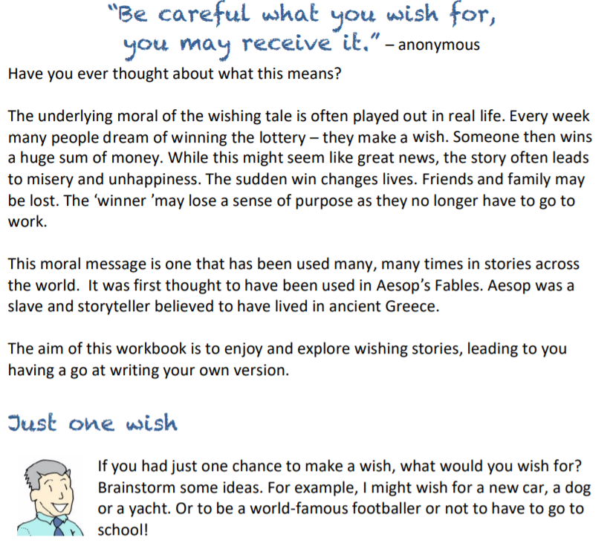

Slide 13
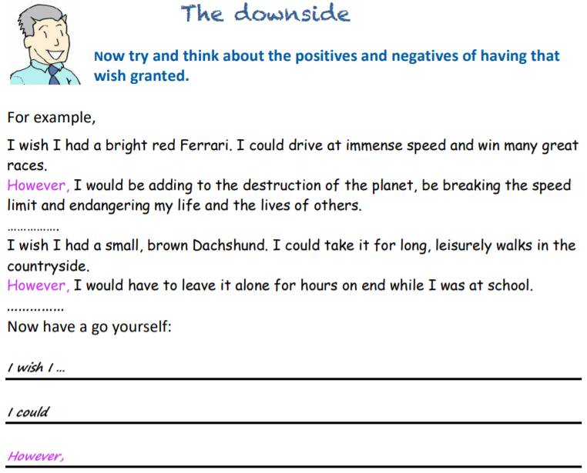
English Learning – Task 1

Slide 14
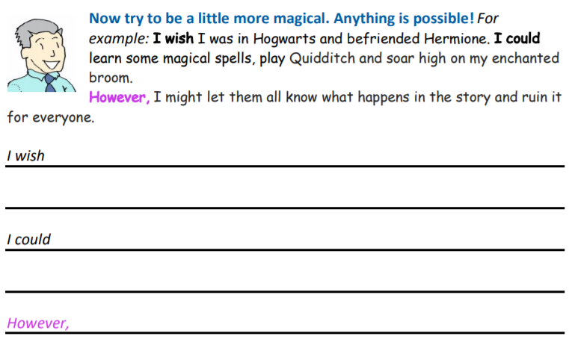

Slide 15
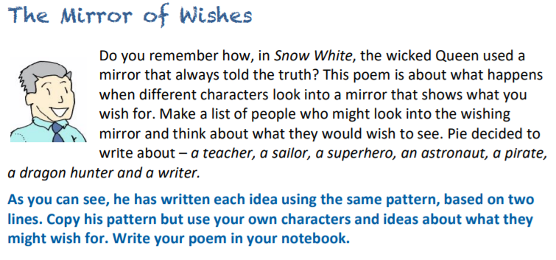
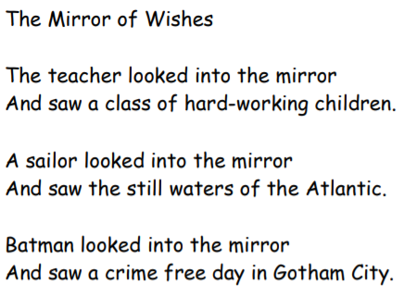
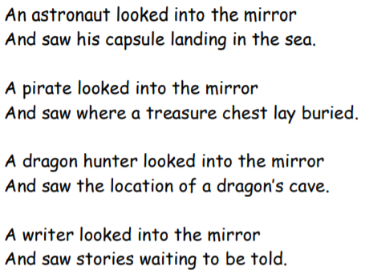
English Learning – Task 2

Slide 16
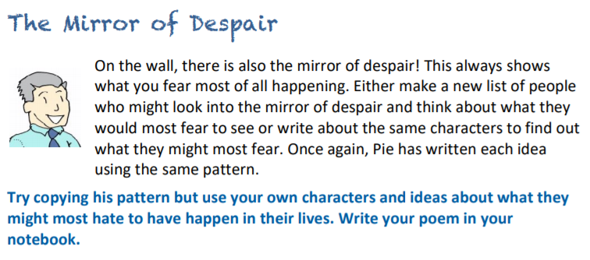
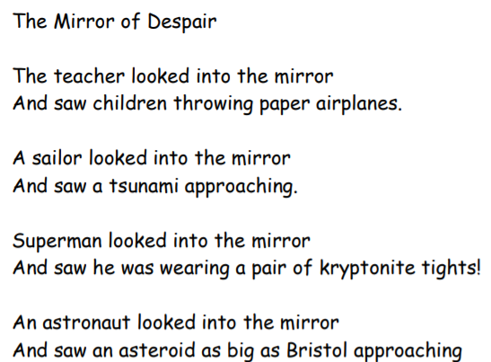
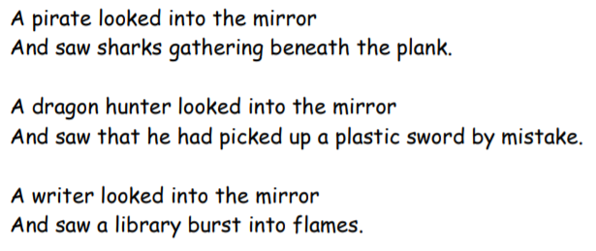
English Learning – Task 3

Slide 17
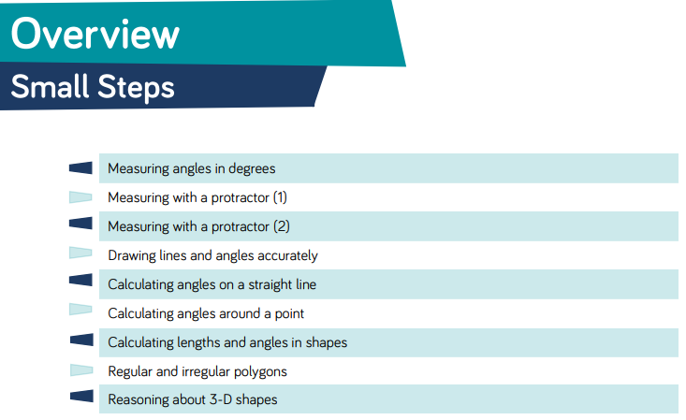
Here are the new small steps for this area for maths!

Slide 18
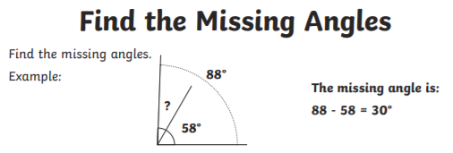
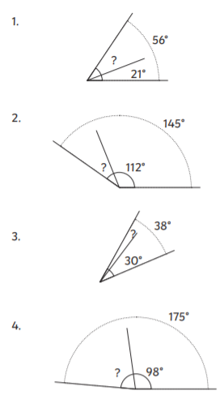
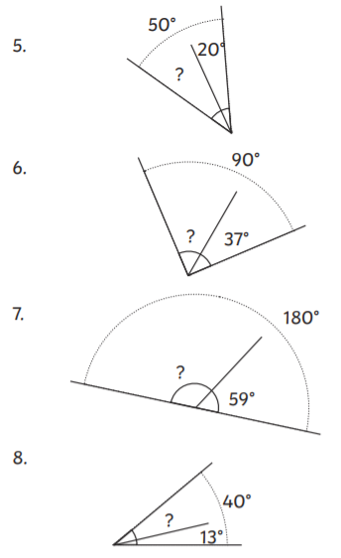
Maths Learning - Task 1

Slide 19
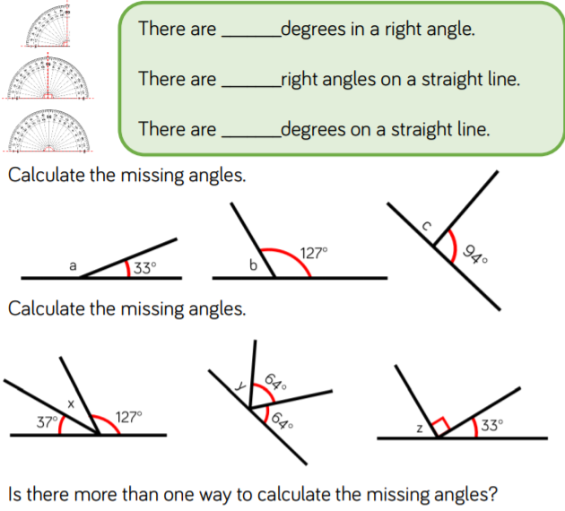
Maths Learning - Task 2
HELP:
You’ll be using your addition and subtraction skills here. You need all of the angles to add up to 180 degrees.
This video might help:
https://www.youtube.com/watch?v=cBIJmmz8flI

Slide 20
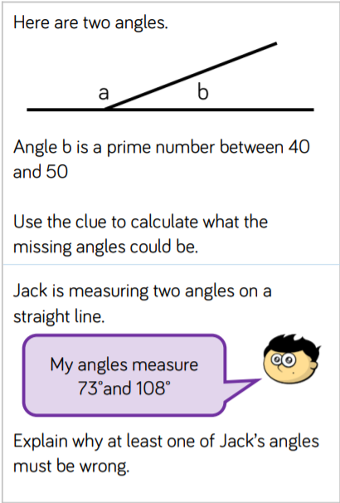
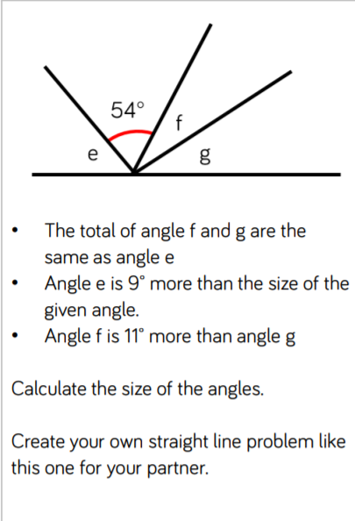
Maths Learning – Task 3

Slide 21
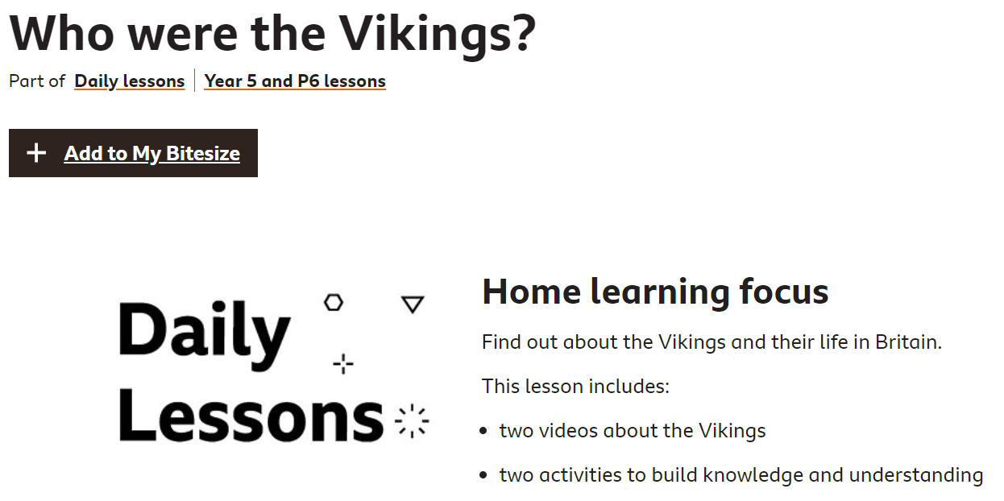
Topic
https://www.bbc.co.uk/bitesize/articles/zvhtwnb
Have a go at this lesson and then begin to identify similarities and differences between the Anglo-Saxons and the Vikings!

Slide 22

P.E.
It is important to keep your children active. If it is safe to do so, ensure they have some time outside throughout the day. Please visit Joe Wicks YouTube channel (https://www.youtube.com/channel/UCAxW1XT0iEJo0TYlRfn6rYQ), which has lots of exercise videos for children. He will also be hosting a live P.E. lessons Monday to Friday at 9:00am.

Slide 23

Classroom Secrets
The site classroom secrets https://classroomsecrets.co.uk/free-home-learning-packs/ has free class packs which provide some great additional ideas and resources you can use.

Slide 24
Maths Learning - Task 1 ANSWERS
35
33
8
77
30
53
121
27

Slide 25
Maths Learning - Task 2 ANSWERS
90
2
180
86
147
53
90
(Square shows right angle)
52
16
57

Slide 26
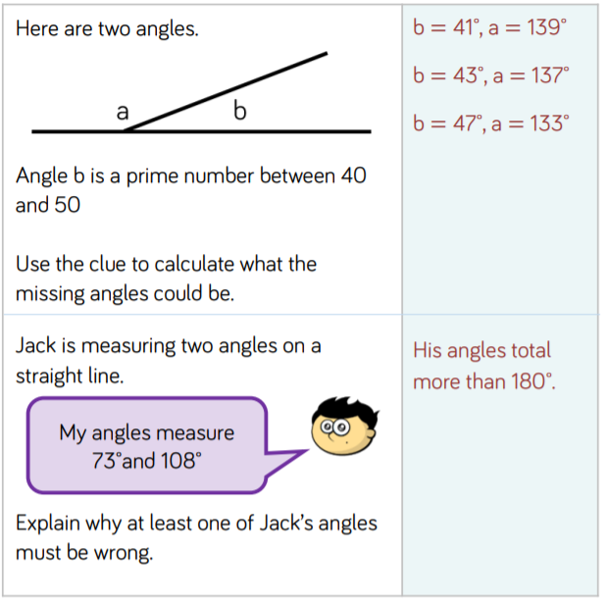
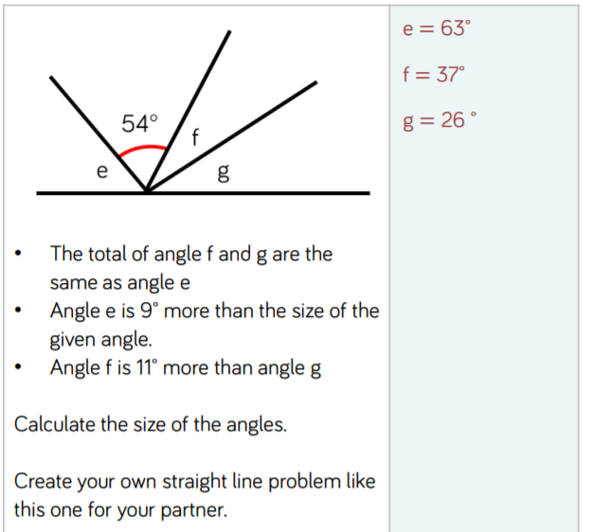
Maths Learning – Task 3 ANSWERS

