Slide 1

Home Learning
Year 5 Term 6 Week 4

Slide 2
Message from the class teacher
Hello Fisher!
It has been so lovely getting to see some of you in school and speak to some of you on the phone this week! You’ve told me lots about all your home learning and what you’ve been getting up to, which sounds very exciting. Don’t worry though, if I haven’t called you yet, I’ll give you a ring on Thursday or Friday this week between 9am and 3pm – so listen out for me!
This week, we’ll start planning and writing our Beowulf newspaper reports. We really want to engage our reader into wanting to find out more so really try to hook them in! You could share your work with either another adult or a sibling to see what they think.
Have a great week!
Miss Horton ☺

Slide 3

Reading
Hopefully you have access to books at home, but we have sent home extra books with your child.
Accelerated Reading
Home quizzing is not always recommended but in this case we have adjusted the settings to allow quizzing to happen at home.
If your child wants to read a book from home, please check that there is a quiz available for the book and that the book level (BL) is within or near to your child’s reading range. Also take note of the quiz number for future reference.
To check books please visit: https://www.arbookfind.co.uk/
Go to the next page for how to quiz.

Slide 4



AR quizzing at home.
To log into AR to take a quiz please visit: https://ukhosted27.renlearn.co.uk/2240835/
Your child should know what to do from here and should know their login details. If they are not aware, most details are written in their reading record.
Click on Accelerated reader.
Type in the name the book or the quiz number.
We advise students complete quizzes unaided. If parents/carers wish to support their child, they can do so in the following ways:
Discuss the book with your child as the book is being read
Ask your child to read the question out loud
Re-word questions for your child, if necessary
Ask your child which answers are not correct

Slide 5

Visit http://readon.myon.co.uk

Slide 6

Choose an area that interests you or use the search option.

Slide 7


Using My Maths
Children should know their way round My Maths but here are some reminders on how access the lessons. Visit: www.mymaths.co.uk
bapchild
divide162

Slide 8

Using My Maths
Access any lesson based on what your child is learning in class or search the topic in the search bar.
Use the login portal to access specific homework and lessons that your teacher has set.

Slide 9

Maths – White Rose Home Learning
In school we follow the White Rose scheme of learning. Their website has put together free lessons and resources that link to the learning taking place in school. Please visit: https://whiterosemaths.com/homelearning/

Slide 10



TT Rockstars
To access TT Rockstars please visit: https://play.ttrockstars.com/auth/school
Start typing in the school name or the post code (ME99NL)
Pupils type in their username and password, usually written in their reading record.
Pupils can practice all tables but Year 2 should be practicing 2, 5, and 10’s
Year 3: 2,5,10,3,4,8’s
Year 4,5,6: all tables

Slide 11

Accessing Twinkl
Many educational content providers are offering free access to their resources. Twinkl is a website that we use from time to time to resource our lessons to aid in teacher input and pupil activities.
We will be able to direct you towards activities and learning via this website based on lessons that may be missed due to absence. To access Twinkl please visit: www.twinkl.co.uk/offer
You will have to sign up and put in the offer code: UKTWINKLHELPS

Slide 12
English Learning – Task 1
Go through the following slides on what makes a great newspaper report. Following this, complete the planning sheet on the slide after.
The newspaper report you will be writing is based upon Beowulf and Grendel’s battle. We do not have the details of the specific dates and times it happened, so you can use your imagination on this (just bearing in mind this is an Anglo-Saxon tale!)
You will also need to consider who you will interview about the event – go back through the chapters I have posted previously and also think about what they might say.

Slide 14

A newspaper report needs to…
Be about an interesting event;
Capture the reader’s attention;
Present factual information;
Be succinct and to the point;

Slide 15


The Essentials First
When the reader reads a newspaper report, they should be given the essential information first, so that they can decide if they wish to read more.
It is important that newspaper reports have the most important information coming first. This is called front-loading.

Slide 16
Structure of a newspaper report
Headline and byline
Lead
Body
Tail

Slide 17
Headline
Headline and byline
For a good headline, you need to:
Catch the reader’s attention so they want to read the rest of the report;
Sum up the story in a few words;
Use powerful and interesting language;
Write in the present tense – even if the report is about an event that has already happened;
Include alliteration or wit at times.
Lead
Body
Tail

Slide 18
Byline
Headline and byline
Lead
For a good byline, you need:
The writer’s name;
The writer’s speciality (for example, Sports reporter, Food correspondent, Crime editor, Deputy politic editor, Senior fashion reporter);
A link to the writer’s Twitter account (for example, @dgoodman).
Body
Tail

Slide 19
Lead
Headline and byline
For a good lead paragraph, you need to;
Make the paragraph short and snappy so that it briefly explains what has happened;
Ensure that, even if the reader stopped reading at this point, they would still know roughly what happened;
Use past tense in most cases;
Make sure the first paragraph answers as many of these six questions as you can –
Who? What? Where? Why? When? How?
Lead
Body
Tail

Slide 20
Body
For a good body section, you need to:
Add more information and detail to your lead paragraph;
Include background information, evidence, facts and quotes from people involved in or connected to the event/story;
Continue to write in order of importance, putting the most important information in the first few paragraphs of the body section.
Headline and byline
Lead
Body
Having quotes from witnesses or experts
will make your report more credible and interesting.
Tail
Be sure to use correct punctuation for quotes!

Slide 21
Tail
For a good tail section:
Give the reader the opportunity to gain additional information if they are particularly interested in the topic of the news report;
Include links to previous news reports or useful websites;
Include a final quote from a witness or expert that helps to sum up the story or that could hint at what might happen next.
Headline and byline
Lead
This ‘Tail’ information can be useful but is not always needed. It tends to be the least important information in the report.
Body
Tail

Slide 22
Example
headline
School Children Raise Funds for Local Charity
Frances Trackall, Education reporter
byline
A small group of Year 5 students from Arkwood Primary School have created a brilliant plan to raise money for a local charity that assists people in the community. Following a visit to the school from a charity representative, the students set out to create a way of raising much needed funds.
The students presented the fundraising idea to school principal Mrs Justine Knight, who saw great potential in the plan to sell produce from the school’s vegetable garden to local restaurants and, in turn, raise money for the local charity. She stated that ‘the children have displayed a true sense of community in their fundraising plan.’ Following a meeting with teachers, it is hoped that the students can begin to implement the four phase plan. ‘The school would support students wholly in the fund raising venture,’ Mrs Knight added.
The school plans to sell the garden produce to two local restaurants, beginning in early September. For more information on this fundraising plan, visit the Arkwood Primary School website (www.arkwood.sch.com).
lead
body
tail

Slide 23

Get It Right!
For a GREAT newspaper report you need to:
Keep your most important information near the top of the report;
Cut out the less important sections from the bottom of the report if it ends up being too long;
Keep your sentences short and punchy, so that the report is interesting to your reader;
Check your spelling and your facts…and check them again!

Slide 24
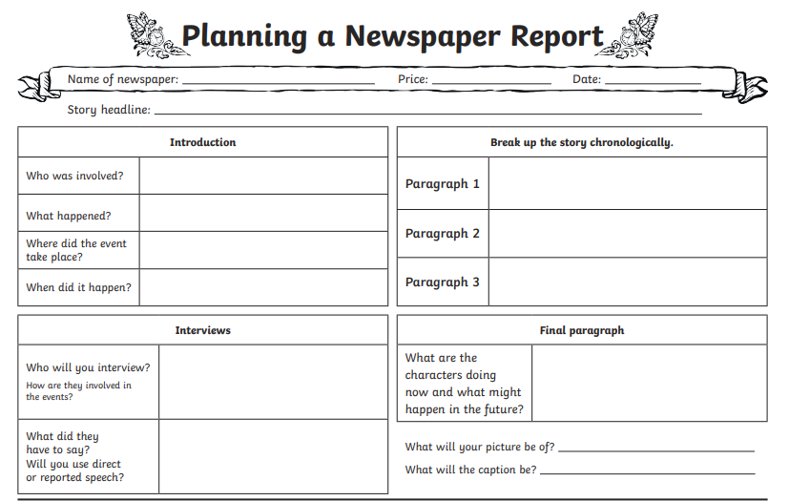

Slide 25
English Learning – Task 2
Start writing! Have a go at beginning to draft your newspaper report.
On the next slide, I’ve shared an example of a good newspaper report that has all of the features labelled on there. Use this for inspiration!
This may take your longer than the week to draft, edit and be finished with – but that’s completely fine!

Slide 26
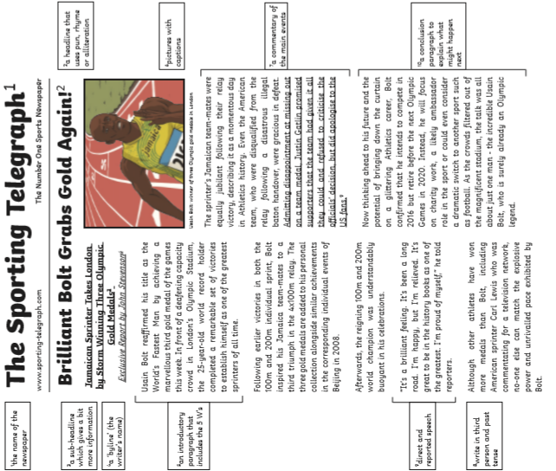

Slide 27
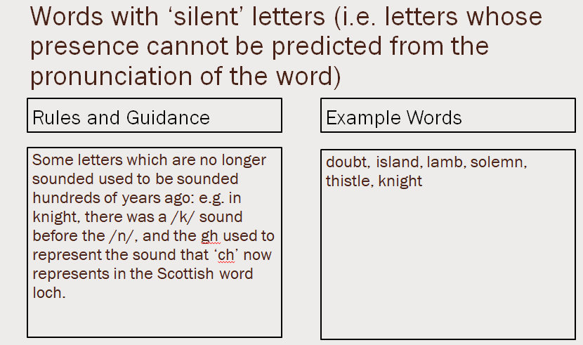
English Learning – Task 3
Practise and try to learn the words on the ‘example words’. We usually do 10 in class so you can either chunk this into smaller groups to learn through the week or learn all of them together.

Slide 28
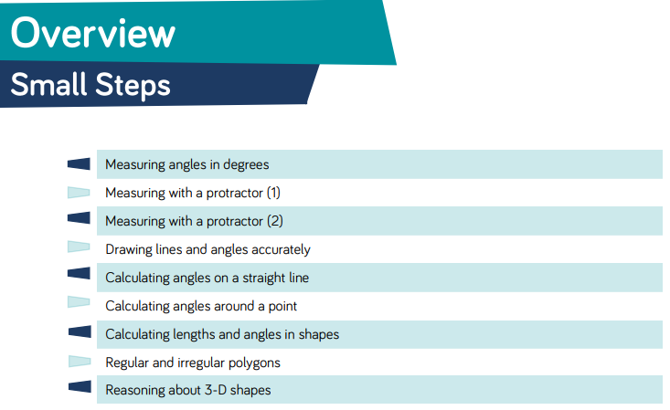
Here are the new small steps for this area for maths!

Slide 29
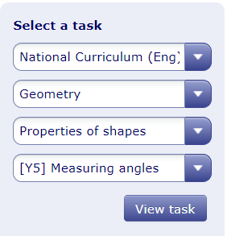
Maths Learning – Task 1
Complete the homework task of ‘Measuring Angles’.
There are some other tasks set on mymaths that you can do prior to this which are from years 3 and 4 to use as a recap task.

Slide 30
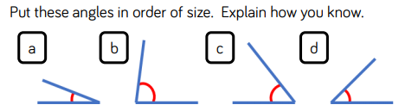
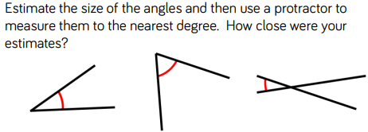
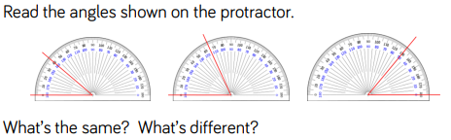
Maths Learning - Task 2

Slide 31
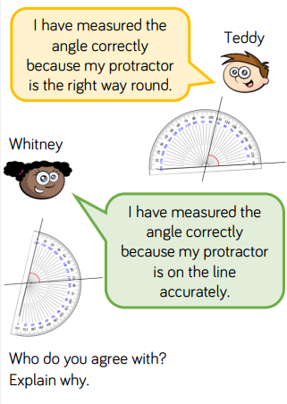
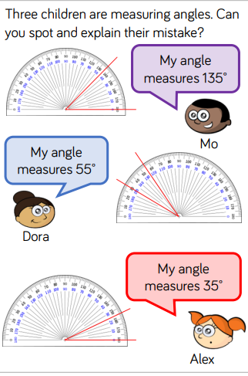
Maths Learning - Task 2

Slide 32
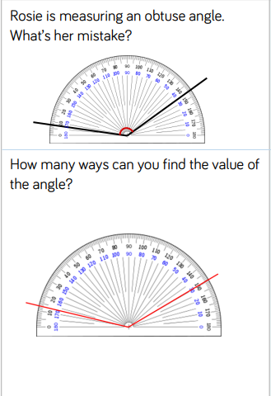
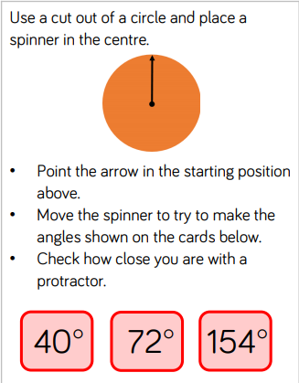
Maths Learning – Task 3

Slide 33
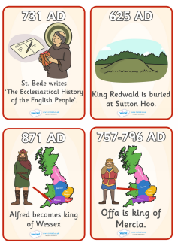
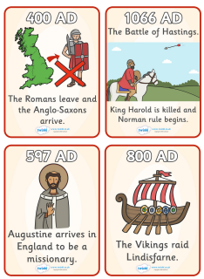
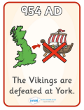
Topic
Put the timeline in the correct order!
You can either print out this page and cut/stick them together or you can just copy them onto paper.
Bonus task – Any words you’re unsure of, find out what they mean! Think about the words ‘missionary’ and ‘Lindisfarne’.

Slide 34

P.E.
It is important to keep your children active. If it is safe to do so, ensure they have some time outside throughout the day. Please visit Joe Wicks YouTube channel (https://www.youtube.com/channel/UCAxW1XT0iEJo0TYlRfn6rYQ), which has lots of exercise videos for children. He will also be hosting a live P.E. lessons Monday to Friday at 9:00am.

Slide 35

Classroom Secrets
The site classroom secrets https://classroomsecrets.co.uk/free-home-learning-packs/ has free class packs which provide some great additional ideas and resources you can use.

Slide 36
Maths Learning – Task 2 ANSWERS
A, D, C, B
Same – all angles are smaller than a right angle (90 degrees).
Same – all angles are smaller than a right angle (90 degrees).

Slide 37
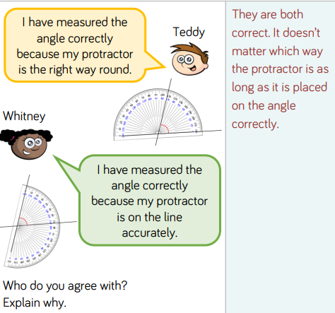
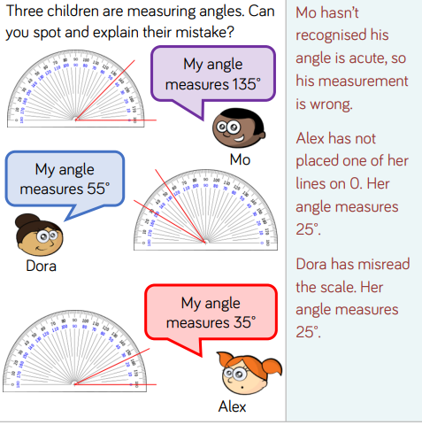
Maths Learning - Task 2

Slide 38
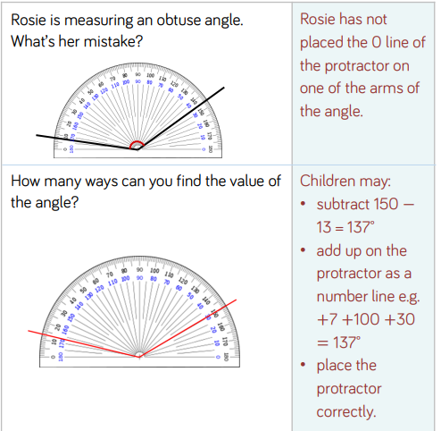
Maths Learning – Task 3 ANSWERS

