Slide 1

Home Learning
Year 5 Term 6 Week 3

Slide 2
Message from the class teacher
Another week down and another excellent effort on your home learning! I’ve spoken to a few children now, when I’ve seen them in school, and it’s been so lovely to hear about what you’ve done at home and the brilliant home learning you’ve produced.
We’re slowly creeping into the world of Beowulf and have just seen our first bit of action in the fight between Beowulf and Grendel. This week, we’re going to continue with the next chapter of the text and we’ll begin to look at the features of newspaper articles for when we try to write one in a few weeks!
This week – we finally finish decimals! It was really important for us to take our time on this as we were not completing this together in class. We’re moving into look at geometry – specifically properties of shape.
Have a great week!
Miss Horton ☺

Slide 3

Reading
Hopefully you have access to books at home, but we have sent home extra books with your child.
Accelerated Reading
Home quizzing is not always recommended but in this case we have adjusted the settings to allow quizzing to happen at home.
If your child wants to read a book from home, please check that there is a quiz available for the book and that the book level (BL) is within or near to your child’s reading range. Also take note of the quiz number for future reference.
To check books please visit: https://www.arbookfind.co.uk/
Go to the next page for how to quiz.

Slide 4



AR quizzing at home.
To log into AR to take a quiz please visit: https://ukhosted27.renlearn.co.uk/2240835/
Your child should know what to do from here and should know their login details. If they are not aware, most details are written in their reading record.
Click on Accelerated reader.
Type in the name the book or the quiz number.
We advise students complete quizzes unaided. If parents/carers wish to support their child, they can do so in the following ways:
Discuss the book with your child as the book is being read
Ask your child to read the question out loud
Re-word questions for your child, if necessary
Ask your child which answers are not correct

Slide 5

Visit http://readon.myon.co.uk

Slide 6

Choose an area that interests you or use the search option.

Slide 7


Using My Maths
Children should know their way round My Maths but here are some reminders on how access the lessons. Visit: www.mymaths.co.uk
bapchild
divide162

Slide 8

Using My Maths
Access any lesson based on what your child is learning in class or search the topic in the search bar.
Use the login portal to access specific homework and lessons that your teacher has set.

Slide 9

Maths – White Rose Home Learning
In school we follow the White Rose scheme of learning. Their website has put together free lessons and resources that link to the learning taking place in school. Please visit: https://whiterosemaths.com/homelearning/

Slide 10



TT Rockstars
To access TT Rockstars please visit: https://play.ttrockstars.com/auth/school
Start typing in the school name or the post code (ME99NL)
Pupils type in their username and password, usually written in their reading record.
Pupils can practice all tables but Year 2 should be practicing 2, 5, and 10’s
Year 3: 2,5,10,3,4,8’s
Year 4,5,6: all tables

Slide 11

Accessing Twinkl
Many educational content providers are offering free access to their resources. Twinkl is a website that we use from time to time to resource our lessons to aid in teacher input and pupil activities.
We will be able to direct you towards activities and learning via this website based on lessons that may be missed due to absence. To access Twinkl please visit: www.twinkl.co.uk/offer
You will have to sign up and put in the offer code: UKTWINKLHELPS

Slide 12
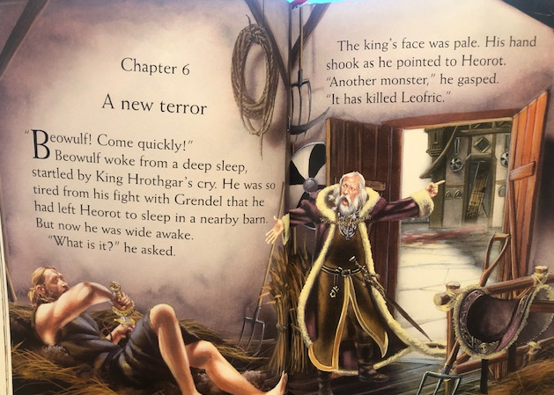

Slide 13
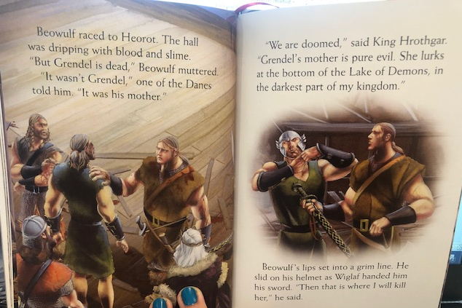

Slide 14
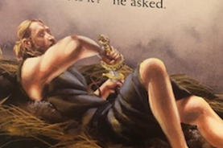
English Learning – Task 1
In the image below, what is Beowulf reaching for? Why is he reaching for this item? Can you use any evidence from the text to support your answer?
‘The king’s face was pale’ What does this mean? Can we describe the expressions on people’s faces using any other colours?
Based upon previous images of Grendel, create an image or description of what you think Grendel’s mother will look like.
What is going to happen next? Create a short prediction – use evidence from the text where you can! (This can be from any previous chapters).

Slide 15
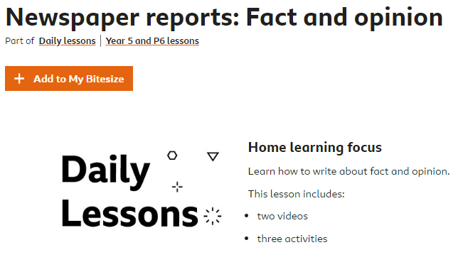
English Learning – Task 2
Complete the BBC Bitesize session on fact and opinions to use for newspaper reports - https://www.bbc.co.uk/bitesize/articles/zjykjp3
In newspaper articles, we want to use facts when we are telling the reader about the events and we may see opinions when a witness is being interviewed. Making sure you know the difference between these will be really helpful when we write our Beowulf reports!

Slide 16
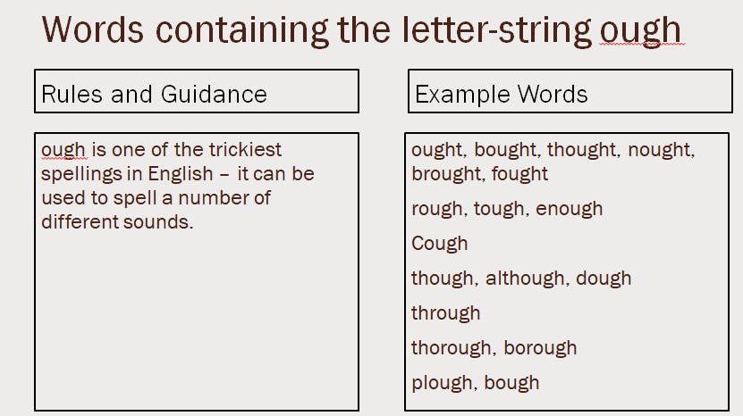
English Learning – Task 3
Practise and try to learn the words on the ‘example words’. We usually do 10 in class so you can either chunk this into smaller groups to learn through the week or learn all of them together.

Slide 17
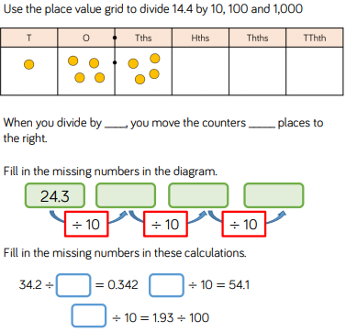
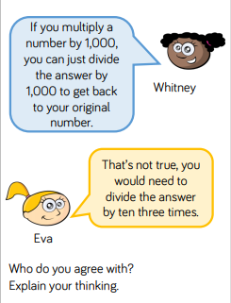
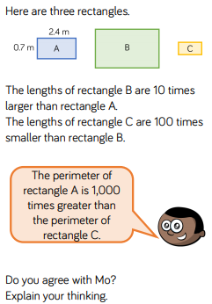
Maths Learning - Task 1

Slide 18
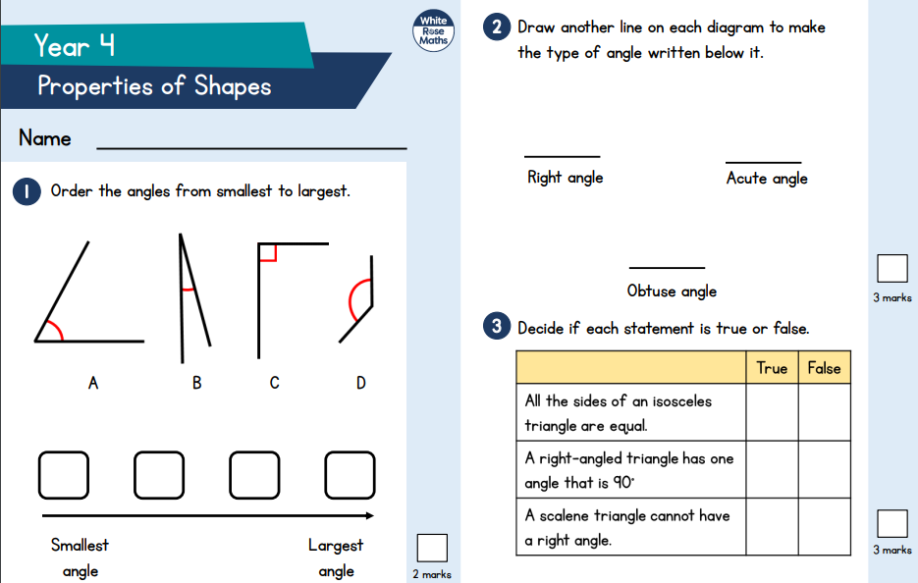
Maths Learning – Task 2
As with any new topic in class, I’ve attached the previous year groups assessment papers so you can see what you know already! Either do the Year 3 or Year 4 paper – answers are on the last slides.

Slide 19
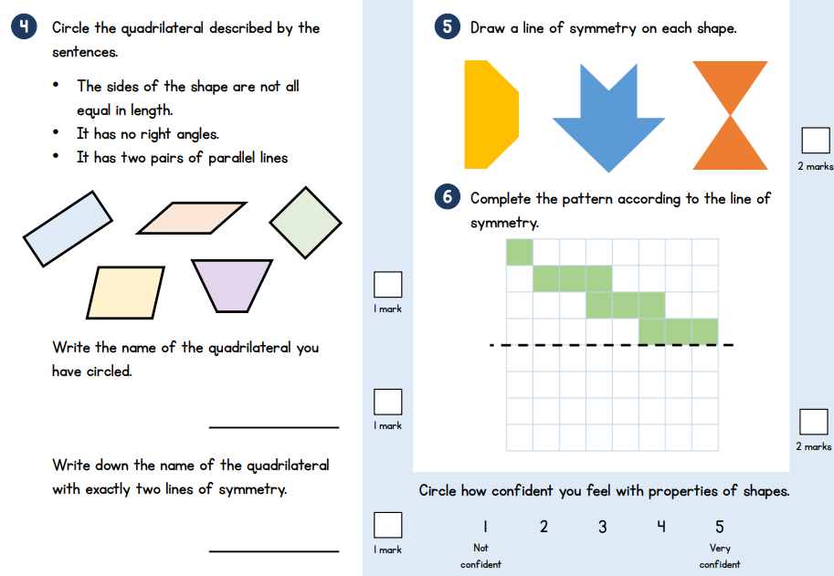

Slide 20
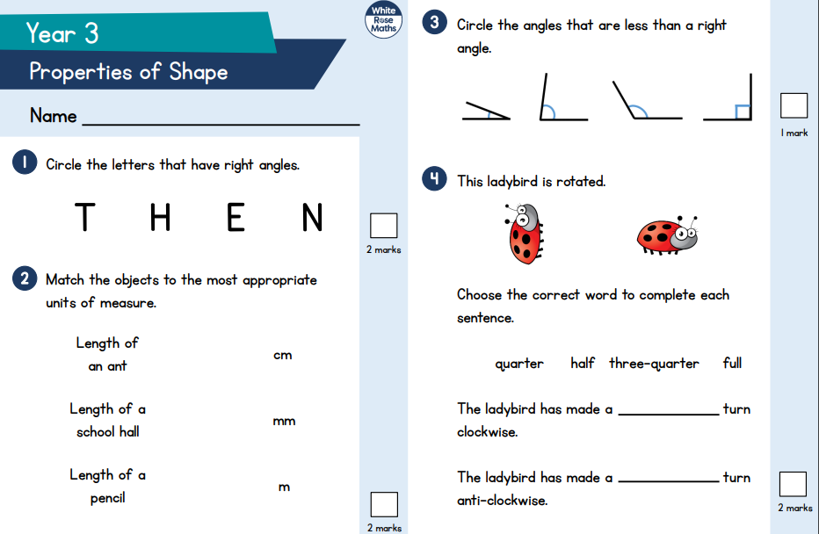

Slide 21
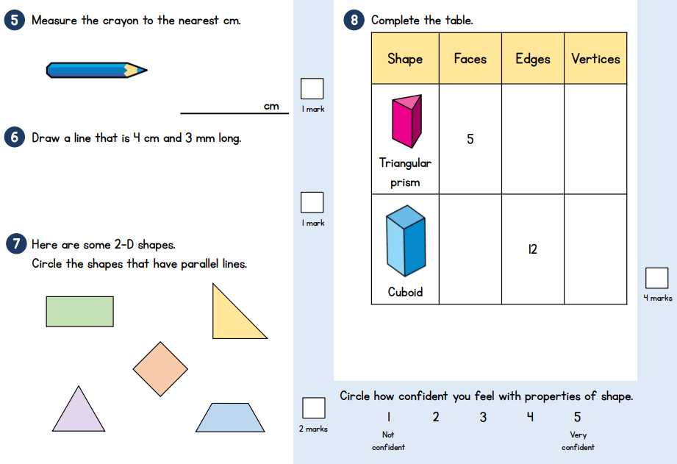

Slide 22
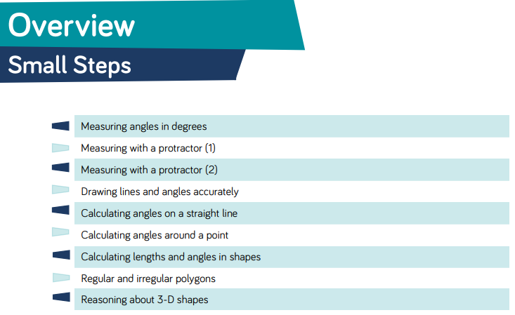
Here are the new small steps for this area for maths!

Slide 23
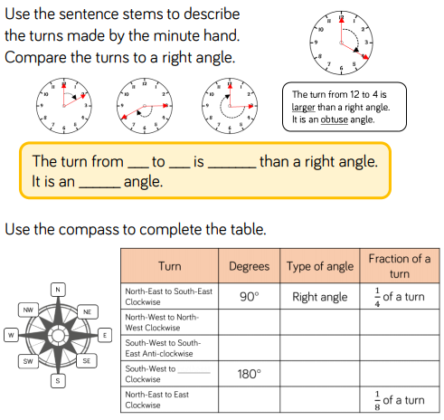
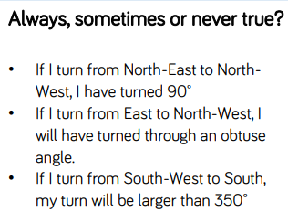
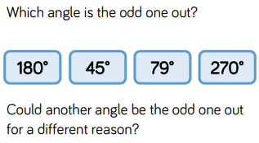
Maths Learning – Task 3

Slide 24
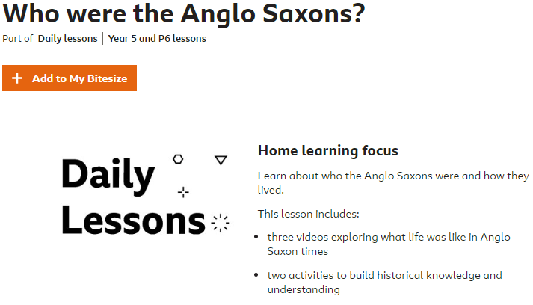
Topic
https://www.bbc.co.uk/bitesize/articles/zmyrcqt
Have a go at the lesson above on further information about the Anglo-Saxon’s!

Slide 25

P.E.
It is important to keep your children active. If it is safe to do so, ensure they have some time outside throughout the day. Please visit Joe Wicks YouTube channel (https://www.youtube.com/channel/UCAxW1XT0iEJo0TYlRfn6rYQ), which has lots of exercise videos for children. He will also be hosting a live P.E. lessons Monday to Friday at 9:00am.

Slide 26

Classroom Secrets
The site classroom secrets https://classroomsecrets.co.uk/free-home-learning-packs/ has free class packs which provide some great additional ideas and resources you can use.

Slide 27
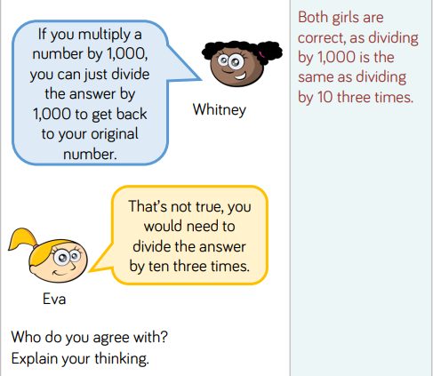
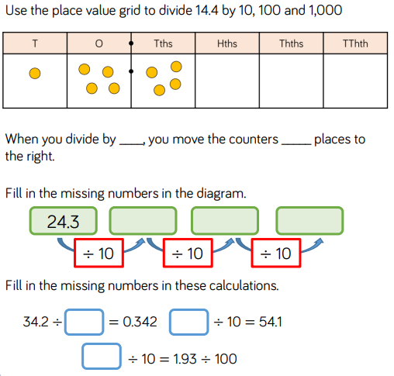
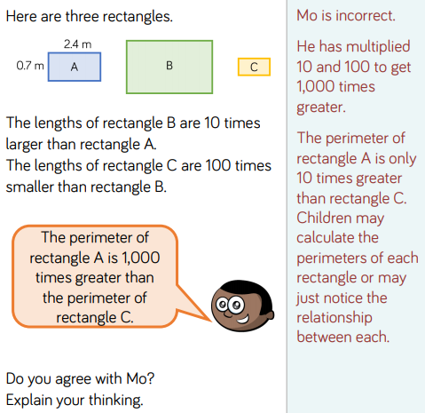
Maths Learning – Task 1 ANSWERS
14.4 ÷ 10 = 1.44 14.4 ÷ 100 = 0.144 14.4 ÷ 1000 = 0.0144
When you divide by 10, you move the counters one place to the right.
When you divide by 100, you move the counters two places to the right.
When you divide by 1000, you move the counters three places to the right
2.43
0.243
0.0243
100
541
0.193

Slide 28
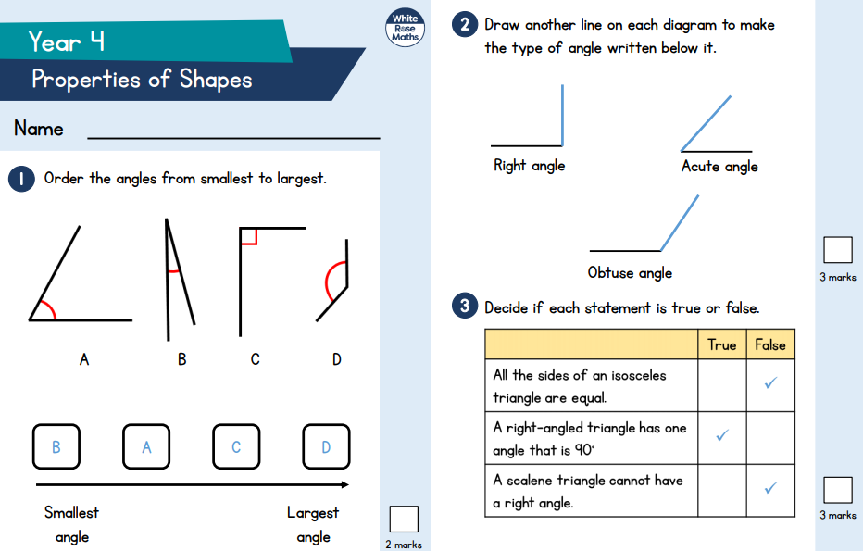
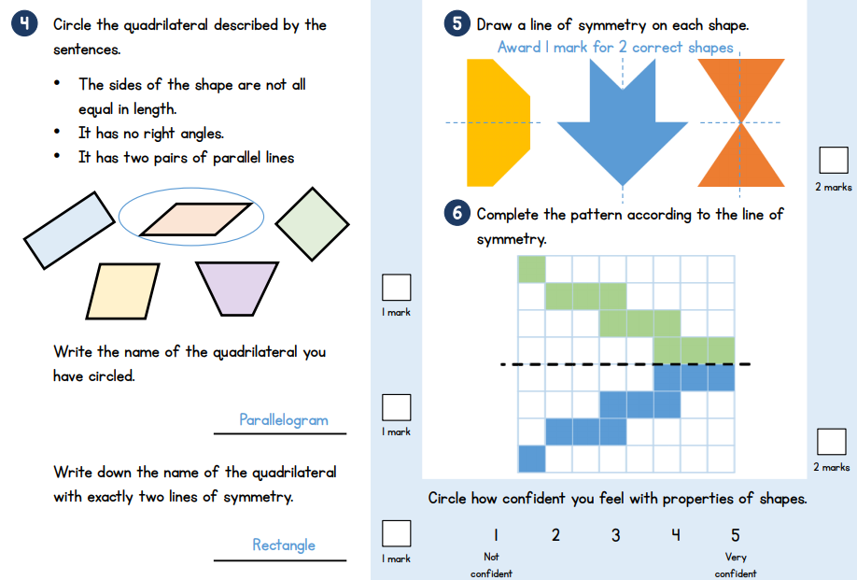
Maths Learning – Task 2 ANSWERS

Slide 29
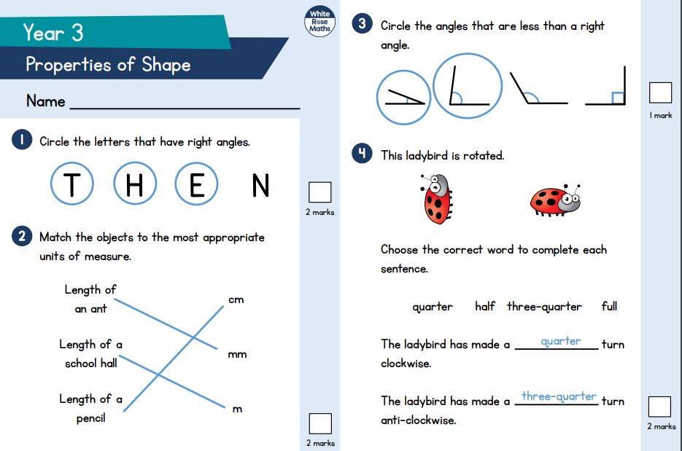
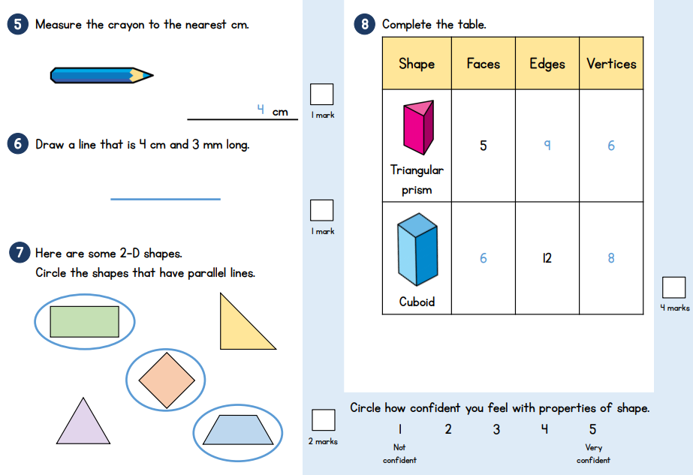
Maths Learning – Task 2 ANSWERS

Slide 30
Maths Learning – Task 3 ANSWERS
The turn from 12 to 2 is smaller than a right angle. It is an acute angle.
The turn from 3 to 8 is larger than a right angle. It is an obtuse angle.
The turn from 3 to 12 is larger than a right angle. It is a reflex angle.
360
A whole
A whole
90
Right angle
¼ of a turn
Obtuse angle
½ of a turn
45
Acute angle

Slide 31
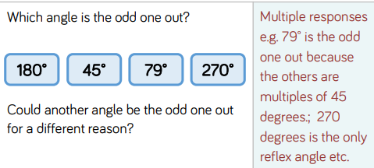
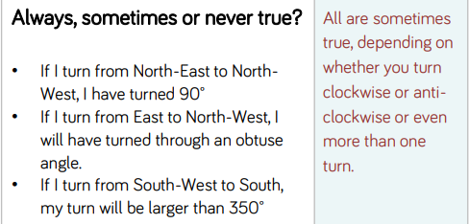
Maths Learning – Task 3 ANSWERS

