Slide 1

Home Learning
Year 5 Term 6 Week 2

Slide 2
Message from the class teacher
Hello again, Fisher. I’ve been very lucky recently as I was able to see a few of you in school last week! It was great to be able to hear about what you had been doing at home and I hope I get to see a few more of you very soon.
For the maths work this week, I’ve used some powerpoint slides that you would have seen in class before (similar ones!). It will be better to view this as a powerpoint, rather than a pdf, so that you can work with the animations too – this way, it won’t overload you with information immediately and will break it down into smaller steps.
The last task on the maths work has been taken from the Friday challenges set by BBC Bitesize! At the end of the article (link on the powerpoint) it explains the ages focused on each question. Have a go at the challenges but don’t be too worried if you find something a bit tricky!
Have a great week!
Miss Horton ☺

Slide 3

Reading
Hopefully you have access to books at home, but we have sent home extra books with your child.
Accelerated Reading
Home quizzing is not always recommended but in this case we have adjusted the settings to allow quizzing to happen at home.
If your child wants to read a book from home, please check that there is a quiz available for the book and that the book level (BL) is within or near to your child’s reading range. Also take note of the quiz number for future reference.
To check books please visit: https://www.arbookfind.co.uk/
Go to the next page for how to quiz.

Slide 4



AR quizzing at home.
To log into AR to take a quiz please visit: https://ukhosted27.renlearn.co.uk/2240835/
Your child should know what to do from here and should know their login details. If they are not aware, most details are written in their reading record.
Click on Accelerated reader.
Type in the name the book or the quiz number.
We advise students complete quizzes unaided. If parents/carers wish to support their child, they can do so in the following ways:
Discuss the book with your child as the book is being read
Ask your child to read the question out loud
Re-word questions for your child, if necessary
Ask your child which answers are not correct

Slide 5

Visit http://readon.myon.co.uk

Slide 6

Choose an area that interests you or use the search option.

Slide 7


Using My Maths
Children should know their way round My Maths but here are some reminders on how access the lessons. Visit: www.mymaths.co.uk
bapchild
divide162

Slide 8

Using My Maths
Access any lesson based on what your child is learning in class or search the topic in the search bar.
Use the login portal to access specific homework and lessons that your teacher has set.

Slide 9

Maths – White Rose Home Learning
In school we follow the White Rose scheme of learning. Their website has put together free lessons and resources that link to the learning taking place in school. Please visit: https://whiterosemaths.com/homelearning/

Slide 10



TT Rockstars
To access TT Rockstars please visit: https://play.ttrockstars.com/auth/school
Start typing in the school name or the post code (ME99NL)
Pupils type in their username and password, usually written in their reading record.
Pupils can practice all tables but Year 2 should be practicing 2, 5, and 10’s
Year 3: 2,5,10,3,4,8’s
Year 4,5,6: all tables

Slide 11

Accessing Twinkl
Many educational content providers are offering free access to their resources. Twinkl is a website that we use from time to time to resource our lessons to aid in teacher input and pupil activities.
We will be able to direct you towards activities and learning via this website based on lessons that may be missed due to absence. To access Twinkl please visit: www.twinkl.co.uk/offer
You will have to sign up and put in the offer code: UKTWINKLHELPS

Slide 12
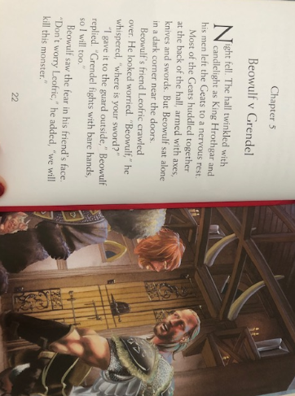

Slide 13
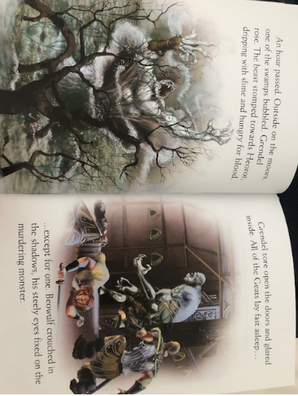

Slide 14
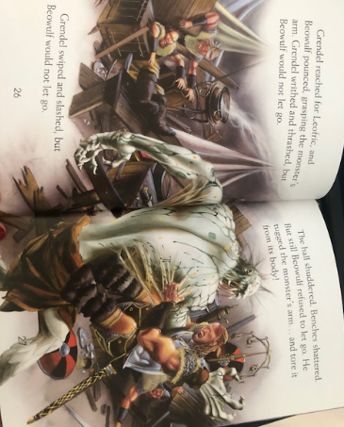

Slide 15
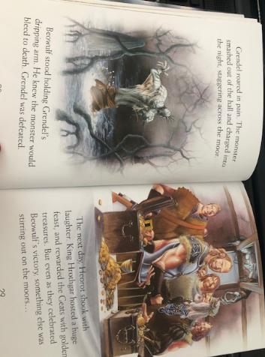

Slide 16
English Learning – Task 1
Read through chapter 5 and answer the following:
Why do you think Beowulf is sat ‘alone in a dark corner’?
2. He says that he will be fighting Grendel without his sword – do you think this is a good idea? Why is Beowulf doing this? Can you find evidence in the text to support your answer?
3. Grendel is described as ‘murdering monster’ – what descriptive technique has been used here? Can you think of any other ways to describe Grendel or Beowulf using this technique?
4. ‘Grendel writhed and thrashed, but Beowulf would not let go’
‘Grendel swiped and slashed, but Beowulf would not let go’
Why has this phrasing been repeated? What is the effect on the reader?
5. ‘Grendel roared in pain’ – Can you think of any other ways to explain his outburst? You may want to use a thesaurus to find synonyms for roared!
6. ‘But even as they celebrated Beowulf’s victory, something else was stirring out on the moors…’
What do you think is stirring? Create a prediction for what you think will happen next!

Slide 17
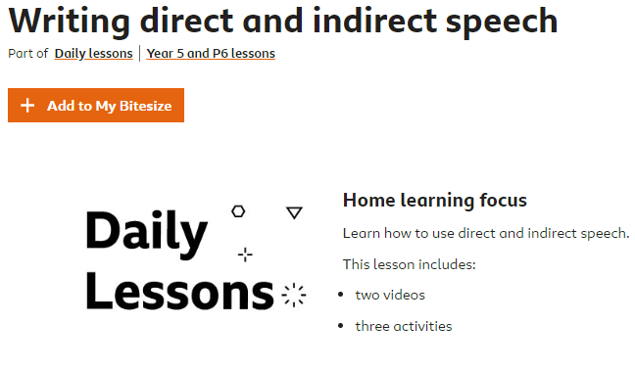
English Learning – Task 2
Complete the following lesson on using direct and indirect speech – we’ve done a little bit of this so far this year!
https://www.bbc.co.uk/bitesize/articles/zm63c7h

Slide 18
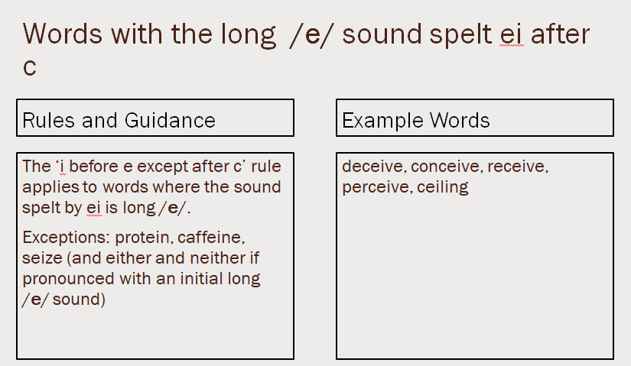
English Learning – Task 3
Practise and try to learn the words on the ‘example words’. We usually do 10 in class so you can either chunk this into smaller groups to learn through the week or learn all of them together.

Slide 19
Maths Learning – Task 1
The following slides are focusing on the small step of decimal sequences.

Slide 20

Decimal Sequences
Diving
Complete the sequence.
1st term | 2nd term | 3rd term | 4th term | 5th term
1.21 | 1.34 | 1.47
0.01
0.01
0.01
0.01
0.01
0.01
0.01
0.01
0.01
0.1
0.01
0.01
0.1
0.01
0.01
0.1
0.01
0.1
0.01
0.01
0.1
0.01
0.01
0.1
0.1
0.1
0.1
0.01
0.1
0.01
0.1
0.1
0.01
0.1
0.1
0.1
1
0.1
0.01
1
0.1
0.01
1
0.1
0.01
1
0.1
0.01
1
0.1
0.1
0.1
1.60
1.73
What is the rule for the sequence?
Increase by 0.13 each time.

Slide 21
Decimal Sequences
Diving
What is the rule for this sequence?
3.25
3.1
2.95
2.8
The rule is _______ by ____ each time.
The rule is decrease by 0.15 each time.
Continue this sequences and write the rule:
2.85
3.1
3.35
3.6
3.85
4.1
4.35
The rule is _______ ____ .
The rule is increase by 0.25 each time.

Slide 22

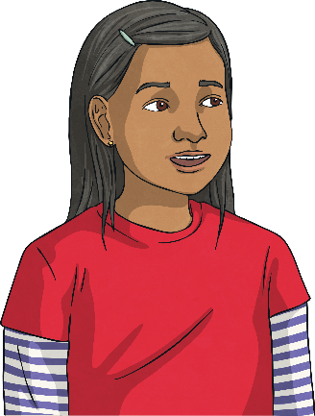
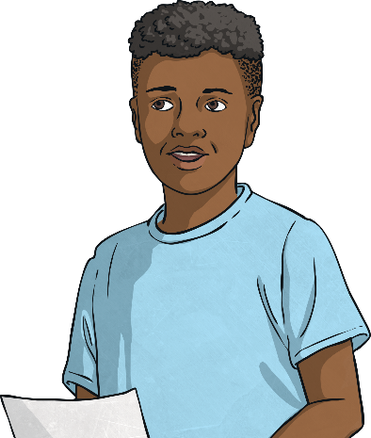
Decimal Sequences
Deeper
A sequence is decreased by 0.15 each time.
2.52 is the fourth term of the sequence.
2.82
2.52
2.22
What is the second term of the sequence?
What is the sixth term of the sequence?
2.82
2.22

Slide 23
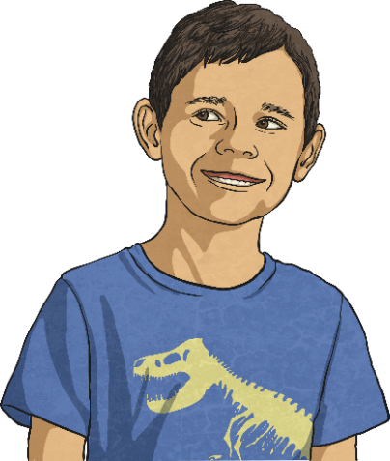
Decimal Sequences
Deeper
Here is the start of a sequence:
6.15
6.5
6.85
7.2
7.55
7.9
8.25
8.6
If I continued writing
the sequence, 8.3 would
be included.
Do you agree with Junaid?
Explain your answer.
No.
7.55, 7.9, 8.25 and 8.6 would be the next four terms in the sequence.
8.3 is between the seventh and eighth term so 8.3 would not be included.
Junaid

Slide 24
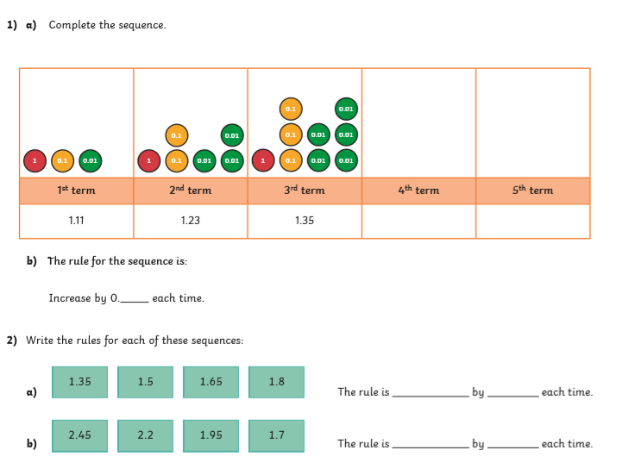
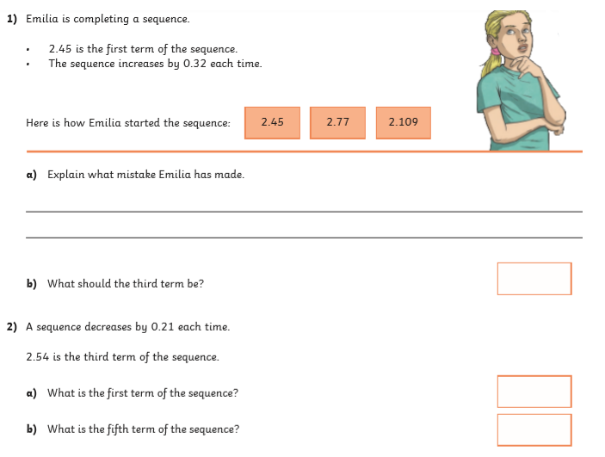
Task 1

Slide 25
Maths Learning – Task 2
The following slides are focusing on the small step of multiplying decimals.

Slide 26
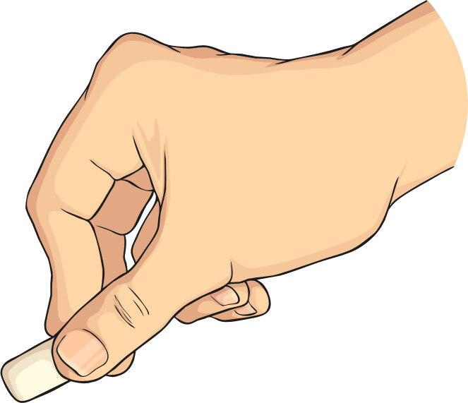

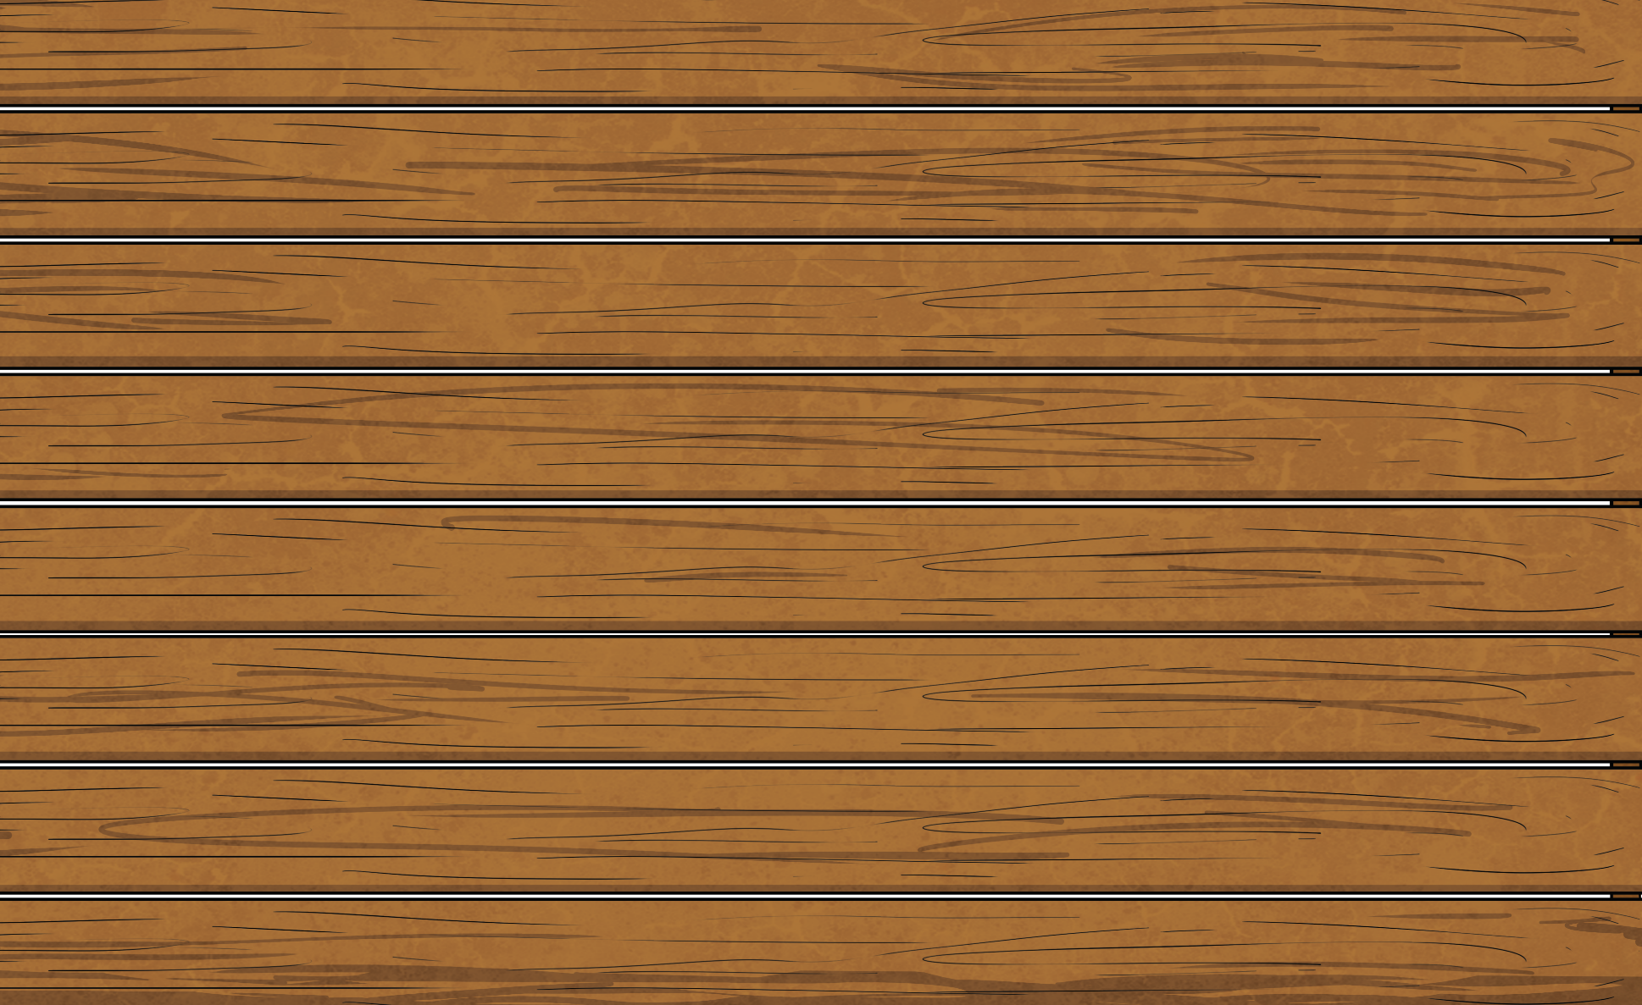

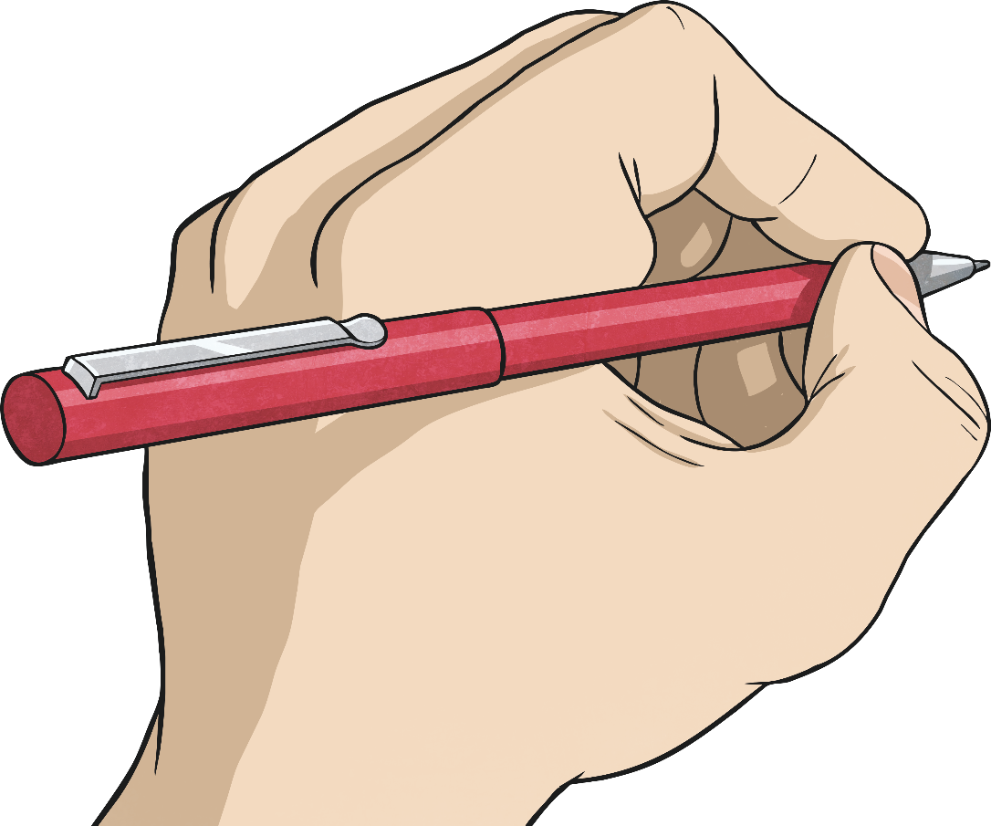
Multiplying Decimals by 10, 100 and 1000.
Diving
What is the answer when 2.34 is multiplied by 100?
hundreds | tens | ones | tenths | hundredths | thousandths
2
3
4
23.4
234
2340
23
234

Slide 27
Multiplying Decimals by 10, 100 and 1000.
Diving
What is the answer when 0.056 is multiplied by 10?
1.102 × 100 =
1201
hundreds | tens | ones | tenths | hundredths | thousandths
0
0
5
6
110.2 × 10 =
1102
0.056
056
0.56
1.201 × 1000 =
0.56
56
0.56
110.2

Slide 28
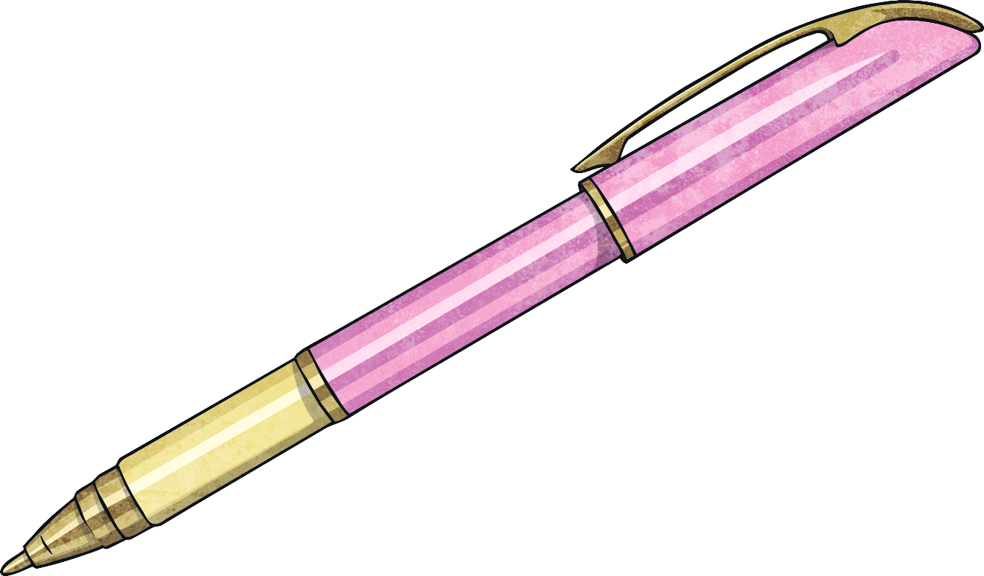
Multiplying Decimals by 10, 100 and 1000.
Diving
Match each calculation to the correct answer.
1.102 × 100 =
1201
110.2 × 10 =
1102
1.201 × 1000 =
110.2

Slide 29
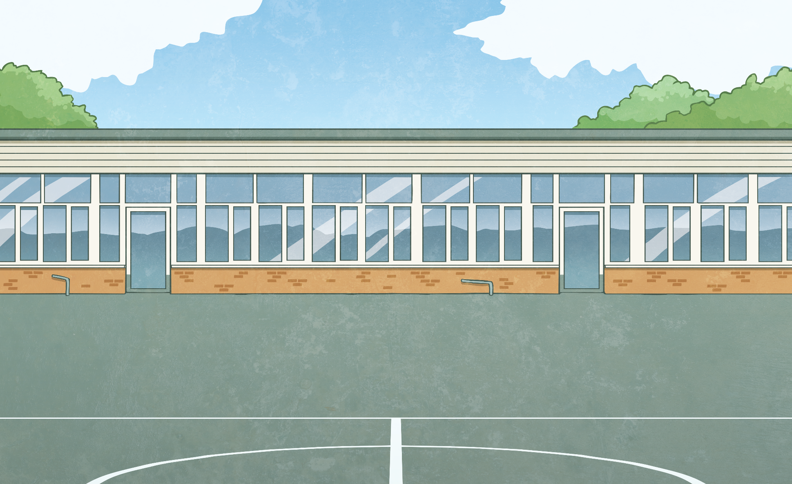
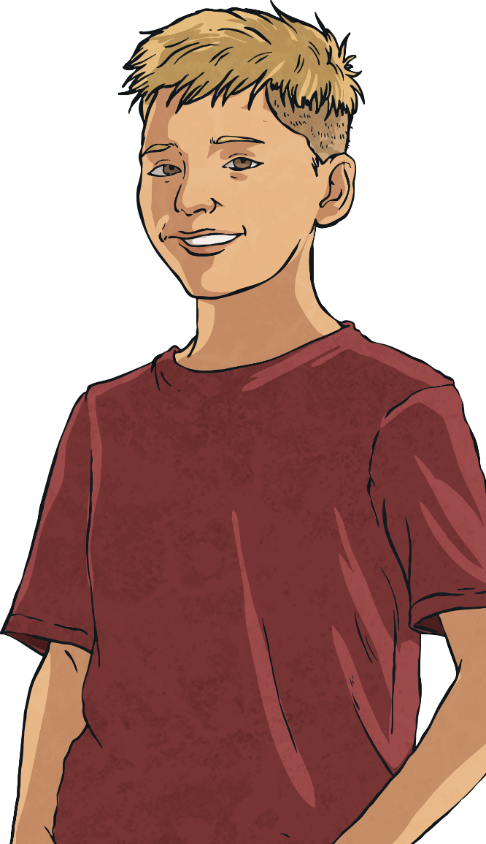
Multiplying Decimals by 10, 100 and 1000.
Deeper
You only ever need to add a zero when multiplying by 10.
Do you agree with Ben?
Explain your answer.
Ben is incorrect.
Although 235 × 10 requires ‘adding’ a zero to the end
to give you 2350, this does not necessarily work with decimals:
1.34 × 10 = 13.4
1.34 × 10 ≠ 1.340

Slide 30
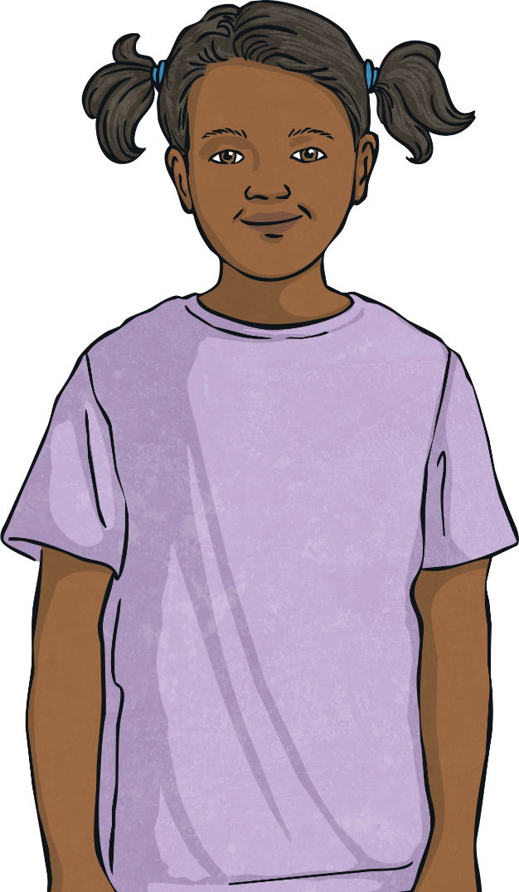
Multiplying Decimals by 10, 100 and 1000.
Deeper
Multiplying by 100 is the same as multiplying by 10 and then by another 10.
Do you agree with Simran?
Explain your answer.
Simran is correct.
10 × 10 is 100 so multiplying
by 100 is the same as
multiplying by 10 twice.

Slide 31

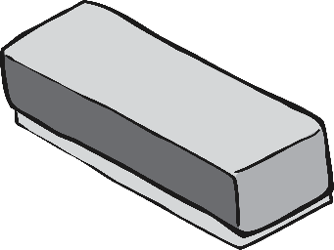
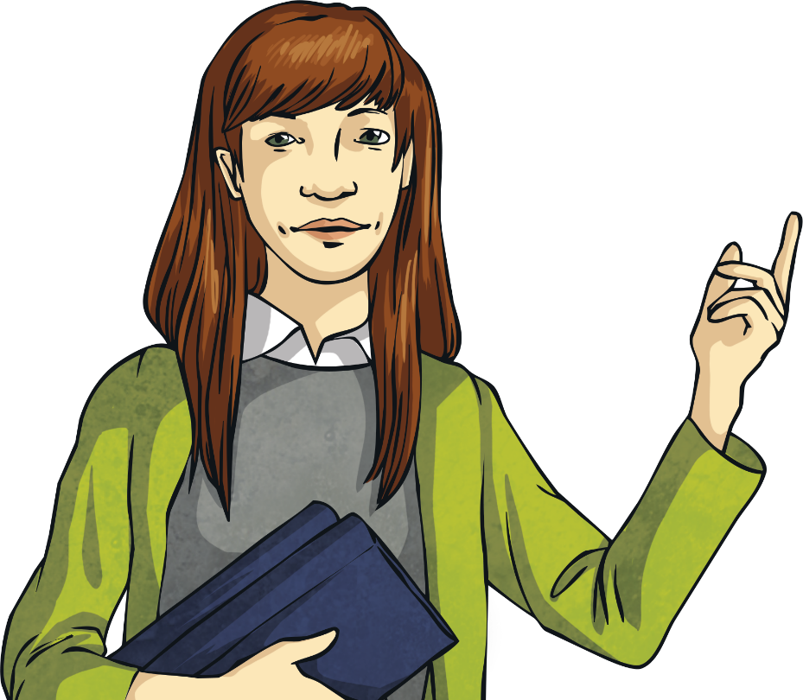
Multiplying Decimals by 10, 100 and 1000.
Deeper
Complete the calculation. Explain your answer.
10
5.06 × 100 × = 5060
÷ 10 ÷ 10 = 3.412
5.06 × 100 = 506
506 × 10 = 5060
5.06 × 100 × 10 = 5060

Slide 32
Multiplying Decimals by 10, 100 and 1000.
Deeper
Complete the calculation. Explain your answer.
3.412
÷ 10 ÷ 10 = 3.412
We can find the answer using the inverse of division which is multiplication.
3.412 × 10 × 10 = 341.2
Therefore:
341.2 ÷ 10 ÷ 10 = 3.412

Slide 33
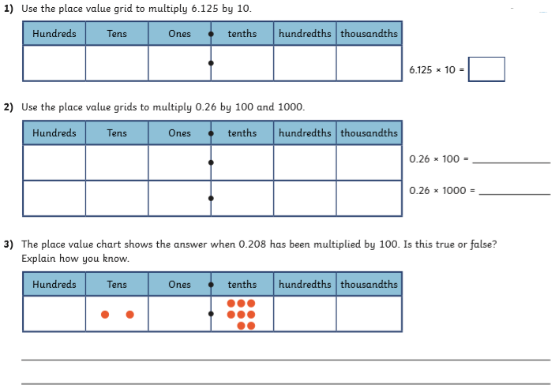
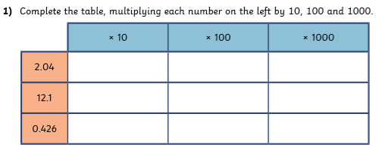
Maths Learning – Task 2

Slide 34
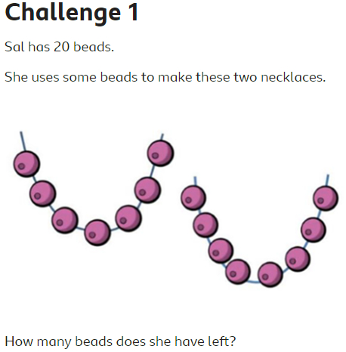
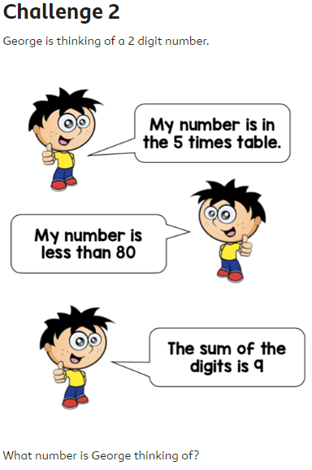
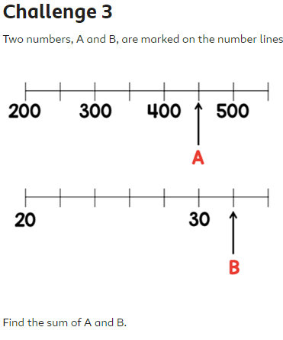
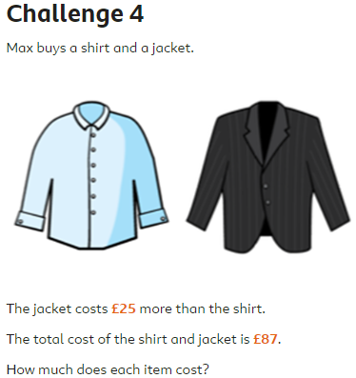
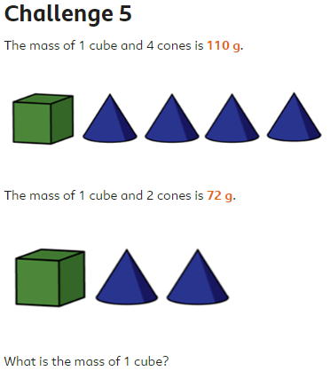
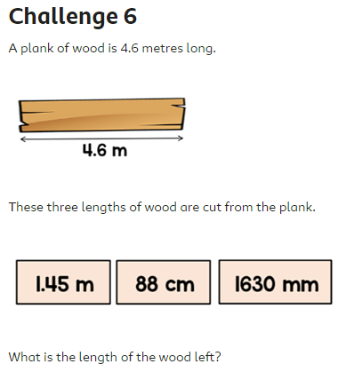
Maths Learning – Task 3
https://www.bbc.co.uk/bitesize/articles/zk66dp3

Slide 35
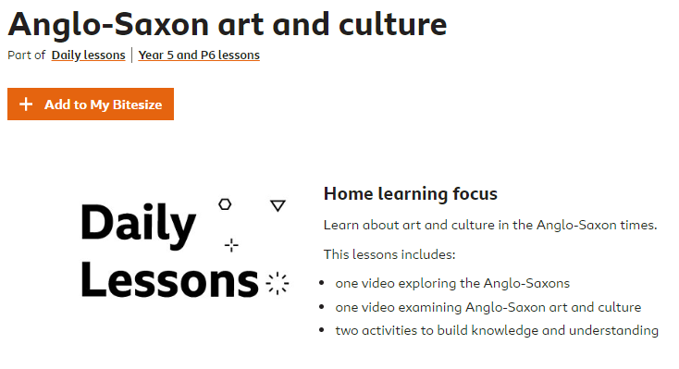
Topic
https://www.bbc.co.uk/bitesize/articles/z3j9ydm
Have a go at the lesson above on Anglo-Saxon art and culture!

Slide 36

P.E.
It is important to keep your children active. If it is safe to do so, ensure they have some time outside throughout the day. Please visit Joe Wicks YouTube channel (https://www.youtube.com/channel/UCAxW1XT0iEJo0TYlRfn6rYQ), which has lots of exercise videos for children. He will also be hosting a live P.E. lessons Monday to Friday at 9:00am.

Slide 37

Classroom Secrets
The site classroom secrets https://classroomsecrets.co.uk/free-home-learning-packs/ has free class packs which provide some great additional ideas and resources you can use.

Slide 38
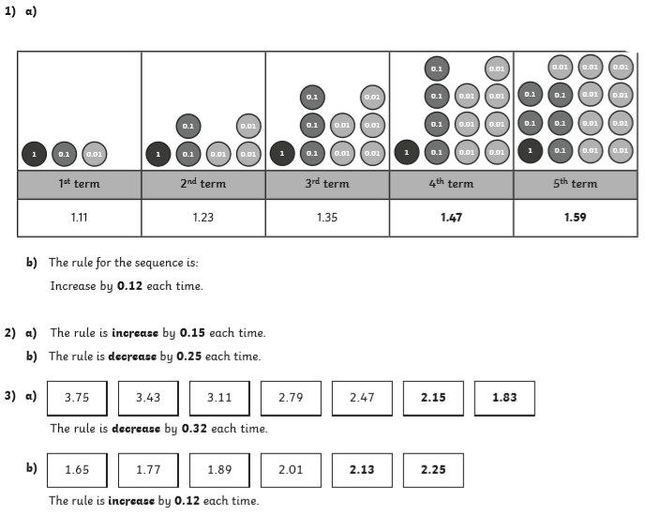
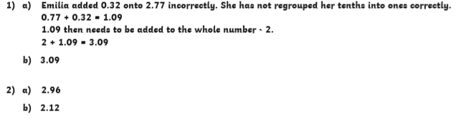
Maths Learning – Task 1 ANSWERS

Slide 39
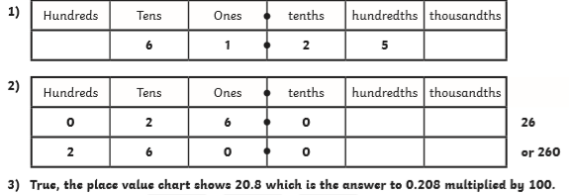
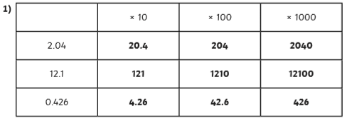
Maths Learning – Task 2 ANSWERS

Slide 40
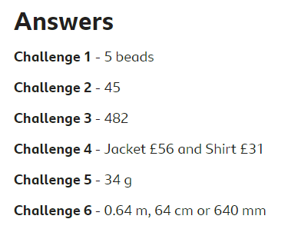
Maths Learning – Task 3 ANSWERS

