Slide 1

Home Learning
Year 5 Term 6 Week 1

Slide 2
Message from the class teacher
Hello Fisher – I hope you had a lovely half term and made the most of the sunshine, I certainly did!
This week, we’re back onto Beowulf for English! As we continue with the text, make sure you check back on your prediction to see if you were correct! Maybe your prediction will change as we continue through.
We are still making our way through the decimals work – it’s very heavy on ensuring you have the place value in the correct places. Sometimes you may need to double check you’re not making silly mistakes, as we know I would!
And it’s another comparison/research focus for Anglo-Saxons this week!
Have a great week!
Miss Horton ☺

Slide 3

Reading
Hopefully you have access to books at home, but we have sent home extra books with your child.
Accelerated Reading
Home quizzing is not always recommended but in this case we have adjusted the settings to allow quizzing to happen at home.
If your child wants to read a book from home, please check that there is a quiz available for the book and that the book level (BL) is within or near to your child’s reading range. Also take note of the quiz number for future reference.
To check books please visit: https://www.arbookfind.co.uk/
Go to the next page for how to quiz.

Slide 4



AR quizzing at home.
To log into AR to take a quiz please visit: https://ukhosted27.renlearn.co.uk/2240835/
Your child should know what to do from here and should know their login details. If they are not aware, most details are written in their reading record.
Click on Accelerated reader.
Type in the name the book or the quiz number.
We advise students complete quizzes unaided. If parents/carers wish to support their child, they can do so in the following ways:
Discuss the book with your child as the book is being read
Ask your child to read the question out loud
Re-word questions for your child, if necessary
Ask your child which answers are not correct

Slide 5

Visit http://readon.myon.co.uk

Slide 6

Choose an area that interests you or use the search option.

Slide 7


Using My Maths
Children should know their way round My Maths but here are some reminders on how access the lessons. Visit: www.mymaths.co.uk
bapchild
divide162

Slide 8

Using My Maths
Access any lesson based on what your child is learning in class or search the topic in the search bar.
Use the login portal to access specific homework and lessons that your teacher has set.

Slide 9

Maths – White Rose Home Learning
In school we follow the White Rose scheme of learning. Their website has put together free lessons and resources that link to the learning taking place in school. Please visit: https://whiterosemaths.com/homelearning/

Slide 10



TT Rockstars
To access TT Rockstars please visit: https://play.ttrockstars.com/auth/school
Start typing in the school name or the post code (ME99NL)
Pupils type in their username and password, usually written in their reading record.
Pupils can practice all tables but Year 2 should be practicing 2, 5, and 10’s
Year 3: 2,5,10,3,4,8’s
Year 4,5,6: all tables

Slide 11

Accessing Twinkl
Many educational content providers are offering free access to their resources. Twinkl is a website that we use from time to time to resource our lessons to aid in teacher input and pupil activities.
We will be able to direct you towards activities and learning via this website based on lessons that may be missed due to absence. To access Twinkl please visit: www.twinkl.co.uk/offer
You will have to sign up and put in the offer code: UKTWINKLHELPS

Slide 12
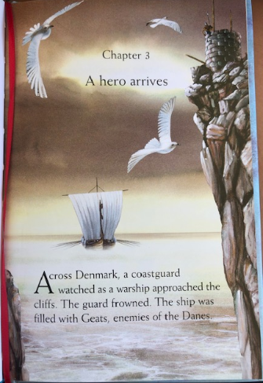

Slide 13
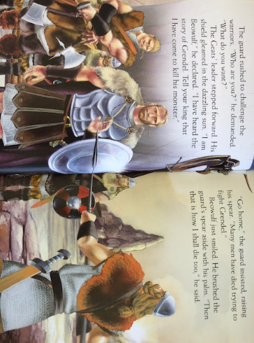

Slide 14
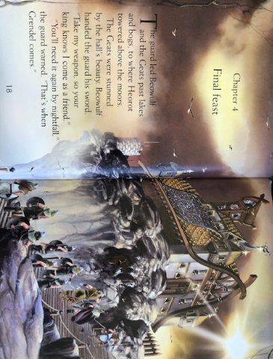

Slide 15
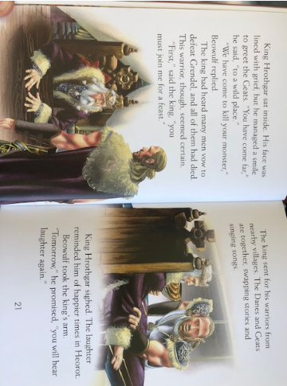

Slide 16
English Learning – Task 1
Read through chapter 3 and 4 and answer the following:
Chapter 3:
1. Beowulf says ‘Tell your king that I have come to kill his monster’
What sort of person do you think Beowulf is?
What is his personality like? Does he appear apprehensive or worried when he says this?
2. The guard then says ‘Go home’…’Many men have died trying to fight Grendel’
What do you think the guard thinks of Beowulf? Why do you think this?
Chapter 4:
3. Have a look at the setting on page 19. Write a short setting description just based on the outside of the building. Think about the descriptive techniques we have learnt in class – what similes/metaphors/expanded noun phrases etc could you use?
4. King Hrothgar’s face was ‘lined with grief’ – what sort of technique is this? (Hint: Is his face actually lined with grief?).
5. ‘Tomorrow, you will hear laughter again’ – What types of feelings does this promise give to the King and to the reader? What are we now expecting will happen?

Slide 17
English Learning – Task 2
Here are some links for some SPaG activities to have a go at – these are good concepts to revisit and practise!
Subordinating Conjunctions - https://www.bbc.co.uk/bitesize/topics/zwwp8mn/articles/zqk37p3
Coordinating Conjunctions –
https://www.bbc.co.uk/bitesize/topics/zwwp8mn/articles/z9wvqhv
Relative Clauses –
https://www.bbc.co.uk/bitesize/topics/zwwp8mn/articles/zsrt4qt
Prepositions –
https://www.bbc.co.uk/bitesize/topics/zwwp8mn/articles/zw38srd
Fronted Adverbials –
https://www.bbc.co.uk/bitesize/topics/zwwp8mn/articles/zp937p3

Slide 18
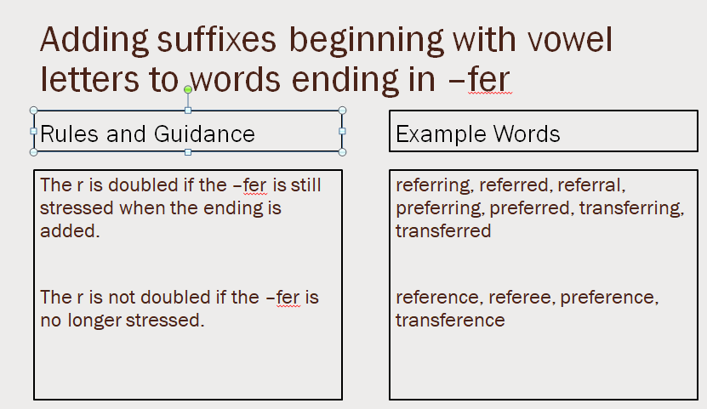
English Learning – Task 3
Practise and try to learn the words on the ‘example words’. We usually do 10 in class so you can either chunk this into smaller groups to learn through the week or learn all of them together.

Slide 19
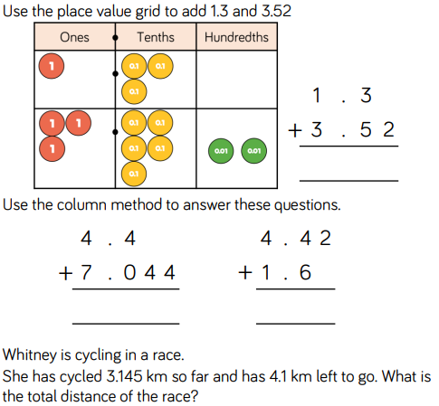
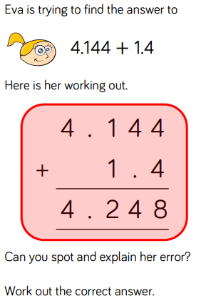
Maths Learning – Task 1

Slide 20
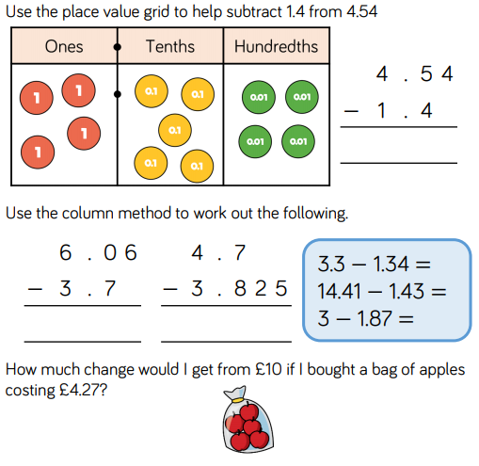
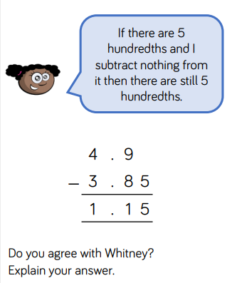
Maths Learning – Task 2

Slide 21
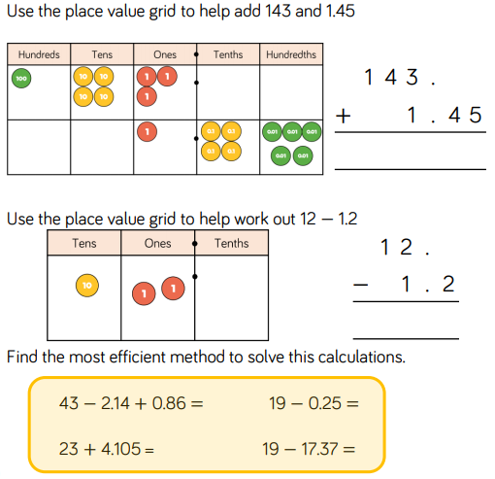
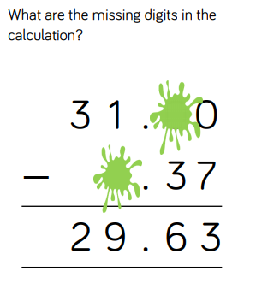
Maths Learning – Task 3

Slide 22
Topic: Anglo-Saxons
I wonder what everyday life was like in the Anglo-Saxon period?
Create a poster/leaflet (whatever you like really!) sharing what everyday life was like and create some comparisons to everyday life now.
You may want to think about what life was like before lockdown and what life is currently like to give a good depth of explanation and comparison!

Slide 23

P.E.
It is important to keep your children active. If it is safe to do so, ensure they have some time outside throughout the day. Please visit Joe Wicks YouTube channel (https://www.youtube.com/channel/UCAxW1XT0iEJo0TYlRfn6rYQ), which has lots of exercise videos for children. He will also be hosting a live P.E. lessons Monday to Friday at 9:00am.

Slide 24

Classroom Secrets
The site classroom secrets https://classroomsecrets.co.uk/free-home-learning-packs/ has free class packs which provide some great additional ideas and resources you can use.

Slide 25
Maths Learning – Task 1 ANSWERS
4 . 8 2
1 1. 4 4 4
6 . 0 2
7.245 km
The digits are lined up incorrectly. Eva needs to line up the decimal point. The correct answer is 5.544.

Slide 26
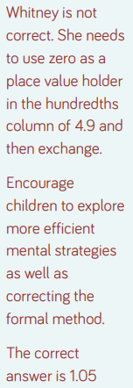
Maths Learning – Task 2 ANSWERS
3 . 1 4
2 . 3 6
0 . 8 7 5
£5.73
1.96
12.98
1.13

Slide 27
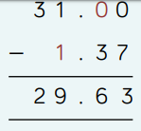
Maths Learning – Task 3 ANSWERS
141.55
10.8
40
27.105
18.75
1.63

