Slide 1

Home Learning
Year 5 Half Term

Slide 2
Message from the class teacher
Half term is finally upon us, Year 5! I’m hoping the weather stays as we’ve been so lucky so far.
Just wanted to say that you’ve all worked exceptionally hard throughout this challenging time – you should be incredibly proud of yourselves. You’ve researched into the Anglo-Saxons, developed your understanding of decimals, created predictions and considered a new plot of Beowulf and you’ve done this with support from your adult/s at home – without myself or Mrs Austin to be there to help!
Your adults have worked very hard to support you through this time so make sure you say thank you to them! Enjoy a bit of a break over half term and reflect on how well you’ve handled these weird times.
For half term, I’ve set some tasks that would be usual things to continue with (times tables, handwriting, reading, etc) but I have also added some little extras at the end that you might want to include to keep you busy!
Have a great week!
Miss Horton ☺

Slide 3
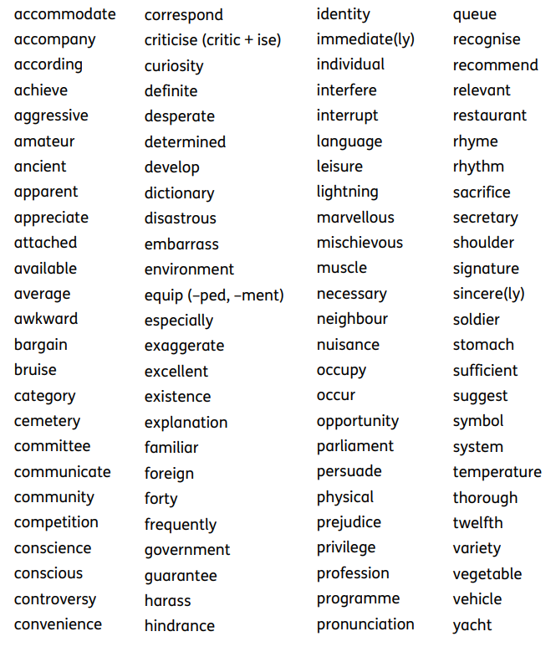
Year 5/6 Spelling List

Slide 4
Maths
This is another great time to ensure you’ve got your times tables practice up to scratch! I’ve set the tables again on TT Rockstars so make sure you check that out.
If you’re really bored, go ahead and challenge me!
Also – check you know your number bonds! Can you think of all the pairs of numbers that add together to make 20, 50, 100? Hopefully you’ll have rapid fire knowledge by the time we get back!
BBC Bitesize won’t be uploading any new lessons through half term, so maybe check through if there are any activities that you haven’t completed yet.
https://www.bbc.co.uk/bitesize/tags/zhgppg8/year-5-lessons/1
Note: It’s your half term – none of this is compulsory so it’s only if you want to keep a routine or keep busy!

Slide 5
Handwriting Resources
I’ve attached some free links for resources that can be some excellent handwriting practice:
https://www.twinkl.co.uk/resources/new-2014-curriculum-resources-ks2-english-resources/new-2014-curriculum-resources-ks2-english-resources-upper-ks2-years-5-and-6/new-2014-curriculum-resources-ks2-english-resources-upper-ks2-years-5-and-6-writing-handwriting
https://www.primaryresources.co.uk/english/englishA5.htm
https://www.tes.com/teaching-resource/cursive-and-non-cursive-handwriting-booklet-6390251
Reading
Ensure you’re keeping up with your regular reading! Remember to check on AR to see if you can quiz on them too.
My challenge – can you read both a fiction and non-fiction text in half term?

Slide 6
Topic: Anglo-Saxons
I’ve listed a range of different activities you could do related to our topic focus. This is by no means a definitive list and you might think of your own – get creative!
Research Anglo-Saxon runes, then use the runes to write a secret message to an adult at home!
Create a word search or crossword linked to the Anglo-Saxons.
Create or draw a replica artefact from the Anglo-Saxons (e.g. Coins, jewellery, armour, weapon).
Create or draw an Anglo-Saxon dwelling using any materials you wish.
Research into an area of interest for Anglo-Saxons – create a poster/leaflet/presentation about what you’ve found out!

