Slide 1


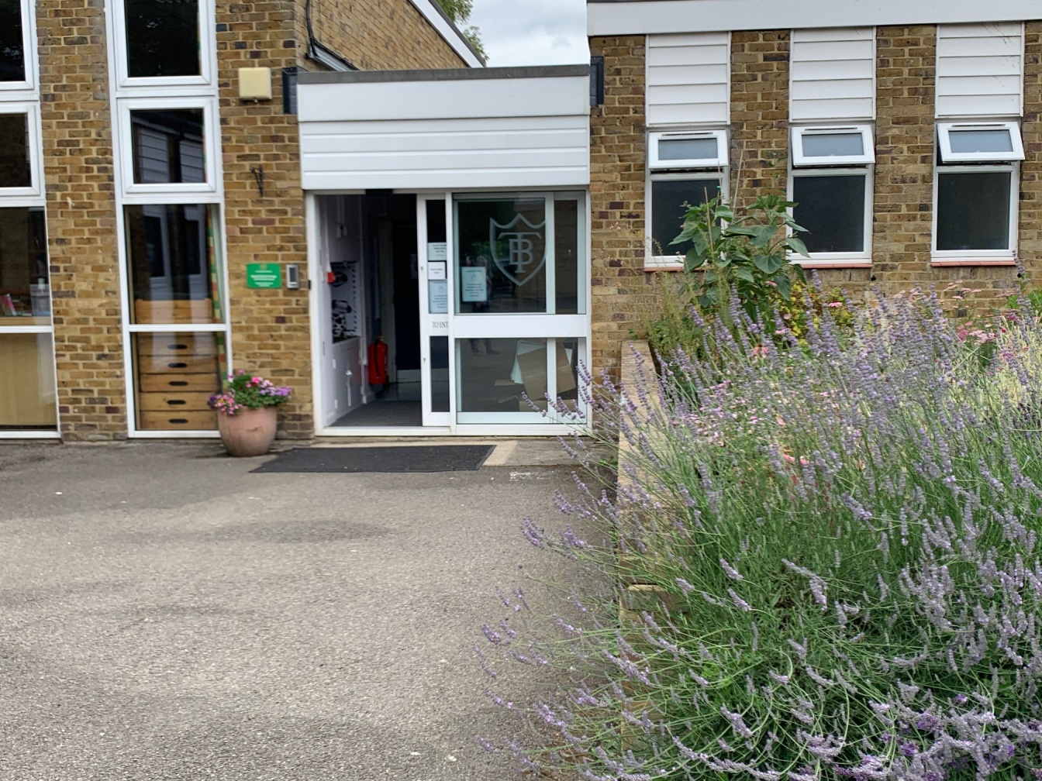
Welcome Back To School!

Slide 2
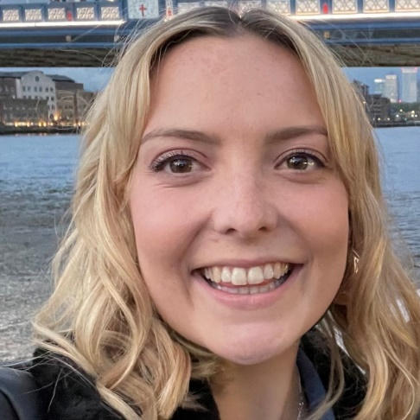
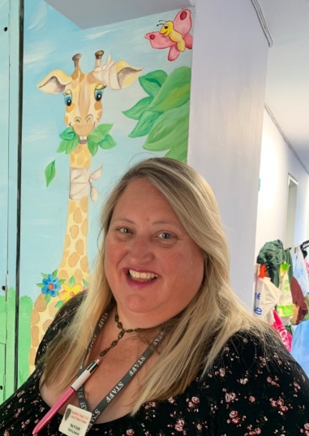
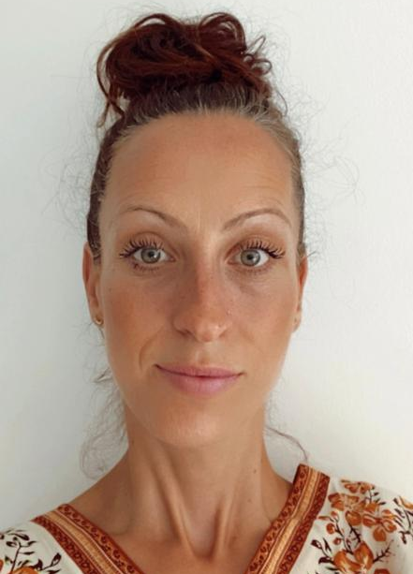
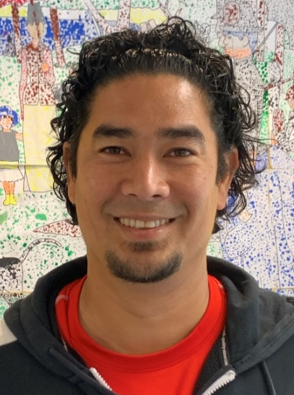
Mrs Smith
Year 3 Teaching Assistant
(full time)
Year 3 Team
Miss Martin
Year 3 Teacher
Mrs Osei
Year 3 Teaching Assistant (mornings only)
Mr Affonso
Year 3 Support Staff
(2 afternoons)

Slide 3
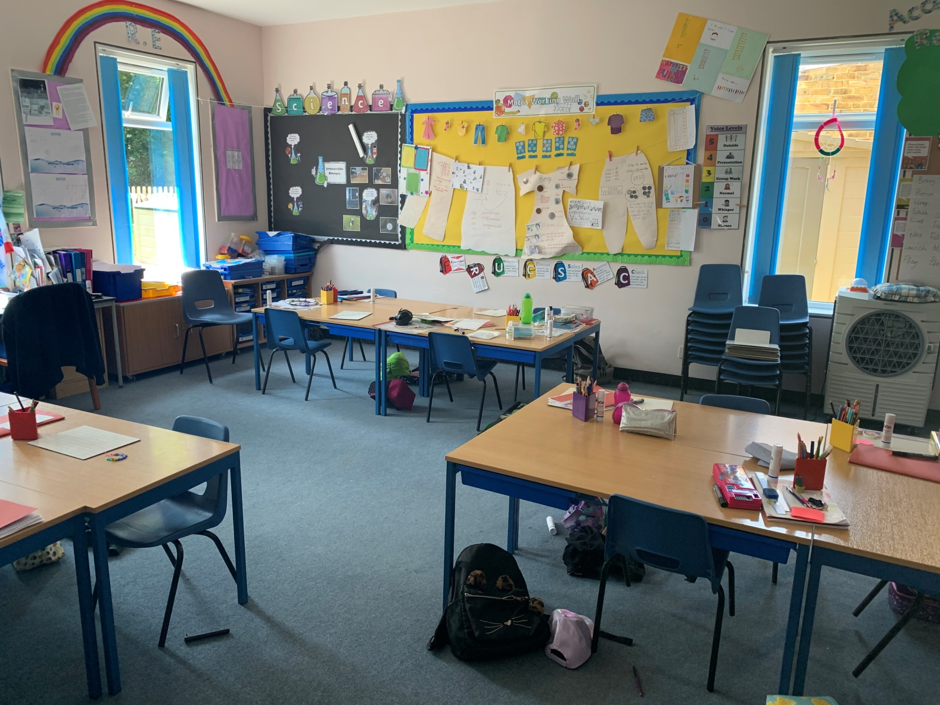
Here is the Year 3 Classroom

Slide 4
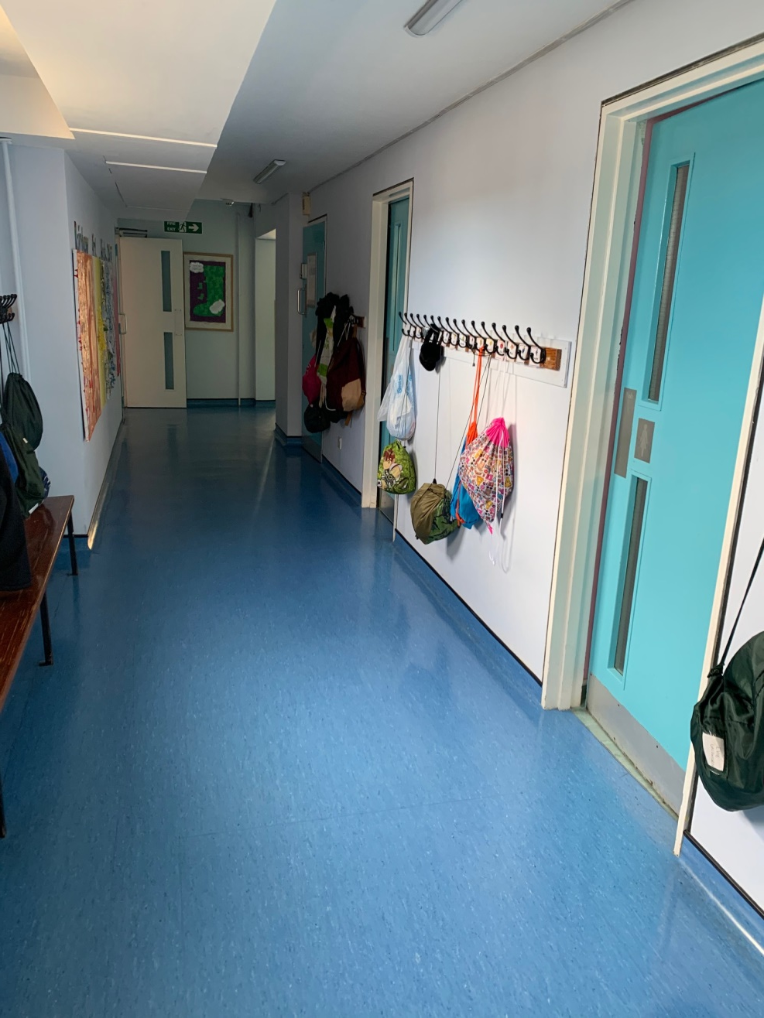
Here is the Year 3 cloakroom and toilet.

Slide 5
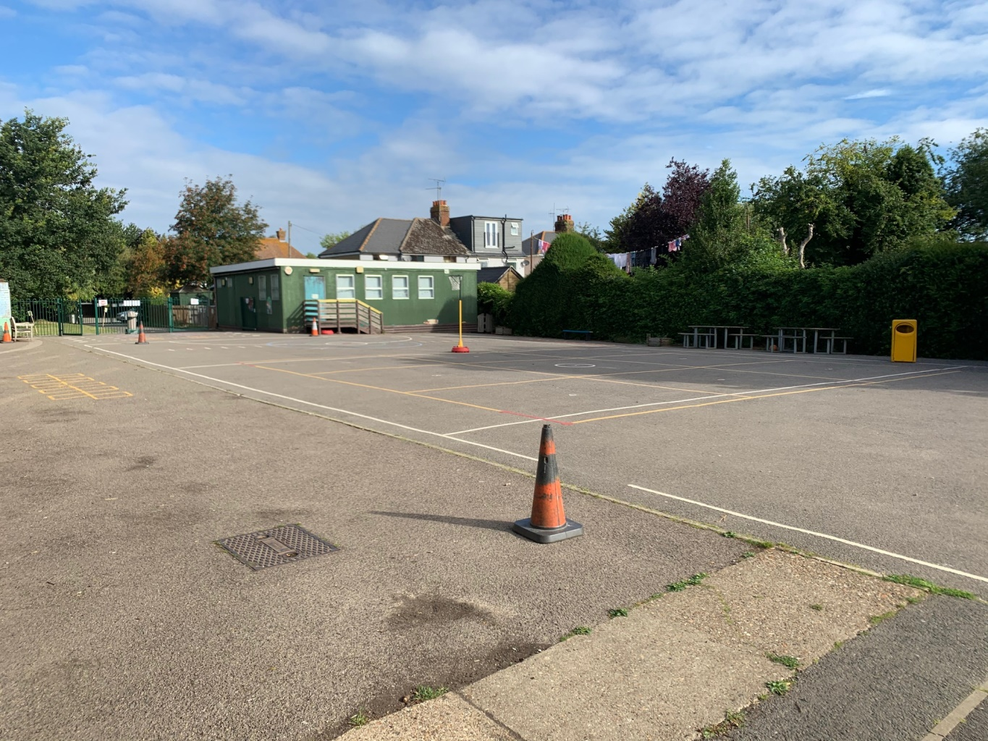
Here is the Junior Playground!

Slide 6
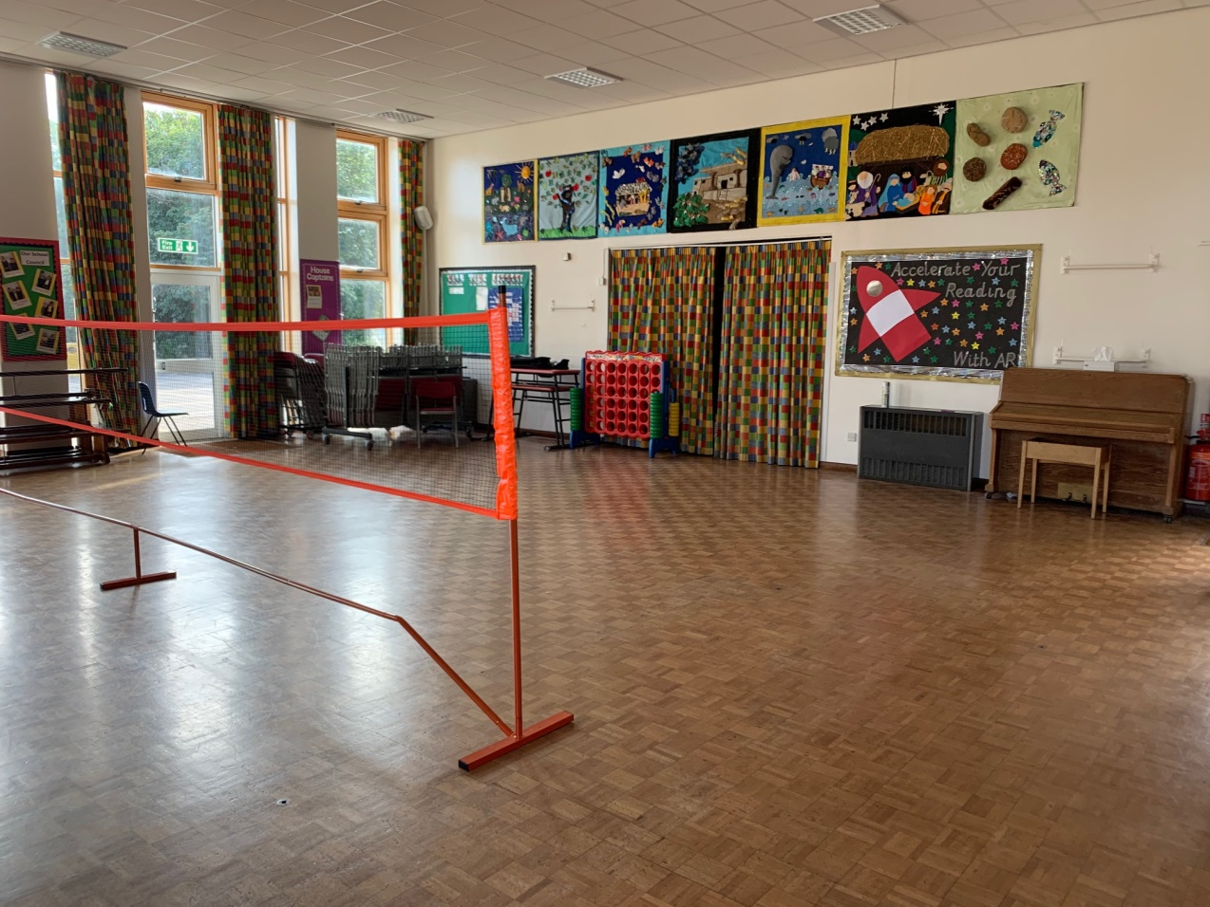
Here is the Hall
You eat your lunch here.
You might have PE lessons in here.
What sport do you think the children will be playing today?

Slide 7
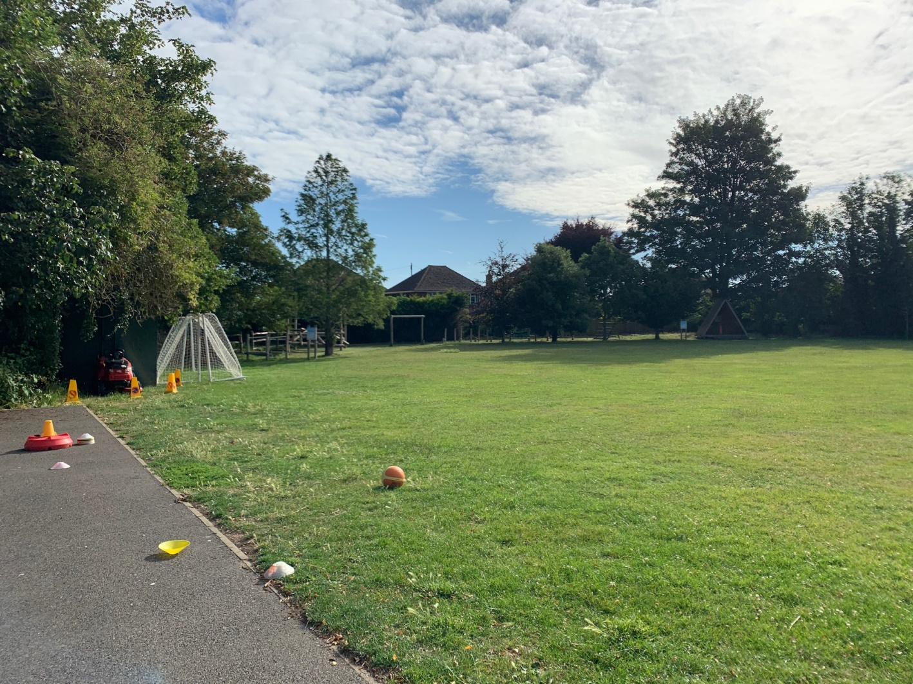
Here is the field where we go at breaktime and lunchtimes when it’s not too wet.

Slide 8
Here are some other people you might see…….

Slide 9
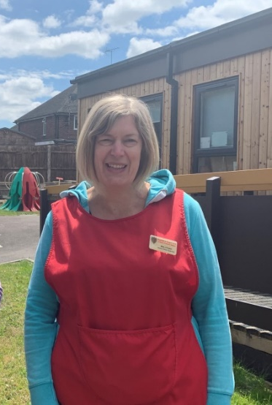
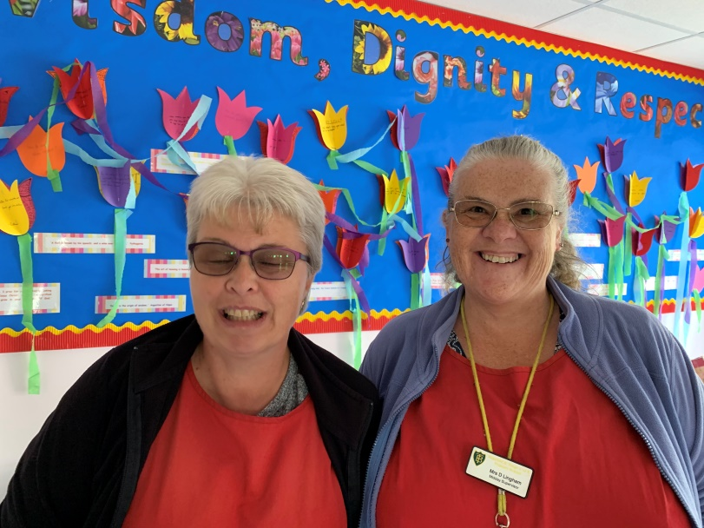
Mrs Foster
Mrs Mitchell and Mrs Lingham
They also run Breakfast Club if you come in early. They make great toast!
Mrs Osei
At Lunch time these ladies will look after you…

Slide 10
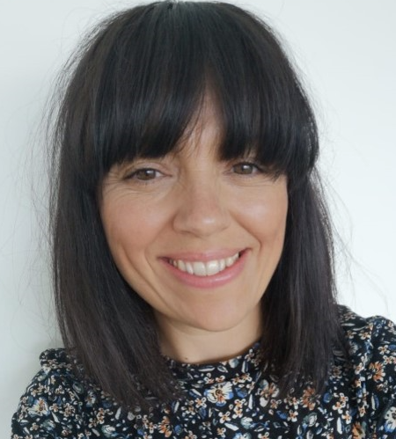
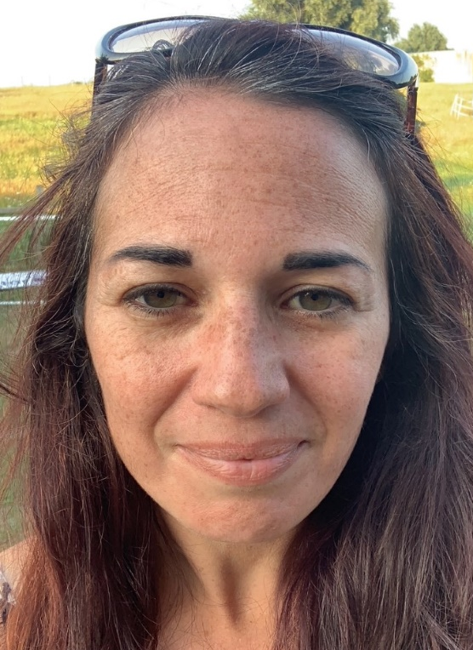
This is Mrs Long, our Wellbeing Leader
She is good at listening if someone is worried about something.
Mrs Gambell
She is our SENCO and works hard to make sure everyone feels included in our school.

Slide 11
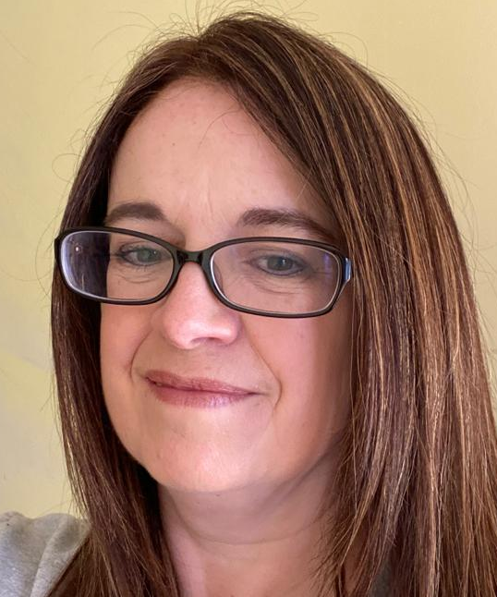
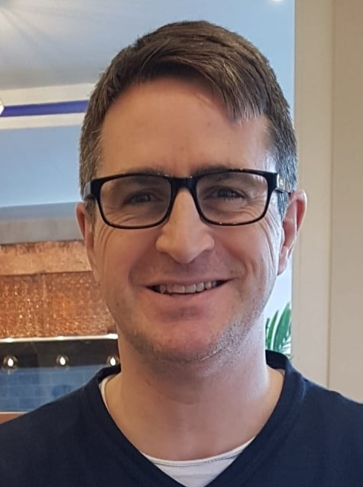
Mrs Julier
She is our Music teacher.
Rev Simon
He is our School Chaplain

Slide 12
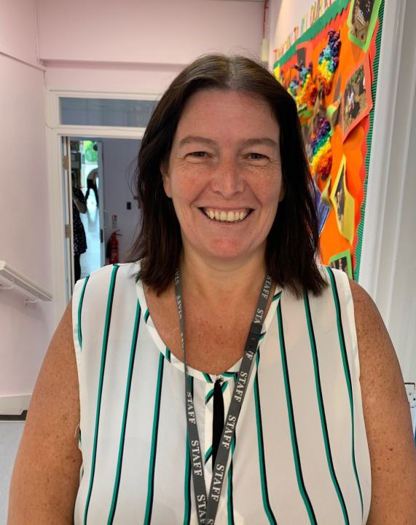
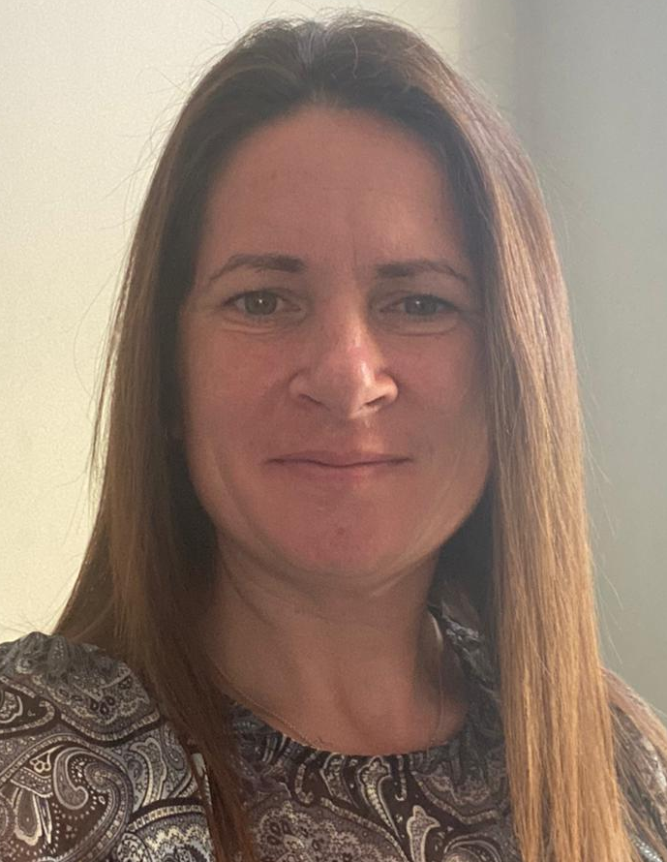
You will see these lovely ladies every day when you go to the office, or walk to the Hall…
Mrs Smedley
She helps out at lunch time, and she also works in Year R too. What a busy lady!
Mrs Barwick
She is the Office Manager and is in charge of the registers and the glue sticks!

Slide 13
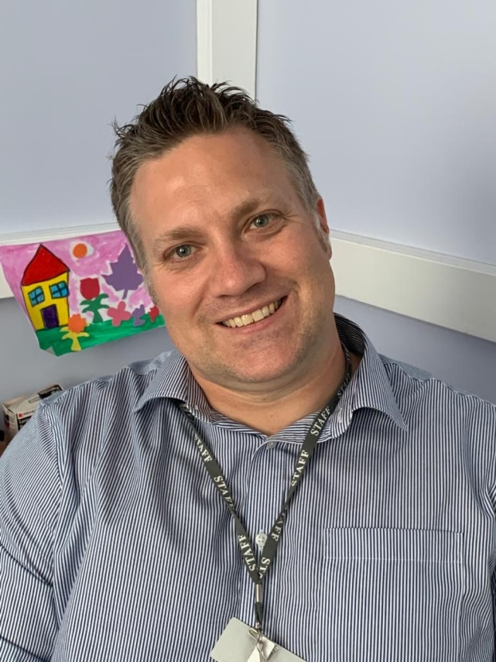
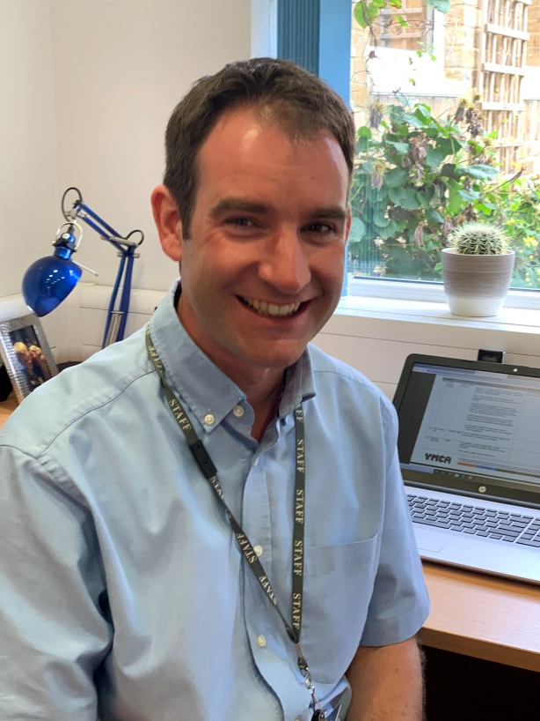
Mr Kelly
He is our Headteacher.
You will see him during your day. He can’t wait to have all the children back in school.
Mr Smiley
He is our Deputy Headteacher
He also teaches Year 5 and does the Ribbon Dance.

Slide 14
We are looking forward to seeing you in September!
Have a lovely summer holiday.
From all of us at Bapchild School

