Slide 1

Home Learning
Year 5 Term 5 Week 5

Slide 2
Message from the class teacher
Hello Fisher! Another week down, which means another week closer to being back at school (hopefully!). I hope you’ve all been out enjoying the sunshine and I suspect some of you would have had some VE Day celebrations!
Last week, we delved further into the world of Beowulf and were introduced to our monster/villain of the text – Grendel! This week, we’re going to take a minor pause and do a bit of a focus of spelling, punctutation and grammar work – all of which we would have looked at in class previously and the children should be familiar with (fingers crossed).
We’re also shifting back onto our topic work as we’ve completed our R.E. focus. This week, we’re focusing on comparisons between Anglo-Saxon houses and our own. You may even want to draw an image of your house to help compare!
Have a great week!
Miss Horton ☺

Slide 3

Reading
Hopefully you have access to books at home, but we have sent home extra books with your child.
Accelerated Reading
Home quizzing is not always recommended but in this case we have adjusted the settings to allow quizzing to happen at home.
If your child wants to read a book from home, please check that there is a quiz available for the book and that the book level (BL) is within or near to your child’s reading range. Also take note of the quiz number for future reference.
To check books please visit: https://www.arbookfind.co.uk/
Go to the next page for how to quiz.

Slide 4



AR quizzing at home.
To log into AR to take a quiz please visit: https://ukhosted27.renlearn.co.uk/2240835/
Your child should know what to do from here and should know their login details. If they are not aware, most details are written in their reading record.
Click on Accelerated reader.
Type in the name the book or the quiz number.
We advise students complete quizzes unaided. If parents/carers wish to support their child, they can do so in the following ways:
Discuss the book with your child as the book is being read
Ask your child to read the question out loud
Re-word questions for your child, if necessary
Ask your child which answers are not correct

Slide 5

Visit http://readon.myon.co.uk

Slide 6

Choose an area that interests you or use the search option.

Slide 7


Using My Maths
Children should know their way round My Maths but here are some reminders on how access the lessons. Visit: www.mymaths.co.uk
bapchild
divide162

Slide 8

Using My Maths
Access any lesson based on what your child is learning in class or search the topic in the search bar.
Use the login portal to access specific homework and lessons that your teacher has set.

Slide 9

Maths – White Rose Home Learning
In school we follow the White Rose scheme of learning. Their website has put together free lessons and resources that link to the learning taking place in school. Please visit: https://whiterosemaths.com/homelearning/

Slide 10



TT Rockstars
To access TT Rockstars please visit: https://play.ttrockstars.com/auth/school
Start typing in the school name or the post code (ME99NL)
Pupils type in their username and password, usually written in their reading record.
Pupils can practice all tables but Year 2 should be practicing 2, 5, and 10’s
Year 3: 2,5,10,3,4,8’s
Year 4,5,6: all tables

Slide 11

Accessing Twinkl
Many educational content providers are offering free access to their resources. Twinkl is a website that we use from time to time to resource our lessons to aid in teacher input and pupil activities.
We will be able to direct you towards activities and learning via this website based on lessons that may be missed due to absence. To access Twinkl please visit: www.twinkl.co.uk/offer
You will have to sign up and put in the offer code: UKTWINKLHELPS

Slide 12
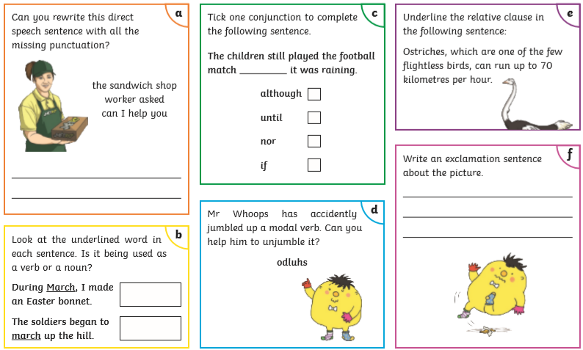
English Learning – Task 1

Slide 13

English Learning – Task 2
So far, we’ve read chapters 1 and 2. Whilst they are quite short – we’ve learnt quite a lot in them!
Could you please create a summary of what we’ve read so far and then create a prediction of what you think might happen next!

Slide 14
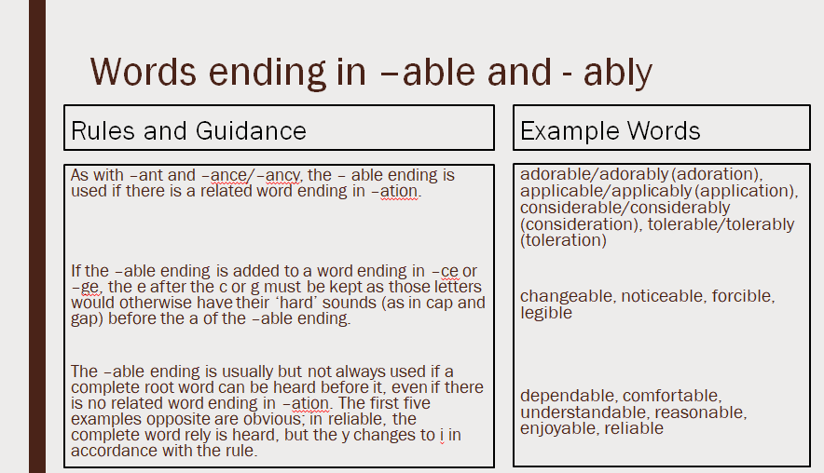
English Learning – Task 3
Practise and try to learn the words on the ‘example words’. We usually do 10 in class so you can either chunk this into smaller groups to learn through the week or learn all of them together.

Slide 15
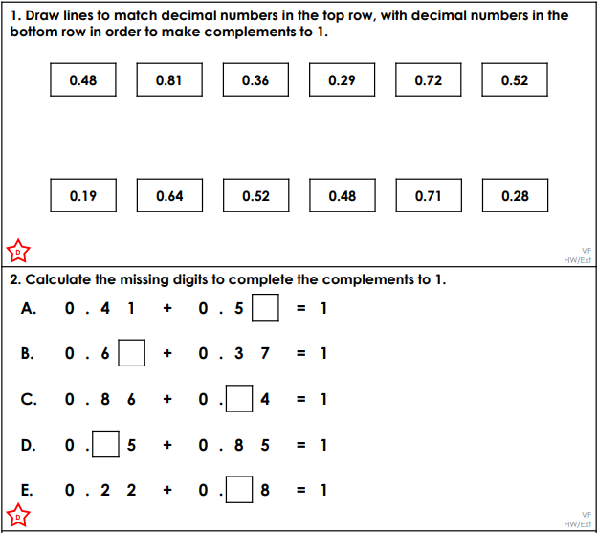
Maths Learning – Task 1

Slide 16
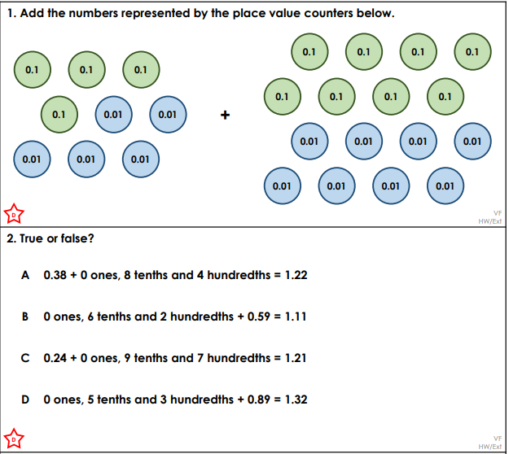
Maths Learning – Task 2

Slide 17
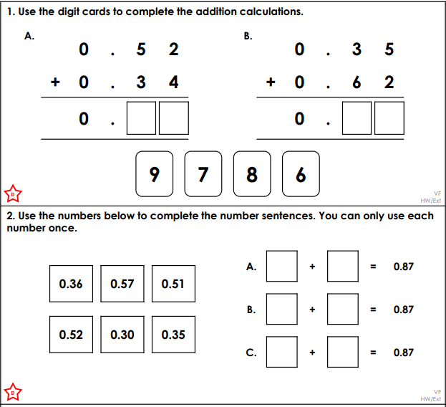
Maths Learning – Task 3

Slide 18
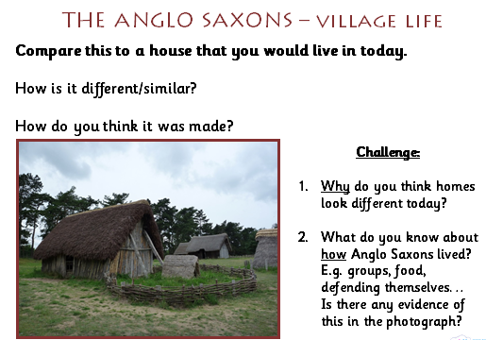
Topic: Anglo-Saxons

Slide 19

P.E.
It is important to keep your children active. If it is safe to do so, ensure they have some time outside throughout the day. Please visit Joe Wicks YouTube channel (https://www.youtube.com/channel/UCAxW1XT0iEJo0TYlRfn6rYQ), which has lots of exercise videos for children. He will also be hosting a live P.E. lessons Monday to Friday at 9:00am.

Slide 20

Classroom Secrets
The site classroom secrets https://classroomsecrets.co.uk/free-home-learning-packs/ has free class packs which provide some great additional ideas and resources you can use.

