Slide 1

Home Learning
Year 5 Term 5 Week 4

Slide 2
Message from the class teacher
Hello again – another week into term 5. I hope you’ve had another excellent week of home learning and have been keeping busy. This week will see us continuing with our maths work on decimals, Beowulf in English and finishing our R.E. work for our focus.
Beowulf is a slightly different text to the type of texts we’ve looked at in class so far, so this may be the text that really grips you! This week we meet the monster of our text – Grendel! We thought about the ‘evil’ that was rising last week – is this what you expected him to look like? It’s definitely closer to what I’m looking like most mornings right now! (Kidding – as you’d expect, I’m still living in gym wear!!).
I hope you’re all keeping active during this time – we’ve had some lovely weather and it’s the perfect excuse to get in your daily outdoor exercise. I’ve been walking a lot and I’m surprised I haven’t spotted more of you yet! Just make sure you’re staying home and staying safe – we’ll all be back together soon and it’ll be brilliant to be together again. Have a great week.
Miss Horton ☺

Slide 3

Reading
Hopefully you have access to books at home, but we have sent home extra books with your child.
Accelerated Reading
Home quizzing is not always recommended but in this case we have adjusted the settings to allow quizzing to happen at home.
If your child wants to read a book from home, please check that there is a quiz available for the book and that the book level (BL) is within or near to your child’s reading range. Also take note of the quiz number for future reference.
To check books please visit: https://www.arbookfind.co.uk/
Go to the next page for how to quiz.

Slide 4



AR quizzing at home.
To log into AR to take a quiz please visit: https://ukhosted27.renlearn.co.uk/2240835/
Your child should know what to do from here and should know their login details. If they are not aware, most details are written in their reading record.
Click on Accelerated reader.
Type in the name the book or the quiz number.
We advise students complete quizzes unaided. If parents/carers wish to support their child, they can do so in the following ways:
Discuss the book with your child as the book is being read
Ask your child to read the question out loud
Re-word questions for your child, if necessary
Ask your child which answers are not correct

Slide 5

Visit http://readon.myon.co.uk

Slide 6

Choose an area that interests you or use the search option.

Slide 7


Using My Maths
Children should know their way round My Maths but here are some reminders on how access the lessons. Visit: www.mymaths.co.uk
bapchild
divide162

Slide 8

Using My Maths
Access any lesson based on what your child is learning in class or search the topic in the search bar.
Use the login portal to access specific homework and lessons that your teacher has set.

Slide 9

Maths – White Rose Home Learning
In school we follow the White Rose scheme of learning. Their website has put together free lessons and resources that link to the learning taking place in school. Please visit: https://whiterosemaths.com/homelearning/

Slide 10



TT Rockstars
To access TT Rockstars please visit: https://play.ttrockstars.com/auth/school
Start typing in the school name or the post code (ME99NL)
Pupils type in their username and password, usually written in their reading record.
Pupils can practice all tables but Year 2 should be practicing 2, 5, and 10’s
Year 3: 2,5,10,3,4,8’s
Year 4,5,6: all tables

Slide 11

Accessing Twinkl
Many educational content providers are offering free access to their resources. Twinkl is a website that we use from time to time to resource our lessons to aid in teacher input and pupil activities.
We will be able to direct you towards activities and learning via this website based on lessons that may be missed due to absence. To access Twinkl please visit: www.twinkl.co.uk/offer
You will have to sign up and put in the offer code: UKTWINKLHELPS

Slide 12
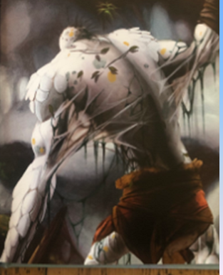
English Learning – Task 1
Last week, we read chapter 1 and were introduced to the setting of Beowulf – Denmark. We looked at the language used in the text and considered why the author had used it and what the impact was on the reader.
On the first page of the new chapter,
we see the back of Grendel – the monster
in our text.
Why do you think they haven’t showed us
his face?
What is the purpose of this?
What do you think Grendel’s face looks like?
(You could get creative and either draw or
make a mask – have some fun!)

Slide 13
English Learning – Task 2
Chapter 2: A monster strikes
On the following slides, I have attached images of the next chapter of Beowulf.
Using the chapter, I want you to think about the following:
How do you think the people of Heorot are feeling?
Think about the description of Denmark and Heorot in the first chapter and what we know about them as people.
Try writing in role as someone who was there when Grendel attacked them. Write a short recount – explaining the events that happened (you can use the chapter to help you!) and link in the thoughts and feelings about these events.
Note: There is no obligation to buy the text as I’ll be posting it on here – however, I’ve attached the link from where I bought my copy.
https://www.amazon.co.uk/Beowulf-Young-Reading-Three-Purple/dp/0746096860

Slide 14
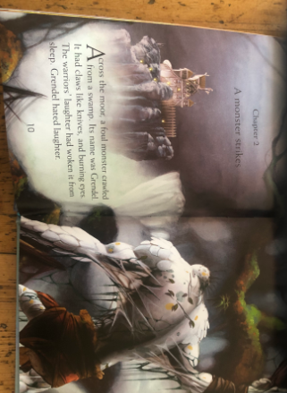

Slide 15
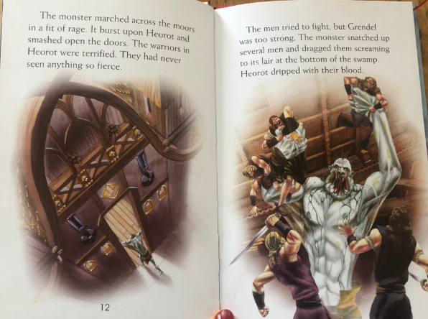

Slide 16
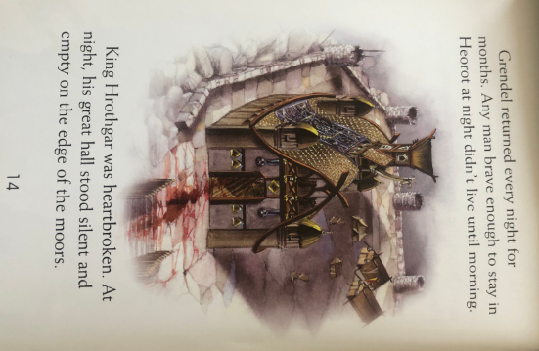

Slide 17
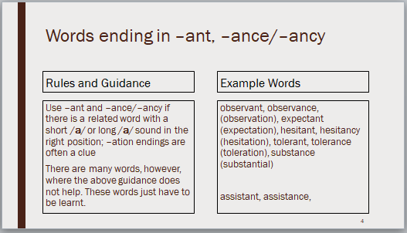
English Learning – Task 3
Practise and try to learn the words on the ‘example words’. We usually do 10 in class so you can either chunk this into smaller groups to learn through the week or learn all of them together.

Slide 18
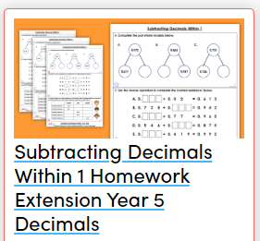
Maths Learning – Task 1
Your first task will be to complete the Classroom Secrets work on adding decimals (https://classroomsecrets.co.uk/subtracting-decimals-within-1-homework-extension-year-5-decimals/) This can either be printed out and worked on or you could just use it on screen and write down your answers. The sheets are levelled by a D, E and GD. In class, we have used these letters to try work:
D – If you’re not 100% and need something a bit easier to try first.
E – If you think you’ve got it but want a bit more practise.
GD – You understand the concept and want a challenge.
You do not have to do just one of these – if you complete D and think it was easier than expected, you may want to move up to E. It is completely up to you.
I’ve set this work to further support the children on concepts they’ve learnt previously and help them retain their previous learning.
On the final slide, there is further information on how to access this.

Slide 19
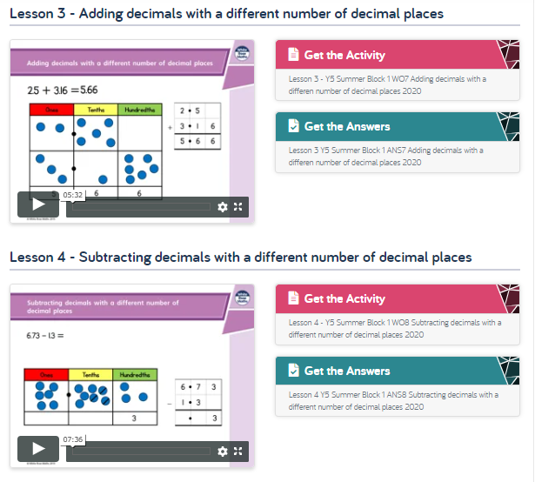
Maths Learning – Tasks 2/3
Then, please complete the Summer Week 2 White Rose lessons 3 and 4. They should look like this:

Slide 20
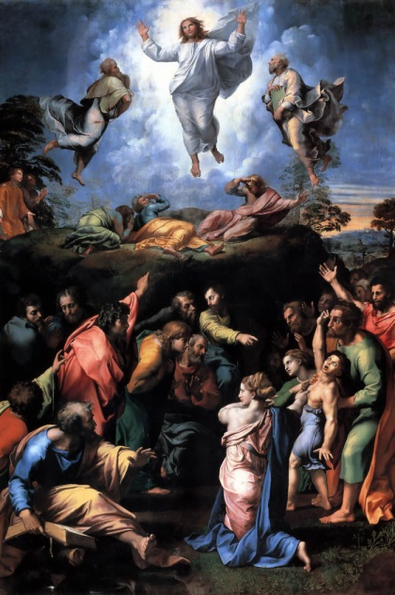
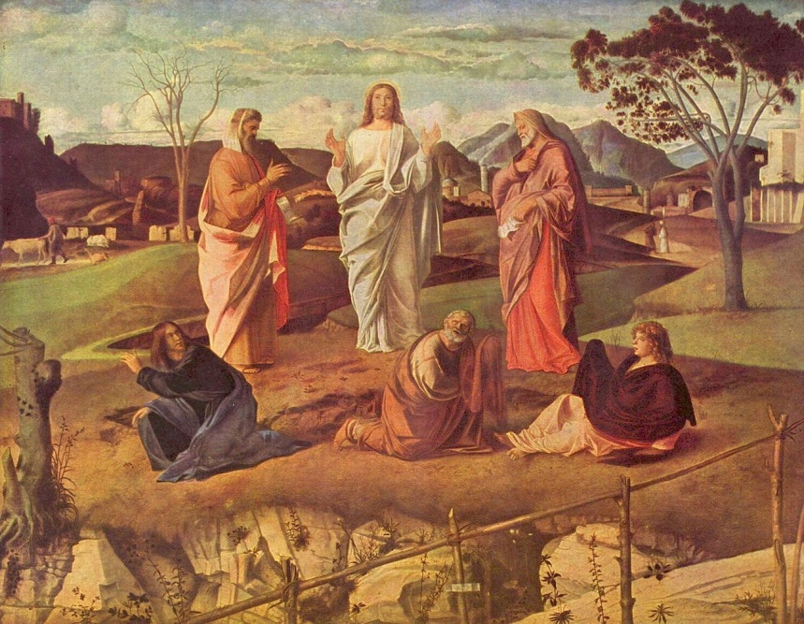
R.E. - The Transfiguration, Matthew 17:1–13 or Luke 9:28–36
Read the passages highlighted above – if you do not have a Bible at home, you can use this link to search for the passage: https://www.biblegateway.com/
Look at the two pieces of art below:
Raphael Bellini
Using the artwork and the Bible passages that we’ve looked at over the past few weeks – have a go at the following:
Write a diary entry as if you were one of the disciples who witnessed the Transfiguration.
What might you need to include to inform people about this? You could imagine you’re explaining it to an adult at home and this will help them learn too. We’ve done plenty of diaries in class so we should be very familiar with the features of a diary entry.

Slide 21

P.E.
It is important to keep your children active. If it is safe to do so, ensure they have some time outside throughout the day. Please visit Joe Wicks YouTube channel (https://www.youtube.com/channel/UCAxW1XT0iEJo0TYlRfn6rYQ), which has lots of exercise videos for children. He will also be hosting a live P.E. lessons Monday to Friday at 9:00am.

Slide 22

Classroom Secrets
The site classroom secrets https://classroomsecrets.co.uk/free-home-learning-packs/ has free class packs which provide some great additional ideas and resources you can use.

