Slide 1

Home Learning
Year 5 Term 5 Week 3

Slide 2
Message from the class teacher
Hello Fisher Class! Welcome to week 3 of term 5. Last week saw you creating character descriptions based on an image and using your inference to predict what our text, Beowulf, will be about. Hopefully, this has sparked an interest into our new book.
This week, we will be continuing with the R.E. work. Please do not worry if you haven’t yet finished from week 2, but just make sure you’ve completed week 2 before going onto this week’s work.
In the English section, I’ve added some spellings to have a practise of this week. Think about the usual way we’d learn them in class – find the definitions (what do these words mean?), what they look like in context (how would we use these words in sentences?) and think of a visual representation to support the meaning (can I create an image to help me remember this word?). You may even want to have a spelling test on Friday with an adult at home – you could test them on the words too!
Maths will continue with the White Rose lessons – again, please do not worry if you’re not completely caught up. Just make sure you’ve completed the lessons from last week before this week.
I hope you’re enjoying your home learning and are finding out new and exciting things! I can’t wait until we’re all back together and sharing our learning in class. Stay safe and hopefully see you soon,
Miss Horton ☺

Slide 3

Reading
Hopefully you have access to books at home, but we have sent home extra books with your child.
Accelerated Reading
Home quizzing is not always recommended but in this case we have adjusted the settings to allow quizzing to happen at home.
If your child wants to read a book from home, please check that there is a quiz available for the book and that the book level (BL) is within or near to your child’s reading range. Also take note of the quiz number for future reference.
To check books please visit: https://www.arbookfind.co.uk/
Go to the next page for how to quiz.

Slide 4



AR quizzing at home.
To log into AR to take a quiz please visit: https://ukhosted27.renlearn.co.uk/2240835/
Your child should know what to do from here and should know their login details. If they are not aware, most details are written in their reading record.
Click on Accelerated reader.
Type in the name the book or the quiz number.
We advise students complete quizzes unaided. If parents/carers wish to support their child, they can do so in the following ways:
Discuss the book with your child as the book is being read
Ask your child to read the question out loud
Re-word questions for your child, if necessary
Ask your child which answers are not correct

Slide 5

Visit http://readon.myon.co.uk

Slide 6

Choose an area that interests you or use the search option.

Slide 7


Using My Maths
Children should know their way round My Maths but here are some reminders on how access the lessons. Visit: www.mymaths.co.uk
bapchild
divide162

Slide 8

Using My Maths
Access any lesson based on what your child is learning in class or search the topic in the search bar.
Use the login portal to access specific homework and lessons that your teacher has set.

Slide 9

Maths – White Rose Home Learning
In school we follow the White Rose scheme of learning. Their website has put together free lessons and resources that link to the learning taking place in school. Please visit: https://whiterosemaths.com/homelearning/

Slide 10



TT Rockstars
To access TT Rockstars please visit: https://play.ttrockstars.com/auth/school
Start typing in the school name or the post code (ME99NL)
Pupils type in their username and password, usually written in their reading record.
Pupils can practice all tables but Year 2 should be practicing 2, 5, and 10’s
Year 3: 2,5,10,3,4,8’s
Year 4,5,6: all tables

Slide 11

Accessing Twinkl
Many educational content providers are offering free access to their resources. Twinkl is a website that we use from time to time to resource our lessons to aid in teacher input and pupil activities.
We will be able to direct you towards activities and learning via this website based on lessons that may be missed due to absence. To access Twinkl please visit: www.twinkl.co.uk/offer
You will have to sign up and put in the offer code: UKTWINKLHELPS

Slide 12

English Learning – Task 1
Last week, you created predictions about our new text based upon the cover. For task 1, I have now provided the actual blurb for the text.
I want you to compare this to your prediction and think about these questions:
What did you predict correctly?
Why was your prediction different?
What clues led you to your prediction?
Why are blurbs an important feature for
books?
Does every type of book have a blurb?

Slide 13
English Learning – Task 2
Chapter 1: The great Hall
On the following slides, I have attached images of the first chapter of Beowulf.
Using the chapter, answer the following questions:
‘Denmark was a wild place’ – what does this suggest about it? Do you know where Denmark is?
‘they howled and growled and shrieked and snarled’ – why does the author list these different types of words? What is the impact/purpose of this? What types of words are ‘howled’, ‘growled’, ‘shrieked’ and ‘snarled’.
The king, Hrothgar, is referred to as a ‘warlord’ – what does this suggest about him?
We end the chapter with ‘But outside, something evil was rising…’ – What do you think is ‘rising’? What do you predict will happen in the next chapter?
Note: There is no obligation to buy the text as I’ll be posting it on here – however, I’ve attached the link from where I bought my copy.
https://www.amazon.co.uk/Beowulf-Young-Reading-Three-Purple/dp/0746096860

Slide 14
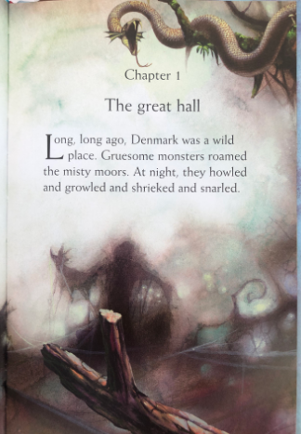

Slide 15
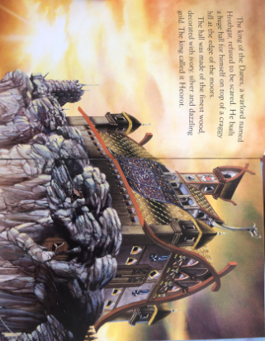

Slide 16
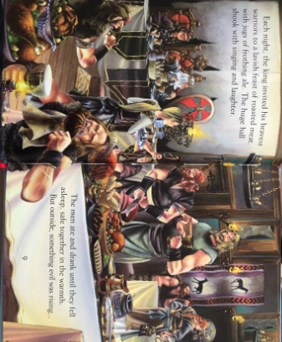

Slide 17
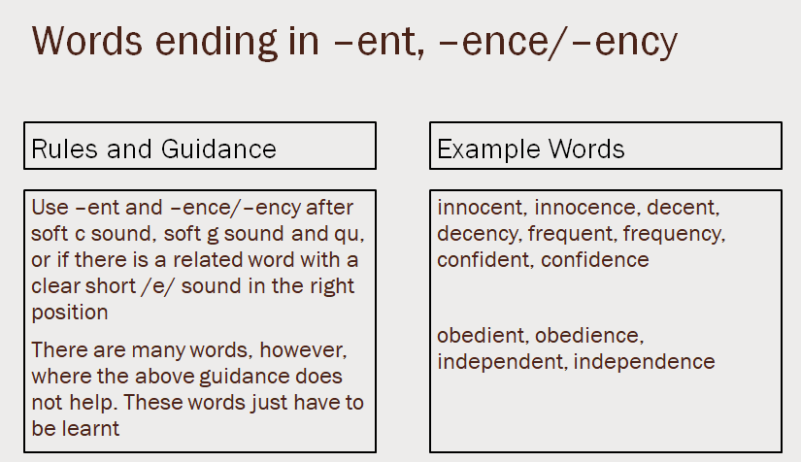
English Learning – Task 3
Practise and try to learn the words on the ‘example words’. We usually do 10 in class but you’re welcome to learn all 12 from this list!

Slide 18
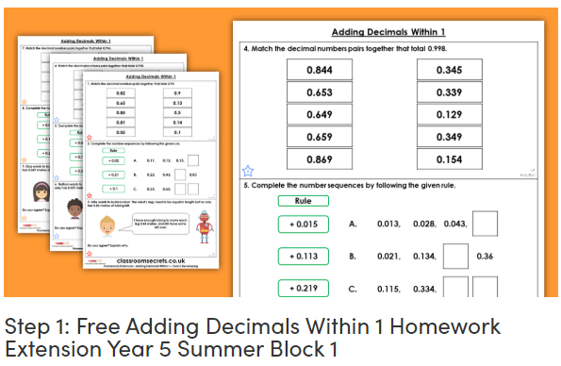
Maths Learning – Task 1
Your first task will be to complete the Classroom Secrets work on adding decimals (https://classroomsecrets.co.uk/free-adding-decimals-within-1-homework-extension-year-5-decimals/). This can either be printed out and worked on or you could just use it on screen and write down your answers. The sheets are levelled by a D, E and GD. In class, we have used these letters to try work:
D – If you’re not 100% and need something a bit easier to try first.
E – If you think you’ve got it but want a bit more practise.
GD – You understand the concept and want a challenge.
You do not have to do just one of these – if you complete D and think it was easier than expected, you may want to move up to E. It is completely up to you.
On the final slide, there is further information on how to access this.

Slide 19
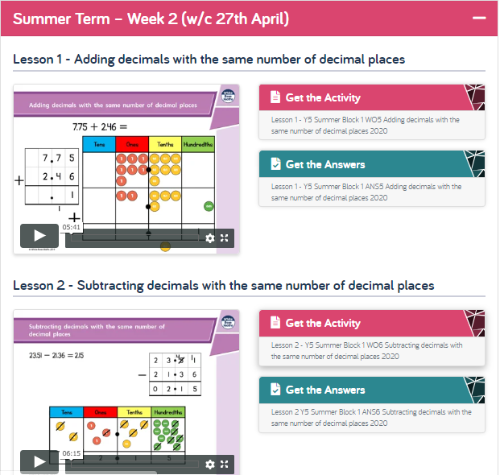
Maths Learning – Tasks 2/3
Then, please complete the Summer Week 2 White Rose lessons 1 and 2. They should look like this:

Slide 20
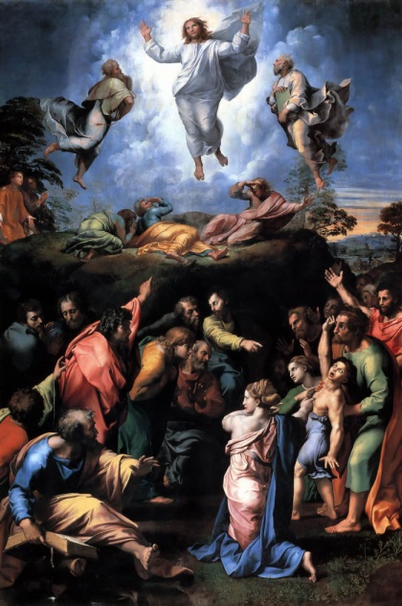
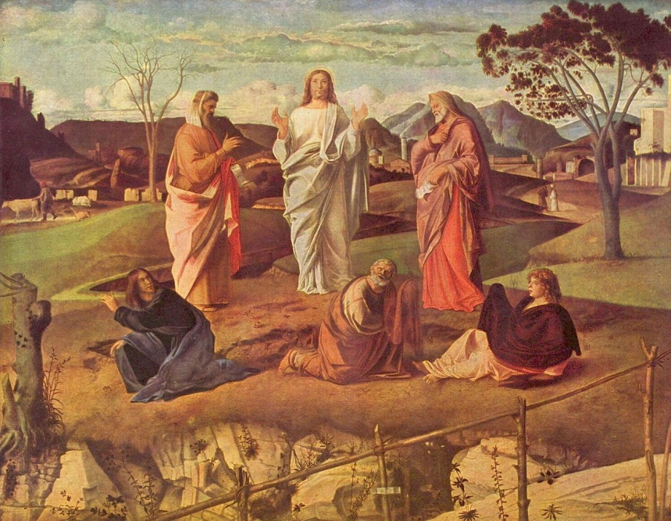
R.E. - The Transfiguration, Matthew 17:1–13 or Luke 9:28–36
Read the passages highlighted above – if you do not have a Bible at home, you can use this link to search for the passage: https://www.biblegateway.com/
Look at the two pieces of art below:
Raphael Bellini
Think about the artwork we looked at last week. Can you write the descriptions that would be put under the art for when it is displayed in a gallery?
Think about what connections there are to the Bible, why this story is important to Christians and what clues it gives us to show that Jesus more important than the expected Messiah, and actually the Son of God.

Slide 21

P.E.
It is important to keep your children active. If it is safe to do so, ensure they have some time outside throughout the day. Please visit Joe Wicks YouTube channel (https://www.youtube.com/channel/UCAxW1XT0iEJo0TYlRfn6rYQ), which has lots of exercise videos for children. He will also be hosting a live P.E. lessons Monday to Friday at 9:00am.

Slide 22

Classroom Secrets
The site classroom secrets https://classroomsecrets.co.uk/free-home-learning-packs/ has free class packs which provide some great additional ideas and resources you can use.

