Slide 1

Home Learning
Year 5 Term 5 Week 2

Slide 2
Message from the class teacher
Week 2 already! We had a short first week of term 5, but I’m sure you still did some brilliant learning!
I hope you’ve found some areas of interest for our Anglo-Saxon topic. We’ll be delving further into this time period in more depth through the term. I will be introducing you to our new text in the English tasks too!
This week, I’ve set some R.E. work alongside the maths and English work. We will be focusing on the R.E. work for a few weeks (so don’t worry if you do not complete it as it will carry over) and this will be looking at our previous big question from class – Was Jesus the Messiah? We will be using our work on this to dig a bit deeper into our learning.
Keep up the great home learning and I am looking forward to being back in class with you very soon (fingers crossed!).
Miss Horton ☺

Slide 3

Reading
Hopefully you have access to books at home, but we have sent home extra books with your child.
Accelerated Reading
Home quizzing is not always recommended but in this case we have adjusted the settings to allow quizzing to happen at home.
If your child wants to read a book from home, please check that there is a quiz available for the book and that the book level (BL) is within or near to your child’s reading range. Also take note of the quiz number for future reference.
To check books please visit: https://www.arbookfind.co.uk/
Go to the next page for how to quiz.

Slide 4



AR quizzing at home.
To log into AR to take a quiz please visit: https://ukhosted27.renlearn.co.uk/2240835/
Your child should know what to do from here and should know their login details. If they are not aware, most details are written in their reading record.
Click on Accelerated reader.
Type in the name the book or the quiz number.
We advise students complete quizzes unaided. If parents/carers wish to support their child, they can do so in the following ways:
Discuss the book with your child as the book is being read
Ask your child to read the question out loud
Re-word questions for your child, if necessary
Ask your child which answers are not correct

Slide 5

Visit http://readon.myon.co.uk

Slide 6

Choose an area that interests you or use the search option.

Slide 7


Using My Maths
Children should know their way round My Maths but here are some reminders on how access the lessons. Visit: www.mymaths.co.uk
bapchild
divide162

Slide 8

Using My Maths
Access any lesson based on what your child is learning in class or search the topic in the search bar.
Use the login portal to access specific homework and lessons that your teacher has set.

Slide 9

Maths – White Rose Home Learning
In school we follow the White Rose scheme of learning. Their website has put together free lessons and resources that link to the learning taking place in school. Please visit: https://whiterosemaths.com/homelearning/

Slide 10



TT Rockstars
To access TT Rockstars please visit: https://play.ttrockstars.com/auth/school
Start typing in the school name or the post code (ME99NL)
Pupils type in their username and password, usually written in their reading record.
Pupils can practice all tables but Year 2 should be practicing 2, 5, and 10’s
Year 3: 2,5,10,3,4,8’s
Year 4,5,6: all tables

Slide 11

Accessing Twinkl
Many educational content providers are offering free access to their resources. Twinkl is a website that we use from time to time to resource our lessons to aid in teacher input and pupil activities.
We will be able to direct you towards activities and learning via this website based on lessons that may be missed due to absence. To access Twinkl please visit: www.twinkl.co.uk/offer
You will have to sign up and put in the offer code: UKTWINKLHELPS

Slide 12
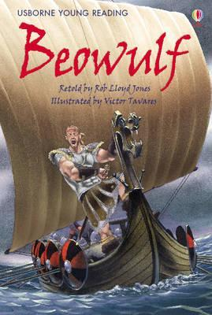
English Learning – Task 1
We are going to start looking at our new Anglo-Saxon text of Beowulf! As with any new text, I would like you to think about the potential narrative of this text.
Create a mind-map of things you notice about the text.
Then, using these clues, create a prediction sharing your ideas and why you think this could be what the story will be about.
Think about when I’m a bit silly in class – does this story look like it’s going to be about Miss Horton’s Christmas adventure? Probably not… so what can we identify that will help us create a sensible prediction?

Slide 13
English Learning – Task 2
Character Description:
On the cover of our new text, we can see our main character – Beowulf!
For task 2, I would like you to write a character description on about Beowulf. We currently can only do this on his physical appearance so think about the interesting adjectives you could use to describe what he looks like.
Think about the following descriptive techniques:
Adjectives
Similes
Metaphors
Personification
Alliteration
Can you use any of these in your description?

Slide 14
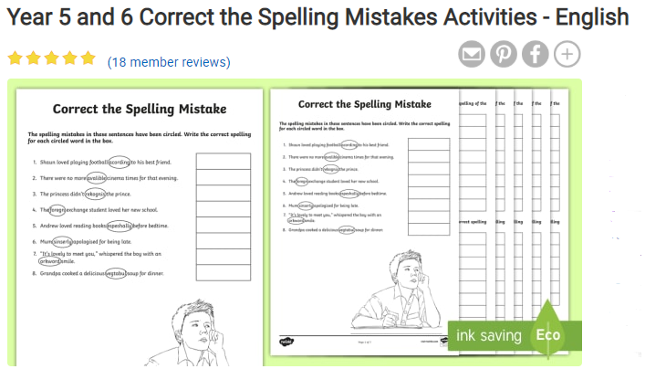
English Learning – Task 3
Have a go a this spelling correction activity!
https://www.twinkl.co.uk/resource/t2-e-2583-year-5-and-6-correct-th-spelling-mistakes-activity-sheets
You don’t necessarily need to print this, but could download it and then correct the sentences on paper. This is a good way to practise spelling words in context.
An additional task to follow this could be to practise the ones that you didn’t understand or you got incorrect. Perhaps you and an adult could test each other on the spellings!

Slide 15
Maths Learning
Please complete the Summer Week 1 White Rose lessons 2, 3 and 4 which carry on from last week’s learning on adding decimals. (https://whiterosemaths.com/homelearning/year- 5/) .
Use the activities and the videos to support your learning – there’s answers too for you to self-mark or for an adult to mark!
There will also be further optional work on mymaths that can be completed if you would like further practise on the topics.
Additionally, White Rose also have the whole unit of decimals on their website that can also be used alongside the lessons they are doing. (https://wrm-13b48.kxcdn.com/wp-content/uploads/2019/04/2019/04/2019/04/Year-5-2018-19-Summer-Block-1-Decimals.pdf)

Slide 16
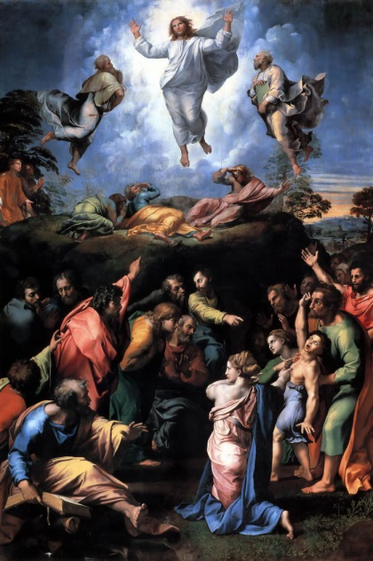
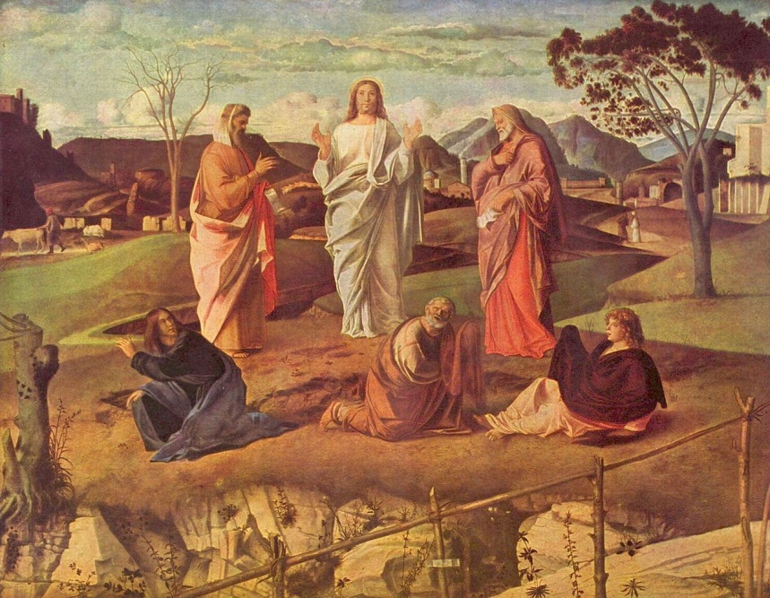
R.E. - The Transfiguration, Matthew 17:1–13 or Luke 9:28–36
Read the passages highlighted above – if you do not have a Bible at home, you can use this link to search for the passage: https://www.biblegateway.com/
Look at the two pieces of art below:
Raphael Bellini
Both the Bible passages and the artwork show ‘The Transfiguration’. Using the passages and the artwork, think about these questions:
Why do Christians believe Jesus is the Son of God?
How might Peter, James and John have felt on the mountain?
Who are Moses and Elijah? Why are they there?

Slide 17

P.E.
It is important to keep your children active. If it is safe to do so, ensure they have some time outside throughout the day. Please visit Joe Wicks YouTube channel (https://www.youtube.com/channel/UCAxW1XT0iEJo0TYlRfn6rYQ), which has lots of exercise videos for children. He will also be hosting a live P.E. lessons Monday to Friday at 9:00am.

Slide 18

Classroom Secrets
The site classroom secrets https://classroomsecrets.co.uk/free-home-learning-packs/ has free class packs which provide some great additional ideas and resources you can use.

